Slide 1
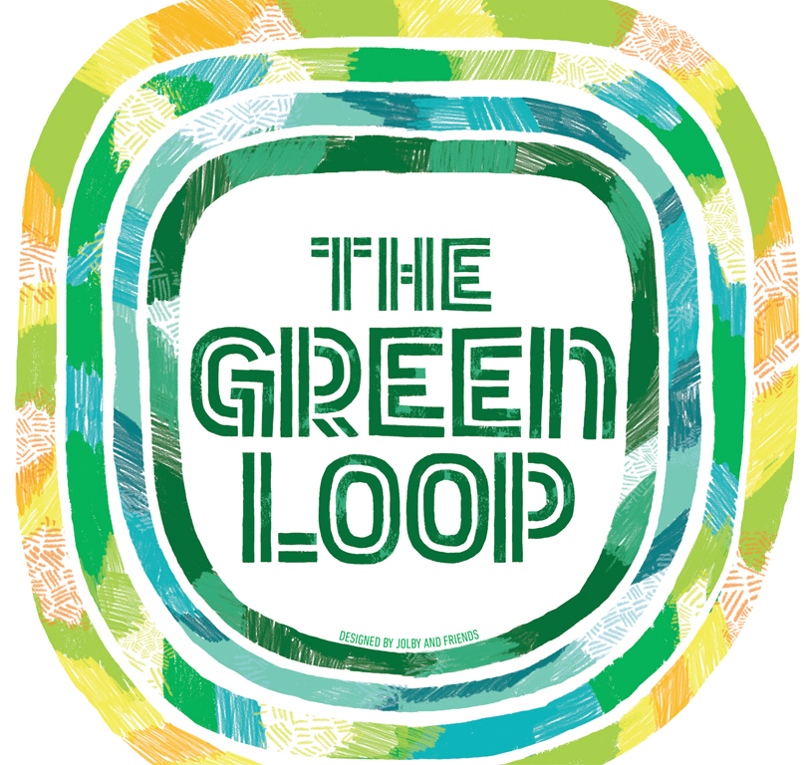
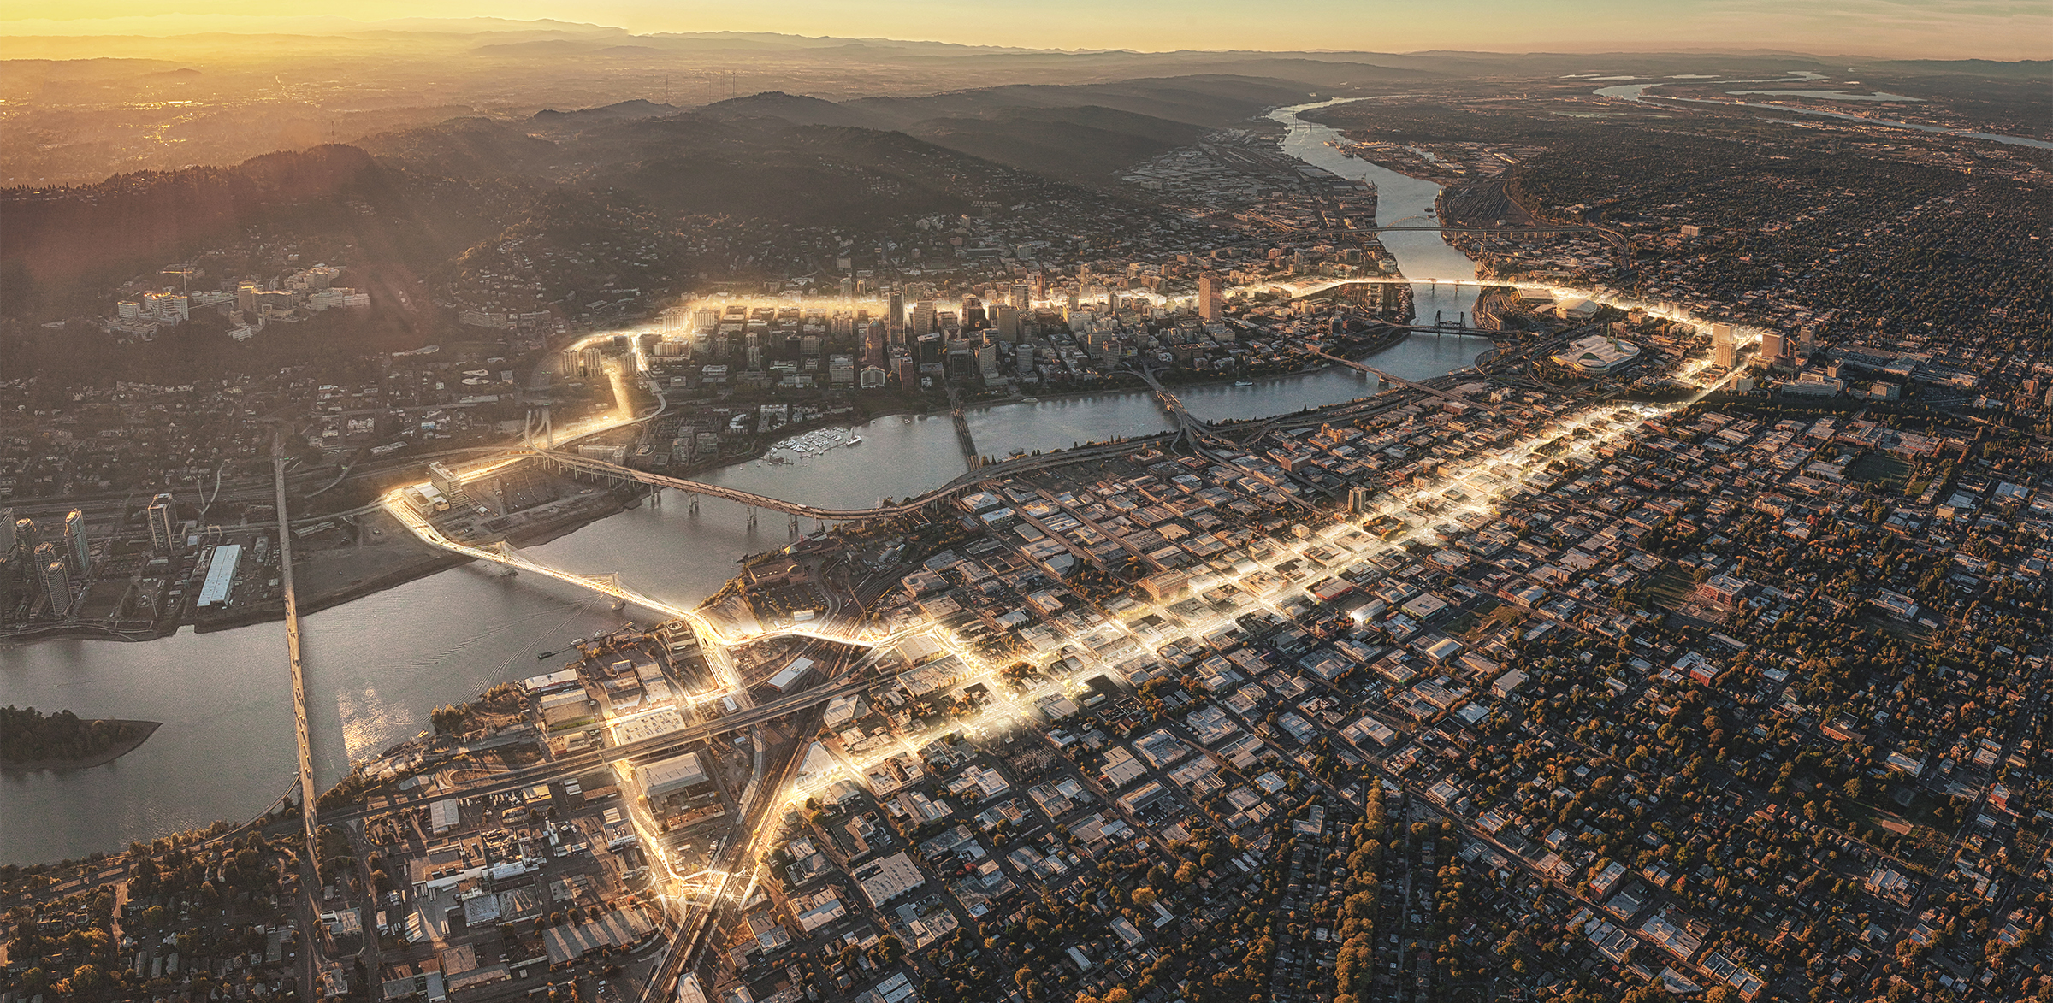
The Green Loop: A 21st Century Public Works Project
Credit: Untitled Studios

Slide 2
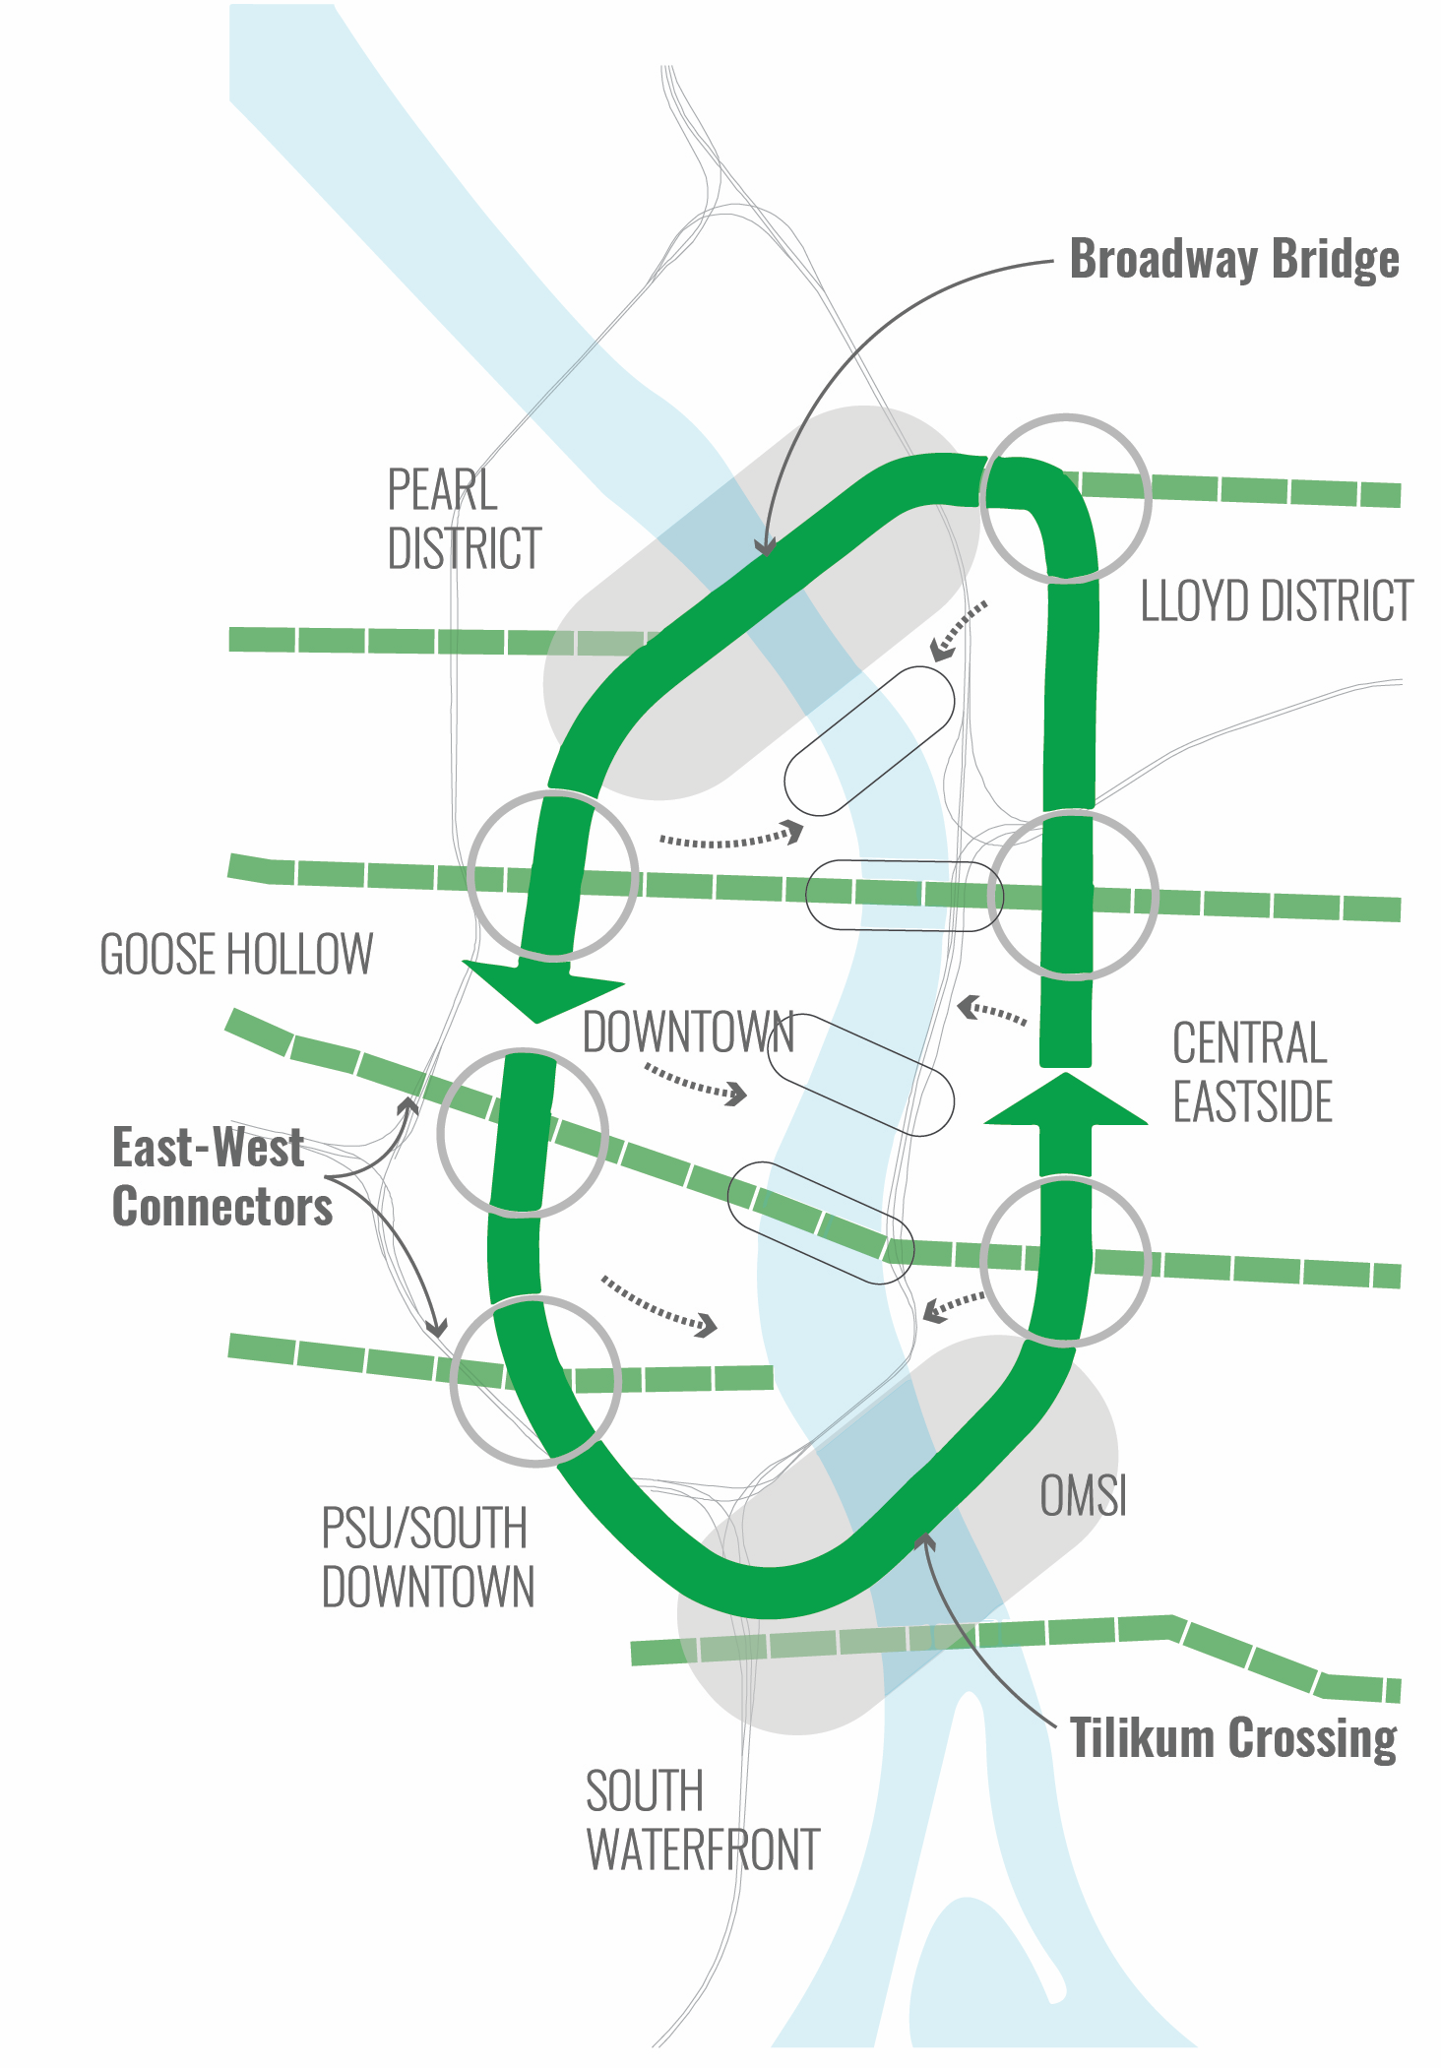
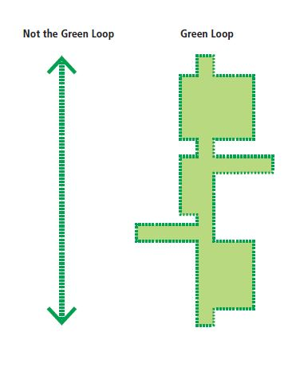
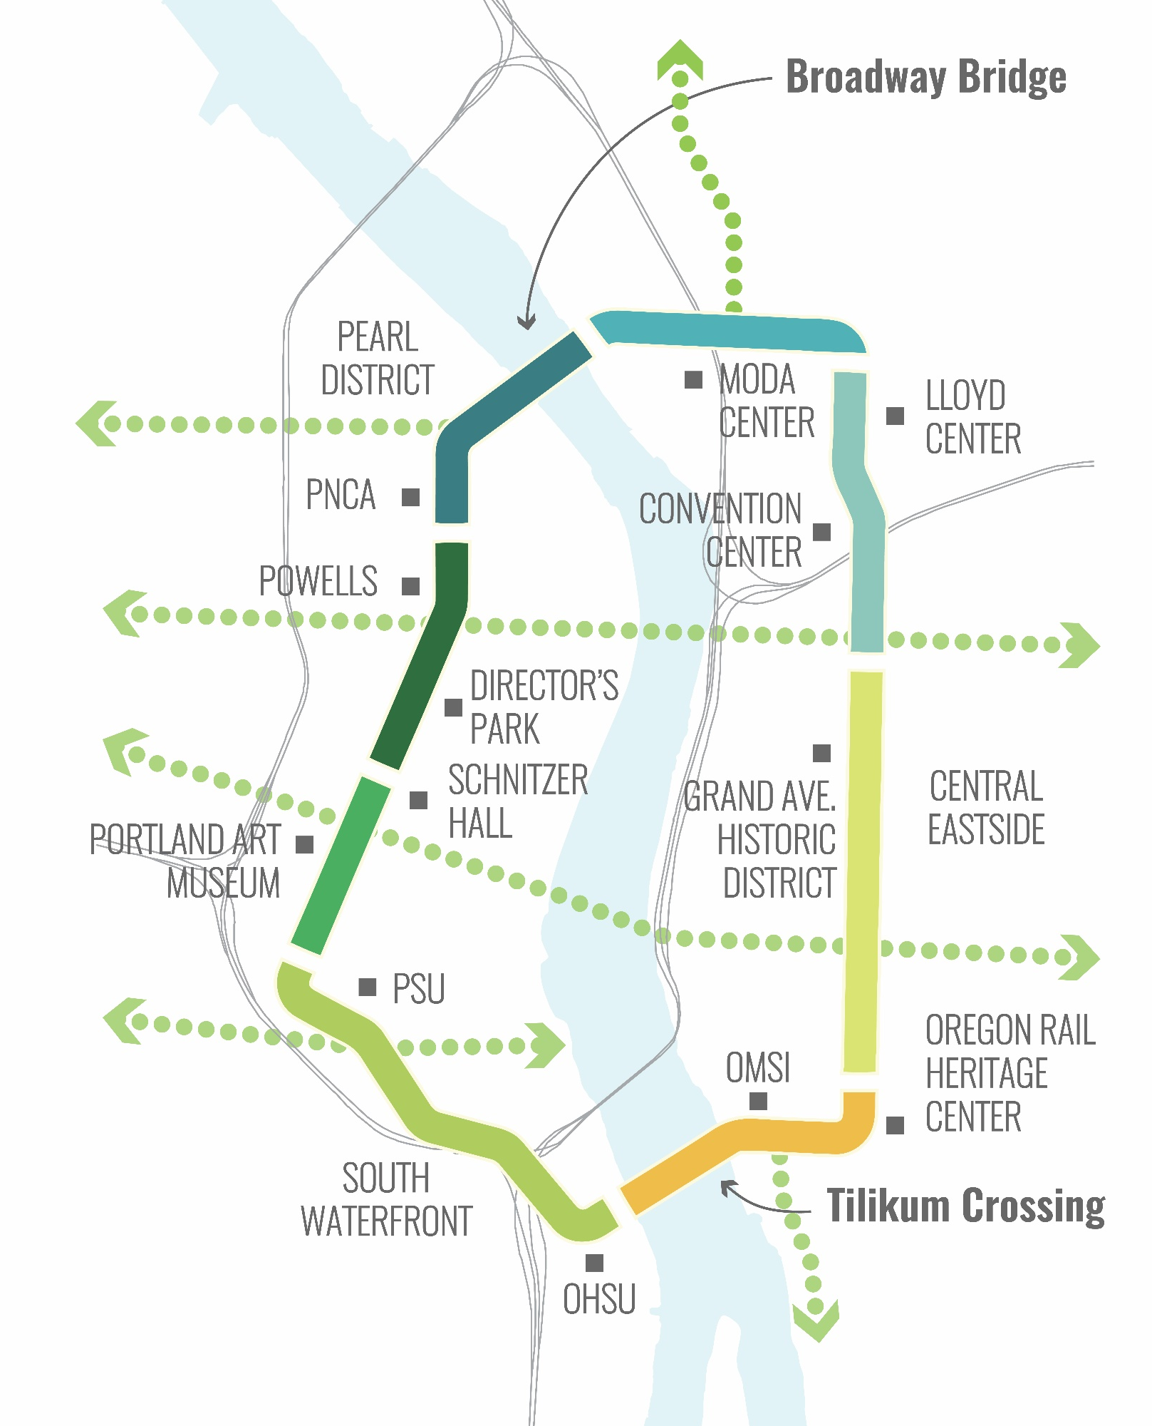
The Green Loop is a six-mile linear park that invites residents, employees and visitors to experience Portland’s Central City in an entirely new way.
Notes:
At its core, the Green Loop is a 6-mile walking and biking linear park. The concept connects the Broadway Bridge on the northern end to the Tilikum Crossing Bridge at the southern end. Both of these locations have tremendous redevelopment potential that can bring people closer to the Willamette River. A series of clear east-west connections link surrounding neighborhoods and districts to the loop and on through to the river. The Green Loop is an example of being more intentional with the Central City’s street network, prioritizing some routes for some functions and others for others, ala the Transit Mall.

Slide 3
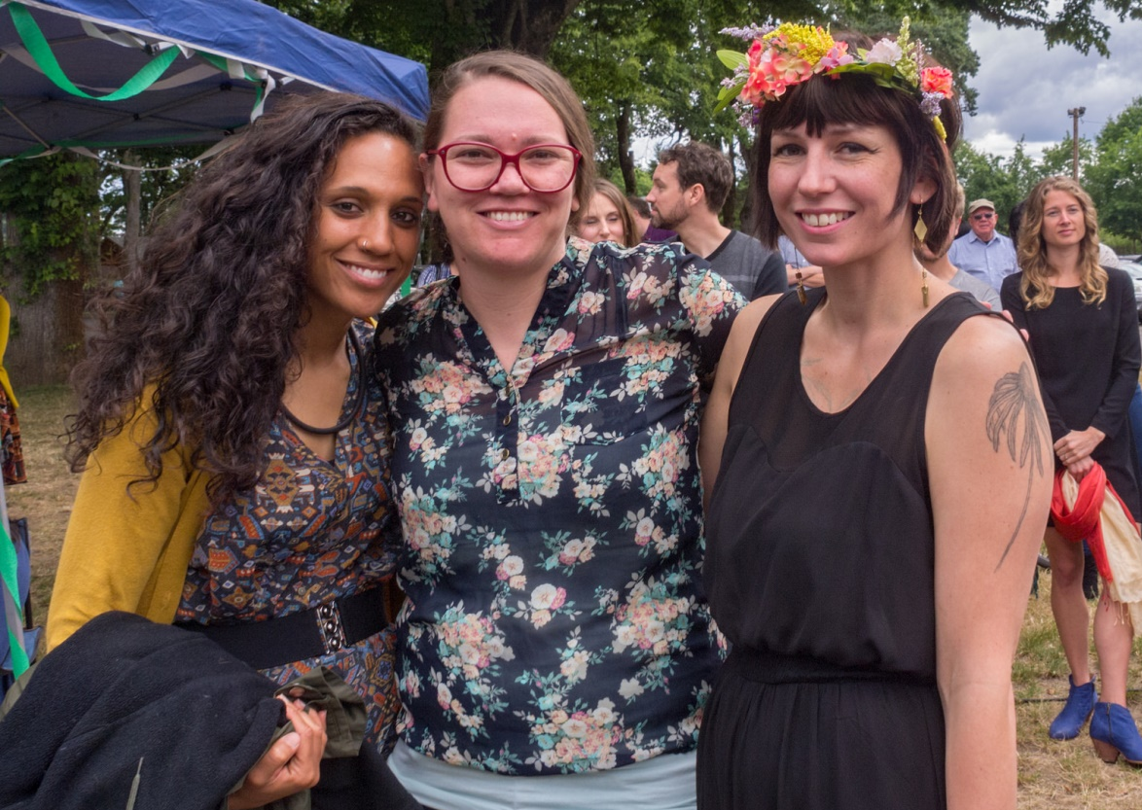
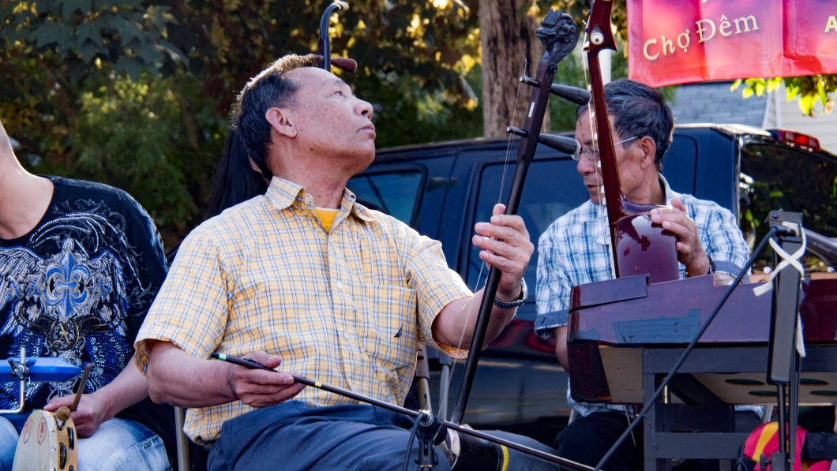
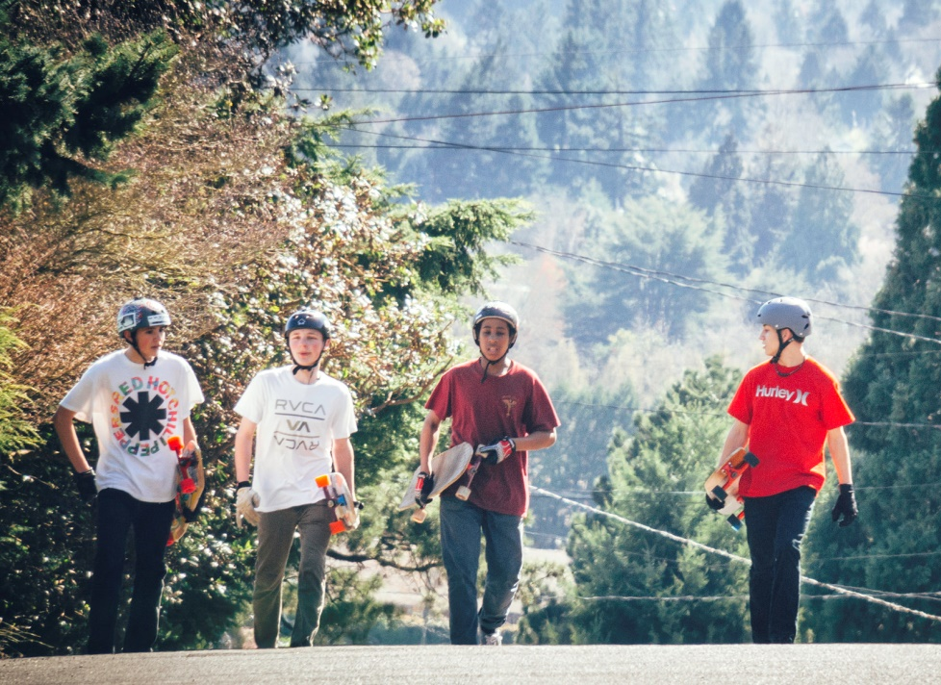
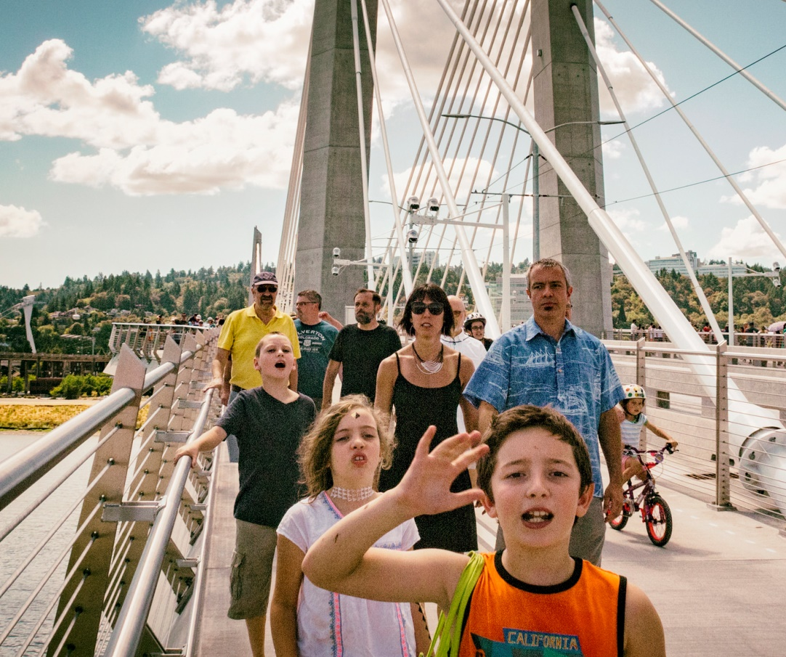
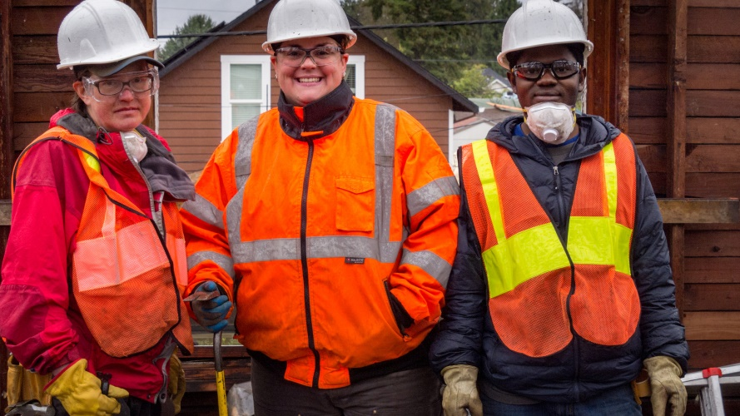
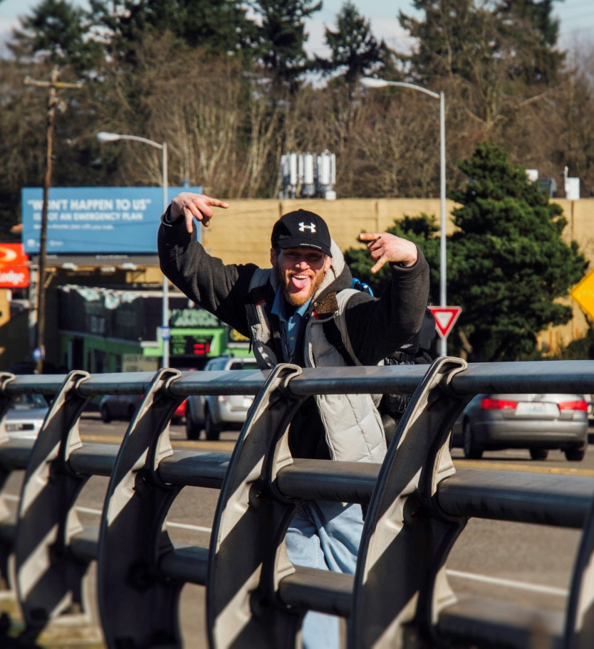
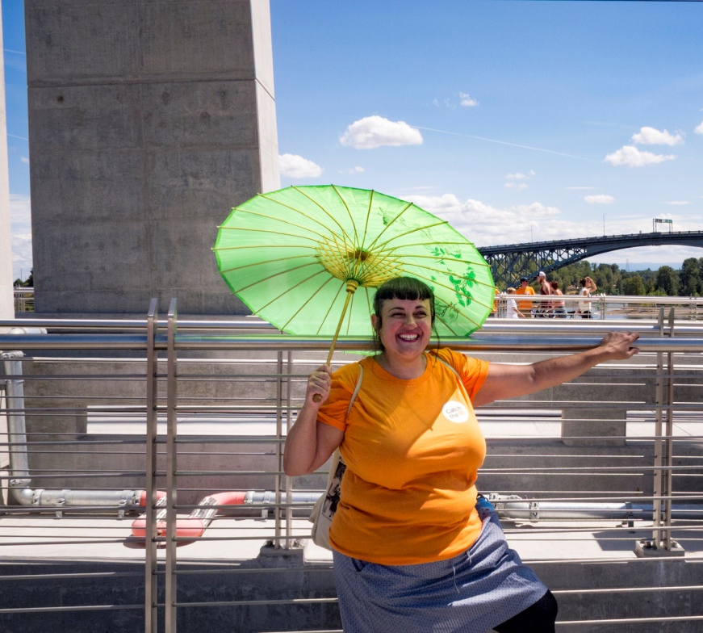
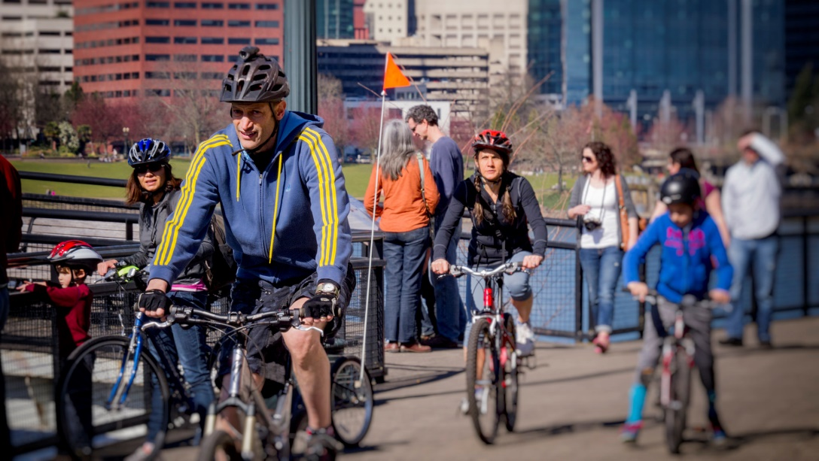
The Green Loop is about people.
Notes:
It’s about all people, old and new Portlanders and visitors too, from all backgrounds and walks of life. This is a place where people are free to make new memories as they experience some of Portland’s great places.
The Green Loop is intended to create a linear park that offers safe access and connections for a broad range of people. The target user group are the 8 – 80 year olds who are here today and the growing population of Portlanders who will visit, work, learn, and live in the Central City in the generations to come.

Slide 4
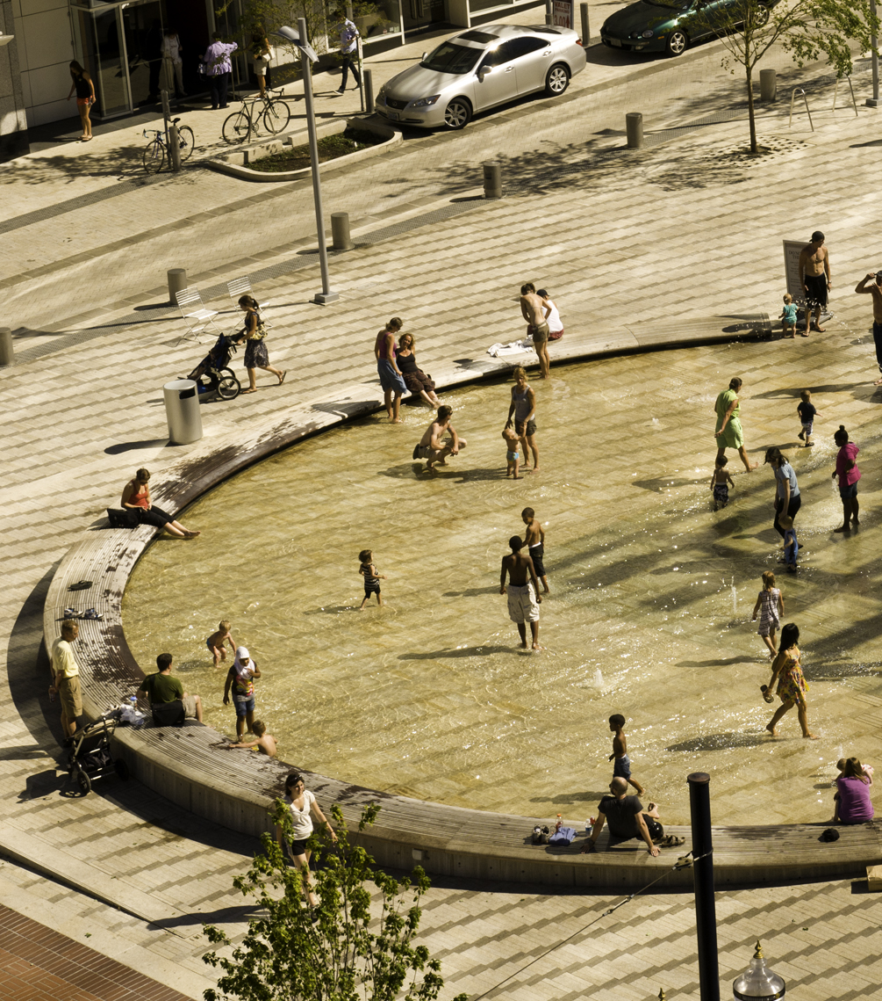
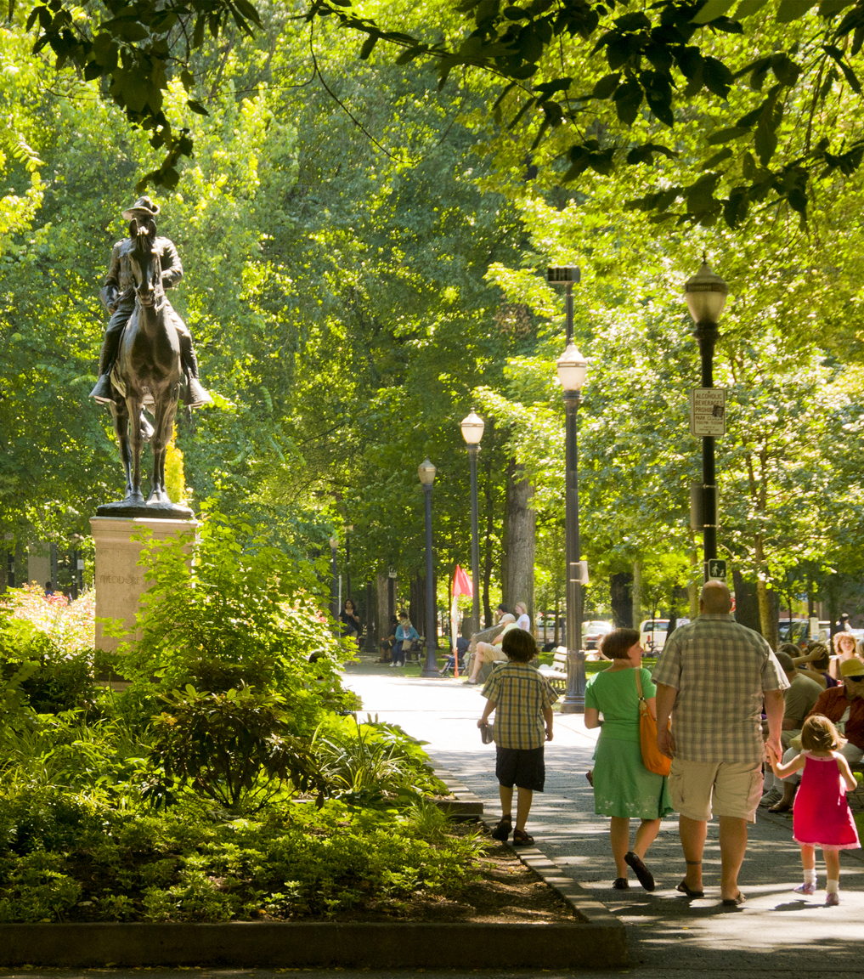
The Green Loop is about public space.
Notes:
Besides a way to move through the Central City, the Green Loop builds on the signature open space system that exists today, most notably on the west side, while creating opportunities for gathering and recreating on the east side where there aren’t currently any places of respite or activity.

Slide 5
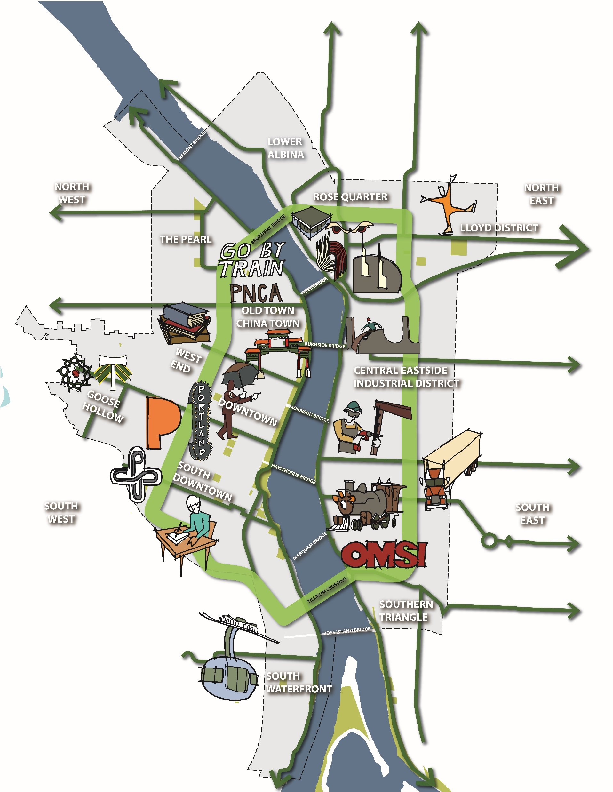
Like “Sunday Parkways every day,” the Green Loop will connect all Portlanders to regional destinations, cultural attractions, employment centers and signature open spaces.

Slide 6
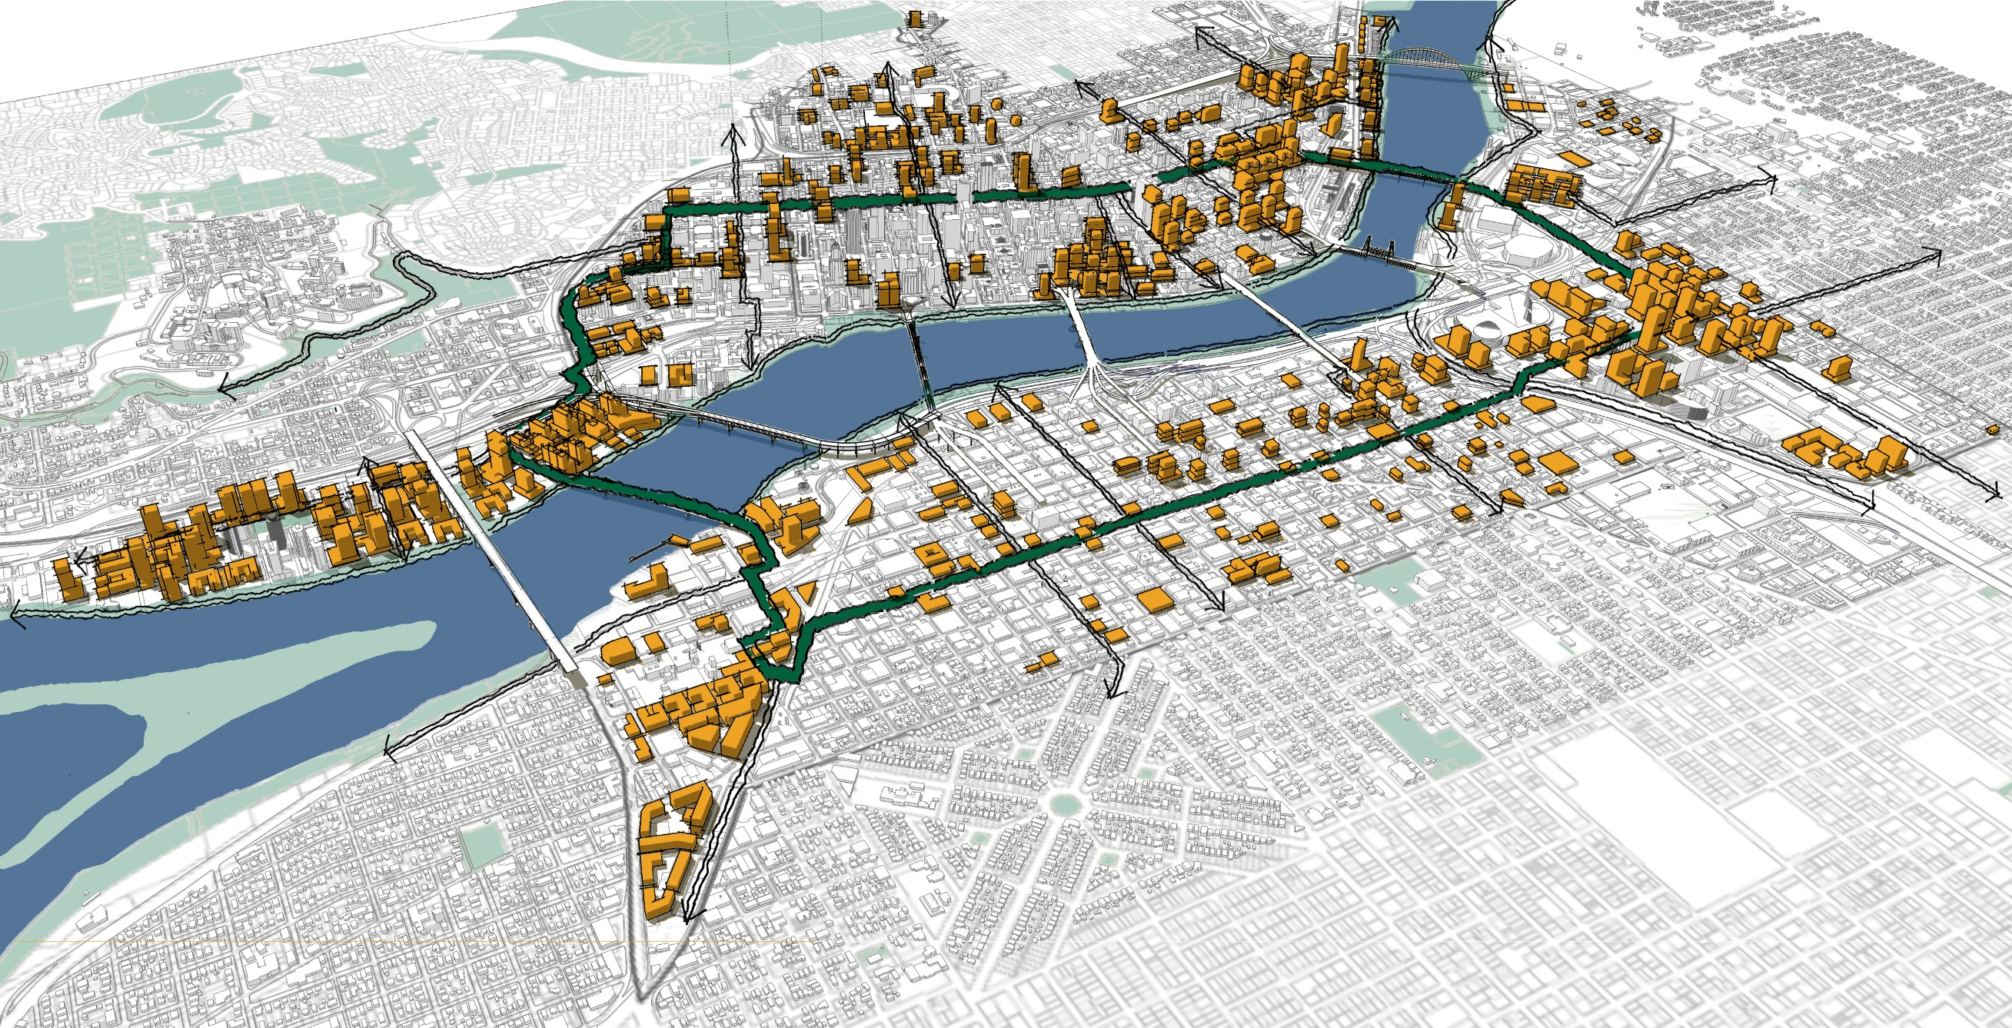
organizing growth.
The Green Loop is about
Why Here?
In the next 20 years, the Central City will be home to:
30 percent of the growth in
3 percent of the land area.
+ 36,000 new households
+ 50,000 new jobs
Notes:
The Green Loop builds on existing greenway paths and the Willamette River Loop between the Steel and Hawthorne Bridges. It adds a concentric ring roughly 10 blocks from the river, reaching the Central City’s places of highest activity and potential density with a series of safe east-west connections to surrounding areas.
The Central City has a lot of room to grow in the next 35 years. The diagram on the left shows a potential future build-out within the areas of high redevelopment capacity (circa 2012) in orange. As the Central City grows, it has the potential to shape new development around the Green Loop’s recreation and open space network.

Slide 7
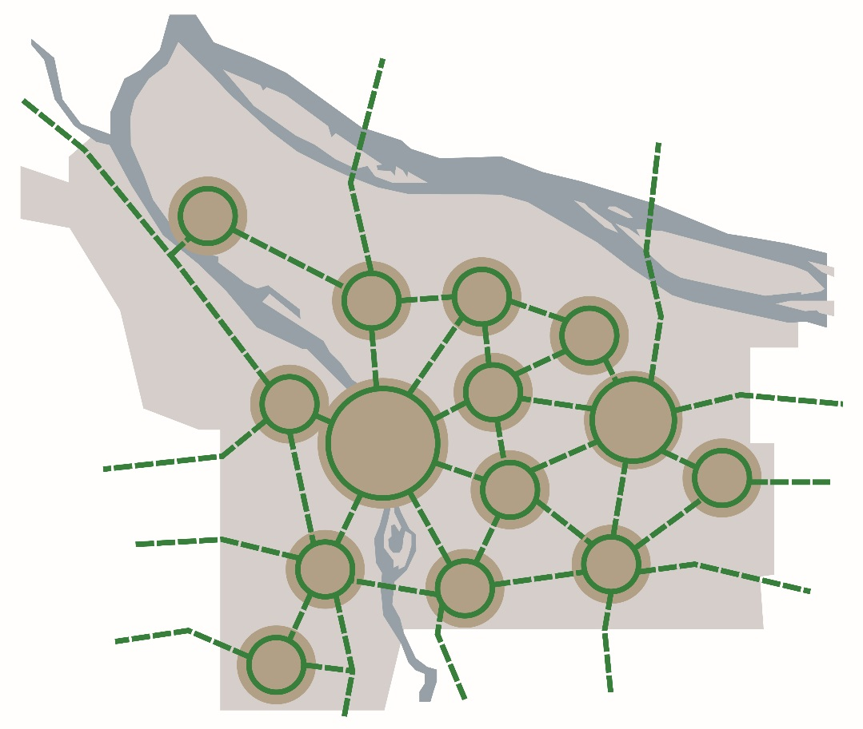
a citywide vision.
The Green Loop is part of
System of neighborhood circuits,
linked by City Greenways

Slide 8
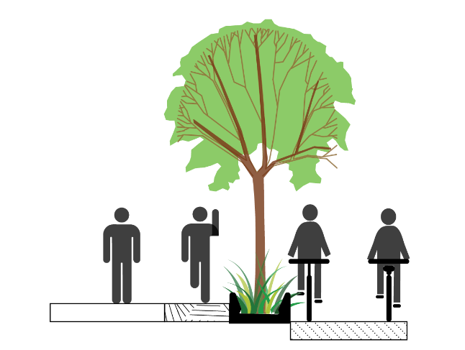
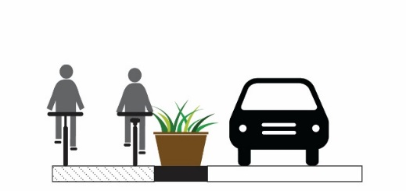
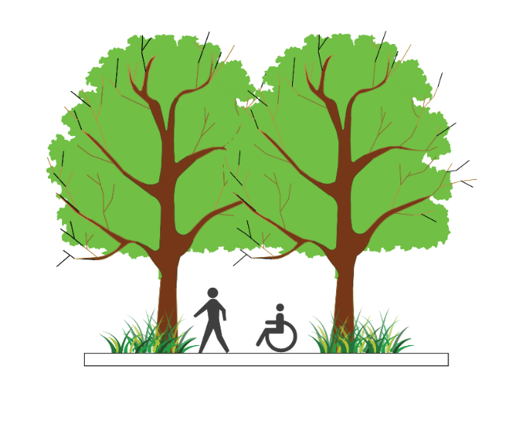
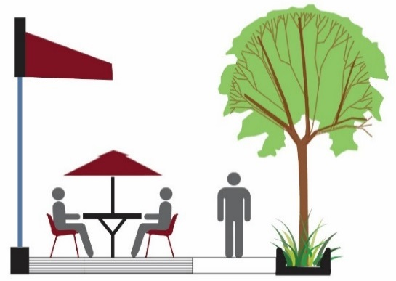
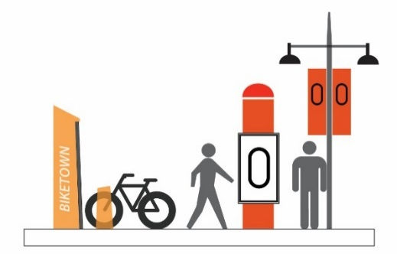
DESIGN PRINCIPLES
THE GREEN LOOP
PHYSICAL SEPARATION
WALKING, JOGGING,
BIKING
CONNECTED CANOPY
BUILDING ORIENTATION
BRANDING/IDENTITY
CREATIVE FURNISHING DESIGN
Notes:
The Green Loop aims to follow four key design principles:
It will incorporate a multi-use path that is intended to accommodate but separate pedestrians and joggers from cyclists.
Though it will be located within many of Central City’s existing street network, the Green Loop will be physically separated from cars.
Where possible, the Green Loop will include a connected tree canopy as well as pedestrian and bicycle-related amenities such as seating, bike racks, lighting, wayfinding, and water fountains.

Slide 9
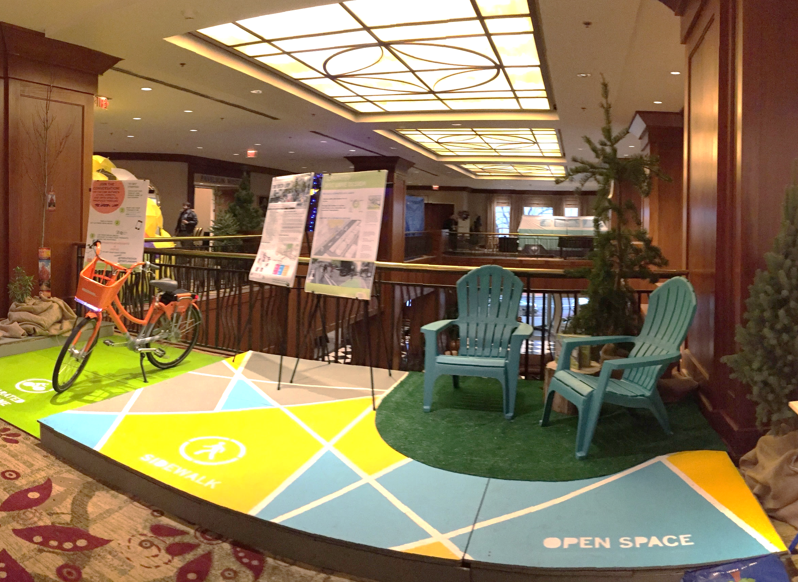
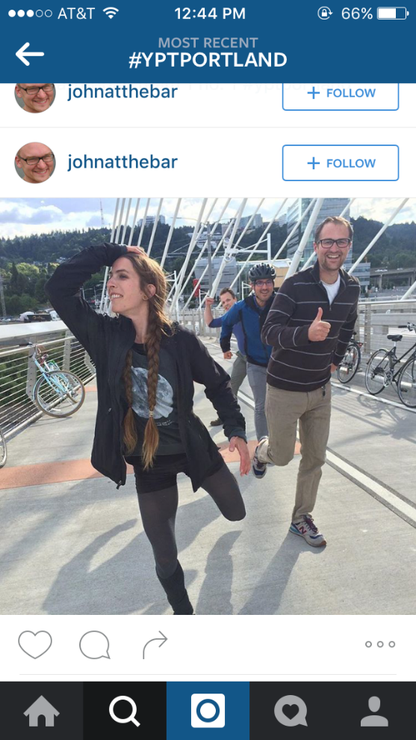
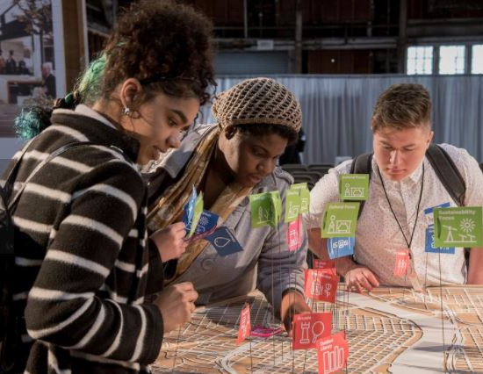
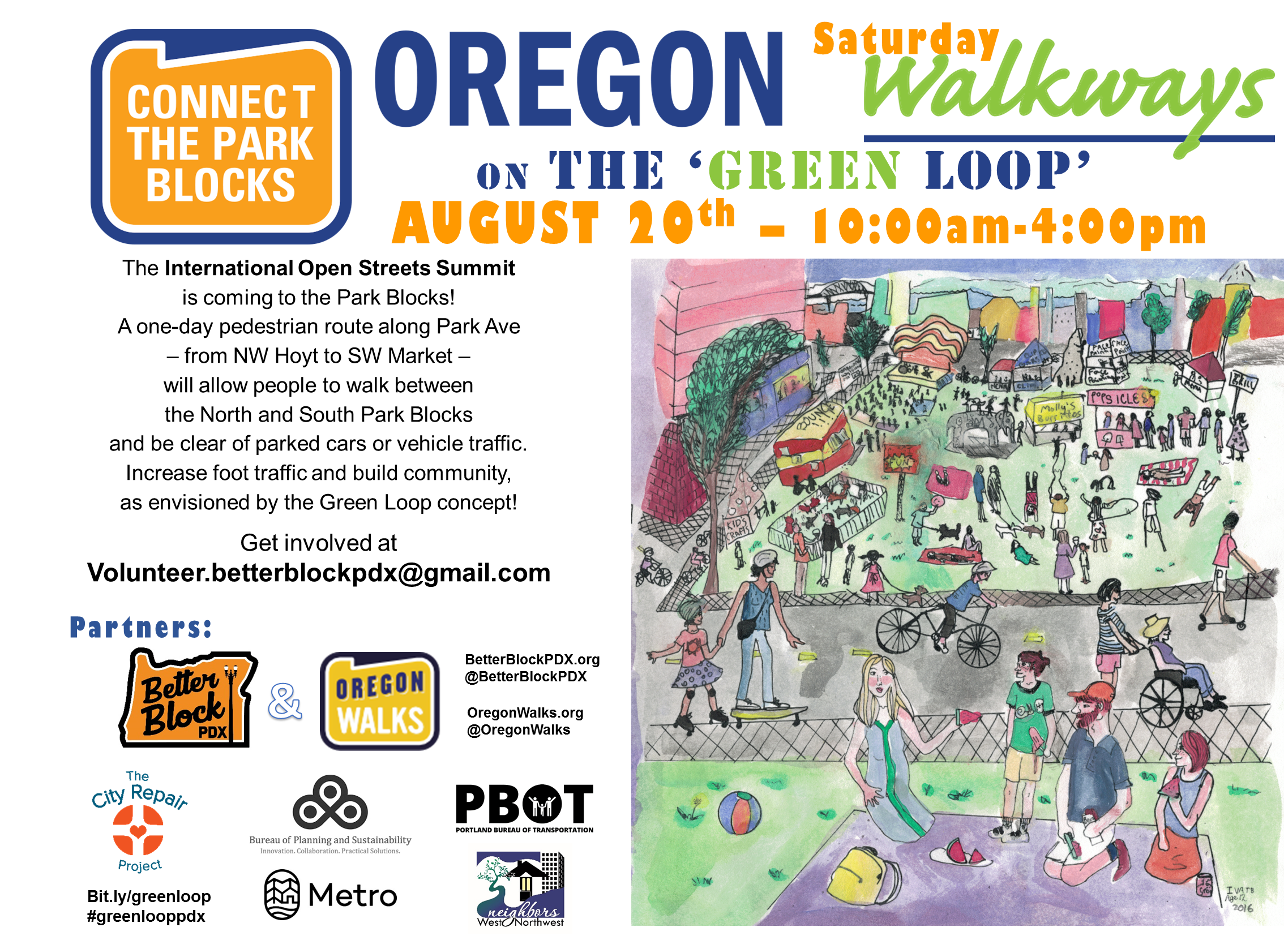
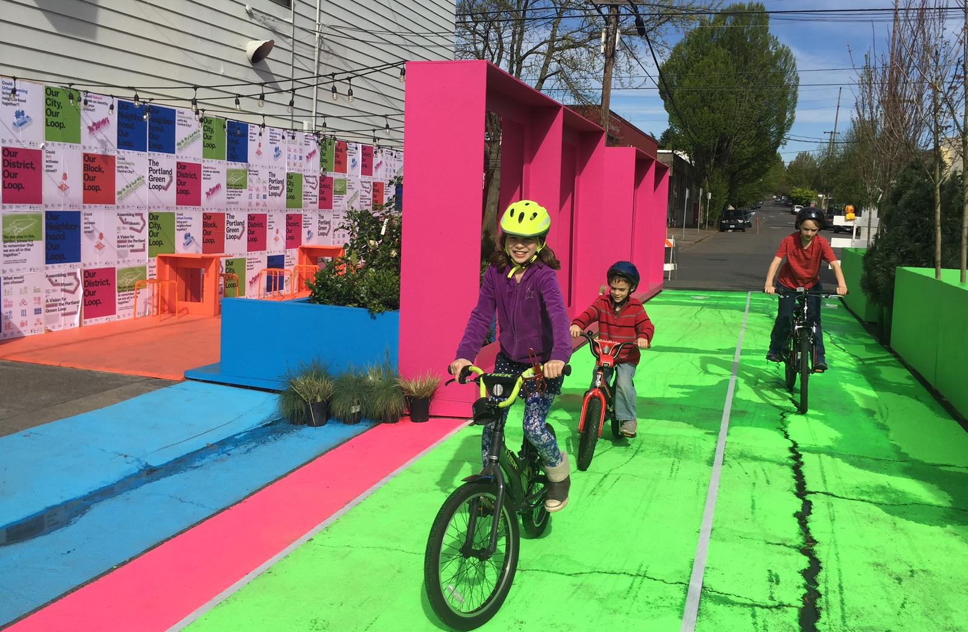
Community Involvement
The Green Loop
Oregon Walkways 2016
YPT Scavenger Hunt 2016
Design Week Portland 2016

Slide 10
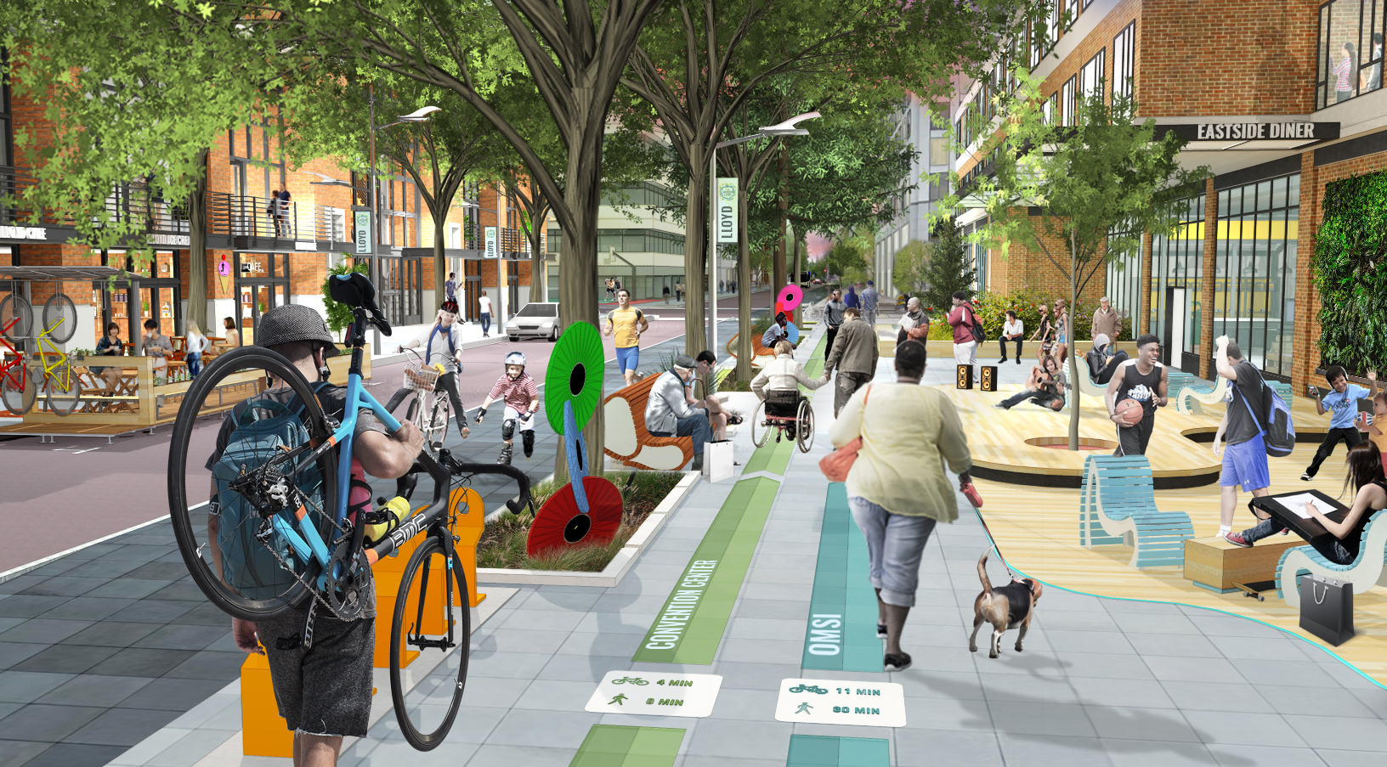
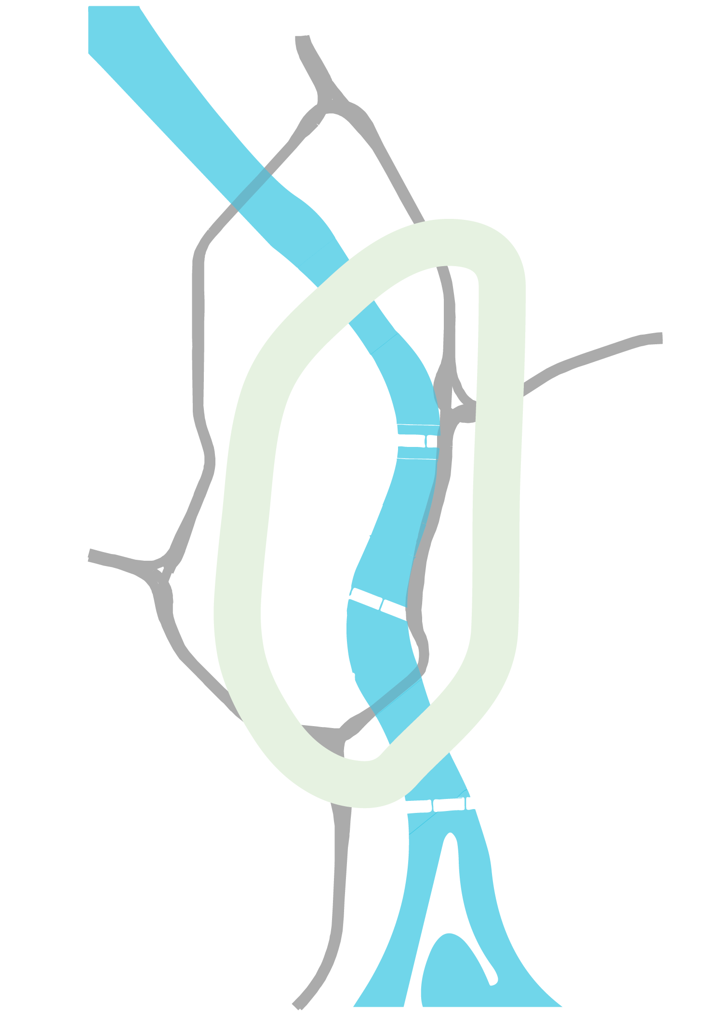
Lloyd District

Slide 11
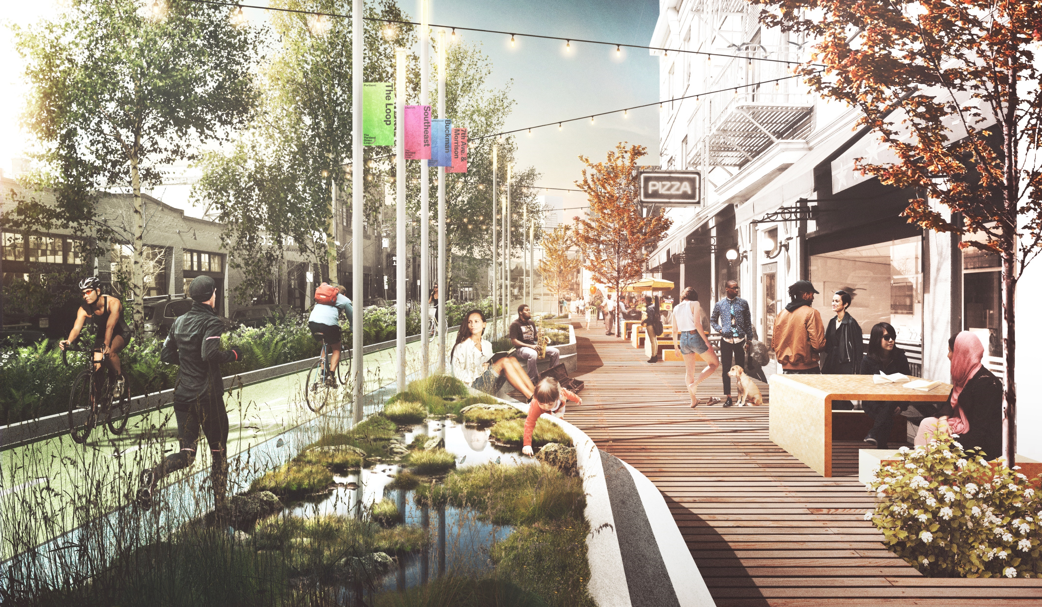
Central Eastside
Credit: Untitled Studio
Notes:
This artist rendering is a potential vision for what the Green Loop could look like on the North Park Blocks, with features that include:
a physically separated bike path
pedestrian improvements
potential jogging path
signature wayfinding signage and lighting.
new development oriented to the Green Loop with active ground floors
outdoor seating
visible “green” stormwater features and landscaping.

Slide 12
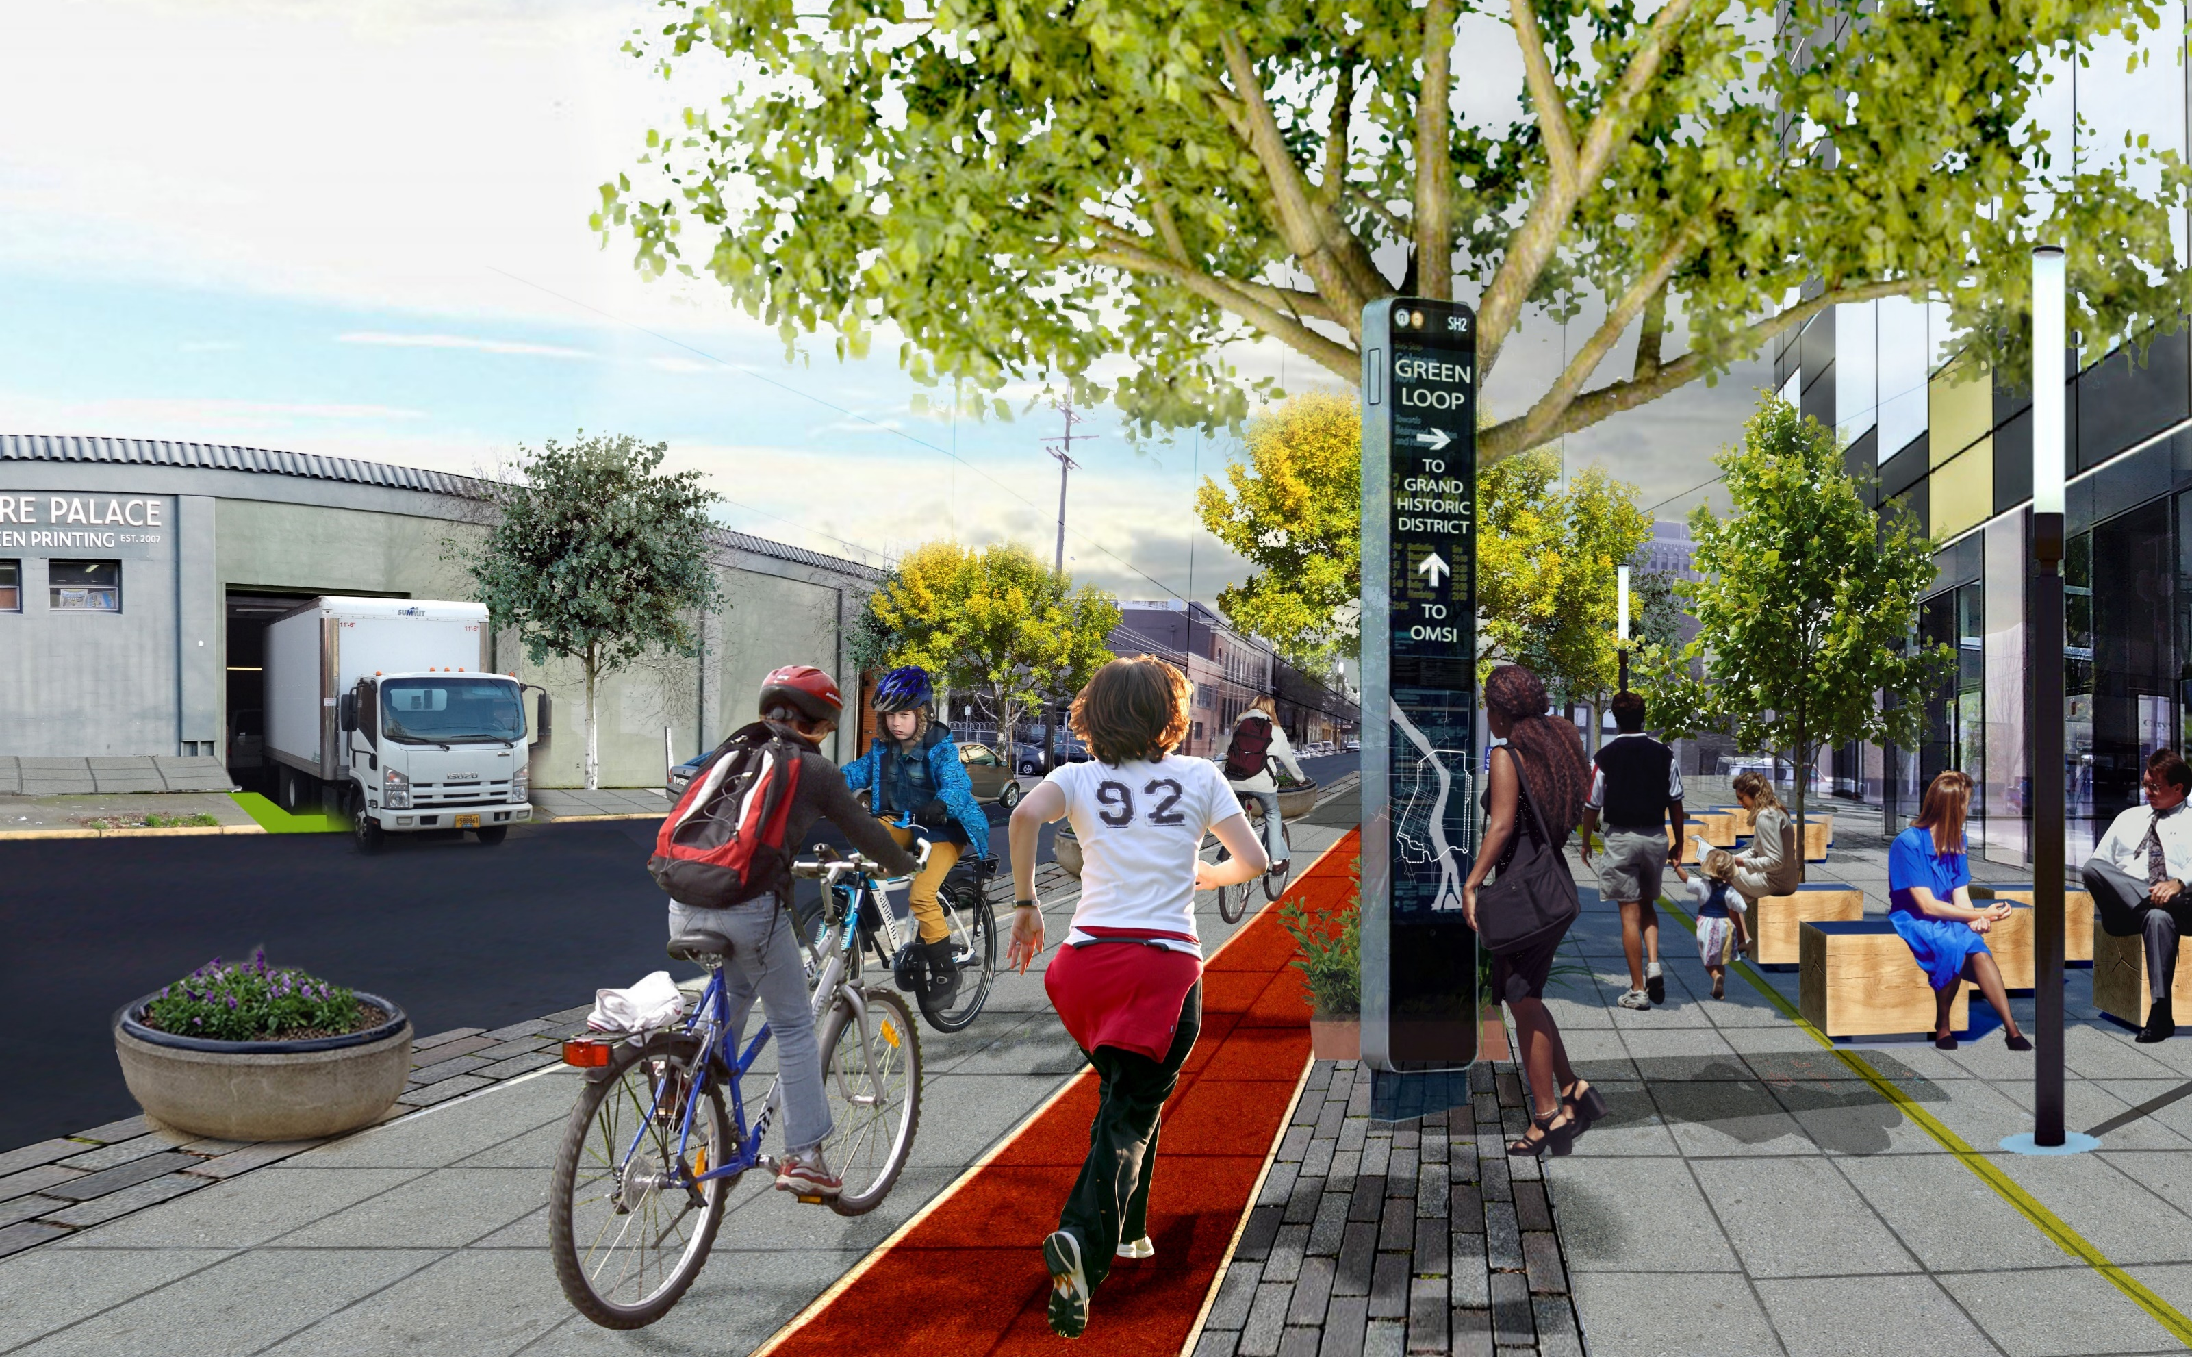

Slide 13
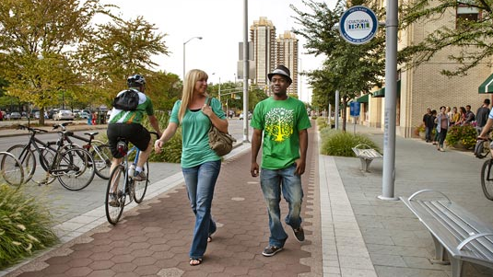
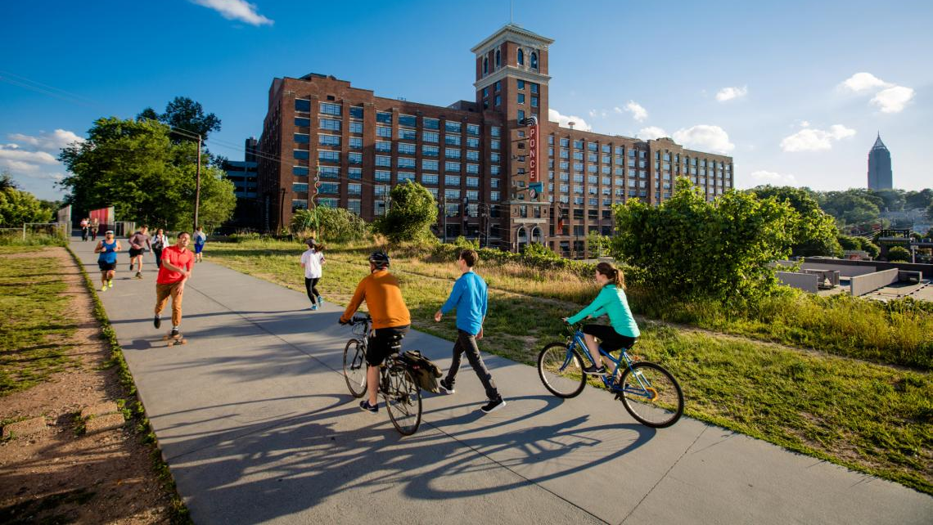
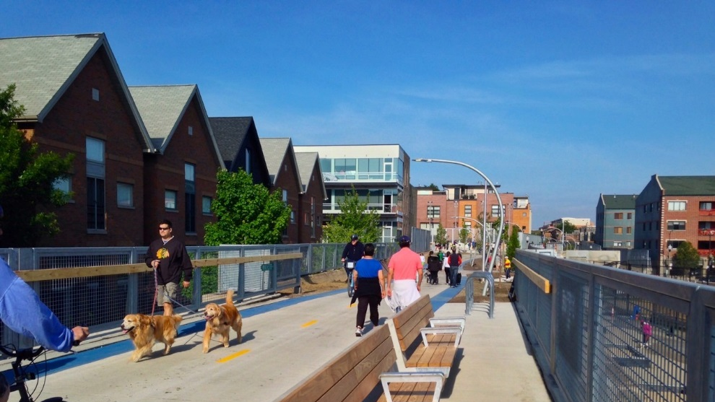
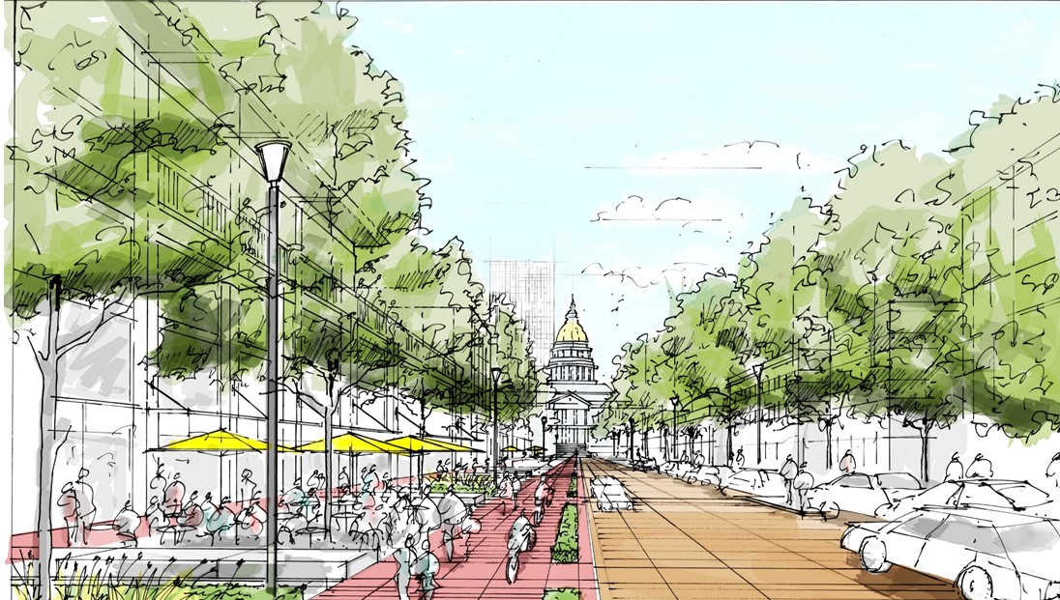
Precedents
The Green Loop
The Indianapolis Cultural Trail
The Atlanta Beltline
The Chicago Bloomingdale Trail – “The 606”
The Denver 5280 Loop
Notes:
Many other cities are investing in low-stress, placemaking strategies that incorporate active transportation through the centers of their downtowns.
The example from Vancouver shows a lower cost, perhaps initial-phase approaches to consider.
New York and Indianapolis show more permanent solutions that have had measureable impacts for walking and biking for each city. The Indiana Cultural Trail connects several institutions along an 8 mile trail. Though it is a high level of design throughout the length of the trail, over half of it was funded by federal transportation funding, and most of the remainder was funded privately.
The example in Chicago is the 606 – a new highly visible elevated linear park and trail system – is a separated bicycle, jogging and pedestrian connection across six neighborhoods, which will provide three miles of green space, connecting six neighborhood parks at ground level, a wheel-friendly event plaza, an observatory, art installations, educational programming, and other amenities.

Slide 14
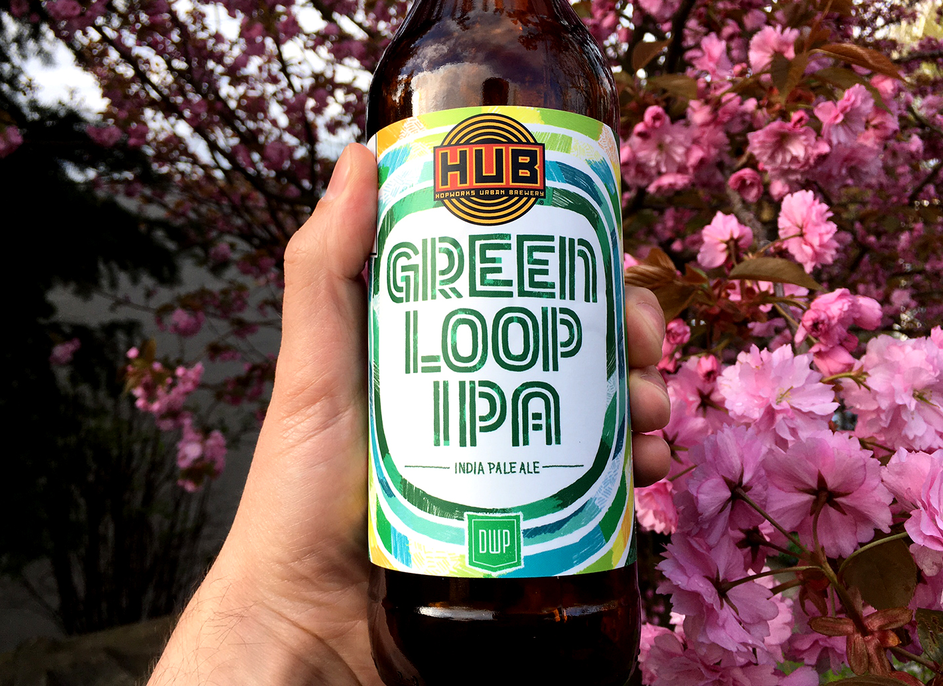
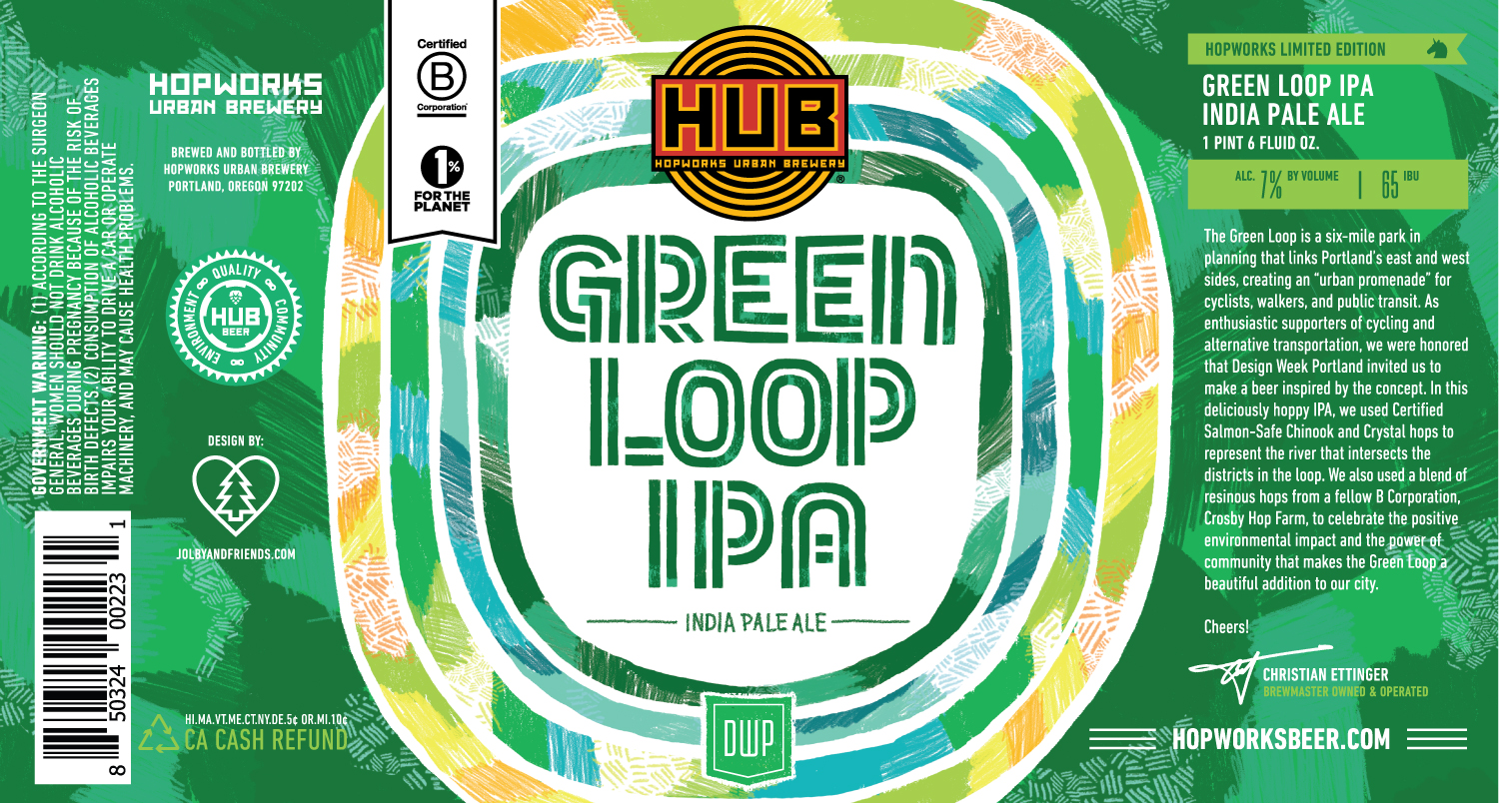
Community Involvement
The Green Loop
Logo credit: Jolby & Friends
Hopworks Urban Brewery [HUB] brewed a special edition Green Loop IPA for Design Week Portland’s opening party.

Slide 15
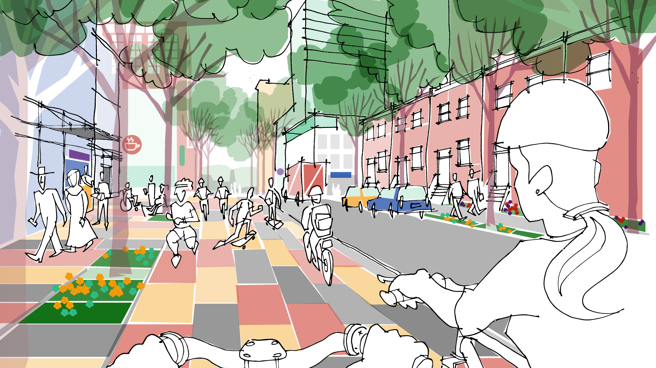
Adopted with Central City 2035 Plan

Slide 16
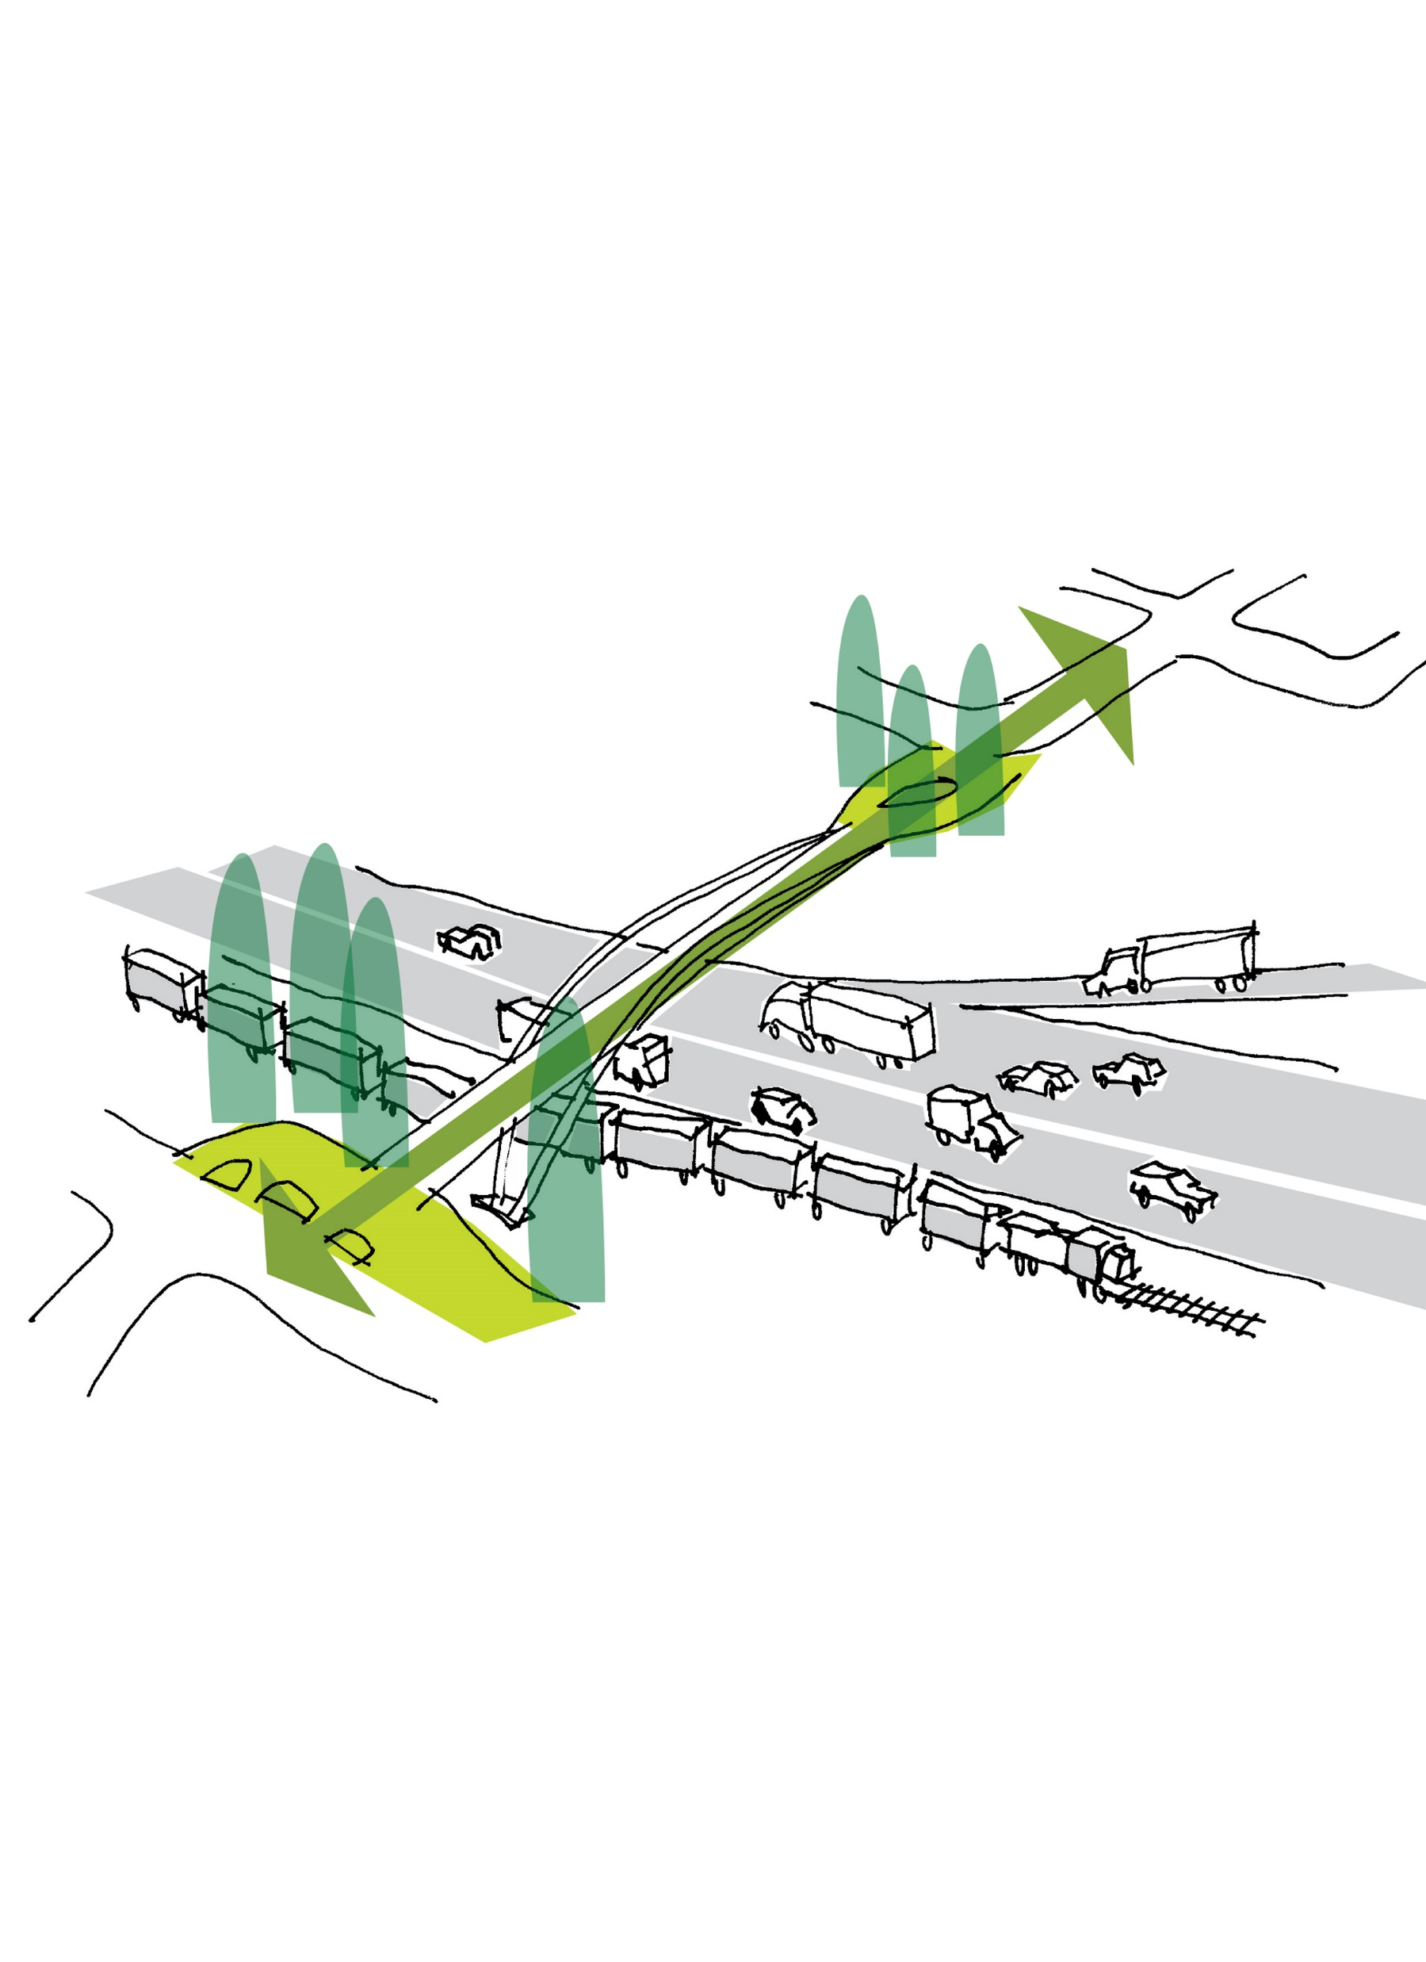
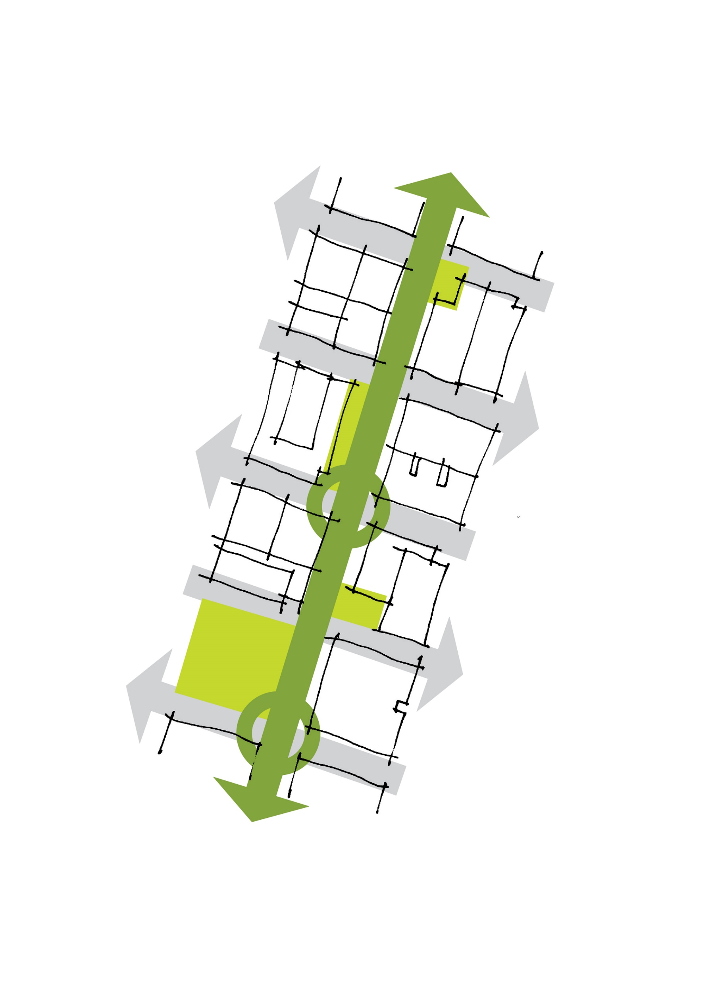
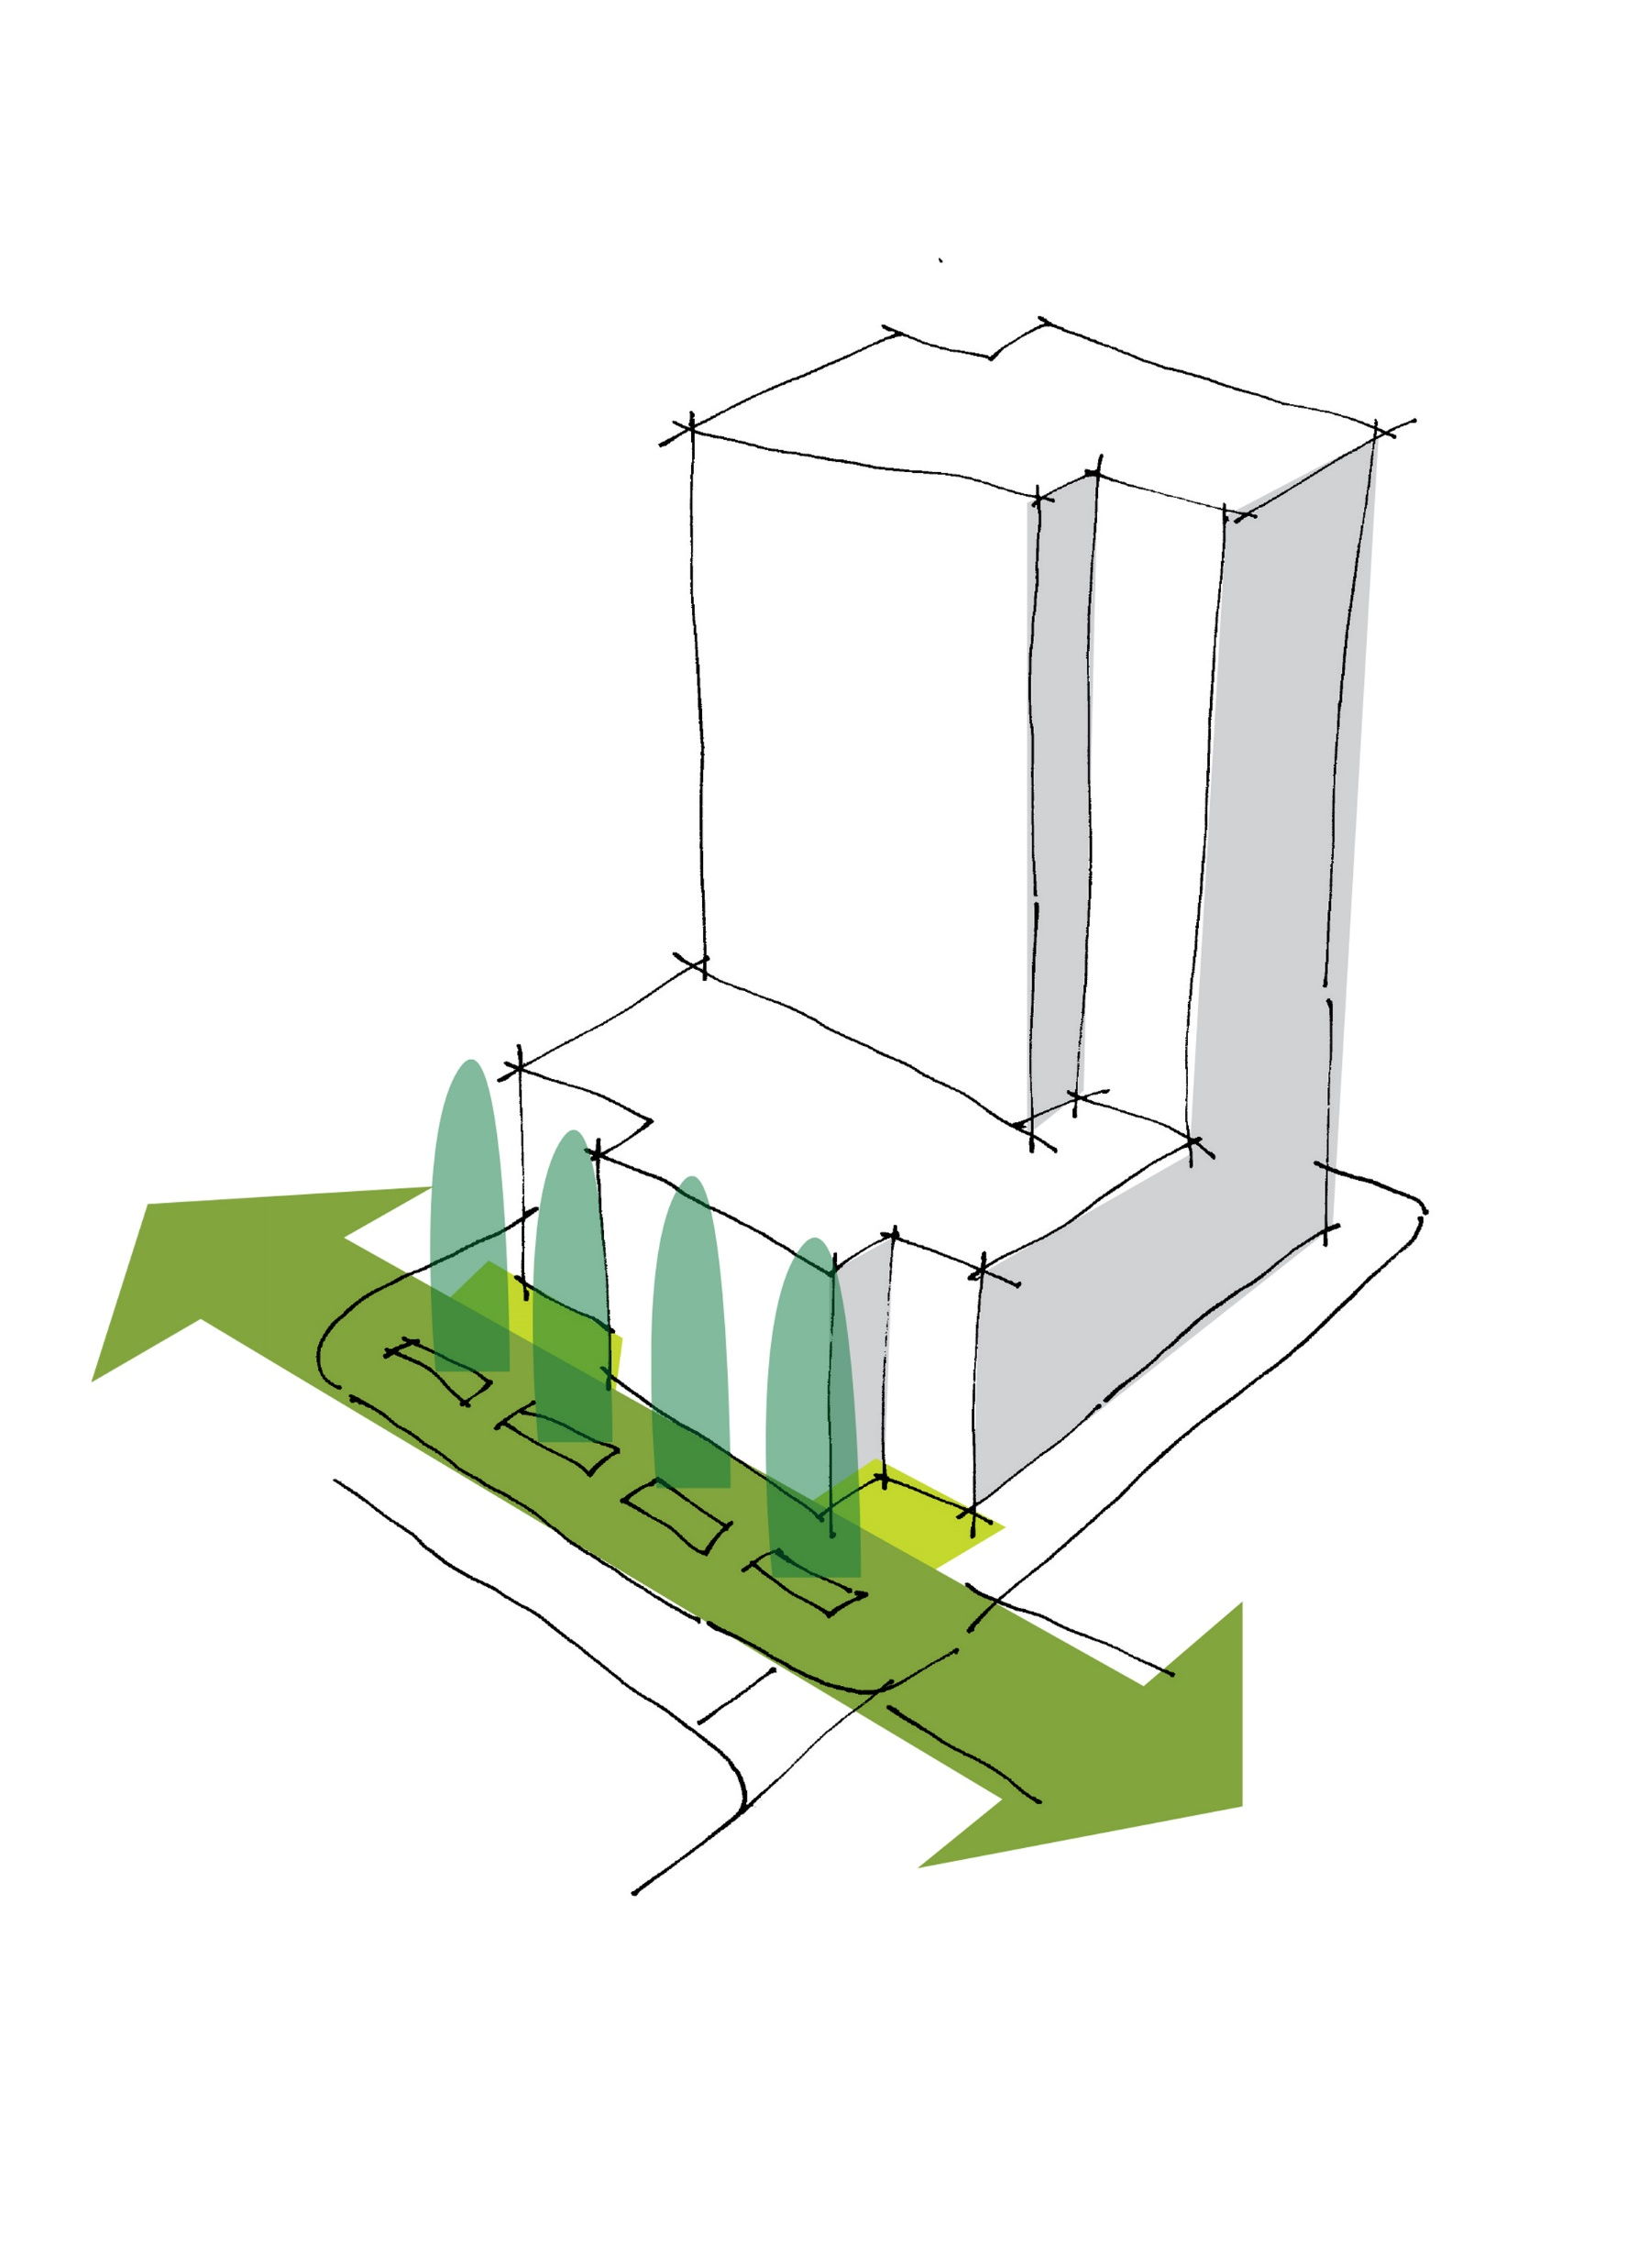
Public Infrastructure
Loop Implementation
Development Regulations
Capital Improvements

Slide 17
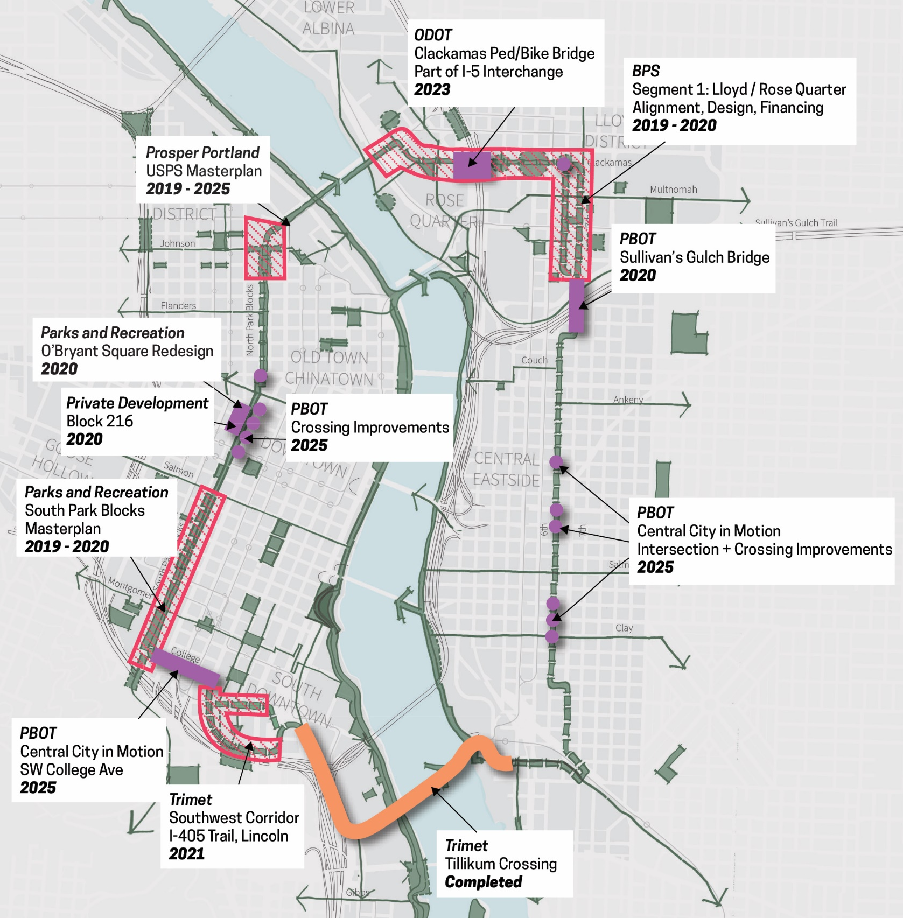
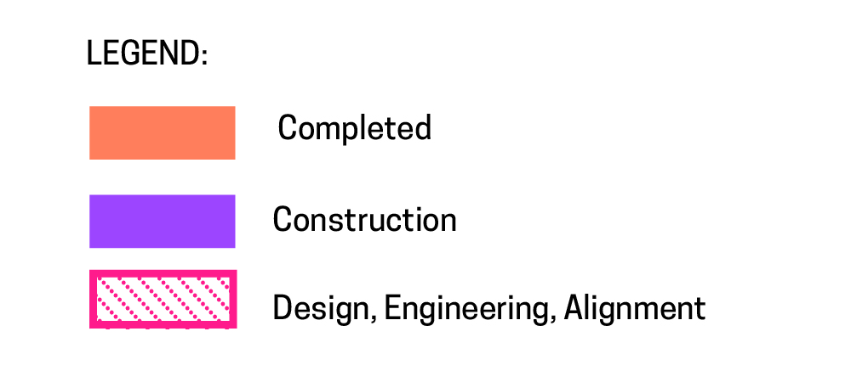
Loop in Progress

Slide 18
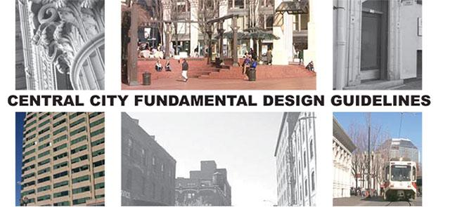
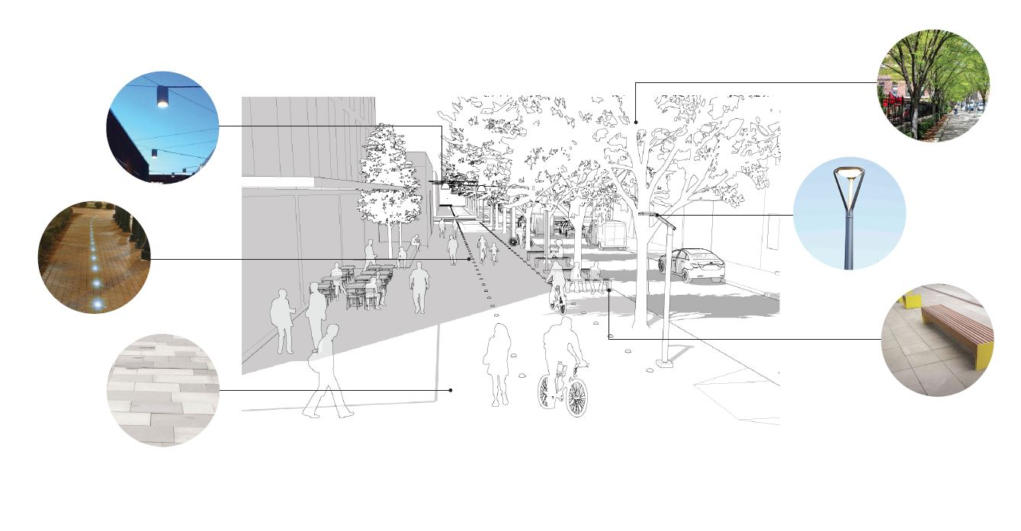
Public and Private Standards and Guidelines

Slide 19
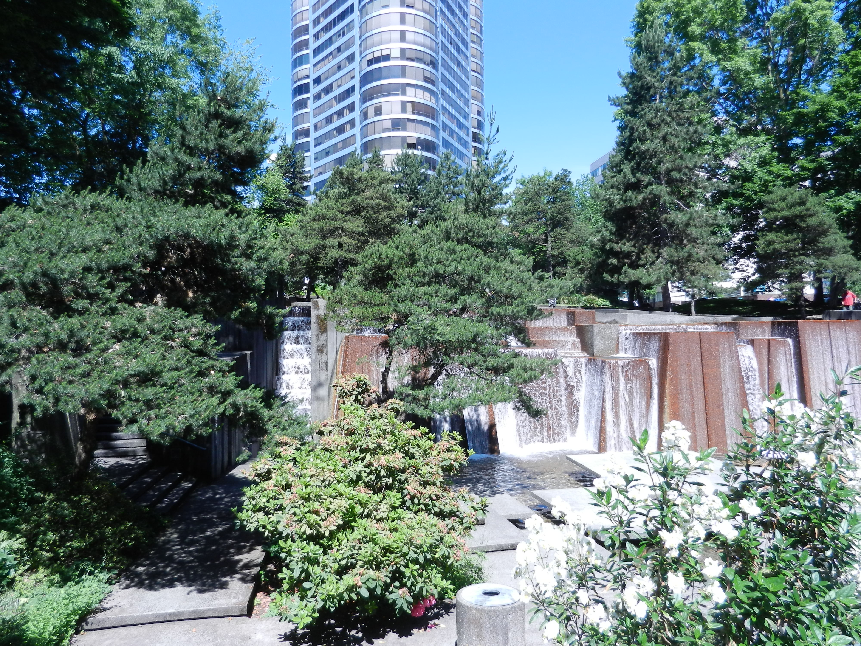
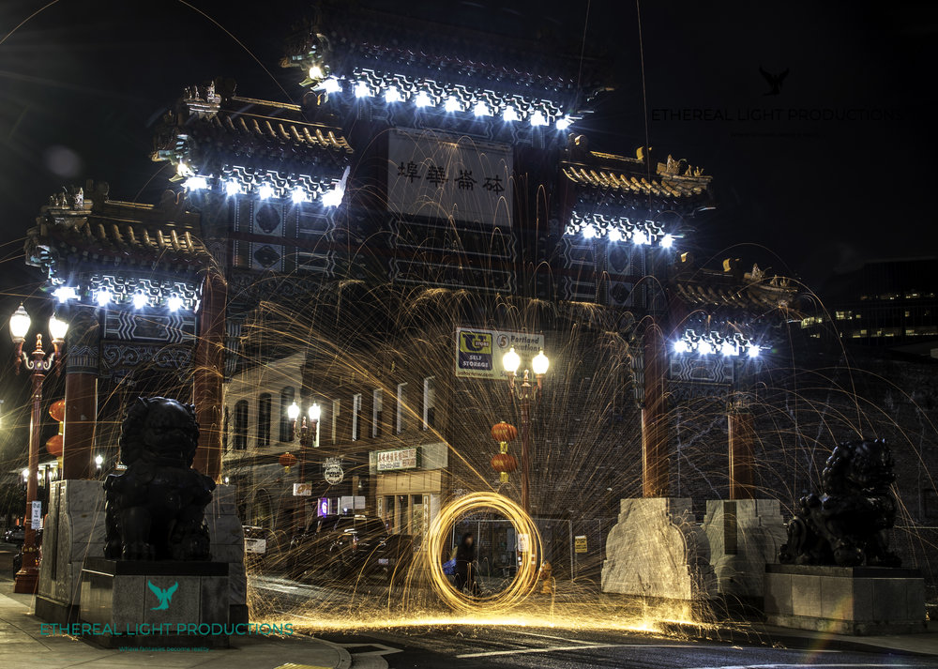
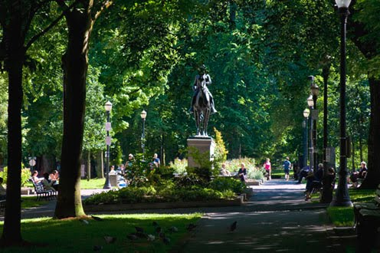
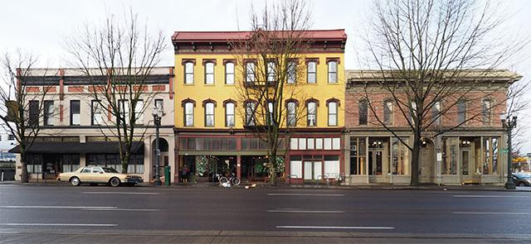
Linking Historic Places

Slide 20
Stories of the City

Slide 21
Cobblestones

Slide 23
The Green Loop
Leveraging Public Investments
Capital Projects:
1
Trimet: Tilikum Crossing Bridge
3
2
PBOT: I-84 Sullivan’s Crossing Pedestrian/Bicycle Bridge
4
2
5
3
ODOT: I-5 Broadway/Weidler Interchange Project
4
Prosper Portland: Broadway Corridor Framework Plan
5
PBOT: Central City in Motion
6
Metro/Trimet: Southwest Corridor Transit
6
7
1
8
7
TBD: “Hill Park” connection
8
Metro/Trimet: Division Transit Project

