Slide 1
Agenda Item 71:
Sidewalk Repair Appeal
January 30, 2019
Notes:
Good morning
I’m Tara Wasiak, PBOT MO Group Manager, this is my colleague Amy –
We’re here for Mr. Bell’s sidewalk repair appeal

Slide 2
Background
April 18, 2016
  Unsafe sidewalk reported on SE 60th, just north of SE Division

Slide 3
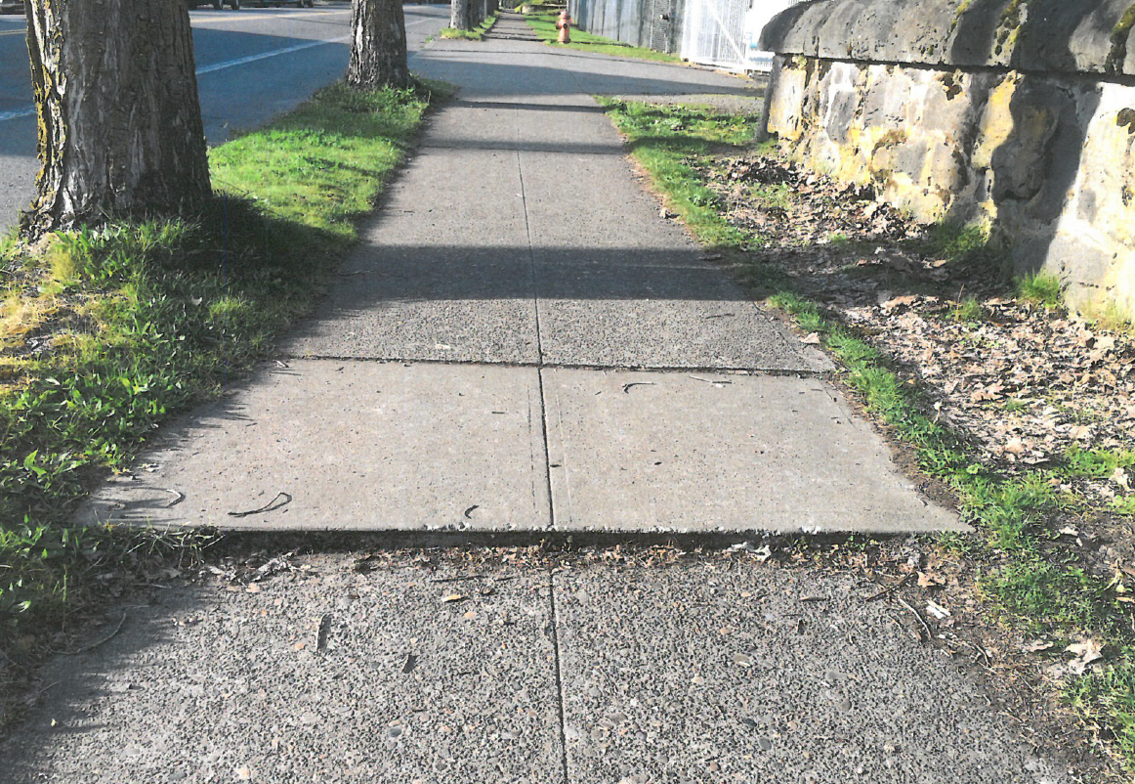
Reported hazard

Slide 4
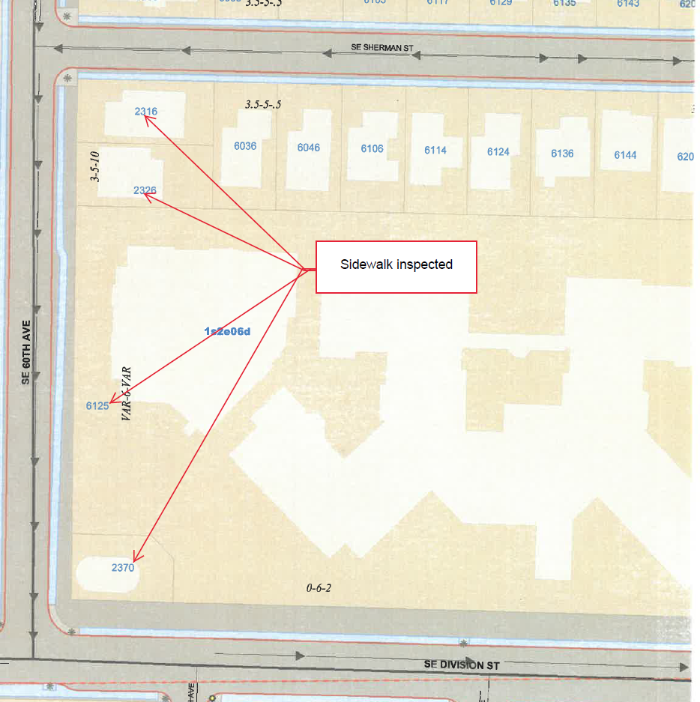
Inspection area
The block face of SE 60th, from SE Division to SE Sherman was inspected for hazards

Slide 5
Timeline of events
July 18, 2016
  A Sidewalk Repair Notice was sent to Mr. Bell
  In accordance with Portland City Code 17.28.20
  Per City Code 17.28.090, Mr. Bell had 60 days to:
    Obtain a permit; complete the repairs himself or hire a contractor
    Request that the City make the repairs
July 27, 2017
  A Reminder Letter was sent to Mr. Bell

Slide 6
Estimated cost of repairs
Notes:
This estimate is if the City does the work on the property owner’s behalf.
And because the City’s work is guaranteed for 3 years – these charges include full block replacement.
Often times property owners get approval to do more minimal repairs which can result in substantially lower costs.

Slide 7
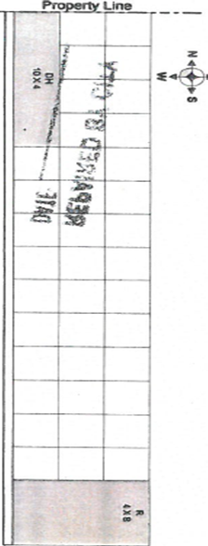
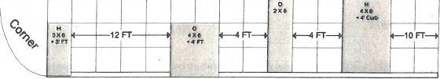
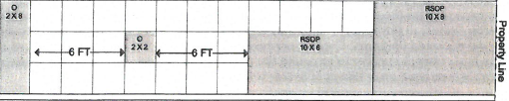
Repair Notice includes a diagram:
Notes:
The diagram locates the hazards found on the sidewalk abutting the property

Slide 8
Repair Notice includes the standards:
Notes:
This ½” standard often seems stringent upon first glance – but from a safety standpoint – the larger deviations in the sidewalk are easy to spot..
these ½” deviations are harder see – especially at night – and they cause trip and falls.
The ½” standard has been in place for at least the last 30 years

Slide 9
Other cities with similar sidewalk programs and standards
  Seattle, WA:
    Sidewalks posted for hazards ≥ ½”
  Sacramento, CA:
    Sidewalks posted for hazards ≥ ½”
  Denver, CO:
    Sidewalks posted for hazards for “any change in the official grade of the sidewalk” and at the discretion of the inspector
Notes:
City of Portland is not alone
Maintenance & Repair of sidewalks is the responsibility of the property owner in Seattle, Sacramento and Denver

Slide 10
Timeline continued
August 29, 2017
  A Final Inspection was requested and performed.
  No work started, property failed inspection.
September 15, 2017
  Sidewalk Inspector met with Mr. Bell.
  Minimal repairs and financing options were discussed
November 17, 2017
  Property was posted with a doorhanger by a contractor working on behalf of the City
December 8, 2017
  Final Inspection of the work performed by the contractor was complete. Contractor was subsequently paid.

Slide 11
Timeline continued
February 28, 2018
  Mr. Bell appeared before City Council to contest the need for repairs, the validity of the charges, and to point out that more hazardous sidewalks exist in other parts of the City
May 11, 2018
  The assessment was reviewed
  A revised assessment and the determination of remonstrance sent to Mr. Bell
Notes:
The assessment did not include the work done on the property line on SE Division
The property line on SE 60th was harder to determine without a professional survey so these charges were removed

Slide 12
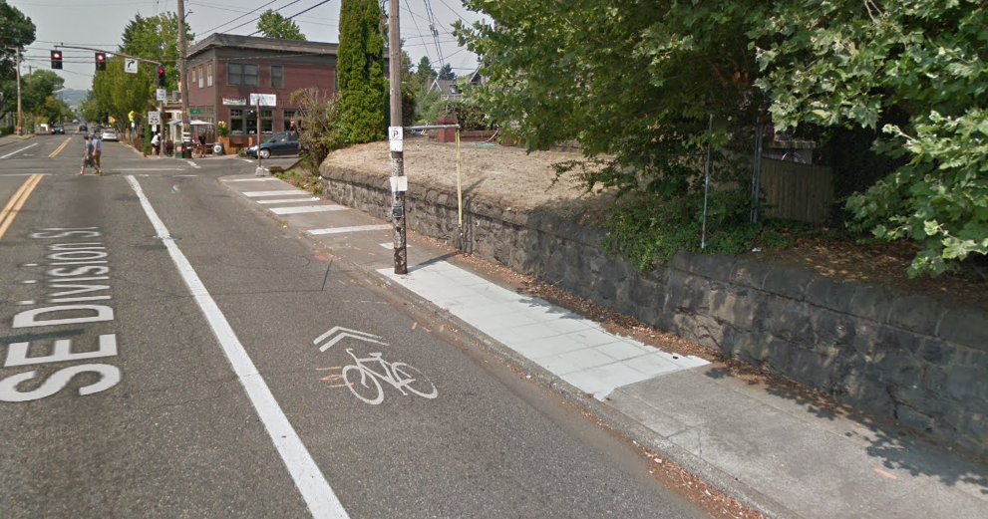
Work beyond with property line on SE Division was not assessed

Slide 13
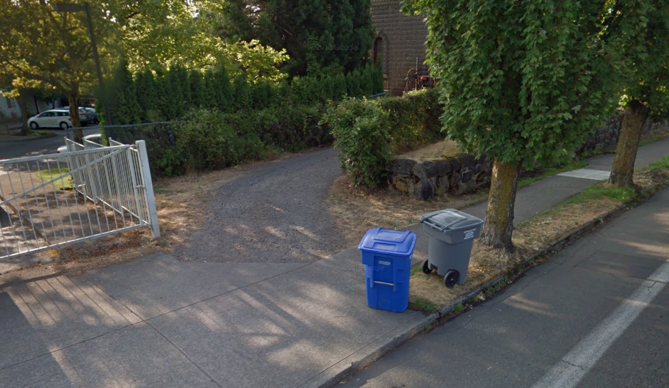
Contested property line on SE 60th

Slide 14
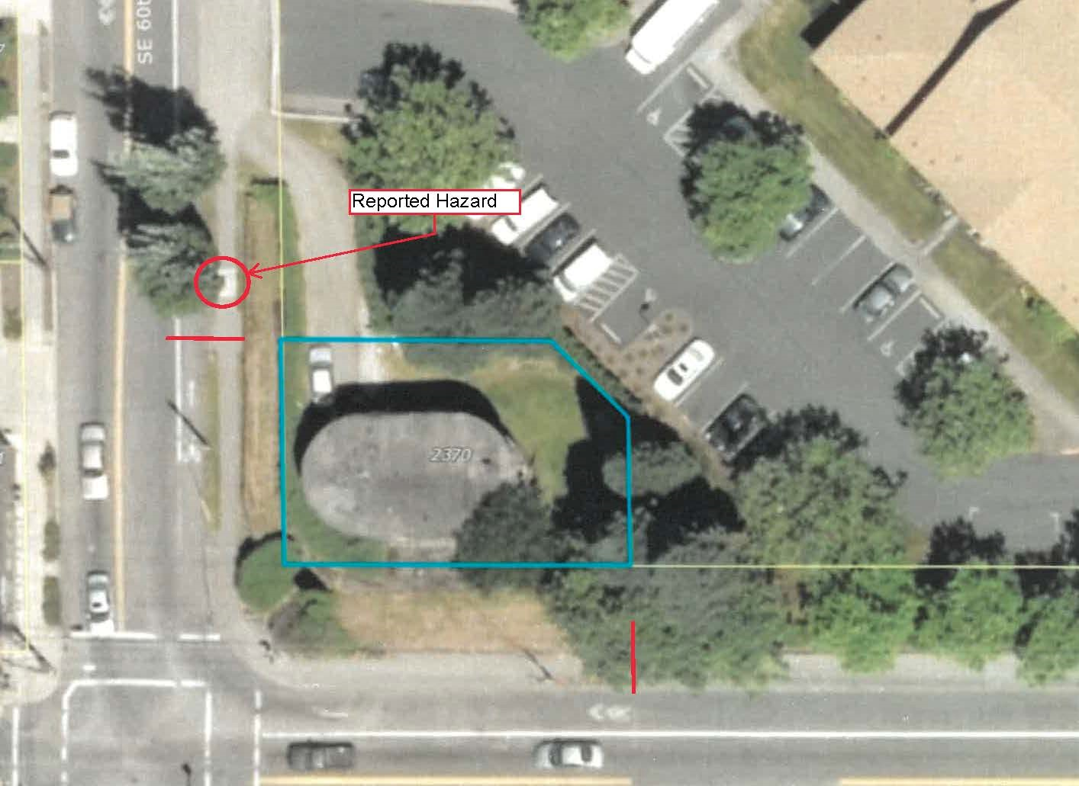
Contested property line on NE 60th Ave, continued.

Slide 15
Revised assessment
  Revised assessment as of May 11, 2018:

Slide 16
Timeline continued
June 14, 2018
  Mr. Bell appeared before City Council for the second time.
  The Sidewalk Maintenance Office was directed by Council to further investigate.
June 18 -29, 2018
  Mr. Bell and PBOT’s administrator of the Sidewalk Repair contractors exchanged a series of emails. Areas of concern:
    Curb repair
    Placement of doorhanger by City contractor
Notes:
Field decision to leave curbs that were on the Sidewalk Repair Notice.
Saw cuts in the curb – rather than a full curb replacement were deemed to be suitable.
The was deemed adequate to minimize futher damage..
Courtesy doorhanger placed by the City contractor, on unused stairs.
This was placed as a courtesy, there is no legal requirement to do so. Ideally, this would have been placed on the door, but due to the unique layout of this property (long driveway easement), it wasn’t done. The doorhanger was instead placed on the railing to the set of stairs on the corner. These stairs are apparently not used.

Slide 17
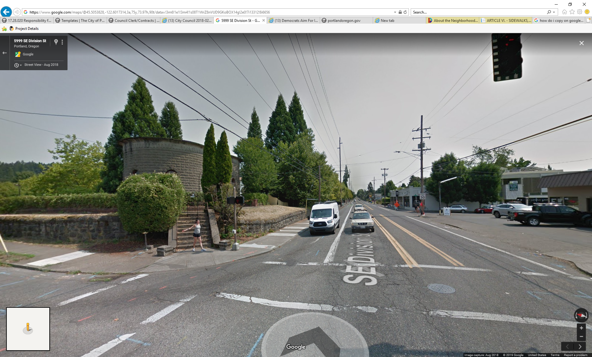
Doorhanger placement on stairs
Insert “after photos” showing the work that was done at Mr. Bell’s property (use Lee’ s photos or Google earth.. Whatever one is best

Slide 18
Timeline continued
September 26, 2018
  City Engineer reviewed the remonstrance of assessment
  Determined that the work was required by City Code and the charges were appropriate

Slide 19
Second revised assessment
  Revised assessment as of September 26, 2018:
Notes:
In recognition of the hardship that these repairs can present – and in an effort to resolve this issue – the permit fee and the 10% auditor’s fee have been waived.
We believe that the assessment is fair and reasonable based on the work that was performed.
Here are some pictures of the completed work…

Slide 20
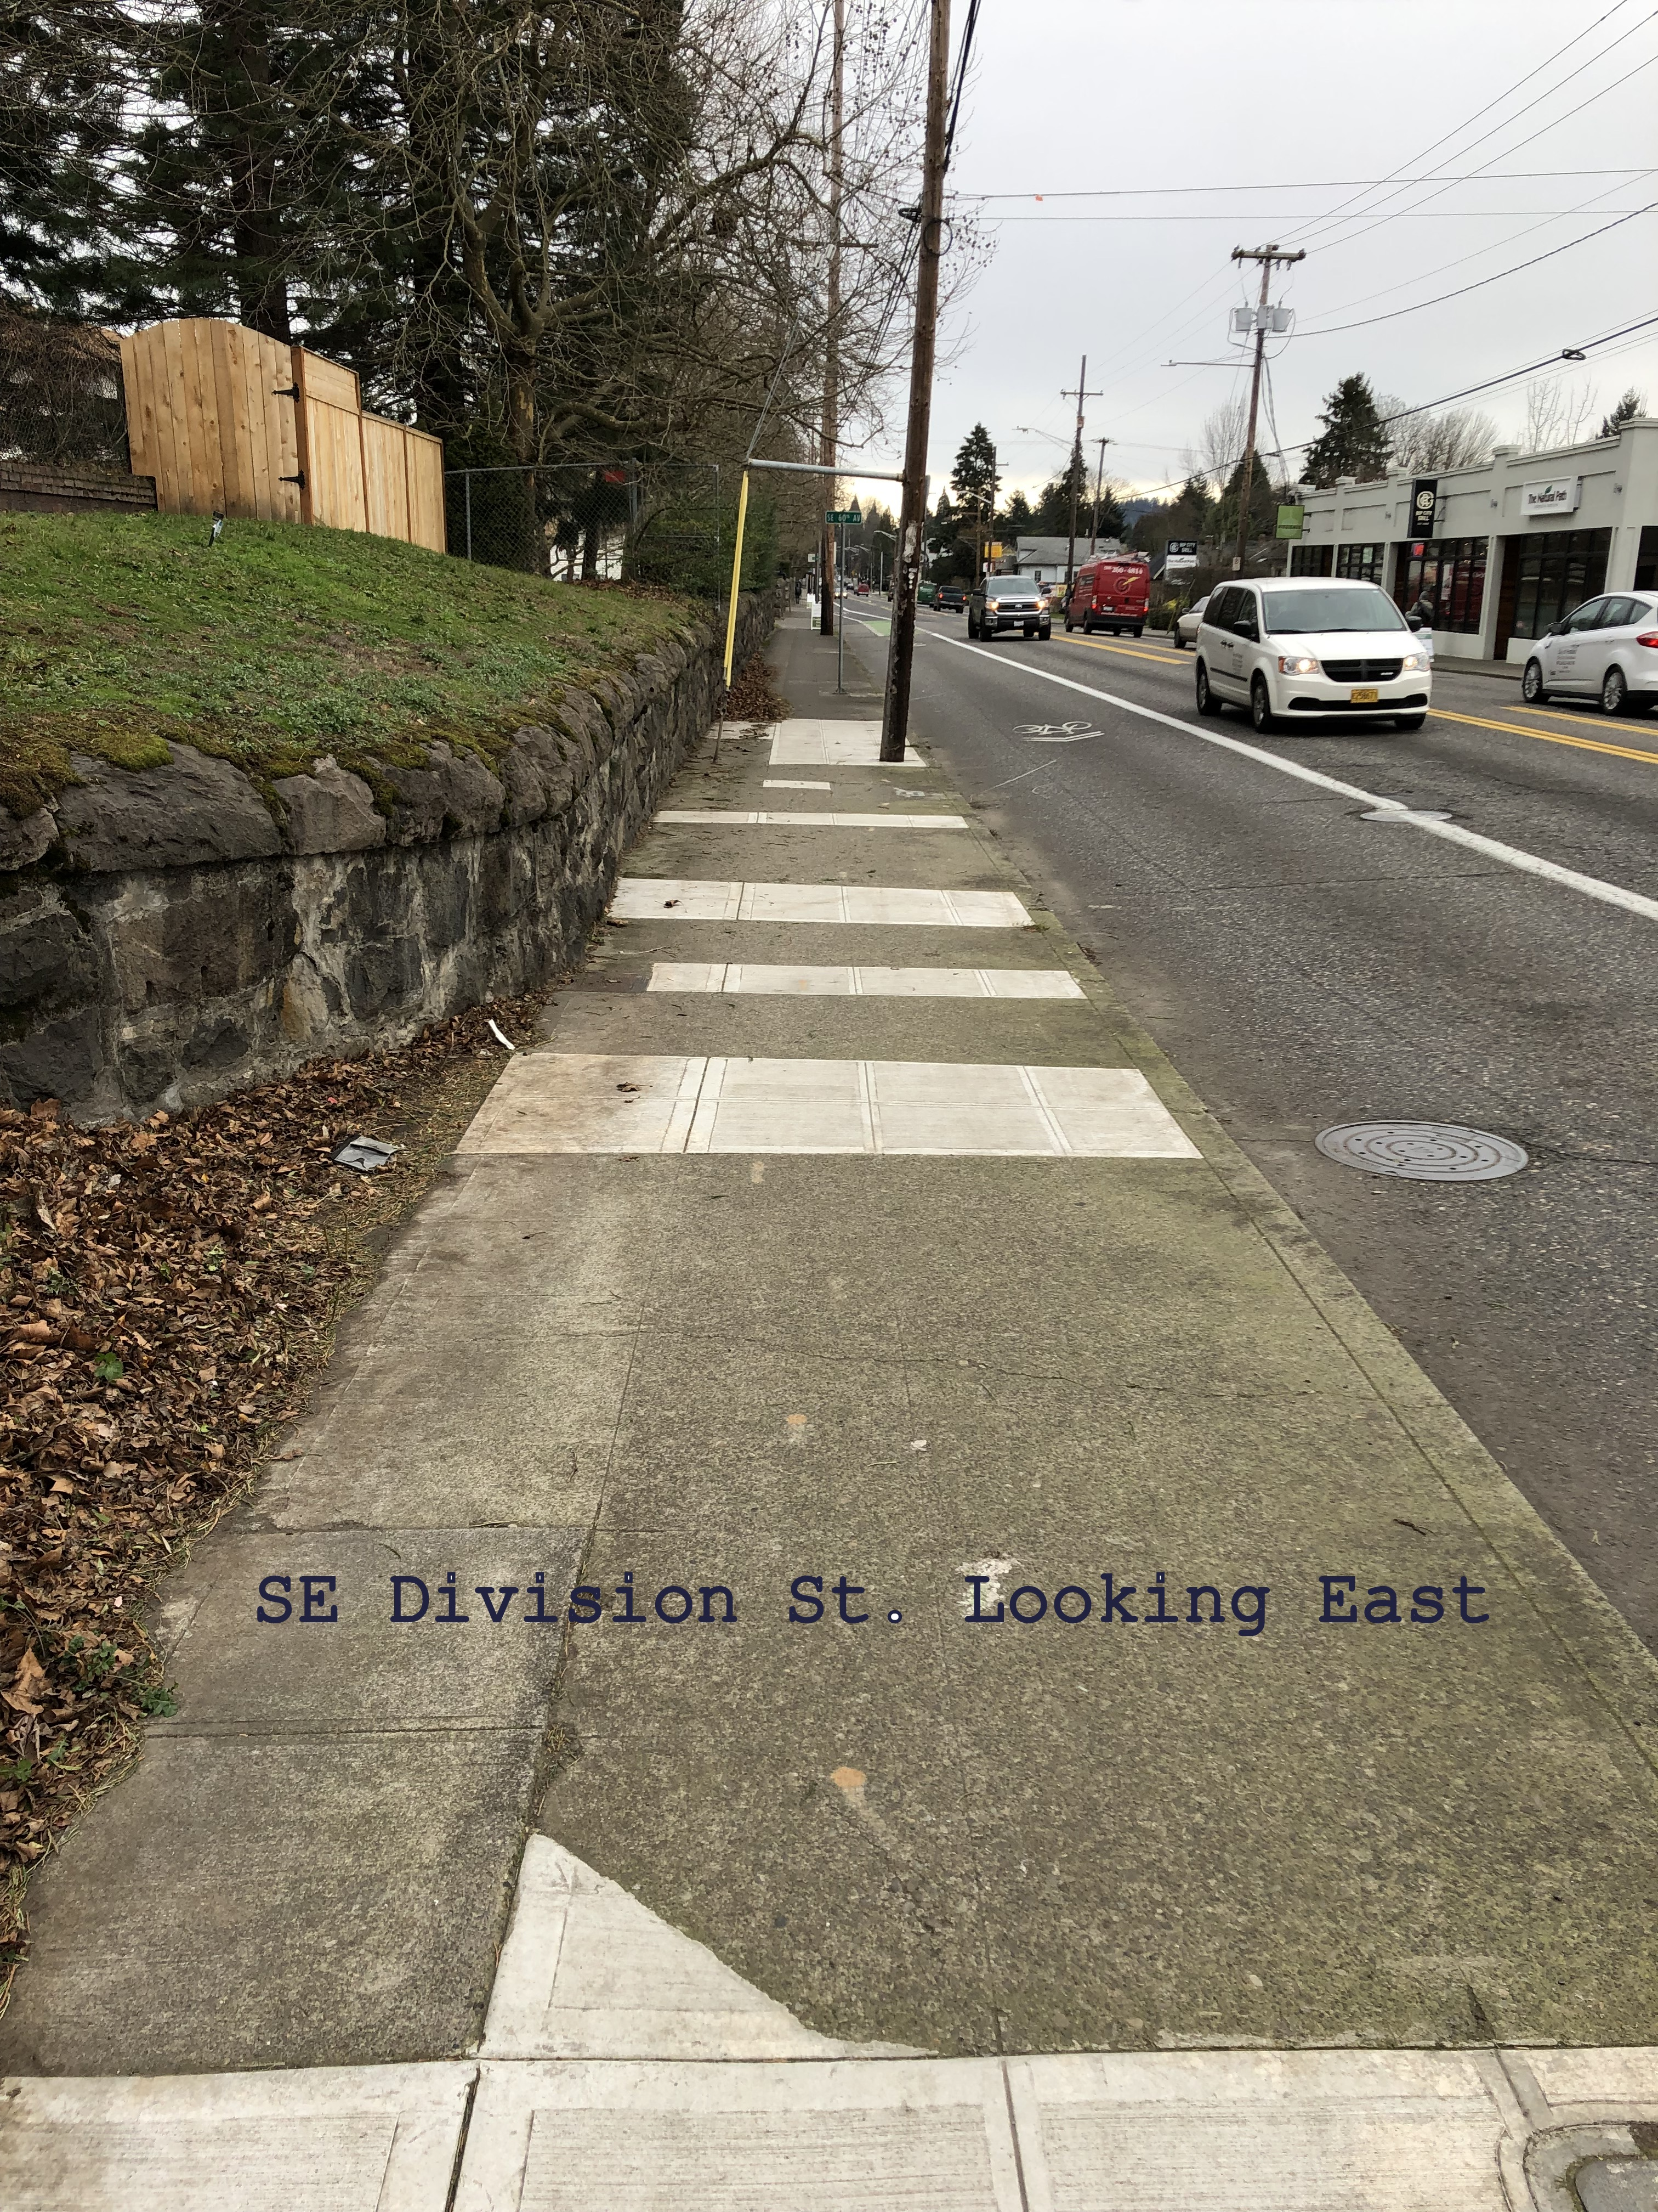
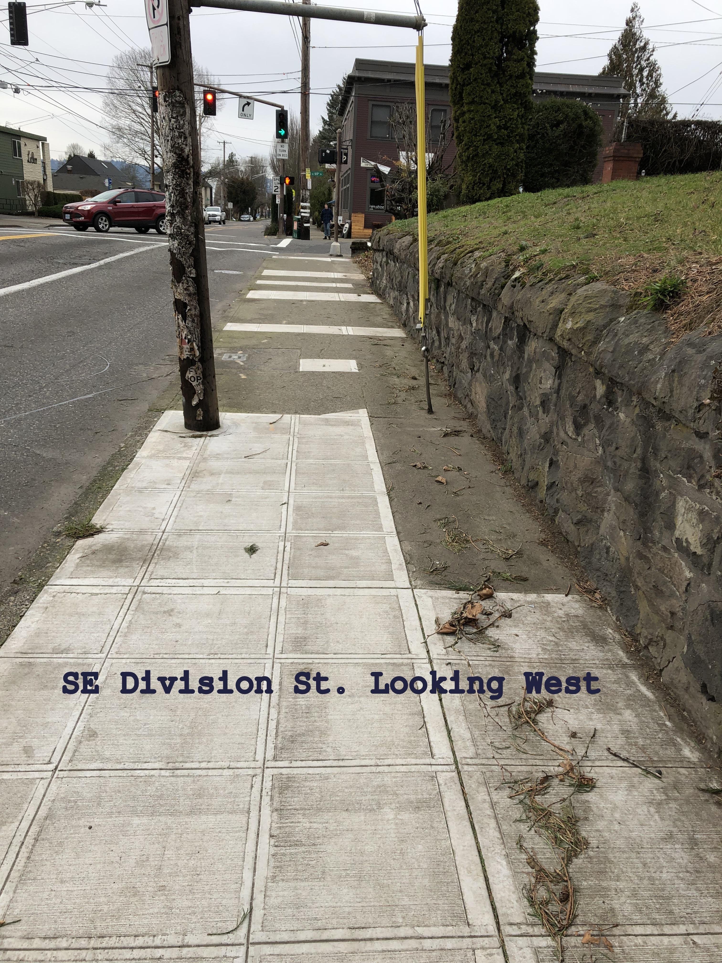
Completed repairs
Insert “after photos” showing the work that was do

Slide 21
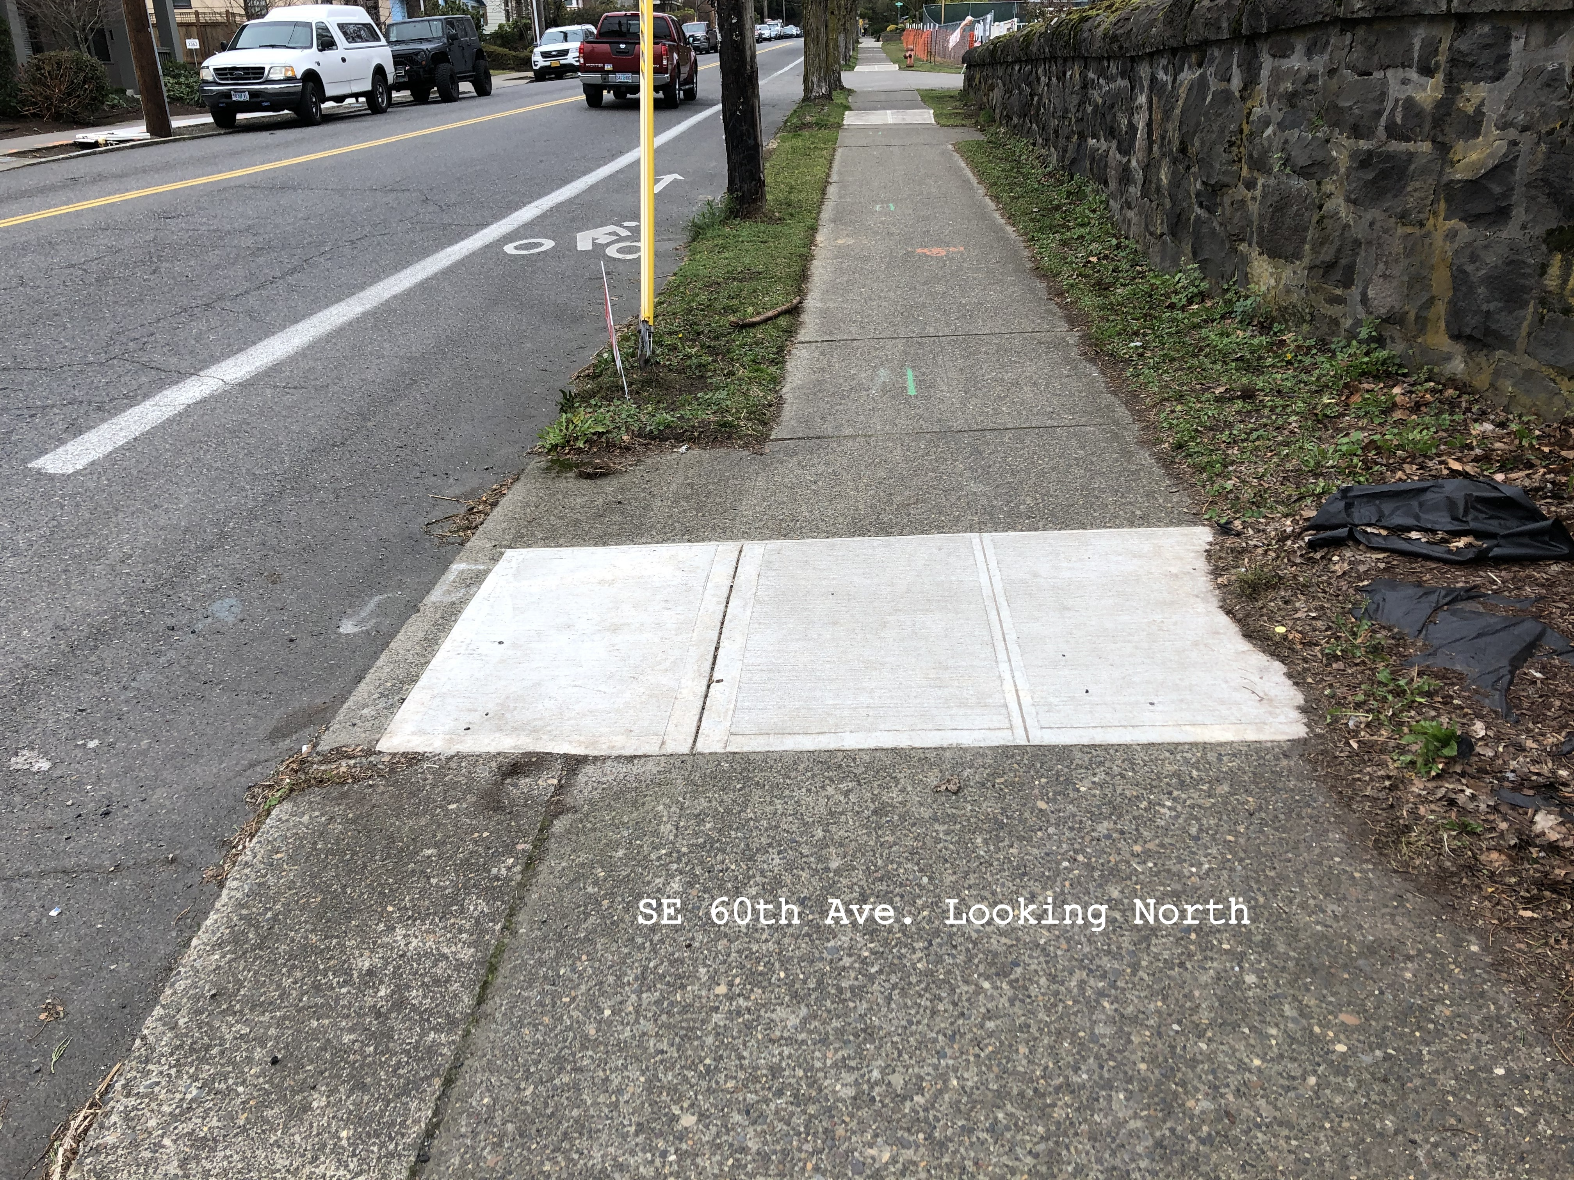
Completed repairs, continued

Slide 22
Improvements to the Sidewalk Inspection Process
Sidewalk Repair Notices & Frequently Asked Questions
  Update and clarified:
    No obligation to use contractors that solicit business
    Possibility of making minimum repairs
    Financing options are available
Exploring New Initiatives:
  Proactive inspection system to address equity concerns
  New financing strategies to reduce the burden on low-income property owners
  Developing a strategy to address repair needs on City-owned properties
Notes:
Thanks to Mr. Bell’s engagement and the City Ombudsman, Margie Sollinger – the Sidewalk repair notice and the FAQs have been improved.
And in partnerships with Commissioner Eudaly’s office we are exploring new initiatives
So that brings us to where we are today. Amy and I are here to answer any questions you might have. Thank you.

