Slide 1

Portland City Council
Willamette River Crossing
Portland Water Bureau
December 12, 2018
Lester Spitler
Chief Procurement Officer
Michael Stuhr, P.E.
Director
Teresa Elliot, P.E. Chief Engineer
Tim Collins, P.E
Supervising Engineer
Notes:
1
1) Portland Water Bureau and Procurement Services recommend acceptance of the Design-Build contract.
2) Portland Water Bureau recommends approval of Eminent Domain Ordinance.

Slide 2
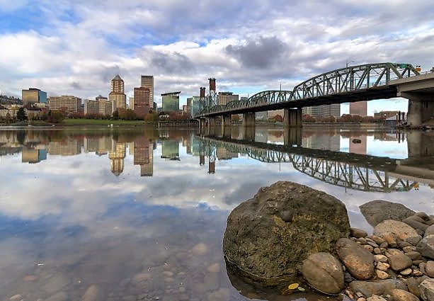
Why build a new water main across the Willamette River?
2

Slide 3
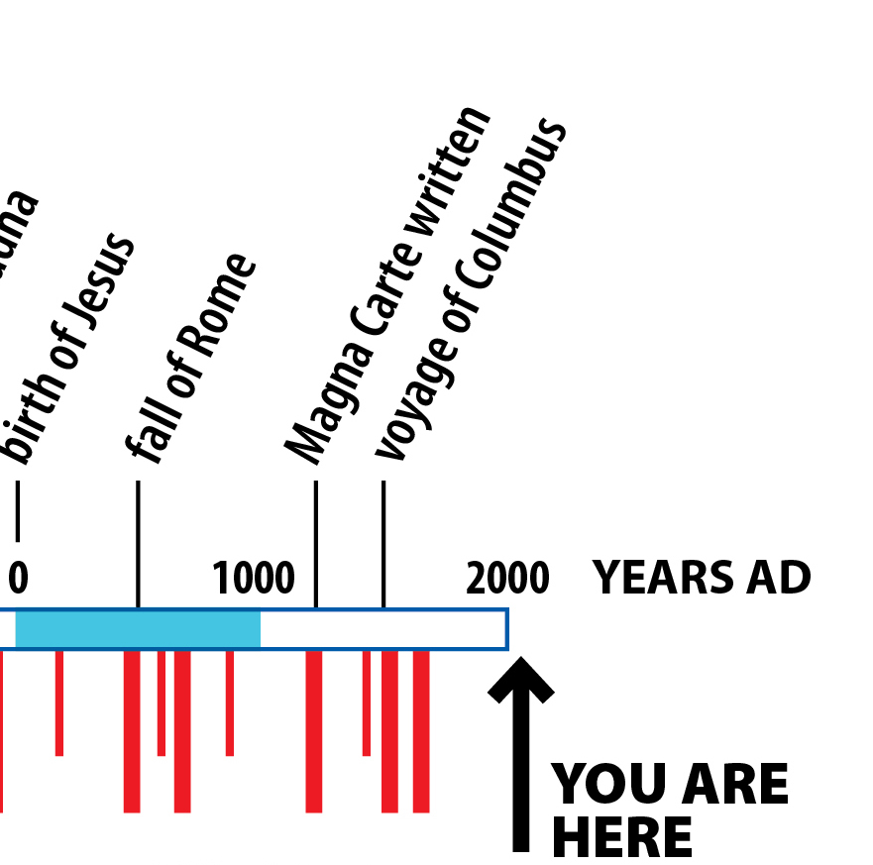

Portland is Preparing for a Major Earthquake
Seismic Hazards
last major earthquake
(1700)
318
YOU ARE
HERE
YRS
Recurrence Interval: 350 years
Notes:
30-35% chance of a Cascadia Subduction Zone (CSZ) Earthquake in the next 50 years
Somewhat likely in our lifetime
Very likely in our grandchildren’s lifetime.

Slide 4
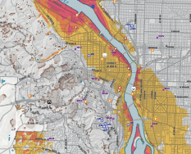
River Crossings are in Vulnerable Soils
Notes:
Highly liquefiable fill soils adjacent to Willamette River and within the downtown core area.
Due to soft river bank deposits and artificial fill placed near riverbanks.
All the river crossing are buried in these deposits.

Slide 5
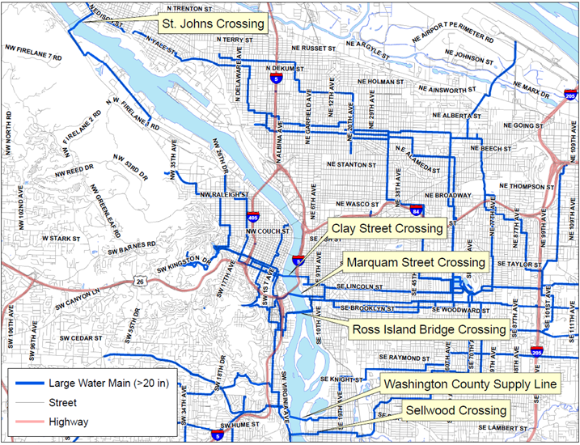

No Seismically Hardened Crossings
All 6 crossings likely damaged during a Cascadia Subduction Zone (CSZ) Earthquake.
Notes:
Per the Water Supply Seismic Study (2017)

Slide 6
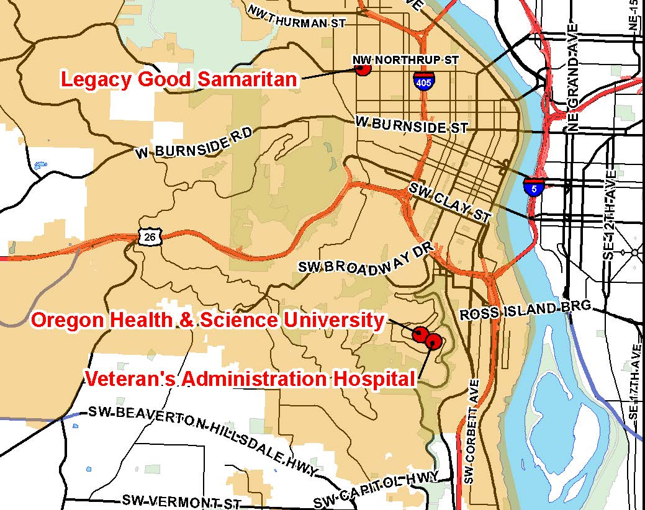
Economic Losses
Failure of River Crossing Impacts All of Portland
6 -12 months to get water to westside of Willamette, current status
$1.6B - $3.0B lost revenue over 6 months
Three (3) major hospital campuses without water
31% of city’s employment in affected area
Economic impacts lasting years longer than outage
6
Notes:
Per the WRX Business Case Report (2014)
Employment numbers per April 2009, Central Portland Retail Research and Analysis Study
New Orleans population still not recovered from Hurricane Katrina, 10 years later.

Slide 7






Project Challenges
Installing a Water Main Beneath the Willamette is Difficult
Complex geology
Highly urban area
Requires specialized equipment and experience
Complex easement agreements
Majority cannot be accessed from surface
Nearly 1 mile in length
7
Notes:
The greater the length, the greater the increased risk from constructability issues (pull back, coating damage, frak out)
The vast majority of the alignment will be deeper than 20’ (conventional surface trenching).
The alignment passes through 5 geologic layers with high groundwater pressures below the Willamette River.
There are only 4-6 companies nationwide that can do a project of this length, depth, and diameter.
The project is through the most densely urban area in Oregon.
Approximately 10 different easements or permits will be required to get authority to place the main.

Slide 8
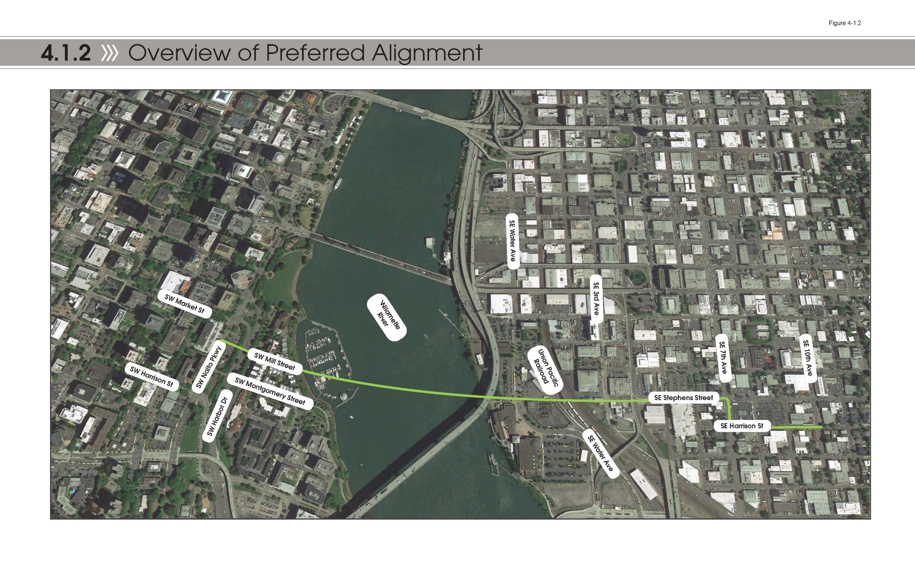

Proposed Alignment
SW Mill Street to SE Stephens Street
Hawthorne Bridge
Staging Area & Shaft
Receiving Pit
Block J
Staging Area & Drilling Pit
Carrier Pipe
Marquam Bridge
Notes:
Installation from west to east.
Block J will be drilling pit
Receiving pit will be in SE Stephens
Provides an alignment predominantly in public right-of-way and surface easements previously acquired by PWB (abandoned Mill Street easement).
Avoids the Marquam Bridge bents/piers.
Minimal drilling under occupied buildings.

Slide 9
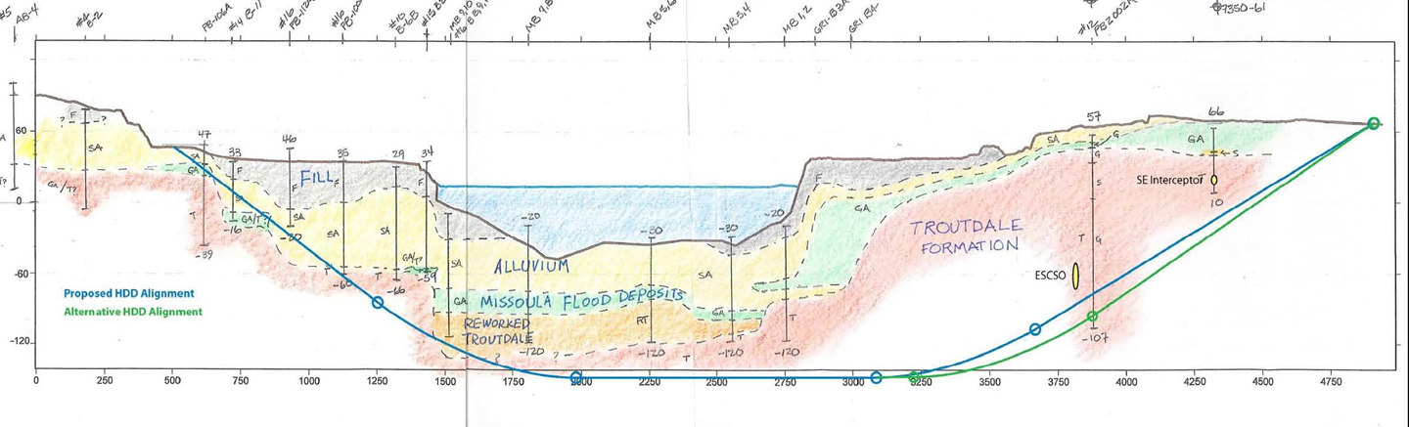
Proposed Configuration
Advantages of Alignment
Marquam Bridge pier
and piles
Intermediate Shaft
Horizontal Directional Drilling (HDD)
Microtunnel
Notes:
Two trenchless installations. HDD is 2,740’, Microtunnel 1,900’ long.
Using carrier pipe will eliminate conflicts with existing overhead utilities and significantly reduce traffic disruptions.
Beneath liquefiable soils & deep enough to eliminate impact on Willamette River

Slide 10
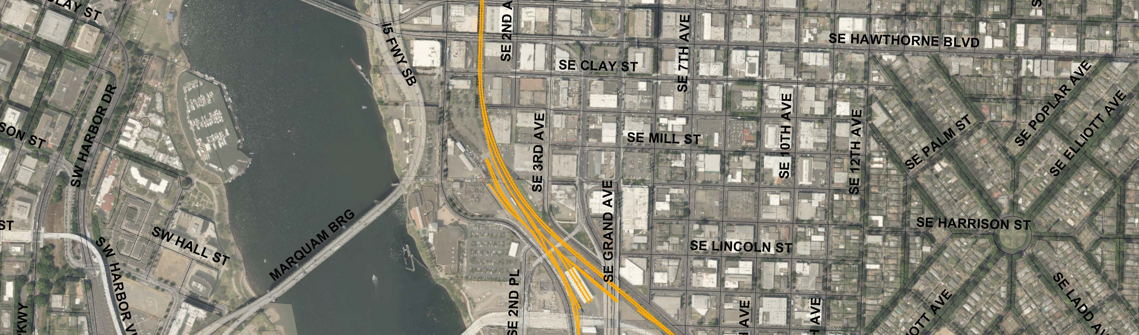
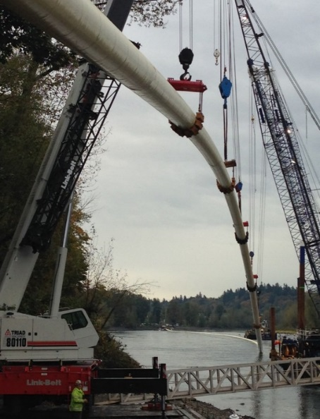
Proposed Construction Method
Limits Pipe Loft by 700-ft Over Original Concept
UPRR
Proposed Design
Original Design
7 Blocks
4 Blocks
Willamette River
HDD
Microtunnel
Notes:
HDD requires that pipe needs to be installed all in one piece.
Original concept required lofting pipe over much greater area.
Proposed concept reduces area of neighborhood impacts.

Slide 11

Public Involvement Strategy
Engaging Public to Build Project Understanding
Public Involvement
Two Project Briefings
PUB and Property Owners
PUB Presentation 11/2018
Ground Level Partnership
PWB, Design-Build Team, and Public from beginning and throughout project
Two Open Houses
Property Owners
675 Mailers
Notes:
Public Involvement to date:
2 Project Briefings (DTNA, CEIC)
2 Open Houses in the project area
675 Mailers to neighboring residents and businesses
Completed a transportation survey of east side project area
PUB presentation well received 11/15
Property owners contacted about easements.

Slide 12
Equity Contracting Participation Estimates
Disadvantaged/Minority-owned/Woman-owned/Emerging Small Business (D/M/W/ESB)
35% of
non-specialty
subcontracts to D/M/W/ESB
$73.5M Contract Amount
Notes:
Horizontal Directional Drilling is considered specialty work. The cost of the HDD is approximately $35M.
Anticipated percentage of the design and applicable non-specialty subcontracts – 35% D/M/W/ESB of which 6% is ESB.

Slide 13
Project History
20 Years of Study
System Vulnerability Assessment Study (PWB Planning, 2000 )
Basis of Design Report (PWB Planning, February 2010 )
Construction Methods Evaluation (PWB, McMillen Jacobs, Brown and Caldwell, February 2012 )
Construction Method & Alignment Criteria (MSA, Shannon and Wilson, Staheli, March 2014 )
Council Presentation for Alternative Procurement, (December 2015 )
Short Listed 3 Design-Build Teams (JW Fowler, Kiewitt, Haskell, June 2017)
Proposal Received (Fowler, April 2018)
Notes:
We have been studying this project for almost two decades.

Slide 14



Current Status
Received one Design-Build proposal from JW Fowler
Cost is higher than budgeted
Three teams qualified
14
Notes:
Two stage RFQ RFP process
Three DB teams were short-listed as interested and qualified.
The JW Fowler team decided to submit a proposal.
The alignment proposed has the lowest number of easements/permits required.
Much of the alignment is along existing ROW or PWB owned property.
Current construction easement at $40M, proposal is at $73.5M, 56% increase.

Slide 15
Project Costs
Construction cost higher than expected.
Design-Build Contract
2015 Ordinance
Proposal
$40M
$73.5M
Low Confidence Estimate
High Confidence
Activity | Budget
Design Build Contract | $40M
Consulting | $4M
Internal resources, permits, easements, property | $8M
Contingency | $5M
Project total (expended + budget) | $57M
Activity | Budget
Design Build Contract | $73.5M
Consulting | $4M
Internal resources, permits, easements, property | $6.5M
Contingency | $6M
Project Total (expended + budget) | $90M
Notes:
58% Increase for total project budget. (90-57)/57
80% Increase for construction contract budget. (72-40)/40
Contingency reduced to reflect selection of alignment.
No rate increase. Cost will be managed by moving projects around in the 5-year CIP.

Slide 16
Cost Influences Since 2015
Construction Inflation
Schedule
Construction Inflation
Steel Prices
Market Conditions
Steel
Modified Construction Method
Reduce Public Impact
Less Risk
Market Conditions for Horizontal Directional Drilling
Modified Construction
Schedule
Notes:
Why the proposed cost is higher than estimate from 12/2015
1 Construction Inflation
While inflation has only increased at 1.5% per annum, construction costs have increased at 2x this rate or around 3% per year Construction is anticipated to start in June 2020 (Jan 2019 NTP plus easement acquisition and mobilization - 18 mos) – approx. 4 years after estimate date of 2017
$ 6,000,000
2 Steel Prices
Steel prices have increased by 16% in the last three years with a 10% increase over the last year (PPI Commodity http://data.bls.gov/cgi-bin/srgate). Assuming 10% increase per year until construction starts (4 years from 2017) and a 25% steel tariff - steel increase is on the order of $2M
$ 2,000,000
3 Constructability & Urban Considerations
The interactives with Contractors during the procurement process indicated that the original HDD concept was not viable, primarily due to pipe pullback risks. Further - the east side pipe staging area due to increased vehicular and bicycle traffic along with business density increases has made surface pipe storage more challenging. A viable alternative was developed that required an intermediate shaft and microtunnel to address the pullback risk. This alternative increased costs.
$ 14,000,000
4 HDD Market Conditions
Market conditions including significant comeback in the oil and gas industry work since the original estimate, has resulted in HDD Contractors being less willing to take on higher risk municipal projects without additional premium. Further - due to recent past problems with HDD work in urban areas (King County and Detroit), HDD contractors are including higher risk pricing. This resulted in increased HDD costs, as measured by daily drilling rates to increase from $26,000 per day to $45,000 per day, number of shifts required (109 vs 77) and higher mobilization/demobilization costs.
$ 4,500,000
5 Easement Acquisition Duration
Due to easement acquisition time – the project duration is greater than originally anticipated resulting in greater general conditions costs. 14 months of additional general conditions supervision plus project facilities, scheduling, etc.
$ 5,500,000
6 GC Risk Design & Construction Risk Allocation
Urban setting - coupled with underground risk, long HDD bore and reduced competition -10% based on Fowler OH & profit benchmark margin from King county of 30% - versus estimate average of 20%
$ 5,000,000
Total $ 37,000,000
55% increase

Slide 17

Easement Strategy
Temporary and Permanent Easements
3 Permanent Easements
3 Temporary Easements
Hawthorne Bridge
Marquam Bridge
Notes:
3 Private property Permanent easements
3 Private property Construction easements
5 Public property permits of entry
Original alignment could have included 15 easements

Slide 18
Anticipated Schedule
Design
Preliminary Design
Final Design
Construction
Shaft
HDD
Microtunnel
Closeout
Testing
Commissioning
11/2019
10/2021
1/2022

Slide 19
Recommendation
Portland Water Bureau and Procurement Services recommend acceptance of the Design-Build contract.
Portland Water Bureau recommends approval of Eminent Domain Ordinance.

Slide 20
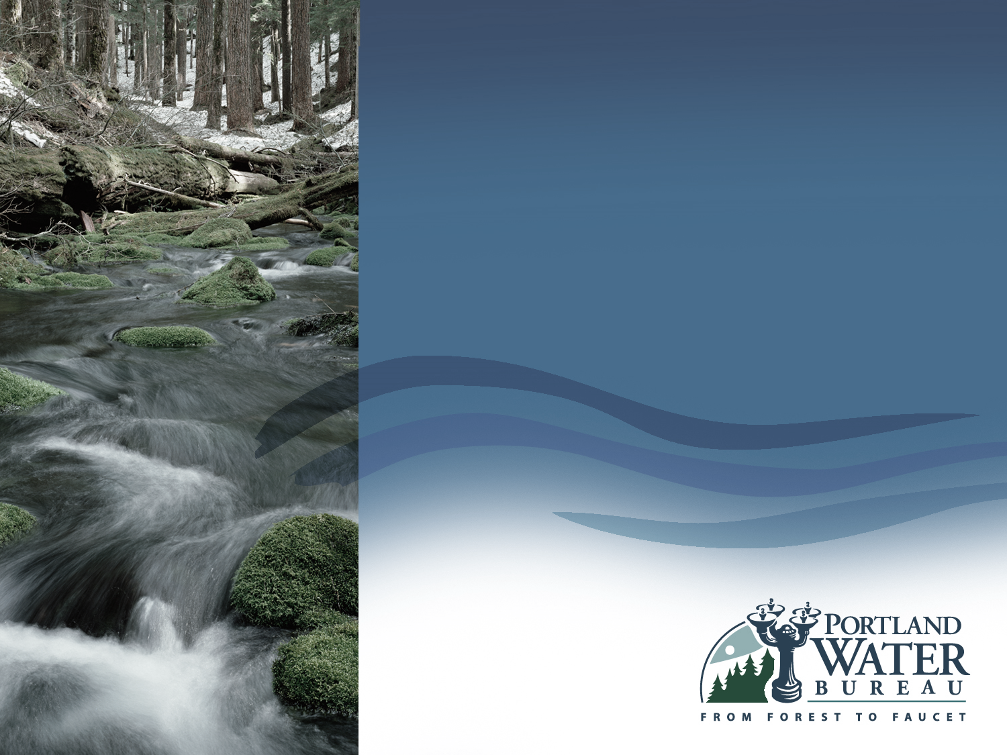
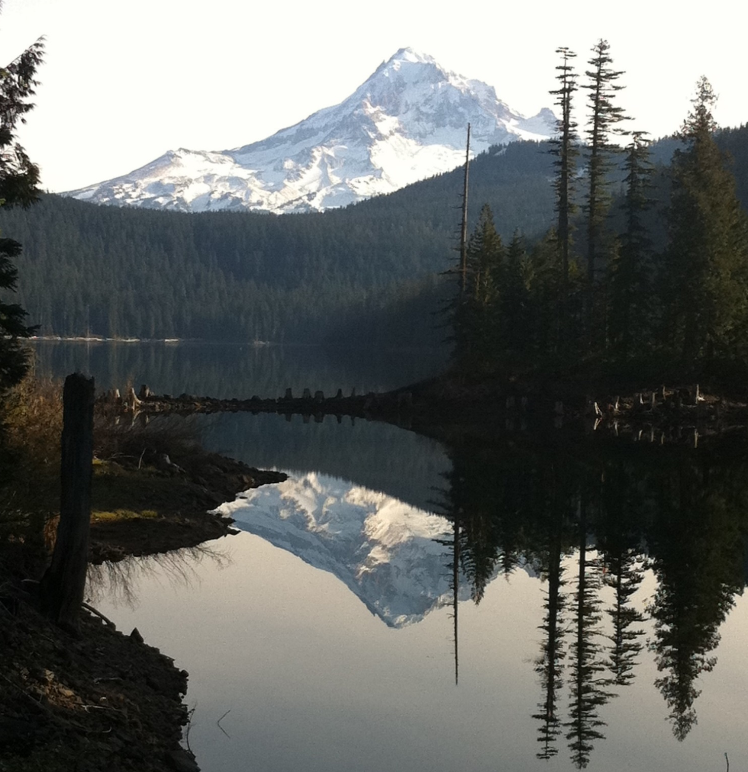
Questions?
20

Slide 21
Slides after this point are for reference only.
Notes:
Are these dates and the work correct?

Slide 22
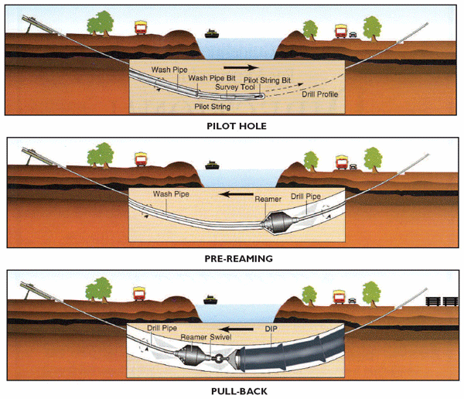
HDD Construction Strategy
HDD Schematic
Notes:
Pipe hole drilling along alignment.
Successive drilling increases size of boring.
Once up to final size pipe installed all at one time.

Slide 23
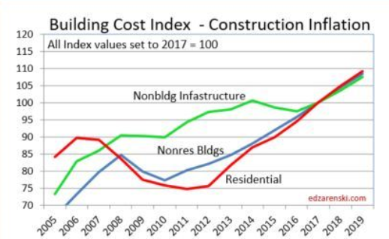
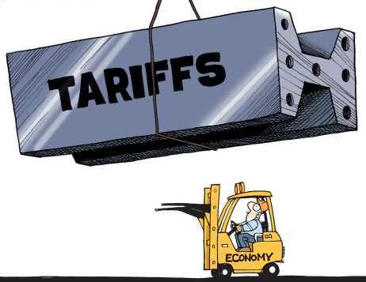

Bidding/ Construction Environment
Factors Impacting Project
- Construction Analytics, 2-13-18

Slide 24
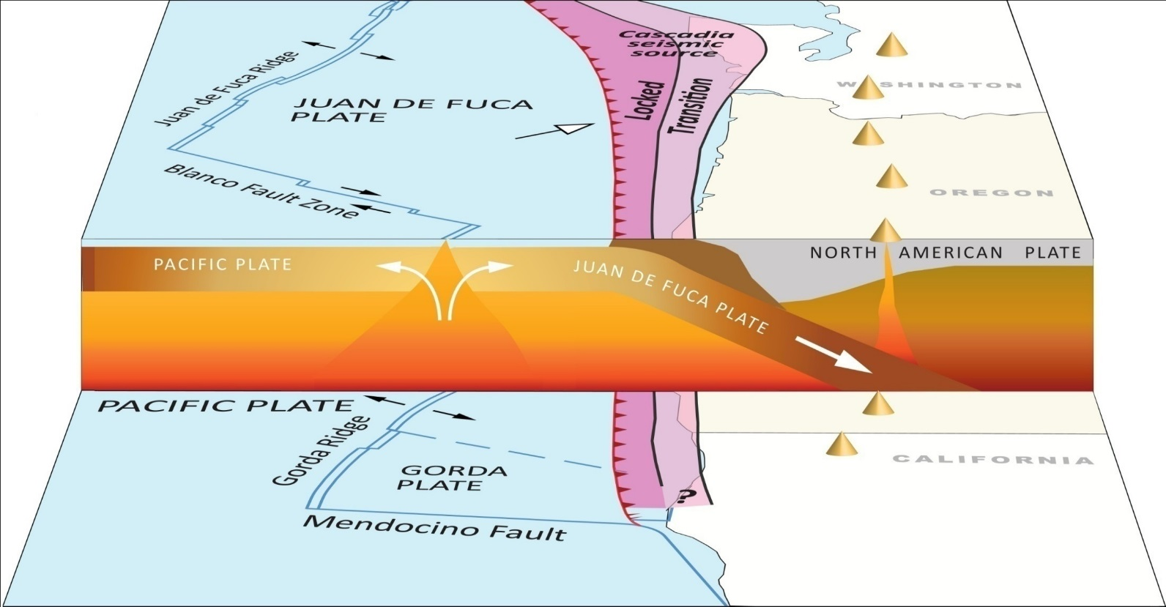
Seismic Hazards
We Live in a Dangerous Place
24
Notes:
Significant chance of a CSZ earthquake in our lifetime.
Nearly certain during our grandchildren’s lives.

Slide 25
Budget Impacts
Funds shifted from Bull Run Conduit rehabilitation work to Willamette River Crossing in the 5-yr budget.
Recent interior inspections of Conduits 2 & 3 indicate conduits are in better shape than anticipated.
DB Contract improves budgetary certainty and reduces likelihood of claims.
Notes:
The interior inspection of Conduits 2 & 3 were completed in the last two years. They show that conduits are in better shape than anticipated.
This money can be shifted to WRX.

Slide 26
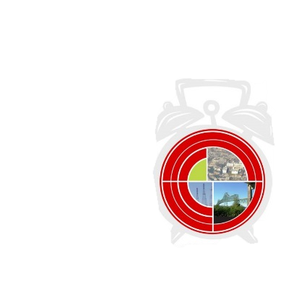
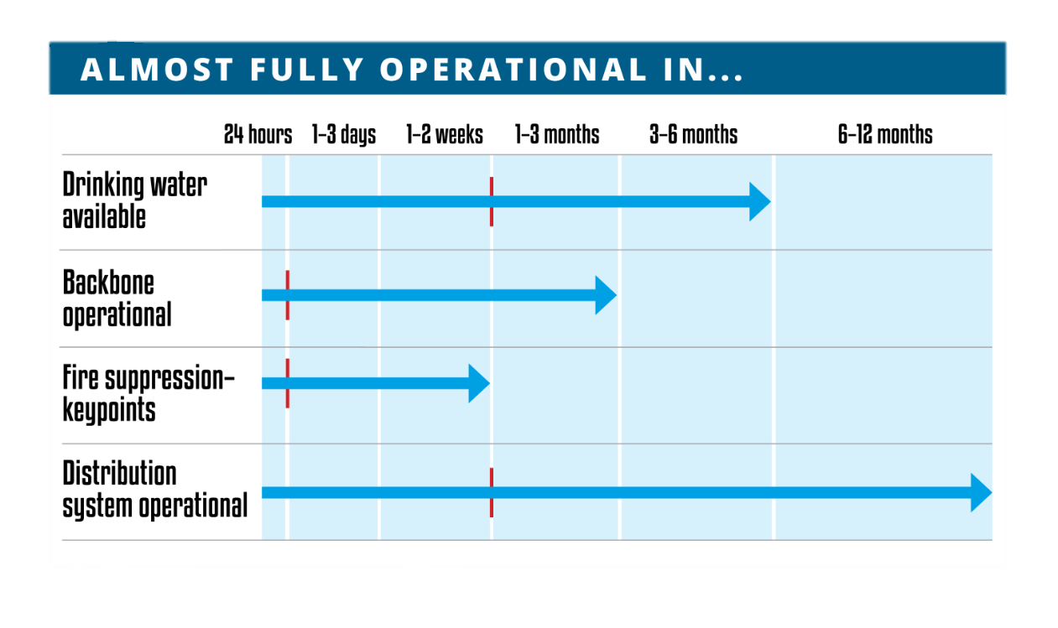
Current Recovery Estimate
A Long Way to Go to Meet Oregon Resilience Plan Recommendations
I - ORP Recommendation
Notes:
Per the Water Supply Seismic Study (2017)

Slide 27
Economic Losses (DRAFT 1)
6- to 12-Month Outage Anticipated in the Event of a 500-year Seismic Event
Consequence of 6-month outage: $1.6-$2.7bn
> $10.2B/yr in economic activity (in 2014 dollars)
> 31% of the city’s employment (April 2009, Central Portland Retail Research and Analysis Study)
> Three major hospital system campuses
Central Portland
27
Notes:
Per the WRX Business Case Report (2014)

Slide 28
Budget
Justification for Current Costs Higher than 2015 Estimate
# | Item | Description | Amount
1 | Construction Inflation | While inflation has only increased at 1.5% per annum, construction costs have increased at 2x this rate or around 3% per year. Construction is anticipated to start in June 2020 (Jan 2019 NTP plus easement acquisition and mobilization - 18 mos) – approx. 4 years after original estimate of 2017. | $ 6,000,000
2 | Steel Prices | Steel prices have increased by 16% in the last three years with a 10% increase over the last year (PPI Commodity http://data.bls.gov/cgi-bin/srgate). Assuming 10% increase per year until construction starts (4 years from 2017) and a 25% steel tariff - steel increase is on the order of $2M. | $ 2,000,000
3 | Constructability | Interactions with Contractors during the procurement process indicated that the original HDD concept was not viable, primarily due to pipe pullback risks. Further, the east side pipe staging area makes surface pipe storage difficult due to increased vehicular and bicycle traffic along with business density. A viable alternative was developed that requires an intermediate shaft and microtunnel to address the pullback risk and mitigate the surface pipe storage issue. This alternative increases costs. The underground risk, long HDD bore and reduced competition impacted the benchmark profit margin. 10% based on Fowler OH & profit benchmark margin from King county of 30%, versus estimate average of 20% | $ 19,000,000
4 | HDD Market Conditions | Market conditions, including significant comeback in the oil and gas industry since the original estimate, has resulted in HDD Contractors being less willing to take on higher risk municipal projects without additional premium. Further - due to recent past problems with HDD work in urban areas (King County and Detroit), HDD contractors are including higher risk pricing. This resulted in increased HDD costs, as measured by daily drilling rates to increase from $26,000 per day to $45,000 per day, number of shifts required (109 vs 77) and higher mobilization/demobilization costs. | $ 4,500,000
5 | Easement Acquisition Duration | Due to easement acquisition time – the project duration is greater than originally anticipated resulting in greater general conditions costs. 14 months of additional general conditions supervision plus project facilities, scheduling, etc. | $ 5,500,000
 | Total |  | $ 37,000,000
Notes:
Why the proposed cost is higher than estimate from 12/2015

Slide 29
Easement Strategy
Temporary and Permanent Easements
Notes:
Types of Easements:
Permanent
Temporary – what’s the public involvement?

