Slide 1
Constructing Civic Dialogues
Grant Program

Slide 2
December 5, 2018 – Constructing Civic Dialogues
Background
Constructing Civic Dialogues Program complements and expands the Neighborhood Mediation Program.
Civic Life allocated over $4,000,000 for mediation and facilitation services from 2002-2019 to Resolutions Northwest.
1,670 mediation cases over 15 years
745 people served through facilitation services in 2017-18

Slide 3
December 5, 2018 – Constructing Civic Dialogues
Serving the City & the Community
Intends to build capacity to promote the common good. This means City employees that are more able to facilitate productive interactions, having the tools for culturally appropriate conflict resolution, and doing skill-building to putting our equity intentions into practice.

Slide 4
December 5, 2018 – Constructing Civic Dialogues
Serving the City & the Community
Program timeline: January – June 2019
Outputs: Serve 1600 people through 73 opportunities for training, dialogue, conversation, services, and events.

Slide 5
December 5, 2018 – Constructing Civic Dialogues
Goals: Office of Community & Civic Life
This program meets the goals of the Office of Community & Civic Life by:
Building inclusive structures by expanding grant partners to include a broader spectrum of approaches to constructive conflict, understanding different perspectives, and skill building;
Contributing to adaptive governance through the coordination of this program as a cohort of grant partners that come together to collaborate and reach shared goals;
Supporting fulfilled and empowered Portlanders by providing free facilitation, services, and skill building to an increased number and diversity of people in the City’s networks.

Slide 6
December 5, 2018 – Constructing Civic Dialogues
Grant Partners
AORTA Collective
A worker-owned cooperative devoted to strengthening movements for social justice. They will focus on conflict resolution and skill building through six workshops and post-training consulting services.

Slide 7
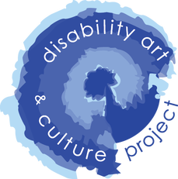
December 5, 2018 – Constructing Civic Dialogues
Grant Partners
Disability Art & Culture Project
DACP utilizes the performing arts as a method of examining disability in relation to society. They will offer five workshops on disability culture and disability justice – three to City networks & two to the disability refugee community.

Slide 8
December 5, 2018 – Constructing Civic Dialogues
Grant Partners
Oregon Humanities
Oregon Humanities works to transform communities by creating spaces that invite diverse perspectives and explore challenging questions in order to strive for just communities. They will host 50 facilitated conversations and train 50 facilitators.

Slide 9
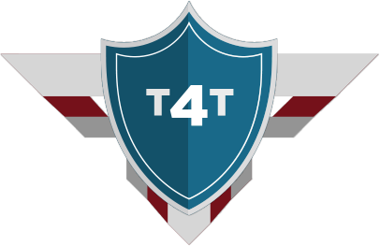
December 5, 2018 – Constructing Civic Dialogues
Grant Partners
Training 4 Transformation
T4T a minority, women owned emerging small business that works with government agencies, civic and organizations to support them in creating a culture of equity and inclusion. They will facilitate four workshops on racism and trauma to build tools for resiliency.

Slide 10
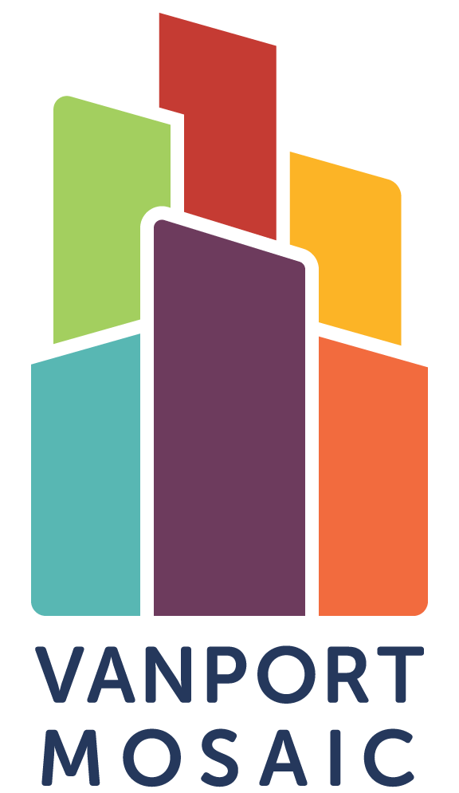
December 5, 2018 – Constructing Civic Dialogues
Grant Partners
Vanport Mosaic
Vanport Mosaic presents uncomfortable community histories through inclusive, accessible and welcoming initiatives, using memory activism to foster community connection. They will host five story circles with different cultural communities to develop understandings of different approaches to conflict and resilience.

Slide 11
December 5, 2018 – Constructing Civic Dialogues
Outcomes
January – June 2019
Engage City of Portland networks to build skills, offer opportunities to understand different perspectives, and be prepared for constructive conflict.

Slide 12
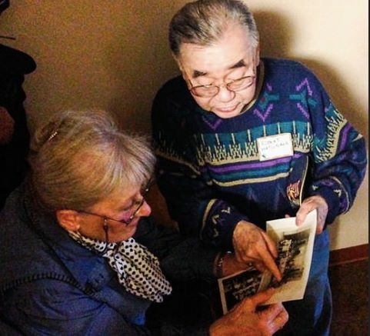
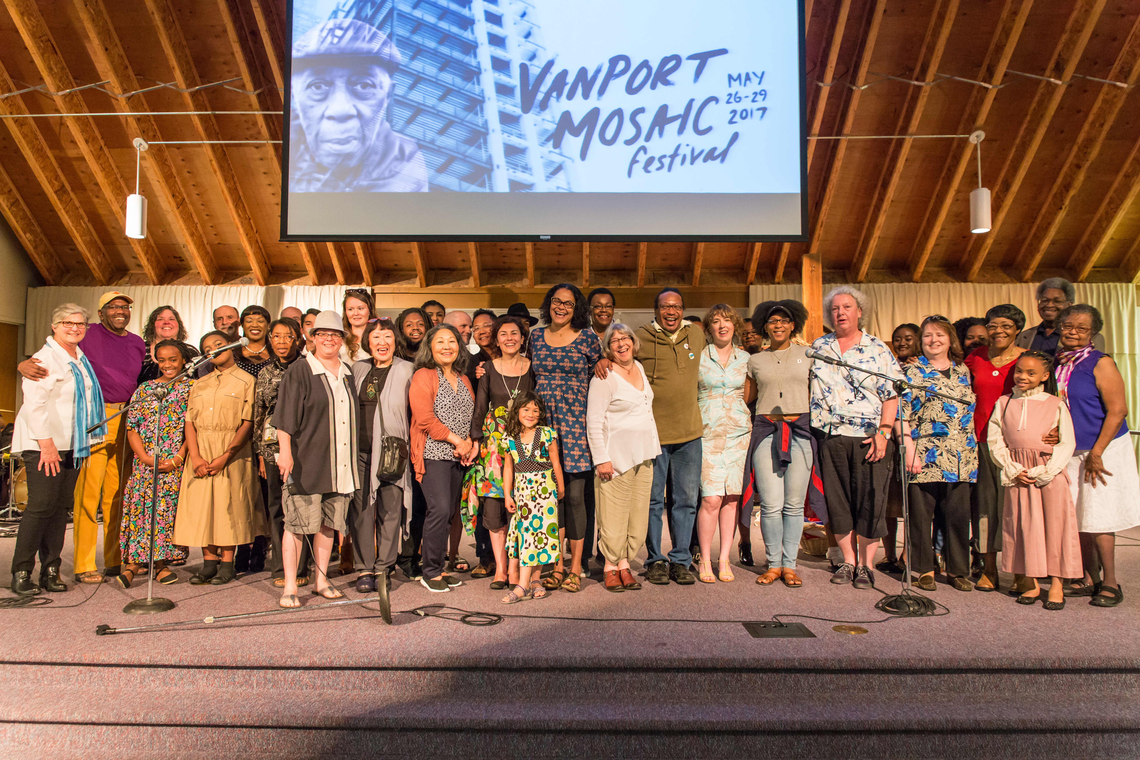
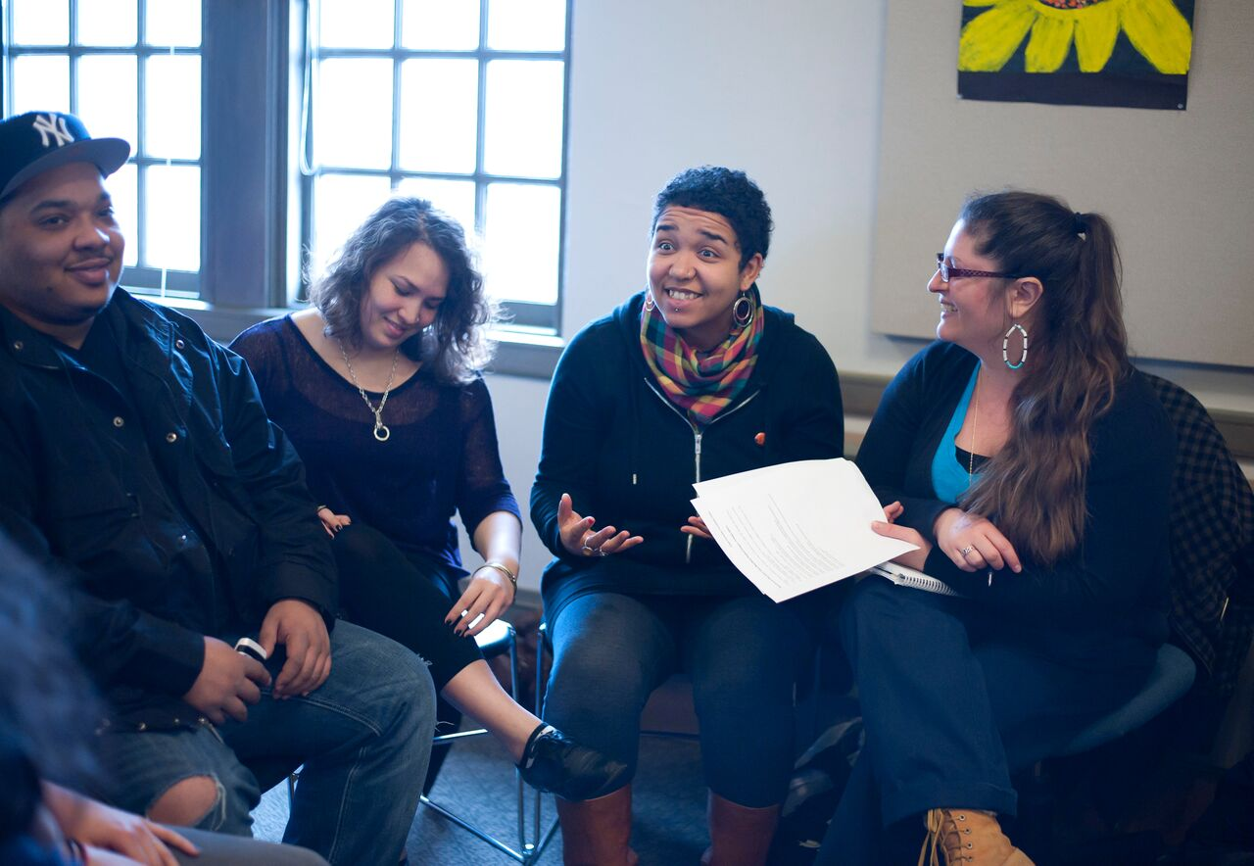
Grant Partners
AORTA Collective
Disability Art & Culture Project
Oregon Humanities
Training 4 Transformation
Vanport Mosaic
Vanport Mosaic
Vanport Mosaic
Oregon Humanities, Fred Joe
Oregon Humanities, Fred Joe

