Slide 1
King + Parks

Slide 2
King + Parks Team
Portland Community Reinvestment Initiatives
Sponsor, developer and long-term owner
25+ years serving the N/NE Portland community
Colas Construction (MBE)
Merryman Barnes Architects (WBE)

Slide 3
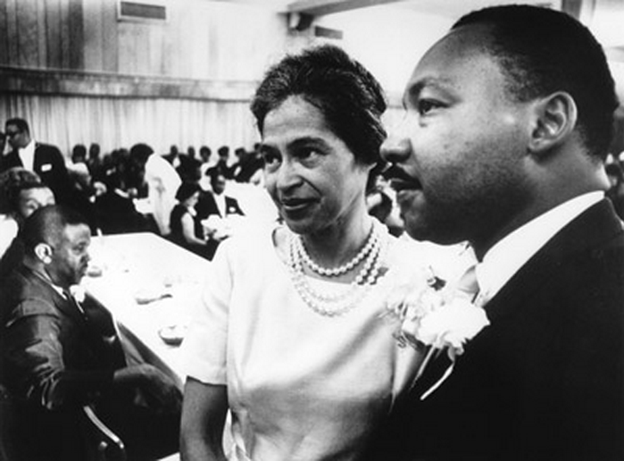
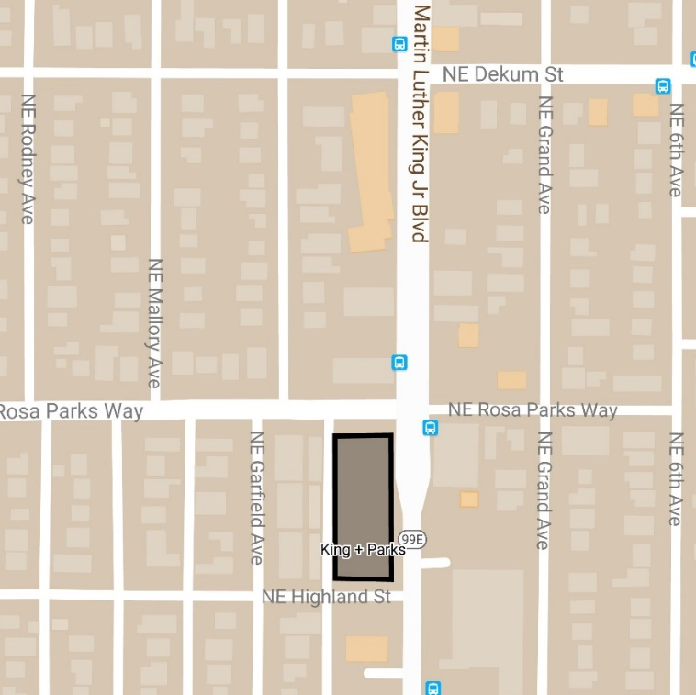
King + Parks History
Piedmont Neighborhood
Intersection of Martin Luther King Jr Blvd + Rosa Parks Way
Significance to the Black/African American community
King + Parks Apartments

Slide 4
King + Parks Overview
4-story building along MLK, steps down to 3-stories on West-side to relate to adjacent neighborhood
80,000 square feet total
1,200 SF community room for resident programming and neighborhood use
70 affordable homes
Majority 2- and 3-bedroom homes,
All 3-bedrooms are townhome design with direct access to courtyard
Central outdoor courtyard and play area
Parking exceeds code requirements

Slide 5
King + Parks Unit Mix
Unit Size | SF | AMI % | Target Rent/Mo | Quantity | Total
1-bedroom | 617 | Project Based Section 8 | 30% of HH income | 6 | 20
 |  | 30% | $391 | 2
 |  | 60% | $849 | 12
2-bedroom | 830 | Project Based Section 8 | 30% of HH income | 8 | 37
 |  | 30% | $421 | 2
 |  | 60% | $916 | 27
3-bedroom | 1,199 | Project Based Section 8 | 30% of HH income | 6 | 12
 |  | 60% | $1,171 | 6

Slide 6
King + Parks Financing
$11.28 million LIHTC Equity (U.S. Bank)
$5.7 million Interstate URA TIF + contributed land value (PHB)
$5.7 million permanent debt (Umpqua Bank)
$400,000 OHCS GHAP
$162,275 OHCS Weatherization Grant
$25,000 Metro Art Grant
SDC Waivers, property tax exemption, CET Waiver
20 Project -based Section 8 Vouchers (Home Forward)

Slide 7
King + Parks Community Benefits
Construction to exceed 30% MWESB participation
Ongoing opportunities for subcontractors on future Colas, PCRI projects
Professional services approx. 80% MWESB
Earth Advantage Gold Certification
Grant Funds Received for Public Art Component
Metro Placemaking Grant, funds from Neighborhood Association

Slide 8
King + Parks Timeline
Complete: Land Use Review & Permits
Financing: HUD, OHCS, Construction and permanent loan financing approvals in place
Pending: LIHTC equity and PHB funds
December 2018: Start of Construction
February 2020: Completion

