Slide 1
King Parks Apartments
Shannon Callahan, Housing Director
December 5, 2018

Slide 2
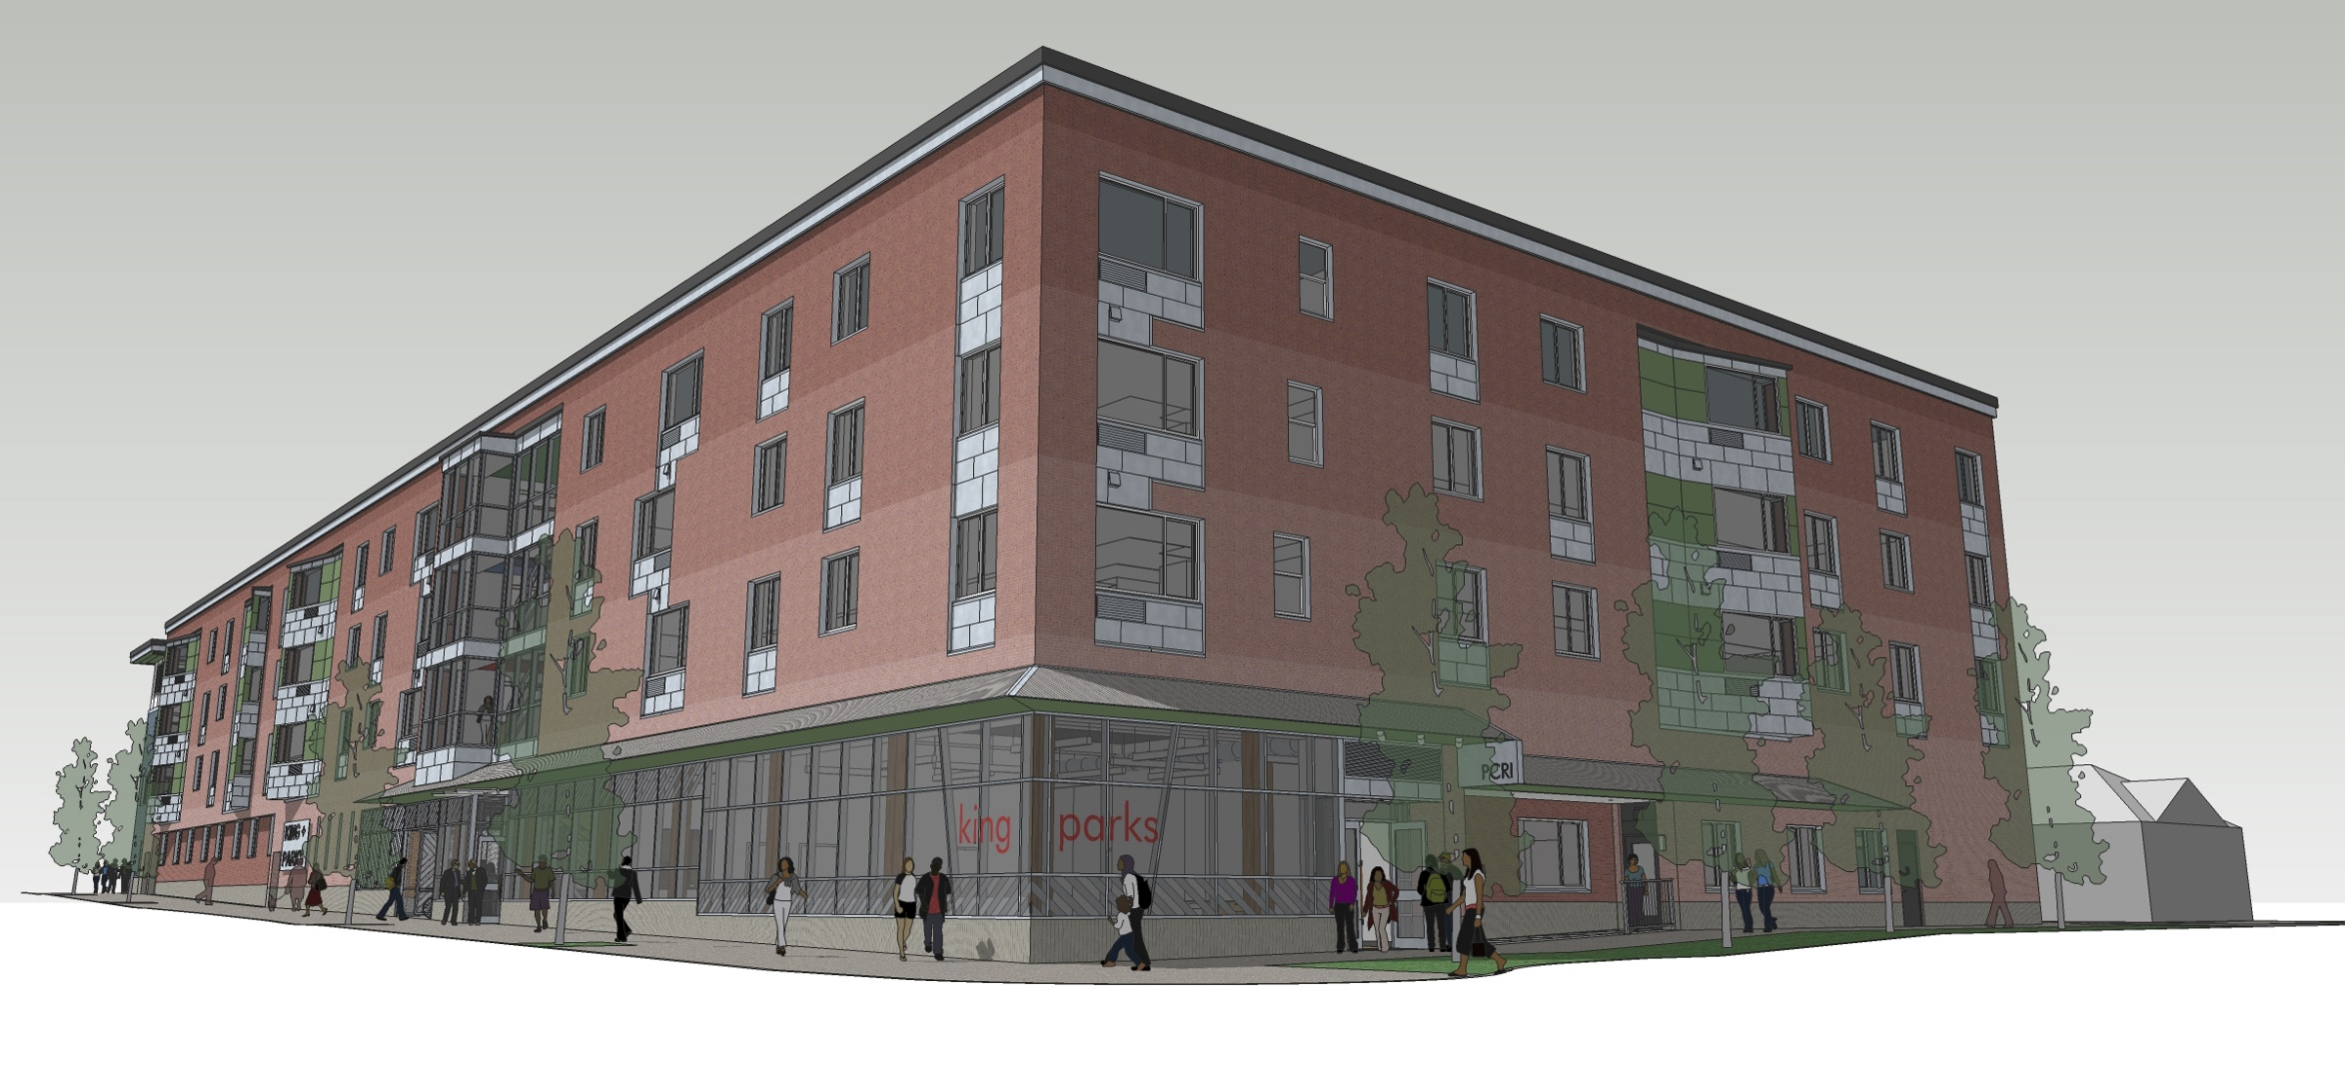
King Parks
70 newly constructed units at MLK Blvd. and Rosa Parks Way
Housing for 198 residents
Focused on formerly homeless or those at-risk
71% family-sized units
N/NE Preference Policy
Notes:
Key location in Interstate Corridor (intersection of Piedmont and Woodlawn neighborhoods), 1 block south of PCRI offices and Combined Opportunity Score of 3.
Thank partnership among many
PCRI –Developer-Owner
PHB – Funder
Public Agencies - OHCS for 9% provision tax credits and GHAP funding
Private Partners
Colas Construction-GC (MWESB certified)
Marryman Barnes Architects (MWESB certified)
Umpqua Bank & US Bank in tax credit

Slide 3
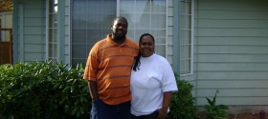
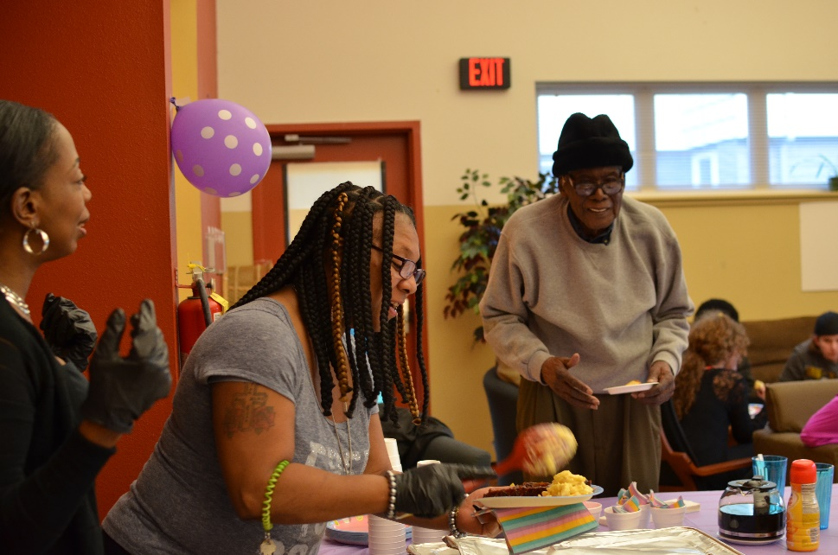
Public Benefits
All units at or below 60% Area Median Income (AMI)
20 units serve homeless families receiving PBS8 vouchers
4 units at 30% AMI unsubsidized for very low income residents
Exceeds City DMWESB contracting goals
Notes:
Total Affordability Breakdown
@ 30% (unsubsidized)
65 @ 60% (20 w/ PBS8 vouchers)
1 Unrestricted MGR unit
70 total
Unit breakdown (average unit size is 1.9)
1BR 20
2BR 38
3BR 12
Total 70
(29% of Project are PBS8 & 70% of the PBS8s are in family sized units)
Expected MWESB is 30% compared to City target of 20% for hard costs construction

Slide 4
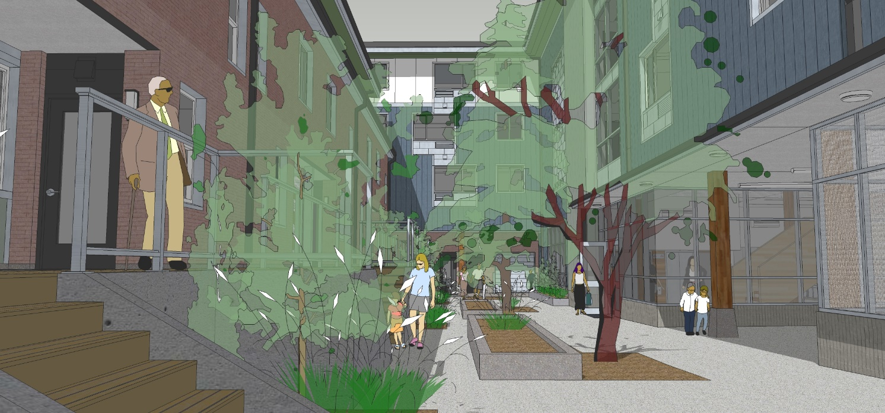
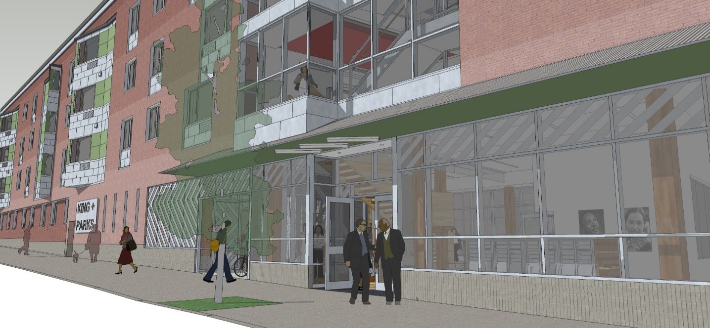
City Contribution
Conveyance of City-owned land at nominal cost
$5.7 million construction and permanent loan
$1,178,000 in SDC exemptions
Notes:
City Support works out to under $100,000k / unit (consisting of land $15k and loans $81k) for new construction in Interstate Corridor
Favorable funding leverages over 4 x outside funding – 9% low income housing credit equity and grants – for each dollar of PHB funds

Slide 5
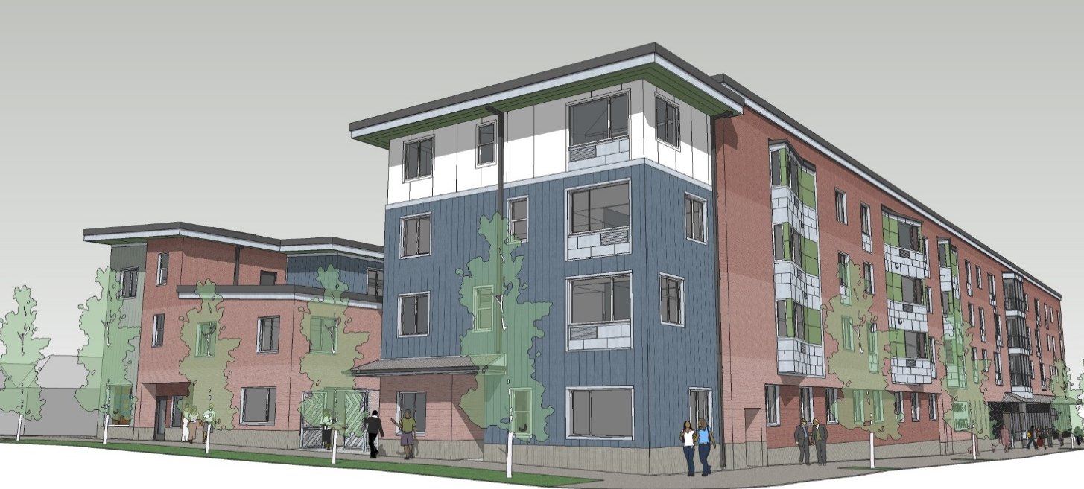
Recommended Action
Conveyance of City-owned land
Approve $5,700,000 loan
Execution of all necessary documentation for the Project by PHB Executive Director
4

