Slide 1

LU 18-174083 CU
Conditional Use Review for new parking lot at Imago Dei Ministries property at 1404 SE Ankeny Street
BDS Staff presentation to CITY COUNCIL
OCTOBER 25, 2018

Slide 2
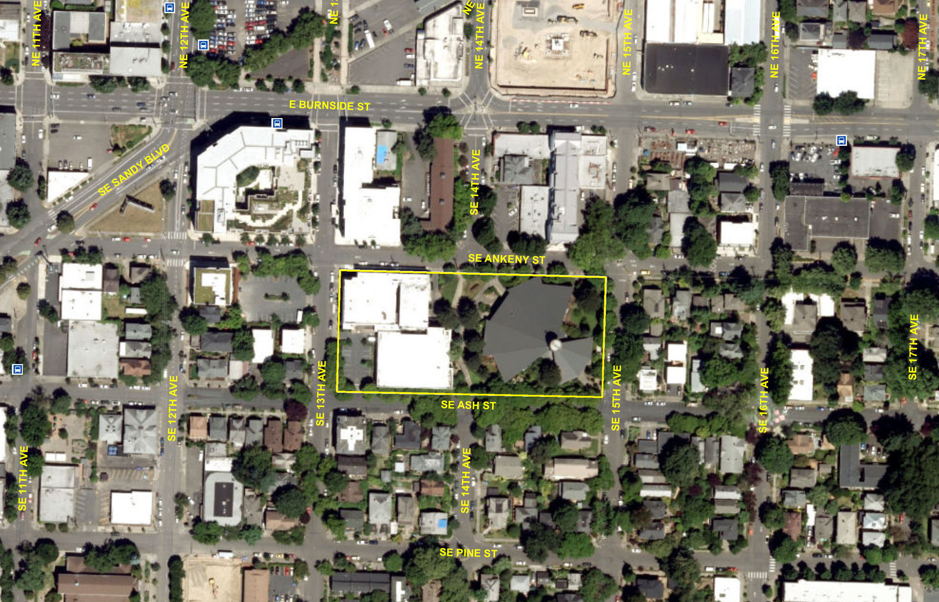

Slide 4
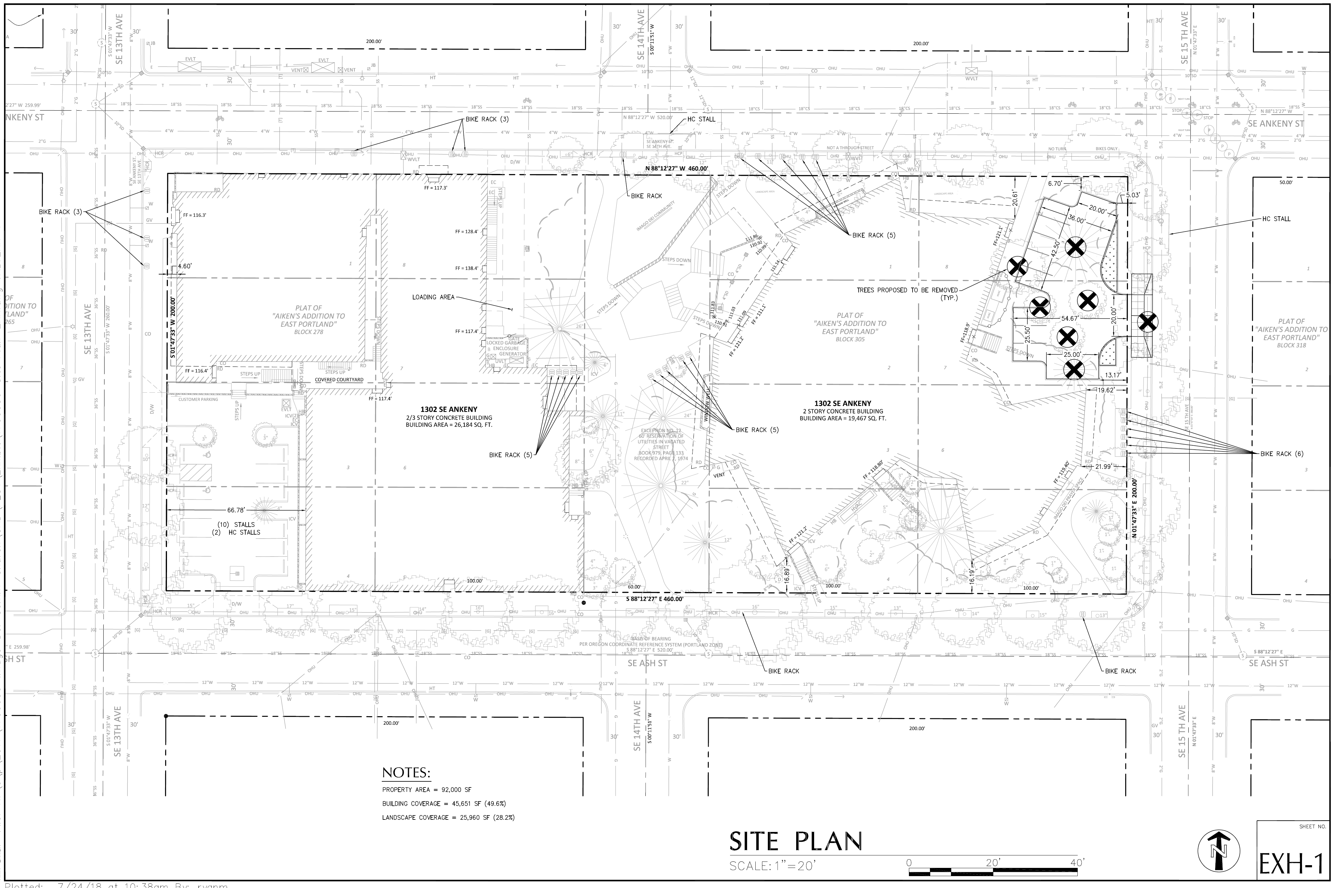

Slide 5
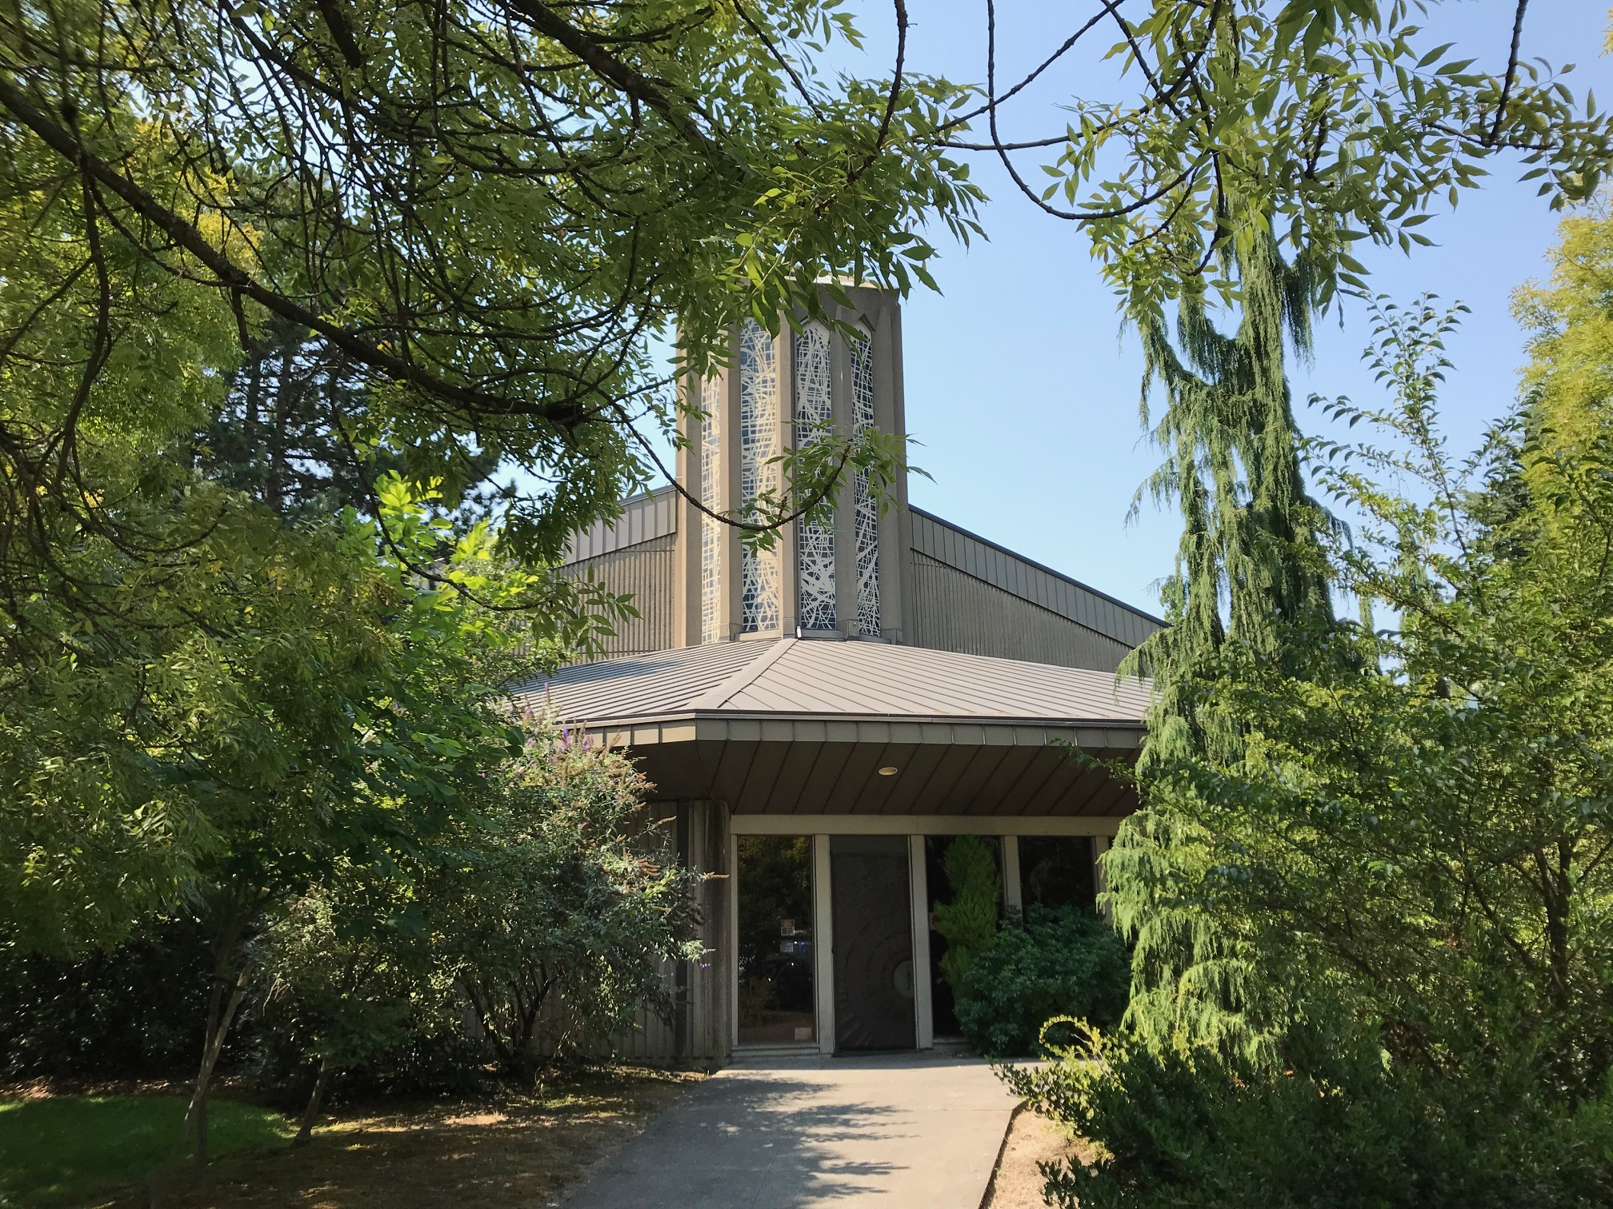

Slide 6
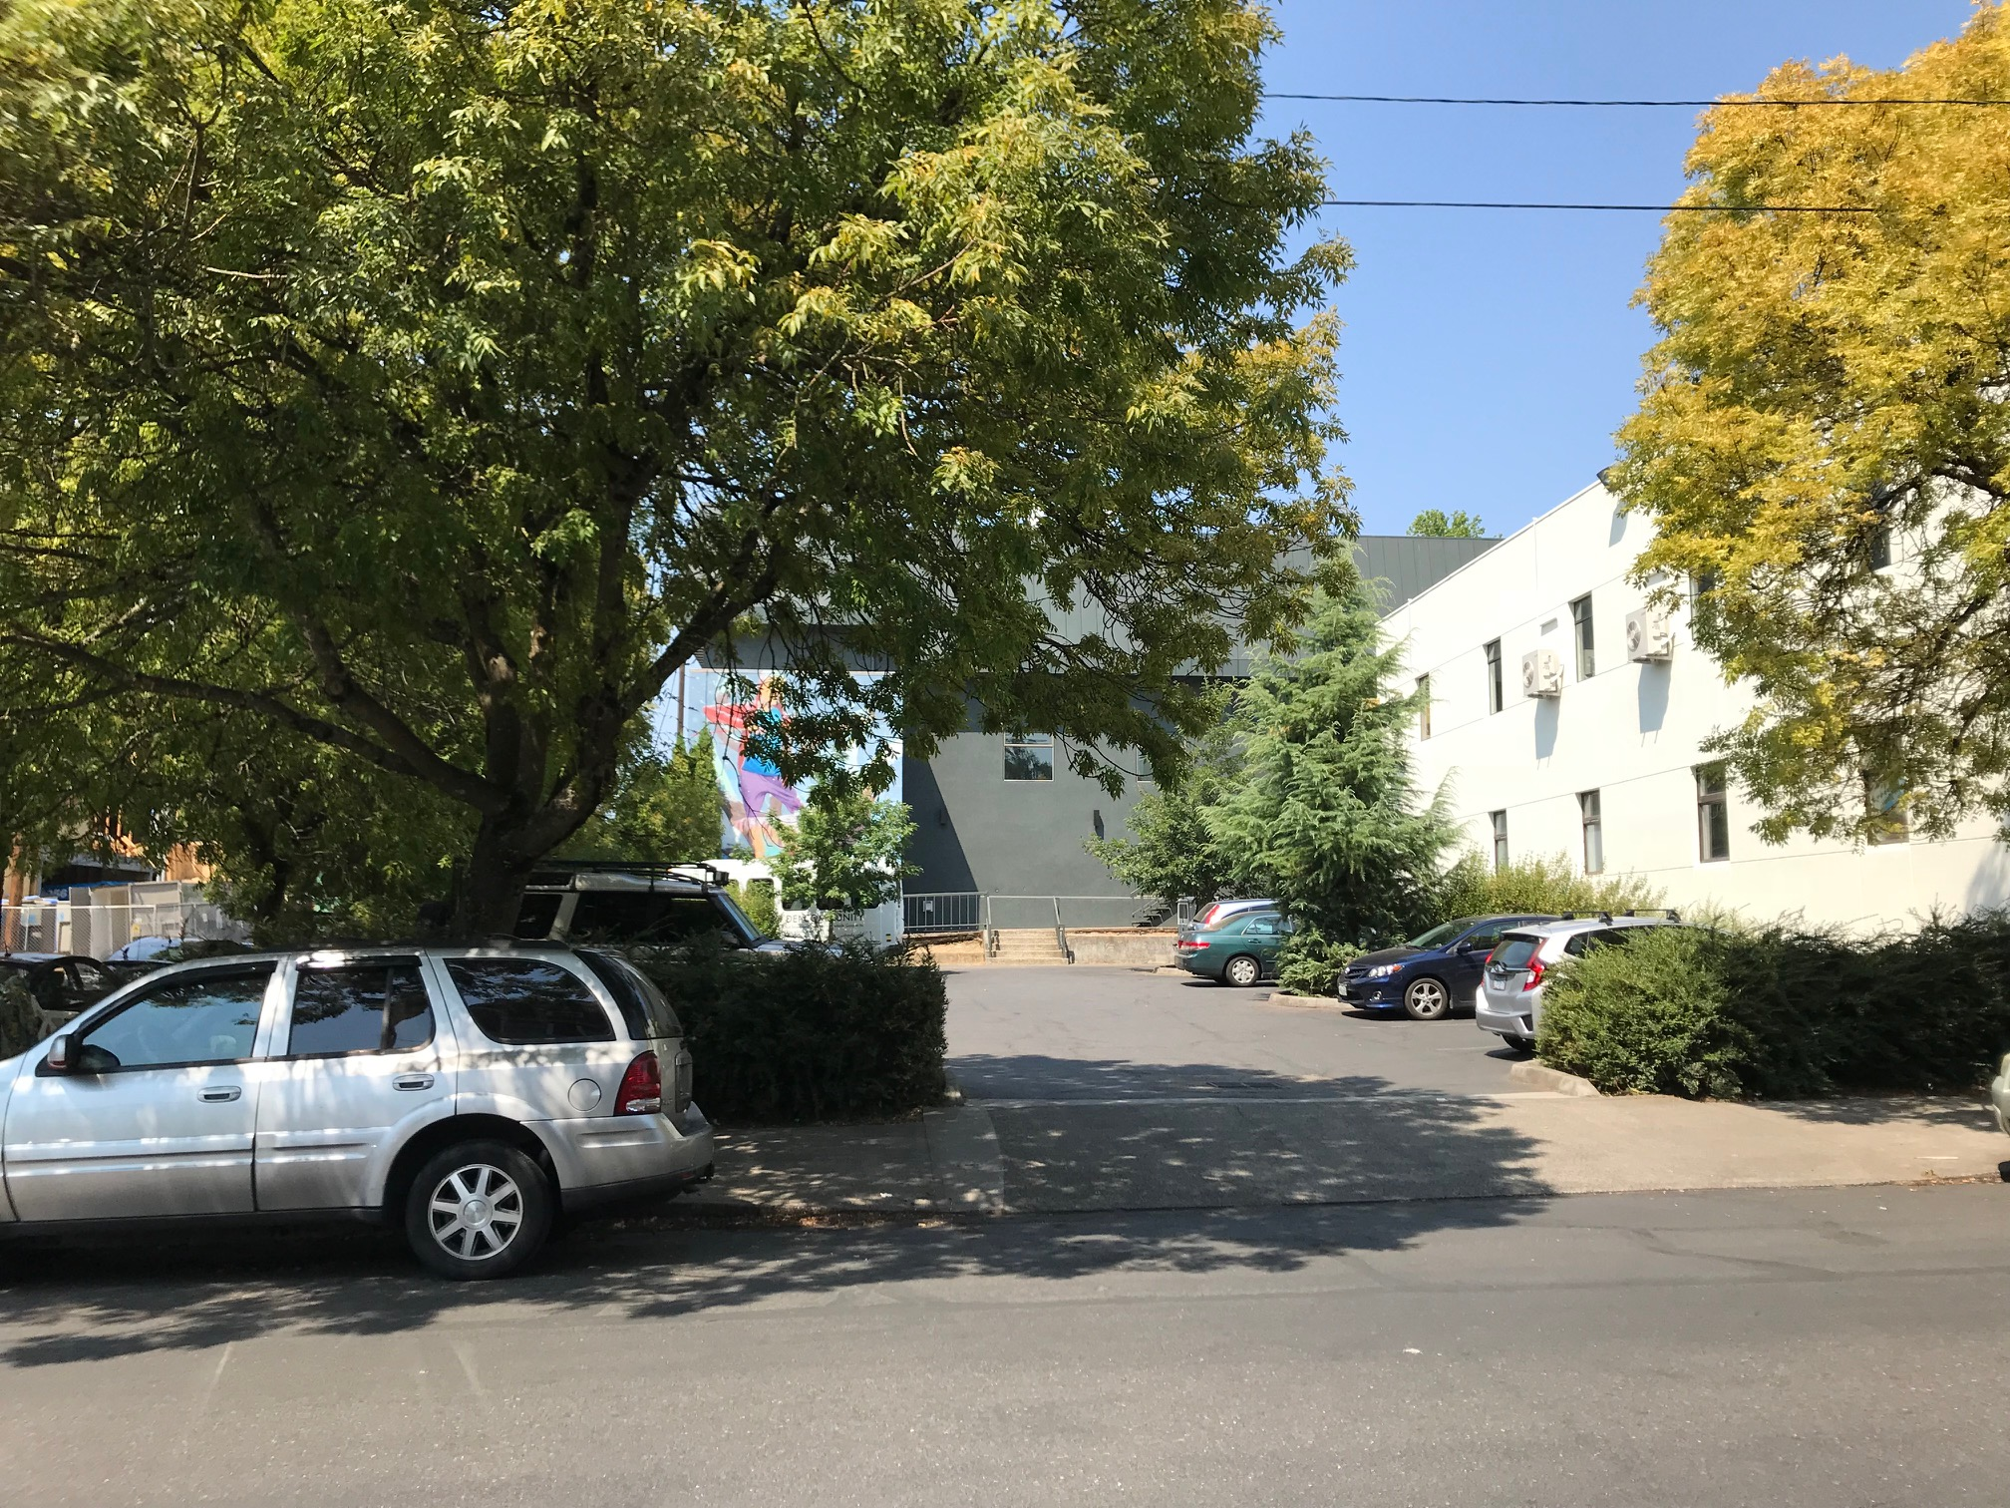

Slide 7
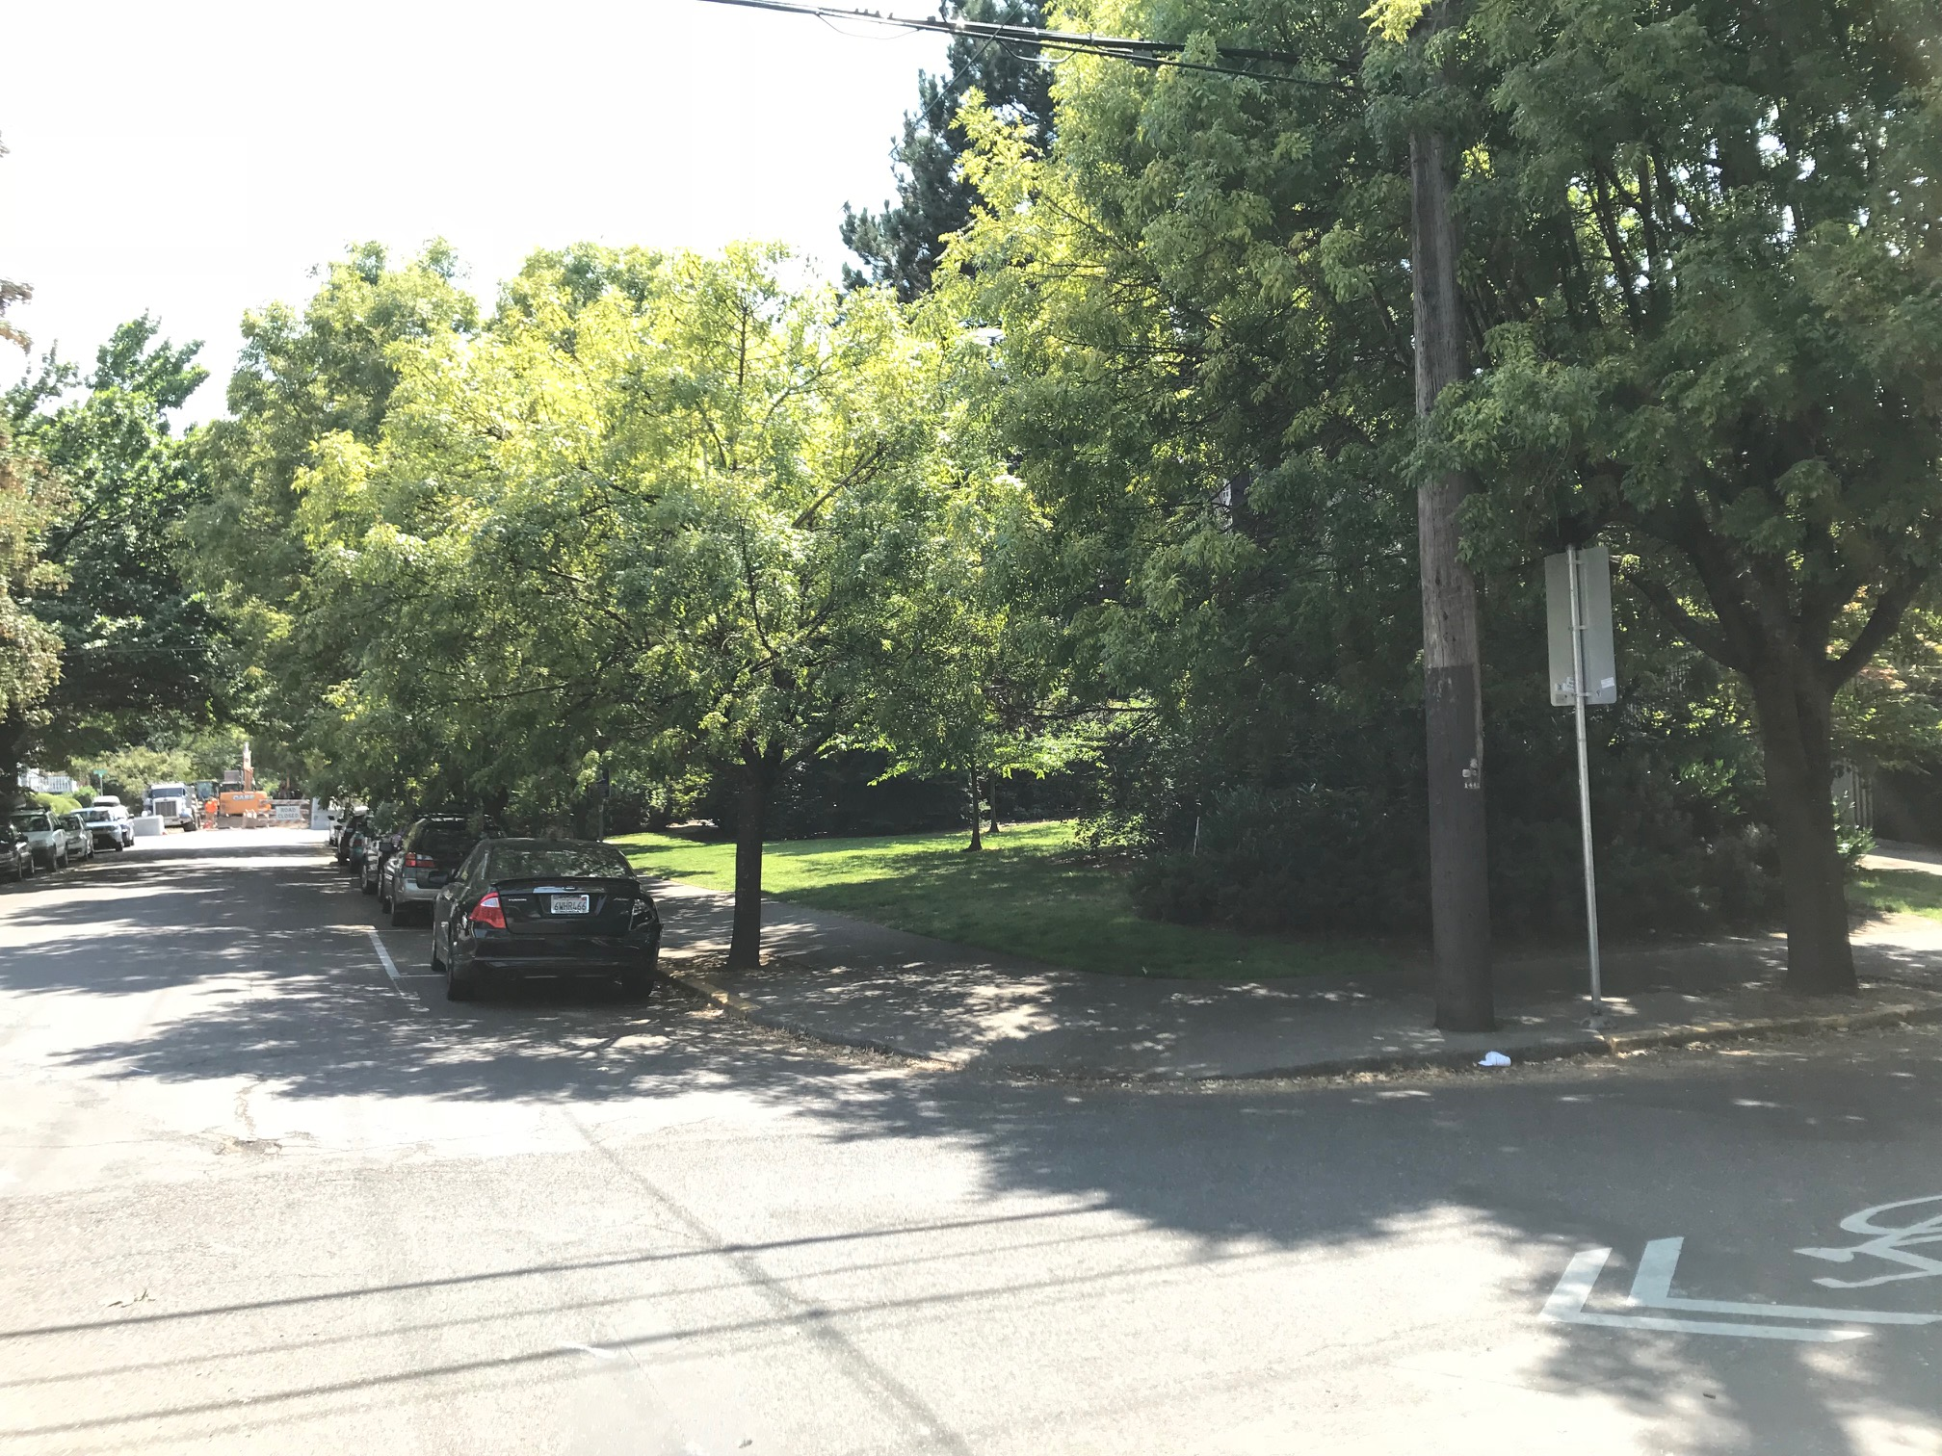

Slide 8
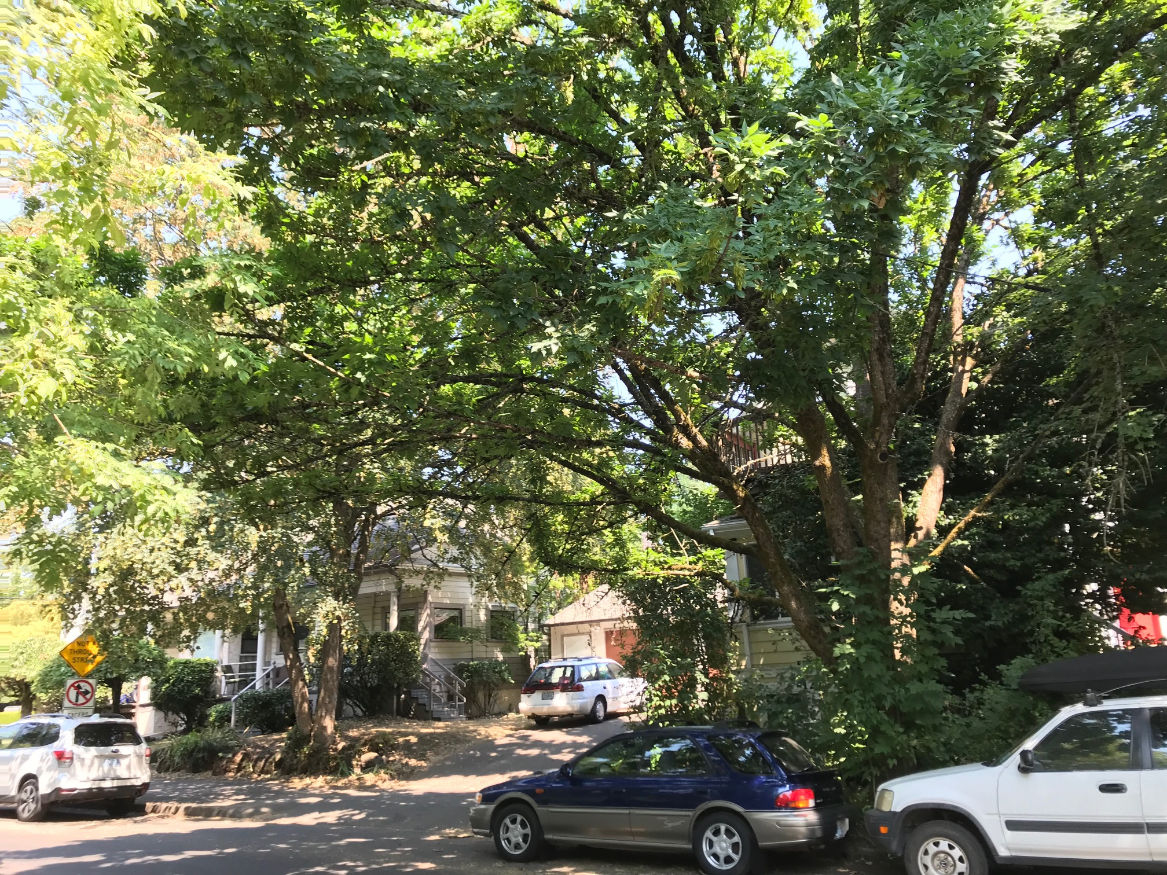

Slide 9
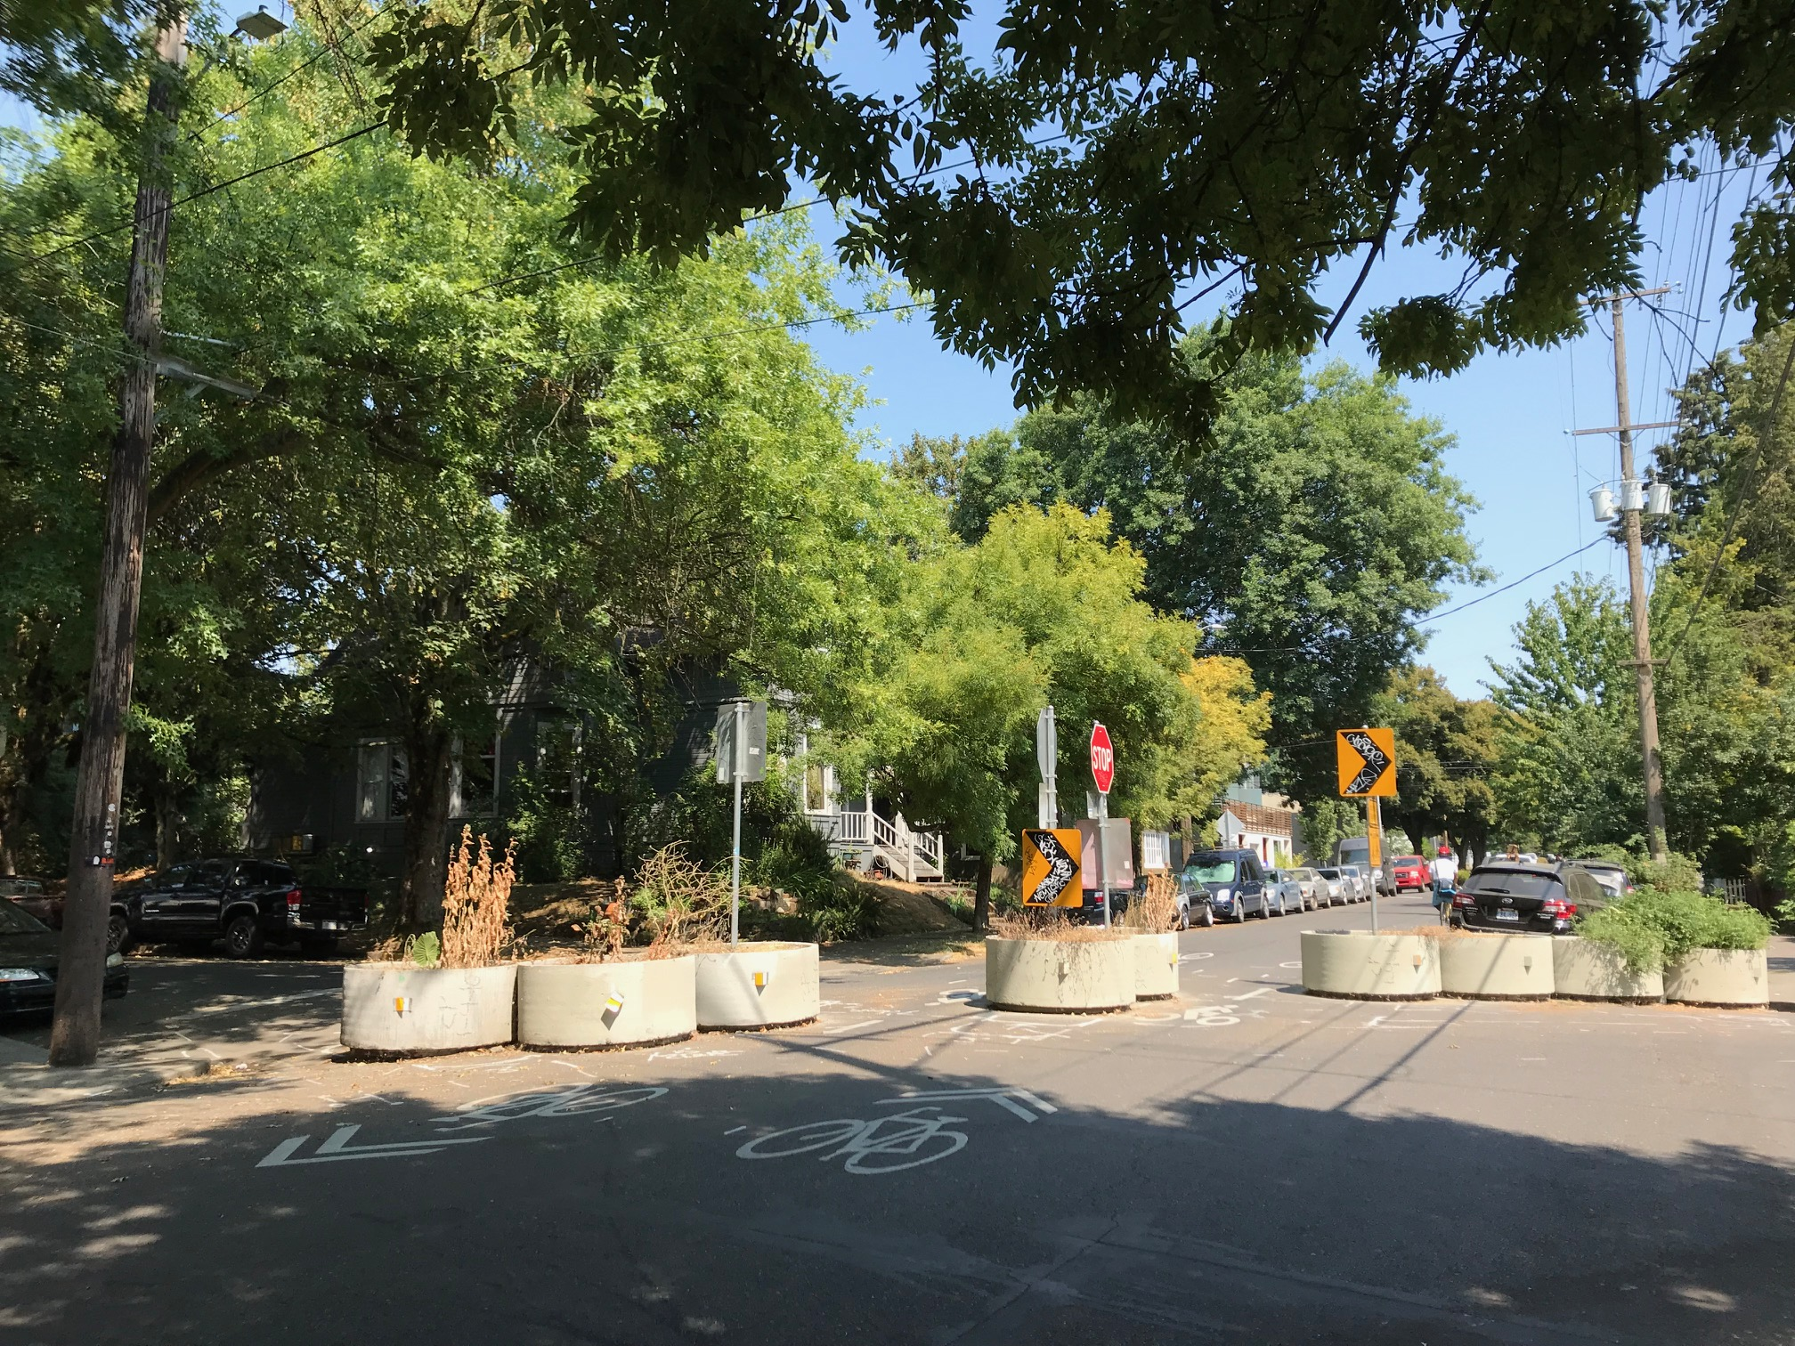

Slide 10
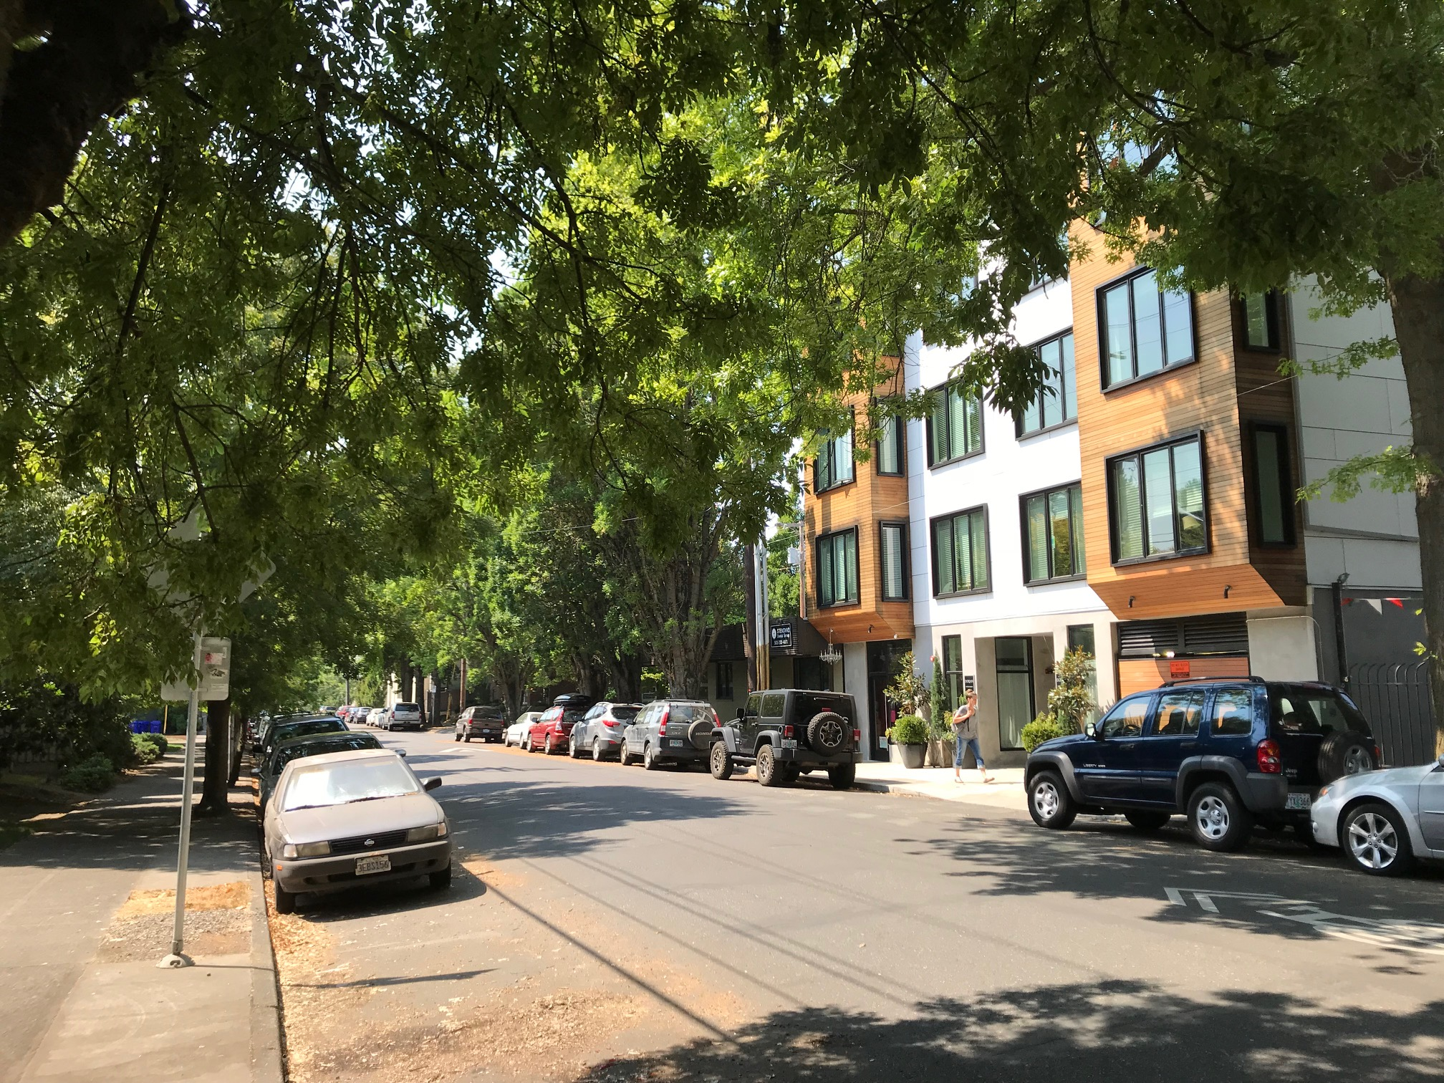

Slide 11
Conditional Use Approval Criteria
33.815.105: Institutional and Other Uses in R Zones
Proportion of Household Living uses
Physical compatibility
Livability
Adequacy of public services
Area plans

Slide 12
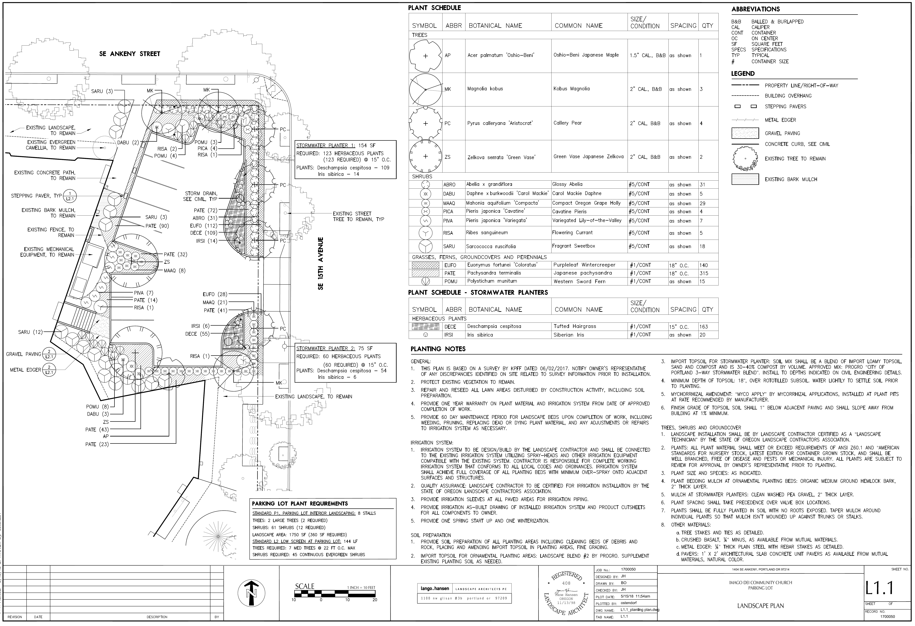

Slide 13
Conditional Use Approval Criteria
33.815.105: Institutional and Other Uses in R Zones
Proportion of Household Living uses
Physical compatibility
Livability
Adequacy of public services
Area plans

Slide 14
LU 18-174083 CU
Hearings Officer decision:
Approval
BDS Staff presentation to CITY COUNCIL
OCTOBER 25, 2018

