Slide 1
NE 46th Avenue & Saratoga Court
Local Improvement District
Resolution of Intent Hearing
November 7, 2018 – Agenda Item #1143
Staff presenting: Andrew Aebi, Local Improvement District Administrator
All photos taken on October 31, 2018 by Andrew Aebi (except for slide #9)

Slide 2
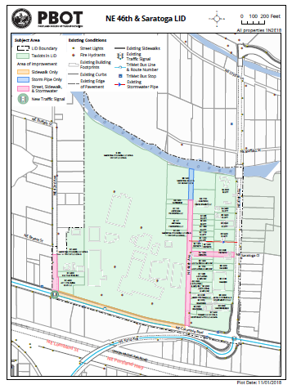
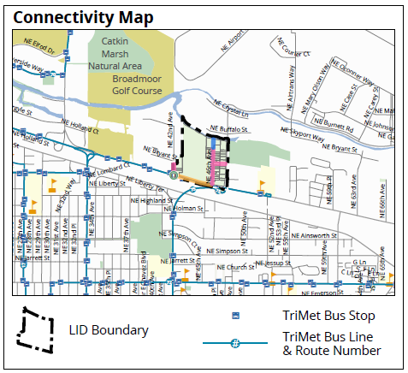
LID Map & Columbia/Lombard Corridor

Slide 3
Project Scope
Coordinated New Infrastructure
1) Improve unpaved NE 46th Avenue north of NE Columbia Blvd.
2) Construct new east-west NE Saratoga Court (NE 46th-47th Aves.)
Signalize NE 42nd & Columbia Blvd. intersection reducing
21-block gap on NE Columbia Blvd. from NE 21st to 47th Aves.
4) Add street lighting
5) Coordinate potential bus stop relocation for safe transit access
6) Construct new stormwater outfall to Columbia Slough
Potential partnership with BES Columbia Slough Sediment Program
for stormwater treatment and habitat improvements

Slide 4
Largest LID in City History
Outside Central City
Financial Overview
$ 9,010,000 LID: Columbia Bus Base (77.4%)
$ 2,624,000 LID: Other Properties (13.3%)
$ 1,188,000 PBOT: Overhead Funding (9.3%)
$12,822,000 Total Project Funding (100.0%)
Columbia Bus Base funding of LID includes scope elements not required as conditions of development.
LID funding may be voluntarily increased for bus stop relocation and providing safe bus operator relief point for Columbia Bus Base.

Slide 5
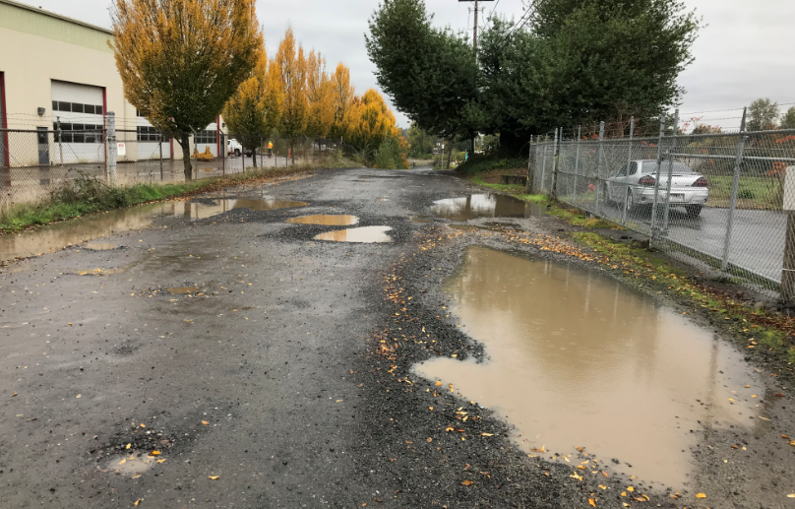
Unpaved NE 46th Avenue
Opportunity for Industrial Living-Wage Jobs

Slide 6
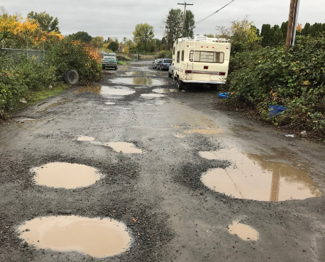
Unpaved NE 46th Avenue
One Property Owner Has Maintained Since 1967

Slide 7
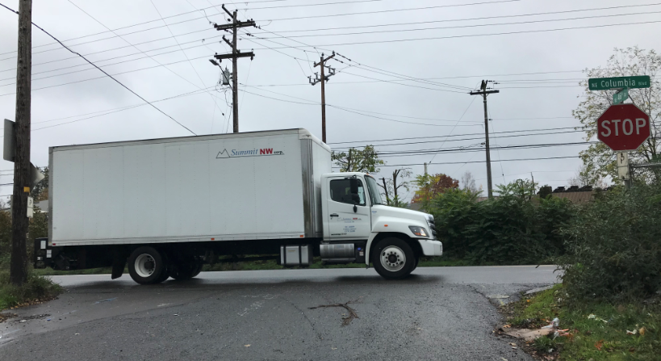
NE Saratoga Ct. Egress to NE 47th Ave.
Alternative to eastbound NE Columbia Blvd. left turn
at unsignalized NE 46th & Columbia

Slide 8
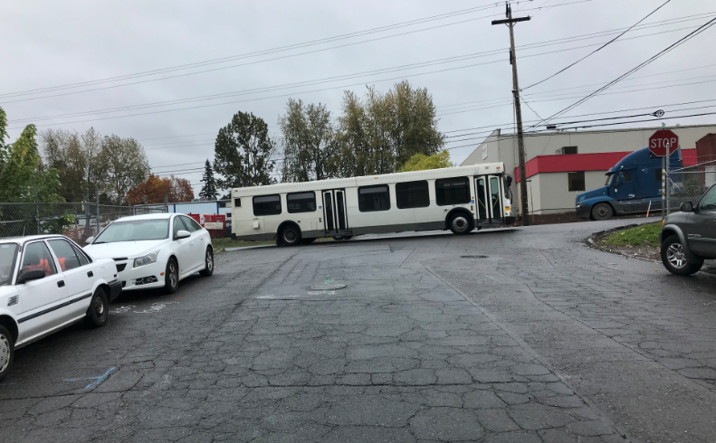
Unsignalized NE 42nd & Columbia Blvd.
Very Poor Pavement Condition (19 on 0-100 scale)
Add new traffic signal

Slide 9
Rebuild NE 42nd Avenue in concrete
Contrast with N. Marine Dr. west of N. Force Ave. (below)
Pavement score on 0 – 100 scale: 100 (very good condition)
N. Marine Dr. constructed Feb. 1992
N. Marine Dr. pavement condition rated in April 2014
N. Marine Dr. Google Street View from Oct. 2015

Slide 10
Cully Association of Neighbors
June 2018 Infrastructure Deficiencies and Equity
Unpaved:
9.4% of street centerline in Cully vs. 2.8% Citywide
(Cully’s unpaved streets are more than triple the Citywide proportion of unpaved streets)
Sidewalk coverage ratio:
29.2% of all streets in Cully vs. 62.5% Citywide
(Cully residents less than half as likely to have a sidewalk on their street as Citywide)
Equity score of 10:
46.1% of people identify as people of color or Hispanic
20.1% of households have limited English proficiency
Median income of less than $40K per year

Slide 11
38-Year Change in Tri-County Region
1980 to 2018 Population, Economic & Transit Trends
1980 (year third bus base opened; no light rail service):
Population: 1,053,100
Average earnings per employee: $15,302
Average transit fare: $0.39
Fixed route vehicle hours (bus equivalent): 1,544,000
Bus Bases: 3
2018 (planned new fourth bus base and sixth light rail line):
Population: 1,846,285
Average earnings per employee: $60,355
Average transit fare: $1.53
Fixed route vehicle hours (bus equivalent): 3,589,768
Bus Bases: 3

Slide 12
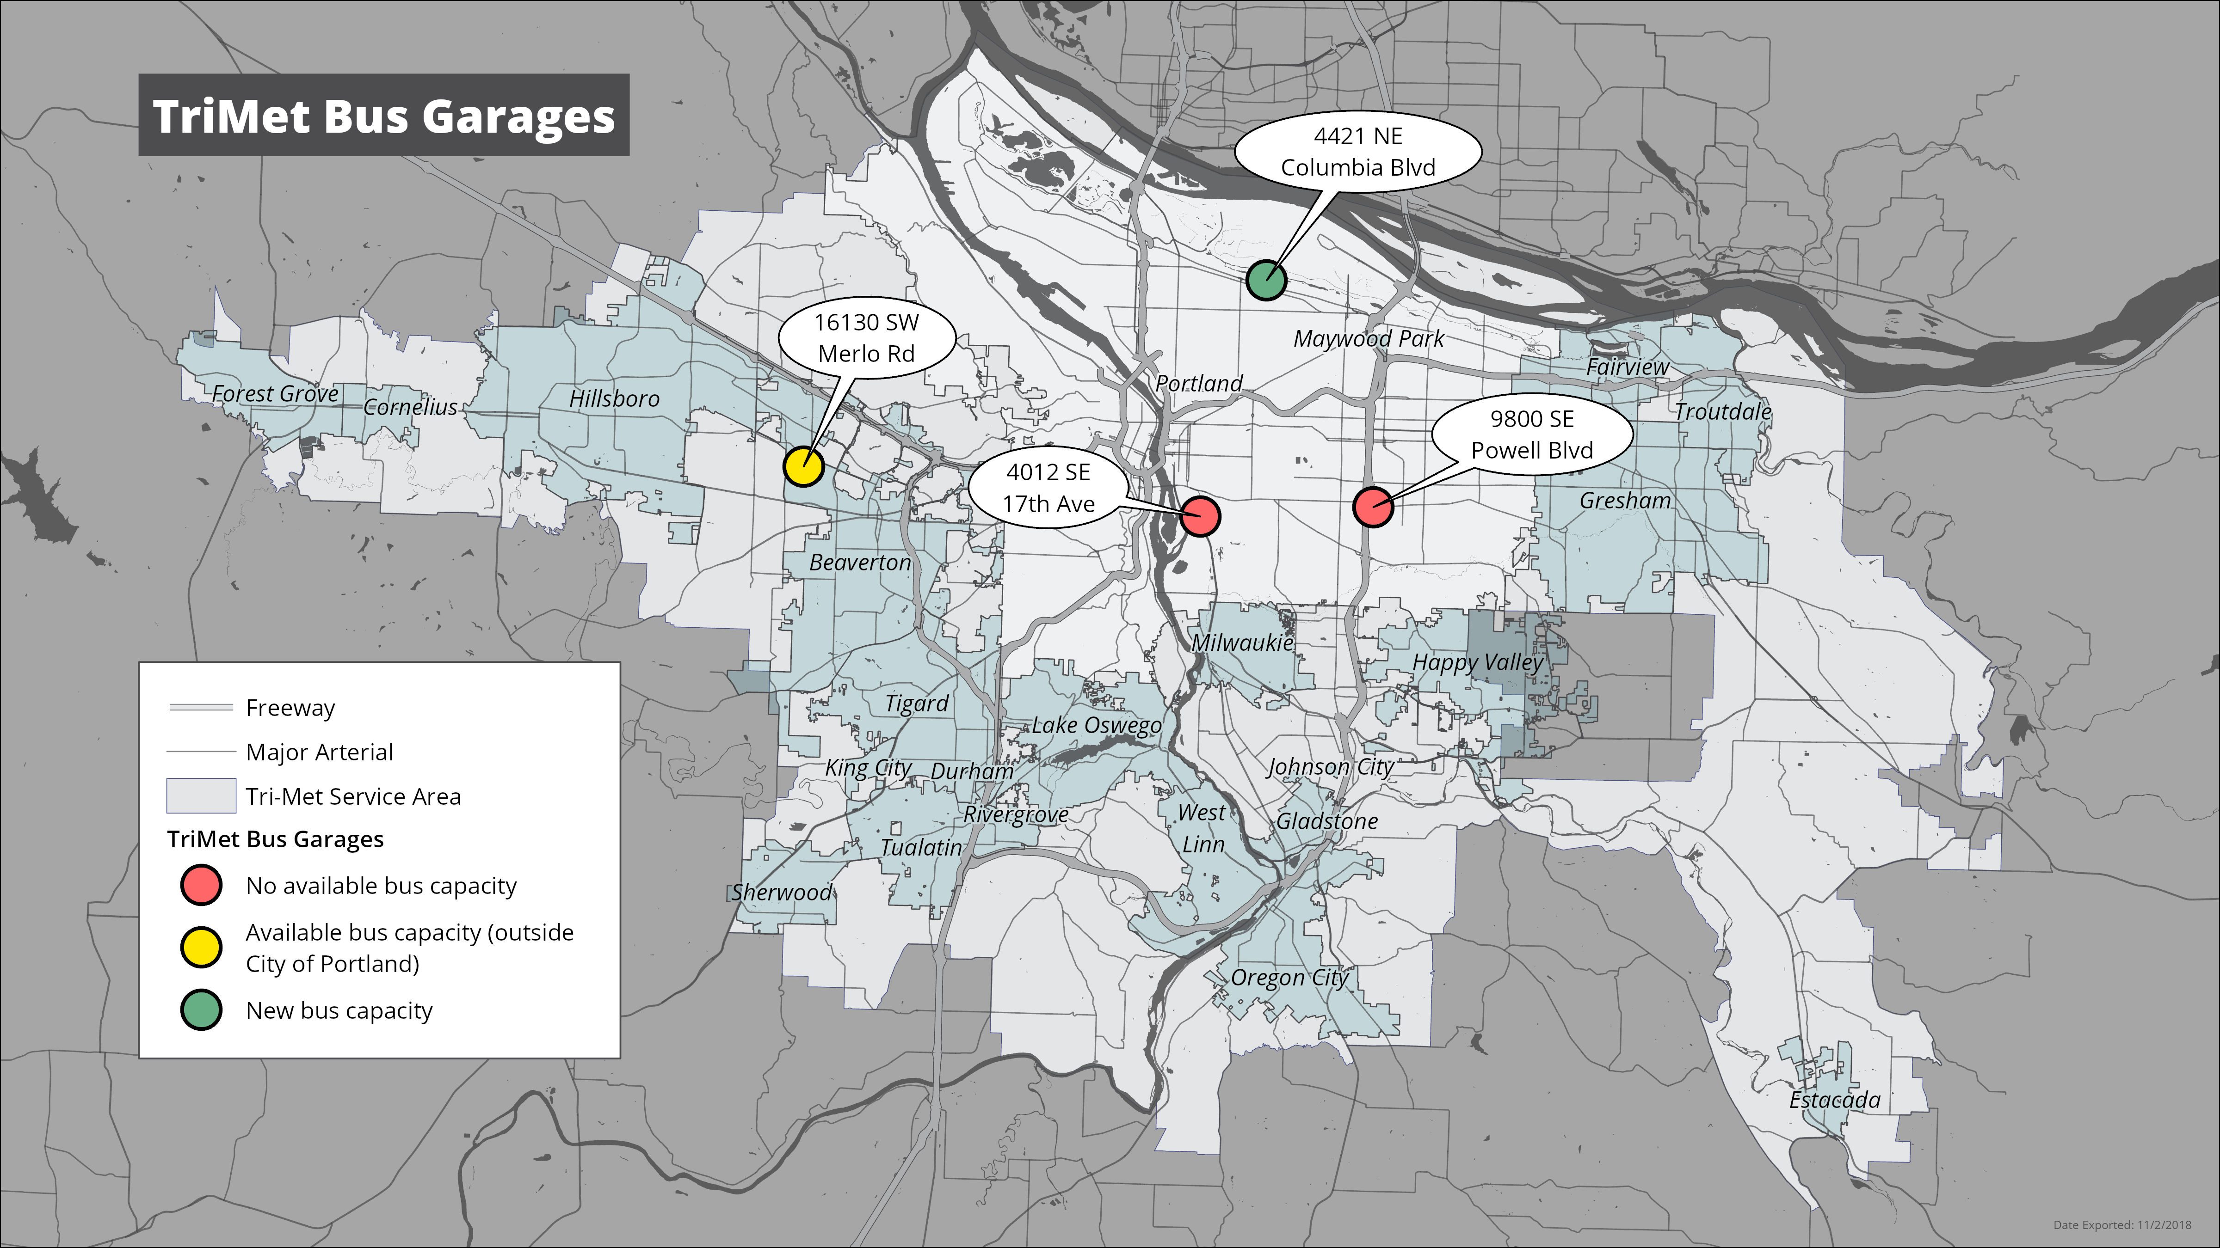
Columbia Bus Base
Fourth bus base in region; first new one since 1980

