Slide 1



Proposed Street Vacation
for Unnamed Road east of NE 160th Avenue and
south of NE Halsey St.

Slide 2
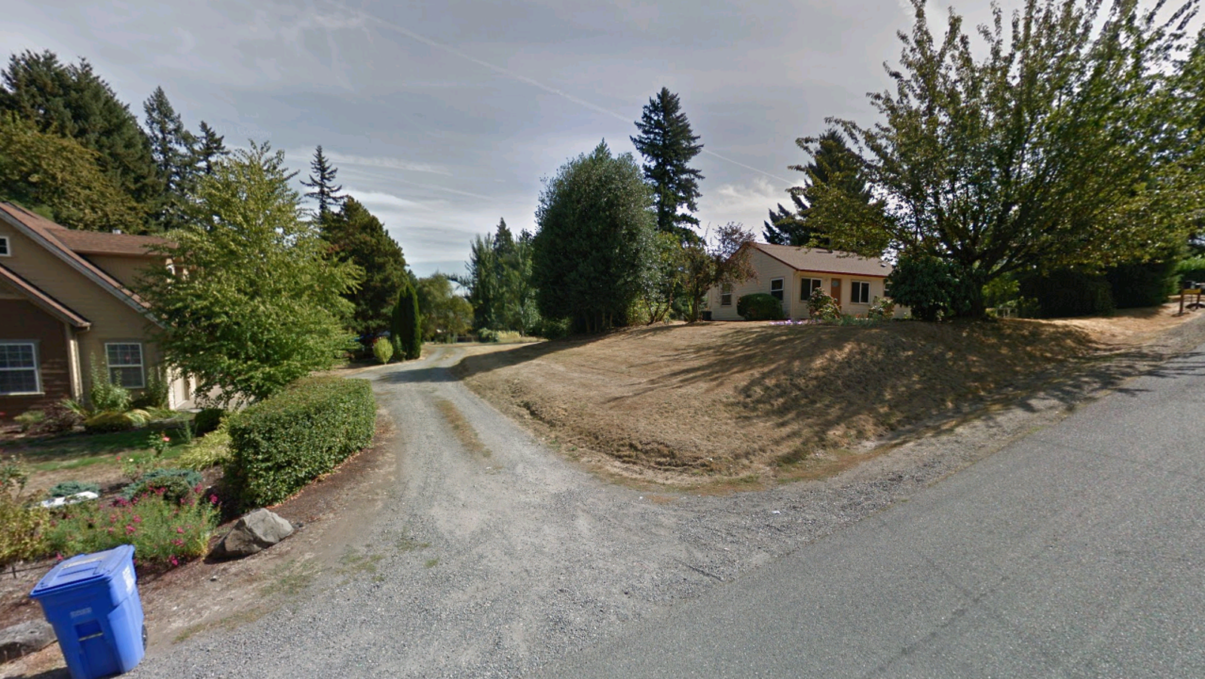
Unnamed Road: View from NE 160th Avenue (Looking east)

Slide 3
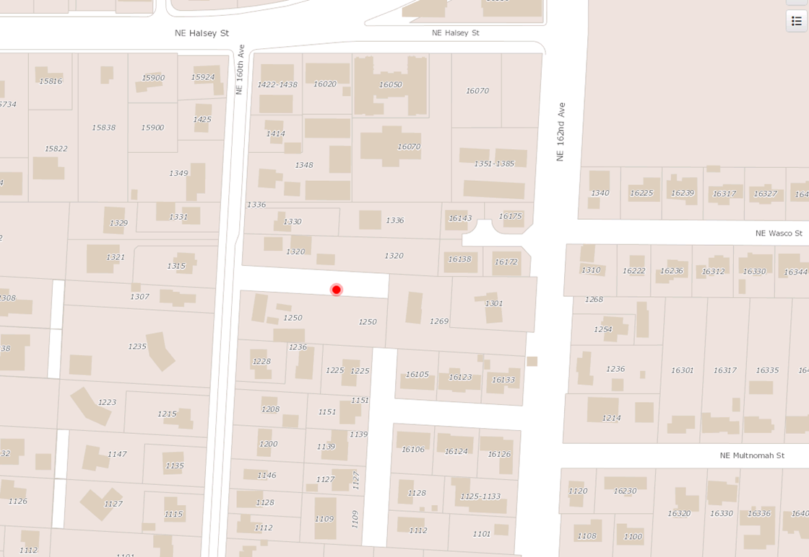
Unnamed Road as shown on PortlandMaps

Slide 4
Portland City Boundary

Slide 5
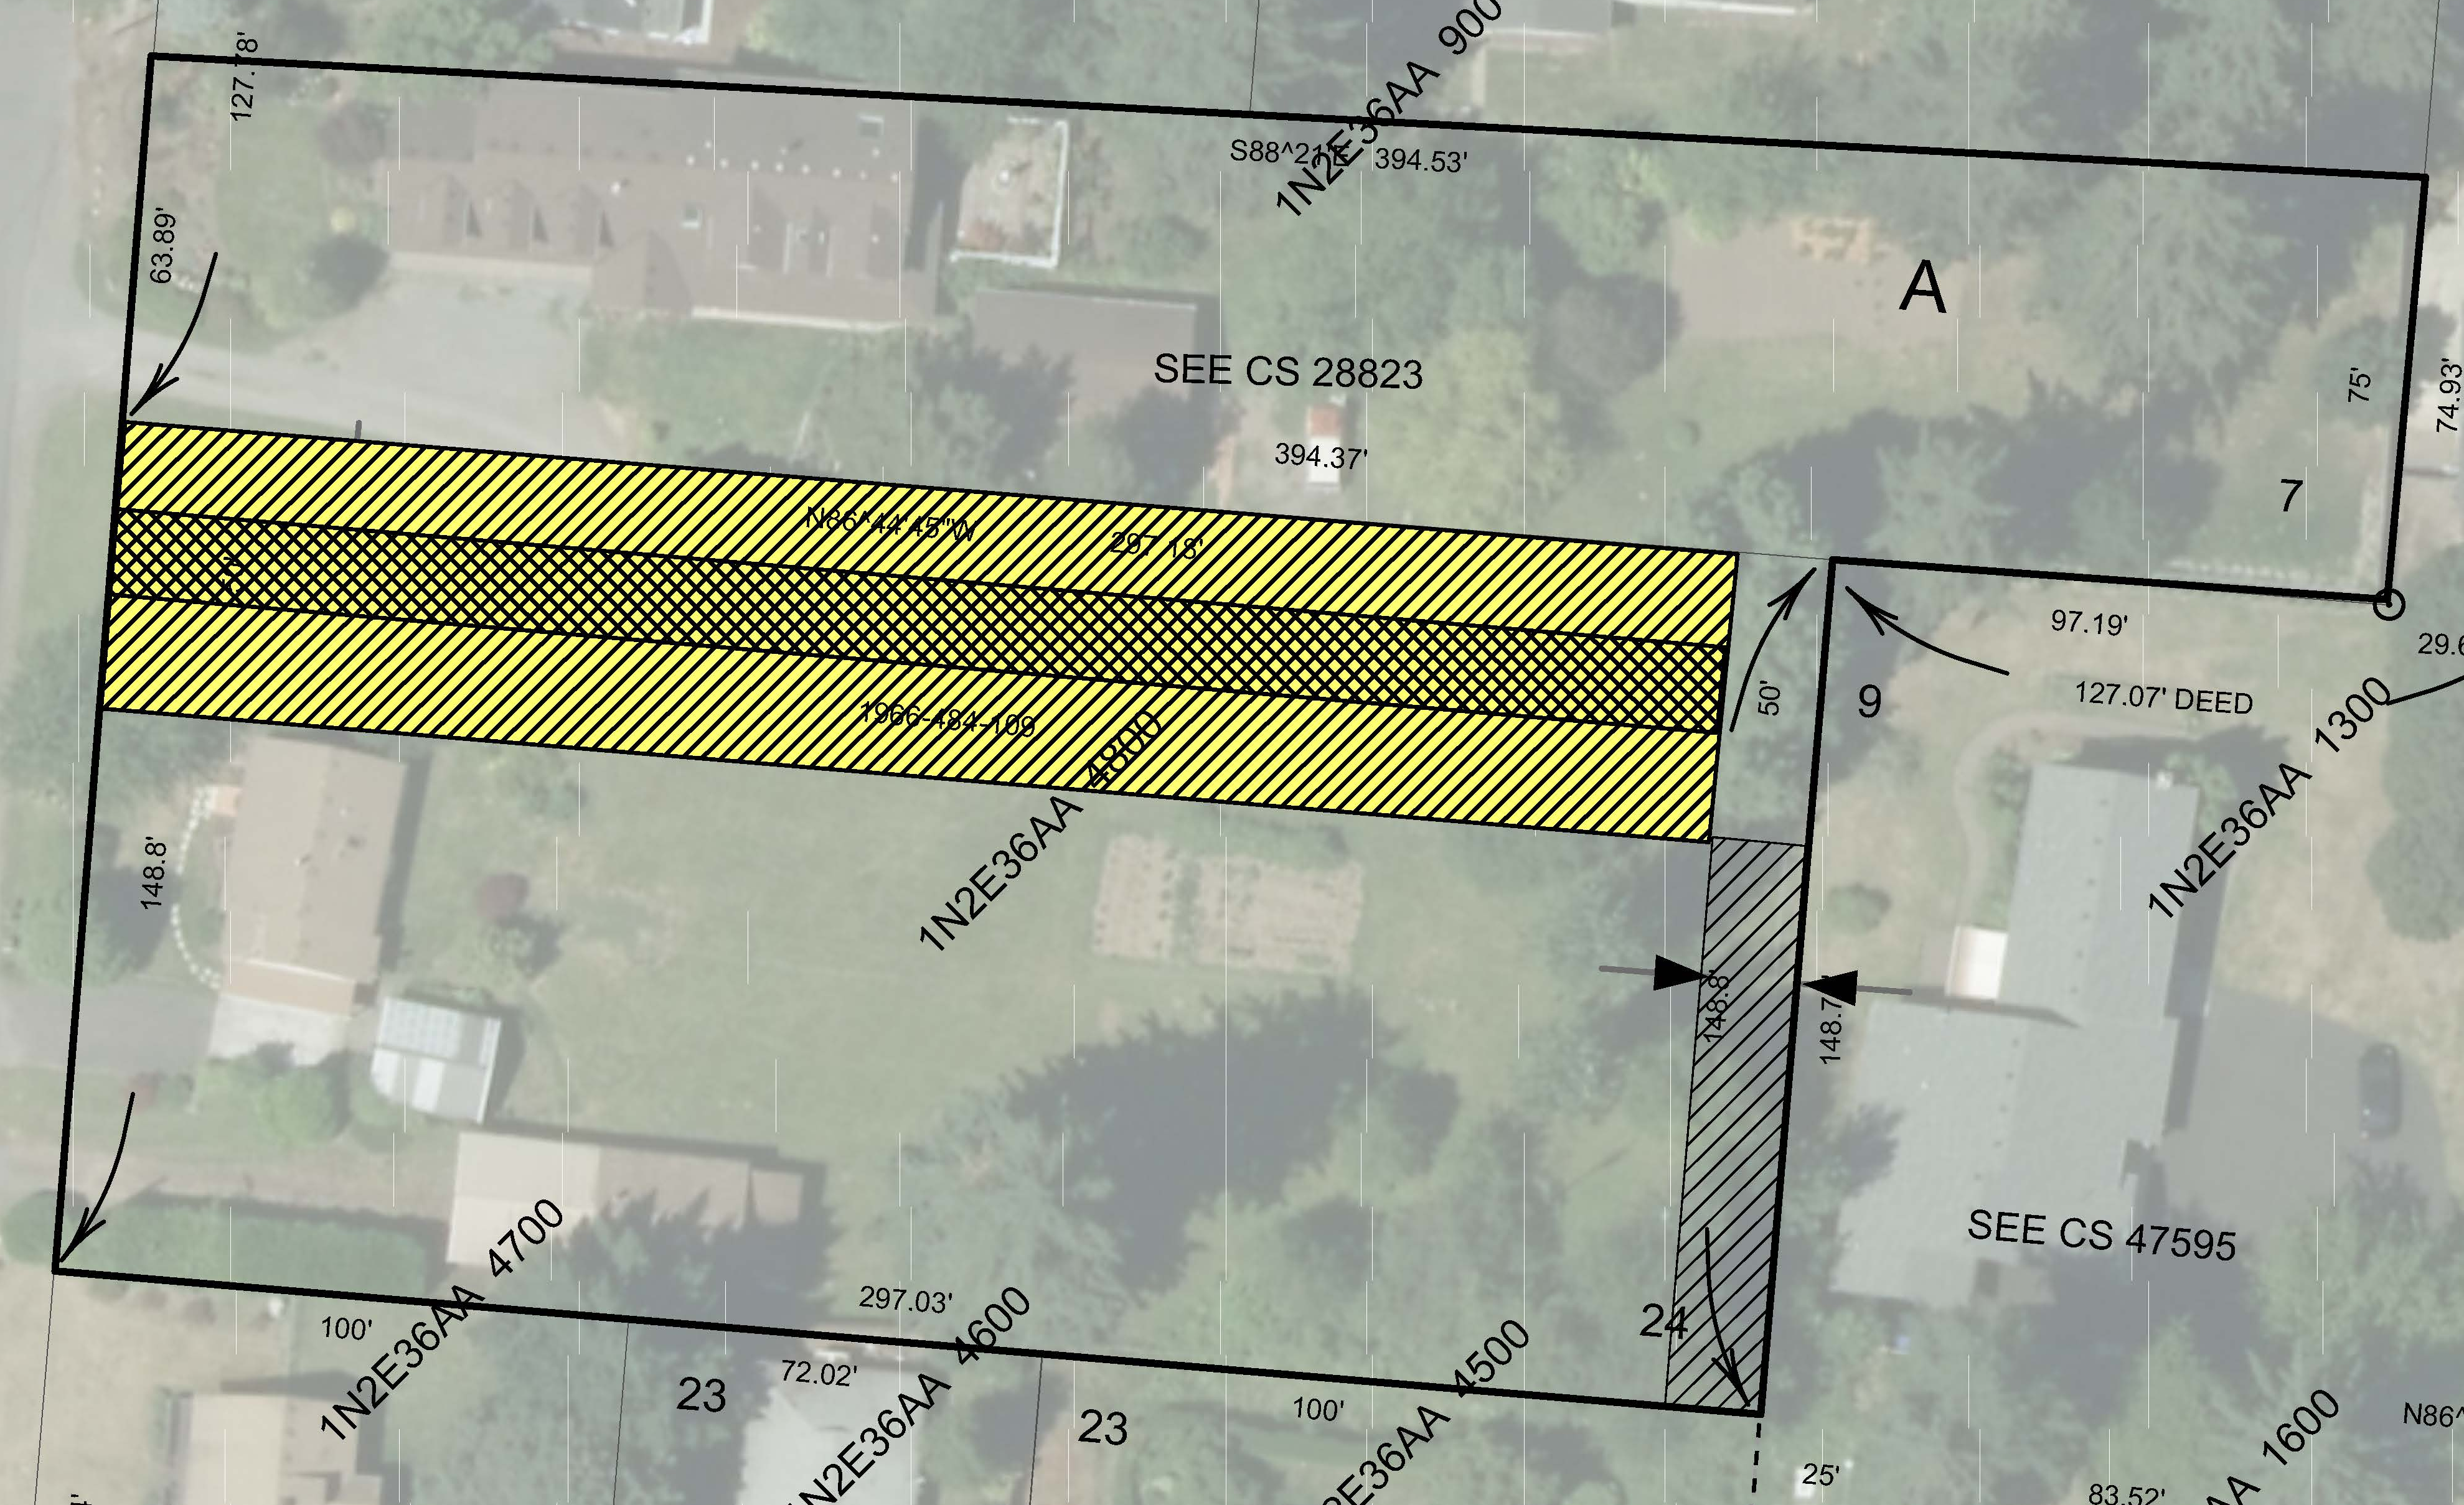
Proposed Vacation Area
Walkway Easement
16 ft. ROW extension of NE 161st Ave.

Slide 6
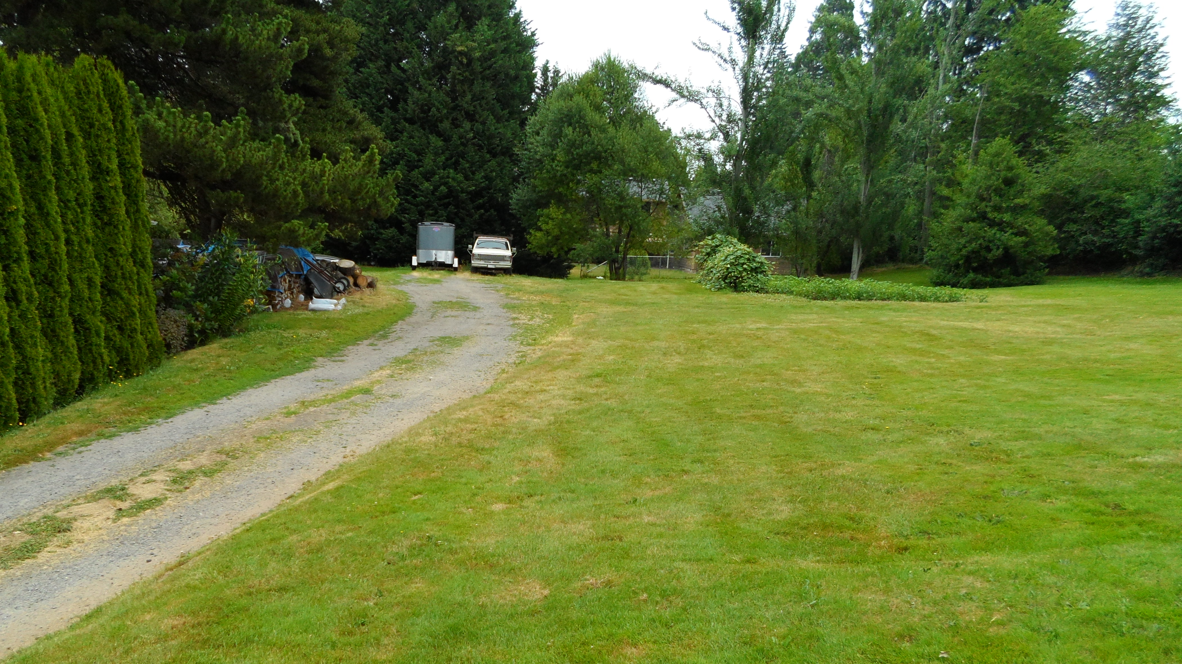
Unnamed Road Looking East

Slide 7
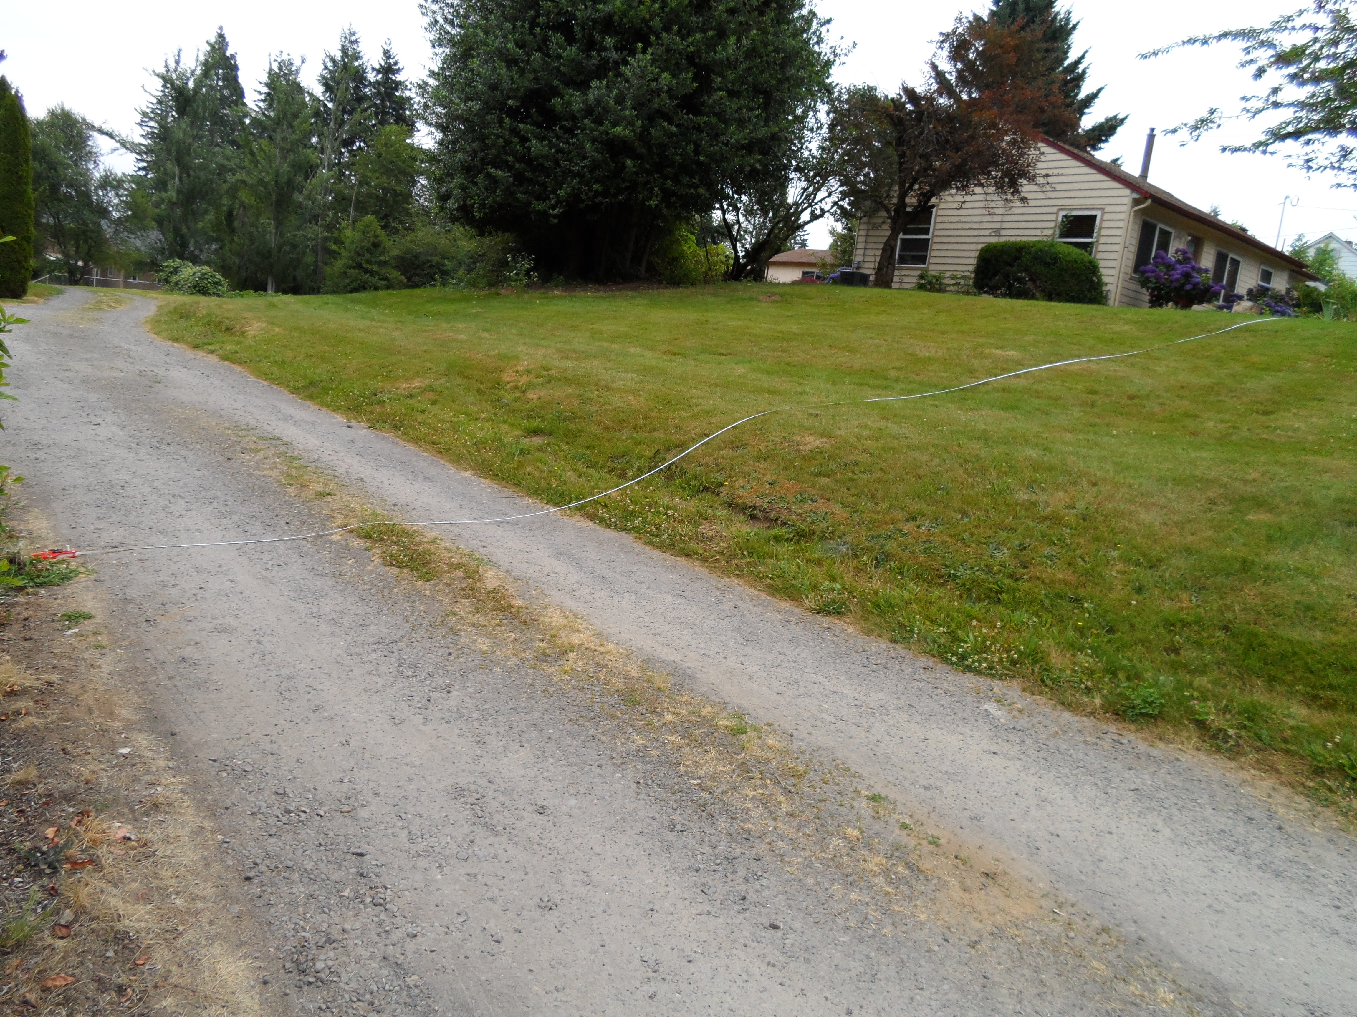
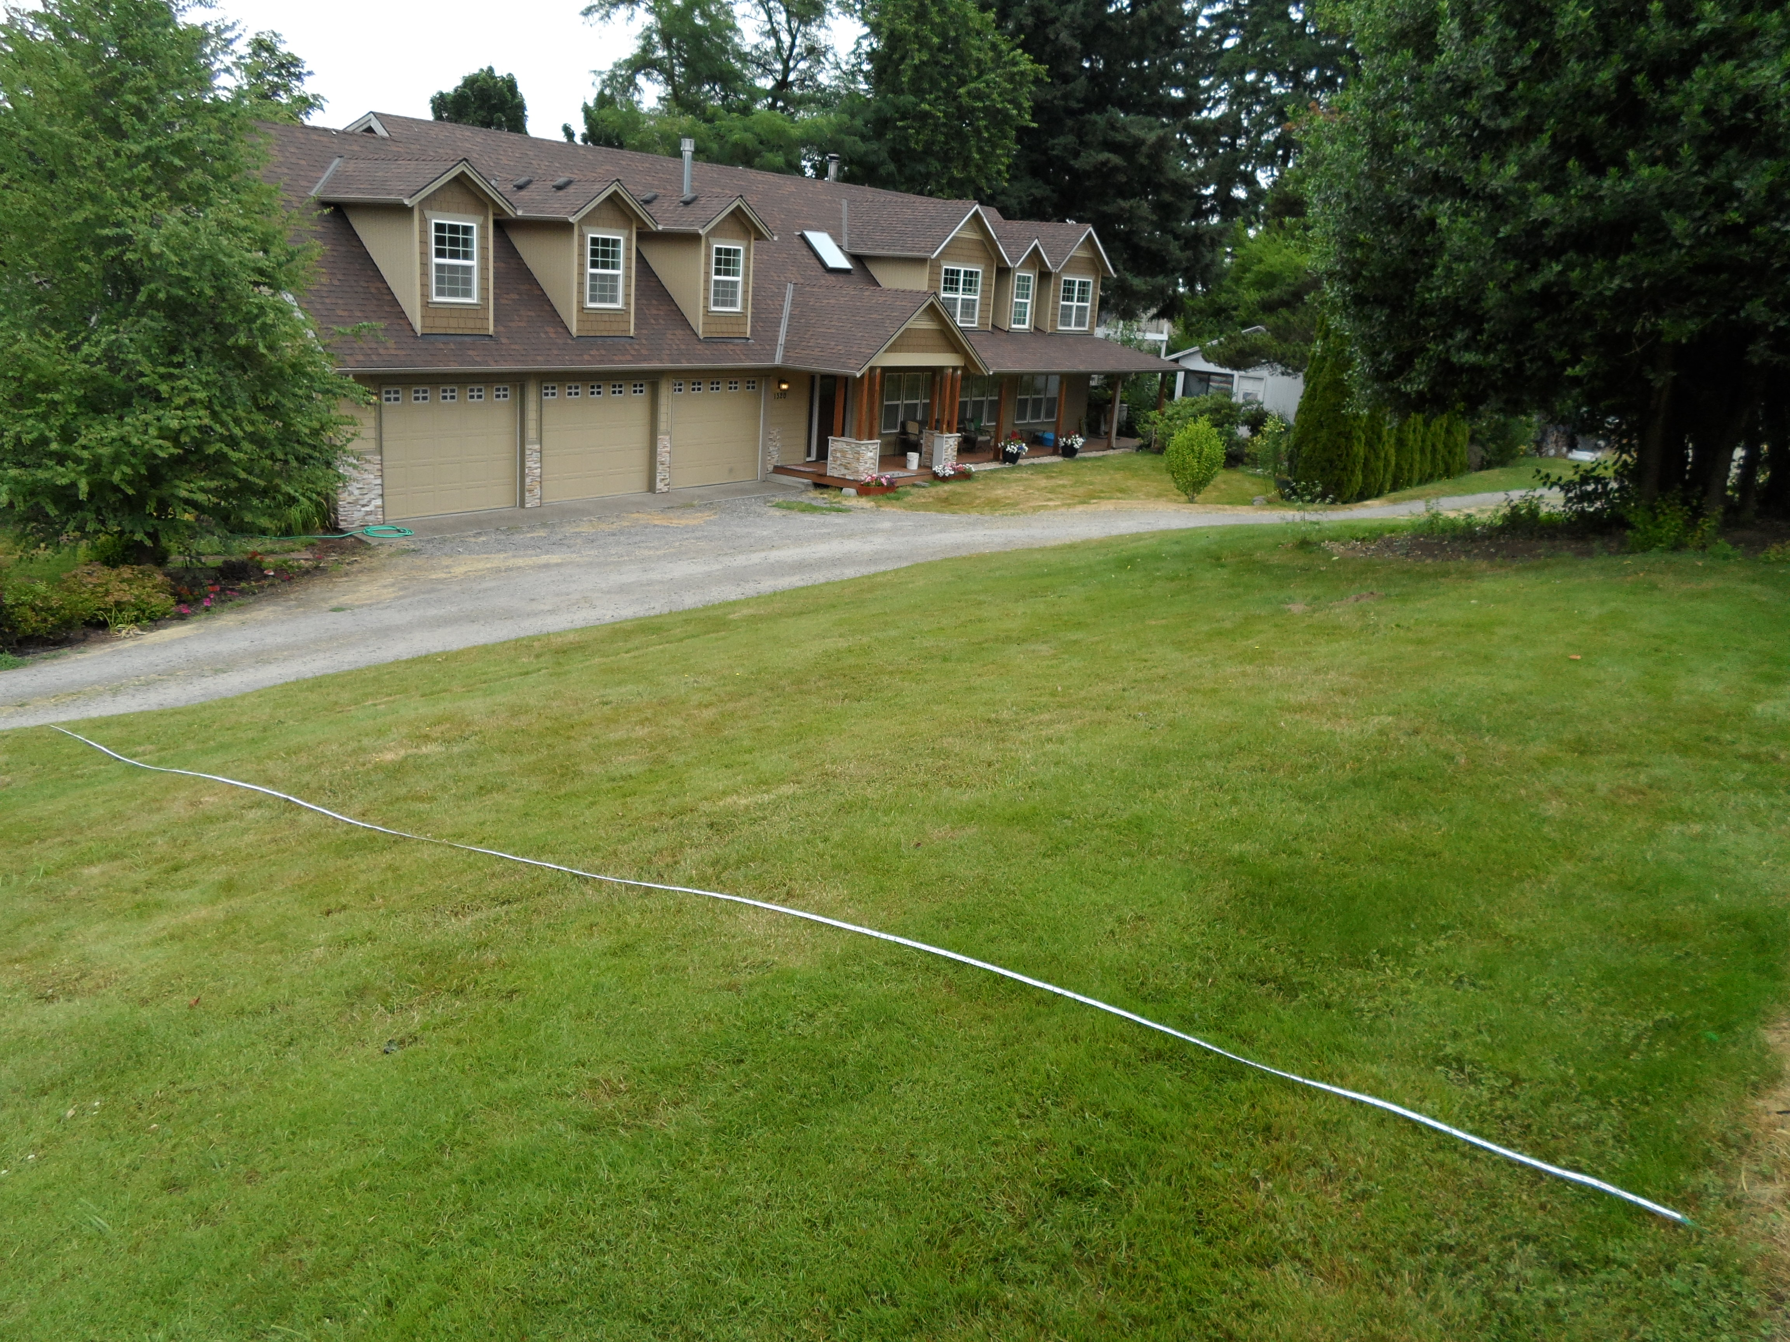
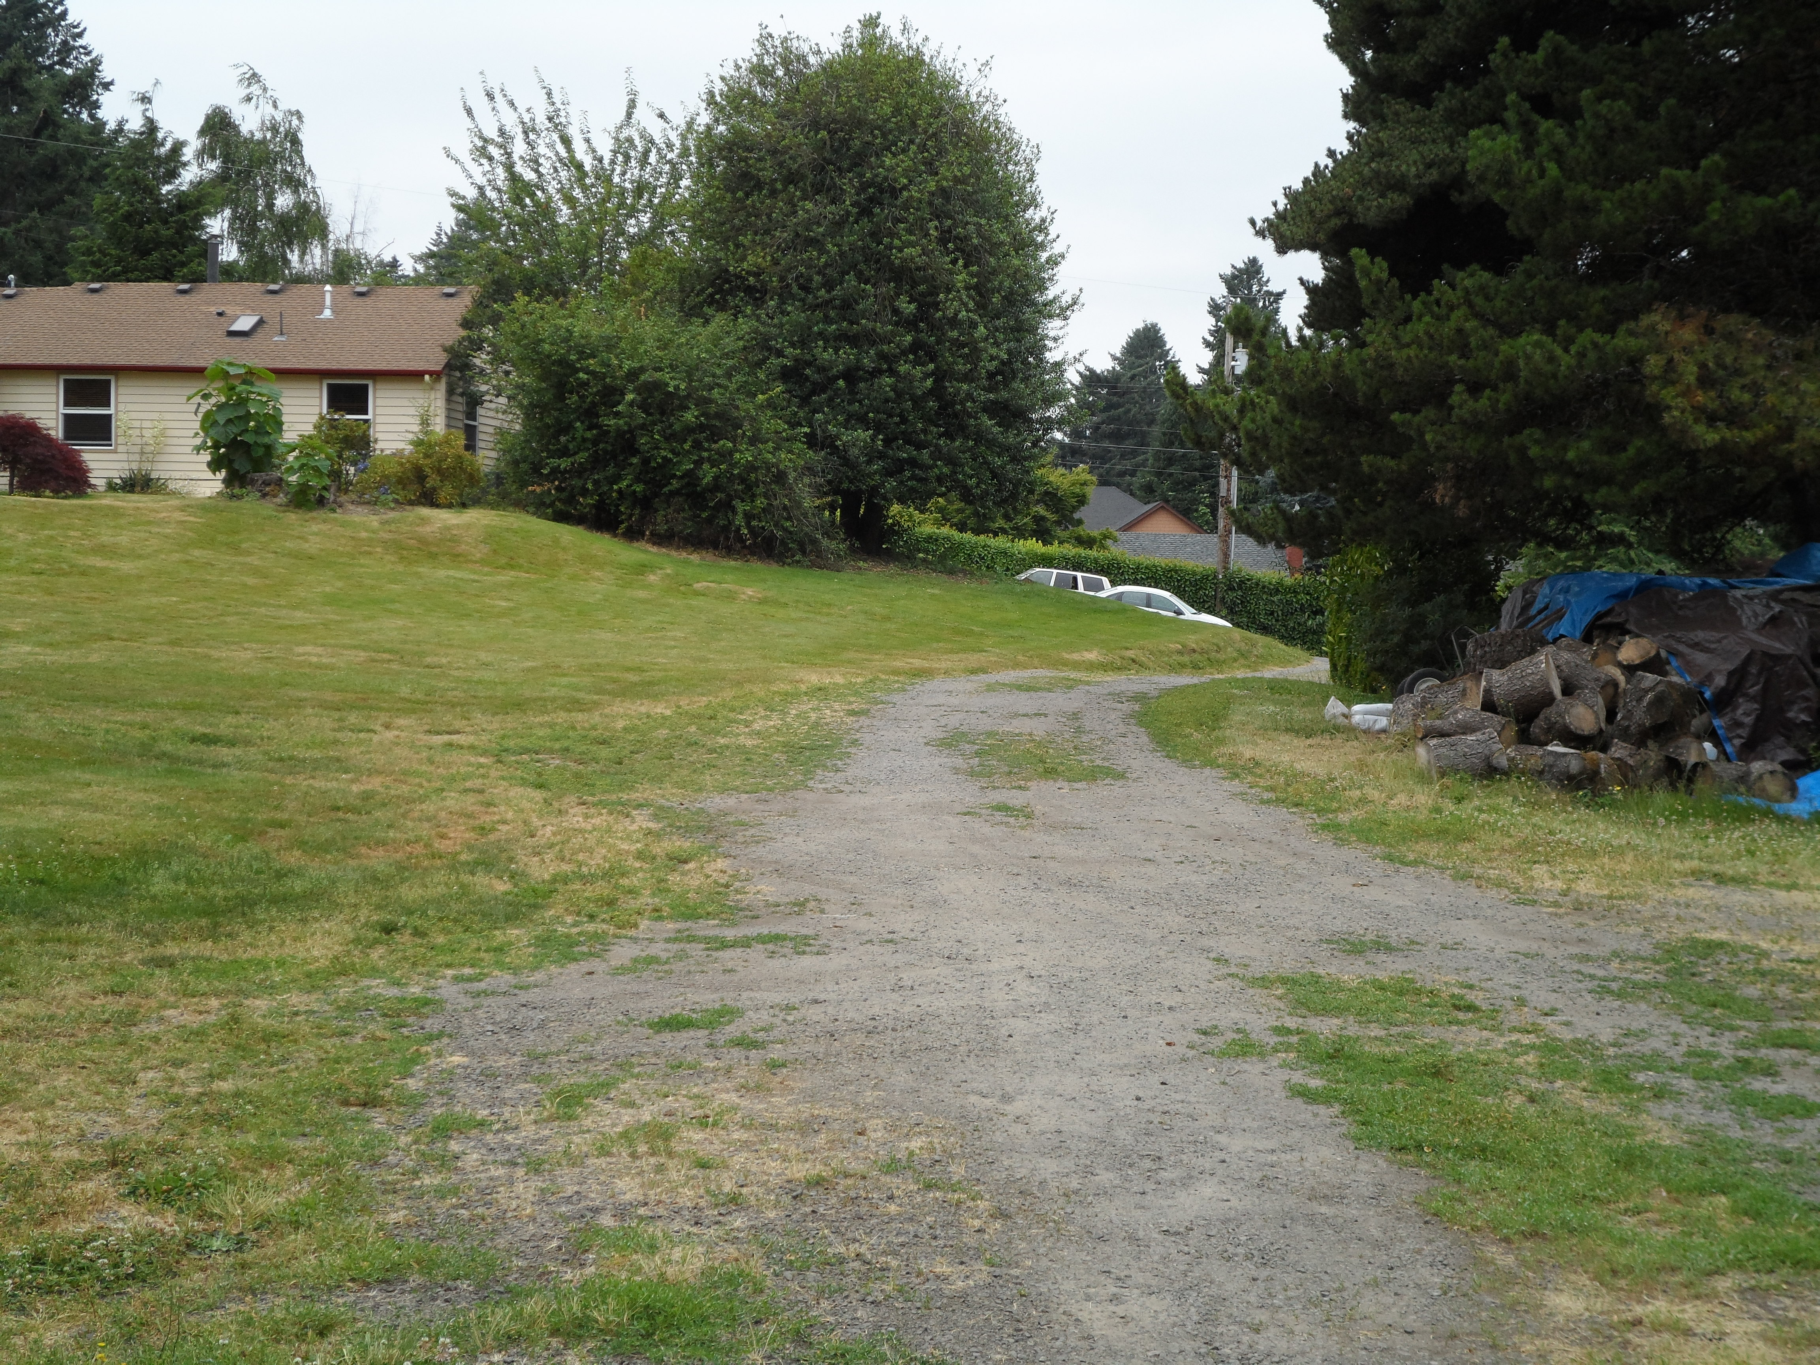
Additional Views

Slide 8
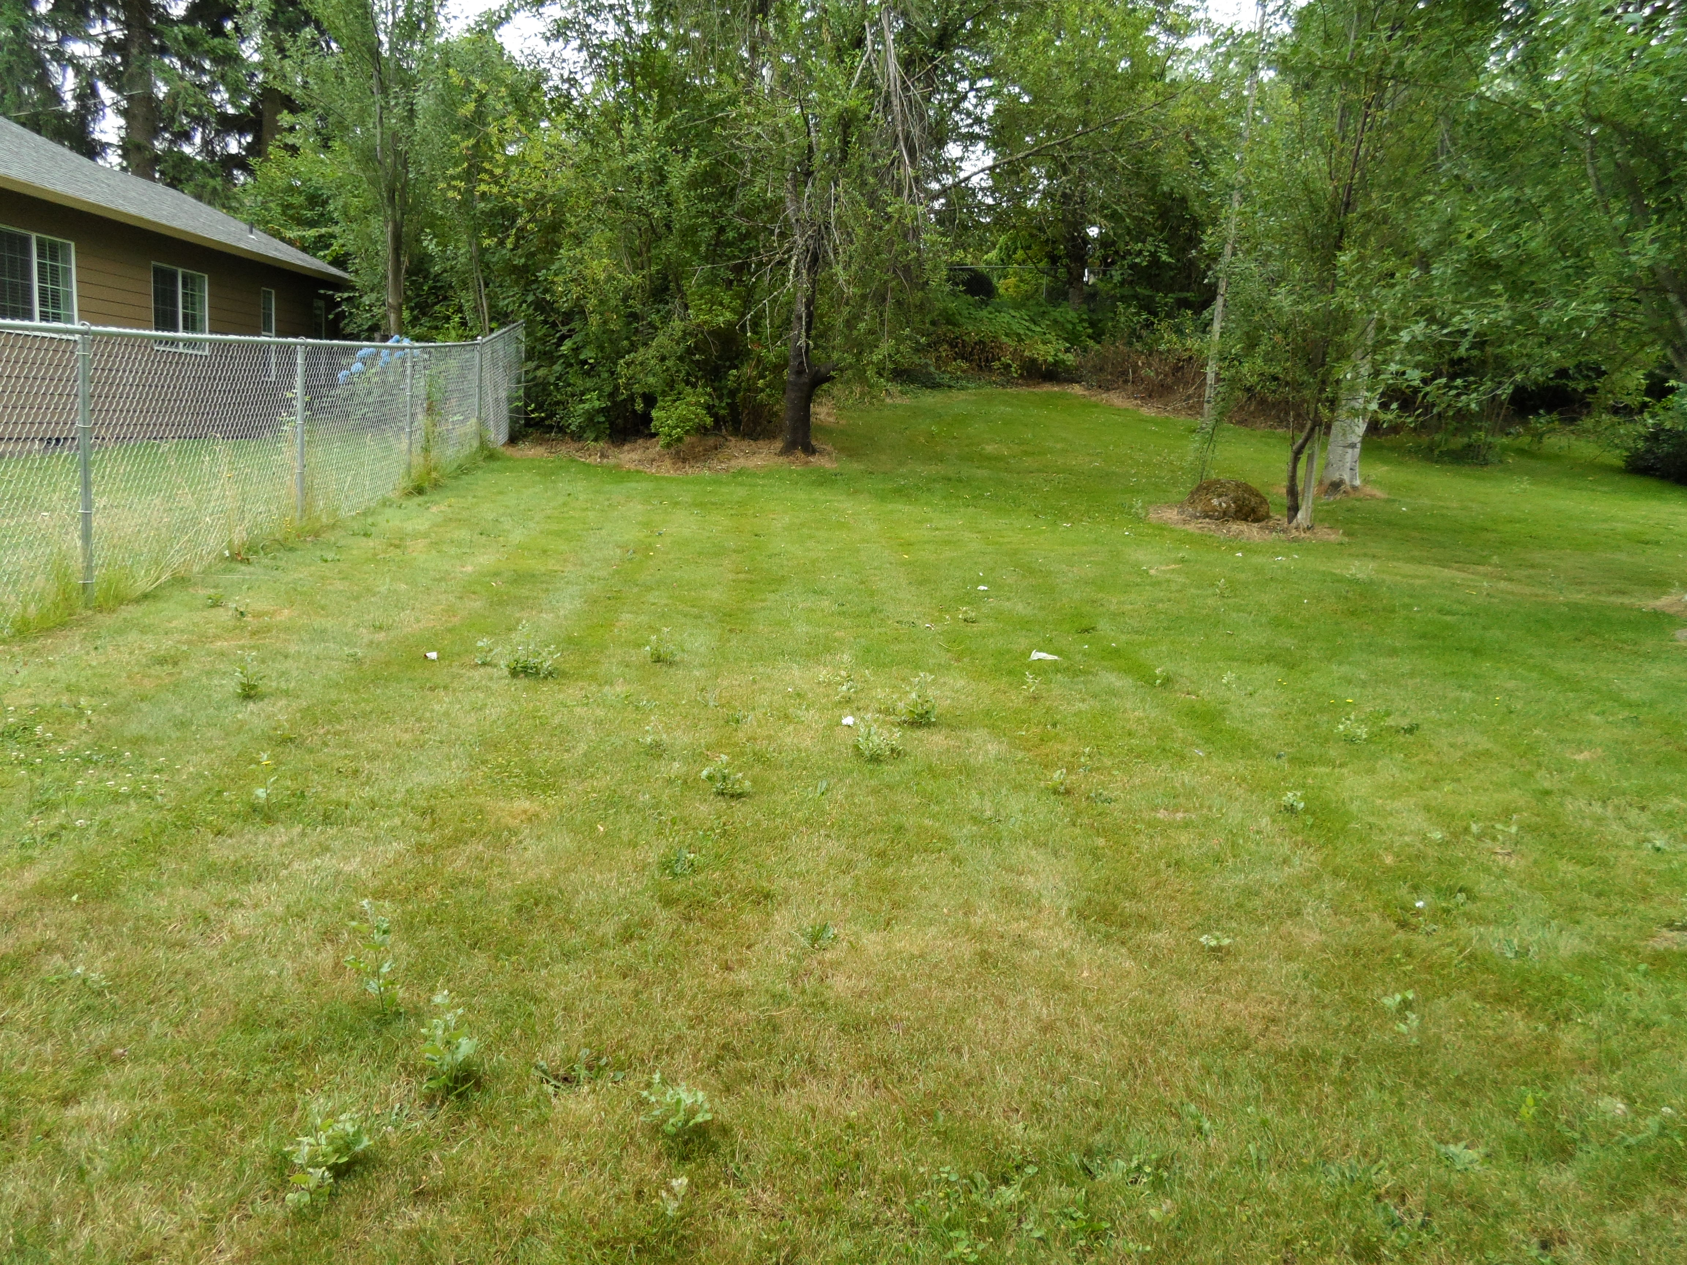
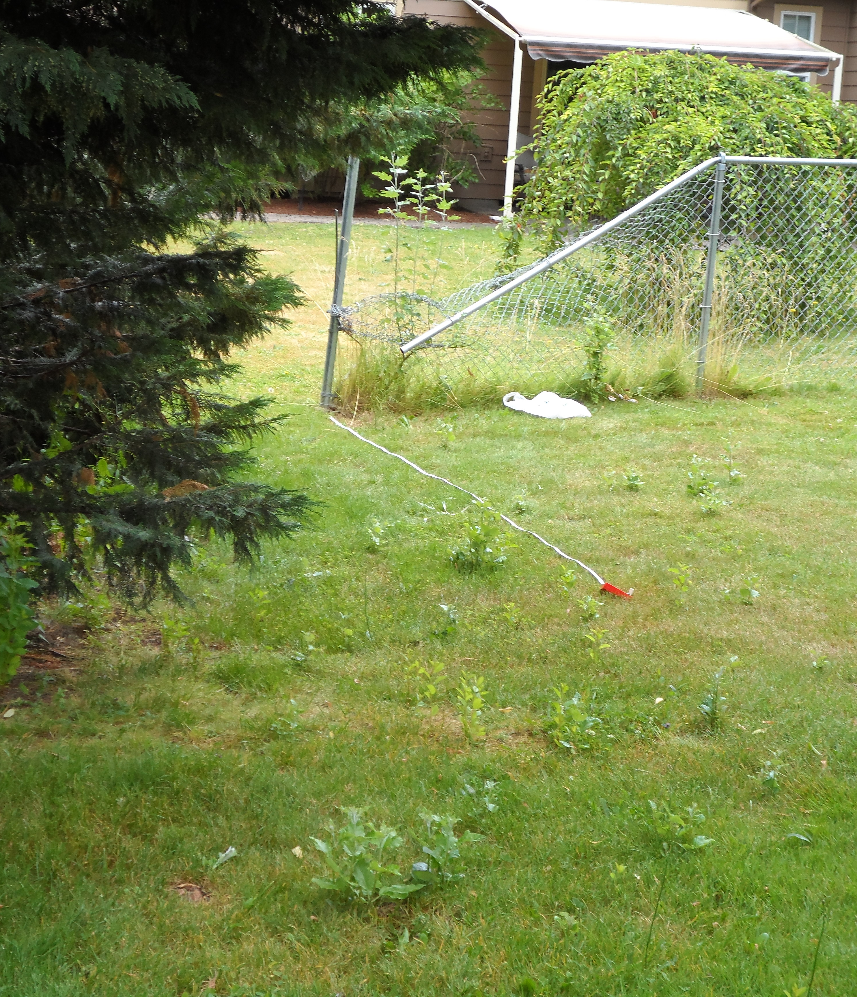
South towards NE 161st Ave.

Slide 9


Possible
Subdivision
Scenario
Potential Lot Lines
15 ft. wide public walkway.
20 ft. wide private driveway
16 ft. wide ROW extension of NE 161st Ave.
Potential Lot Lines

