Slide 1
Inclusionary Housing MULTE Approvals
26th & Upshur Apartments
Nehalem Apartments
October 17, 2018

Slide 2
Inclusionary Housing MULTE Applications
Summary
Projects | 2
New Units | 208
IH Units | 60
Highlights
1 project is also a receiving site for 2 other developments
1 project in Northwest & 1 project in Sellwood

Slide 3
26th & Upshur Apartments 2590 NW Upshur Ave
Unit Size | Count | Income Restriction (MFI)
Studio | 7 | 80%
Studio | 36 | Market
One-Bedroom | 15 | 80%
One-Bedroom | 85 | Market
Two-Bedroom | 0 | 80%
Two-Bedroom | 2 | Market
TOTAL | 145
Total Units: 145
80% MFI Units: 22
Market Rate Units: 123

Slide 4
Nehalem Apartments 1645 SE Nehalem
Unit Size | Count | Income Restriction (MFI)
Studio | 2 | 80%
Studio | 7 | 60%
Studio | 5 | Market
One-Bedroom | 7 | 80%
One-Bedroom | 21 | 60%
One-Bedroom | 19 | Market
Two-Bedroom | 1 | 60%
Two-Bedroom | 1 | Market
TOTAL | 63
Total Units: 63
80% MFI Units: 9
60% MFI Units: 29
Market Rate Units: 25

Slide 5
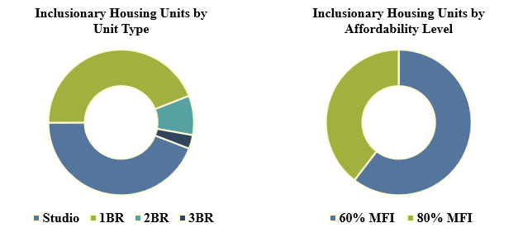
Inclusionary Housing 18-Month Update
Subtitle
5

Slide 6
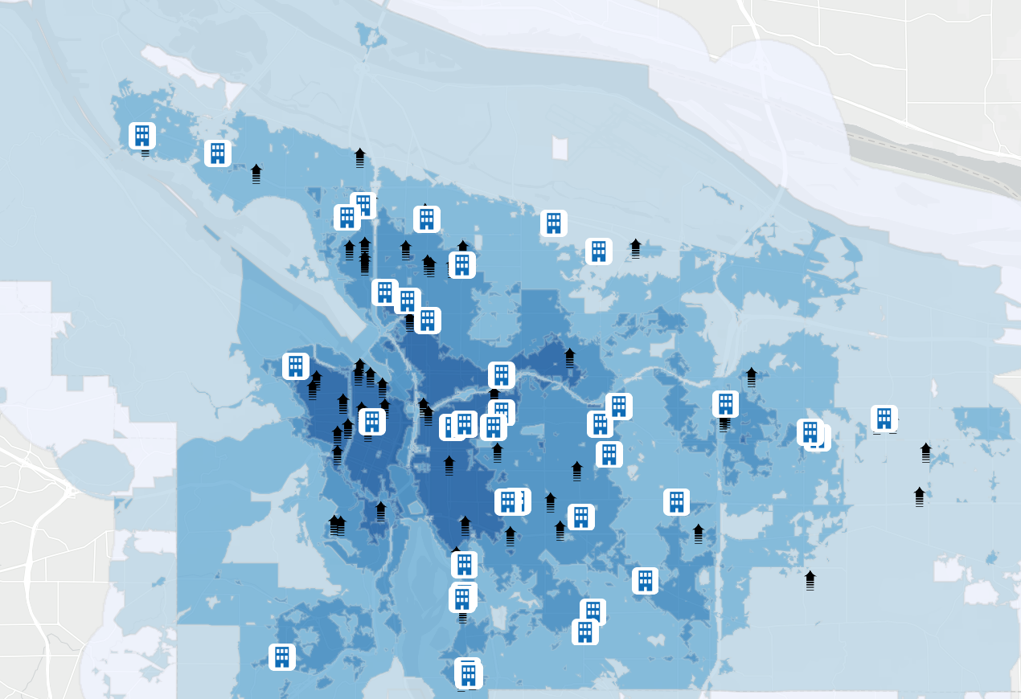
Inclusionary Housing 18-Month Update
6

