Slide 1
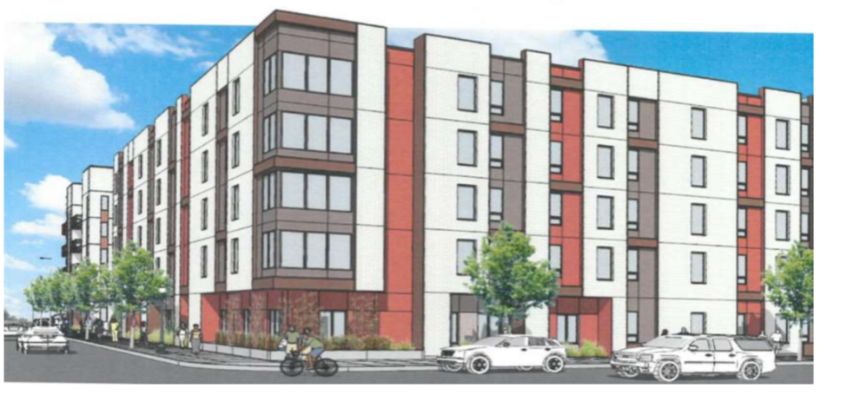
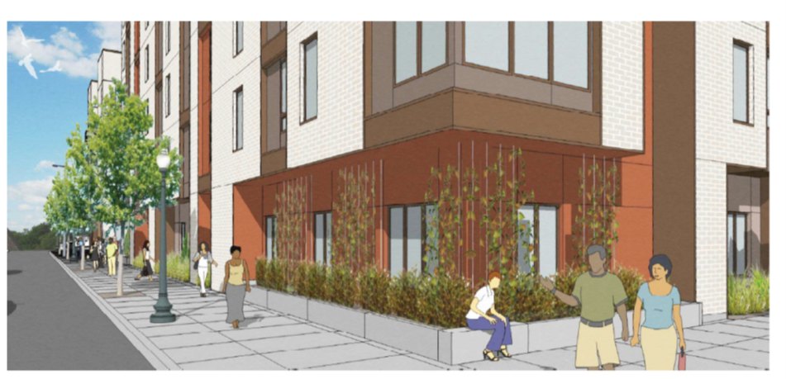
Magnolia 2 Apartments
Portland Housing Bureau
October 17, 2018
Shannon Callahan,
Interim Director

Slide 2
Magnolia 2 Apartments
Combined project along Martin Luther King Jr. Boulevard
Magnolia 1
Built 50 units
Magnolia 2
New 50 unit construction

Slide 3
145 people housed
Unit Mix and Affordability: 50 Total Units
Unit Type | Count | MFI Regulated
1-bed | 1 | 30%
1-bed - PSH | 1 | 30%
1-bed | 5 | 50%
1-bed | 10 | 60%
2-bed | 1 | 30%
2-bed - PSH | 1 | 30%
2-bed | 8 | 50%
2-bed | 13 | 60%
3-bed | 1 | 30%
3-bed - PSH | 1 | 30%
3-bed | 3 | 50%
3-bed | 5 | 60%
Total Units | 50
Unit Size | Count
1-bed | 17
2-bed | 23
3-bed | 10
Total Units | 50
Most 30% AMI units will house tenants referred through Homeless Family System of Care.
*3 units at 30% AMI are PSH, supported by Joint Office of Homeless Services
Unit Affordability | Count
30% AMI | 6
50% AMI | 18
60% AMI | 28
Notes:
Units: 50
1 Bed: 17
2 Bed: 23
3 Bed: 10
Min: 103
Max: 186
Average: 144.5 (145)

