Slide 1

LU 17-113086
Comprehensive Plan Map Amendment
Zoning Map Amendment
Conditional Use Master Plan
Adjustment Review
presentation to CITY COUNCIL
SEPTEMBER 12, 2018

Slide 2
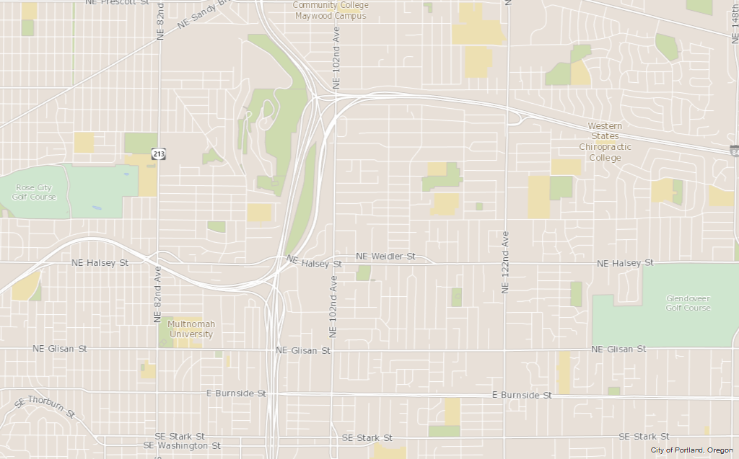

Slide 3
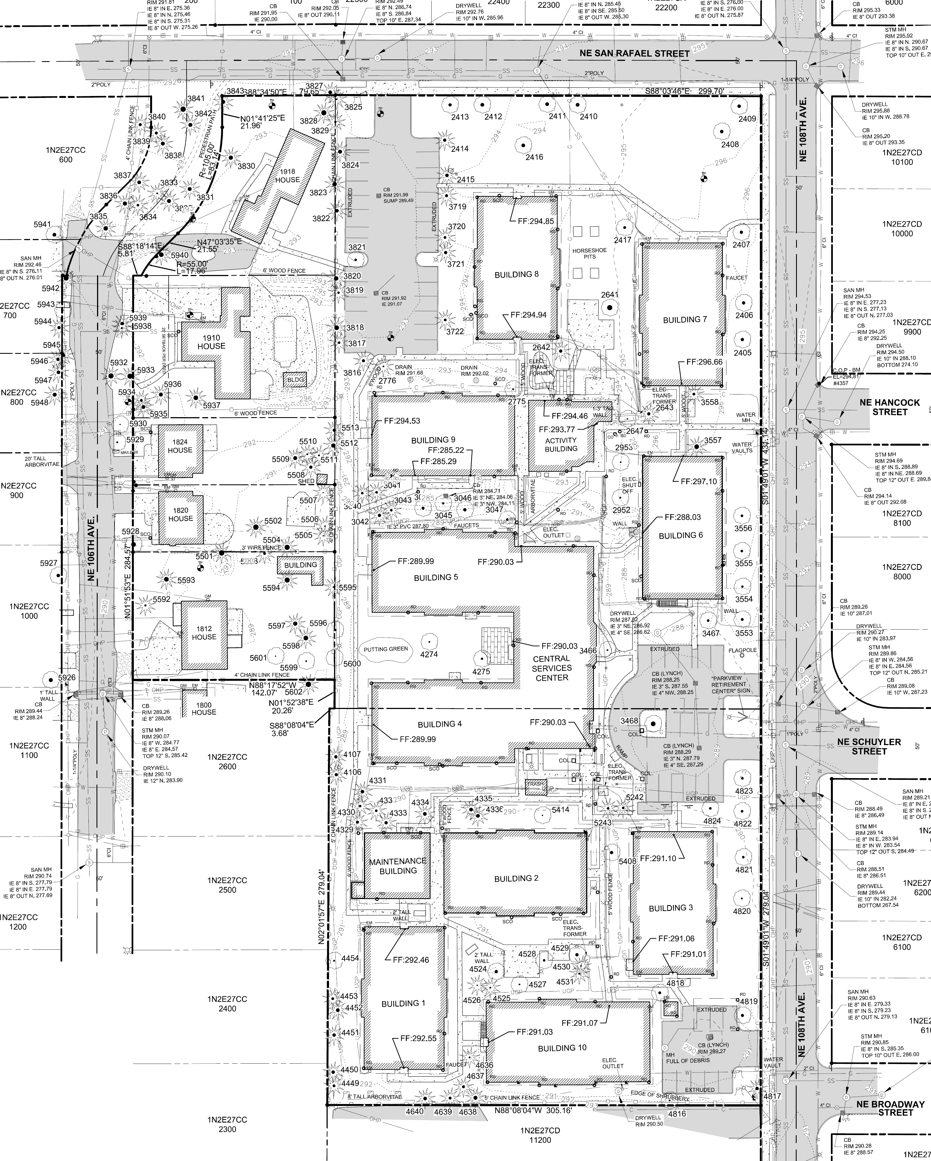

Slide 5
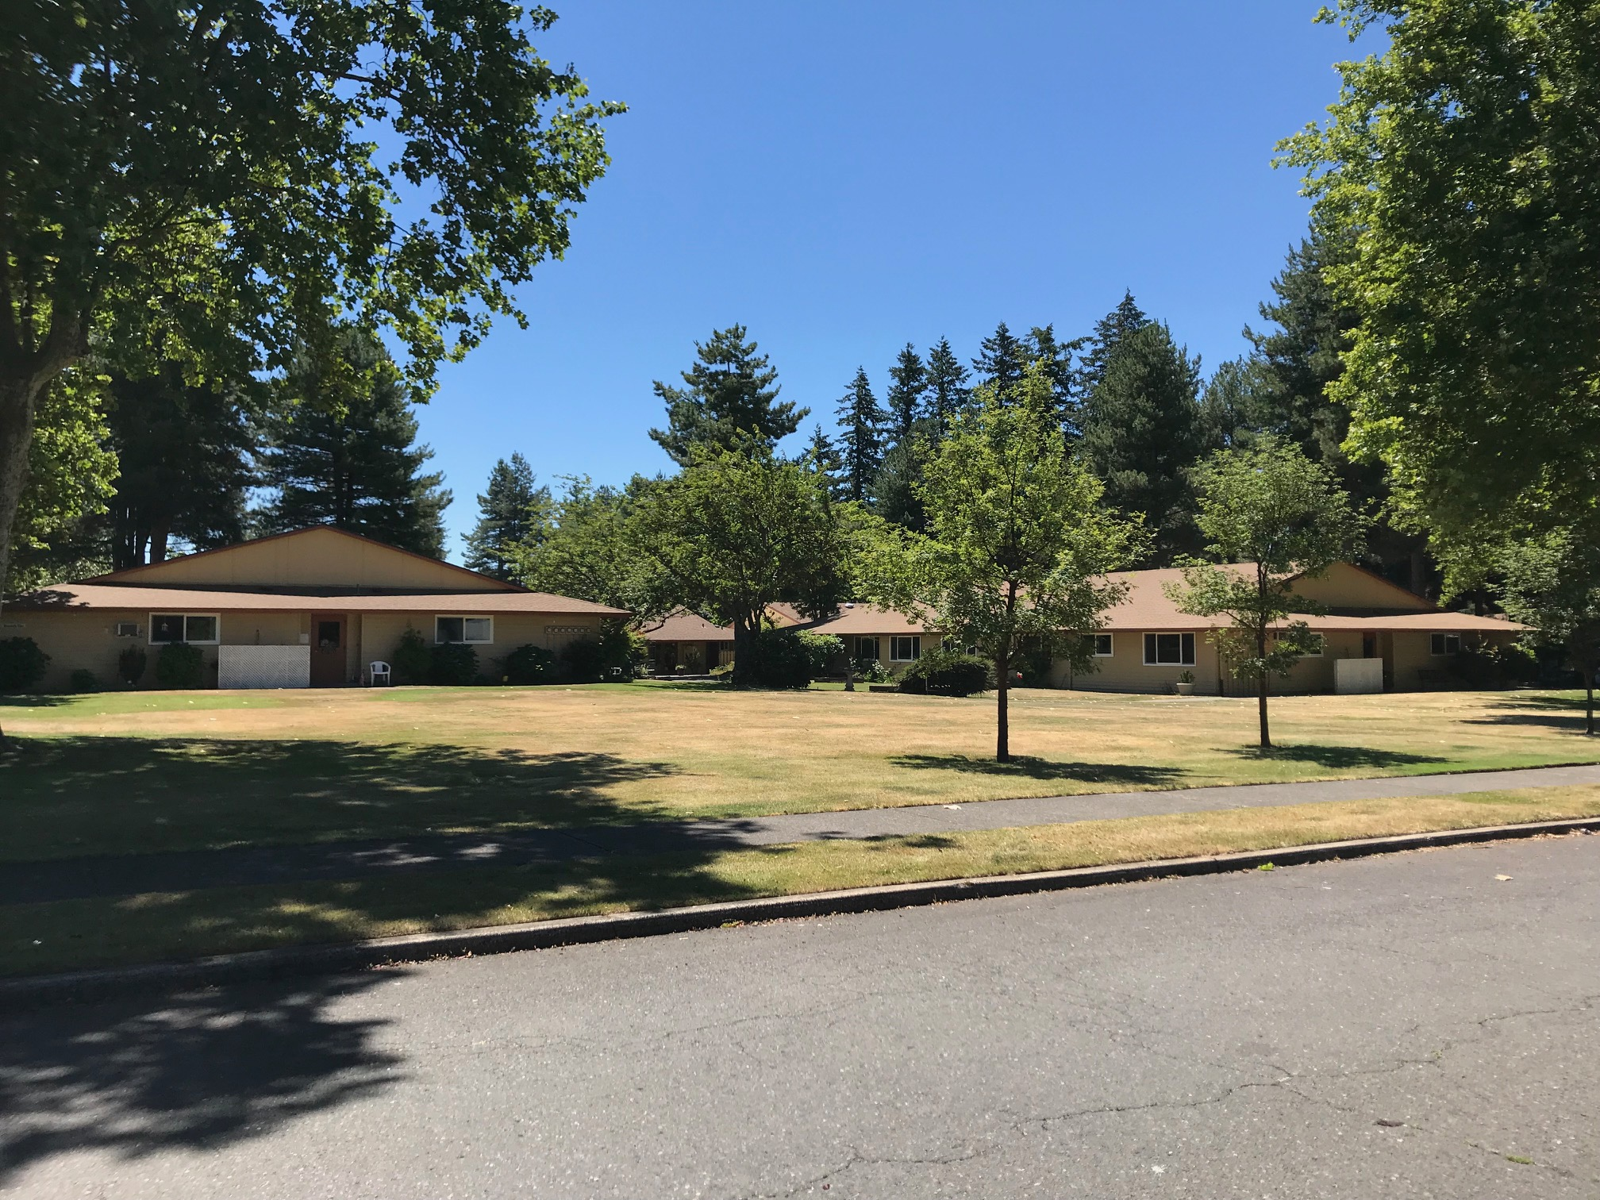
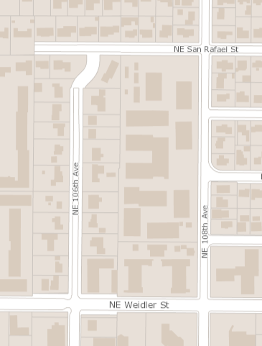

Slide 6
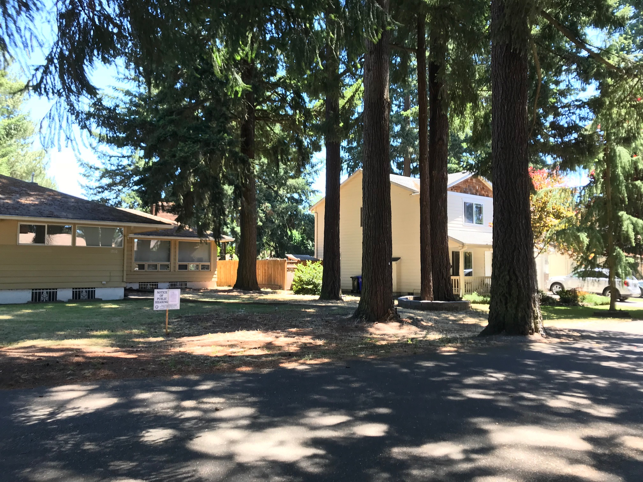

Slide 7
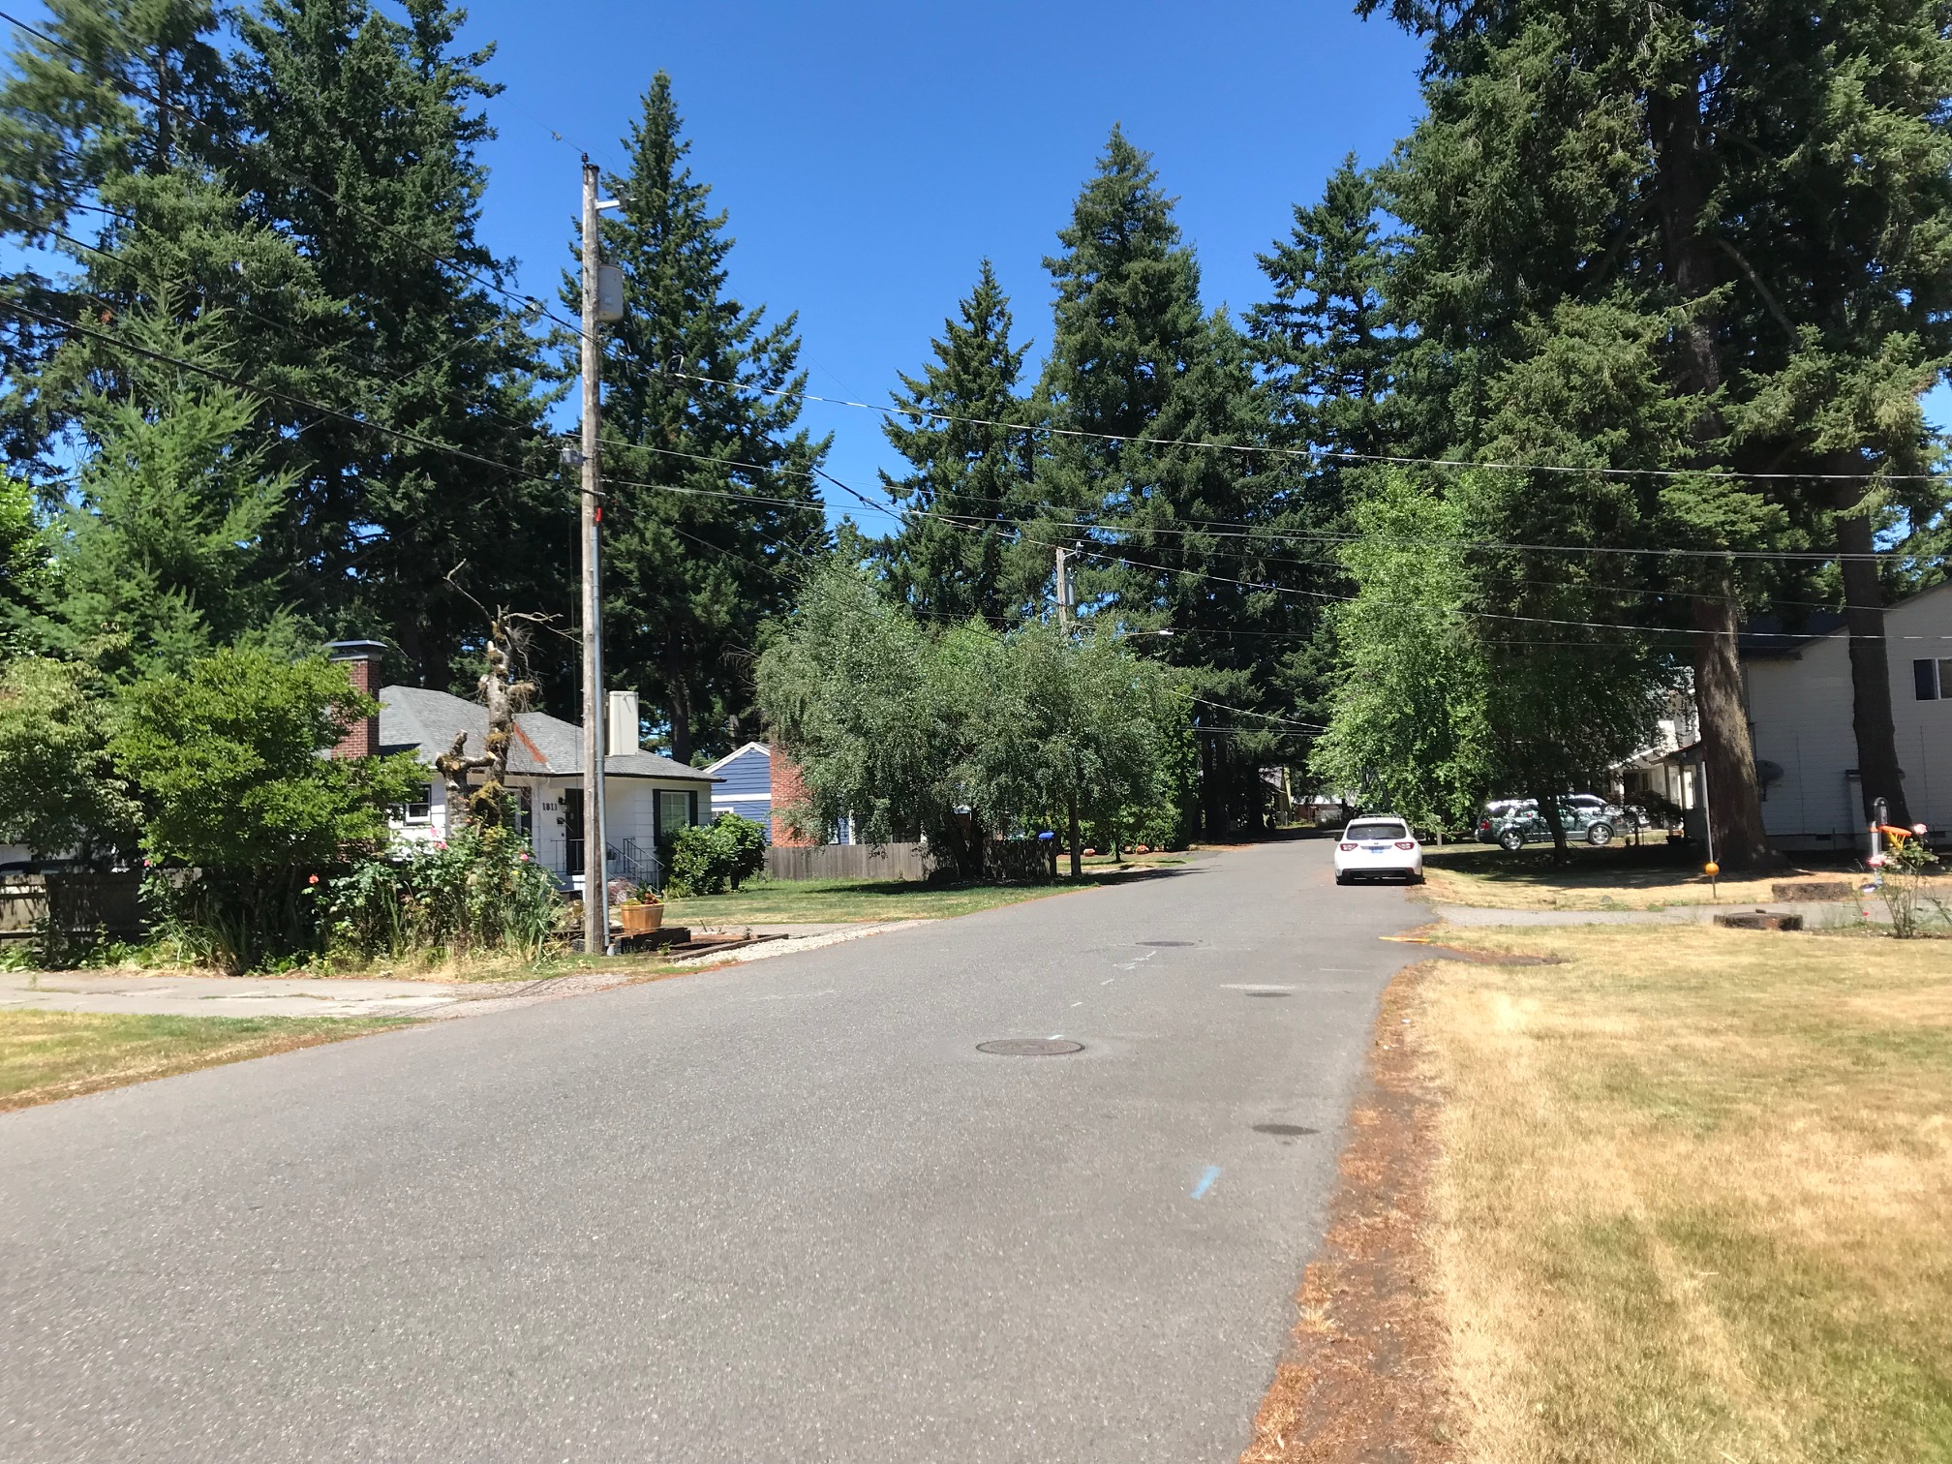

Slide 8
Comprehensive Plan Map Amendment Approval Criteria
33.810.050.A
On balance, the proposed designation is equally or more supportive of the Comprehensive Plan as a whole.
The proposed designation is consistent with statewide planning goals.

Slide 9
Zoning Map Amendment Approval Criteria
33.855.050
Compliance with the Comprehensive Plan Map
Adequacy of public services
Site must be within the City’s boundary of incorporation

Slide 10
Conditional Use Master Plan Approval Criteria
33.820.050
The master plan contains the components required by 33.820.070;
The proposed uses in the master plan comply with the applicable conditional use approval criteria; and
Zoning Code requirements will be met, except where adjustments are being approved as part of the master plan.

Slide 11
Conditional Use Approval Criteria
33.815.105: Institutional and Other Uses in R Zones
Proportion of Household Living uses
Physical compatibility
Livability
Adequacy of public services
Area plans

Slide 12
Proposed memory care building
Proposed independent living apartment building

Slide 13
Conditional Use Approval Criteria
33.815.105: Institutional and Other Uses in R Zones
Proportion of Household Living uses
Physical compatibility
Livability
Adequacy of public services
Area plans

Slide 14
Adjustment requested:
Reduce the minimum number of long-term bike parking spaces from
1.1 spaces per apartment to 1 space for every 8 apartments
Adjustment Review Approval Criteria
33.805.040
The proposal will equally or better meet the purpose of the regulation
The proposal will not significantly detract from the livability or appearance of the area
E. Any impacts resulting from the adjustment are mitigated to the extent practical

Slide 15
LU 17-113086
Hearings Officer recommendation: approval with conditions

