Slide 1
Design Commission Briefing #2
October 18, 2018

Slide 2
AGENDA OVERVIEW
Where We’ve Been and Where We’re Going
Placemaking Vision
Preliminary Development Concept Alternatives
Feedback to Date
Next Steps
Notes:
Jahmese

Slide 3
Where We’ve Been and Where We’re Going

Slide 4
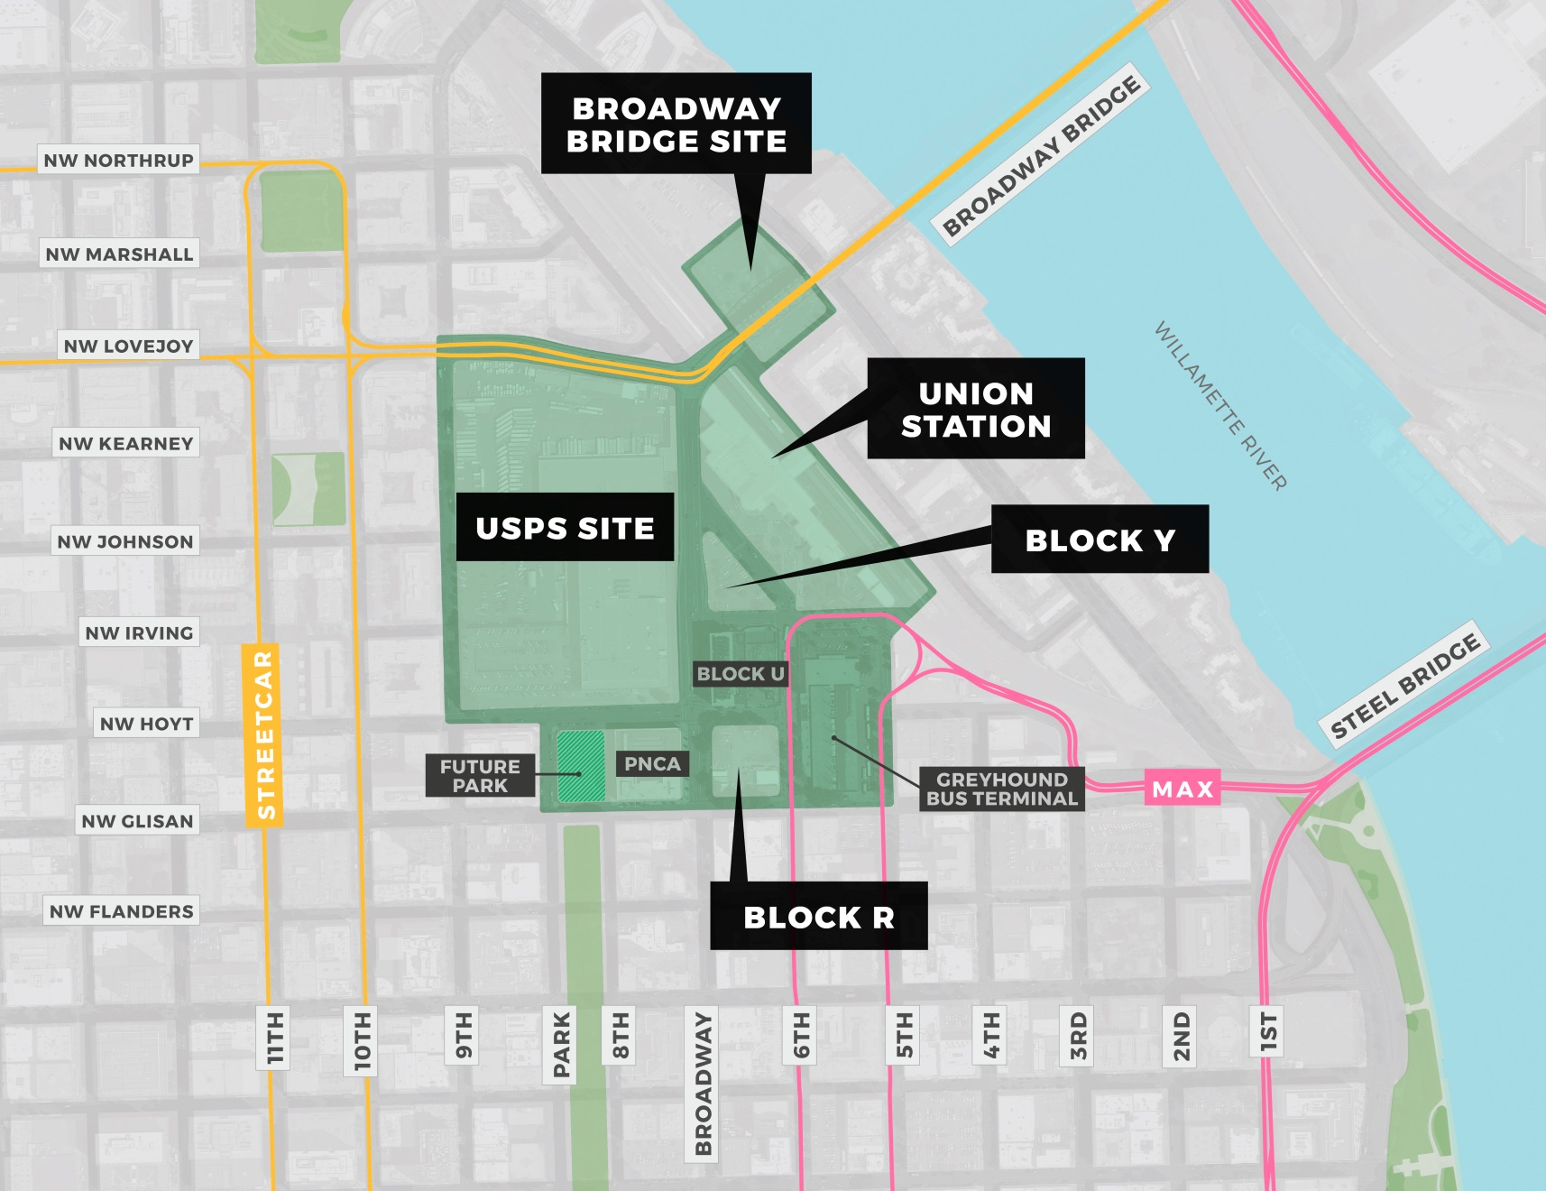
Master Plan Study Area

Slide 5
Where We’ve Been, Where We’re Going
Project Vision
Developer RFQ
and Selection
RFQ Evaluation Criteria
Public Forum
Developer Selection
Guiding Principles
Project Goals
Board Approval
Board Approval for ZGF Scope of Work and Continuum as Developer Advisor
Steering
Committee
Kick-Off
Development
Planning Begins
Vision and Program
Financial Resources
Public Benefits
July 2018
Sept 2018
Site Conditions Overview
Placemaking Activities
Nov 2018
Design Commission Briefing Kick-Off
B2: Preliminary development concepts
C1: Refined development concepts
C2: Evaluate development concepts
Jan 2019
C3: Move forward with a preferred development concept
End of Steering
Committee Work
Equitable
Development
Project
Implementation
& Oversight
Agreement Negotiations &
Land Use Review Process
Approved
Agreements &
Development
Plan
April 2019

Slide 6
EXECUTIVE COMMITTEE
Prosper Portland & Portland Housing Bureau Executive Directors
WHO IS SHAPING THE PROJECT
Public
Open Houses, online and field surveys, etc.
Steering Committee
Developer
(Continuum)
Consultant Team
City Bureaus
BPS
PBOT
BDS
BES
Parks
PGE
NW Natural
TriMet
Streetcar
RACC
Regional
Solutions
INPUTS
INPUTS
Vision, Technical, Policy
PLANNING & SUSTAINABILITY COMMISSION
DECISIONMAKERS
PORTLAND HOUSING ADVISORY COMMISSION
PROSPER PORTLAND BOARD
DESIGN COMMISSION
CITY COUNCIL

Slide 7
Placemaking Vision

Slide 8
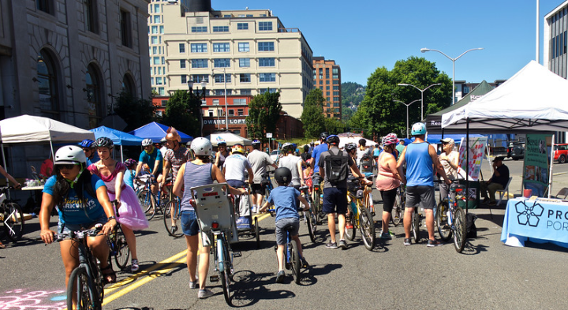
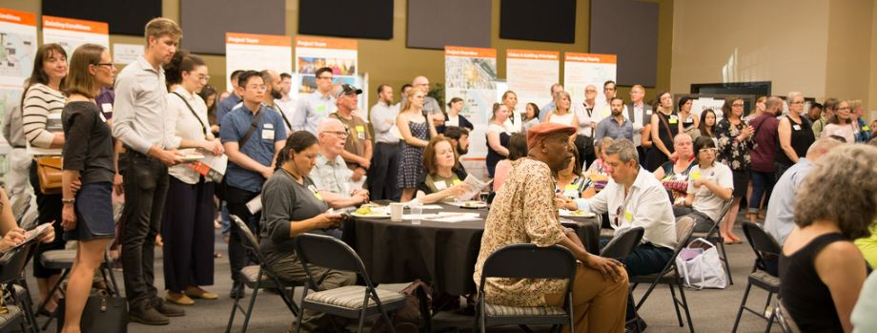
WHO WE’VE HEARD FROM
Steering Committee June 26, July 24, Sept 25
Stakeholders June 25 - July 13
Sunday Parkways July 22
Public Partners Technical Team July 23, Aug 14, Sept, 11, Oct 9
Public Open House June 25, Sept 26
Design Commission July 24, Oct 18
Jose Gonzalez, Milagro Theatre
Ian Williams , Business owner in Old Town
Brett Horner & Tate White, Portland Parks and Recreation
Rick Turoczy, Portland Incubator Experiment
George Devendorf, Transition Projects
Gerik Kransky, Street Trust
Mauricio Leclerc & Zef Wagner, PBOT
Candace Kita,. APANO
Elaine Friesen-Strang, AARP
Vivian Satterfield, OPAL Environmental
Michael Szporluk, Consultant advocating for people with disabilities
Shea Flaherty, Hacienda CDC, Mercado

Slide 9
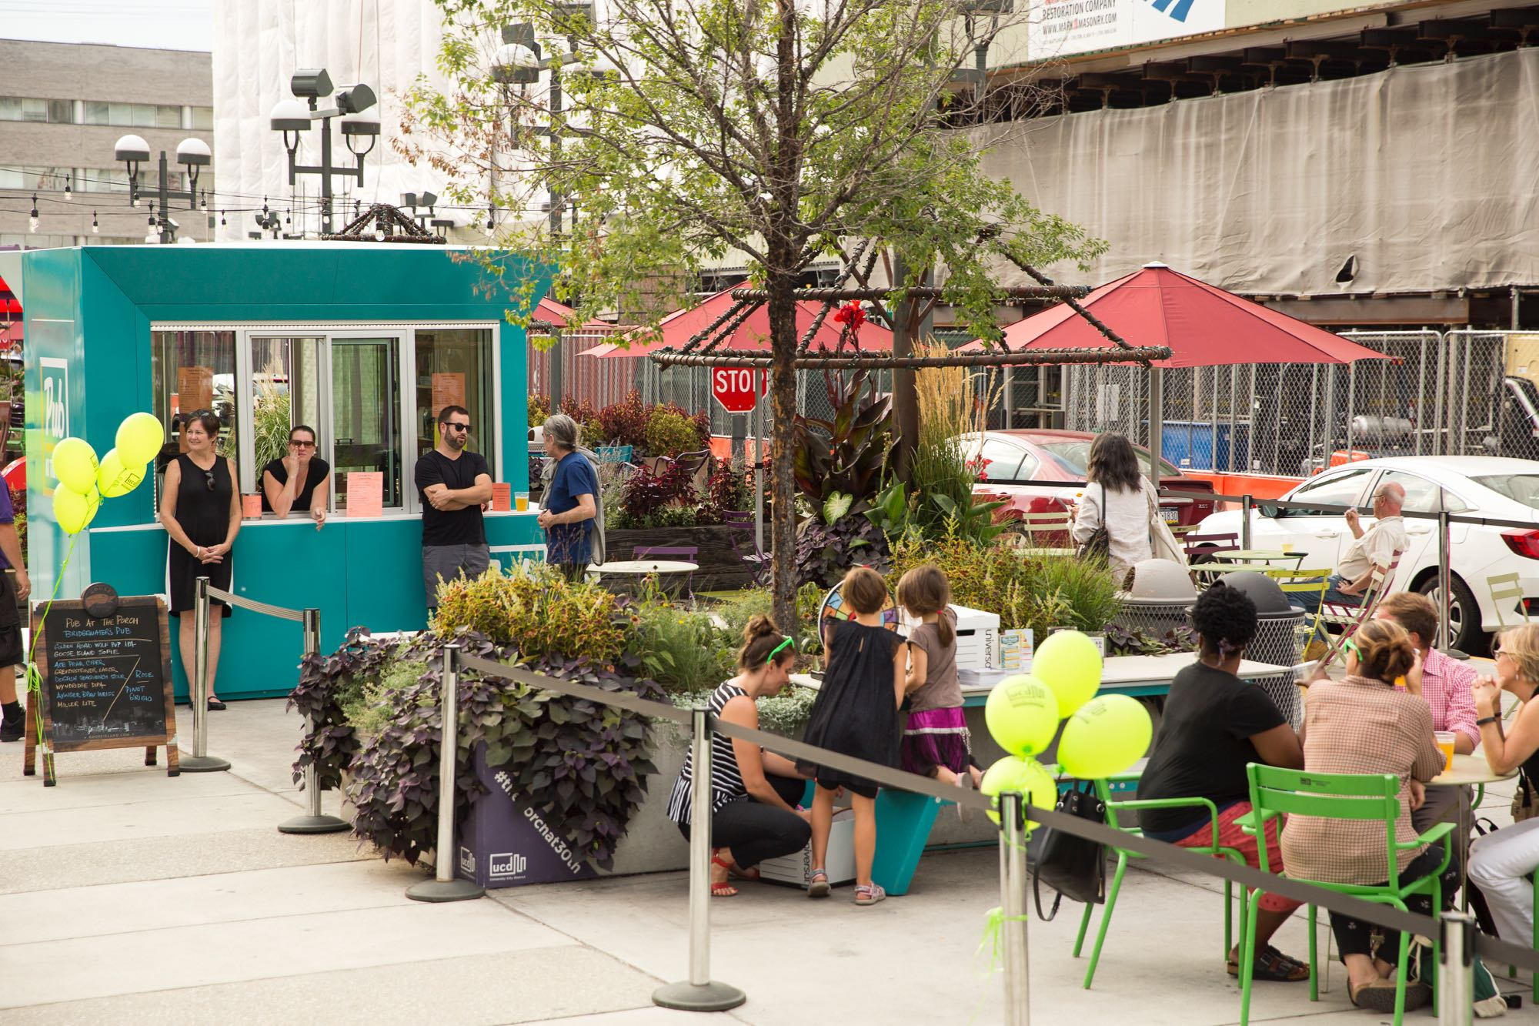
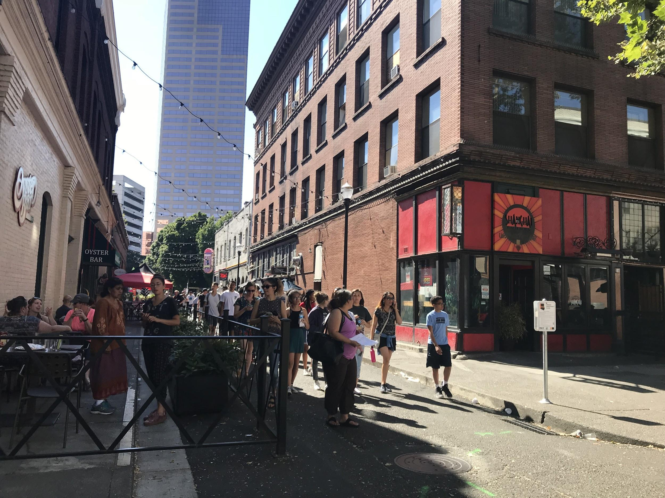
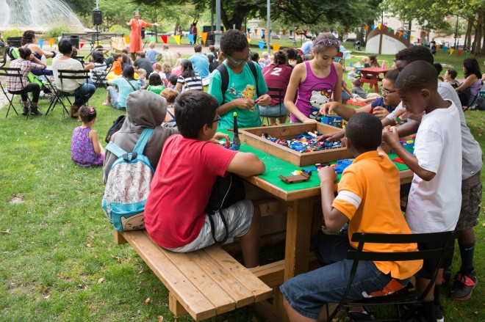
ACCOUNTABLE
Establish a mission-driven district management organization.
Embrace flexibility and experimentation.
CONNECTED
Contribute to the Green Loop through a series of connected public destinations.
Treat streets and paths as places for people to linger and gather.
Break up the standard Portland grid to create a distinctive space.
EQUITABLE
Create new civic space with citywide and multi-cultural appeal.
Foster a retail mix and public realm that reflects the range of incomes, household types, and other needs of new residents.
Balance the needs of people experiencing homelessness & other users.
Pursue alternative security strategies, working with vulnerable communities.
HIGH LEVEL FEEDBACK
Notes:
NOLAN

Slide 10
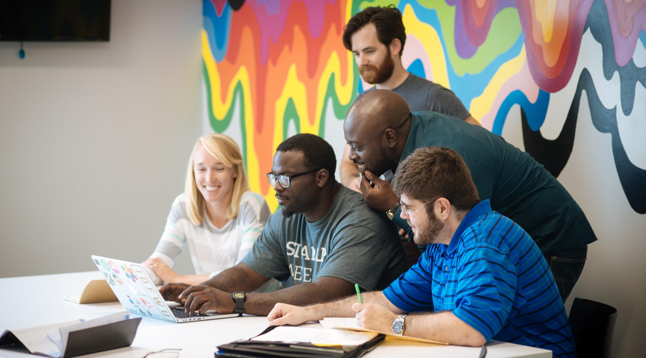
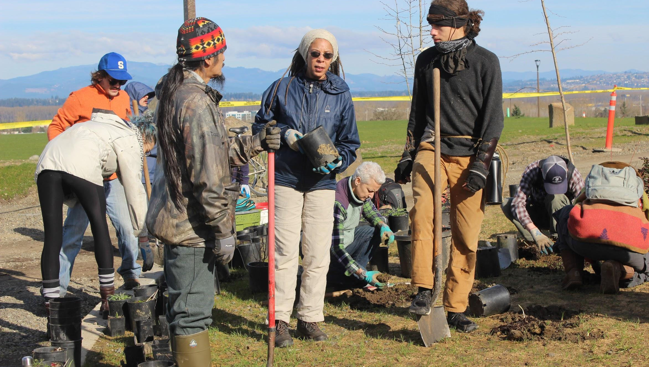
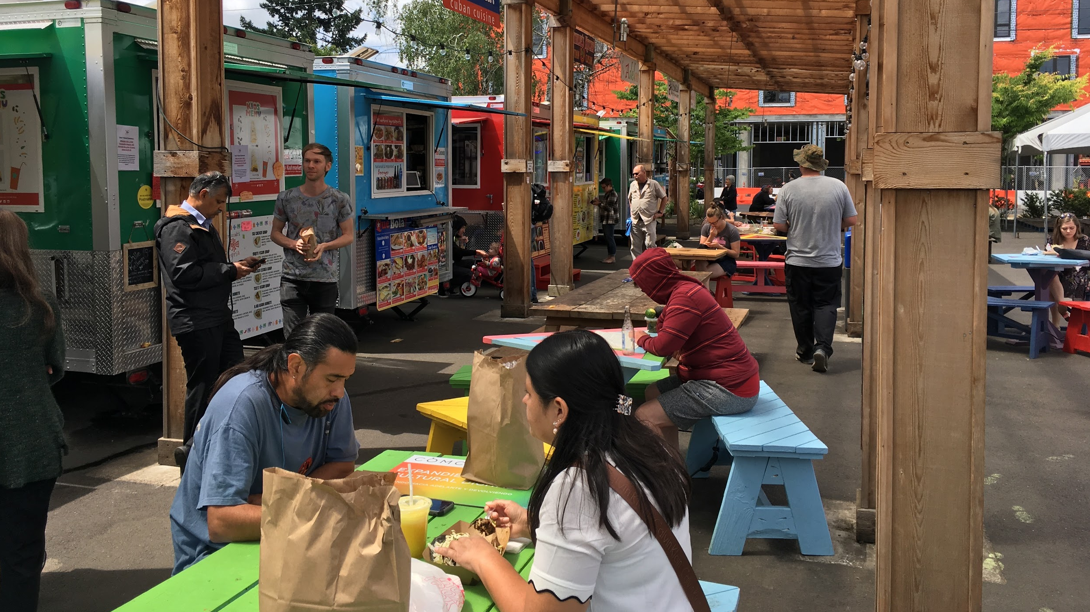
PROSPEROUS
Integrate space and support for entrepreneurs, small businesses, and workforce development into the public realm.
Leverage procurement processes and operations to support local minority- and women-owned businesses.
Create opportunities for job-training and employment for the houseless.
RESILIENT
Build social resilience through community-based programs.
Implement “green” infrastructure that invites interaction and directly benefits human wellbeing.
Showcase a sustainable approach to energy and waste through materials and methods.
VIBRANT
Create a true variety of gathering places.
Co-curate programming with an emphasis on culture and commerce.
Embed the arts into the everyday functions of places.
Cultivate a well-used public realm all day, week and year.
HIGH LEVEL FEEDBACK
Notes:
NOLAN

Slide 11
DESIGN COMMISSION INPUT
Legacy: place-making opportunity to create something distinctly different
Context: hub tying together Old Town Chinatown, Pearl and Waterfront
Connectivity: tangible vision for destination and connectivity of community to broader fabric
Equity: describe reasons for the broader community to engage in this specific place and how this translates to community equity
Notes:
NOLAN

Slide 12
Preliminary Concepts

Slide 13
DEVELOPMENT PLANNING
Phase B1: Vision & Programming
Phase B2: Preliminary Concepts
Process Overview
Phase C1: Concept Refinement
Phase C2: Select One Concept
Phase C3: Advance Concept
All Phases: Community Benefit Priorities
Phase D1: Draft Plan
Phase D2: Final Plan

Slide 14
DEVELOP CONCEPT ALTERNATIVES
Develop up to 3 Concept Alternatives with comparable densities for Urban Design & Development:
Street plan
Block Configuration
Location, scale & purpose of open spaces
Height, Massing & Orientation
Floor Area Quantity & Distribution
Land Uses, with emphasis on Affordable Housing
Parking

Slide 15
REFINED CONCEPT ALTERNATIVES
Land use mix
Building height, massing and orientation
Open space programming and configuration, including Green Loop
Multimodal access and circulation
Connectivity
Parking strategies, including electric vehicles and autonomous vehicles
Define service, loading and access zones
Green infrastructure and low-carbon and/or district energy concepts
Financial feasibility analysis
Phasing impact review (as appropriate)
High-level technical systems cost analysis (BES/PGE/Infrastructure)
Design guidelines assessment
Community benefit priorities application

Slide 16
2015 FRAMEWORK PLAN
Land Use
4,000 jobs
2,400 households including ~ 700 affordable units
Streets, Parks & Open Space
Entitlements
Increase to 7:1 FAR; 250’ / 400’ Height
Investment
Land value is directly impacted by:
scale of private market rate development
assumptions regarding public infrastructure/improvements
Land value plus housing funds are the largest resources to support public benefits

Slide 17
DEVELOPMENT PLANNING
Preliminary Concept Alternatives
WHAT IS CONSISTENT
Commercial & Housing Affordability
Place Management
Accessibility
Existing Anchors
WHAT IS DIFFERENT
Parcel Layout
Road Network
Types of Open Space
Union Station as Place
Arts and Culture Elements
The Green Loop
Concept:
Play
Program
Physical
Concept: Nature
Program
Physical
Concept: Discovery
Program
Physical
VISION

Slide 18
OPEN HOUSE IN JULY
Notes:
NOLAN

Slide 19
GUIDELINES TO THEMES
18 Development Themes

Slide 20
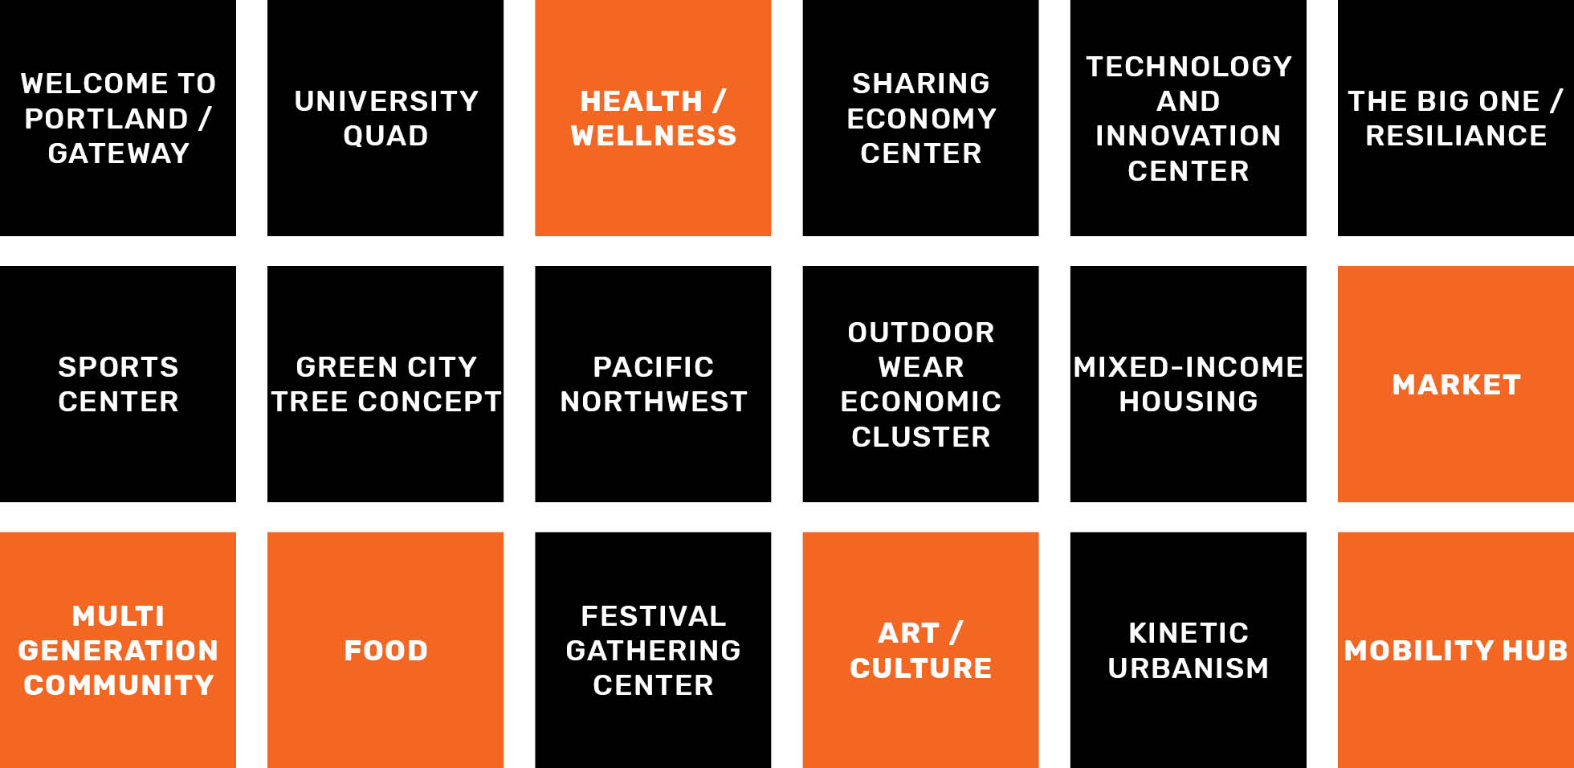
GUILDLINES TO THEMES
18 Development Themes

Slide 21
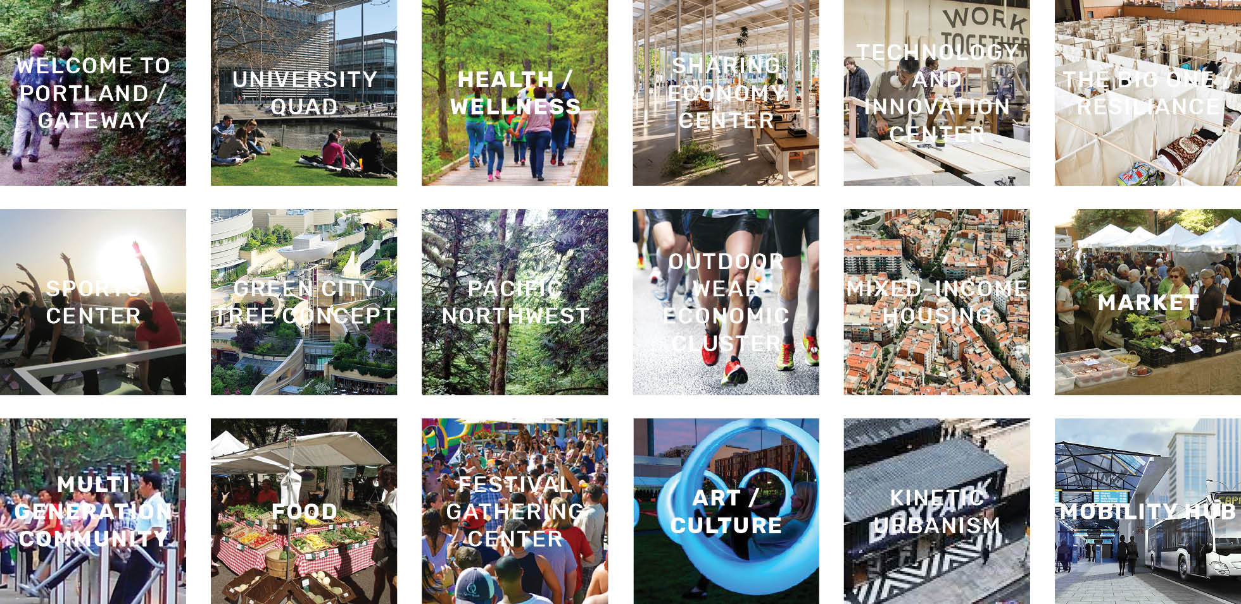
THEMES TO CONCEPTS
6
Gateway to Oregon
Game Changer
Green City
Old Town New City
The Neighborhood
Heart

Slide 22
THEMES TO CONCEPTS
6 to 4
Gateway to Oregon
Local Services + Residential
Game Changer
Green City
Employment + Innovation
Old Town New City
Health + Wellness + Nature
The Neighborhood
Festival + Gathering + Resiliency
Heart

Slide 23
THEMES TO CONCEPTS
6 to 4 to 3
Local Services + Residential
NATURE
Employment + Innovation
DISCOVERY
Health + Wellness + Nature
Festival + Gathering + Resiliency
PLAY

Slide 24
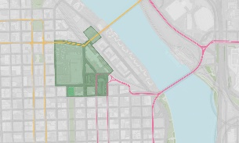
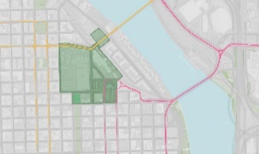
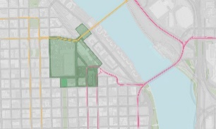
NEIGHBORHOOD & CONTEXT
View Corridors
NW Johnson at Jamison Park
Mid-way of Broadway Bridge
Old Thunderbird Motel Site
Mid-way of Steel Bridge

Slide 25
VARIATIONS TESTED
PARCEL DIVISION
PLAY
NATURE
DISCOVERY

Slide 26
VARIATIONS TESTED
GREEN LOOP
PLAY
NATURE
DISCOVERY

Slide 27
VARIATIONS TESTED
STREET NETWORK
PLAY
NATURE
DISCOVERY

Slide 28
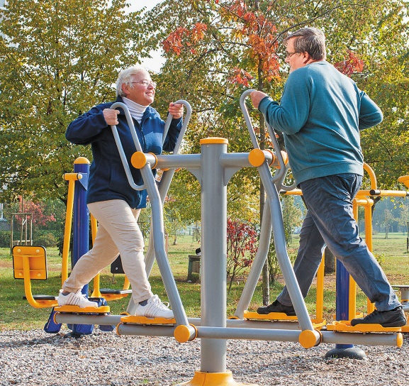
PLAY
Key Themes
RESILIENT COMMUNITY
Art Plaza
Woonerf (Living Streets)
HEALTH & WELLNESS
Small Business Incubator
Adaptive Reuse
ACTIVE RECREATION

Slide 29
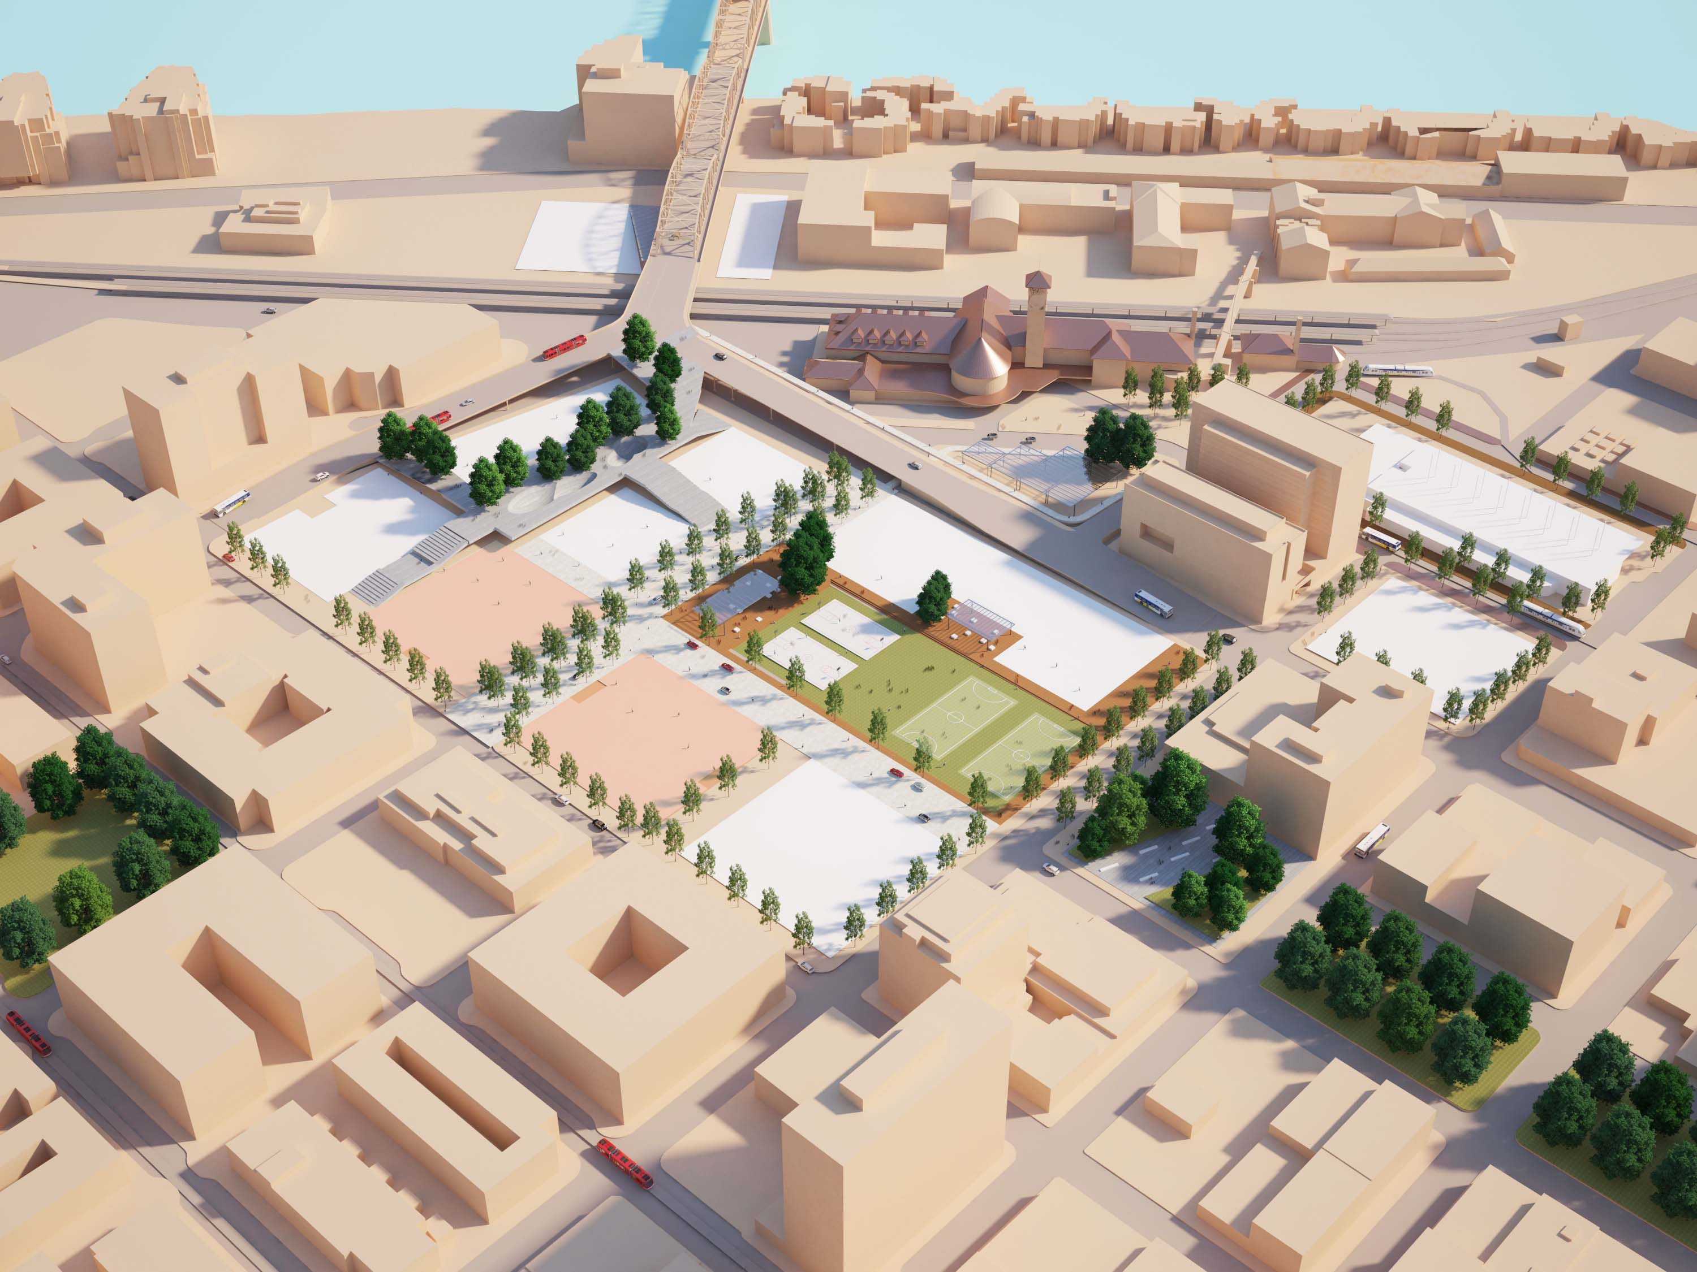
PLAY
Axon View
BROADWAY BRIDGE
NW LOVEJOY
NW BROADWAY
TRANSIT MALL
PNCA
NW JOHNSON
NW PARK
NW HOYT
NW 9TH
Notes:
NOLAN

Slide 30
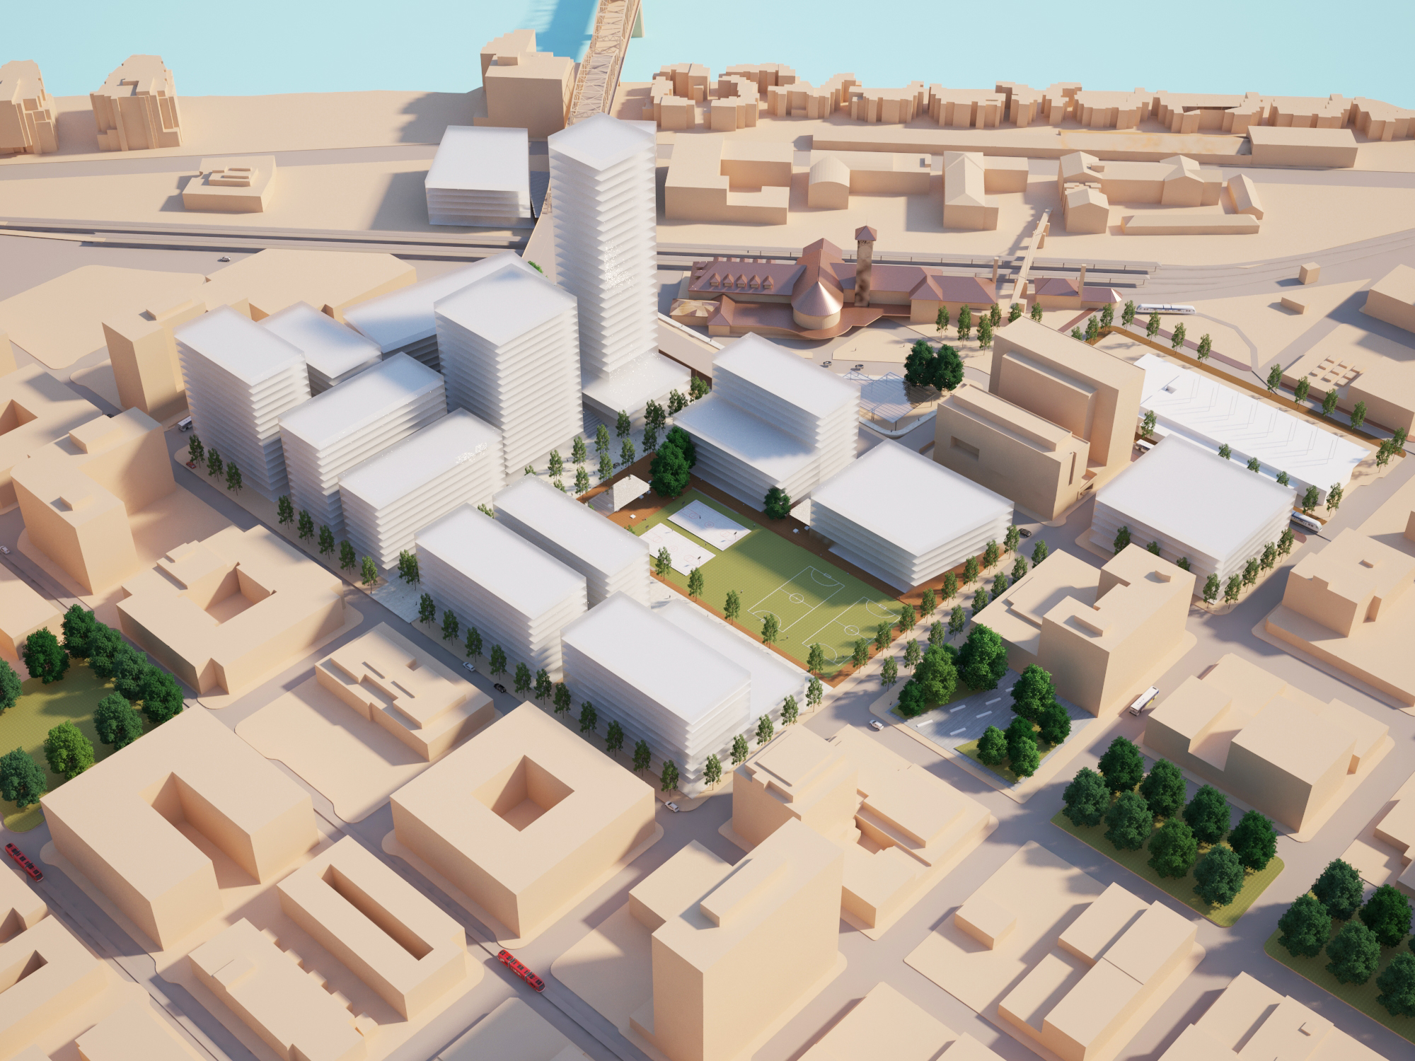
PLAY
Building Massing
PNCA
NW JOHNSON
NW PARK
NW HOYT
NW 9TH
Notes:
NOLAN

Slide 31
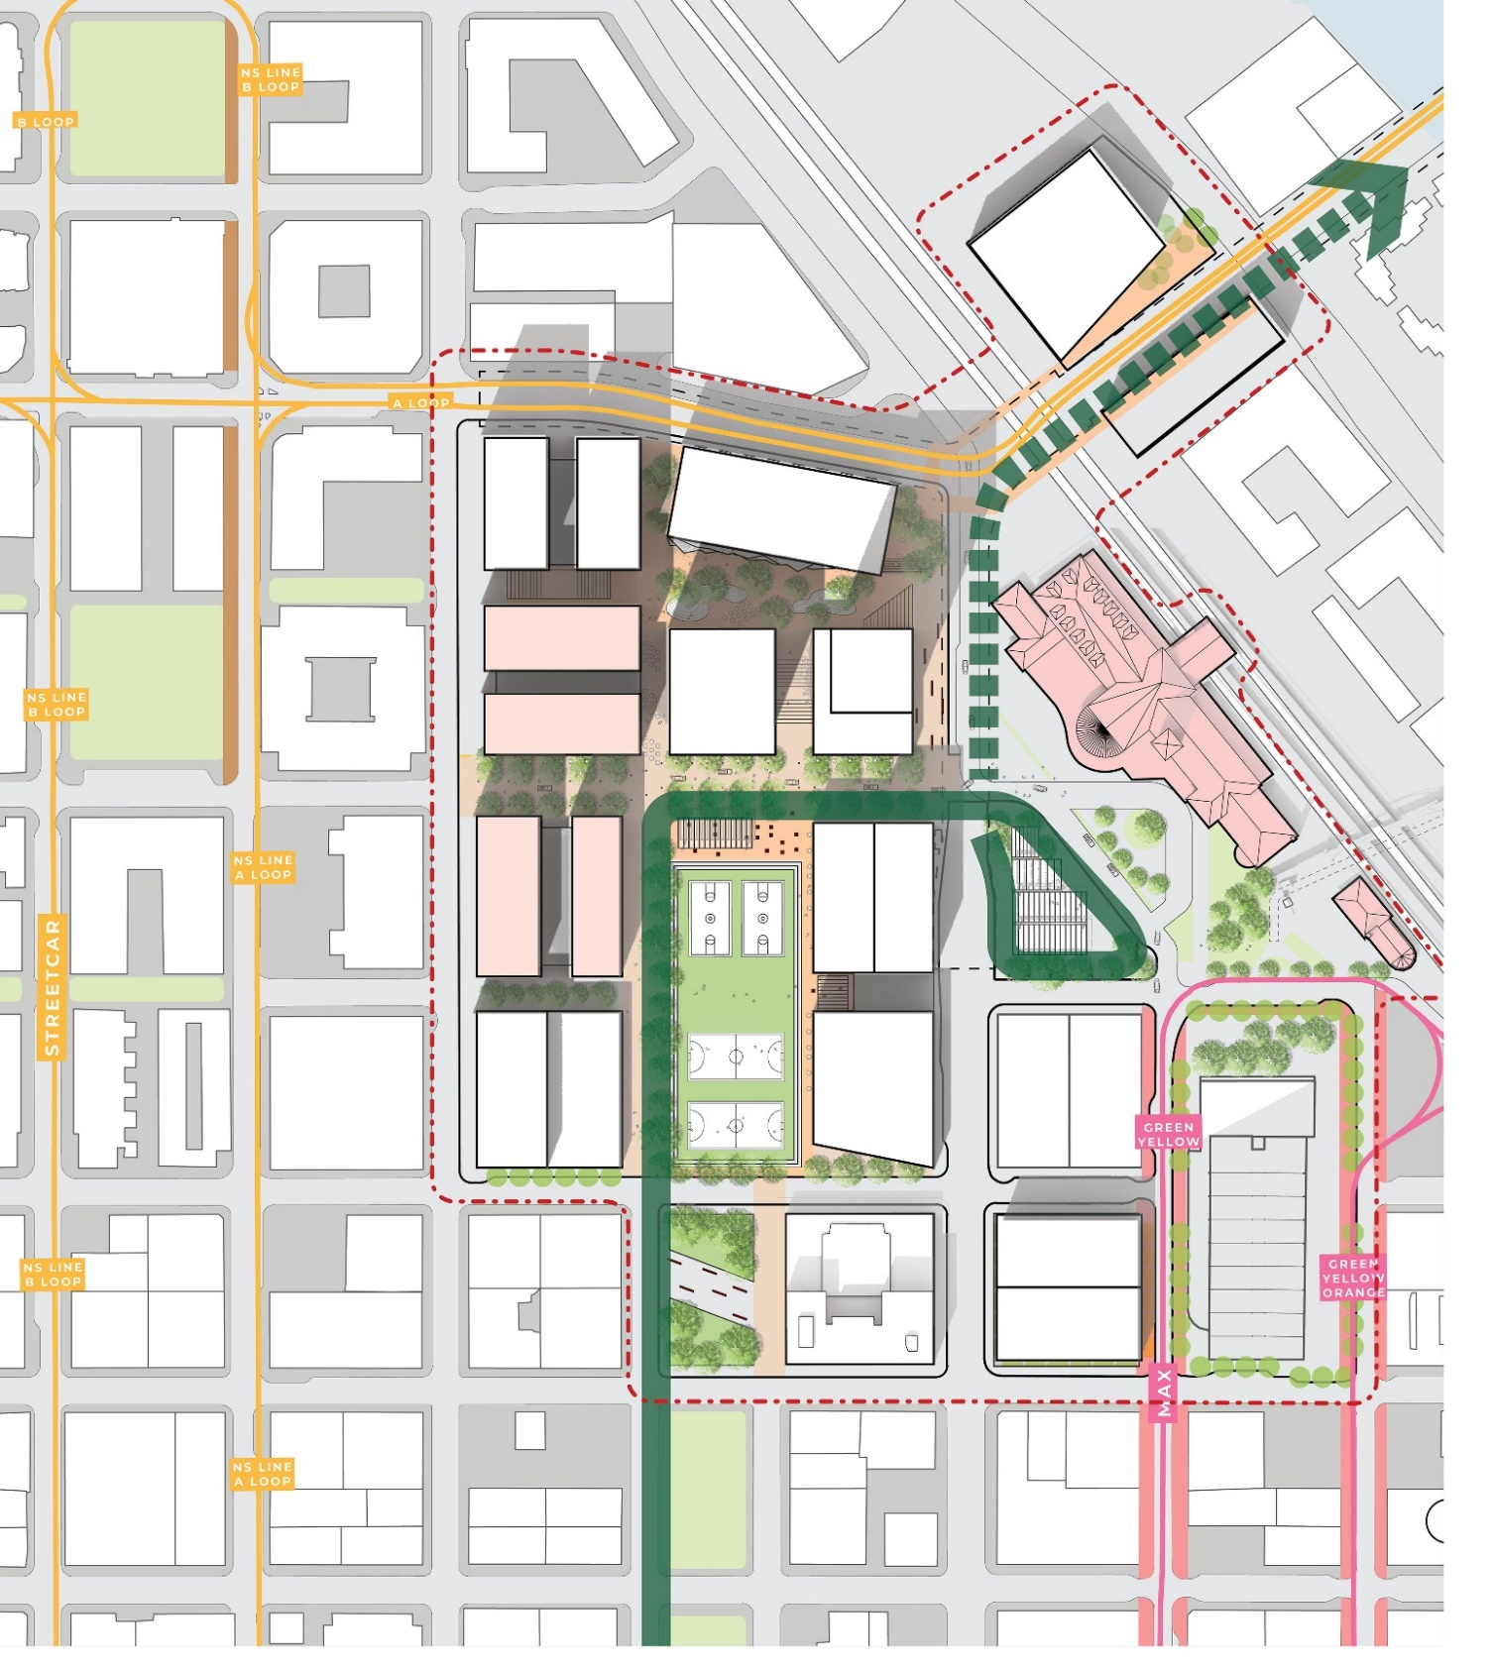
PLAY
NW MARSHALL
Plan View
NW LOVEJOY
NW KEARNEY
NW JOHNSON
NW IRVING
BCC
MULT. CO.
NW HOYT
PNCA
NW GLISAN
NW 9TH
NW 8TH
NW BROADWAY
NW FLANDERS
Notes:
NOLAN

Slide 32
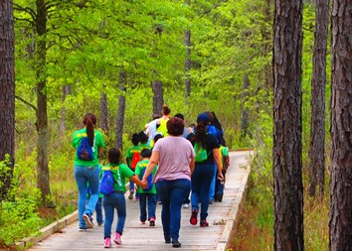
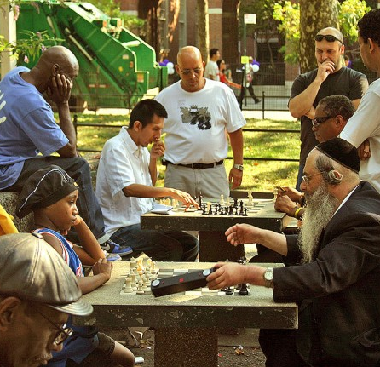
NATURE
Key themes
GREEN HEART
Green Jobs
Iconic Architecture
SHIFT THE GRID
Community Gardens
Connect to the River
GATHERING SPACES

Slide 33
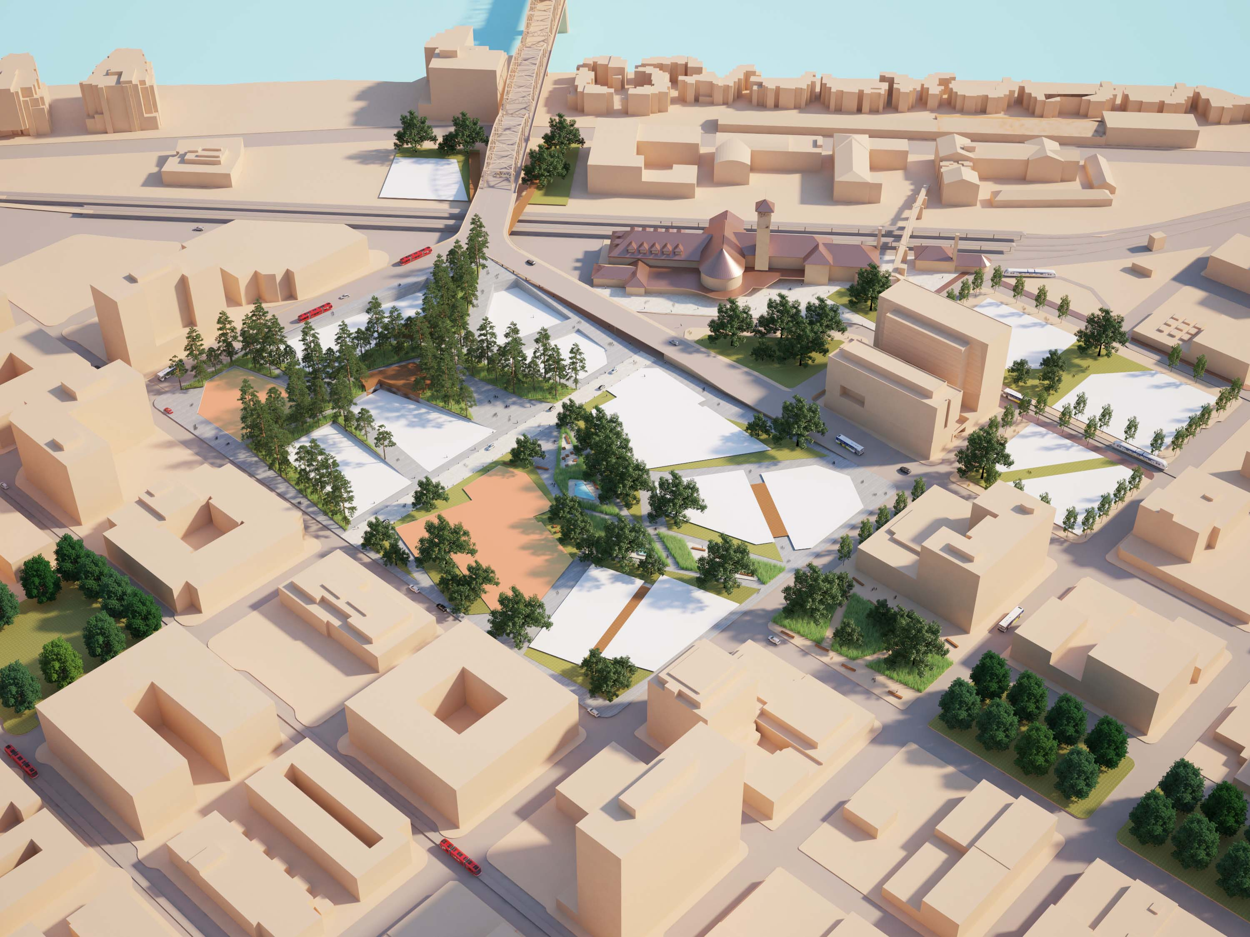
NATURE
Axon View
BROADWAY BRIDGE
NW LOVEJOY
NW BROADWAY
TRANSIT MALL
PNCA
NW JOHNSON
NW PARK
NW HOYT
NW 9TH
Notes:
NOLAN

Slide 34
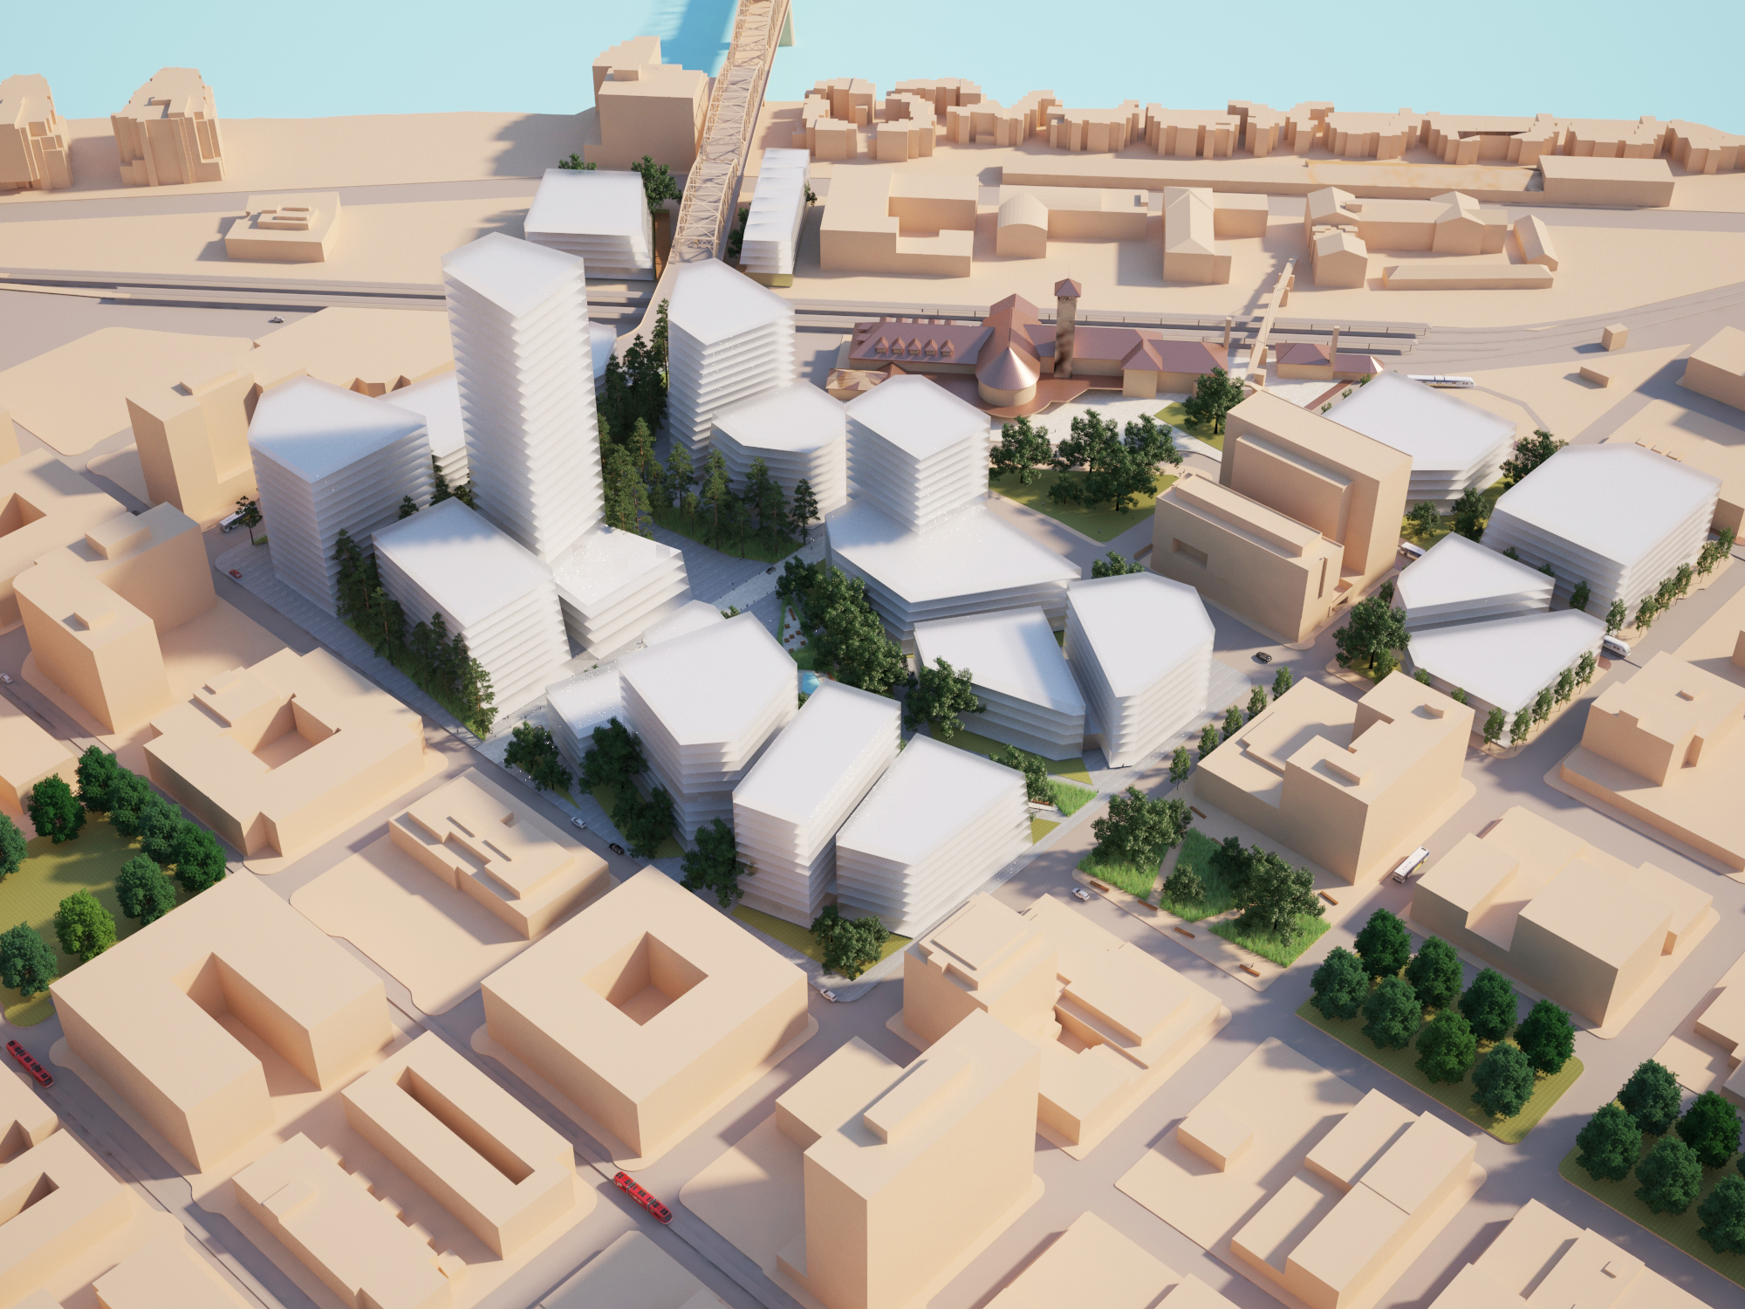
NATURE
Building Massing
PNCA
NW JOHNSON
NW PARK
NW HOYT
NW 9TH
Notes:
NOLAN

Slide 35
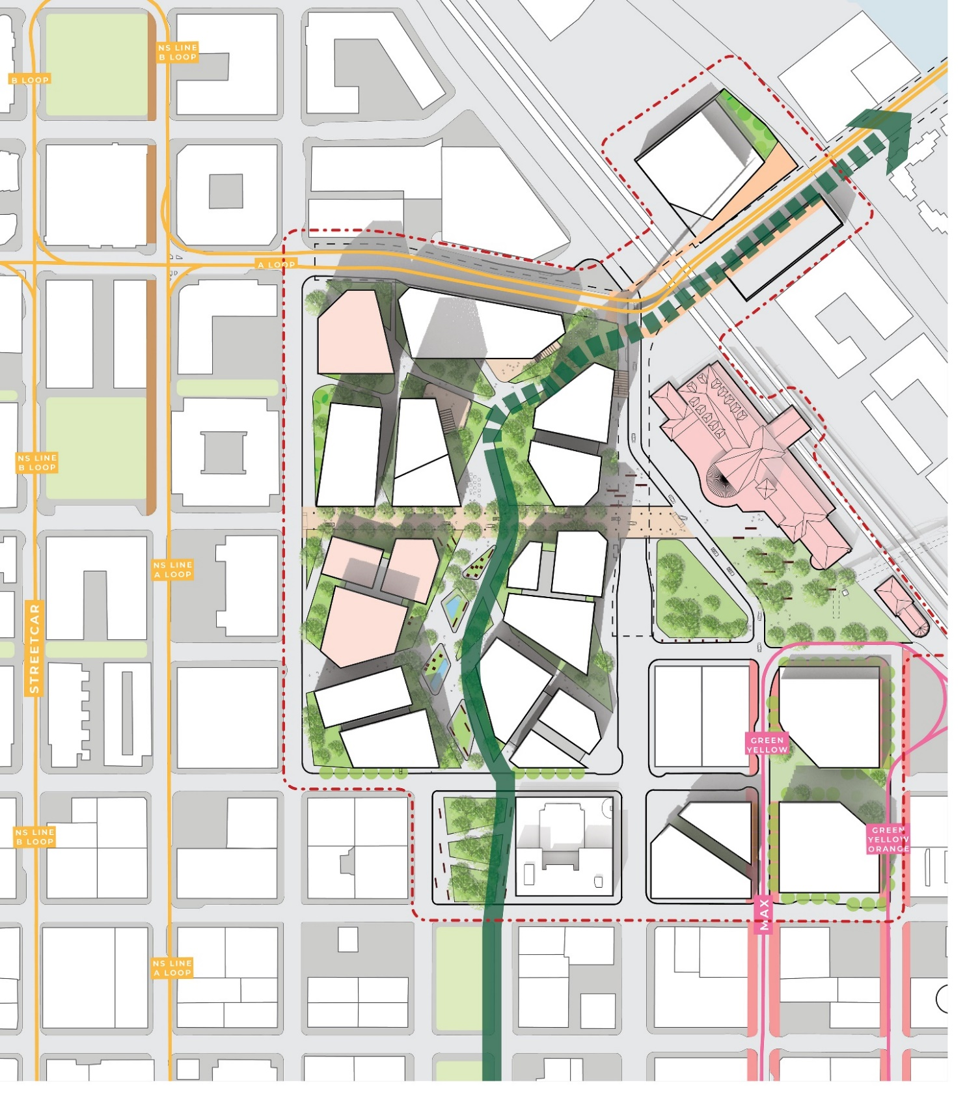
NATURE
NW MARSHALL
Plan View
NW LOVEJOY
NW KEARNEY
NW JOHNSON
NW IRVING
BCC
MULT. CO.
NW HOYT
PNCA
NW GLISAN
NW 9TH
NW PARK
NW 8TH
NW BROADWAY
NW FLANDERS
Notes:
NOLAN

Slide 36
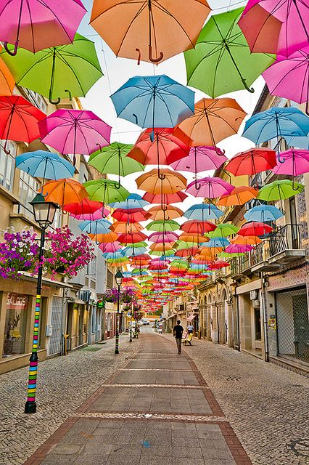
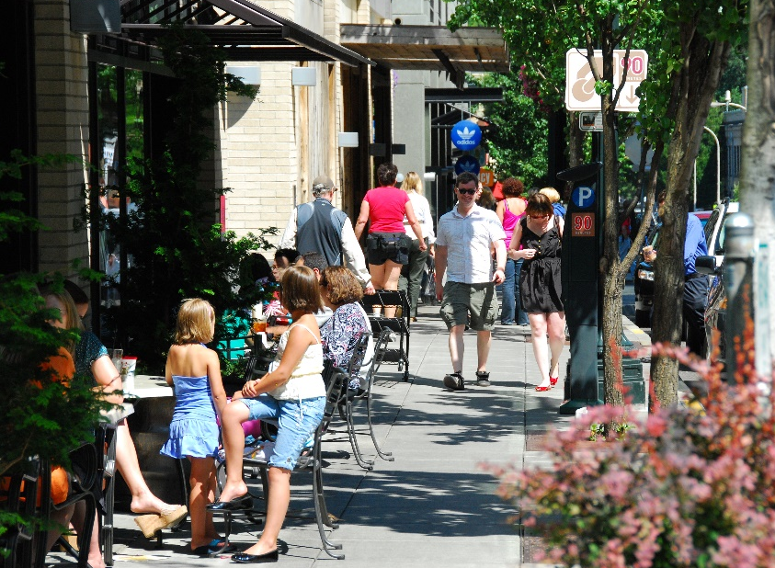
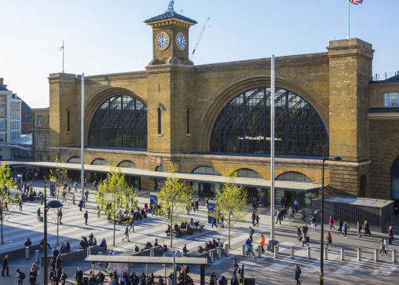
DISCOVERY
Key themes
INCREMENTAL DEVELOPMENT
Link Old Town/
Chinatown to Pearl
Independent Retail
Community Market
UNION STATION/ PUBLIC SQUARE
Pocket Parks
CULTURE ALLEYS

Slide 37
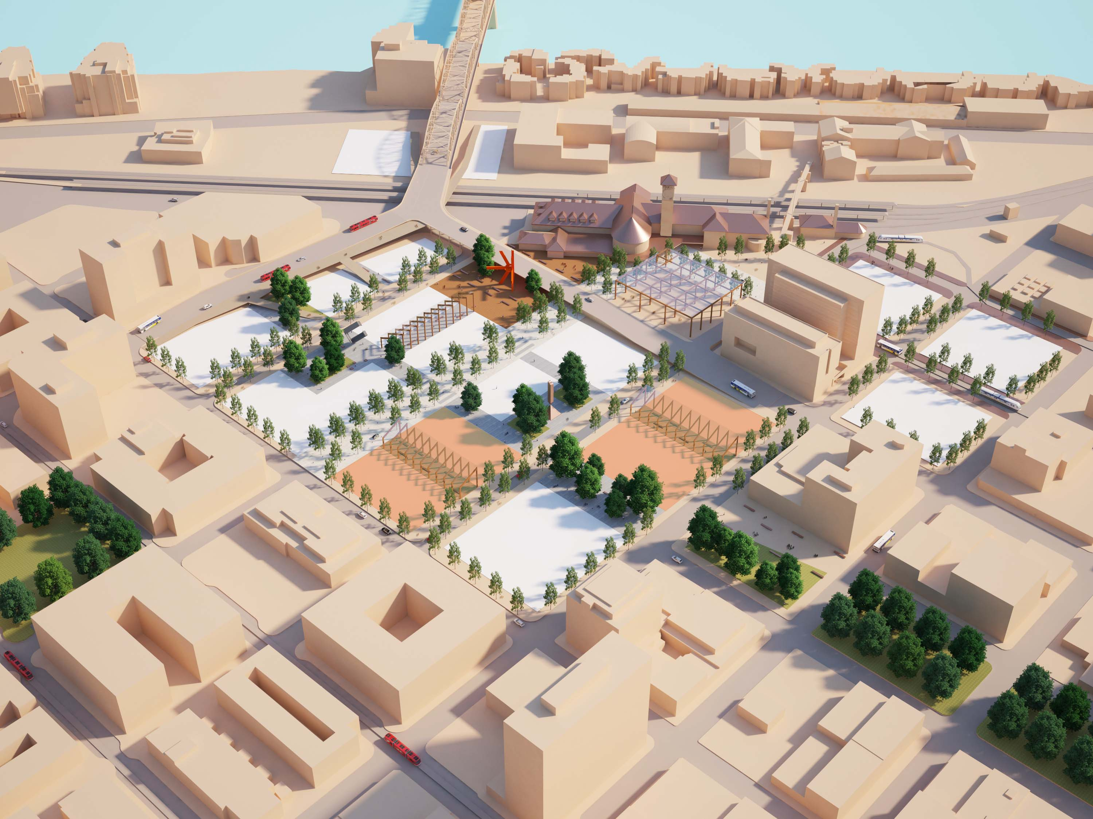
DISCOVERY
Axon View
BROADWAY BRIDGE
NW LOVEJOY
NW BROADWAY
TRANSIT MALL
PNCA
NW JOHNSON
NW PARK
NW HOYT
NW 9TH
Notes:
NOLAN

Slide 38
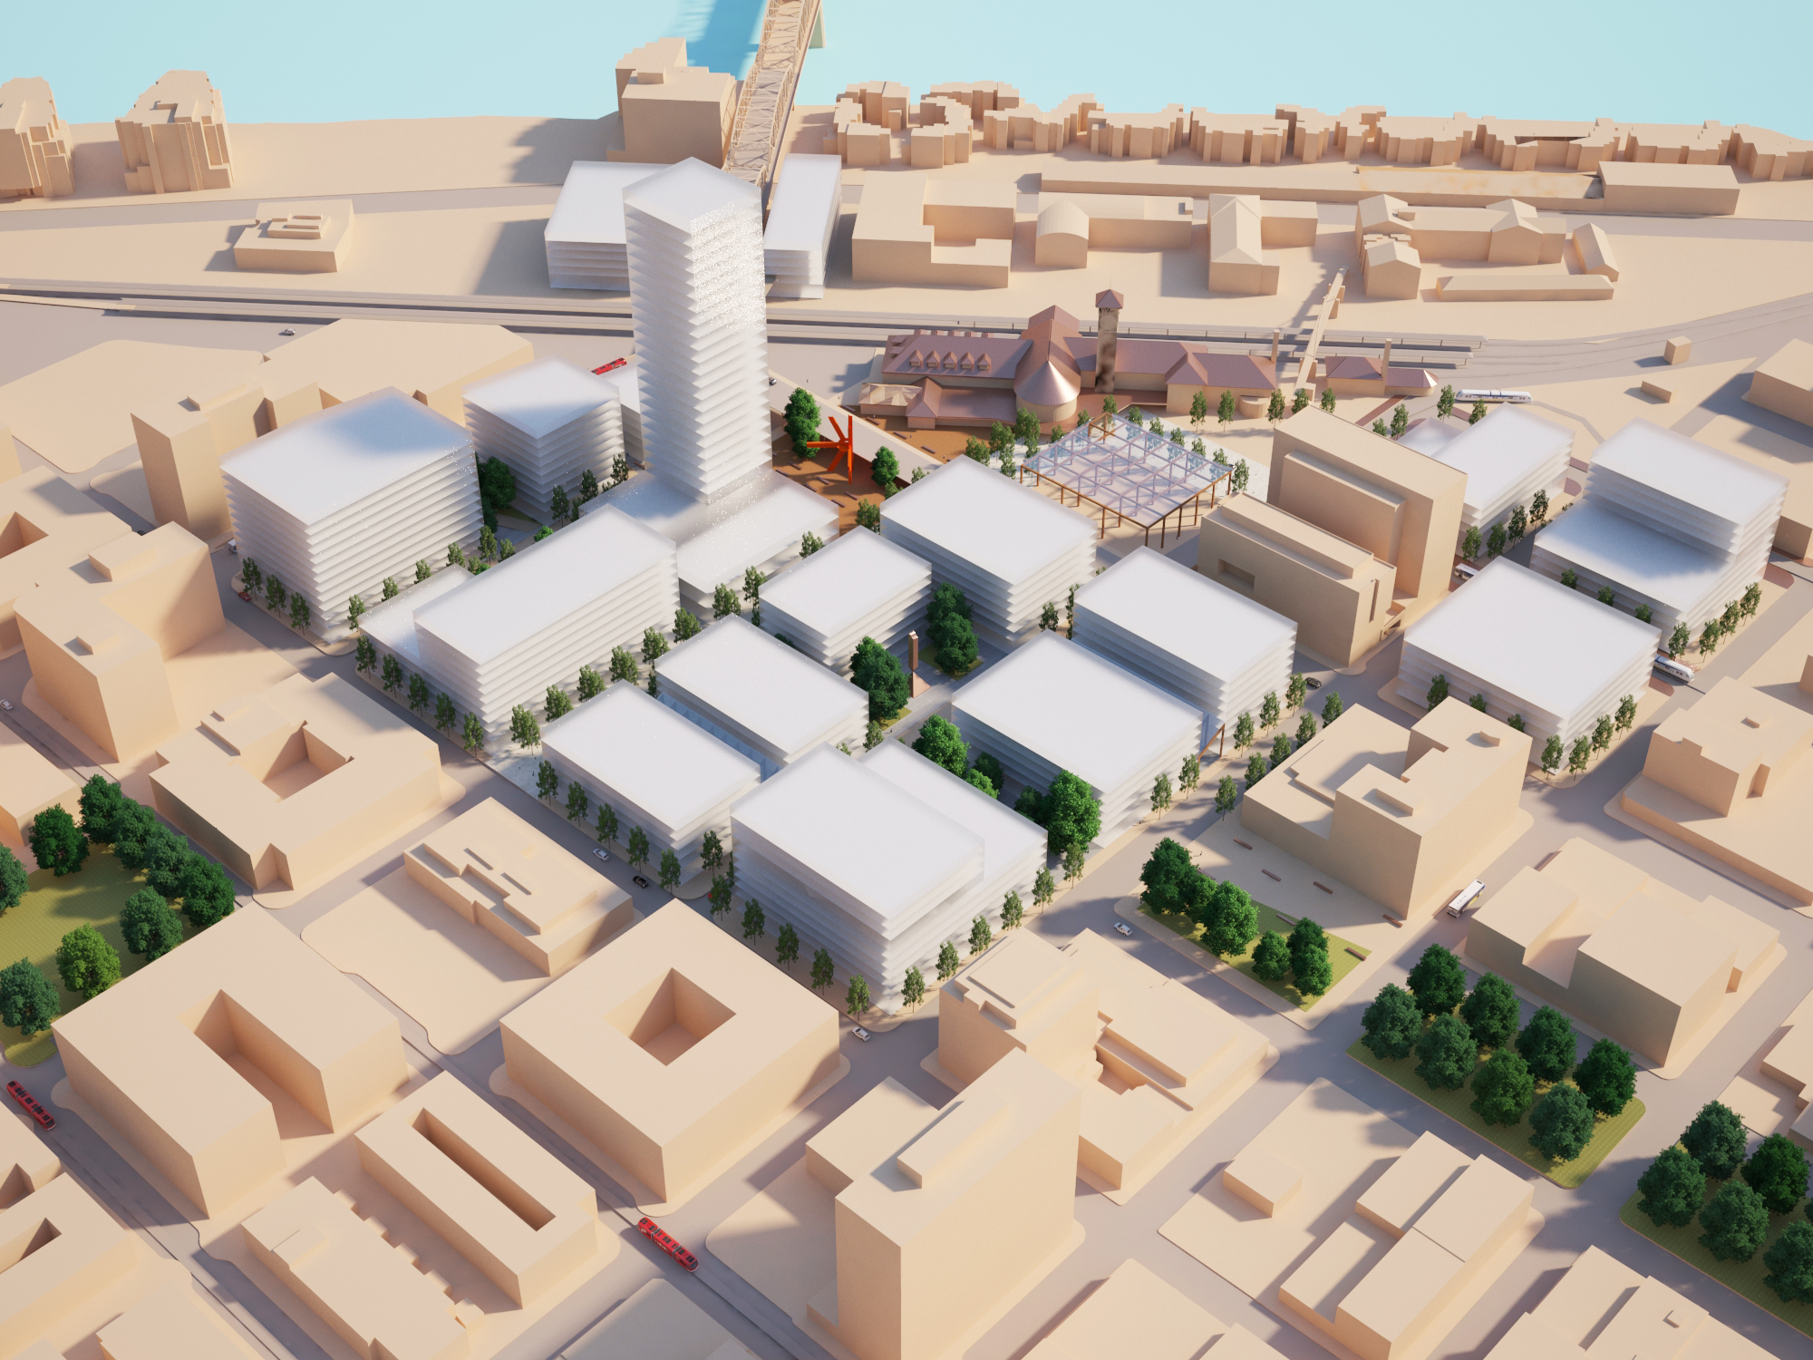
DISCOVERY
Building Massing
PNCA
NW JOHNSON
NW PARK
NW HOYT
NW 9TH
Notes:
NOLAN

Slide 39
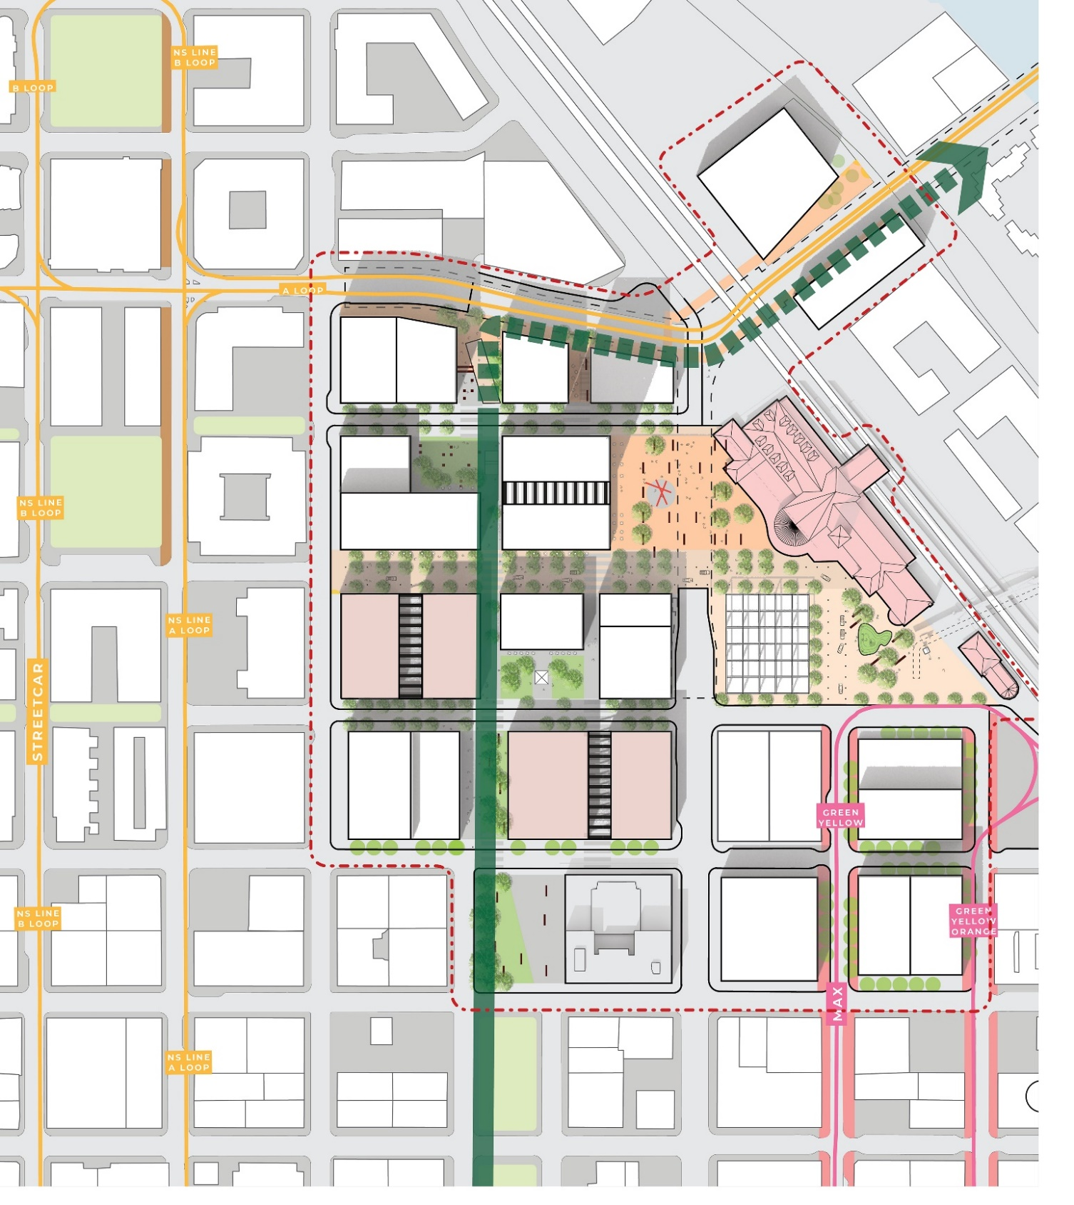
DISCOVERY
NW MARSHALL
Plan View
NW LOVEJOY
NW KEARNEY
NW JOHNSON
NW IRVING
BCC
MULT. CO.
NW HOYT
PNCA
NW GLISAN
NW 9TH
NW 8TH
NW BROADWAY
NW FLANDERS
Notes:
NOLAN

Slide 40
Feedback to Date
Notes:
Jahmese

Slide 41
WHAT WE’VE HEARD…
Open Space
Prefer 1 or 2 multi-purpose public spaces
Distributed public space feels private
Consider maintenance and operations needs and partnerships
Ensure flexible use of public realm vs single purpose
Need intentional and thoughtful terminus to Park Blocks
All three concepts should integrate active recreation
Green Loop should be centrally located and may require an interim approach until later phases of development
The change in grade allows opportunity for roof spaces to have active uses
Need an iconic public art strategy

Slide 42
WHAT WE’VE HEARD…
Open Space
Mixed input on “Nature”
Strongest sense of place and unique identity; like urban forest
Challenging to phase and won’t feel complete until fully implemented
Doesn’t feel safe and is not universally culturally inviting
Reduce features that inhibit flexible use of space
Mixed input on Union Station plaza
Like the use of Union Station and plaza as a focal point / main attraction
Feels too tucked away and disconnected
It is important for the public area under the viaduct to be activated 24-7 to feel safe
“Edge uses” are critical to successful open space

Slide 43
WHAT WE’VE HEARD…
Street Plan and Block Configuration
Johnson Street
Consider scheduled hours for service access and closure for pedestrian use
Important connector between Union Station, Boardwalk/Pearl park series, NW Portland
“Main Street” opportunity
Need to consider how Johnson bifurcates site and ensure northern portion does not feel private
A mixed-use street connection between NW Hoyt and NW Johnson is needed for site permeability, utility distribution and service access

Slide 44
WHAT WE’VE HEARD…
Street Plan and Block Configuration
Breaking the standard street grid is interesting and inviting
Strengthen connectivity to Old Town / Chinatown
Need to further explore parking and loading access
Mixed input on parcel size
Smaller parcels feel inviting
Smaller parcels feel exclusive
Need flexibility for large employer opportunity / campus
Smaller parcels more accessible for local developers and investment
Smaller parcels better support incremental phasing and ability to adapt to market dynamics

Slide 45
WHAT WE’VE HEARD…
Height, Massing & Orientation
Opportunity for singular iconic tall building combined with Broadway Bridge gateway and plaza
Irregular building form is interesting but is financially and functionally challenging
Consider framing of open space and axis of Broadway Bridge
Consider impact on adjacent uses and public realm including area under viaduct
Implementation
Careful consideration of phasing and the ability for the area to be successful during any phase of development
Need ability to adapt to changes in market

Slide 46
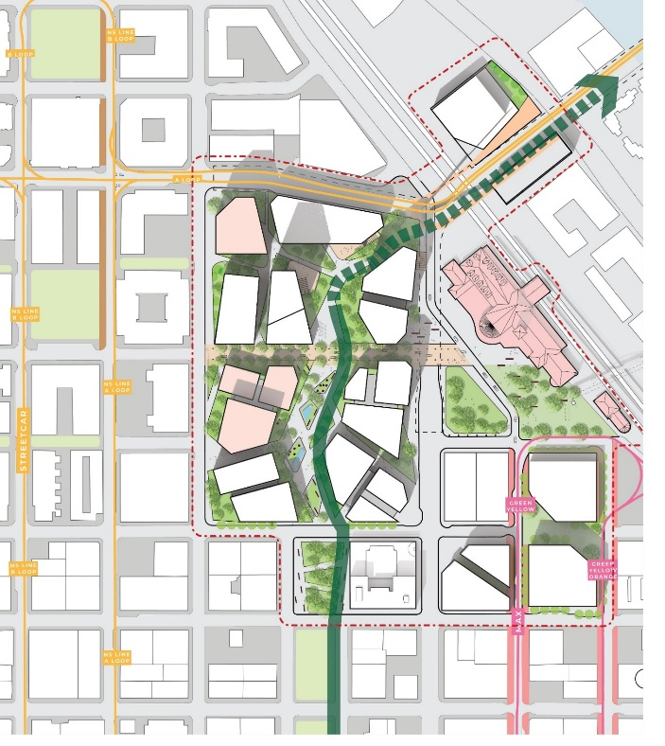
MASTER PLAN INPUT
Play
Discovery
Nature
What’s working and where do you have concern regarding:
Street plan and Block Configuration
Location, scale & purpose of open spaces
Height, Massing & Orientation

Slide 47
Next Steps
Notes:
Jahmese

Slide 48
NEXT STEPS
Concept Alternatives Development
Public Partners Technical Team Meeting Nov 13th, Dec 11th
Design Commission: Pre-App Meeting Late Nov / early Dec
Steering Committee Meeting Nov 27th
Open House #3 Nov 28th
Design Commission: DAR #1 Mid-December

Slide 49
Thank You
Notes:
Thank and acknowledge the work of
Steering Committee and Evaluation Committee
Developer candidates
ZGF
June
We have and will continue to learn from each other in this process as we move forward

