Slide 1
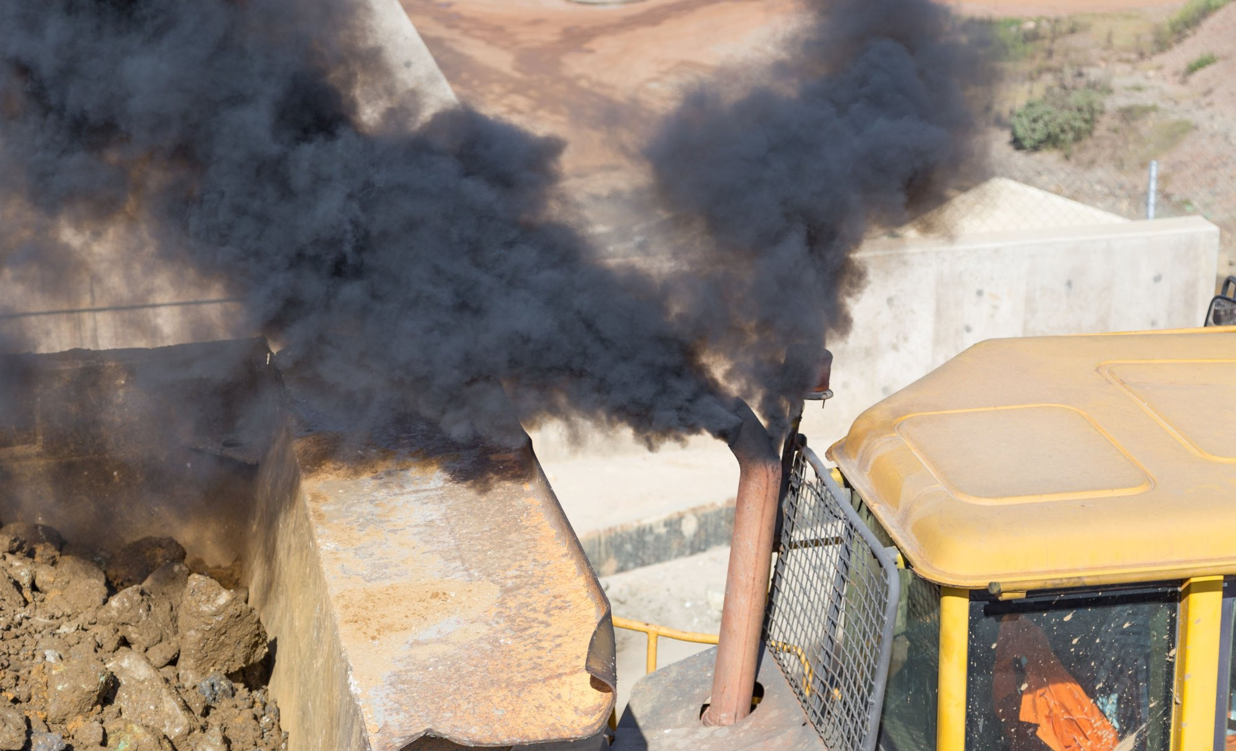
Clean Air Construction Standards Taking local action for health and cleaner air
September 20, 2018

Slide 2
Background
PATS findings about Portland air quality
2006- 2011 - $2.3 Million in fleet retrofits
2010 Piloted Clean Diesel Contracting policy
2016 Convened regional workgroup to develop a regional approach

Slide 3
Regional Workgroup

Slide 4
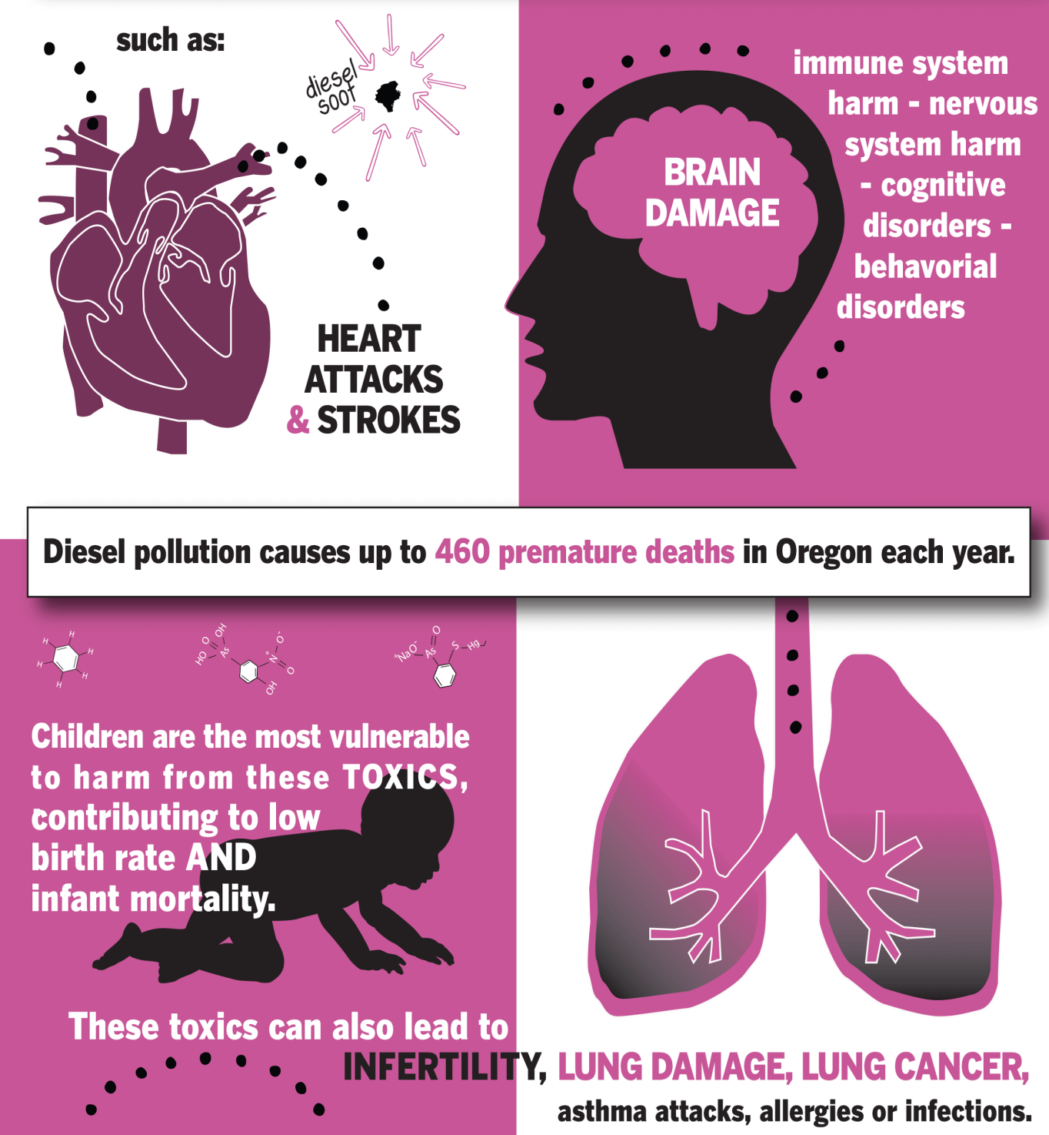
Why diesel exhaust?
Notes:
Diesel exhaust is a complex mixture of gases and particles. The public health concern comes primarily from the ultra fine particles emitted by diesel engines. These particles can be very small at 1 micrometer in diameter or about 100 times smaller than the width of human hair. This small size allows these particles to bypass the body’s natural defenses, penetrating deep into the lungs. Although these are aerosols, their small size permits them to pass through the lungs into the bloodstream. With diesel exhaust especially these particles are predominately carbon and other toxics in the air can adsorb on the particle and thus get transported throughout the body leading to a series of wide ranging health effects in the respiratory, cardiovascular and even the nervous system.
Diesel is a known human carcinogen as determined by the International Agency for Research on Cancer (IARC) typically expressed and lung and bladder cancers. Diesel particles are known to increase risk for heart attacks and are suspected as a causal factor in increasing risk for autism, impaired cognition and amyotrophic lateral sclerosis or ALS, commonly known as Lou Gehrig’s disease.
Children and elderly are especially vulnerable. Asthma incidence is a concern for children. While asthma is triggered by a number of sources, when the state of California charged its health assessment agency with determining the five most hazardous pollutants for children, diesel exhaust made the list for its role in asthma. Elderly are especially vulnerable to heart disease from episodic and long term exposure to diesel particulate.

Slide 5
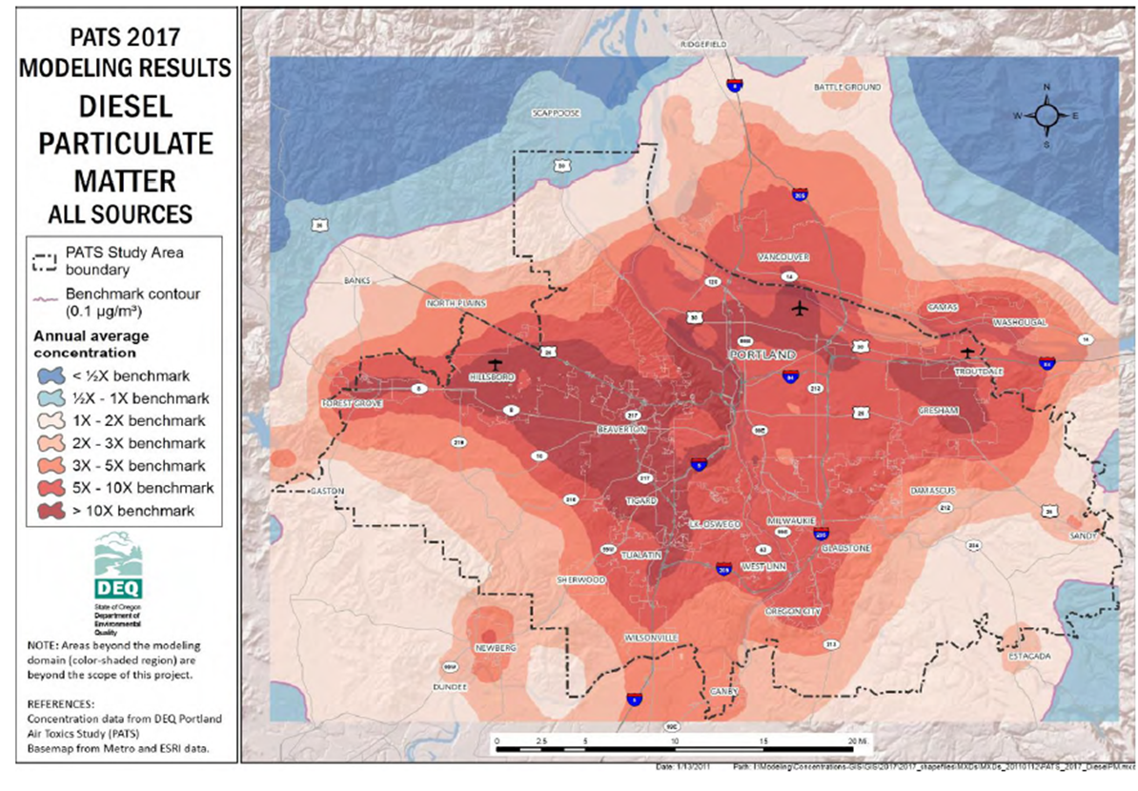
Regional Air Quality
Notes:
In 2006 DEQ completed an air quality modeling study called the Portland Air Toxics Assessment or PATA. This study used local meteorology, topography and emission information about population, neighborhood, car, truck, industrial and smaller sources to predict the level of 12 air toxics (hazardous air pollutants). Levels of ten of these pollutants are estimated to be above benchmark concentrations recommended by the Air Toxics Science Advisory Committee and recently adopted by the Environmental Quality Commission.
Diesel exhaust poses one of the highest health risks in the Portland airshed of any toxic air contaminant evaluated in the report. Portland Metro area has the highest concentrations of diesel pollution in the State of Oregon. Benchmarks are not standards, but rather planning goals and triggers for DEQ’s program. This graphic shows elevated exposure and risk throughout the Portland area outside of hotspots along major highways, freight handling centers and construction sites.
Based on EPA’s most recent national assessment of air toxics concentration, Multnomah County ranks in the top 3 percent of counties nationally for concentration of diesel particulate which also includes New York, Philadelphia, San Francisco, Denver. St. Louis, Baltimore and Seattle , for instance. Los Angeles county has slightly lower concentrations, coming in at the 95th percentile. Overall , about 92 percent of Oregon’s population is living with exposures to diesel exhaust above Oregon benchmark levels.
This may seem anomalous but Oregon is a significant consumer of diesel fuel. For instance we have about 1.2 percent of the country’s population but consume about 1.2 percent of the nation’s diesel fuel. While this may not be surprising on its face given the general usefulness of diesel engines in the economy, California has 12 percent of the nation’s populations but used 6.6 percent of the country’s diesel fuel. This is explained possibly by two factors: Oregon is typically among the top 5 to 10 most trade dependent states and has a larger share of the state GDP coming from manufacturing than either Washington state or California.

Slide 6
Why Focus on Construction Equipment?
Diesel emissions sources in Portland Metro area
Notes:
Diesel Particulate Matter by Source for the Portland Metro area, 2017 PATS
65% of diesel emissions in the Portland metro area come from non-road equipment. The on-road sector is already regulated through manufacturing standards. These emission standards have only more recently been applied to non-road equipment.

Slide 7
Development Process to Date
Surveyed existing contracting programs
Identified key evaluation criteria
Evaluated program alternatives against criteria
Reported findings to internal and external stakeholders
Proposed policy recommendation
Next Step:
Develop proposed contracting standard and supporting program with both internal and external stakeholders
Notes:
In the absence of broader regulation; clean diesel public contracting provides an opportunity for significant diesel emissions on public projects. It benefits the health of agency employees, contactors, and nearby communities. It provides our agencies with a leadership opportunity on a signficant publci health issue.
As key part of our work was to;
a) identify and survey exisiting contracting policicies
b) conduct a comparison of different program elements and evaluate stengths and weekneses
c) adopt our own priorities and preferences to be used as criteria to evaluate various program alternatives
d) report to internal and external stakeholders and solicit feedback.
e) finalize recommendations
f) solicite agency approval for adoption.
i) if approved, build program and develop contracting language.

Slide 8
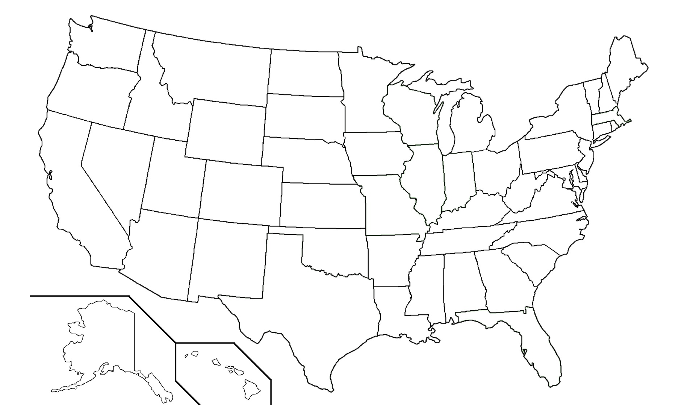
Existing Clean Construction Contracting Policies (Partial List)
Notes:
Clean diesel public contracting isn’t a new concept. A contractor working on our behalf identified and survey 18 programs currently in existance across the U.S. Programs include States, cities, transportation departments, transit authroities, universitiies and a port authorities.
Rhode Island Diesel Emission Reduction Act
New Jersey Department of Environmental Protection Mandatory Diesel Retrofit Program
New York City – Local Law 77
City of Chicago – Clean Diesel Ordinance
Pittsburgh Clean Air Act
San Francisco Clean Construction Ordinance
Cook County (Chicago area) - Green Construction Ordinance
Los Angeles County Metropolitan Transportation Authority - Green Construction Policy
Illinois DOT Special Provision for Construction Air Quality
Massachusetts DOT Diesel Retrofit Specification
Port Authority of New York and New Jersey Clean Diesel Specification
O’Hare Modernization Program
Columbia University
Fort Belvoir Construction Performance Plan
LEED Green Construction Credit Pilot Program
With respect to our evaluation criteria, our priority is to reduce diesel emissions. It’s important that we do so in a manner that;
a) addresses technical limitations and potential safety concerns
b) does not create a large administrative burden on our contractors or agencies
c) does not adversely impact small and disadvantaged businesses or work against our DBE participation goals.

Slide 9
Regional Contracting Goal
Cleanest available equipment
Non-road - EPA Tier 4 standards (including Tier 4i)
On-road - 2007 model or newer dump trucks and cement mixes
OR
EPA or CARB certified Best Available Control Technology (BACT) if available:
Diesel Particulate Filter (DPF), or
Diesel Oxidation Catalyst (DOC) when adequately demonstrated a DPF is not adequate.
OR
Alternative fuel vehicles or equipment

Slide 10
Phased-in Approach
Schedule | Off-road | On-road
On effective date | No idling | No idling
After year 1 | No tier 0 engines allowed*
After year 2 | No tier 1 engines allowed*
After year 3 | No tier 2 engines allowed*
After year 4 | No tier 3 engines allowed* | No pre-2007 engines*
After year 5 | Tier 4 only*
After year 6 | Tier 4 only*
After Year 7 | Tier 4 only** | No pre-2007 engines**
*Older equipment allowed when retrofitted with BACT (DPF to DOC)
**Older equipment allowed only when retrofitted with DPF
Notes:
We understand that there are cost implications with this proposal, both for public agencies and for contractor community.
While engaging with contractors we heard an understanding that air quality standards were likely to follow, but they expressed concerns about the upfront costs of compliance and how the proposal would impact small and disadvantaged firms.
While the approach we are presenting today is broadly consistent with the program description provided to contractors, we have modified the approach based on their feedback at the August 22 Workshop. The following changes have been made:
Idle reduction requirements will take effect immediately.
The standards for non-road vehicles will phase in over an 8-year period from the effective date of the policy to give construction companies time to plan for the transition.
The on-road requirements will only apply to dump trucks and cement mixers and will take effect in year 4 of the program, instead of applying to all on-road vehicles.

Slide 11
Exemptions
Allow limited exemptions from standard:
If the equipment is not able to be retrofit
If compliant rental equipment is not available
If a filter will obscure the vision of the operator, or otherwise impact worker safety
If the equipment is needed for an emergency
If there are special circumstances or unique equipment that would result in a significant and demonstrable hardship for the contractor to invest in upgrades

Slide 12
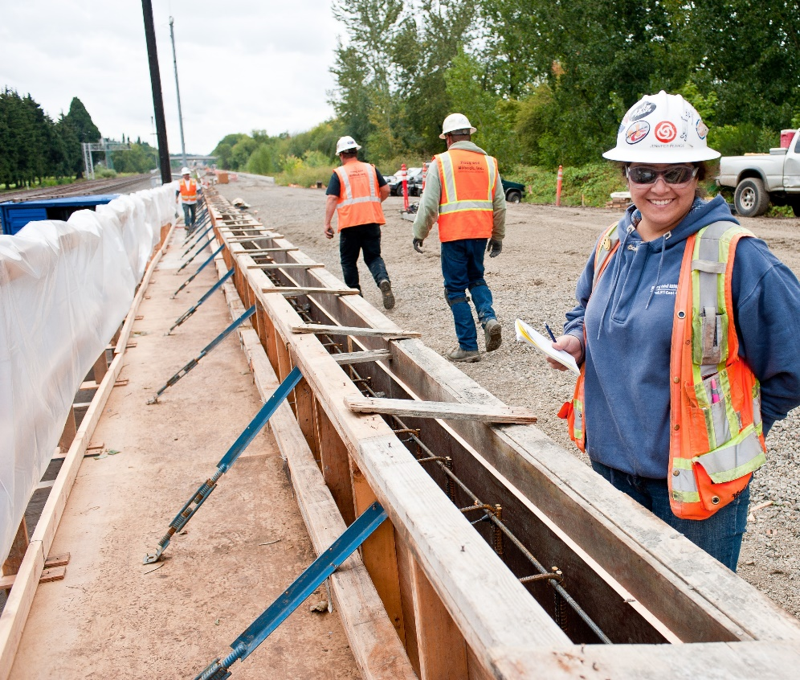
Options for Accommodating Certain Businesses (Such as Small Businesses, or Minority & Women-Owned Firms)
Fund retrofits for some firms
Advocate for VW Settlement funds
Notes:
MWESB Fund
Certified firms doing business with Clean Diesel Policy agencies get access to funds for retrofitting their equipment. Fund would sunset after X years.
Funding comes from VW Settlement, Community Opportunities and Enhancements Program (COEP) funds, and/or General Fund.
MWESB equipment survey underway in January to develop cost estimate for such a fund
VW Settlement
Drawback: Making MWESB compliance contingent on this funding would open ourselves up to seriously undermining the effectiveness of the policy (if money is not available)

Slide 13
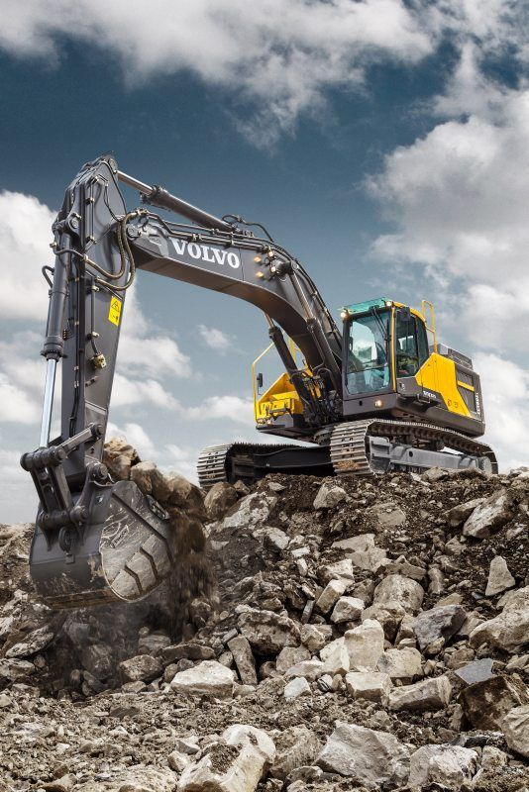
Next Steps
Dec 20th proposed standard and program back to Council
Continue work with regional partners and stakeholders
Identify funding resources to support DMWESB firms
Identify general fund resources for implementation
Notes:
We know this will cost the City both time and financial resources, but reducing diesel particulate pollution in Multnomah County would yield approximately a 10:1 return in human health benefits per dollar invested in off-road engines, such as construction vehicles. (according to the U.S. EPA’s Diesel Emissions Quantifier Health Module)
This is the right step for local government to take to protect the health of Portlanders and now is the right time for action.

Slide 14
Notes:
Jeanne to lead discussion on standards
– If we bring this policy to our Commission this year, is this something you can support? Can please assign staff member to work with us, who can review and provide feedback on the draft?
Any questions or feedback on our proposal?

