Slide 1



Institutionalizing Equity:
Creating a City that Works for All Portlanders
Prepared for Portland City Council | September 19, 2018

Slide 2


The Office is Normalizing Equity
Notes:
The Office of Equity and Human Rights is normalizing the equity conversation in the City. In 2012, only eight City bureaus mentioned equity in key documents and on their websites. In 2015, equity had a significant presence in all bureaus’ key documentation, communications, and outreach.

Slide 3

Influencing Change: Education + Training
Notes:
The Office of Equity and Human Rights training team has delivered Equity 101 Training to over 5,000 City employees, often accommodating challenging shift-work schedules.

Slide 4

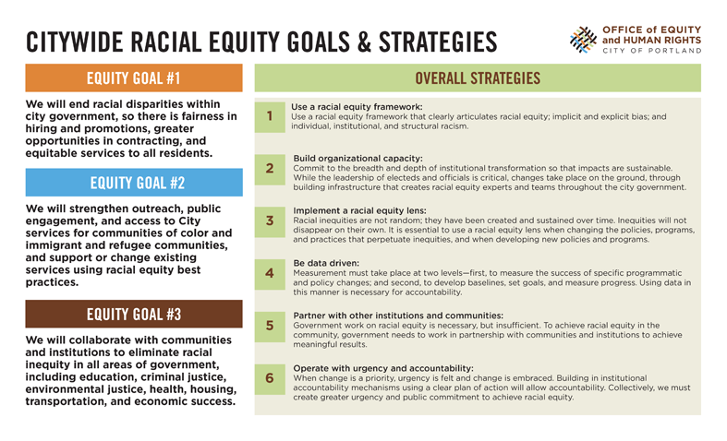
Influencing Change: Citywide Equity Policy
Notes:
In 2015, The Office of Equity and Human Rights developed Citywide Racial Equity Goals and Strategies and City Council adopted them as binding City policy. The Goals and Strategies serve as a guide for each bureau’s Five-Year Racial Equity Plan.

Slide 5
Influencing Change: Workforce Demographics
City staff of color compared to Portland population of color
Notes:
From 2013 to 2018, we see a positive trend in the percentage of People of Color working for the City, compared to the percentage of people of color who live in Portland.
(Link: https://public.tableau.com/profile/matthew.lim#!/vizhome/CouncilSessionOEHR_PoC/FritzChanges)

Slide 6
Influencing Change: Workforce Earnings
Percentage of increase from previous year, by race ($35K to $100K pay range)
Notes:
From 2013 to 2018, we see a noticeable positive trend in workforce earnings overall in the $35,000 to $100,000 annual pay range. For employees of color, the percentage of increase over previous years is significant and moving in a greater, more equitable trend.
The Office of Equity and Human Rights is gathering more detailed demographics data to get a deeper look at the City’s workforce diversity efforts. For example, we are examining retention and promotion rates for employees of color.
(Source: City of Portland SAP. Both graphs are available here: https://public.tableau.com/profile/matthew.lim#!/vizhome/CouncilSessionOEHR_PoC/Earnings)

Slide 7
Opportunity: Higher-earning City Jobs
Percentage of City employees who earn $100K or greater, by race
Notes:
From 2013 to 2018, we see a slight positive trend for City staff of color who earn $100,000 or more a year.
(Source: City of Portland SAP. https://public.tableau.com/profile/matthew.lim#!/vizhome/CouncilSessionOEHR_PoC/FritzChanges)

Slide 8
Collaboration
City Council:
Consulted on city-wide captioning policy
Bureau of Human Resources:
Equity Training is integrated in “Cultural Competency for Managers and Supervisors”
Equity 101 is available in the City Learner system
Office of Community & Civic Life (formerly ONI):
Equity and communications consulting for Welcoming/Inclusive/Sanctuary City Task Force process
Notes:
The Office of Equity and Human Rights provides educational and technical support to elected leaders, Bureau Directors, and City staff.

Slide 9

Collaboration
Portland Housing Bureau:
Equity Training for the Coalition to End Homelessness
Loaned communications position while PHB had a PIO vacancy
City Budget Office:
Budget Equity Assessment Tool
Notes:
The Office of Equity and Human Rights provides educational and technical support to elected leaders, Bureau Directors, and City staff.

Slide 10
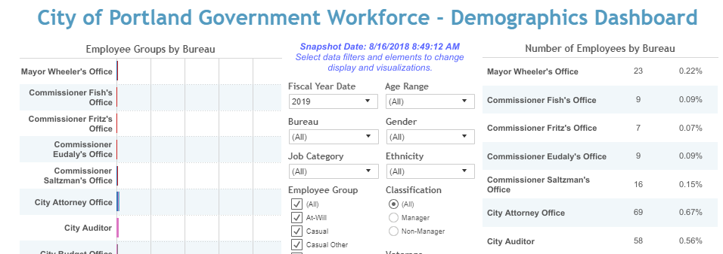
Data Sharing
Bureau of Technology Services and Bureau of Human Resources:
City Demographics Dashboard on the Office of Equity and Human Rights website
Notes:
The Office of Equity and Human Rights provides educational and technical support to elected leaders, Bureau Directors, and City staff.

Slide 11

Partnerships with Other Agencies
Notes:
The Office of Equity and Human Rights’ work and credibility is recognized in the region and across the country. We partner with several agencies and organizations, providing educational and technical support.

Slide 12

Partnerships with Other Agencies
State of Oregon:
Governor’s Office
Oregon Department of Energy
Office of Diversity, Equity, and Inclusion
Other Agencies and Jurisdictions:
City of Tacoma, WA
City of Oakland, CA
City of New Orleans, LA
City of Austin, TX
City of Buffalo, NY
Notes:
The Office of Equity and Human Rights’ work and credibility is recognized in the region and across the country. We partner with several agencies and organizations, providing educational and technical support.

Slide 13

Challenges
Progress reporting on City bureaus’ Racial Equity Plans
Effectively setting City-wide standards in a decentralized government model
Elevating Disability Equity work with limited staff capacity

Slide 14

Opportunities
Increased authority for City-wide accountability from Council
Increased data and research opportunities
Partnering with Community on Strategic Plan

