Slide 1
City Council Briefing
Mary Hull Caballero
City Auditor
Portland Police Bureau Follow-Up
(June 2018)
Private Stormwater Management
(July 2018)
Short-term Rental Regulation (August 2018)

Slide 2
Portland Police: Training
We revisited the 12 training-related recommendations we made to the Police Bureau in 2015
Notes:
My name is Martha Prinz. I’m a Senior Management Auditor and I led our June 2018 audit of Police Training, which was a follow-up audit. In a follow-up audit, we re-visit the recommendations made in the original audit. In this case, the original audit was released in March 2015 and had 12 recommendations.
Gaining and maintaining the public’s trust is more likely when officers do their jobs as they should, and training helps officers keep up with the rapid pace of changes in societal, legal, and policy expectations.
The 2015 audit found improvements had already been made to training since the 2012 U.S. Department of Justice report on the Police Bureau, which included a number of training-related recommendations.

Slide 3
Portland Police: Training
Recommendations in four areas were either implemented or in process
Training records
Training needs assessments, evaluations and reports
Training on important topics
Control over weapons
Notes:
In this audit we found that 5 of our 2015 recommendations had been implemented, 6 were considered in process, and one was no longer relevant due to an operational change made by the Police Bureau. They’re grouped in this slide by topic area.
In the interest of time, I won’t go through each recommendation individually, but the comments I’ll make in the next several slides are grouped according to the themes shown on this slide.

Slide 4
Portland Police: Training
Notes:
It’s important for police agencies to know their officers receive required training. Our 2015 audit found problems with some aspects of how Portland Police tracks officer training.
The Bureau got a new database in January of this year. They’re still working out some kinks with it, but we found the new system has better search capabilities than the old system. It also has a robust reminder system if an officer is found to be missing a required training, as well as other improvements. At the time of our audit, the Bureau was figuring out work-arounds for the unresolved issues.

Slide 5
Portland Police: Training
Notes:
It’s also important that the Police Bureau know what types of training officers need, and, after training is delivered, the Bureau needs to evaluate how well that training actually worked.
The Police Bureau had just begun doing formal needs assessments when we did our 2015 audit, and is now completing an assessment each year. The assessments draw upon a variety of sources and have been improving over time.
The Bureau is also doing more and better evaluations than they were in 2015. This Police Bureau graphic shows some of the inputs and outputs in their needs assessment and evaluation process. Although the Bureau is doing more evaluation than in the past, they aren’t yet doing as much as we said they should in the 2015 audit.
The Police Bureau also still needs to work on how to communicate with the Chief about training effectiveness.

Slide 6
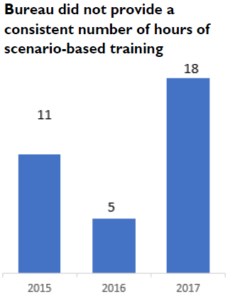
Portland Police: Training
Notes:
Police training programs should address important topics thoroughly and consistently.
In 2015, we recommended the Bureau provide more scenario-based training – as opposed to classroom-based training – and that they more consistently cover such topics as confrontation management, dealing with mental health crises, the need for officers to get medical help for subjects when needed, and not using profanity.
In 2018, we found a lot of variability from year to year in the hours of scenario-based training the Bureau offered, as seen in the chart on this slide. The Bureau also didn’t use actual cases as part of training for tenured officers as much as they could have.
In 2018, we found that officers were receiving more training on the need to get medical help than they had been in 2015, but needed additional training on not using profane or demeaning language.

Slide 7
Portland Police: Training
Notes:
In 2015, we found the Bureau’s three precincts had inconsistent procedures for checking out weapons. We also found that officers didn’t always include weapons information when they logged into the Bureau’s dispatch system, which they were required to do.
The Bureau now has consistent and more thorough procedures for checking out weapons. Those procedures include directing supervisors to conduct an inventory of the armory during each shift and to make sure officers check out weapons properly.
Finally, our 2015 audit recommended that the Bureau provide refresher training on how to store ammunition for less-lethal weapons to avoid repeating an incident in which an officer accidentally loaded live ammunition into a less-lethal shotgun, which resulted in an injury.
That’s no longer possible because the Bureau changed to a different less-lethal launcher which can’t be loaded with live ammunition.
And that concludes my presentation.

Slide 8
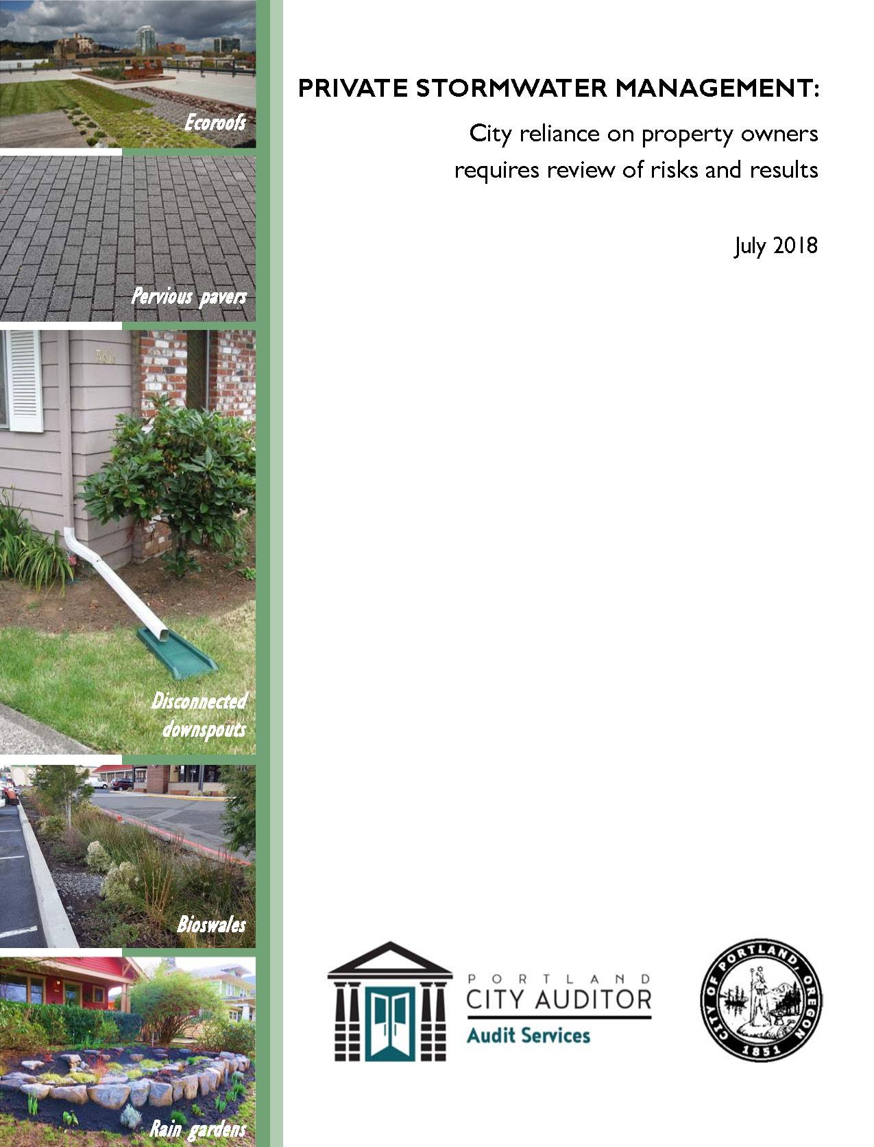
Private Stormwater Management
Bureau of Environmental Services needs to evaluate requirements for stormwater control on private property
Notes:
My name is Elizabeth Pape. I’m a Senior Management Auditor and I led our July 2018 audit of Private Stormwater Management.
This is the first in a series of two audits of BES stormwater management. We are still working with the bureau and will release a second audit on management of green streets and restoration projects in the fall.

Slide 9
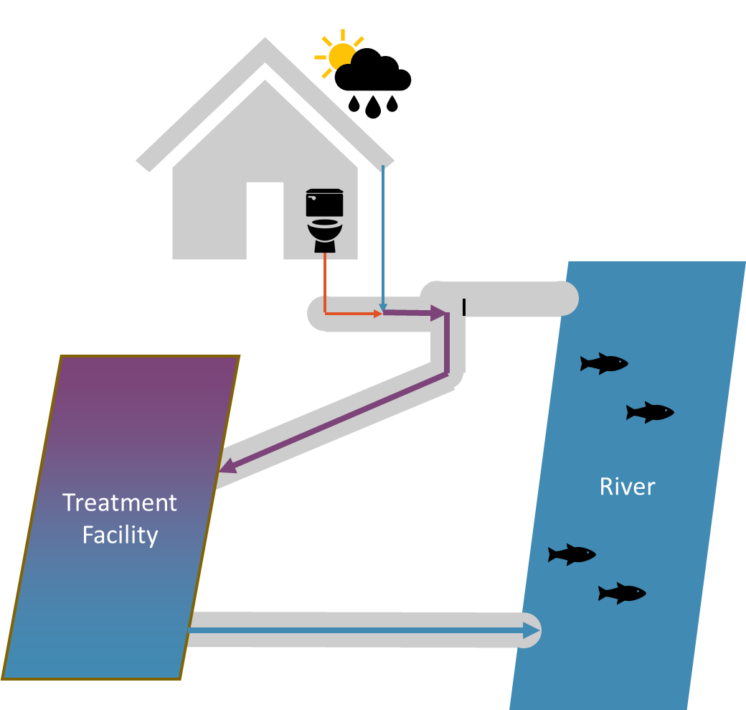
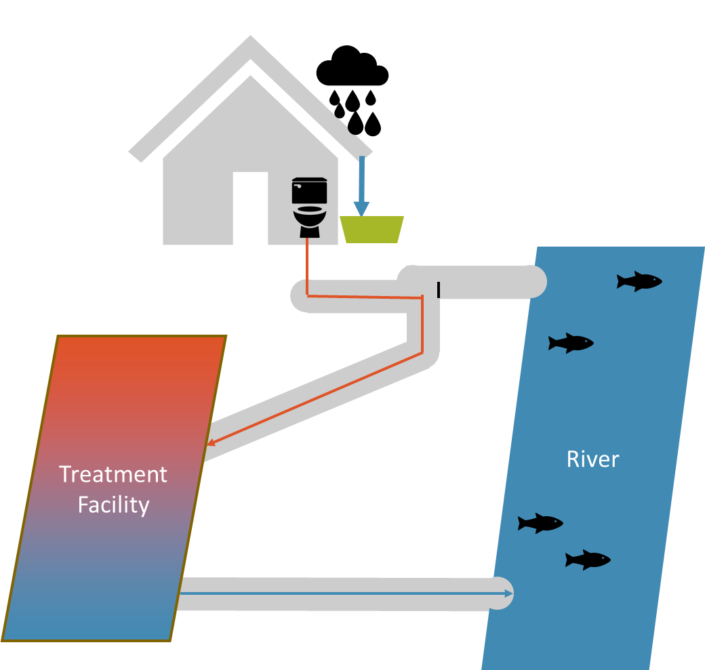
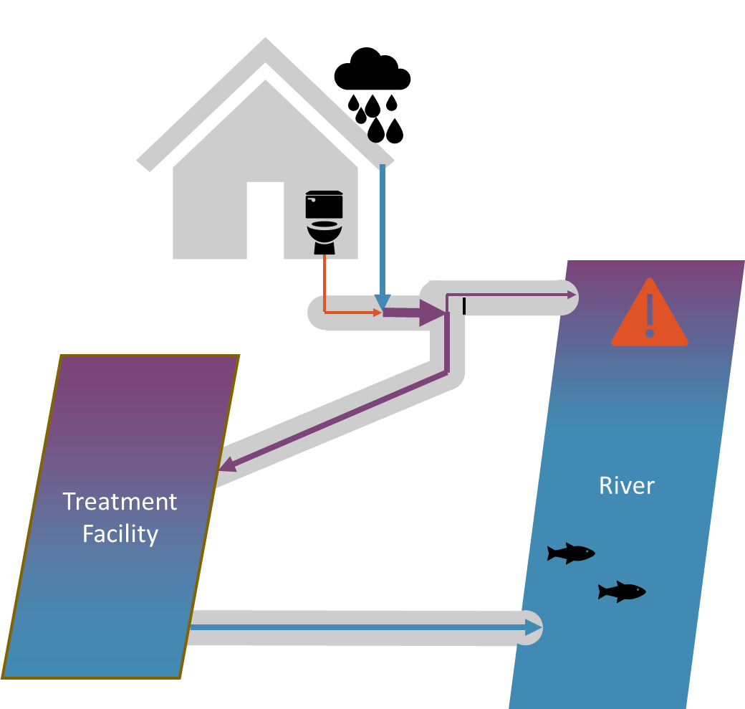
Private Stormwater Management
Notes:
Stormwater is the rain that runs off hard urban structures like roofs and pavement. BES relies on private property owners to treat stormwater generated at their sites to prevent local flooding, sewer system back-ups, erosion, and pollution in natural waterways.
This diagram shows how private structures prevent sewer overflows during heavy rain events.
On sunny days, or days with light rain, the system collects and treats all sewage and stormwater.
On days with heavy rain, untreated mixed wastewater can overflow into the river.
When stormwater is managed on private property, they system is less likely to overflow during heavy rains.

Slide 10
Private Stormwater Management
Drywell
Planter
Swale
Ecoroofs
Notes:
There are a variety of types of structures property owners can use to manage stormwater.
Ecoroofs collect rainwater to reduce runoff
Drywells collect runoff below the ground and allow it to disperse into the ground
Planters collect runoff above ground, filter it, and can allow it to disperse into the ground
Swales collect runoff at the ground level, filter it, and can allow it to disperse into the ground

Slide 11
Private Stormwater Management
Notes:
We looked at 2 of the Bureau’s programs related to stormwater management on private property.
The first was requirements associated with development contained in the Stormwater Management Manual. BES requires management for any development that increases impervious surface more than 500 square feet.
The second program was the Clean Rivers Rewards program which offers discounts for the on-site portion of the stormwater utility fee. These discounts can apply to ratepayers who operate the kinds of structures required by the Stormwater Management Manual, and also similar structures retrofitted to existing properties, not only associated with new development.

Slide 12
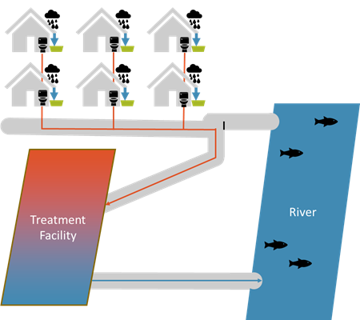
Private Stormwater Management
Finding 1:
Data not adequate for design of stormwater infrastructure
Notes:
Our first finding was that data management systems were not adequate for the design of stormwater infrastructure. The calculations the City uses to decide on the size of pipes and the number of regional stormwater facilities (like a detention pond) require knowledge of what structures are out there. Individual systems interact with regional facilities. You need data on where facilities are located, how much stormwater they are designed to handle, and what condition they are in.

Slide 13
Private Stormwater Management
3 systems with multiple groups responsible
Manual transaction for permit records = potential error
Rewards records lost through GIS
Rewards data not used for system planning
Notes:
The Bureau relies on a variety of data collection methods for private structures that are not organized into a coherent system.
Information is stored in three data systems, each managed by a separate group.
Data collection involved a manual transaction between two systems, introducing the potential for data entry errors
One program relied on a geographic information systems layer that did not include some participating accounts.
One program’s information was not shared with systems planners.

Slide 14
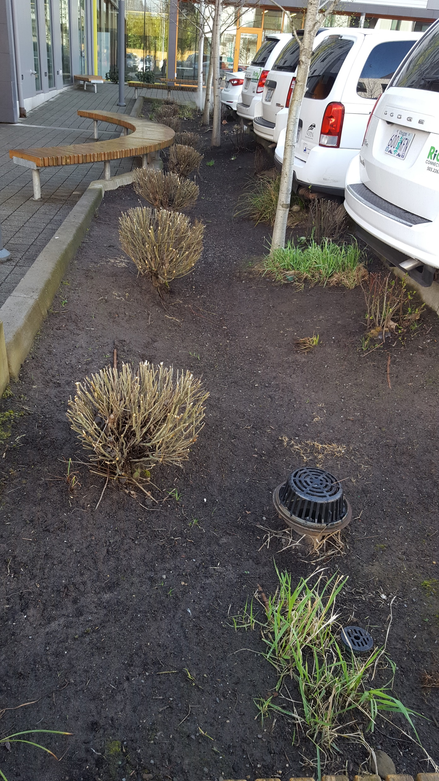
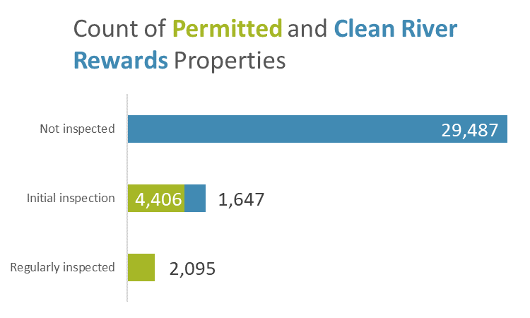
Private Stormwater Management
Notes:
In addition to issues with data management, the bureau also did not have good information on the condition of private structures because it does not inspect most of them. Of the total 37,635 properties: 6 percent were regularly inspected and 78 percent were never inspected (most single family residential).

Slide 15
Private Stormwater Management
Finding 1: Data Management
Recommendation:
single inventory
additional monitoring
Risk: overspending
Notes:
The Bureau risked overspending by building higher-capacity stormwater infrastructure because data systems could not account for the benefits provided by private stormwater management. Private structures can have significant impacts on project budgets. For example, the Woodlawn-King project budget decreased from $6.4 million to $2.2 million after including private structures.
The Bureau used field researchers to compensate for incomplete data. To its credit, the Bureau’s field research meant that the City incorporated information on private stormwater structures into project planning and did not build more pipes and system upgrades than needed. However, the process could have been faster and easier if information was available through well-managed data systems.
Our recommendations. To make data available for system planning the Bureau should
Develop a single information system to inventory private stormwater structures.
Develop additional risk-based monitoring programs.

Slide 16
Private Stormwater Management
?
Finding 2:
Goals not evaluated
Notes:
Since the Bureau adopted the permitting program almost 20 years ago and the Clean River Rewards program over 10 years ago, it has not gone back to assess whether the programs meet goals for stormwater management and rate fairness.
Goals for stormwater management
Staff said that they were unable to quantify the effects of private property structures on the entire system without investing a couple of months of work. The Bureau did not have information on the cost of private stormwater structures, so we could not calculate costs associated with the permitting program.
Adjusting program thresholds could make requirements for efficient. The Bureau’s threshold for requiring stormwater management is 500 square feet, which bureau staff said was one of the lowest thresholds in the country.This low permit threshold may have a high cost with little benefit for stormwater control. Increasing the threshold from 500 square feet to a more standard 1,500 square feet would reduce the number of permits by 8 percent, but decrease the area of impervious surface managed by less than 1 percent.

Slide 17
Private Stormwater Management
Notes:
Adjusting program thresholds could make requirements for efficient. The Bureau’s threshold for requiring stormwater management is 500 square feet, which bureau staff said was one of the lowest thresholds in the country. This low permit threshold may have a high cost with little benefit for stormwater control. Increasing the threshold from 500 square feet to a more standard 1,500 square feet would reduce the number of permits by 8 percent, but decrease the area of impervious surface managed by less than 1 percent.

Slide 18
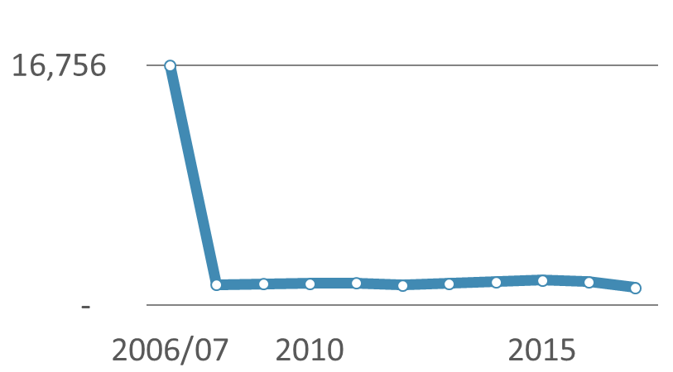
Private Stormwater Management
86%
of permitted properties did not participate in Clean River Rewards
Notes:
Goals for rate fairness
Most ratepayers who manage stormwater onsite do not participate in the Clean River Rewards program. The Bureau estimated that only 30,000 of 90,000 eligible accounts participated. We calculated that 86 percent of properties with permitted structures were not participating even though they should have been eligible.
Eligible ratepayers not only missed out on the discount ($9.60/month), but also paid $1.70 more each month to cover expenses not paid by those who did participate. The majority of eligible rate payers were worse-off than they would be if the program did not exist.
The Bureau’s outreach efforts had a large impact on participation. Over half of participants enrolled in the program’s first year, when there was more extensive outreach. First year enrollment was over 16,000 accounts, compared to around 1,500 accounts each year since then.

Slide 19
Private Stormwater Management
Finding 2: Evaluation
Risk: regulations not efficient
rates not fair
Recommendation:
create a schedule and assign staff
use results to achieve goals
Notes:
Without evaluations, the Bureau could not prove that the benefits of private stormwater management exceeded costs imposed on the private sector and could not adjust program elements to optimize efficiency or effectiveness.
Our recommendations. To regularly assess the performance of the Bureau’s approach to encouraging private stormwater management, it should
Create a schedule and assign staff to periodically evaluate outcomes of the permitting and Clean River Rewards programs against stated goals.
Use the results of evaluations to ensure the achievement of program goals and expectations.

Slide 20
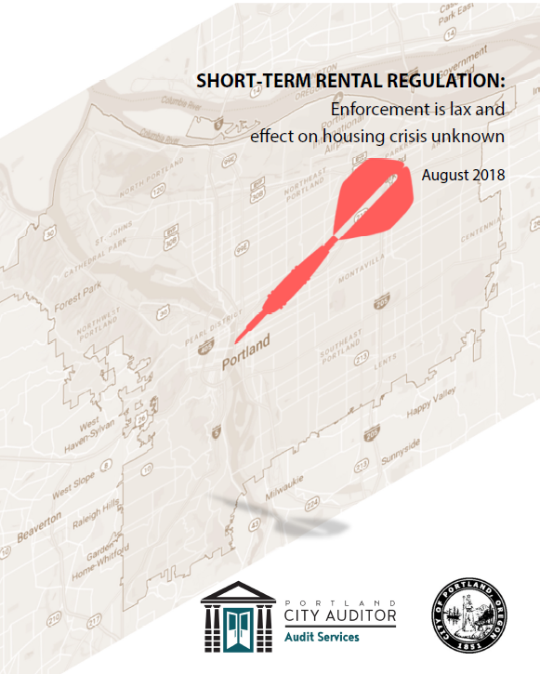
Short-term Rental Regulation
Compliance is low and enforcement is limited
Effect on housing market is unknown
Notes:
My name is Alexandra Fercak and I lead the short-term rental regulation audit, which was released just last month.
In this audit we found that most short-term rental hosts do not have required permits, and the City rarely enforces its regulations.
And despite concerns about the effect of short-term rentals on housing availability and affordability, the City does not collect data needed to effectively regulate these rentals and to monitor the housing market.

Slide 21
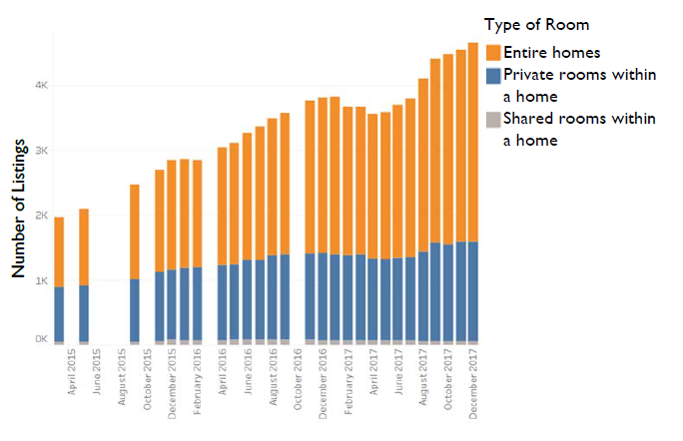
Short-term Rental Regulation
Since 2015, rentals have more than doubled
Notes:
The City began regulating short-term rentals in 2014, when Council changed the zoning code to allow residents to rent their homes for short terms. The intent of the regulation was to preserve the residential character of neighborhoods and to prevent commercial short-term rental activity, but we found that the City’s current regulation approach cannot assure this.
This graph shows that the market has more than doubled since 2015. These are rentals listed just on Airbnb. Note that the largest growth is in rentals of entire homes compared to private rooms within a home.
I should note here that in order to evaluate the regulation of this market , we had to obtain data from a third party. We presented an interactive version of this data on the City Auditor’s website.

Slide 22
Short-term Rental Regulation
Permit process and enforcement not effective
Notes:
The regulations require each host to obtain a short-term rental permit and to follow certain restrictions.
As of October 2017, Development Services had issued over 1,600 active permits. However, during that time there were over 4,600 rentals on Airbnb alone. Adding the number of rentals from the other booking agents operating in Portland, such as HomeAway or Vacasa, we estimate that only about 22 percent of rentals are permitted.
One factor that has limited City bureaus’ ability to enforce the regulations is the lack of data about short-term rental activity, including addresses of rentals, and how often and for how long listings are rented. Of the approximately 15 booking agents active in Portland, none regularly provide data to the City.

Slide 23
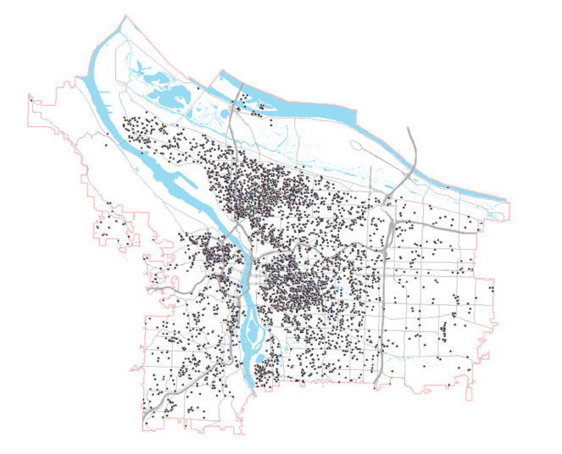
Short-term Rental Regulation
Rental unit locations December 2017
Notes:
This map shows the rentals available in Portland, and it shows some neighborhoods have higher concentrations of short-term rentals.
And as the number of these units has been increasing since 2014, their effect on housing market and neighborhood quality has not been monitored.
No City bureau has been assigned the responsibility to monitor the impact on housing.

Slide 24
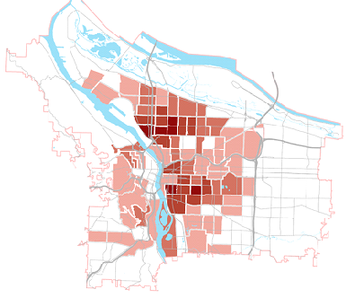
Short-term Rental Regulation
Some Portland neighborhoods have higher short-term rental activity
Notes:
This map is broken out by neighborhoods where we compared short-term rental activity to the number of housing units. As you can see neighborhoods in inner Northeast and inner Southeast are more frequented by renters than other parts of the city. These are also neighborhoods that have experienced gentrification and are facing affordable housing shortages.
These neighborhoods should be monitored to determine how this market affects them.

Slide 25
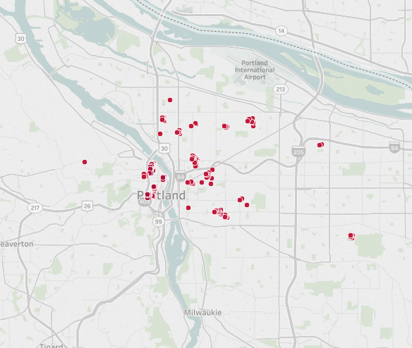
Short-term Rental Regulation
Hosts with multiple short-term rentals may decrease housing supply
Hosts with 6 or more listings
Notes:
Data also shows there are hosts with multiple short-term rentals. This map shows hosts with 6 or more rentals. But since the City doesn’t have information such addresses for these hosts and their listings, it is unclear how much of this activity represents illegal rentals.
For example, some of these hosts are hotels or bed & breakfasts listing separate rooms on the Airbnb website, or some are hosts that list separate bedrooms in one house. Some may be management companies that list units for clients. But the main concern is that these may be hosts listing multiple rentals that are not their primary residence, which would be a violation of City Code.
And because the City doesn’t have access to complete data on these listings, it does not know whether these hosts are removing residences from the housing market, specifically from the long-term rental market.

Slide 26
Short-term Rental Regulation
Recommendations
Revenue and
Development Services:
Obtain data on hosts, listings
Proactive, risk-based enforcement
Revise the permitting process
Housing Bureau:
Monitor and evaluate effects on housing
Report short-term rental data in the State of Housing report
Notes:
To effectively regulate short-term rentals, we make a number of recommendation, which are summarized here.
They include obtaining complete data on active short-term rental hosts and listings from either the booking agents or from other publicly available sources, and using it to proactively enforce the City’s zoning and tax code. We also recommend revising the permitting and enforcement process to meet intended regulation goals.
And to assess the impact of short-term rentals on the housing market, we recommend the Housing Bureau develop a monitoring process of this market to evaluate effects on city’s housing and to report results to City Council.

Slide 27
City Council Briefing
For copies of the reports, go to the
Audit Services Division webpage at:
www.portlandoregon.gov/auditservices

