Slide 1
Sullivan’s Crossing
Bicycle and Pedestrian Bridge
Request for Exemption from Competitive Bidding
August 29, 2018
Lester Spitler, Chief Procurement Officer
Dan Layden, PBOT Project Manager

Slide 2
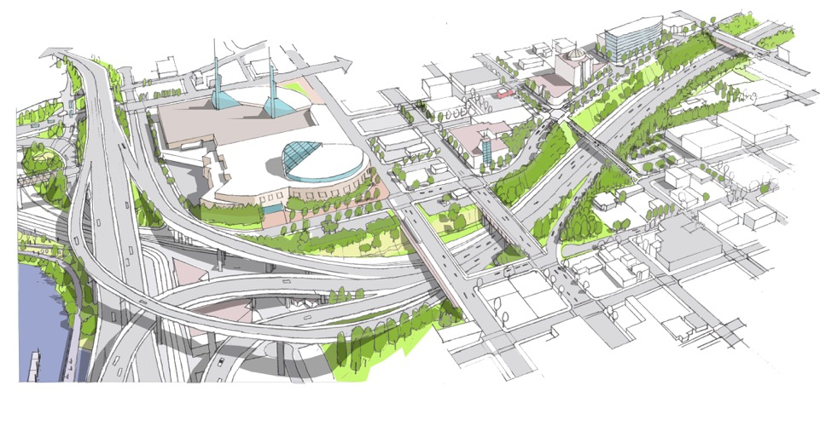
Sullivan’s Crossing

Slide 3
Sullivan’s Crossing

Slide 4
Budget
$13.5M total project budget
$11M TSDCs
$2M Prosper Portland OCCURA
250K from Go Lloyd
250K from CEID

Slide 5
Schedule
Tentative project schedule
Design – Currently at 60%
CMGC Contract: January 2019
100% Design: March 2019
Construction: May 2019-Dec. 2020

Slide 6
Complex Project Elements
Construction adjacent to Union Pacific Railway and Interstate 84
Installation of two 300’ steel arches over the Railway and Interstate Freeway
Installation will need to occur during a weekend closure of the freeway.
Installation of drilled shafts in close proximity to an aging large diameter sewer line.

Slide 7
Alternative Contracting Analysis
Project Team examined two contracting options
Design Bid Build
CM/GC
CM/GC provides significant benefit.

Slide 8
Benefits of CM/GC
Contractor participation in final design phase.
Ability to modify the design to improve constructability
Contractor part of team to plan complicated construction phasing.
Steel can be purchased earlier than with DBB which will reduce price uncertainty.

Slide 9
CM/GC Solicitation Findings
Does not discourage competition
Likely lower cost
Specialized expertise required
Faster total delivery (design and construction)
Better cost control
Public benefits

Slide 10
CM/GC Solicitation Process
Alternative project delivery method allows PBOT actual contracting authority to meet or exceed the City’s D/M/W/ESB participation goals
Community Equity and Inclusion Plan will be used on the construction project

Slide 11
Recommendation
Accept the findings and authorize exempting this project from the low bid process
Authorize the use of the CM/GC Alternative Contracting process

