Slide 1
Bicycle Parking Code Update Project
Design Commission Briefing
September 6, 2018
Notes:
Thank you for letting us brief you again on the bicycle parking code update project.
You heard an update back in October of last year from our colleague Jeffrey Mitchem on the work of our stakeholder advisory committee.
This Committee spent over 18 months coming to consensus on key principles and recommendations to guide staff on an update to the bicycle parking code section of Title 33, 266.
Since then, my colleague Liz Hormann and I have been working with our partners at BDS and BPS to take the concepts from the SAC’s final report and develop draft code language.
Liz and I will be briefing you on these draft requirements today.

Slide 2
Portland to build Complete and Connected Neighborhoods
Community Services
Neighborhood Businesses
Gathering Spaces
Access to Transit
Hub for Active Transportation
Housing Diversity
Safe Streets
Accessible for People of All Ages and Abilities
Human Scale
Local Employment Opportunities
Notes:
DC:
Today as we plan and construct Portland's built environment of the future.
We know that the buildings approved today will likely still be standing in 50 years – hopefully longer.
Tomorrow's Portland is made up of a multitude of complete and connected neighborhoods, where our households have access to a density of destinations nearby, and walking and biking are easy transportation options for much of our day to day needs.
****
The 2035 Comprehensive Plan, the City’s guide for accommodating this growth, aims to focus 80% of the growth in centers (including downtown) and along corridors in an effort to increase density where there are destinations, services and good access to transit, bike and pedestrian infrastructure.
These connected centers and neighborhoods are envisioned as walkable places with dense concentrations of housing and commercial destinations, easy access to well-connected transit, and street and utility infrastructure that can support dense, growing communities.
Neighborhood centers are places with concentrations of businesses and services, housing, gathering places and greenspaces that provide residents with options to live a healthy, active lifestyle. In centers, getting around by walking, biking or wheelchair is safe, attractive and convenient. Access to high-quality transit and protected bikeways make it easy to get to the rest of the city and the region.
An important element of a complete neighborhood is that it is built at a walkable and bikeable human scale, and meets the needs of people of all ages and abilities

Slide 3
How do we get to that vision?
Build for Density:
Commercial/ Mixed Use Zones
Better Housing by Design
Reduce Parking Requirements:
Reduce development costs
Reduce cost of units
More space for units
Provide Transportation Options for Residents:
Transportation Infrastructure
Bicycle Parking
Transportation Demand Management
Notes:
HIDE FOR DC – MAYBE KEEP TO PRACTICE FOR NWDA
[Summary: The City is engaged in many different efforts to build this vision. A few relevant efforts to mention here:
1) new code that encourages density 2) reduction of parking requirements to reduce huge on-site space requirements and development costs and 3) improving transportation options for citizens]
There are many factors at play to reach that vision of healthy, connected Portland neighborhoods with people who are able to walk, bike, and take transit for the majority of their trips, but also where our roads are less congested for the people that need to drive and for freight.
First, we have to build for density, which are some of the major themes from the Mixed Use Project and the Better Housing by Design Project.
Next, to help reduce development costs – the City reduced parking requirements, which also allowed more space for units.
Next, we need to provide and support a variety of transportation options for residents. This includes on street infrastructure, transportation demand management programs, and why we are here today – bicycle parking.
However, there are other project that help in ensuring that Portland neighborhoods continue to be places where people can live, work and play.
That is why we are here in-front of you today, to discuss the Bicycle Parking Code Update Project. – How does that relate to connected and livable neighborhoods, you might ask. Well, as more and more people move to Portland and find them selves living within and along the Centers and Corridors, the City needs to do everything it can to support active modes of transportation.
People are not going to ride their bicycle, if they do not have a place to safely and securely park it at their residence, place of work or while out running errands.

Slide 4
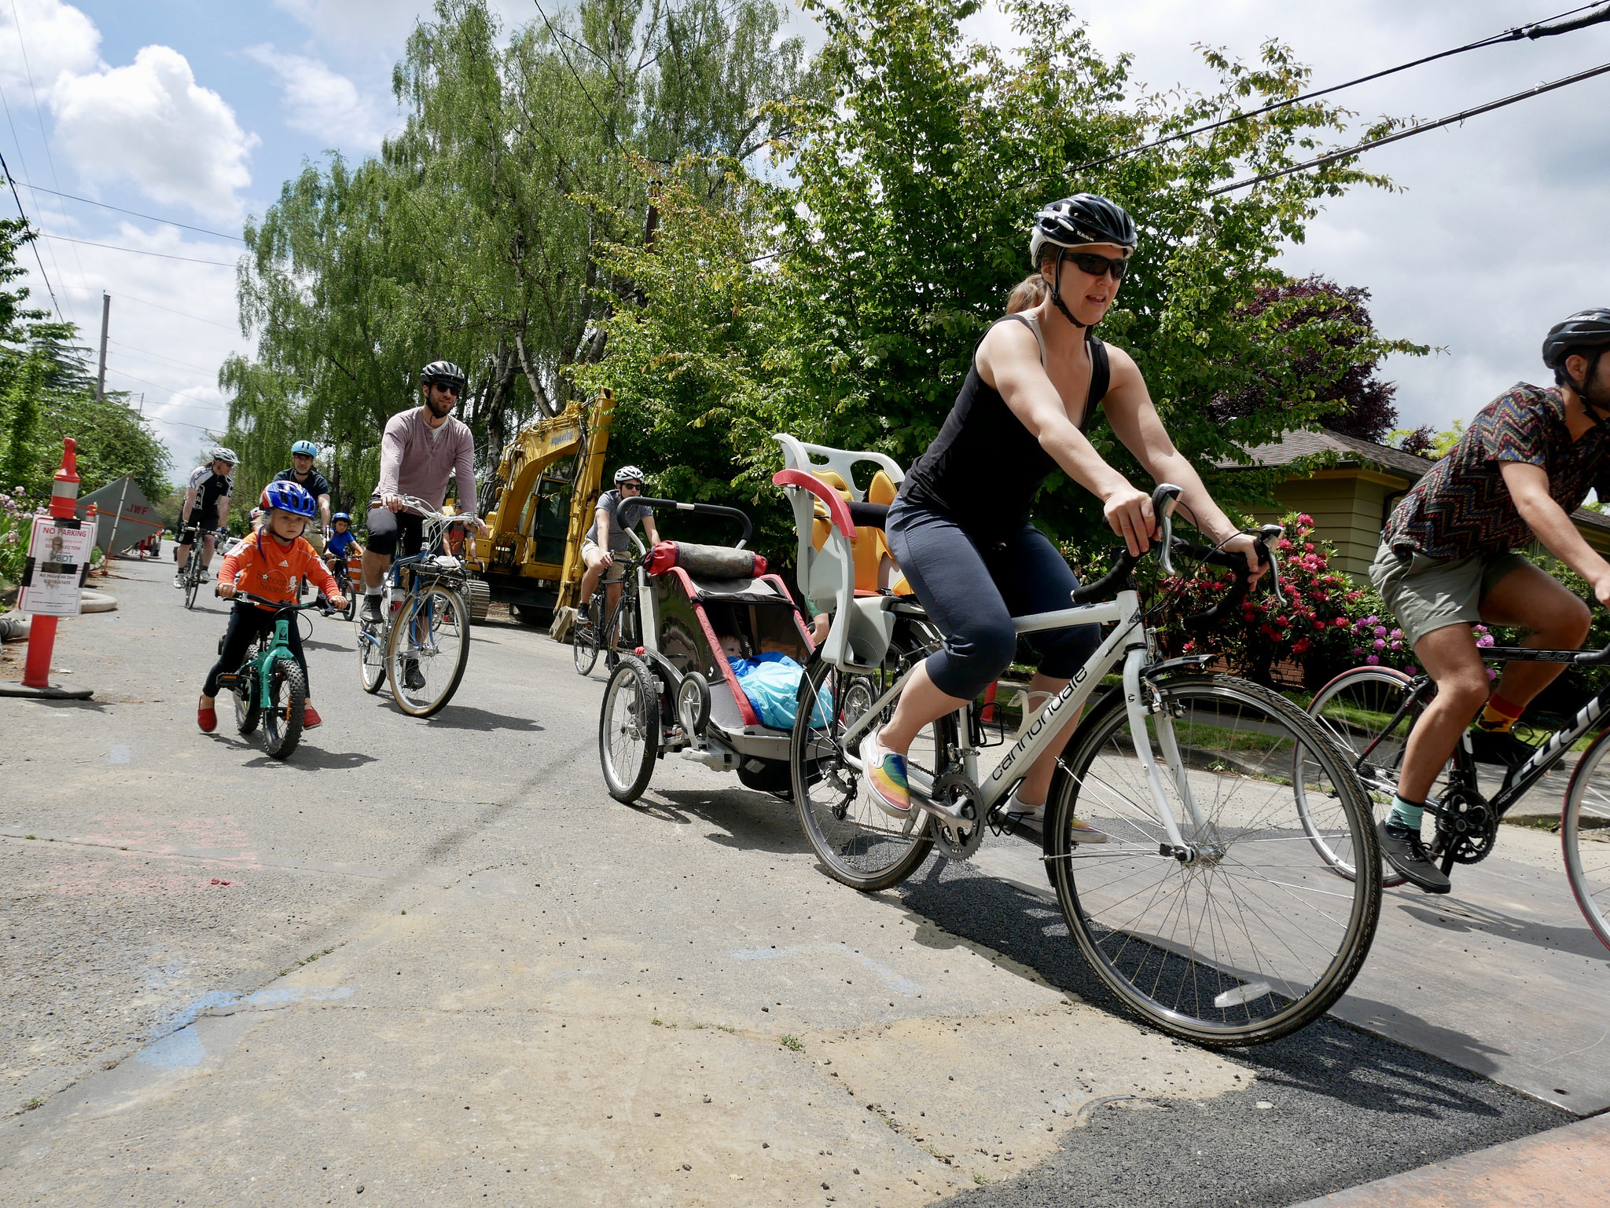
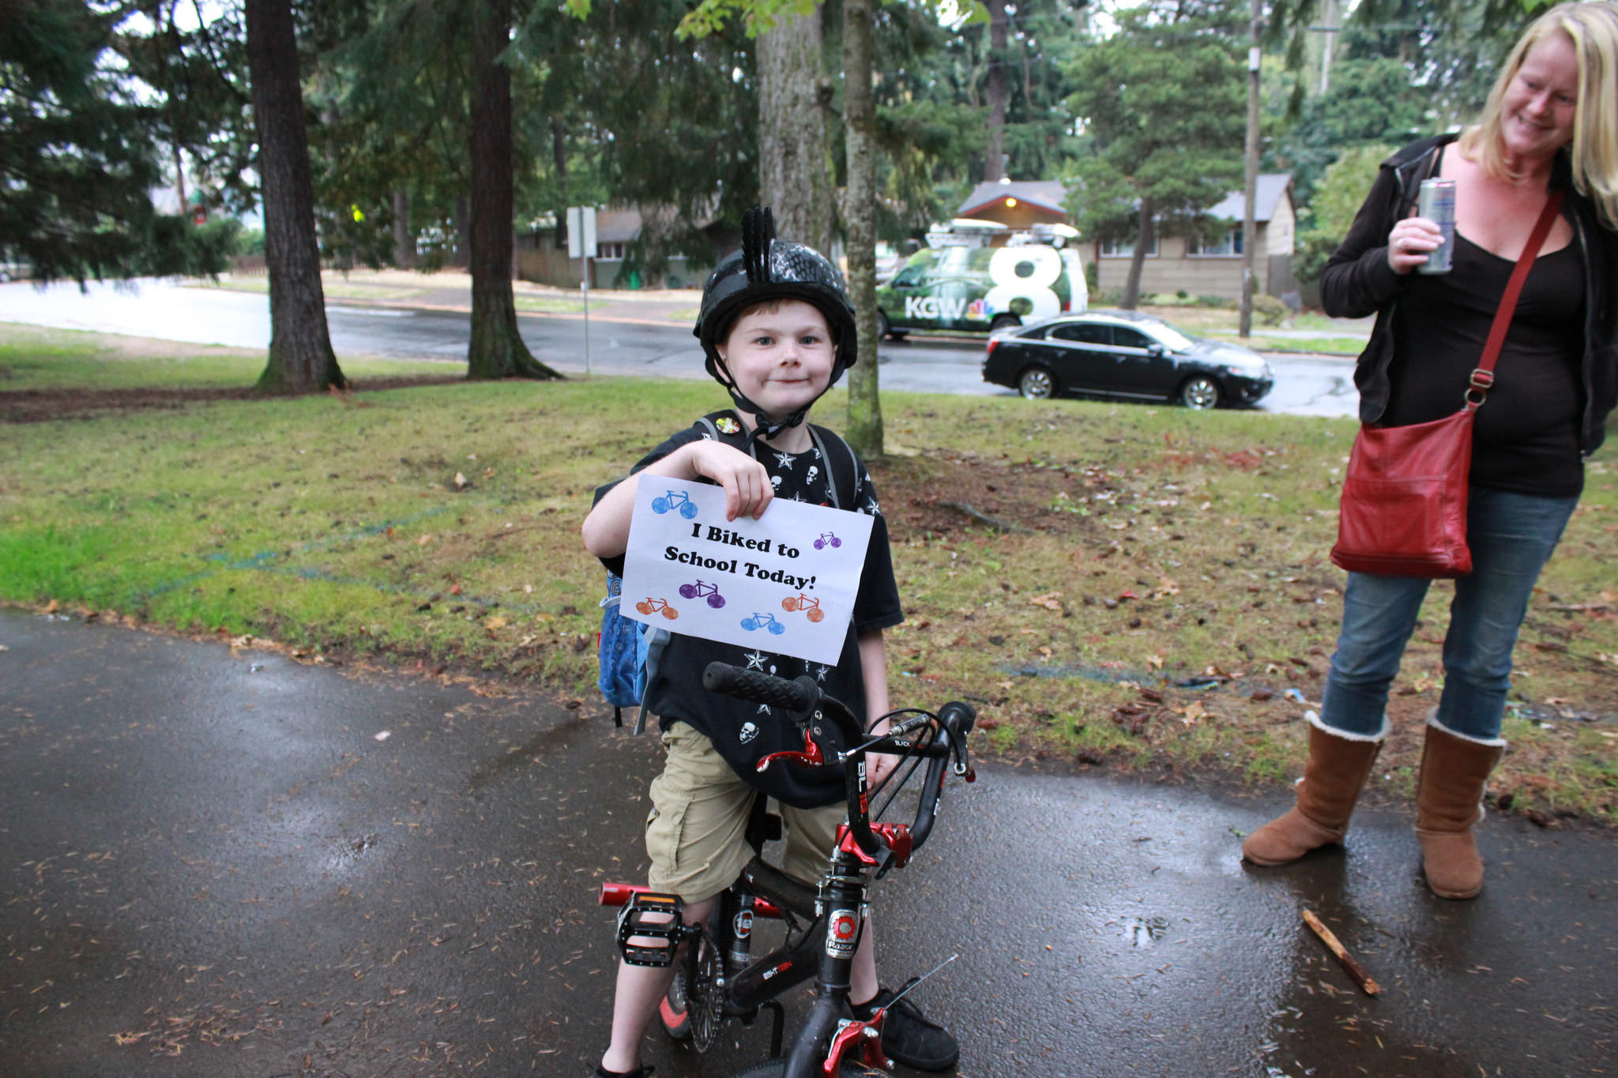
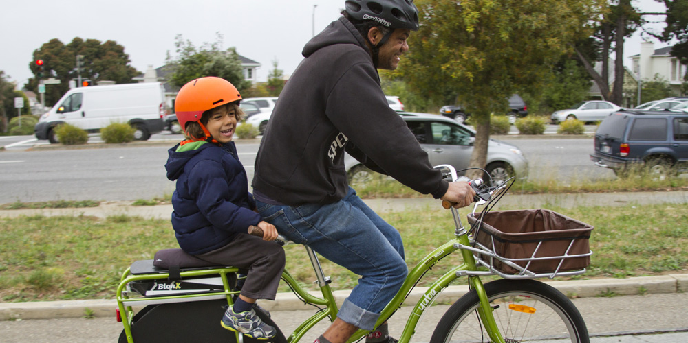
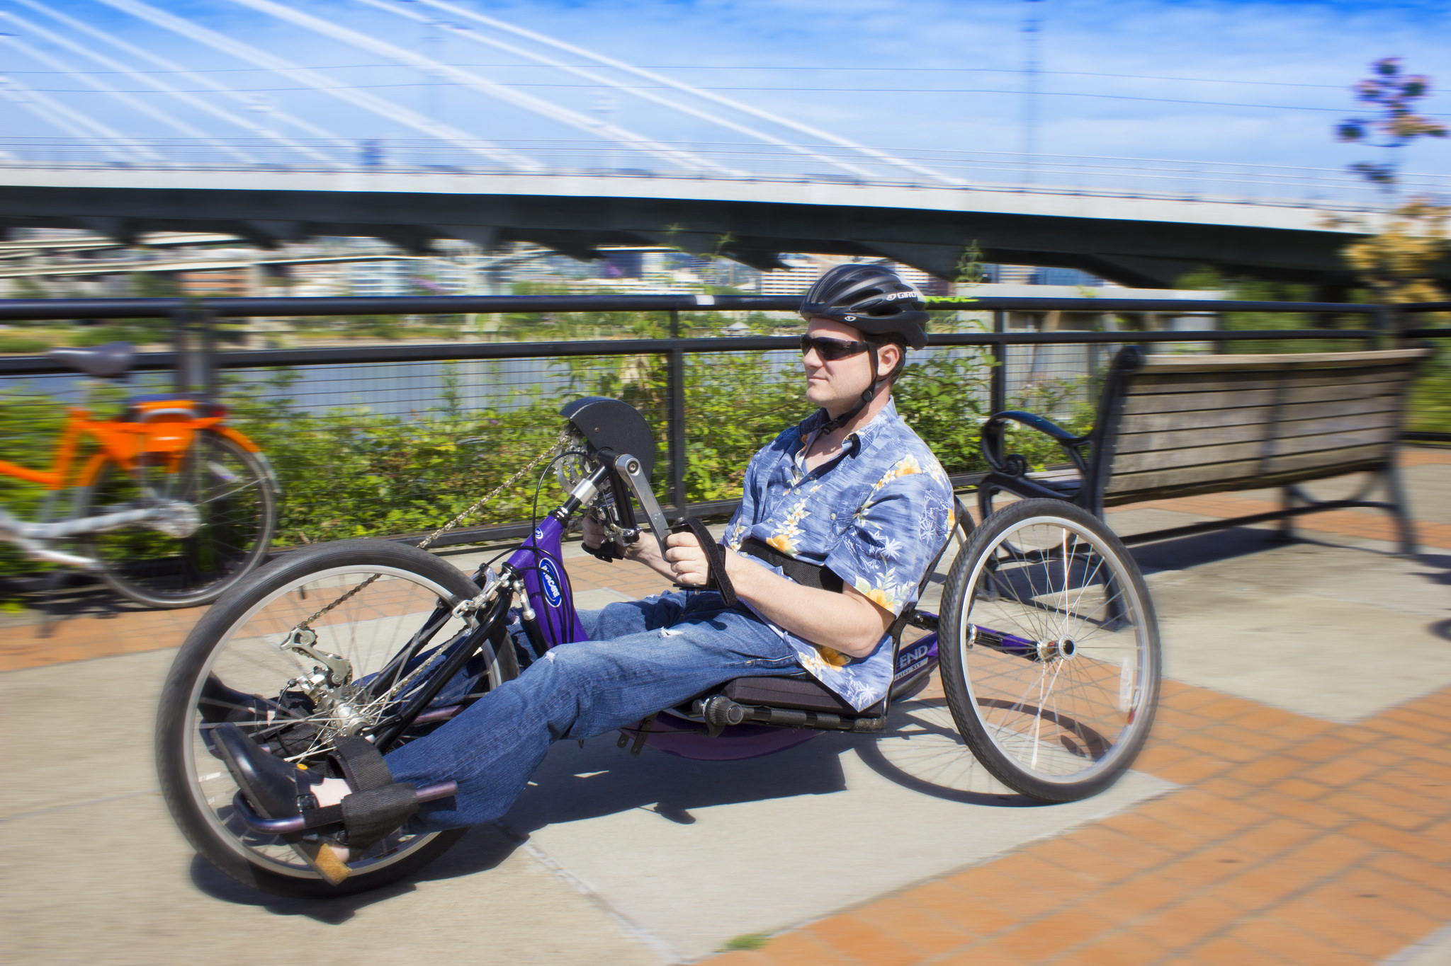
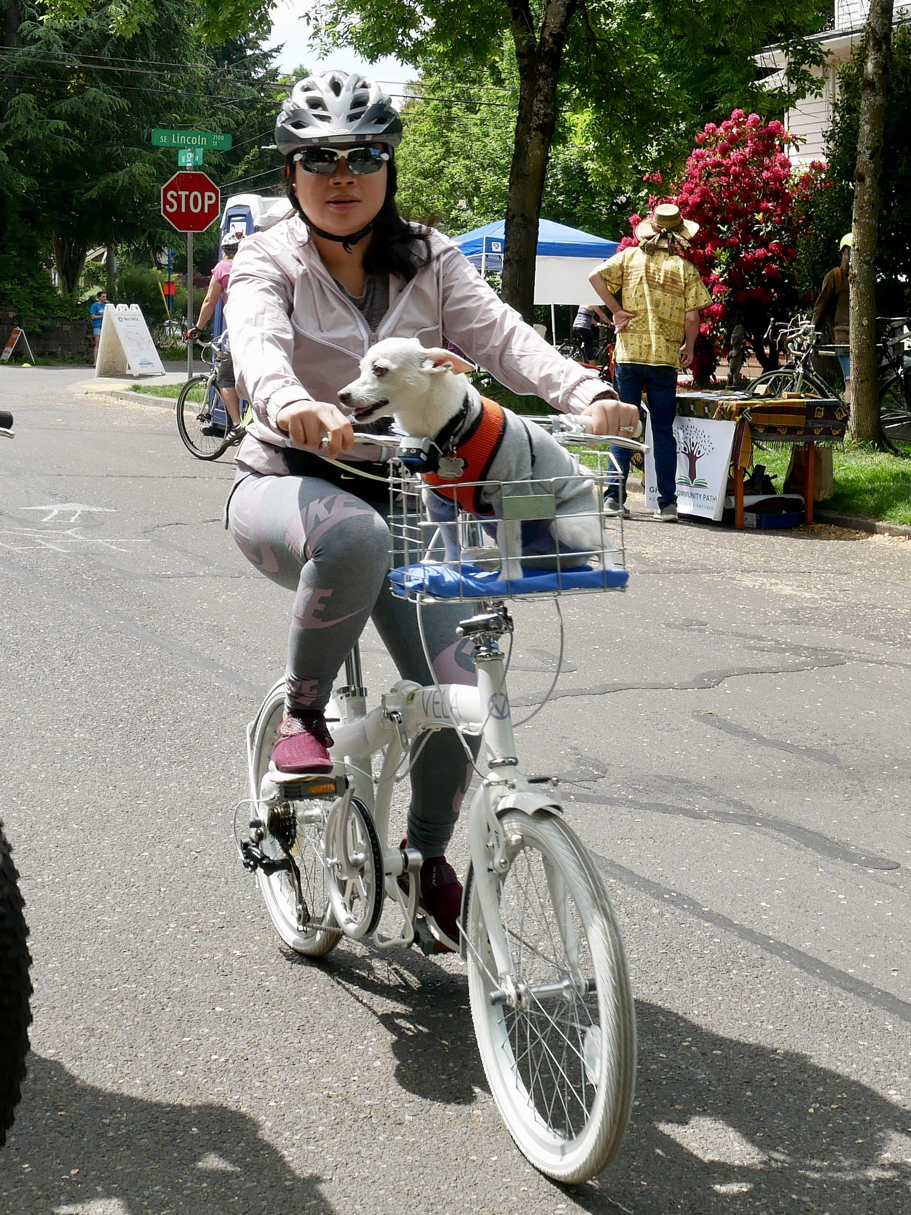
Notes:
and walking and biking are easy transportation options for much of our day to day needs.
HIDE FOR DC
This slide shows photos of people with their bikes who benefit from good bike parking, both types of riders and types of trips that we anticipate
this slide can speak to short and long term parking needs and why we have different provision in code.
Might also be able to speak to the details found in the following slide – code covers requirements for location, security, rack design and amount of parking.
Look at bikeportland.org flickr stream for photos

Slide 5
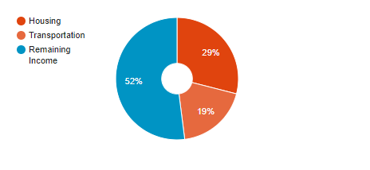
Transportation is the second highest household cost
In Portland the average housing + transportation costs by percentage of income:
Notes:
DC:
And we know that walking and biking are important low cost transportation options for today's Portlander's as well as future Portlanders. Transportation is the second highest household cost; it costing approximately $9,000 a year to own and maintain a car. For many households the inclusion of walking and biking to local destinations can reduce the number of vehicles that their household needs to invest in.
****
Finally, transportation is the second highest household cost for Portlanders, and bicycle parking is one way to support a low cost transportation option for Portlanders.
It costs approximately $9,000 a year to own and maintain a private vehicle. While owning and maintaining a bicycle is a fraction of that cost.
However, people can’t use a low-cost transportation solution like biking, if they are constantly worried about it being stolen or have no place to store and lock their bicycle.
Since low-income households have higher housing and transportation cost burdens than higher income households, providing lower cost transportation options and making it easier for people to use low cost transportation options is extremely important.
2 cars: http://time.com/money/4254578/save-by-selling-car/

Slide 6
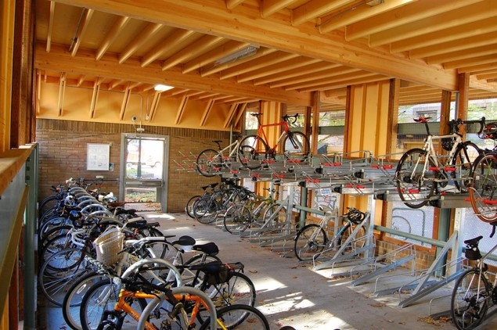
Importance of End-of-Trip Facilities
Bicycle parking is a key component of creating an attractive and functional bicycling network.
Notes:
DC: We also know that in order to support today's households or future households that want to bike, a safe place to store their bikes at home as well as their various destinations is needed
And we know that the lack of safe and convenient bike parking has a direct impact on whether those individuals choose to bike or even own a bike.
*****
We know the lack of a safe, accessible, convenient bicycle parking creates a barrier for people who want to choose bicycle for transportation or recreation.

Slide 7
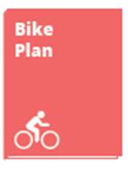
Policy direction
The 2035 Comprehensive Plan and Portland Bicycle Plan for 2030 call for the requirement of sufficient, usable bicycle parking in new development and redevelopment, including spaces for different types of bicycles and persons with different levels of ability.
Notes:
DC: For these reasons Portland has adopted policies and actions that support requiring bicycle parking in private development.
*******
First, there are very specific policies and actions in our city policy documents call for updating our bicycle parking requirements for private development.
In addition to the 25% target bicycle mode split by 2035, the Comprehensive Plan directs us to, quote:
Require the provision of adequate off‐street bicycle parking for new development and redevelopment.
Encourage the provision of parking for different types of bicycles.
In establishing the standards for long-term bicycle parking, consider the needs of persons with different levels of ability.
Further, the Portland Bicycle Plan for 2030, adopted in 2010, directs us to quote, “Seek changes to regulations to ensure all land uses provide ample bike parking and end-of-trip facilities.”
***********
However the Comprehensive Plan also outlines a number of other policy goals, including Equitable Transportation and Housing Affordability. This project is working to balance those policy priorities.
Policy 9.20 Bicycle transportation. Create conditions that make bicycling more attractive than driving for most trips of approximately three miles or less.
[Summary:
1) Council adopted plans, such as Comp and Bike Plan, specifically call on staff to require adequate off-street bicycle parking for new development and redevelopment.]

Slide 8
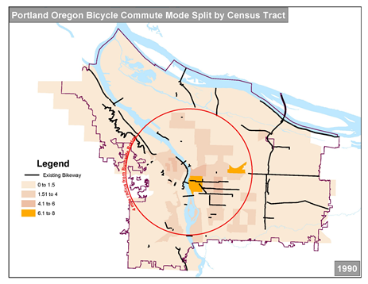
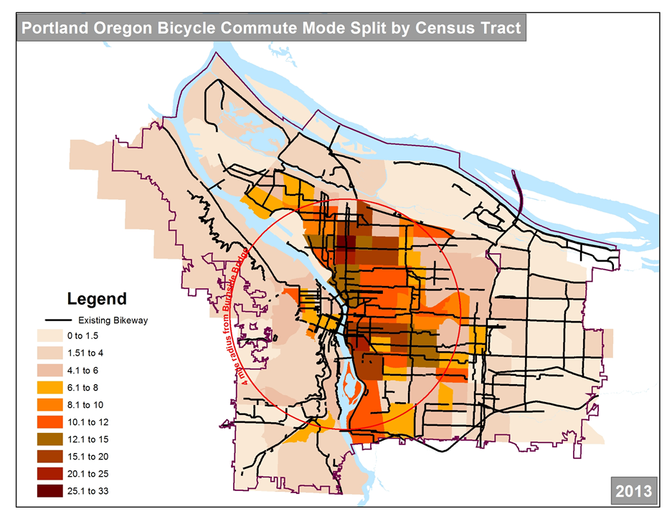
Requirements have not kept pace with growth
We have seen a six-fold increase in commute mode split since most current required bicycle parking rates were adopted.
1.2%
7.2%
Notes:
DC: And since the majority of the rates of bicycle parking were established, we have seen a six-fold increase in the commute mode split in Portland.
******
Since the bicycle parking code was last updated, we have seen a six-fold increase in the commute mode split in Portland. And the requirements for bicycle parking have not kept up with this demand.
Additionally, with the recently adopted 25% bicycle mode split goal, the code standards are drastically out of date.
*The 2013 slide reflects data from the 5-year ACS data. So it covers the time period 2011-2015. I pick the middle year as the display year.

Slide 9
Majority of the Code hasn’t been updated in 20-years
2010 – Long-term amounts increased for multi-family dwelling use category and introduced a tiered standard for multi-dwelling amounts.
1996 – Introduced short-term and long-term requirements. Increased the required amounts and introduced incentives.
2004 – Short-term siting requirements and developed short-term bicycle parking fund.
Notes:
DC: However – this work is long overdue. The majority of the bicycle parking requirements have not been touched in the past twenty years with the exception of some specific and targeted changes; most notably an increase in the amount required for multi dwelling units in 2010 and updates to short term parking requirements in 2004
*****
While Portland is one of the leading bicycling cities in the United States, we have fallen behind.
Portland’s bicycle parking requirements for private development no longer reflect a platinum bicycling city, particularly as city after city has updated their code to reflect best practices in design and to reflect increases in actual and target bicycling rates.
While we have been incrementally updating small elements in code, the majority of the bike parking section, including the majority of the required amounts table, have not been updated in the past 20 years.
Which leads us to why we are here in front of you today.

Slide 10
Issue Scoping and Community Input
Notes:
And this leads us to our recent efforts updating this section of code.

Slide 11
Bicycle Parking Code Update
Bicycle parking requirements are in Title 33.266.200 within the Parking, Loading And Transportation And Parking Demand Management Chapter of the City of Portland Zoning Code and apply to new development and major redevelopment.
Bicycle Parking Code Includes:
Location requirements
Amount of required bike parking
Rack design requirements
Security requirements
1
2
3
4
Notes:
The Bicycle Parking Code Update Project is focused on ensuring new development and major redevelopment is providing adequate, secure and convenient short- and long-term bicycle parking. This is on-site bicycle parking and does not address bicycle parking in the ROW.
Also handbook. …..
Briefly, there are two types of bicycle parking that the code addresses.
Short-term Bicycle Parking is for visitors, typically for people who need to lock their bike for less than two hours. The bike parking is usually uncovered, and located near a building main entrance. The focus on short-term bike parking is to be visible and convenient for use.
Long-term Bicycle Parking is for residential, workplace, transit and student needs, where the bike is typically parked for longer than 2 hours. Long-term bicycle parking is covered and secure.
The code includes, location requirements, rack design standards, security requirements, and the amount of required bike parking depending on the category of use (office, retail, medical centers, etc)

Slide 12
Where are we in the project?
Bicycle Parking Code Update Project Process
We are here
Stakeholder Advisory Committee
Develop early code update concepts
Discussion Draft
Public Outreach and comment period
Proposed Draft and PSC Hearings
Planning and Sustainability Commission
Recommended Draft and City Council
Comments due October 1, 2018
Notes:
HIDE FOR DC presentation
[Summary:
The draft recommendations are now in the Discussion Draft phase – and staff can work through comments through the end of September. ]
We are here today to present the proposals within the Discussion Draft of the Bicycle Parking Code Project.
The Discussion Draft is the point in time where staff can talk feedback and comment on the proposed updates to the bicycle parking code. After the Discussion Draft period – the Proposed Draft will be presented to the Planning and Sustainability Commission later this fall (slated for November 2018); and then a Recommended Draft will be presented to City Council in Spring 2019. There will be time for public testimony at both PSC and Council.

Slide 13
Stakeholder Advisory Committee
Notes:
DC: We began scoping the key issues of this work back in February 2016 with the help of 14 member stakeholder/technical advisory committee that included a wide range of stakeholders from developers to architects to bicycle advocates.
Over its seven meetings, the Committee dove deep into these intricacies and issues of bicycle parking, and spent considerable time weighing the tradeoffs and compromises that needed to be made.
*****
Summary: the draft code provisions were developed with the support a stakeholder advisory committee that met over a period of 18 months ]
While those are the key facts that influenced the need to update the bicycle parking code chapter, PBOT also used a stakeholder advisory committee to guide the early code concept work. The Stakeholder Advisory Committee was convened in February 2016, and included a wide range of stakeholders from developers to architects to bicycle advocates.
This Committee also included representatives from other city bureaus, this combination of stakeholder and technical group, was important because of the key role that the Bureau of Planning and Sustainability and the Bureau of Development Services play in developing and implementing code, respectively.
Over its seven meetings, the Committee dove deep into these intricacies and issues of bicycle parking, and spent considerable time weighing the tradeoffs and compromises that needed to be made.

Slide 14
SAC Issues addressed by Discussion Draft
Bike theft and security concerns
Investigate standards that allow for flexibility in rack design and placement location
Current code has inconsistencies, omissions that make implementation difficult
Rack designs are not usable or accessible for all users and all types of bikes
Not enough bike parking for employees and visitors
Address the complaints from users regarding the exclusive provision of in-unit bike racks
Notes:
DC: the SAC members began their work by identifying a list of issues to address.
Some of the major issues the Committee wanted to tackle during this process, include:
ensuring that there was enough bike parking,
to fix the current inconsistencies and omissions in code that has made implementation difficult, and
to address complaints from users regarding bike parking security concerns and usability issues.
****
The Committee was tasked with addressing a very long and robust scope of work. The scope was developed out of issues raised and identified by staff, from the Committee members themselves, as well as from users of bike parking, and the development community that is tasked with building it.
Some of the major issues the Committee wanted to tackle during this process, include:
ensuring that there was enough bike parking,
to fix the current inconsistencies and omissions in code that has made implementation difficult, and
to address complaints from users regarding bike parking security concerns and usability issues.
Over its seven meetings, the Committee dove deep into these intricacies and issues of bicycle parking, and spent considerable time weighing the tradeoffs and compromises that needed to be made.

Slide 15
Community Engagement - Code Concept Development Phase
Security is top concern
Usability for all types of bikes and people
Preference to not store bike in-unit
Value flexibility in implementation
Who we talked to:
What we heard:
Stakeholder Advisory Committee
Apartment Community Survey
369 Responses
Site Visits and Case Studies
Online Open House
Notes:
[ Summary:
Recommendations were also vetted through other engagement efforts: online community surveys, online open house, site visits, presentations and one on one meetings with stakeholders ]
This also includes feedback we heard from DC and BDS…
Continued outreach….
In addition to the Stakeholder Committee, there were a number of other opportunities where the public could provide input to the code concepts that are include Staff conducted a number of other engagement opportunities to guide the code concepts that are included in the Discussion Draft:
Community Survey
Site Visits
Online Open House

Slide 16
Development Sector Concerns Addressed To Date

Slide 17
Further Community Engagement
Online Survey
One-on-One Meetings
Additional Site Visits
Presentations for community groups
Wonk Night Open House

Slide 18
Major Proposed Changes
Notes:
Now we want to highlight some of the key proposals that are in the Discussion Draft.
You have the full list included in the handout.
We are more than happy to go into details about the others afterwards.

Slide 19
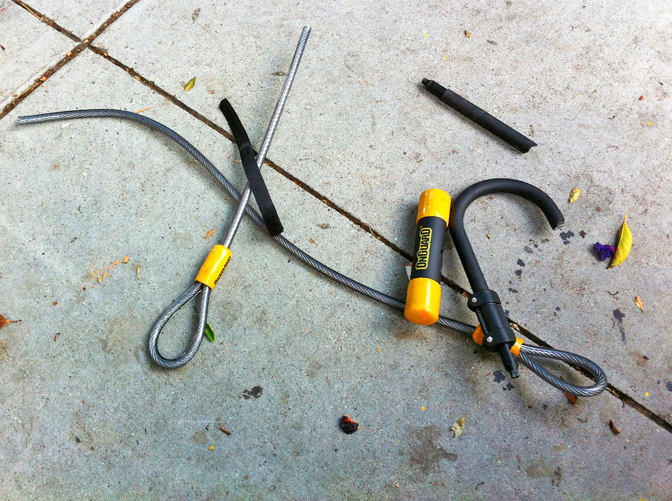
Challenge: Security concerns have grown
Portland Bike Theft Statistics:
~2,500 bike reported stolen annually
$2.5 million worth of property loss
Only 1 in 4 report stolen bikes to police
Concern about the security of bikes was the number one challenge to bicycle parking (27% of respondents).
- 2017 Bicycle Parking in Apartments Community Survey
Notes:
DC
First, We have heard directly from Portlanders that bike theft is one of the top concerns. Nearly, 2,500 bikes are stolen per year in Portland, yet we know that only 1 in 4 are reported to the police.
******
To begin, we hear that bike theft and security are of paramount importance to Portlanders.
Typically about 2500+ bikes are reported stolen every year. $2.5 million worth of property loss. Only about 1 in 4 report their stolen bike to us,
We know that codes' existing security provisions are weak – within view of an attendant for example or monitored by a security camera

Slide 20
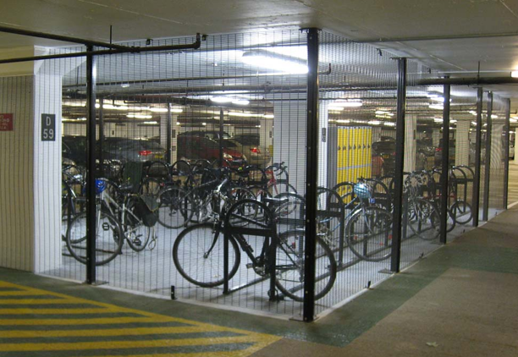
Proposal: Security standards
Long-term bicycle parking must be located in one of the following:
A restricted access, lockable room or enclosure, designated primarily for bicycle parking;
A bicycle locker; or
In a residential unit (per standards).
Other cities that require restricted access rooms for security:
Eugene, OR
Berkeley, CA
Los Angeles, CA
Notes:
As a result, the proposal removes some of the weaker standalone provisions in current code, like being within 100 feet of an attendant or relying solely on a security camera that may or may not be functioning at the time. And puts the emphasis on bike parking being in a restrict access area/ room/ enclosure.

Slide 21
Challenge: Current code limits spacing flexibility
What we have heard:
Staff have been approving adjustments and modifications closer spacing for vertical racks for 5 years.
Adjustments and modifications add time and cost to projects.
The use of space saving racks improve project feasibility.
For every 8 bikes, 3 additional bikes will fit in the same space
Notes:
Next, current code limits the use of space efficient racks – racks with narrower spacing.
While staff have been approving space saving racks for years, a developer was required to get an adjustment or modification, and that adds time and cost to a project.
We know that these types of racks maximize space and thus increase the number of bikes that can fit in a space.
For every 8 bicycle spaces required, new draft spacing provisions will allow an additional 3 bicycle parking spaces in the same amount of required space.

Slide 22
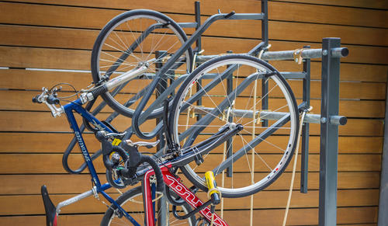
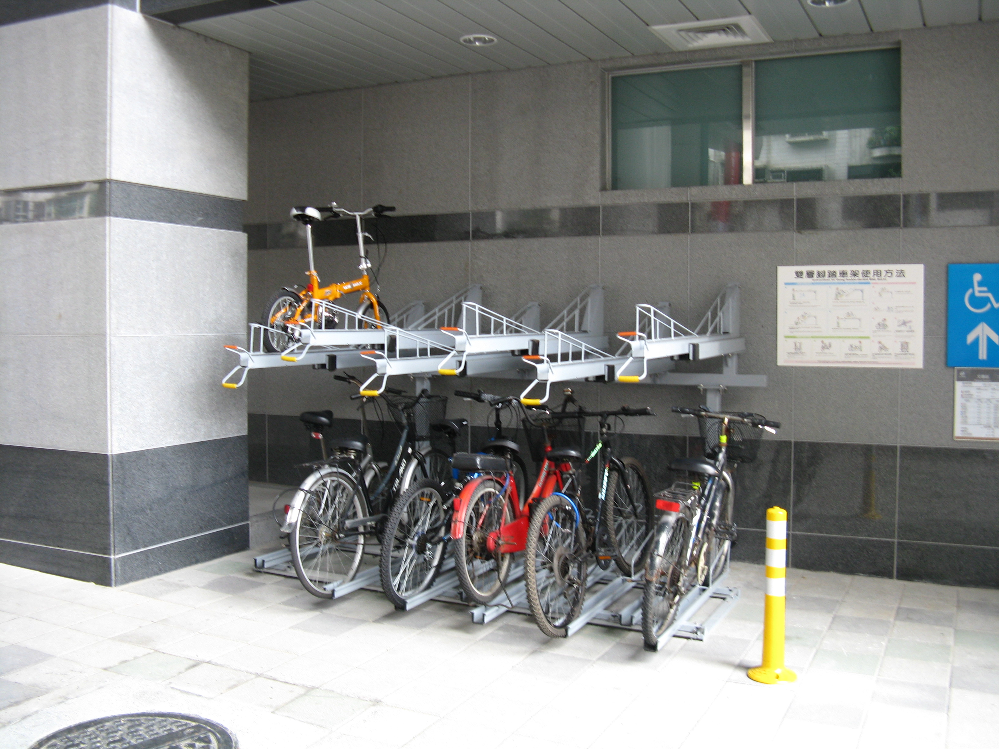
Proposal: Space Saving Racks
Stacked Spaces:
Minimum 1 ft. 5 in. (17-inch) spacing between each rack space, with vertical stagger.
8-foot maneuvering aisle behind rack.
Must include lift assist.
Vertical Spaces:
Minimum 1 ft. 5 in. (17-inch) spacing between each rack.
8-in vertical stagger.
3 ft. 4 in. (40-inch) depth measurement.
Notes:
This gave staff the opportunity to reassess the spacing requirements for a number of configurations.
Including reducing the space needed for vertical and stacked racks.
The inclusion of a stagger reduces handlebar and pedal conflicts while maintaining functionality of the rack.
Finally, by codifying the standards, there is benefit to the streamlining of the permitting process, as developers will not need to spend time and money on the adjustments and modifications for these space efficient racks.

Slide 23
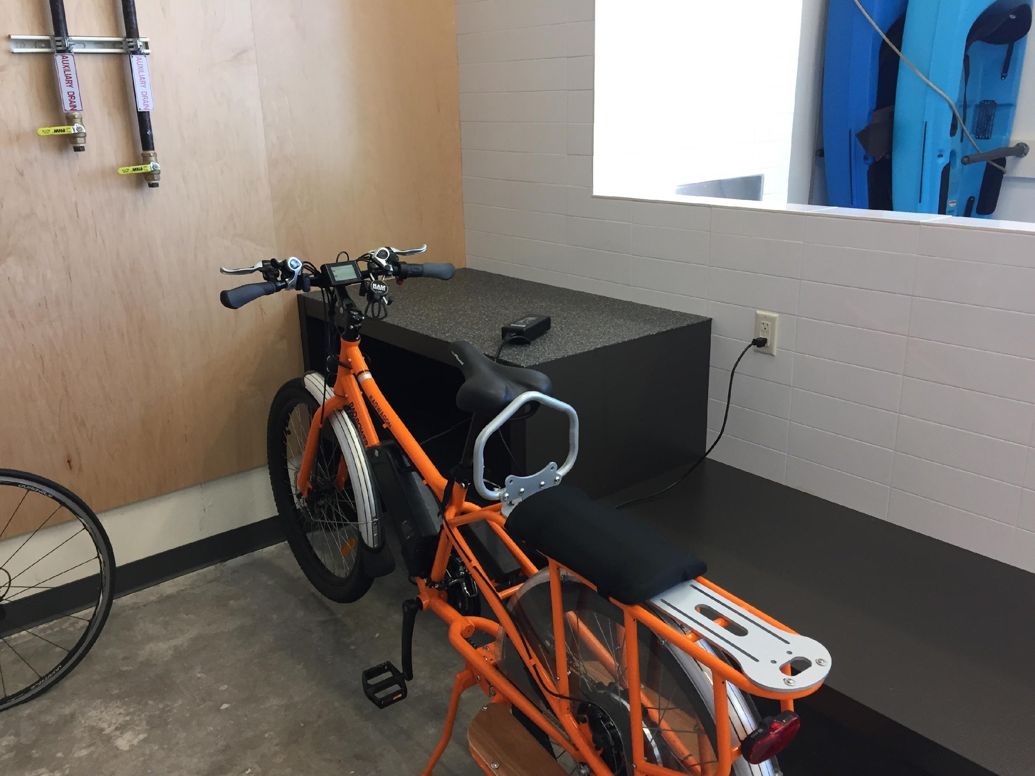
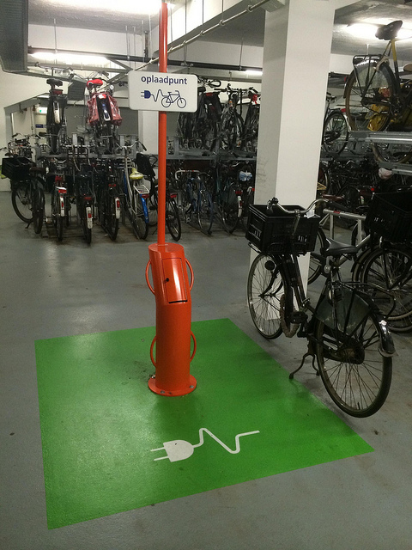
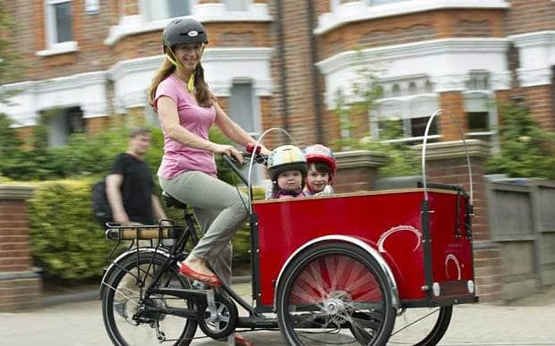
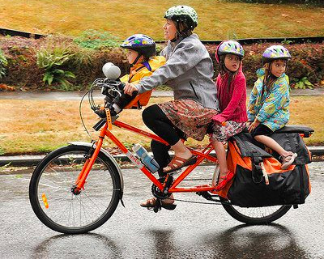
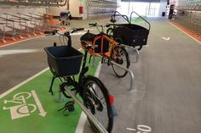
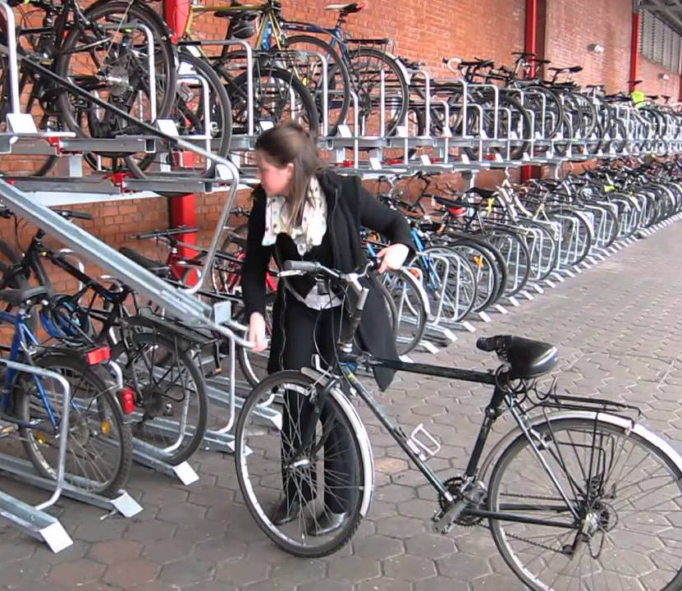
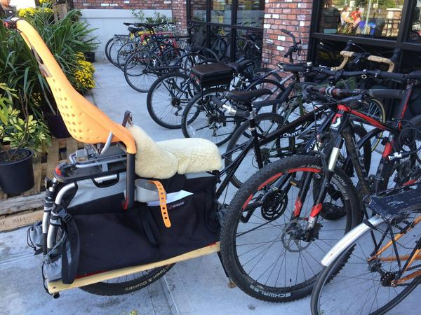
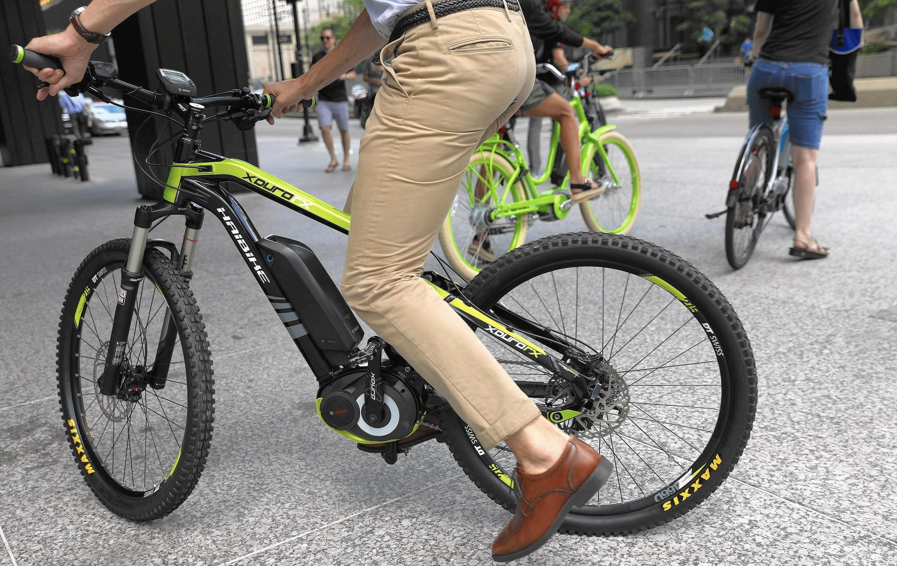
Challenge: Racks don’t work for me
Notes:
Another challenge, is that the code’s design and spatial requirements have not kept up with the types of bikes people are riding today, or meeting the needs of all types of riders.
In fact, 27% of the respondents on our Community Survey reported owning some other type of bike, e-bike, cargo bike, tricycle, etc. (225 responses on that question).
**********
If asked: Bike ownership information is not something that is easily available, however the following is some information that we have:
27% of the respondents on our Community Survey reported owning some other type of bike, e-bike, cargo bike, etc. (225 responses on that question).
The industry does not have numbers of ownership or local sales, especially at the local level. There are some national numbers of sales. Over the last couple years, I believe there has been about 10-15% growth. For Portland, I think this is on the higher end but it is slightly anecdotal.
10% of PBOT survey respondents said they owned an ebike. (202 respondents 8/22)
37% of survey respondents said they owned a larger footprint bike. (201 respondents 8/22)
Global electric bike market projected to grow 60+% by 2025
No clear pdx stats but testimonials from bike shops say they have seen significant growth in e-bike sales over last 4 years
Fastest growing bike category in the industry for the past few years
201 survey responses (August 2018)

Slide 24
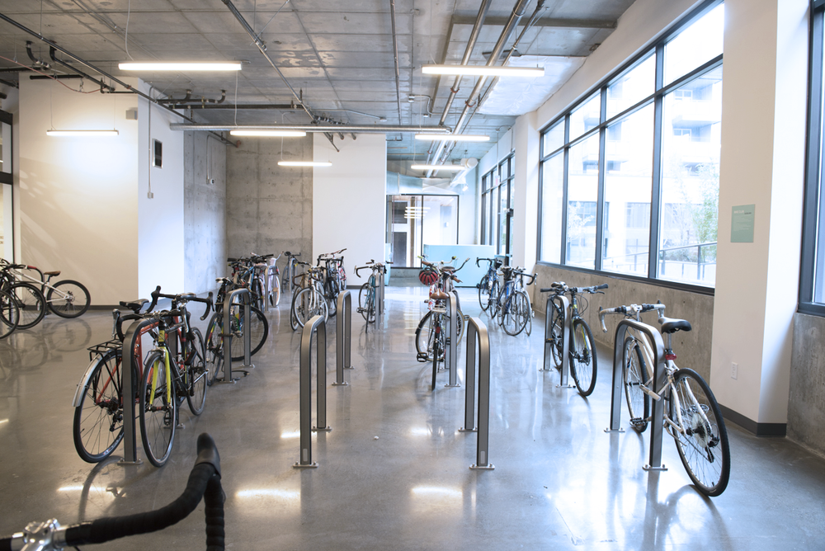
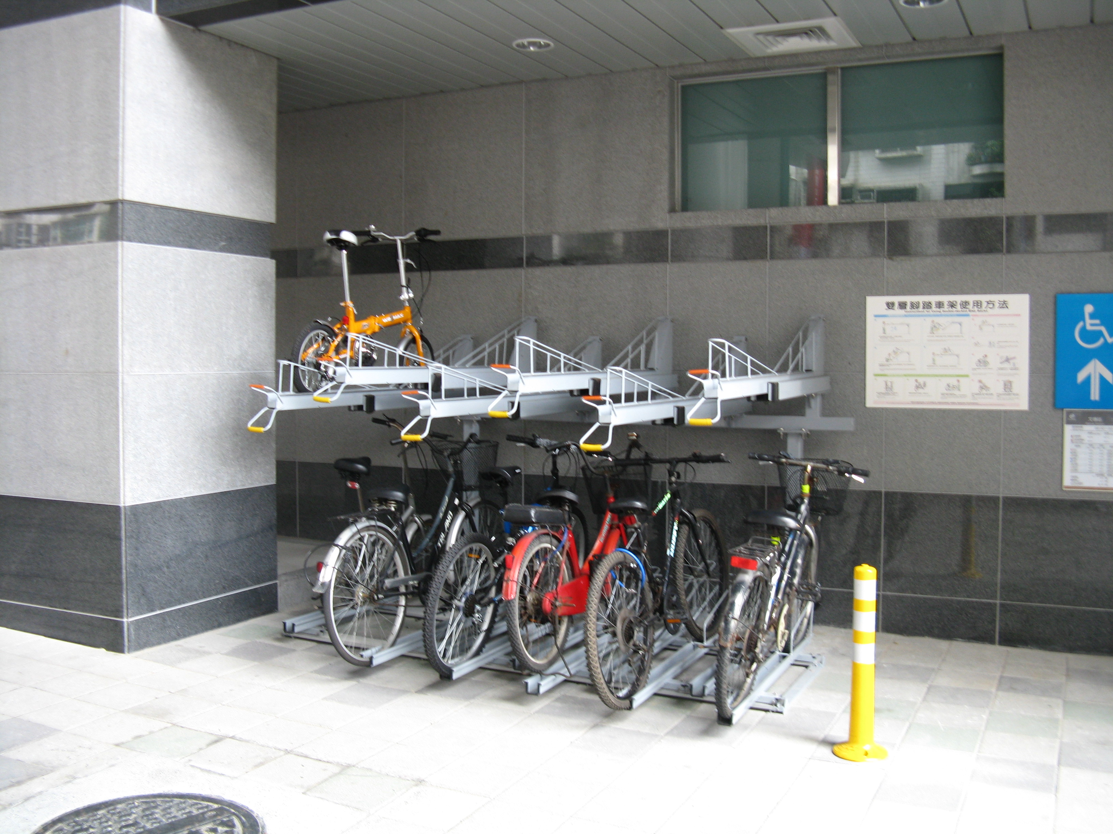
Proposal: Require horizontal racks
If more than 20 long-term spaces are required then 30% of required spaces must be in horizontal racks.
Other cities that limit vertical bicycle parking:
San Francisco, CA
Arlington, VA
Vancouver, BC
Fairfax County, VA
Notes:
Our stakeholder group and staff pushed hard to reduce spacing requirements; however to get to that compromise it was very important that provisions were included to ensure bicycle parking is usable for all people and types of bicycles.
As such the Discussion draft includes the following provisions:
a minimum percentage of horizontal racks so everyone doesn’t have to lift their bike onto a vertical wall-mounted rack,

Slide 25
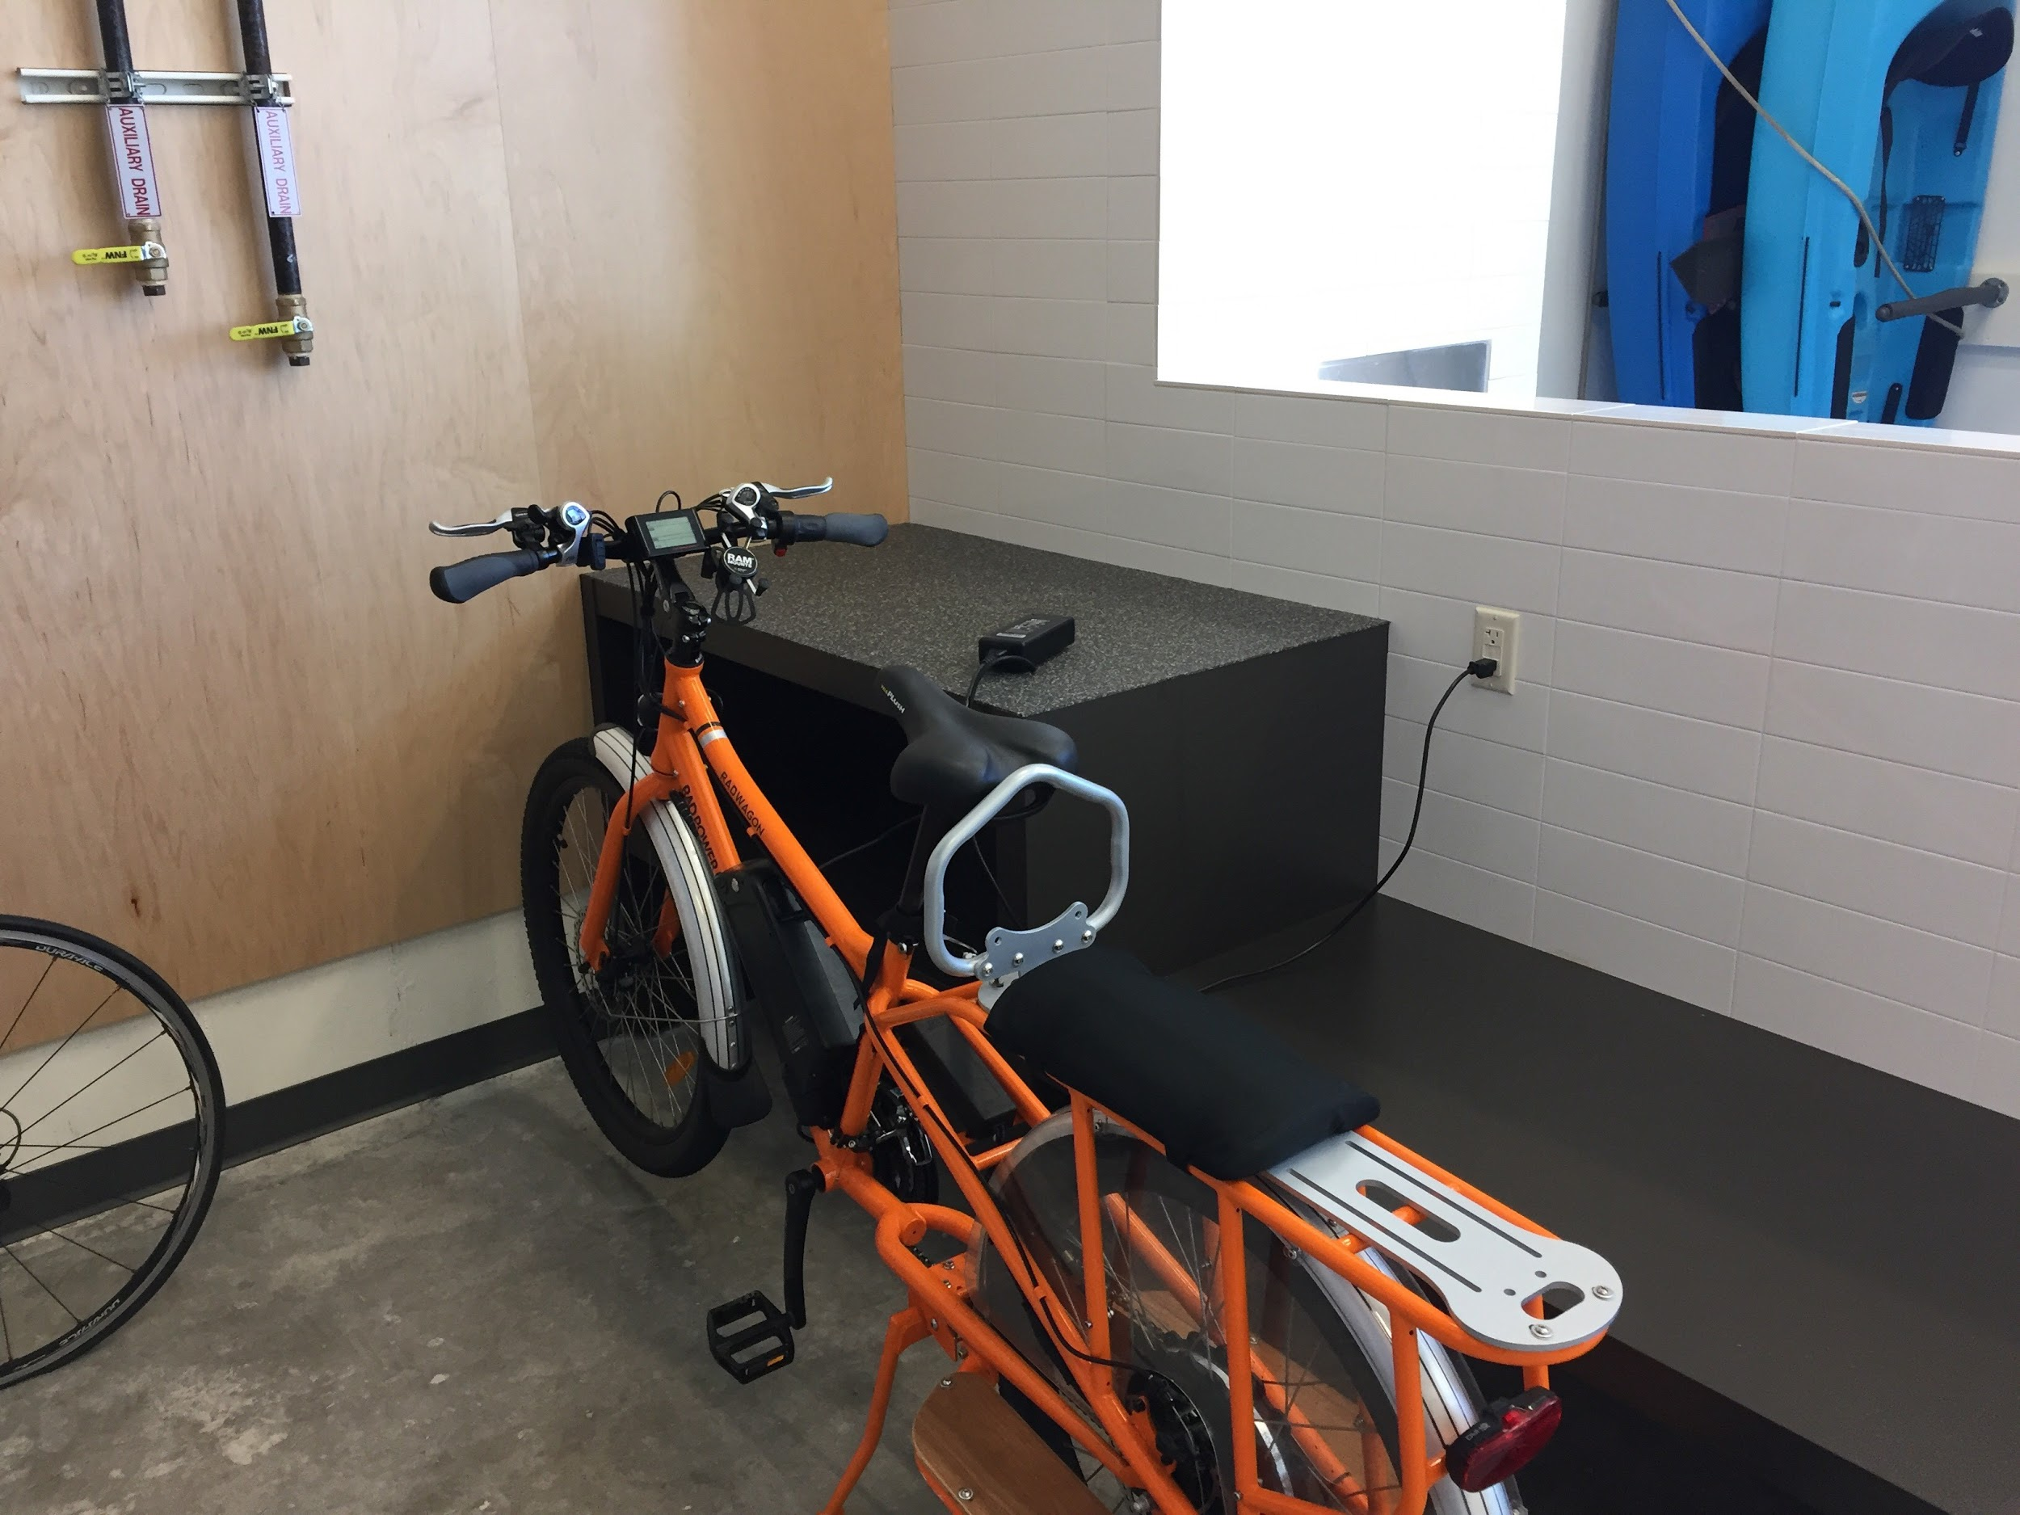
Proposal: Space for larger bikes and e-bikes
If more than 20 long-term spaces are required then:
At least 5% must accommodate a larger bicycle footprint of 3’ x 10’.
At least 5% must have power outlet accessible to horizontal space.
Other cities that require space for e-bikes:
Santa Monica, CA
Fairfax County, VA
Vancouver, BC
Eugene, OR
Other cities that require space for larger bikes:
Santa Monica, CA
Cambridge, MA
Eugene, OR
Notes:
As well as:
Spaces to accommodate e-bikes and non-traditional sized bikes like cargo bikes and long-tail bikes, and
A provision that double-decker racks must include a lift assist mechanism, to aid in the parking of a bike on the upper tier.
Staff looked to balance the desire to increase flexibility while still ensuring usability of bicycle parking.
One final note here – these requirements only apply to developments that have over 20 required long-term bicycle parking spaces. The reasoning is to not overly burden smaller projects where only a couple long-term spaces are required.
Respond to DC and BDS comment on e-bikes..

Slide 26
Challenge: Long-term bike parking in-unit
What staff have heard:
Bicycle racks are being placed in unusable locations in the unit.
Bicycle racks are removed and not returned when new tenants move in.
Damage deposits are being lost when wet, muddy bikes are parked in residential units.
In some projects, all of the long-term bicycle parking is provided in-unit.
A strong user preference to park their bikes in a secure bicycle parking room (from PBOT Community Survey, 2017).
Notes:
We have heard that there are a number of challenges related to allowing required bicycle parking to be placed in residential units.
Our surveys show an overwhelming preference to have bikes be in secure bike rooms.
People are losing their damage deposits because of having to park wet, muddy bikes in their unit; and
Racks are being placed in unusable locations, like over the bed.
We haven’t only heard from residents. Property managers have shared their perspective and having to deal with removing racks from units, building damage from the bikes in the unit, and over crowded bike rooms because users prefer to use the small bike room over the hook in their apartment.

Slide 27
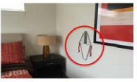
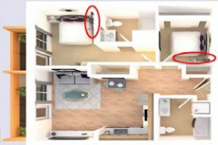
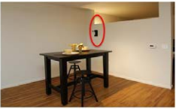
Issue: In-Unit bicycle parking
Other major cities don’t allow required bicycle parking to be placed within a residential unit:
San Francisco, CA
Vancouver, BC
Los Angeles, CA
Seattle, WA
Chicago, IL
Madison, WI
Cambridge, MA
Notes:
For these reasons, most cities in the United States do not allow bicycle parking spaces in an apartment unit or on a balcony to count toward the required long-term bicycle parking. For example, none of the following cities allow required long-term bicycle parking to be placed in-unit or balconies: San Francisco, CA; Vancouver, B.C.; Los Angeles, CA; Seattle, WA; Chicago, IL; Madison, WI; Cambridge, MA.
*****
We heard you in October…
Previous drafts tried to address the challenges with placement in the unit – including design requirements to avoid bad placement of racks, we heard from the development community and from BDS staff that, that was getting too far into the programming of the unit. And therefore, have developed the following compromise proposal….

Slide 28
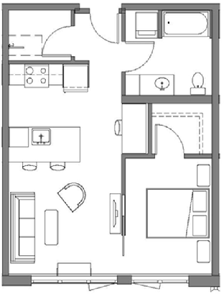
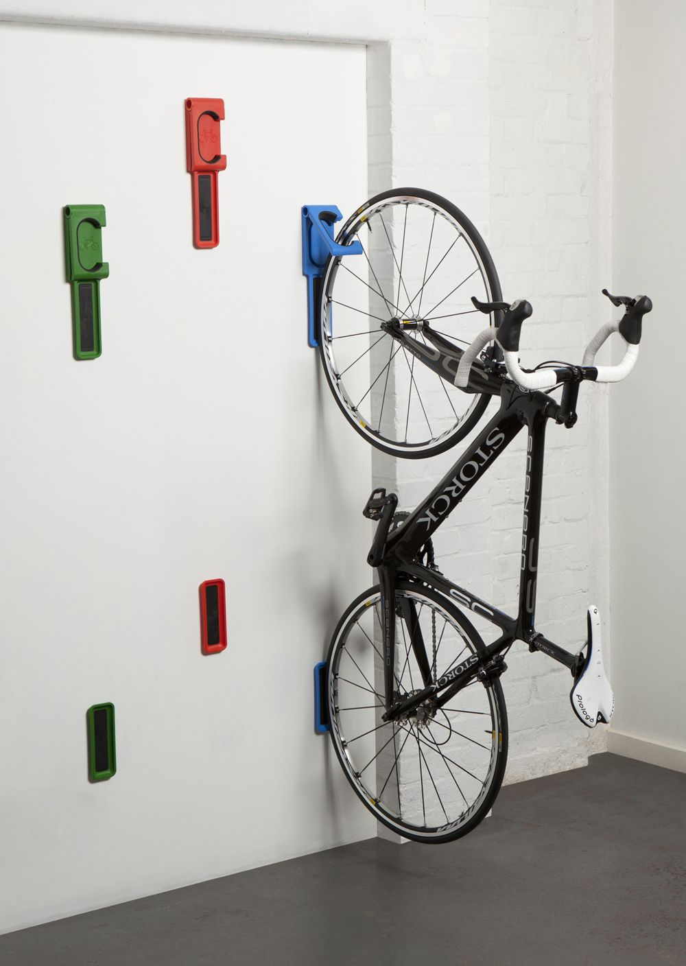
Proposal: Reduce the in-unit allowance
Up to 20% of required long-term bicycle parking spaces may be provided in a dwelling unit.
Must be provided in a rack, but reduced rack requirement.
Maintain the 5-foot maneuvering aisle.
No more than one required space can be in each dwelling unit.
No adjustments or modifications are permitted to this section.
Notes:
Therefore, staff have developed the following compromise proposal to address what we hear from users and property managers, but also that respond to the development community in not overly programming the unit space and the response that doing away with the in-unit requirement would be too much of a burden.
20% represents a big compromise

Slide 29
Challenge: Bike ridership not the same throughout the city
Notes:
As you can see, the rate of people commuting by bicycle is very different depending on geography, with more people that currently ride in the Central City and Inner Neighborhoods.

Slide 30
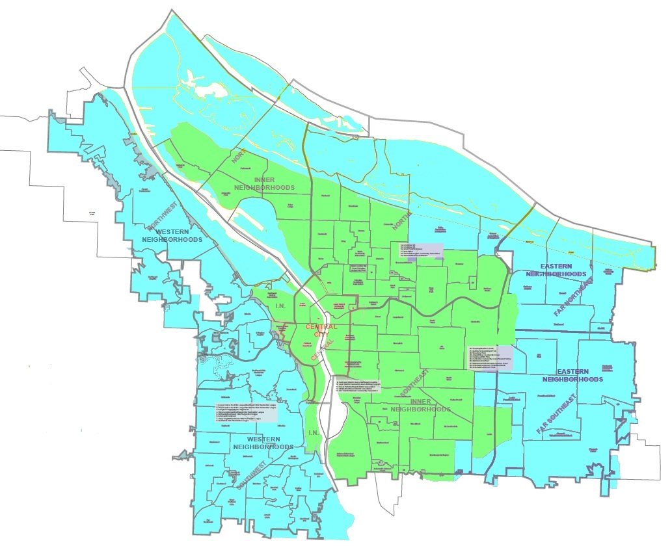
Proposal: Expand the use of geographic tiers
Standard A – Central City, Inner Neighborhoods, Gateway District
Standard B – Eastern and Western Neighborhoods and River
Notes:
Recognizing this, staff are proposing to utilize a tiered system for the amounts of required bicycle parking.
This is not a new strategy, current code includes tiered standards for the Multi-Dwelling uses, with one rate for the Central City and one rate for the rest of the City.
This strategy acknowledges the different ridership rates, while still proposing increases to the amounts, but at a higher rate in the Central City and Inner Neighborhoods.
A final map will be developed for final code and layers will be included in mapworks and Portlandmaps for ease of implementation.

Slide 31
Challenge: Not enough bicycle parking
“We are unable to store bicycles outside. Threatened with eviction if I continue to. Not able to hang inside and it took up too much space. Had to get rid of my bike.”
“No secure parking so bikes have to be brought all the way into the office and sit in what could be workspace.”
“We need more bike racks near shopping, banks, theaters, the post office, etc. Life is more than home and work.”
Notes:
We know people aren’t going to bike if they don’t have a place to park their bikes, whether that be at work, at the grocery store or the restaurant. In fact, the data shows that bicycle parking at the workplace is a major factor in whether people commute to work by bicycle.
We have also heard, through our survey work that if people don’t have a place to store their bike, especially at their apartment, they simply won’t own a bike.

Slide 32
Proposal: Update the minimum required amounts of bicycle parking
Long term bike parking rates for office use anticipates a future rate of 15% of employees commuting by bike
350 sq ft each
Amount of required bicycle parking based on:
Square footage per employee
Percentage of visitor rates
TSDC person trip rates
City’s target mode splits
Notes:
Therefore, one of the biggest components of the project was updating the amounts, which remember the majority of them haven’t been updated in 20 years.
The updates to the minimum required amounts are based on a number of data points, including average square footage per employee (long-term), visitation rates (short-term), and target mode splits (15% for long-term and 25% for short-term).
For example, for the Office Use Category:
We used a pretty conservative number of 350 square feet per employee
And a 15% commute rate to determine the amount of required long-term bicycle parking
We used this same methodology for the other use categories and the result are changes to almost all of the long-term and short-term amounts..

Slide 33
Comparative Rates from Peer Cities

Slide 34
Comparative Rates from Peer Cities

Slide 35
Comparative Rates from Peer Cities

Slide 36
Other proposed changes include:
Two-points of contact required for all bicycle racks
Access routes to bicycle parking cannot include stairs
All long-term bicycle parking to be weather protected
FAR exemption for long-term bicycle parking provided in bike rooms
‘Major remodel’ projects to be brought into compliance for all bike parking per non-conforming processes
Required auto parking areas can be converted to accommodate bicycle parking minimums
Notes:
We have walked you through some of the key changes. However, the project addresses a number of other updates, including:
(read through list?)

Slide 37
Next Steps
Notes:
Throughout this presentation, both Sarah and I have alluded to some of the next steps.

Slide 38
What’s Next?
Public comment open through October 1, 2018
Proposed Draft to Planning and Sustainability Commission in November
City Council in Spring 2019
Develop Bicycle Parking Best Practices Handbook
Notes:
So, what’s next?
The public comment period for the Discussion Draft is open through October 1st.
Staff will then prepare the Proposed Draft for the Planning and Sustainability Commission hearing in November.
The PSC is the next opportunity for public testimony, that will go directly to the PSC
A Recommended Draft will be prepared for City Council and a Hearing in Spring 2019
During this work – staff will also

Slide 39
Thank you.
Notes:
That concludes our presentation today, thank you very much for this opportunity. We are here to answer any questions you might have.

Slide 40
Office Use Category – Case Studies
Development Details | Current Code | Proposed Code | What was Provided
Framework (NE 6th and Davis) – 24,700 sq. ft. | 3 LT Spaces 2 ST Spaces | Standard A: 14 LT Spaces 2 ST Spaces | 14 LT Spaces = 1 per 1,764 sq. ft.
Clay Creative – 77,156 sq. ft. | 8 LT Spaces 2 ST Spaces | Standard A: 43 LT Spaces 4 ST Spaces | 95 LT Spaces = 1 per 812 sq. ft.
Pearl West – 167,000 sq. ft. | 17 LT spaces 4 ST spaces | Standard A: 95 LT spaces 8 ST spaces | 70 LT Spaces = 1 per 2,386 sq. ft.
Lot 5 Station Place – 167,000 sq. ft. | 17 LT spaces 4 ST spaces | Standard A: 95 LT spaces 8 ST spaces | 133 LT Spaces = 1 per 1,256 sq. ft.

