Slide 1
Foreclosure List 2018-02 August 8, 2018
Notes:
Good morning Presiding Commissioner, Commissioners
Marco Maciel, Foreclosure program manager
Gayla Jennings, Auditor’s Office
Mike Liefeld, Code Enforcement program manager with BDS
Brigid O’Callaghan City Treasurer
Also, Dan Simon, Deputy City Attorney with the City Attorney’s Office are all here as partners in this effort.
If you have any questions we are here to answer.

Slide 2
City Foreclosure Focused on Vacant and Distressed Properties
Focused effort to resolve nuisance properties
Minimize the adverse effects caused by these properties in the community
Bring these properties into productive use
Used as a last resort
Notes:
This is the fifth foreclosure list we have brought to Council since focused efforts began in 2016.
The objectives of the process are to resolve the nuisance properties that we have throughout the City.
Minimize the adverse effect caused by these properties in the community and bring these properties to a productive use.
Foreclosure is used as the City’s last resort to address vacant and distressed properties.

Slide 3
The City’s Foreclosure Efforts
Bureau of Development Services (BDS): recommends priority properties to the Auditor’s Office for foreclosure
Auditor’s Office: examines properties, determines which properties to submit to Council for foreclosure consideration, submits lists to Council
City Treasurer: conducts the foreclosure sale
City Attorney: identifies barriers to foreclosure and advises on legal matters
Notes:
These is a cooperative effort by the Bureau of Development Services, The Auditor’s Office, the Treasurer and the City Attorney’s Office.

Slide 4
Results of the Foreclosure Process
68 properties proposed for foreclosure by BDS
17 brought to Council for consideration
44 have paid in full
$1.96M recovered
Foreclosure activity has motivated resolution on many properties
Notes:
To date the efforts of the foreclosure process has resulted in
68 properties proposed for foreclosure by the Bureau of Development Services of which 17 have been brought to Council for vote and 44 have been paid in full.
The amount recovered is approximately $2,000,000 million dollars and the process has motivated many property owners to find a resolution to their properties. Based on our data, nearly 2 out of 3 properties that have been paid in full have been motivated by the foreclosure activity.

Slide 5
Properties Recommended for City Foreclosure
Four properties
13 liens
$67,673.02 owed
Two Extremely Distressed Properties Enforcement Program (EDPEP) cases and one distressed property with chronic maintenance violations
One property has a Mid-County Sewer project lien
Notes:
Today the Auditor’s Office is submitting to Council a list with four vacant and distressed properties with a recommendation to be foreclosed.
Each of the properties is vacant and distressed and has been consuming the limited resources that the City has to continue working toward improving livability, health and safety in our community.

Slide 6
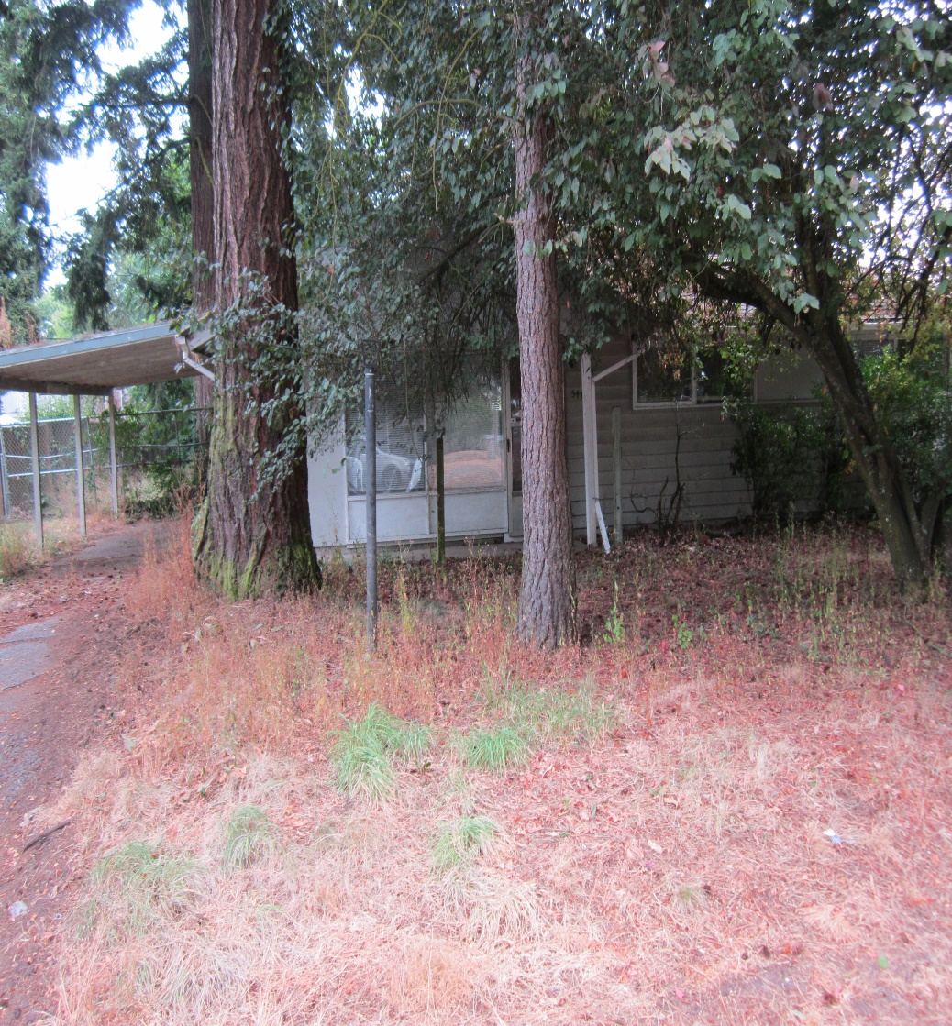
544 SE 137th Ave.
Seven liens against the property
Delinquency ranges from 2012 – 2017
Total amount owed: $31,374.02 (as of May 31, 2018)
Ownership: Oregon State of(DVA) CP: Norman Yee 19390576
Extremely Distressed Property Enforcement Program (EDPEP) case

Slide 7
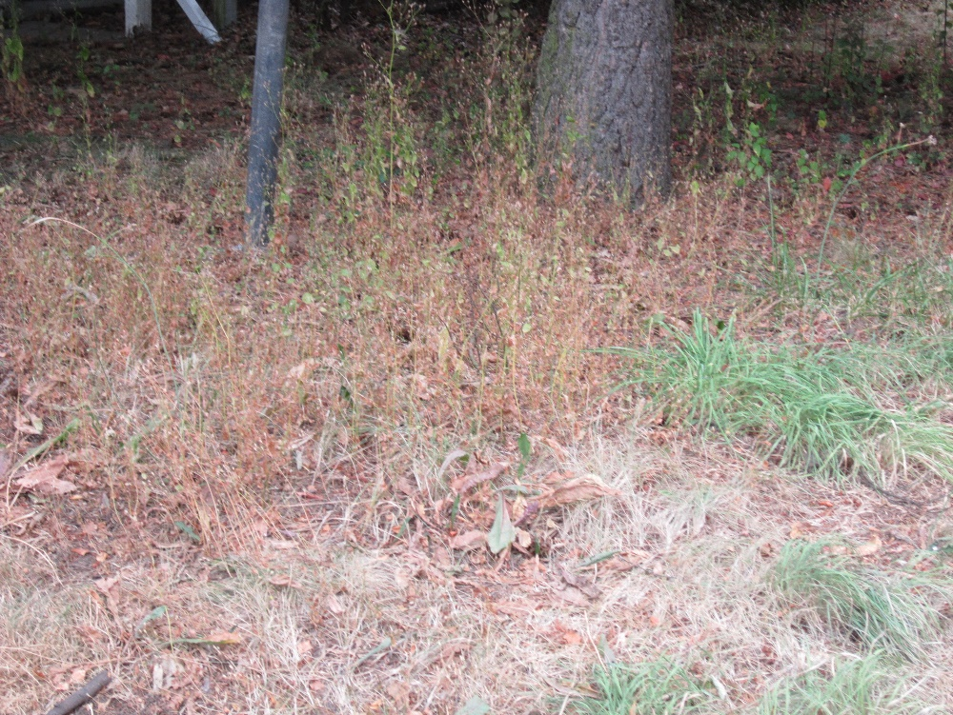
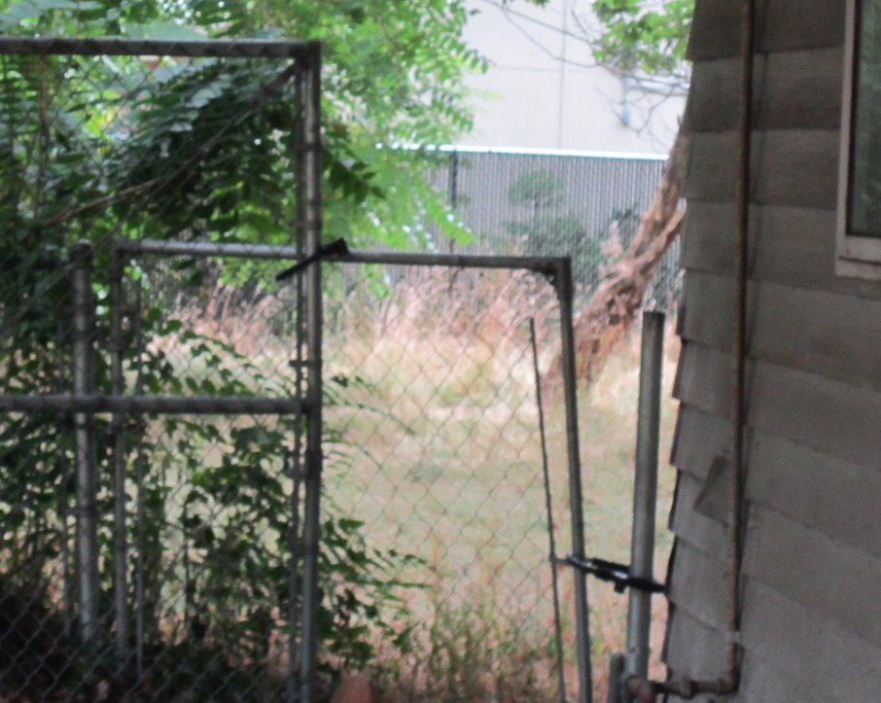
544 SE 137th Ave.
Multiple violations cited including Fire/Life/Safety and Health Sanitation Violations
26 police calls for service since May 2011
BDS has abated exterior yard nuisance issues twice
14 inspections performed by the City
Vacant, attractive for unlawful occupants

Slide 8
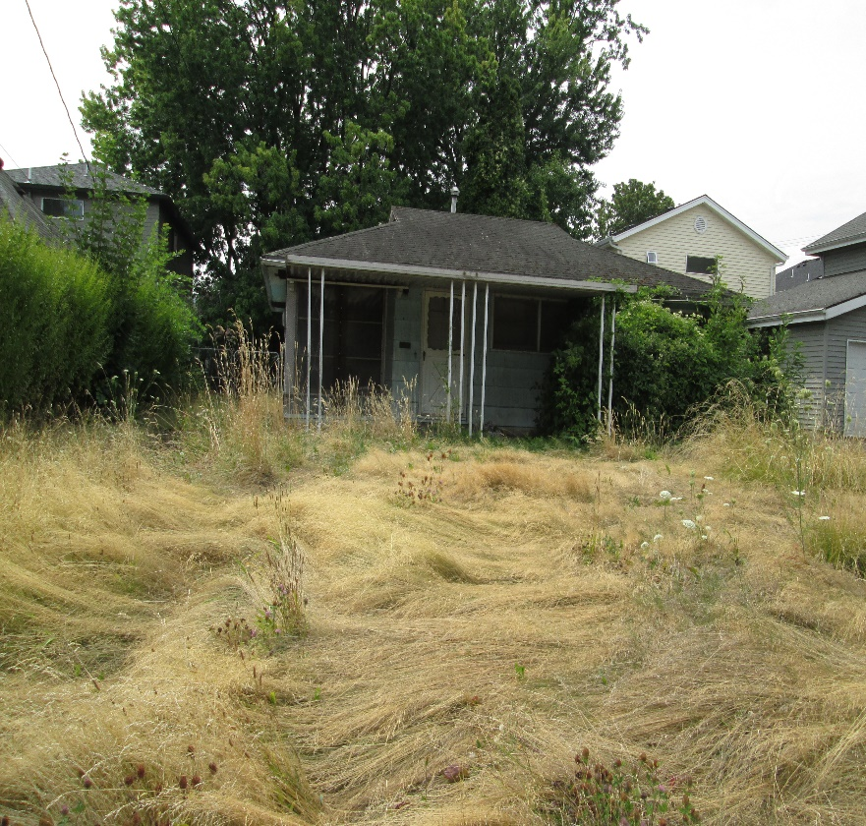
5616 N Harvard St.
Four liens placed against the property
Delinquency ranges from 2014-2018
Total amount owed on liens: $23,442.16 (as of May 31, 2018)
Ownership: Norman Yee

Slide 9
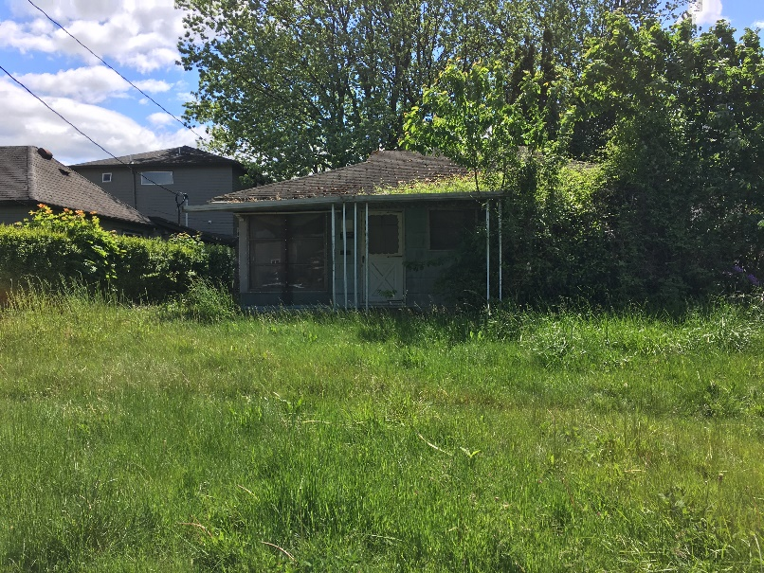
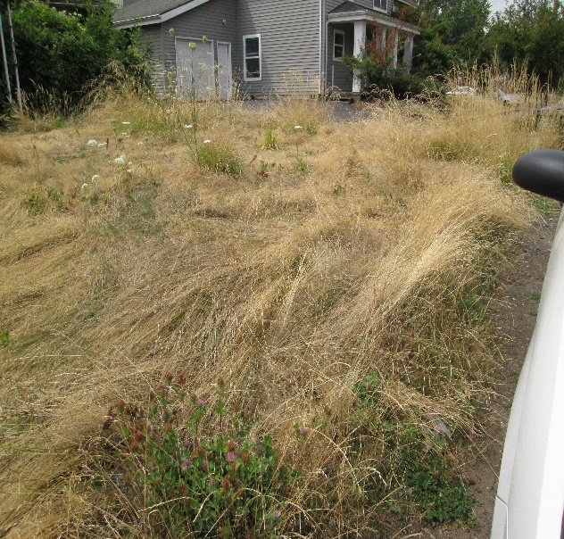
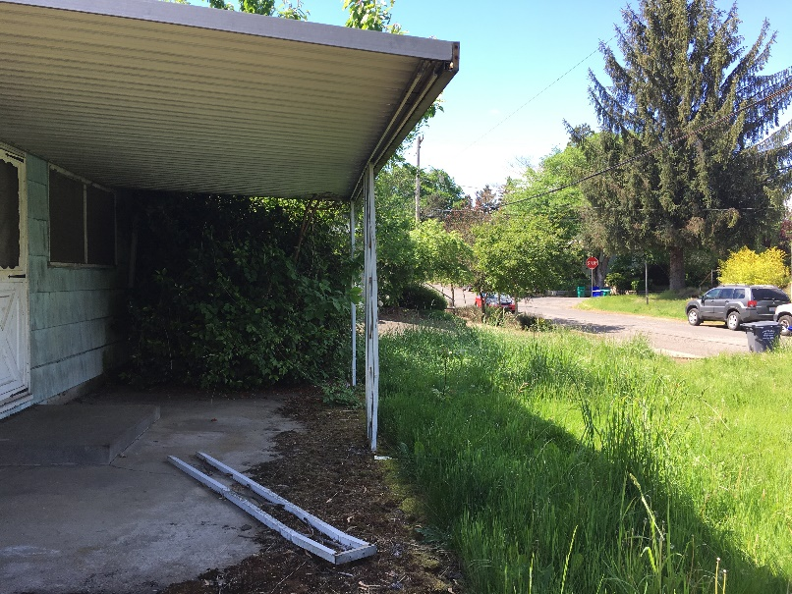
5616 N Harvard St.
Vacant distressed property
Tall grass and overgrown vines over yard and into house
Fire/Life/Safety violations
Windows covered with metal screening
Porch metal leg detached
49 police calls for service since June 2011

Slide 10
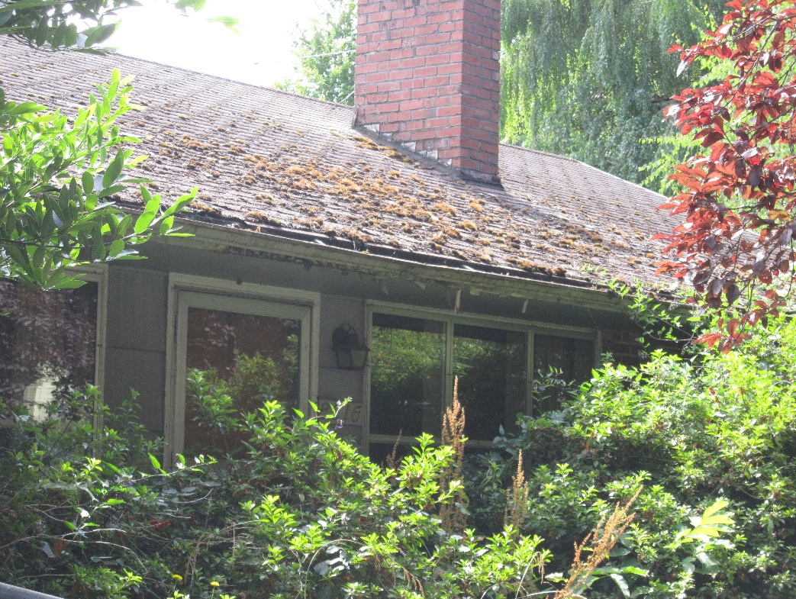
8516 N Calhoun Ave.
One lien placed against the property
Lien assessed in June 2017
Total amount owed on liens: $6,144.21 (as of May 31, 2018)
Ownership: Oregon State of(DVA) CP: Norman Yee 18900564
This is one of the properties that was approved for foreclosure by Council on September 21, 2016
Continuous violation and City managing through nuisance abatements

Slide 11
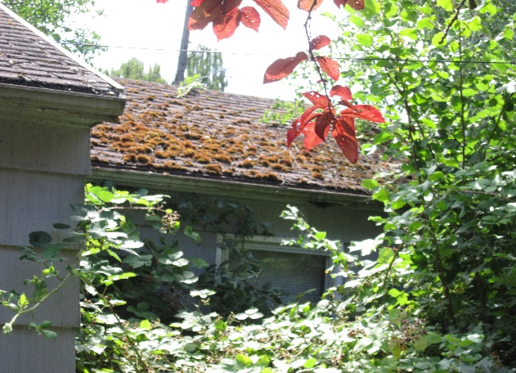
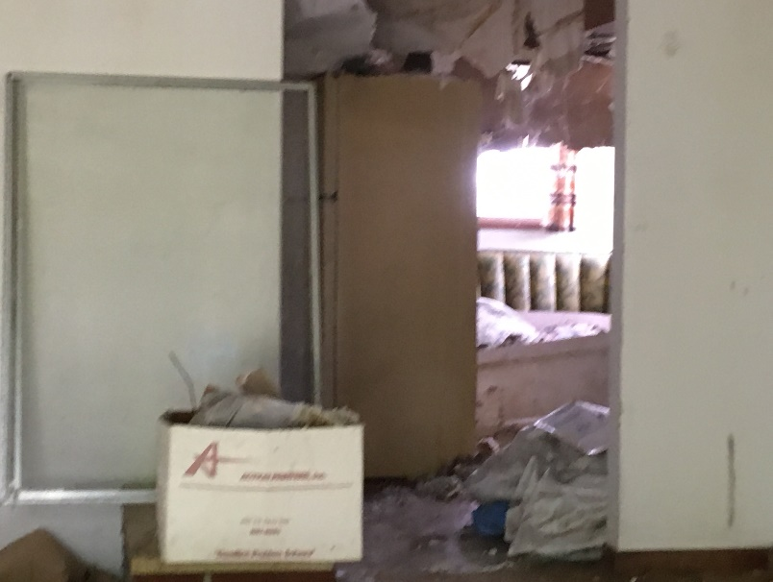
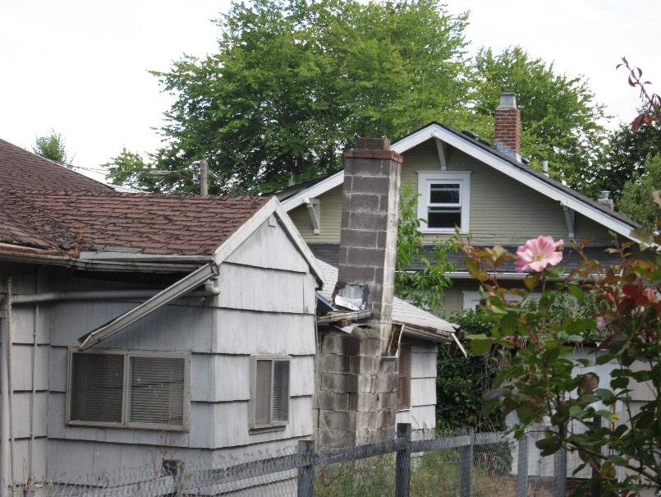
8516 N Calhoun Ave.
Multiple Fire/Life/Safety violations
Health Sanitation Violations
Chimney and roof are collapsing
Attractive for unlawful occupants, garbage dumping
Porch roof detached from header board, ceiling collapsed inside house
19 police calls for service since June 2011

Slide 12
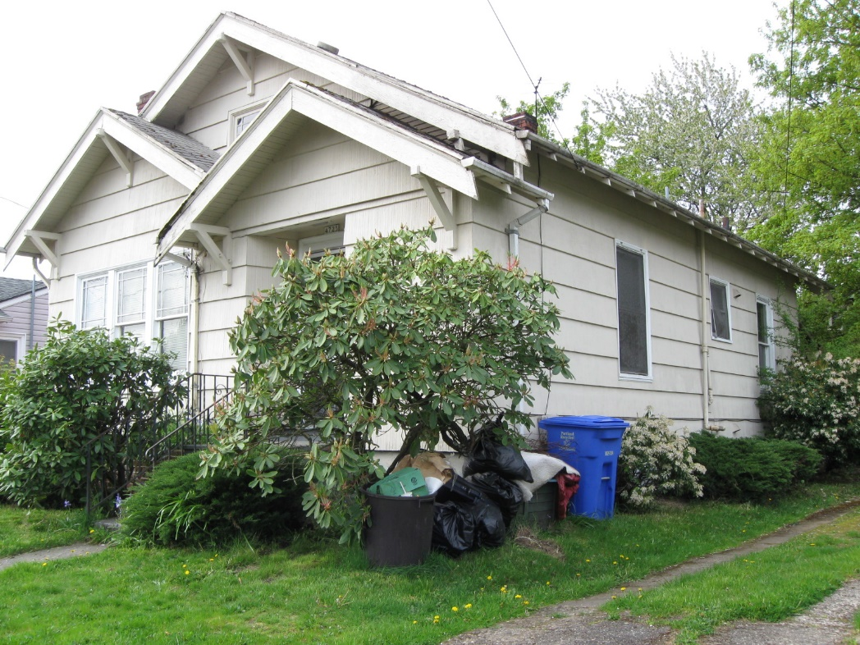
4725 NE 22nd Ave.
One lien placed against the property
Lien assessed in May 2017
Total amount owed on lien: $6,797.43 (as of May 31, 2018)
Ownership: Oregon State OF(DVA) CP: Norman Yee 19251801
This is one of the properties that was approved for foreclosure on September 21, 2016
Extremely Distressed Property Enforcement Program (EDPEP) case
Continuous violation and City managing through nuisance abatements

Slide 13
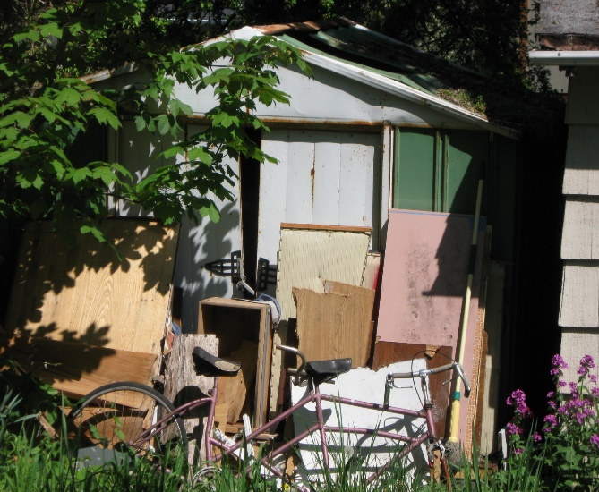
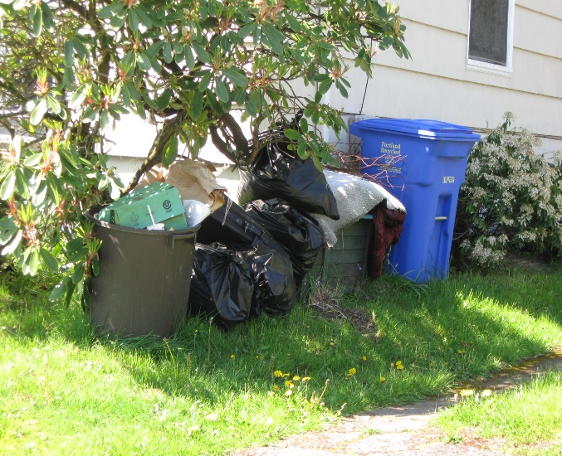
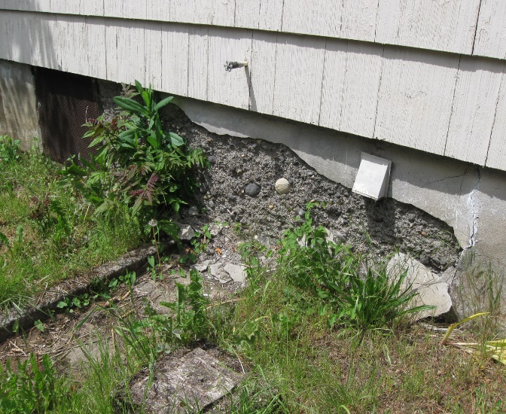
4725 NE 22nd Ave.
Fire/Life/Safety violations
Vacant for over 8 years
Construction debris and materials abandoned in the back yard
Attractive for unlawful occupants
Unapproved shower in the basement
Foundation wall spalling
Chimney is deteriorating and falling apart
3 police calls for service since June 2011

Slide 14
History of Violations/Delinquencies
Violations going back to 2004
Currently there are 10 properties in violation of City Code
Over 140 complaint cases responded to by BDS
Properties have created 121 delinquent liens
142 police calls for service
Four properties included in previous City foreclosure lists
Foreclosure initiated by Multnomah County
Notes:
The property owner has a long history of City Code Housing Maintenance violations with many if not all his investment properties.
Mr. Yee has had four properties included in two of the previous City foreclosure lists as well as properties foreclosed by Multnomah County. Two of the four properties included in this list, have been included in one of the previous lists approved by Council; however, the property owner paid the amounts owed to the City, prior to auction.

Slide 15
Opportunities to Correct Violations/Delinquencies
Catch Up Payment Plan Agreement
Amnesty Program (BDS)
Collections Committee
Stipulated Agreement
Notes:
The City has offered many opportunities to Mr. Yee to correct the violations and solve the delinquencies on his properties. When property owners are willing to resolve the violations, they can contact the Bureau of Development Services and request a review of their cases. Once the review is done, the amount owed is decreased then the Auditor’s Office will provide a payment plan that allow the property owner to repay the amount owed in up to 60 monthly installments. Mr. Yee was encouraged to apply many times, to no avail.
The Bureau of Development Services offered an Amnesty Program where if the property is free of code violations the property owner can enroll and pay a portion of the amount owed and/or pay the remainder in monthly installments. Mr. Yee showed interest, requested information and instructions but decided not to pursue the Amnesty offered by BDS.
After two of Mr. Yee’s properties were included in the 2016 City’s foreclosure list, he requested to have an opportunity to rehabilitate his properties. The City agreed and required that a Stipulated Agreement be signed. The agreement was drafted and delivered to Mr. Yee who never signed the agreement nor did any work in any of the properties.
As demonstrated, the City has made many attempts to assist the property owner to rehabilitate his properties but our efforts have been ineffective.
Therefore, the City Auditor’s Office recommends that Council approves these properties for foreclosure.

Slide 16
Next Steps in the City’s Foreclosure Process
Council votes on whether to foreclose
Auditor’s Office transfers responsibility to City Treasurer to conduct the foreclosure sale
Property owner can pay amount owed up to the sale date
After the sale is conducted, the current owner has a one year redemption period
Notes:
The next steps in the City’s foreclosure process are for the Council to vote on whether to foreclose on the properties within this proposed ordinance. If the ordinance is approved, the Auditor’s Office will transfer the responsibility to the City Treasurer to conduct the foreclosure sale. The property owner can pay the amounts owed up to the sale date. After the sale is conducted, the current owner has a one year redemption period.
This is the end of the presentation and we are happy to answer any questions that you may have.

