Slide 1
Design Commission Work Session
July 26, 2018

Slide 2
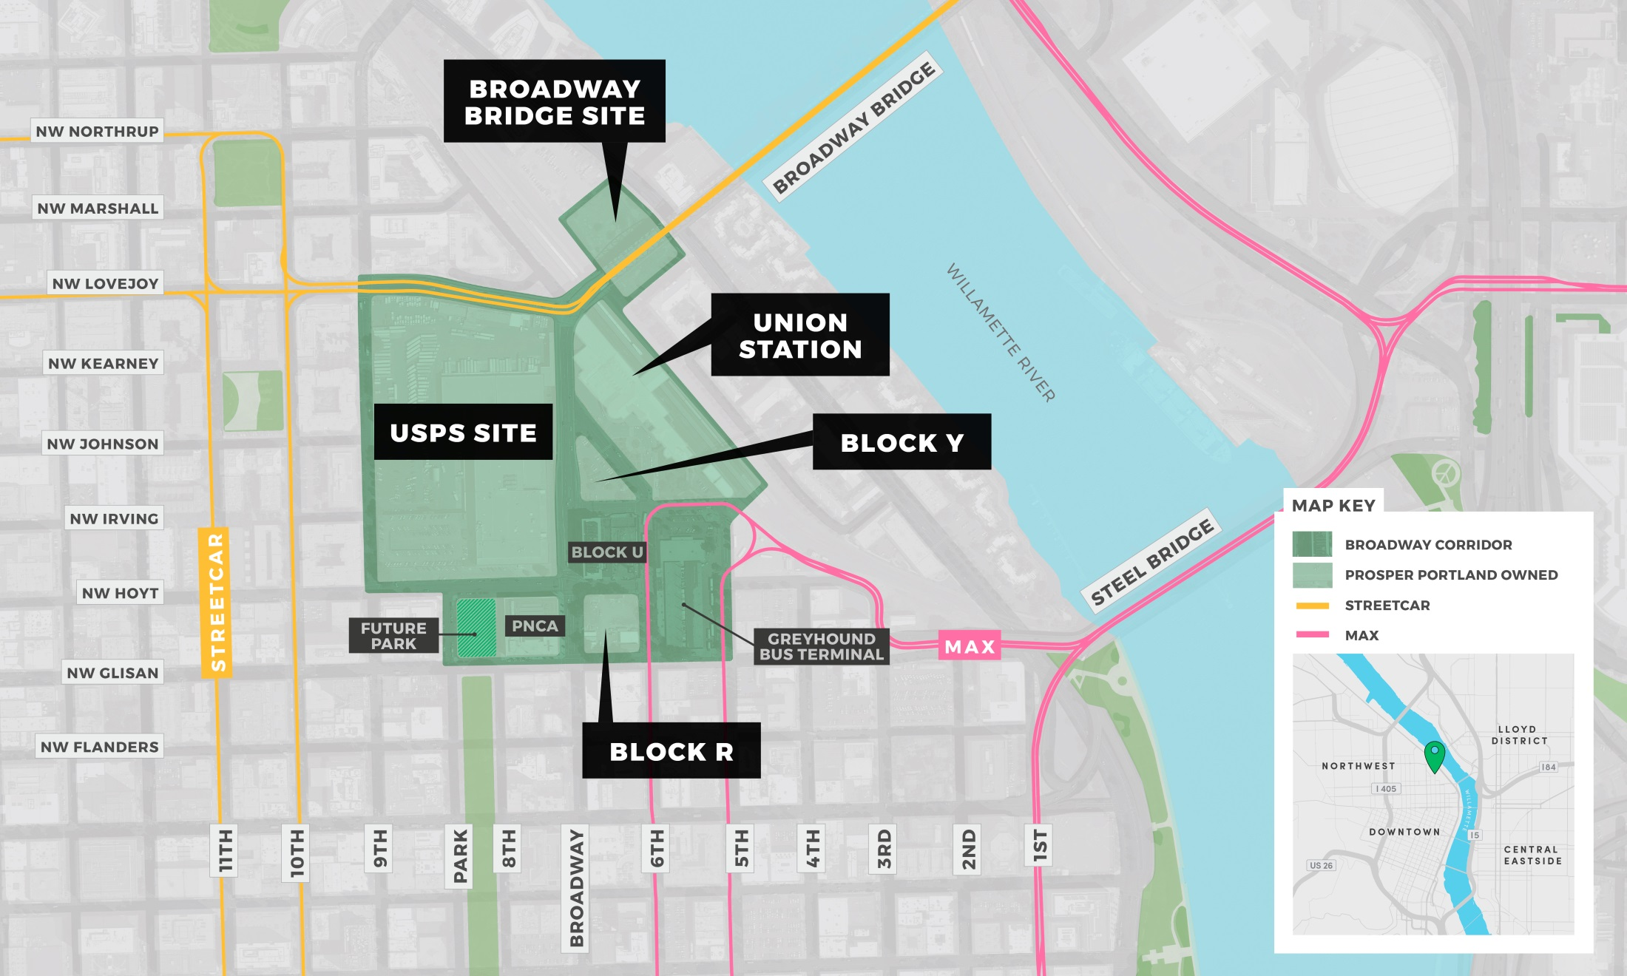
Master Plan Study Area
Notes:
The Opportunity
The opportunity to relocate the Post Office’s industrial functions to an industrial zone has long been a goal of the City of Portland
The site has the opportunity to accommodate nearly 10% of the total growth expected to occur in the Central City over the next 20 years in a location already served by transit and easily served by other infrastructure.
In another location in our region, it could take 400 acres of land and $105M infrastructure to serve these jobs and families
This site can house 4,000 new jobs.
And 2,400 new households.
This process is about the people who will create and access those jobs, construct and live in those units.

Slide 3
Project Context
Notes:
First action before you today is to authorize the selection of Continuum Partners as the preferred developer partner for Broadway Corridor

Slide 4
ECONOMIC GROWTH
50
6
Consecutive months of payroll growth
Money Magazine’s best large cities
TOP
#1
111
Portland grew faster from recession’s trough than any other metro
Increase in population per day
3,000,000 MSA by 2035

Slide 5
INEQUITABLE ECONOMIC GROWTH
½
Communities of color earn $16,636/yr.
White people earn $33,095/yr.
10X
Wealth disparity between communities of color are at least ten times those of whites
7%
30%
Did not graduate from H.S.
White people
Communities of color

Slide 6
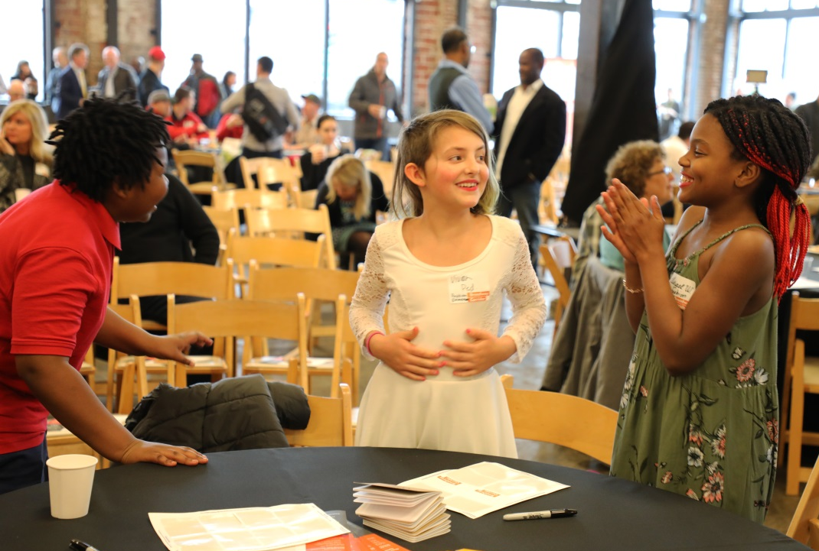
RACIAL EQUITY IMPACT ASSESSMENT
Findings:
Engage regionally diverse stakeholders in a meaningful way
Check assumptions; question every process
Equity conversations before project starts
Be creative in supporting minority and community owned assets
Make competitive process more welcoming
Structure deals with equity goals in mind
Find development partners who will achieve equity objectives
Long-term perspective
Notes:
June
BC is a key opportunity to reduce racial and social disparities and extend benefits to all communities throughout Portland
As part of our early efforts to shift our internal lens, we undertook a Racial Equity Impact Assessment of the Broadway Corridor project, which looks at how institutional racism historically impacts decision making on a project and was an internal audit of past projects
Findings are ways to interrupt the status quo to lead to more equitable outcomes have been incorporated into our project goals and success measures; resulted in key partners on our Steering Committee to achieve equitable outcomes; informed our RFQ process; informed our public engagement plan where we’ve been working with LMS on communications and community engagement to focus involvement efforts on traditionally disengaged Portland residents who don’t traditionally participate in public meetings and who don’t feel they benefit from traditional large scale development projects
The fourth-graders in the picture are from Faubion School and presented their ideas on the Broadway Corridor; toward a long-term perspective is also about how we raise the next generation in our city and what we can do for our younger generations in this city especially when we think of the 20-year build out
Continues to inform our work: findings are a framing device for the visioning ahead, looking at metrics and outcomes, and our general work for the development plan

Slide 7
A DIFFERENT TYPE OF DEVELOPMENT PROJECT
PAST PROJECTS
BROADWAY CORRIDOR
What’s similar?
Predevelopment, permitting, & construction processes
Real estate and financial markets heavily influence development outcomes
Outreach; engagement; and advisory committees
What’s different?
Public-private partnerships on privately held land
Development related public investments occur locally
Engagement after project process and goals have been defined
Agency’s standard policy requirements
Stakeholder input with a focus on nearby businesses & residents
Publicly held, large scale development parcel
Potential for development to generate revenue citywide
Broader engagement early on to help define the process
Community benefits agreement in addition to policy requirements
Input with focus on community based organizations; financially supported organizations
7
Notes:
There are some elements of the project that are similar to our agency’s past projects, like at the Burnside Bridgehead, or at the Lents Town Center, or in Old Town Chinatown
The technical aspects of the development process will be constant, from predevelopment through construction
And our ability to realize shared development related goals will depend heavily on the overall health of our region’s real estate and financial market
But some things are different – from the fact that this property is publically held with a legal obligation to pay back a public line of credit of up to $40 million
To the size and scale of the opportunity
And while we routinely engage the public in our projects, this process is different
We are convening this Steering Committee early on in the process, before a development partner is on board
We are asking for you to help us frame up the priorities for a Community Benefits Agreement before a development is even in discussion
We are broadening our input efforts to communities who haven’t been at the table are included, feel welcome and are financially supported to participate
And we are working with Lara Media on communications and community engagement – focusing our involvement efforts on traditionally disengaged Portland residents who don’t traditionally participate in public meetings and who don’t feel they benefit from traditional large scale development projects

Slide 8
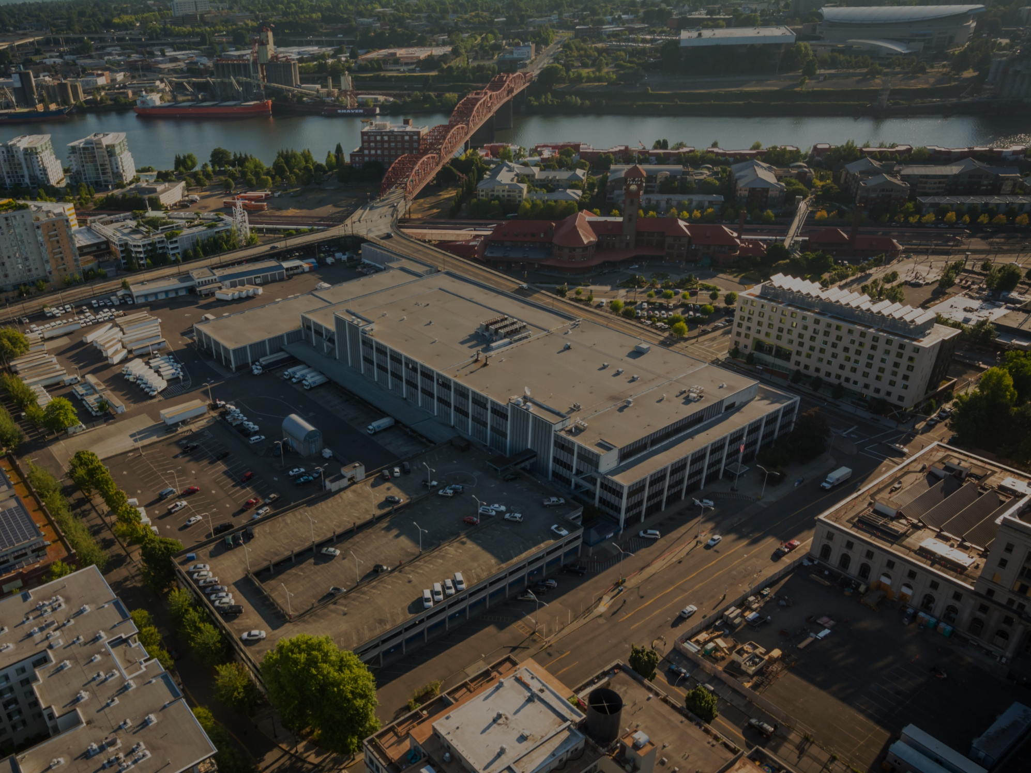
VISION
The Broadway Corridor offers a once-in-a-generation opportunity to create a unique, vibrant, mixed use, dense urban district seamlessly integrated with a regional multi-modal transportation hub in a Portland way. The district vision is one that honors history and culture, fosters social equity and inclusion, and reimagines how Portlanders live, work, enjoy and move through the city.

Slide 9
GUIDING PRINCIPLES
All aspects of the Broadway Corridor development, both public and private, will be:
Accountable: Transparent and delivers targeted and clear, enforceable equitable public benefits,
Connected: Improve accessibility to and through the area for all.
Equitable: Promote social equity, reducing disparities, and extending community benefits.
Prosperous: Foster wealth creation
Resilient: Demonstrate leadership in sustainability
Vibrant: Create a unique and stunning space that attracts, welcomes and reflects diversity, integrates private with public spaces
Notes:
Sarah
There is the formal development process and a lens of putting people first
Guiding principles that Steering Committee have put together to guide their work
Framework for decisions moving forward

Slide 10
FRAMEWORK PLAN
Affordable Housing
700 affordable housing units delivered via PHB investment and inclusionary housing
Streets:
Johnson Street & Park Avenue = 80’ ROW
Parks & Open Space
Two new park blocks + Park Ave. and Irving St.
Green Loop
Bridgehead/Viaduct activation
Entitlements
Increase to 7:1 FAR; 250’ / 400’ Height
Investment
Land value is directly impacted by:
scale of private market rate development
assumptions regarding public infrastructure/improvements
Land value plus housing funds are the largest resources to support public benefits
Significant private investment is required to achieve desired outcomes (~¾ of total estimated costs)
Notes:
The Framework Plan proposed a high level concept for the physical form of development.
And resulted in 4 fixed foundations for our work and the work of a development partner.
The Portland Housing Bureau co-acquired the site with Prosper Portland, investing ~$14.5M to secure rights to develop ~720 units of affordable housing or 30% of the modelled residential units.
This anticipated PHB needing an additional $72 million to invest in the construction of those units at approximately $100K per unit.
Since the Framework Plan was approved in 2015, Council approved the City’s new inclusionary housing policy.
Over the past few months, staff analyzed scenarios to integrate the Framework Plan’s 30% affordable housing commitment with the City’s new inclusionary policy.
The scenario that best aligns with Council direction on the Framework Plan and through inclusionary housing is as follows:
PHB acquires the residential development rights for 720 units
PHB will own or directly control the development of 530 of the 720 units through additional set aside investment, Construction Excise Tax, bond, or other public monies
This reduces the $72 million anticipated cost to $53 million needed in additional resources.
Per the inclusionary housing policy, private development will construct approximately 190 units (or 10% of the non PHB units) at 60% MFI or below.
The preferred concept also provides a foundation of development related public improvements and density with Johnson and 9th as the major public connections, two additional park blocks, and an increase in height and development entitlement from 4:1 to 7:1.
Again, these elements provide a foundation for your discussions
A critical role of the Steering Committee will be to guide prioritizing public benefits, improvements, and investments and considering potential impacts to the value of the land and thus availability of resources for other regional community benefits desired.

Slide 11
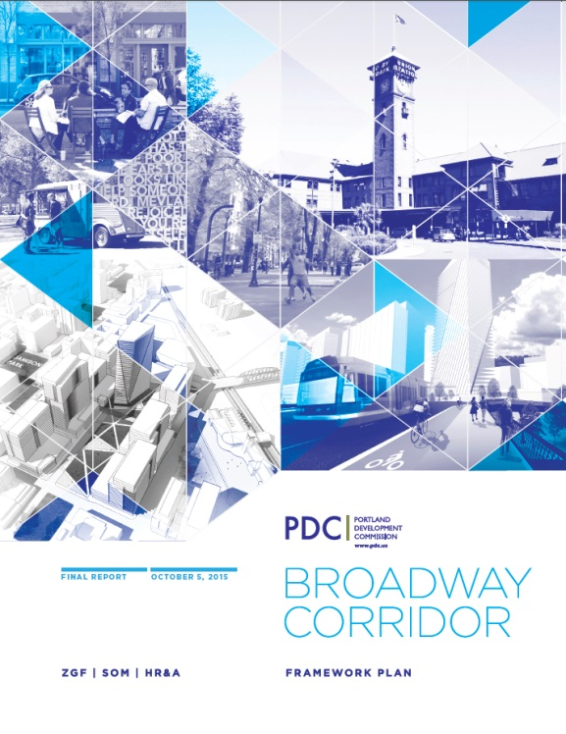
FRAMEWORK PLAN
Notes:
constrained financial resources for acquiring the USPS site and delivering the array of desired community benefits.
The 2015 Framework Plan was a feasibility study to inform a go / no go decision regarding acquisition of the USPS site and City’s authorization of a $40M line of credit.
In order to complete the residual land value analysis we needed to make some starting assumptions
We know that the vision and program for future development will inform the value of the land….
and the value informs the resources we have available to deliver on the public benefits….
Benefits drive and deliver on the vision.
Decisions that impact one leg of the stool will need to be reconciled in the other legs and not impact our ability to repay the line of credit.

Slide 12
PUBLIC RESOURCES
Source | Amount | Use and Considerations
Prosper Portland & PHB Acquisition $ | $88M (spent) | Includes $40M provided via City line of credit
Prosper Portland TIF Budget | $20M (FY 19/20) | Investment limited to permanent physical improvements within River District URA
PBOT System Development Charges | $5M (committed) | Street improvements eligible for SDCs under PBOT program requirements
Other System Development Charges | ~$20M (uncommitted) | Framework Plan modeled ~$20M of additional Parks & PBOT SDCs
Portland Housing Bureau | $5M TIF + Bonds | Total required PHB affordable housing contribution estimated at $53M (~$100,000/unit)
Land Value | TBD less $40M (phased w development) | $40M needed to repay line of credit by 6/2022 Remainder available for investment onsite or elsewhere within City (assuming not TIF restricted) Entitlement increases (FAR and height) positively impacts land value
Other | TBD
TOTAL PUBLIC SOURCES (est.) | ~$50M + Land Value TBD + Housing Bonds TBD
Notes:
Various sources of public resources (color of money) have different uses and requirements
Line of credit needs to be repaid from land value proceeds by June 2022
Resources from Prosper Portland TIF and potential SDC credits are limited to specific improvements
The Portland Housing Bureau needs to identify approximately $53M via TIF, bonds and Construction Excise Tax proceeds to support construction of affordable housing
Flexibility in where and how remaining land value is invested both on and off site
* $25 in TIF and SDCs identified for $35M of infrastructure costs identified in Framework Plan; should public improvements change would require greater than $35
* SDC calculation:
Assumes $14,000 of SDCs per market-rate residential unit and $11 of SDCs per commercial SF
Estimated proportion of SDCs by bureau : Bureaus of Transportation $9M; Parks & Recreation $13M; Environmental Services $14M; and Water $3M.

Slide 13
ESTIMATED COSTS
Total = $1.3B
Notes:
Primary assumptions include:
Acquisition of $88M
Jointly owned by Prosper Portland and Portland Housing Bureau
Affordable Housing
PHB rights to 30% of residential FAR = ~720 units
PHB develops ~530 units via public investment (Approx. $53M by PHB or $100k per unit)
Private partner develops ~190 units (10% of market rate units) at 60% MFI or below via IH
Streets
Johnson Street & Park Avenue = 80’ ROW
Parks & Open Space
Two new park blocks + 8th St and Irving St
Green Loop
Bridgehead/Viaduct activation
Entitlements
Increase to 7:1 FAR; 250’ / 400’ Height (approx. 4 million sf)

Slide 14
Engagement Process
Notes:
First action before you today is to authorize the selection of Continuum Partners as the preferred developer partner for Broadway Corridor

Slide 15
WHERE WE’VE BEEN & WHERE WE’RE GOING
Guiding Principles
Project
Goals
Project
Kick-off
Candidates Public
Forum
July 26
Design Commission Briefing Project overview Preliminary input received to-date
RFQ Issued
ZGF
Scope of Work
Board Approval of ZGF and Continuum
Kick off Development Planning
Community Centered Development Project with Community Benefits
Notes:
Jahmese

Slide 16
PUBLIC PROCESS
BPS,
PBOT,
BDS,
BES,
Parks, TriMet
Streetcar
PGE
NW Natural
RACC
Public
Technical Team
Public
Technical Team
Public
Technical Team
Developer
Steering
Committee
General Public
ZGF
open houses,
online and field surveys, etc.
INPUTS
INPUTS
(Vision, Technical, Policy)
Executive
Committee
Prosper Portland and Portland Housing Bureau Executive Directors
Prosper Portland Board
City Council
Design Commission
DECISIONMAKERS
Planning & Sustainability
Commission
Portland Housing
Advisory Commission
Notes:
Key groups who are shaping the BC project through our processes: general public community engagement, Steering Committee, Exec Committee, Public Partners – the two more official groups that lend itself to Board action will be adding a developer who will serve as an advisor and ZGF who will be bringing in the technical expertise to put together the development plan
42 member Steering Committee, will be doing more focused work in smaller groups that shape the process; helping to frame up priorities for a CBA and overseeing the planning process as an advisory body
Executive Committee
Prosper Portland, Mayor’s Office, PHB, subject matter experts (social equity, capital markets, district system and infrastructure partnerships, legal counsel)
Commissioner Myers is serving as a co-chair of the Steering Committee and will be joining as a liaison to the Executive Committee
Multiple decision makers determined by various elements of the project (contracting requirements, Master Plan, PHB investment, etc)

Slide 17
ROLES AND RESPONSIBILITIES
 | Prosper Portland | Steering Committee | ZGF | Continuum | Other Partners
Development Planning | Lead | Advisor | Consultant to Prosper Portland | Advisor | Public Tech Team advisory
Community Benefits Agreement | Signatory | Stakeholder signatories TBD | -- | Signatory | Stakeholder signatories TBD
Entitlements (FAR, height, Master Plan, lot lines) | Lead | Advisor | Consultant to Prosper Portland | Advisor to Master Plan | Public Tech Team advisory to Master Plan
Horizontal (utilities, streets, parks) | Funding + Phasing + Implementation + Oversight Committee TBD during development planning
Vertical (buildings – design, permitting, construction, leasing) | Seek developers for Union Station, Block Y, Block R following Master Plan | -- | -- | Exclusive Negotiation rights to USPS Property; Rights to PHB portion of USPS Property TBD |  | Local Opportunities Oversight Committee PHB to invest in portion of affordable housing
Notes:
Kimberly

Slide 18
STEERING COMMITTEE
Alicia Daniels Uhlig, International Living Future Institute
Amanda Saul
Andre Bealer, NAMC-Oregon; MCIP
Bridget Bayer, Main Street Alliance
Christian Kaylor, Oregon Employment Department
David Dysert, Pearl District Neighborhood Association
Diana Nuñez, Hispanic Metropolitan Chamber of Commerce
Don Tuski, Pacific Northwest College of Art
Donald Genasci, University of Oregon
Elaine Friesen-Strang, AARP
Elizabeth Leach, Leach Gallery
Emma Brennan, Oregon Tradeswomen
George Devendorf, Transition Projects
George Galster
Gerik Kransky, The Street Trust
Ian Williams, Deadstock Coffee
James Faison, Faison Construction
James Paulson, JMPDX LLC / Worksystems Inc. Board
Jeremy Simer, SEIU Local 49
Jose Gonzalez, Miracle Theatre Group
Joy Alise Davis, Portland African American Leadership Forum
Kelly Haines, Worksystems Inc.
Leigh McIlvaine, Mercy Corps Northwest
Michael Szporluk
Mike Houck, Urban Greenspaces Institute
Nathan Kadish, Ecotrust
Neil Lee, Chinese Consolidated Benevolent Association / LEEKA
IUOE, Local 701
Paul Vanderford, Sustainable Northwest
Paul Lumley, NAYA
Rick Turoczy, PIE
Sam Rodriguez, Mill Creek Residential
Sarah Stevenson, Innovative Housing, Inc.
Tony DeFalco,Verde
Tyrone Poole, OneApp
Veronica S. Leonard, Latino Network
Vivian Satterfield, OPAL Environmental Justice Oregon
Willy Myers, Prosper Portland / Columbia Pacific Building Trades – Co-chair
Zeke Smith, United Way – Co-chair
Notes:
Board 4: Project team & roles

Slide 19
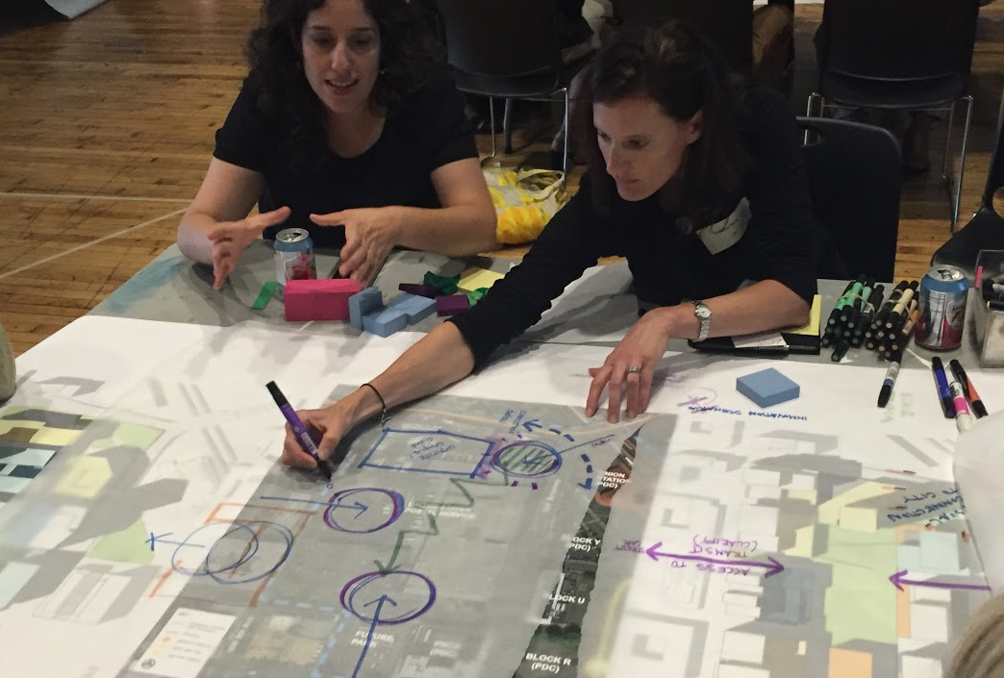
ZGF CONSULTANT TEAM
Urban Design & Architecture: ZGF Architects
Landscape & Open Space Planning: PLACE
Placemaking: Project for Public Spaces
Civil Engineering: AKANA
Structural Engineering: KPFF
Infrastructure: Arup
Sustainability: Brightworks
Transportation Planning: Toole Design Group
Traffic Engineering: Kittelson Associates
Cultural Resources: WLR Consulting
Financial Analysis: EcoNorthwest
Cost Estimating: RLB

Slide 20
ZGF CONSULTANT TEAM
Urban Design & Architecture: ZGF Architects
Landscape & Open Space Planning: PLACE
Placemaking: Project for Public Spaces
Civil Engineering: AKANA
Structural Engineering: KPFF
Infrastructure: Arup
Sustainability: Brightworks
Transportation Planning: Toole Design Group
Traffic Engineering: Kittelson Associates
Cultural Resources: WLR Consulting
Financial Analysis: EcoNorthwest
Cost Estimating: RLB
23% MWESB/DBE
21% MBE/DBE
15% MBE

Slide 21
DEVELOPER ADVISOR
Continuum’s Role
Planning. Serves as an advisor during the development planning, Master Plan, and identification of community benefit priorities. Early engagement helps to ensure implementable development and community benefits.
Implementation. Has exclusive negotiations rights for the redevelopment of the USPS Property.
Affordable Housing Component
PHB develops ~530 units via public investment (est. $53M).
Private partner plans and develops ~190 units (10% of market rate units) at 60% MFI or below.
Timeline
Land transaction repays Line of Credit due to the City by June 2022
Notes:
Wayne or Eric – PDC Legal

Slide 22
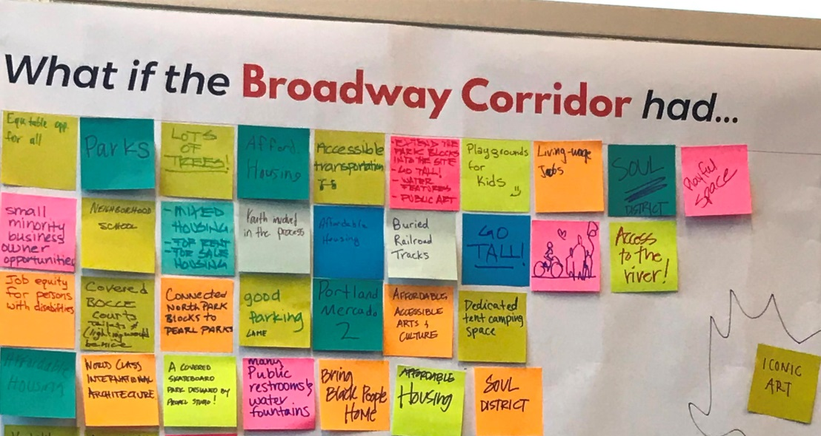
PARTICIPATION OPPORTUNITIES
Notes:
June
Different participation opportunities available to share your opinion
Benefits of participation – shaping the outcome, come together to build community
We need your participation to help inform the benefits and opportunities to your communities
Build awareness
Develop a prosperous project that benefits all Portlanders

Slide 23
Development Plan
Notes:
Second action before you today is to authorize a contract with ZGF for the purpose of completing the development plan for the Broadway Corridor

Slide 24
DEVELOPMENT PLANNING PROCESS
WITH STEERING COMMITTEE & COMMUNITY PARTICIPATION
AGREEMENT NEGOTIATIONS & LAND USE REVIEW PROCESS
Refine Public Benefits Terms Sheet based on Selected Alternative
Refine Public Benefits Categories
Begin Drafting
Public Benefits
Terms Sheet
Begin Defining Oversight Framework
Summer
2019
June
2018
January
2019
Spring
2019
Dev. Plan & Master
Plan
Concept
Alternatives
Refinement
Concept
Alternatives
Evaluation
Draft
Report
Final
Report
Vision & Concept Alternatives Development
Advance
Preferred
Development Plan
USPS Property Master Plan Land Use Review
Notes:
This is a subset of a much more complex diagram we have prepared outlining our process moving forward, including key decision points and engagement opportunities. This phase is anticipated to occur over approximately 18 months, ending in mid to late 2019.
Along the bottom you see the preparation and refinement of development concept alternatives, concluding with the Land Use Review process specific to the USPS Master Plan
Along the top, you see the process to prepare and refine a term sheet or blue print for a future Community Benefits Agreement.
These two efforts will be integrated throughout the planning process – with input from the various parties shown in the diagram shared by June at the start of this presentation, including the Steering Committee, the developer, our public partners, and the broader community engagement initiatives.
We will also have a clear distinction between this engagement and collaboration – and when we pivot to negotiations. At this point, the work of the Steering Committee will conclude and we will engage in the negotiation of various agreements with our partners, including the incorporation of community benefits and the expectations for future oversight.
It is important to note that Prosper Portland is contracting for and directing ZGF’s work for the preparation of the development plan. The developer, Steering Committee, and others will serve as advisors to Proper Portland.
We are optimistic about a partnership with Continuum, but this gives us the ability to own and continue this work in the event the partnership does not go as anticipated.

Slide 25
DEVELOPMENT PLANNING
Phase B1: Vision & Programming
Phase B2: Preliminary Concepts
Process Overview
Phase C1: Concept Refinement
Phase C2: Select One Concept
Phase C3: Advance Concept
All Phases: Community Benefit Priorities
Phase D1: Draft Plan
Phase D2: Final Plan

Slide 26
DEVELOPMENT PLANNING
Phase B1
Ideas
Ideas
Ideas
Vision

Slide 27
DEVELOPMENT PLANNING
Phase B2
Concept 1
Program
Physical
Concept 2
Program
Physical
Concept 3
Program
Physical
VISION

Slide 28
USPS PROPERTY
MASTER PLAN
Land Use Review guiding urban design outcomes:
Strong orientation toward transit and multimodal transportation
Safe and vibrant public realm
Adequate urban services
Appropriate building bulk, height, orientation, and programming
Notes:
Finally, as mentioned, the City will require an approved Master Plan for the USPS Property prior to issuing permits for development.
The specific requirements for the Master Plan are still being finalized by City Council as part of the CC2035 Plan.
Generally, it is intended to ensure the following key outcomes:
Development that has a strong orientation toward transit and multimodal transportation
A safe and vibrant public realm, supported by active ground floor uses, open space areas and an internal circulation system that provides access to adjacent public rights-of-way and multimodal transportation options;
Development that has adequate urban services such as water, stormwater, sewers, and fire hydrants
Building bulk, height, orientation, and programming that protects public views and preserves light and air within the public realm, and that is oriented to a various public amenities

Slide 29
B2: DEVELOP CONCEPT ALTERNATIVES
Develop up to 3 Concept Alternatives with comparable densities for Urban Design & Development:
Street plan
Block Confirmation
Location, scale & purpose of open spaces
Height, Massing & Orientation
Floor Area Quantity & Distribution
Land Uses, with emphasis on Affordable Housing
Parking
Notes:
USPS Property Master Plan: Design Commission & Land Use Review:
Solicit input on concept alternatives for USPS property (via approval criteria-based evaluation)
Confirm Master Plan Boundary (impacted by parking and/or FAR strategy)
Submit Pre-Application Conference Application
Submit Design Advice Request Application

Slide 30
C1: REFINE CONCEPT ALTERNATIVES
Land use mix
Building height, massing and orientation
Open space programming and configuration, including Green Loop
Multimodal access and circulation
Connectivity
Parking strategies, including electric vehicles and autonomous vehicles
Define service, loading and access zones
Green infrastructure and low-carbon and/or district energy concepts
Habitat, wildlife/bird-friendly analysis
Financial feasibility analysis
Phasing impact review (as appropriate)
High-level technical systems cost analysis (BES/PGE/Infrastructure)
Design guidelines assessment
Community benefit priorities application
Notes:
Finally, as mentioned, the City will require an approved Master Plan for the USPS Property prior to issuing permits for development.
The specific requirements for the Master Plan are still being finalized by City Council as part of the CC2035 Plan.
Generally, it is intended to ensure the following key outcomes:
Development that has a strong orientation toward transit and multimodal transportation
A safe and vibrant public realm, supported by active ground floor uses, open space areas and an internal circulation system that provides access to adjacent public rights-of-way and multimodal transportation options;
Development that has adequate urban services such as water, stormwater, sewers, and fire hydrants
Building bulk, height, orientation, and programming that protects public views and preserves light and air within the public realm, and that is oriented to a various public amenities

Slide 31
Site Considerations

Slide 32
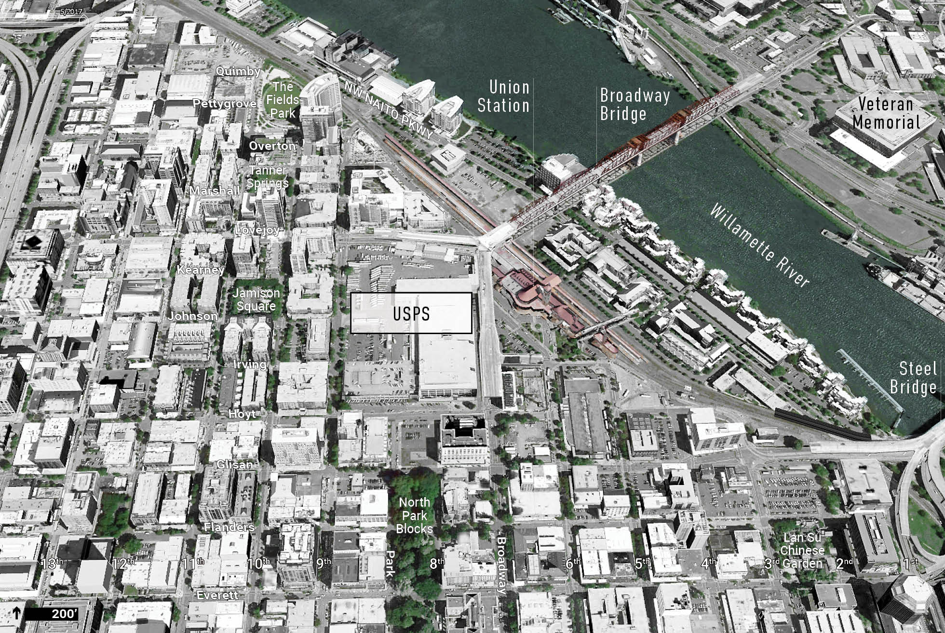
USPS SITE

Slide 33
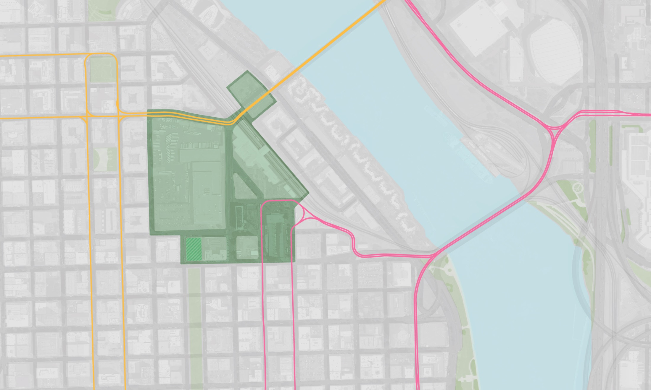
NEIGHBORHOOD & CONTEXT
Site Boundary & Ownership
NW NORTHRUP
BROADWAY BRIDGE SITE
BROADWAY BRIDGE
NW MARSHALL
3.28 AC
NW LOVEJOY
UNION STATION
WILLAMETTE RIVER
NW KEARNEY
4.81 AC
NW JOHNSON
USPS SITE
BLOCK Y
13.33 AC
0.24 AC
NW IRVING
Master Plan Study Area
BLOCK U
STEEL BRIDGE
MAP KEY
NW HOYT
STREETCAR
FUTURE PARK
PNCA
GREYHOUND BUS TERMINAL
MAX
NW GLISAN
BLOCK R
NW FLANDERS
0.87 AC
11TH
10TH
9TH
PARK
8TH
6TH
5TH
4TH
3RD
2ND
1ST
BROADWAY

Slide 34
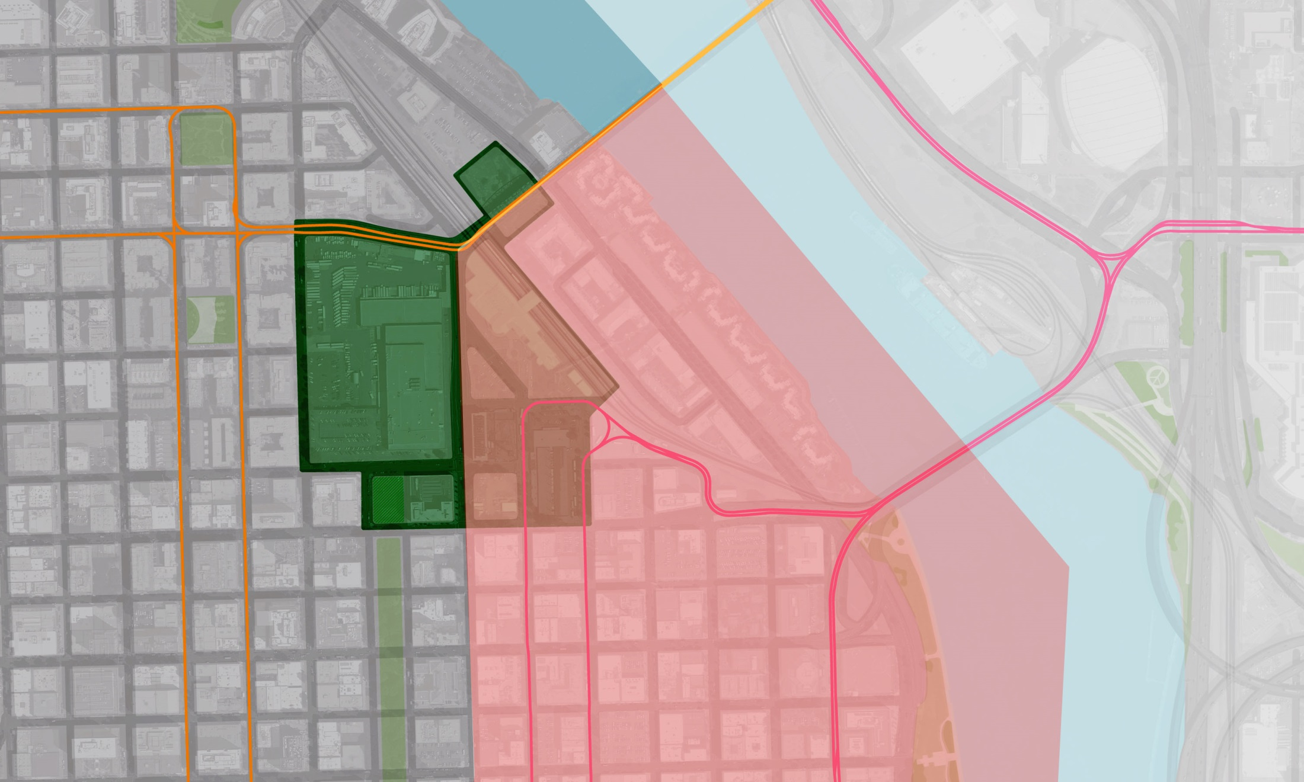
NEIGHBORHOOD & CONTEXT
Districts
NW NORTHRUP
BROADWAY BRIDGE
NW MARSHALL
NW LOVEJOY
WILLAMETTE RIVER
NW KEARNEY
USPS SITE
NW JOHNSON
NW IRVING
STEEL BRIDGE
NW HOYT
STREETCAR
MAX
NW GLISAN
Old Town Chinatown
Pearl District
NW FLANDERS
NW EVERETT
NW DAVIS
11TH
10TH
9TH
PARK
8TH
6TH
5TH
4TH
3RD
2ND
1ST
NATIO
BROADWAY

Slide 35
NEIGHBORHOOD & CONTEXT
Anchor Uses
Union Station
600,000 annual riders
10 daily trains
Regional bus service
29,500 leasable SF
Bud Clark Commons
130 Units <35% AMI
90 bed shelter
day resource center & clinic
Greyhound
20 daily arrivals / departures
PNCA
550 students
94 faculty
1400 community ed students
700 annual free programs
Mult Co Heath Dept HQ
350 health professionals
Specialty clinic & pharmacy

Slide 36
NEIGHBORHOOD & CONTEXT
Adjacent Affordable Housing
Station Place
176 Units / 55+
30-80% AMI
Yards at Union Station
158 Units
60% AMI
Lovejoy Station
181 Units
40-80% AMI
Pearl Court
199 Units
40-60% AMI
Bud Clark Commons
130 Units
<35% AMI

Slide 37
NEIGHBORHOOD & CONTEXT
Infrastructure & Barriers
Lovejoy Viaduct
Rail Yard
Broadway Ramp
Car- Orientated Naito Parkway

Slide 38
NEIGHBORHOOD & CONTEXT
Transit Access
Intercity Bus
MODA CENTER
Rose Quarter Transit Center
Amtrak
Passenger Drop-off
Bikeshare
Bikeshare
Intercity Bus
B
B
B
B
Bolt Bus
Greyhound Bus Terminal
Bikeshare

Slide 39
NEIGHBORHOOD & CONTEXT
Open Space & Waterfront Access
1,000’
Tanner Springs Park
Access to Water
Willamette River Greenway Trail
Jamison Square
2,000’
Lan Su Chinese Garden
Tom McCall Waterfront Park
North Park Blocks
Access to Water

Slide 40
NEIGHBORHOOD & CONTEXT
Planned Improvements
The Green Loop
Union Station Modernization
Johnson Neighborhood Greenway
Trimet Division Transit Terminus
Future Park
Potential Downsizing or Consolidation of Greyhound Facility
Flanders Neighborhood Greenway

Slide 41
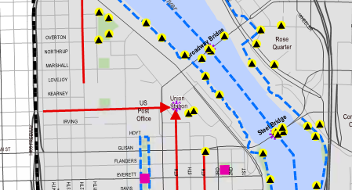
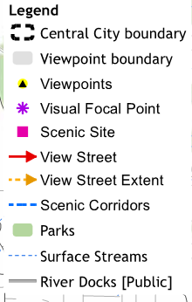
NEIGHBORHOOD & CONTEXT
Central City Scenic Resources
View Corridors

Slide 42
Feedback to Date

Slide 43
Who we’ve heard from
Steering Committee June 26, July 24
Stakeholders June 25 - July 13
Jose Gonzalez, Milagro Theatre Ian Williams , Business owner in Old Town
Brett Horner & Tate White, Portland Parks and Recreation Rick Turoczy, Portland Incubator Experiment
George Devendorf, Transition Projects Gerik Kransky, Street Trust
Mauricio Leclerc & Zef Wagner, PBOT Candace Kita,. APANO
Elaine Friesen-Strang, AARP Vivian Satterfield, OPAL Environmental
Michael Szporluk, Consultant advocating for people with disabilities Shea Flaherty, Hacienda CDC, Mercado
Sunday Parkways July 22
Public Partners Technical Team July 23
Public Open House June 25

Slide 44
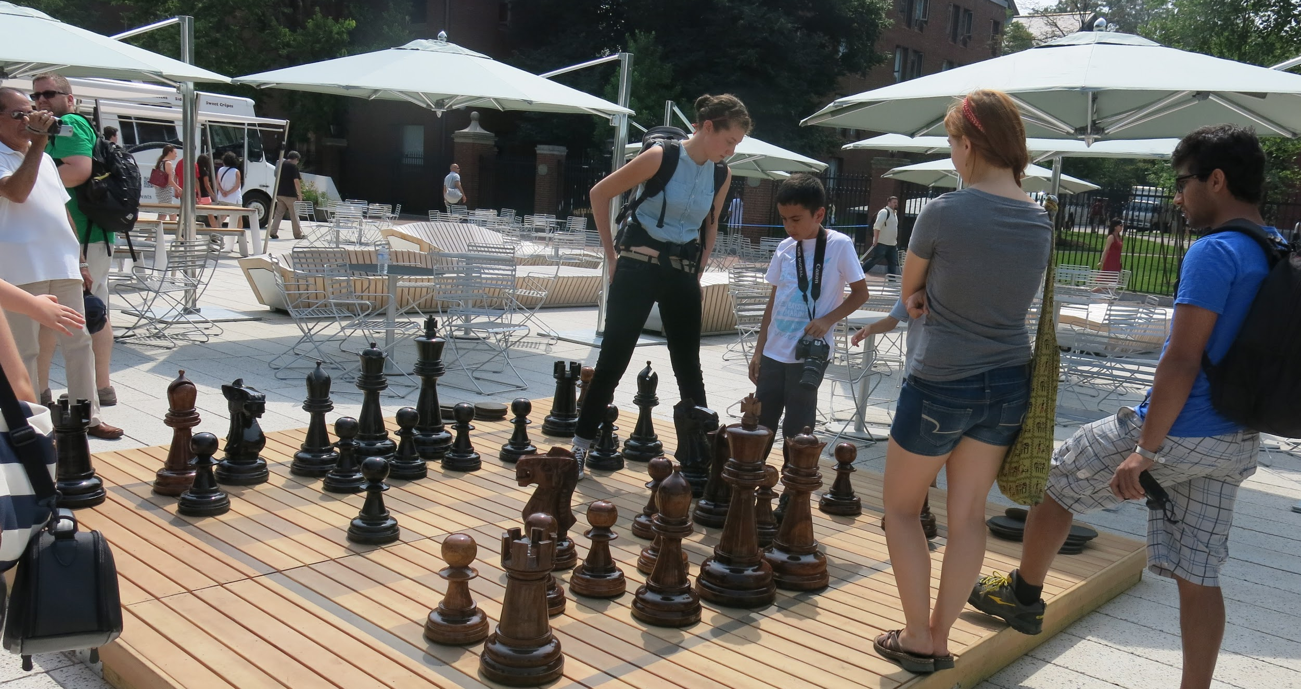
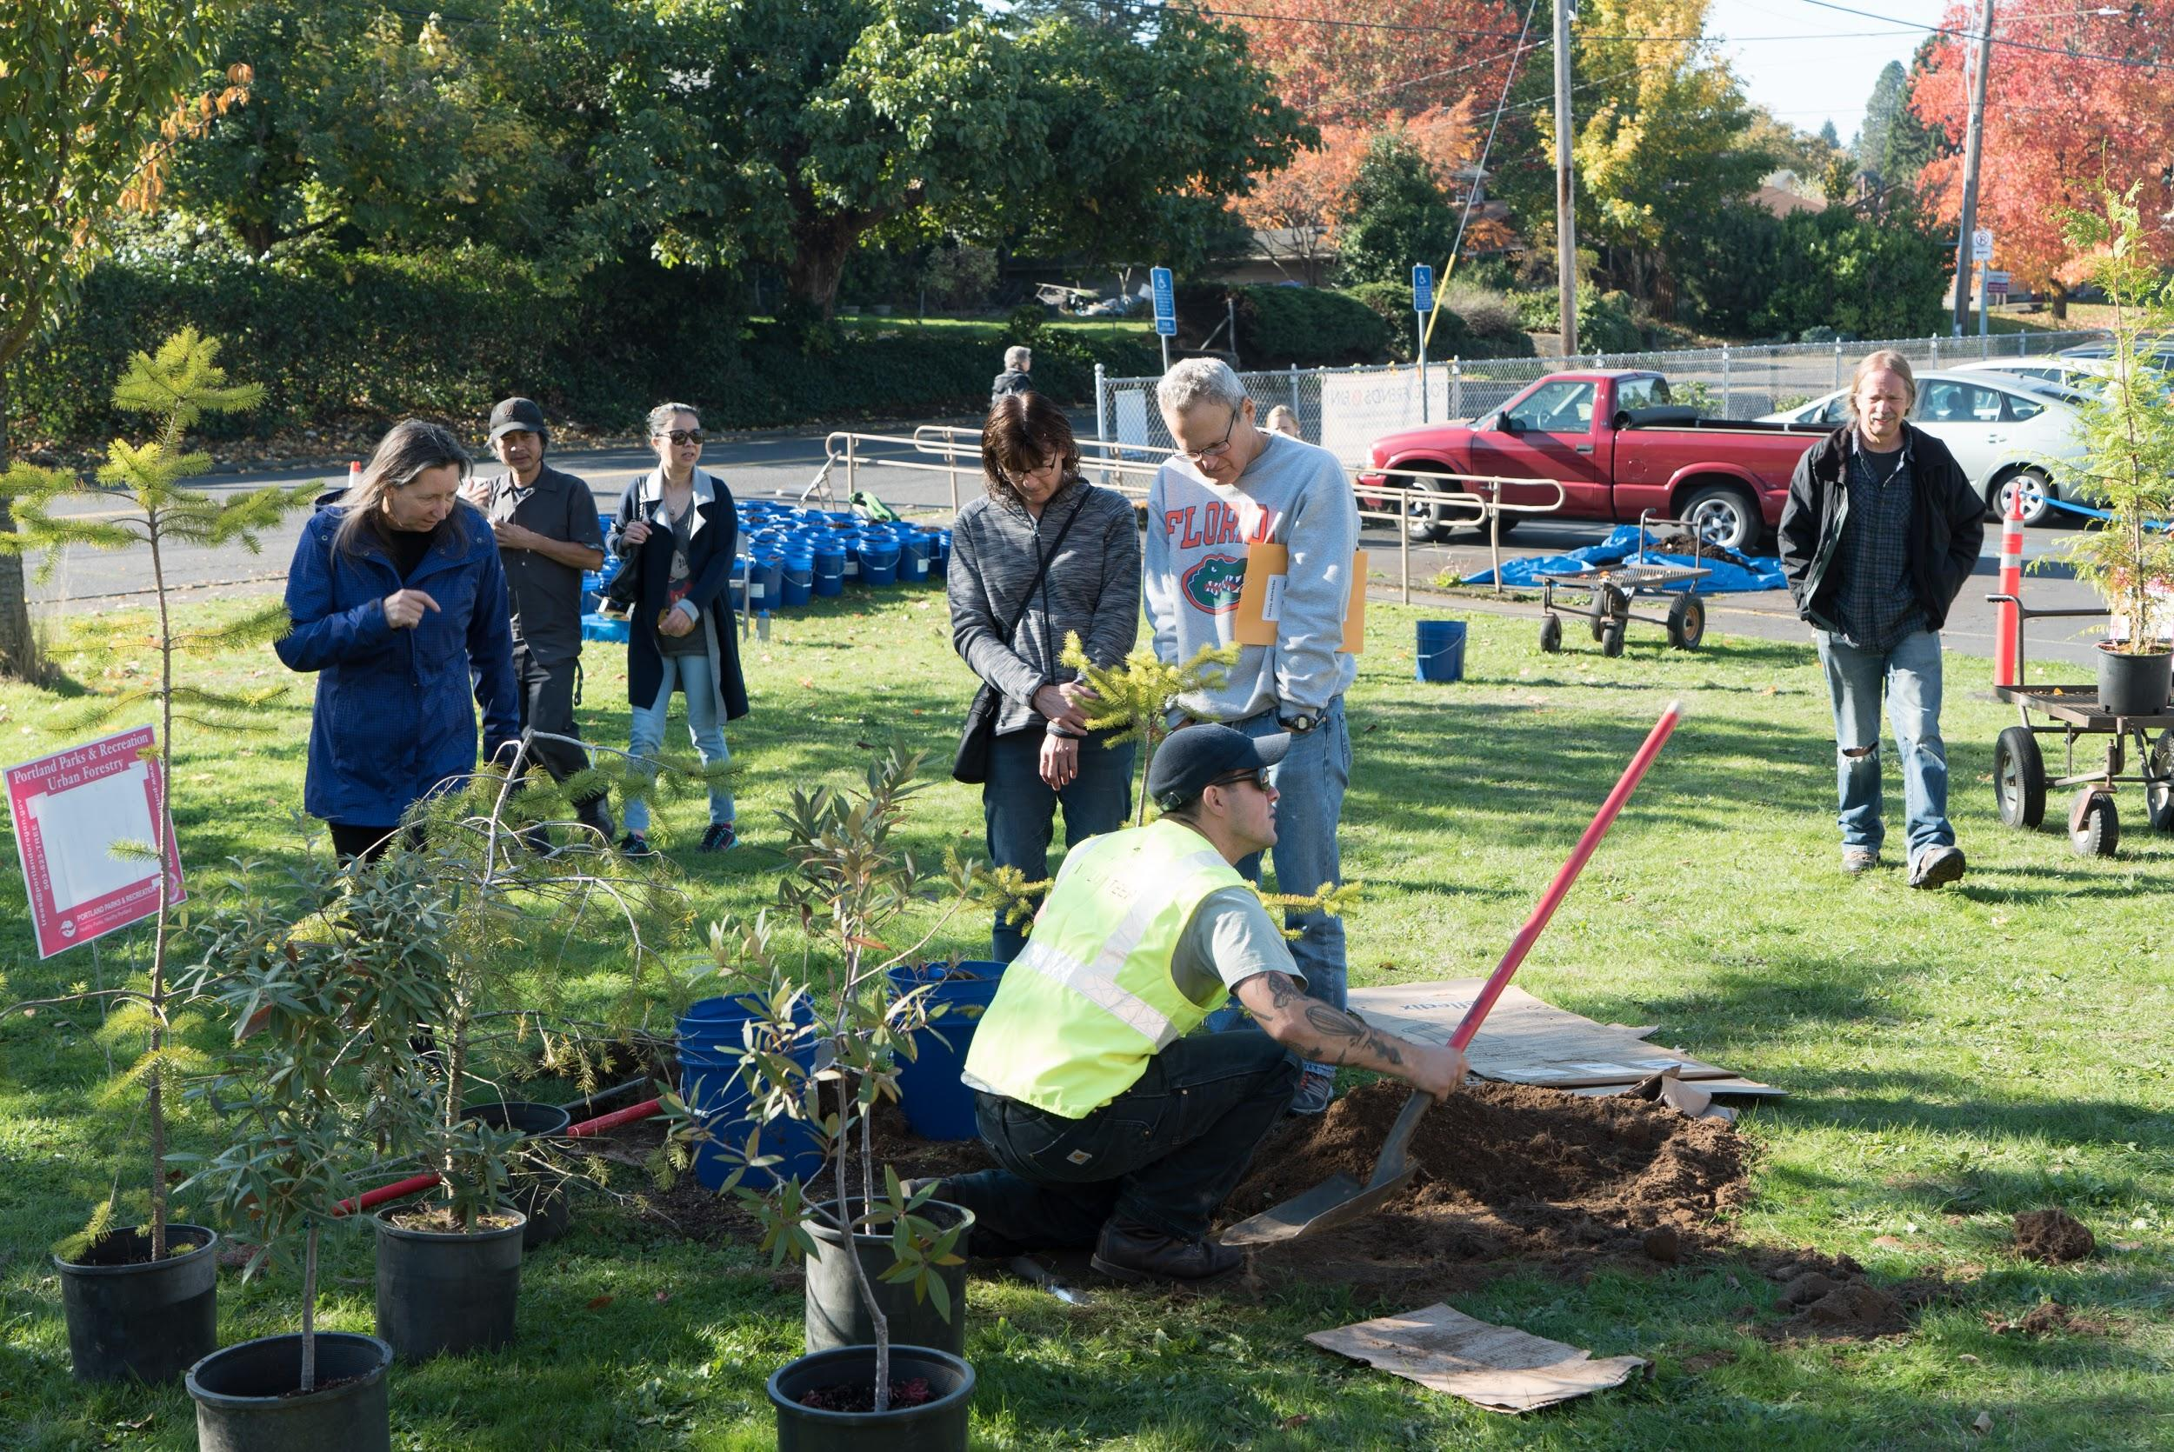
Accountable
An Open-Ended Vision
Give future residents a chance to weigh in
Interim activations to test ideas early
Place Management
Create a place management organization for the Broadway Corridor
Achieve placemaking goals and facilitate equity-oriented programs

Slide 45
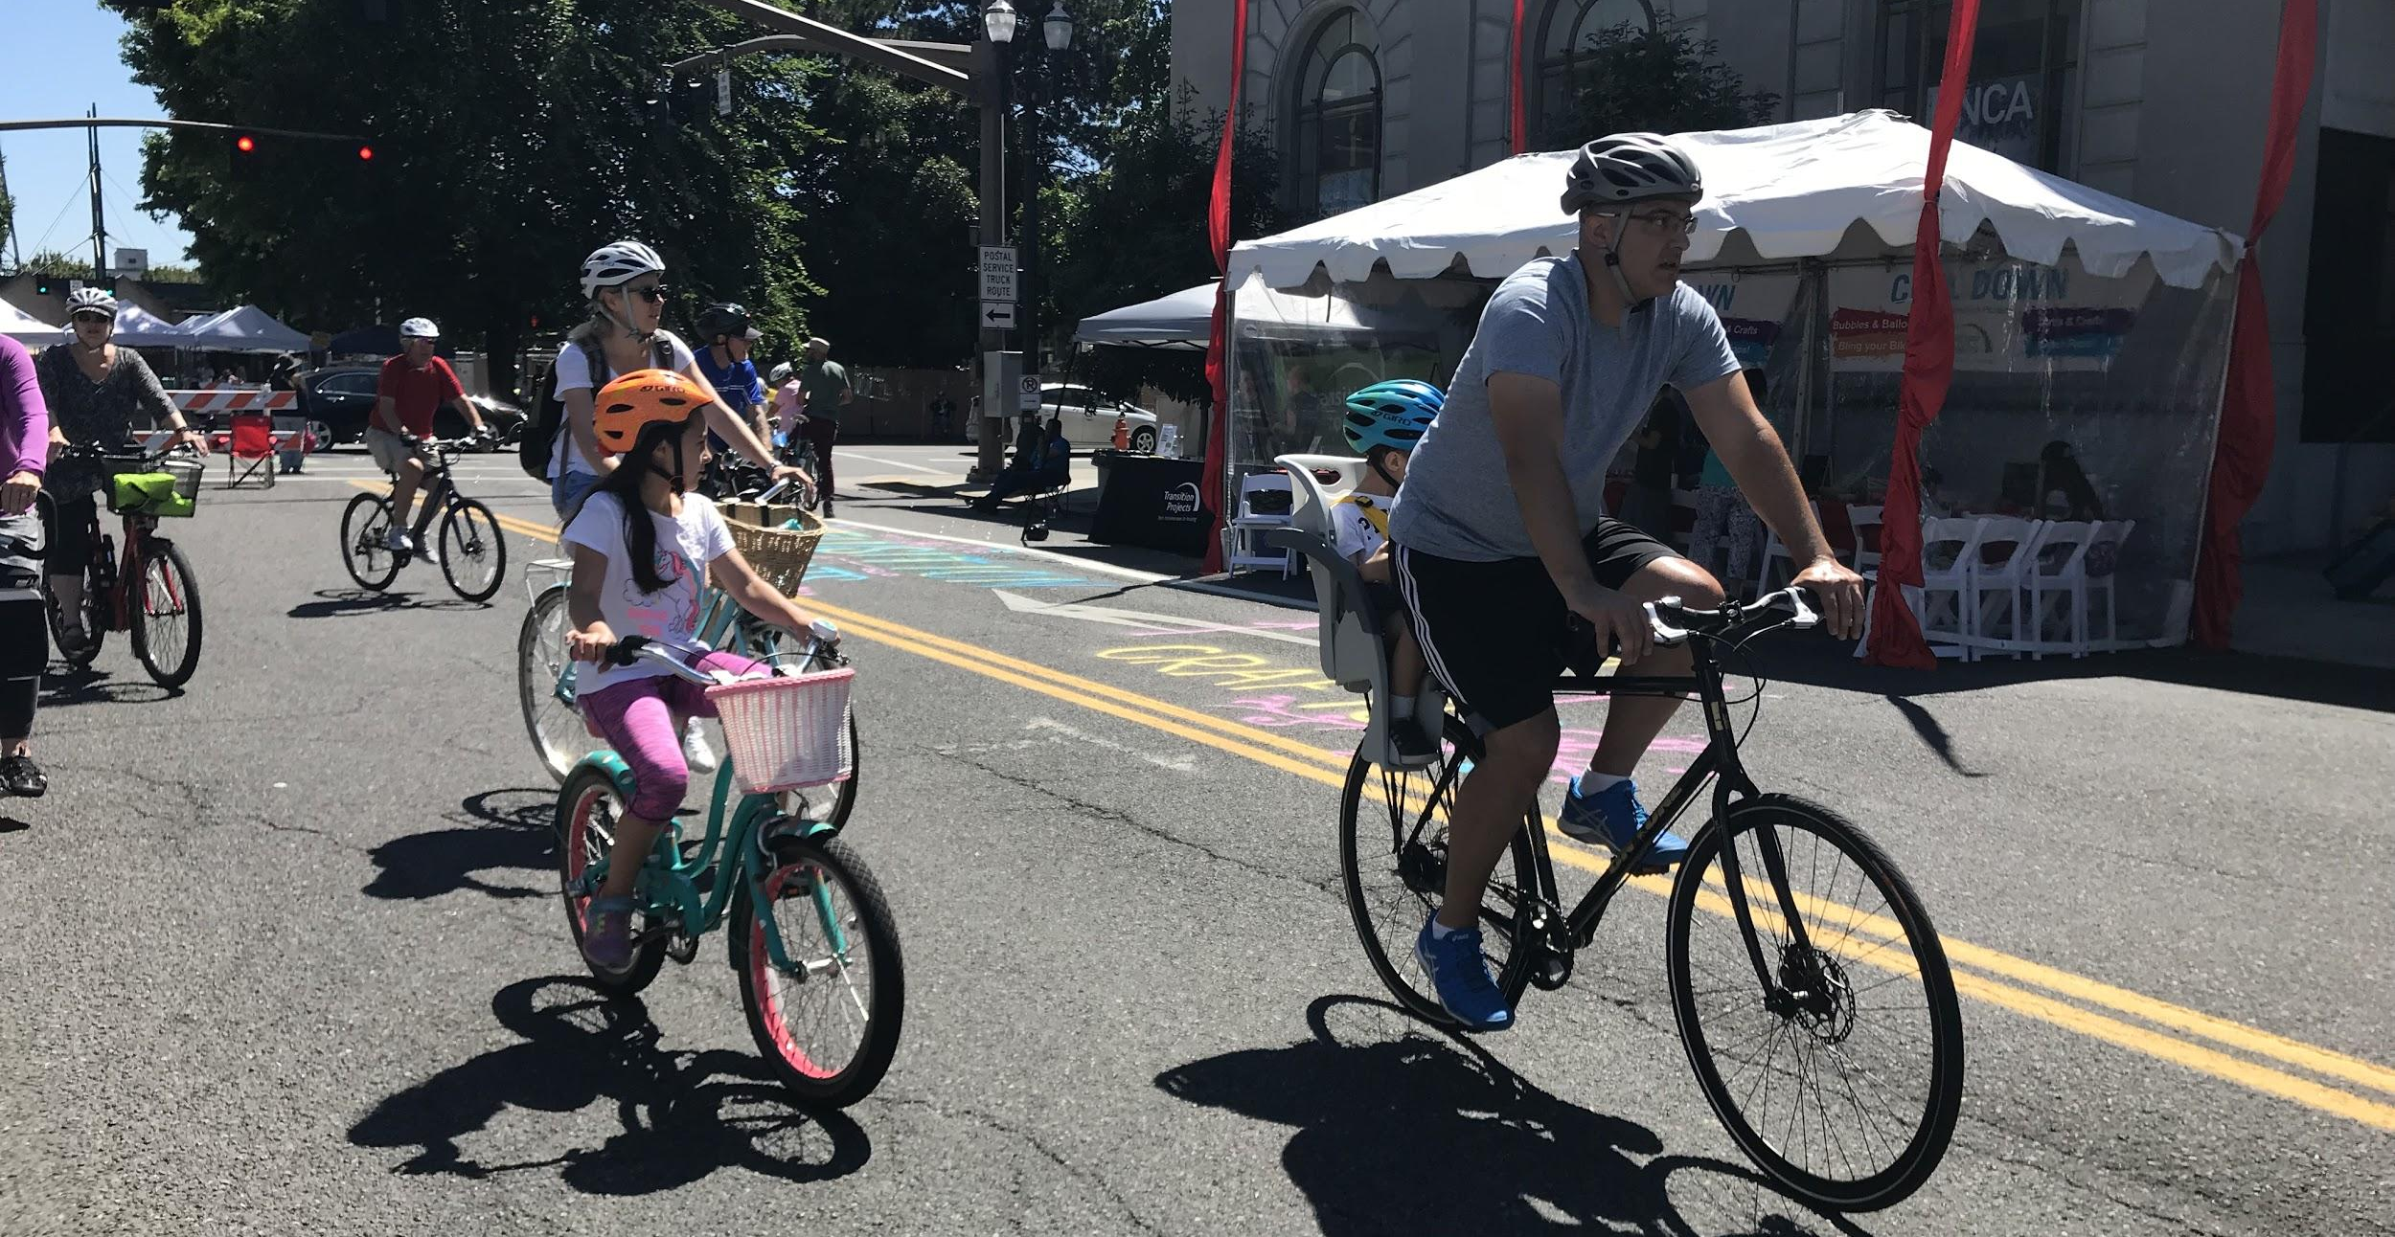
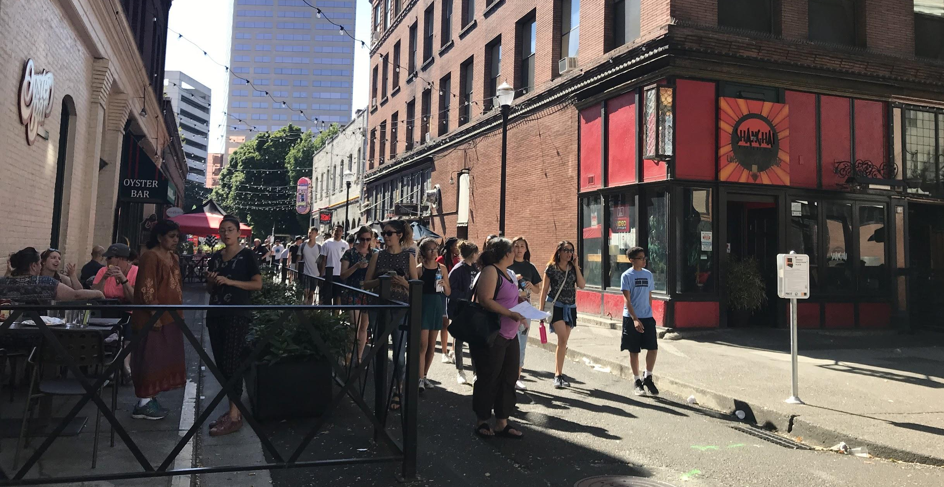
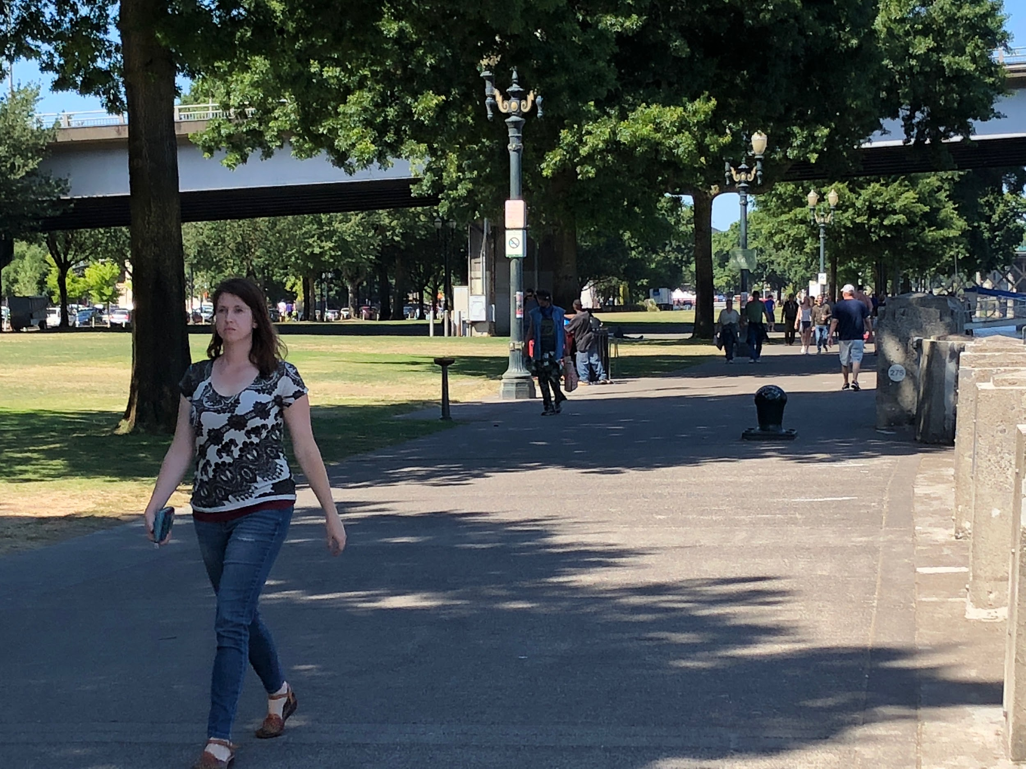
Connected
Green Loop
Implement the Green Loop vision for the area
Streets as Places
Introduce creative strategies to ensure pedestrian orientation
Knit the site to the surrounding city
Waterfront Access
How could waterfront access be improved?

Slide 46
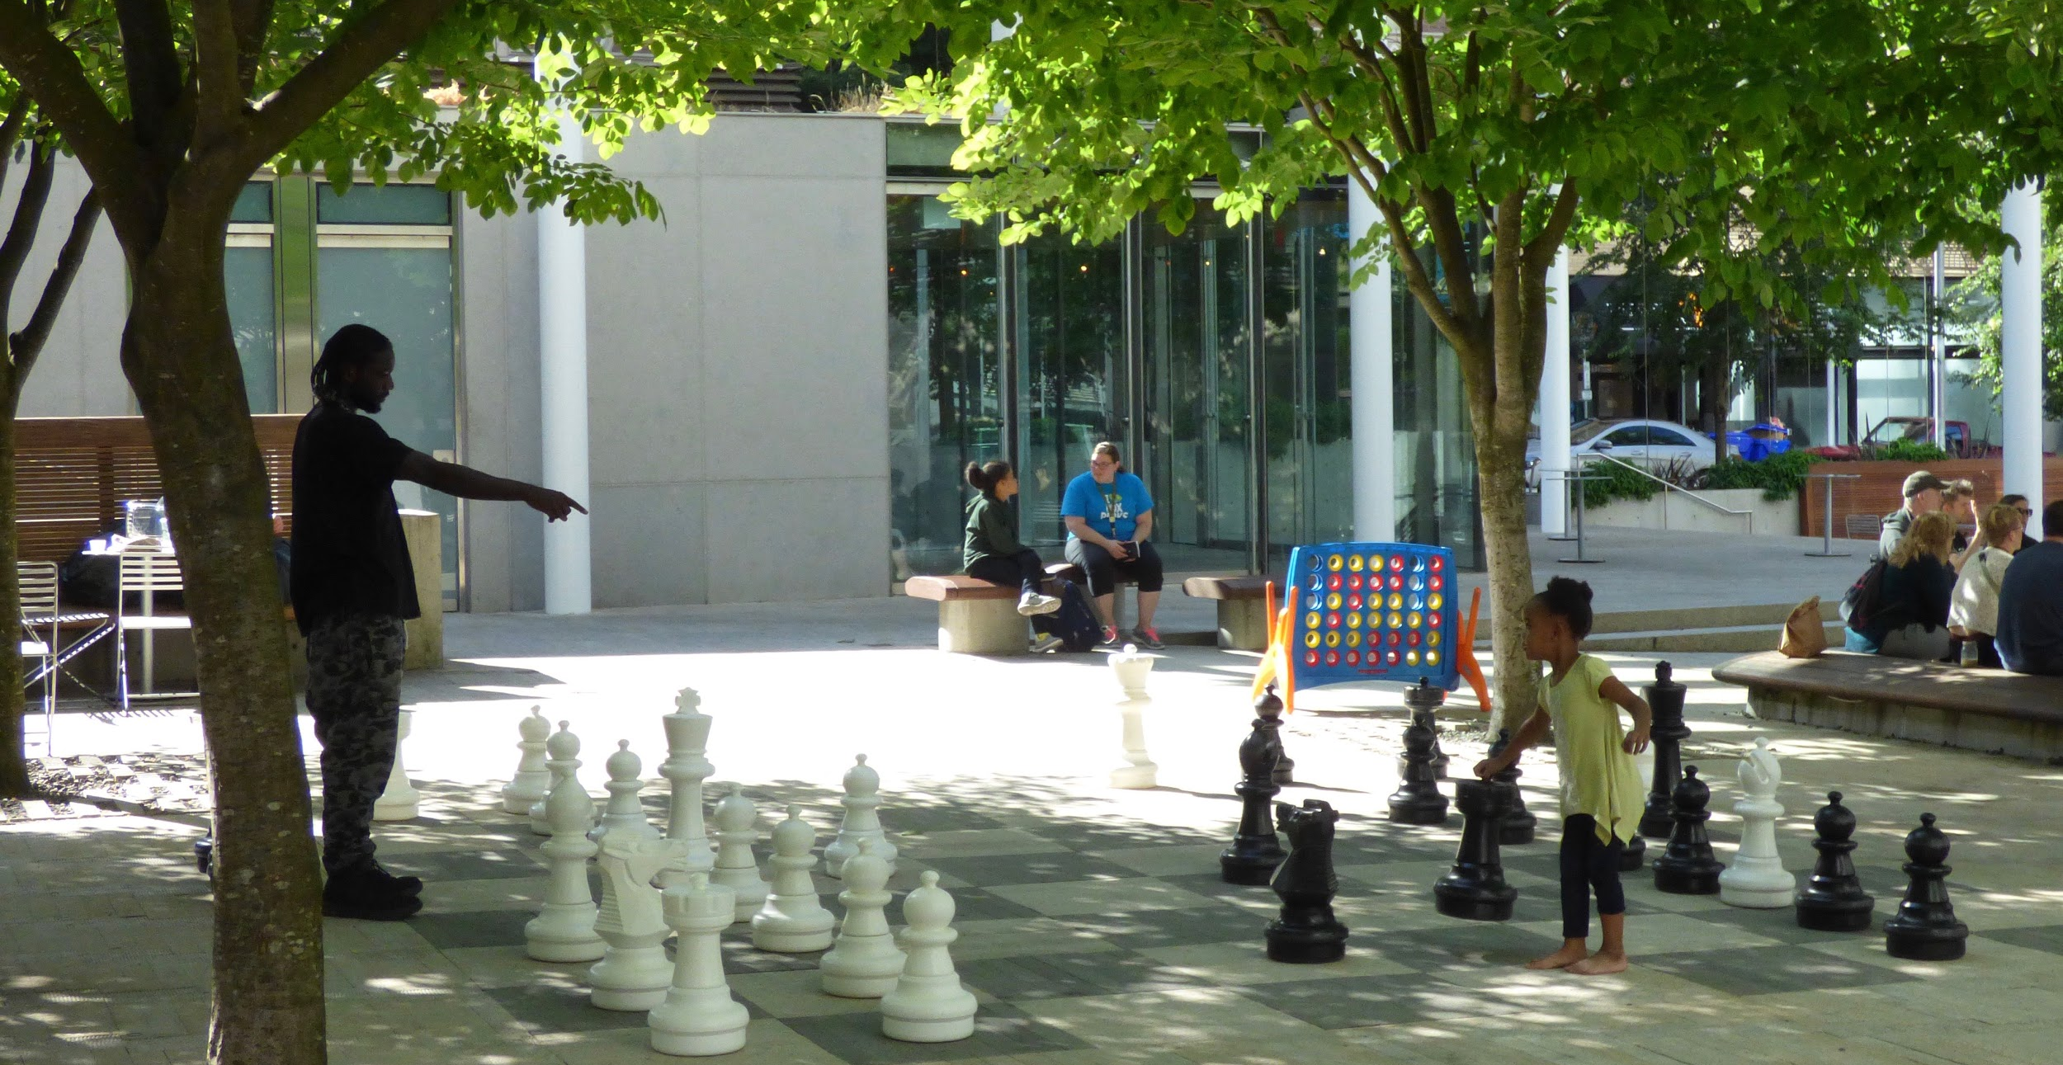
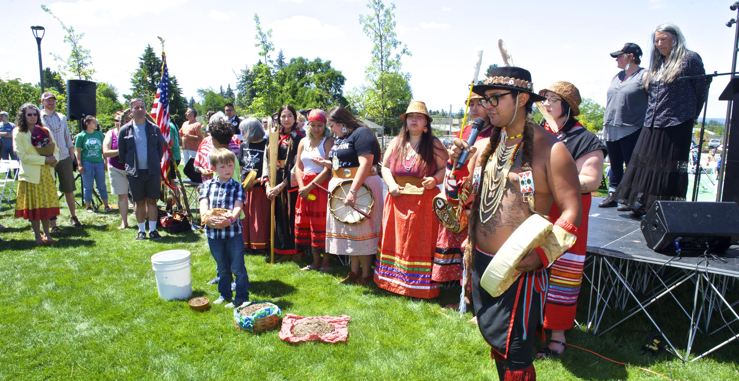
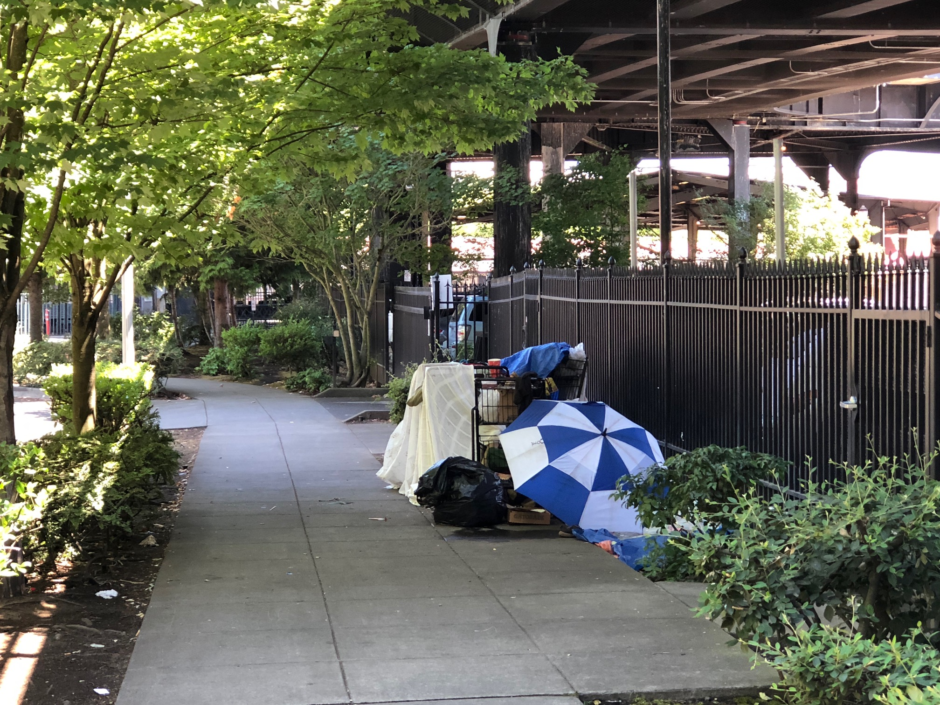
Equitable
Equitable
No One’s Backyard
Ensure public spaces serve a diverse audience
Cultural Diversity
Food, arts, culture, and landmarks to attract a diverse constituency
For and by individuals in the communities they intend to reach
Homelessness
Support for shelters, mobile engagement teams, services

Slide 47
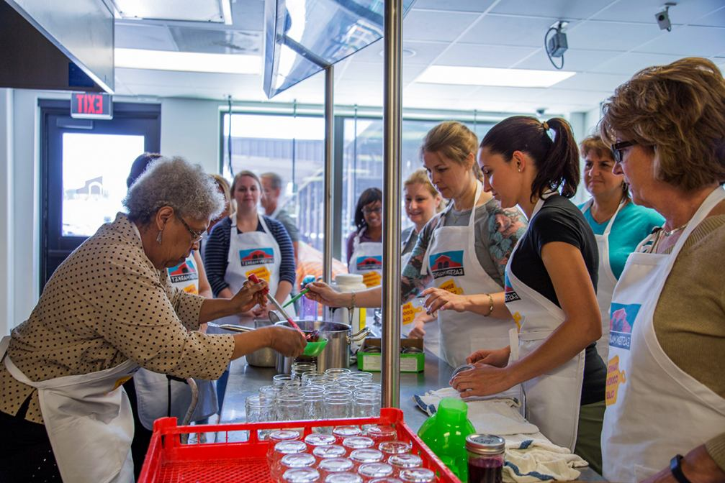
Prosperous
Entrepreneurship
Affordable retail, work space for new businesses, support organizations, and public amenities in one place
Portland Mercado-like space
Procurement & Operations
Contract with local talent
Encourage minority and women-owned businesses

Slide 48
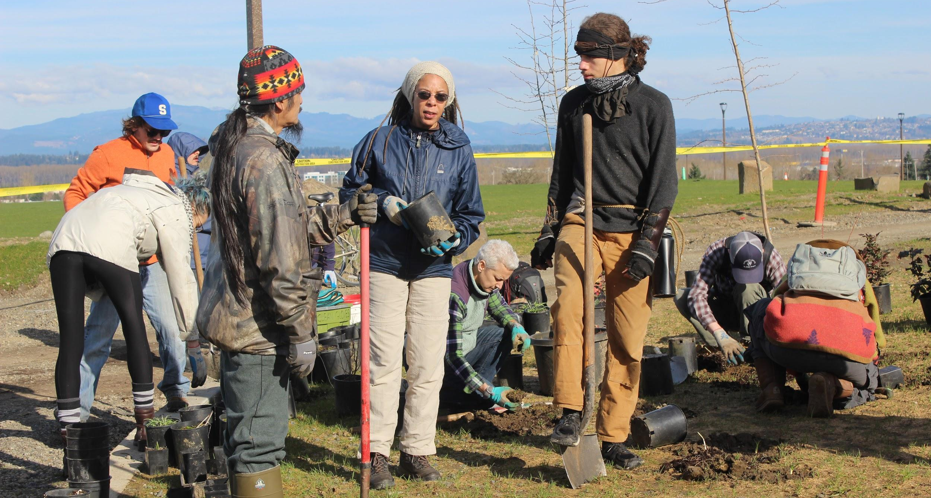
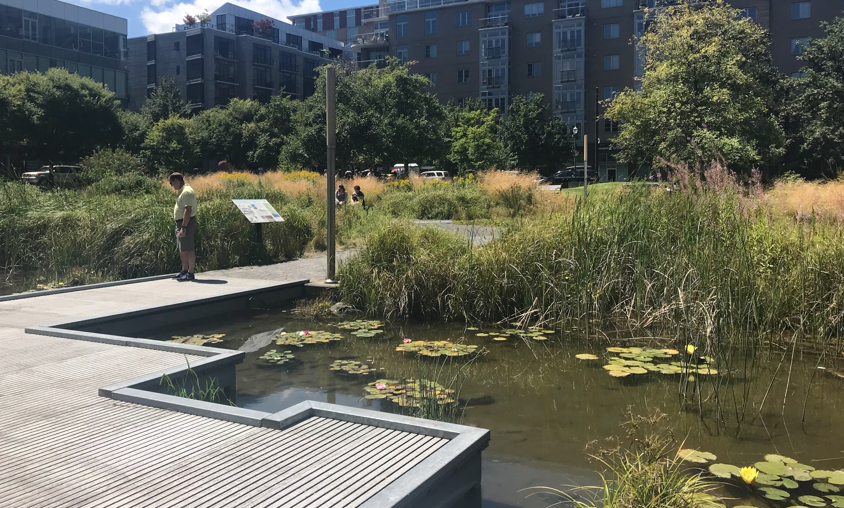
Resilient
Double-Duty Greenery
Natural elements that provide human uses
Community gardens, ecoroofs with agriculture, vertical greenery
Water Management
Green drainage system with opportunities for human use
Educational opportunities

Slide 49
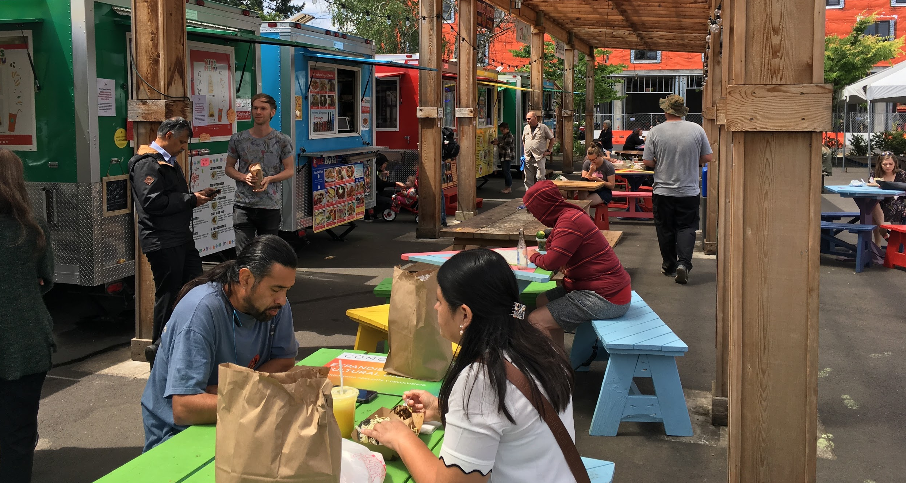
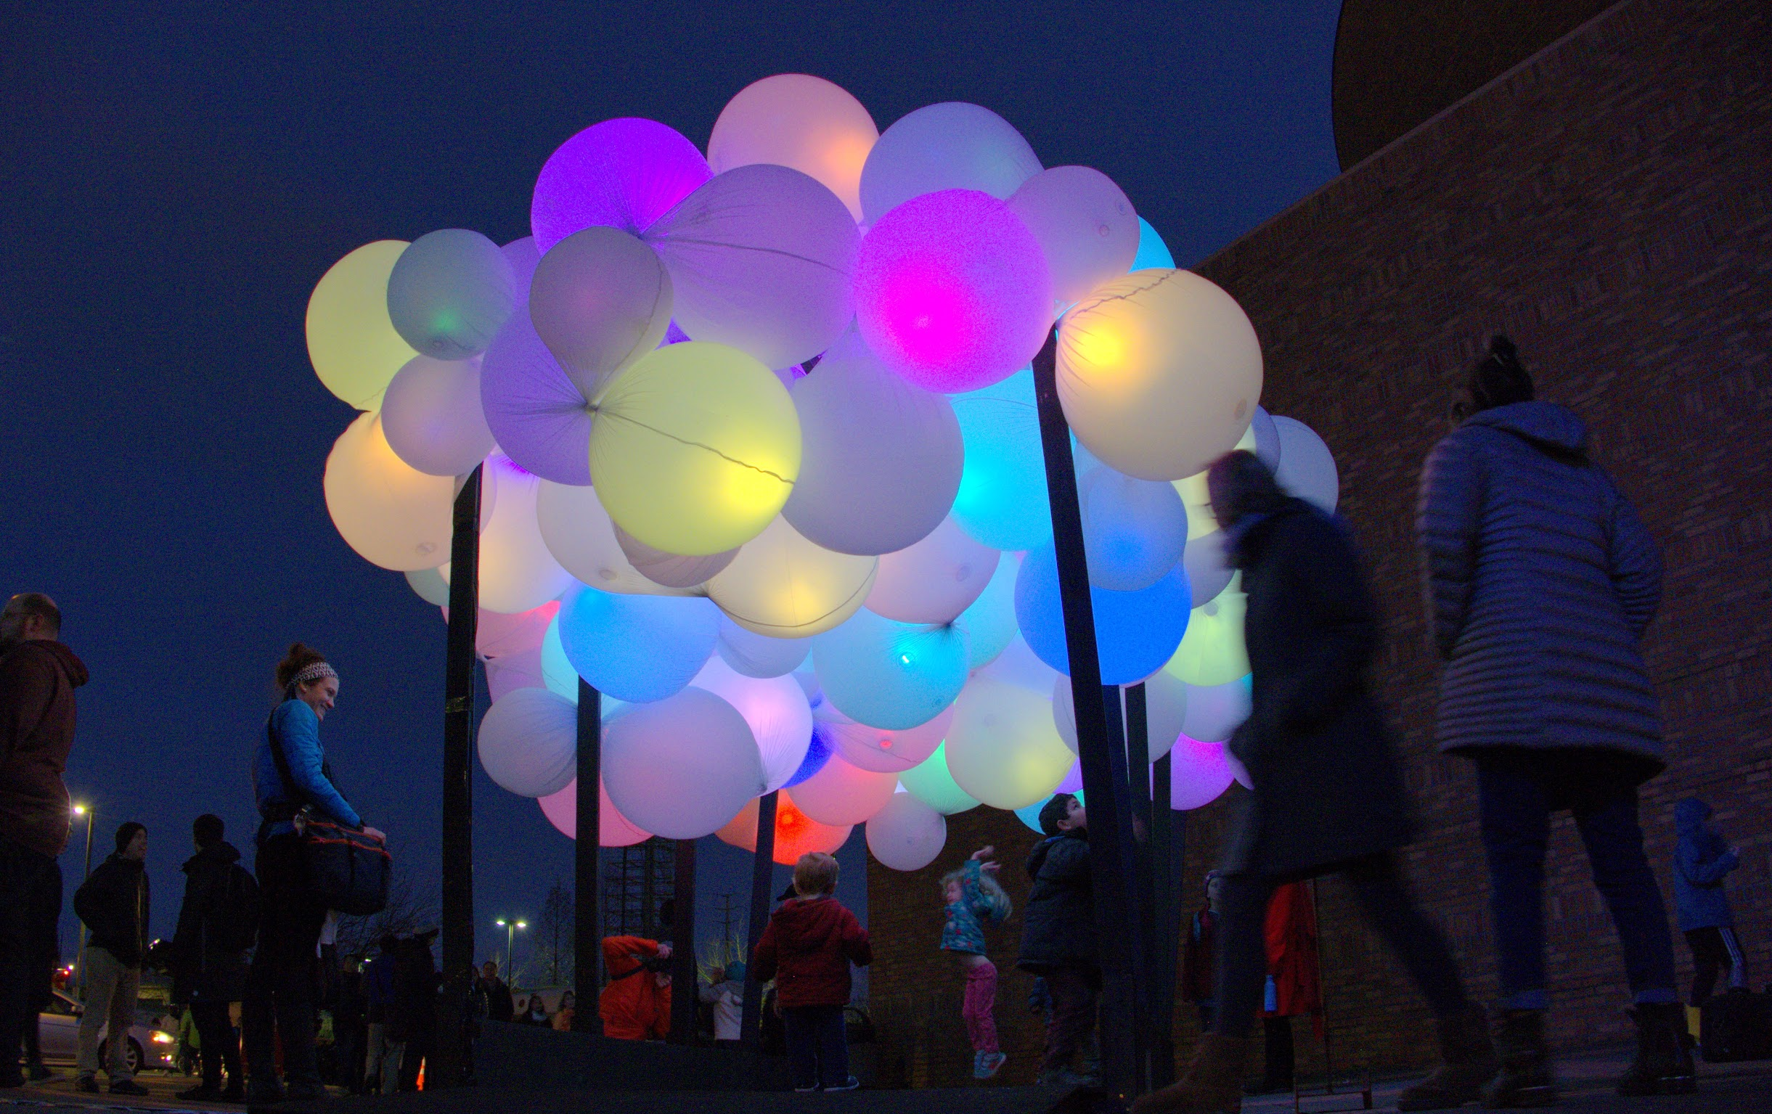
Vibrant
Food
Affordable food trucks with public space amenities
Inclusive entrepreneurship
Arts & Culture
Affordable cultural programming that supports diverse artists
Art that brings diverse people together

Slide 50
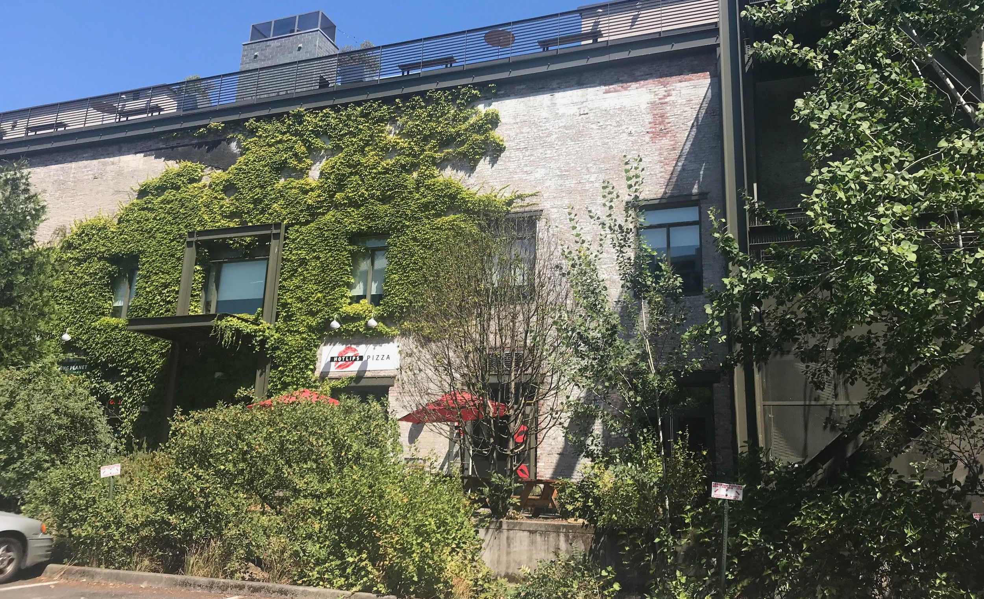
Vibrant
Recreation
Create opportunities for recreation
Basketball, ice-skating, soccer pitches suggested
Existing Anchors
Ecotrust, Union Station, Transition Projects, the Pacific Northwest College of Art could help activate the site

Slide 51
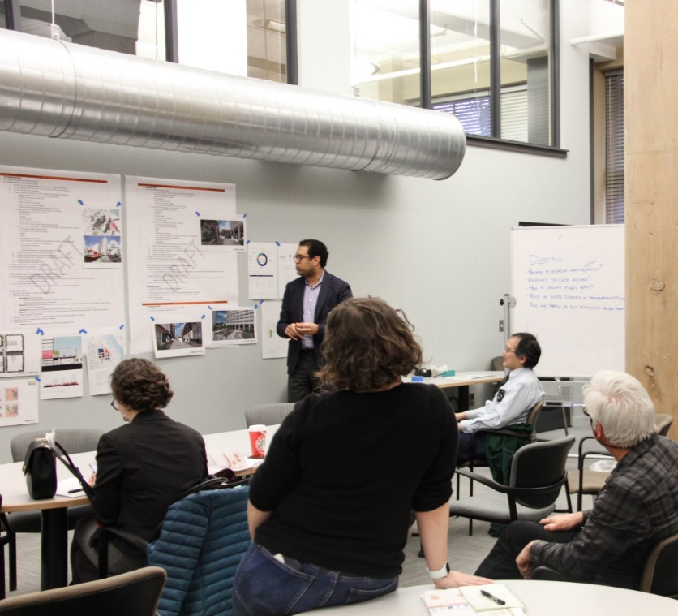
NEXT STEPS
Phase B2: Develop Concept Alternatives
Steering Committee Meeting, September 25th
Open House #2, September 26th
Design Commission Work Session, October 4th
Notes:
Next steps:
-- A non-binding MOU with Continuum outlining our values and expectations for the partnership moving forward and providing exclusive negotiation rights for the redevelopment of the USPS property
-- onboarding the Continuum team to the project and local community
-- and finalizing a contract with ZGF
This will allow us to kick-off our development planning work in June.

Slide 52
QUESTIONS Is our process clear? Criteria to focus on at this time? Are there particular themes emerging that support the criteria well?
Notes:
Thank and acknowledge the work of
Steering Committee and Evaluation Committee
Developer candidates
ZGF
June
We have and will continue to learn from each other in this process as we move forward

Slide 53
NEIGHBORHOOD & CONTEXT
Pacific Northwest College of Art
412 Undergraduate Students
111 Graduate Students
26 PNCA | PENSOLE Intensive Students
1,400 Community Education Students of all ages
94 faculty members
700 free public programs each year

Slide 54
NEIGHBORHOOD & CONTEXT
Bud Clark Commons
Permanent Housing
130 studio homes
Serves residents who have experienced homelessness
Income below 35% AMI
Doreen’s Place (TPI)
Short term housing, 90 beds
Day Resource Center (TPI)
Bud Clark Clinic (CCC)

Slide 55
NEIGHBORHOOD & CONTEXT
Multnomah County Health Department HQ
350 health professionals, including tri-county health officer, public health nurses, epidemiologists, and administrators
Small specialty clinic and pharmacy

Slide 56
NEIGHBORHOOD & CONTEXT
Union Station
Oldest major passenger terminal on the West Coast
10 daily passenger trains
Amtrak Cascades from Eugene to Seattle and Vancouver, BC
Coast Starlight from Seattle to Los Angeles
Empire Builder from Seattle/Portland to Chicago
Intercity bus lines
Limited food & retail services
Modernization effort underway

Slide 57
FEEDBACK TO DATE
Will be updated following 7/24 Steering Committee and 7/25 Open House
Notes:
Next steps:
-- A non-binding MOU with Continuum outlining our values and expectations for the partnership moving forward and providing exclusive negotiation rights for the redevelopment of the USPS property
-- onboarding the Continuum team to the project and local community
-- and finalizing a contract with ZGF
This will allow us to kick-off our development planning work in June.

Slide 58
NEXT STEPS
Phase B2: Preliminary Concepts
Steering Committee Meeting, September 25th
Open House #2, September 26th
Design Commission Work Session, October 4th
Notes:
Next steps:
-- A non-binding MOU with Continuum outlining our values and expectations for the partnership moving forward and providing exclusive negotiation rights for the redevelopment of the USPS property
-- onboarding the Continuum team to the project and local community
-- and finalizing a contract with ZGF
This will allow us to kick-off our development planning work in June.

Slide 59
MASTER PLAN APPROVAL CRITERIA
This Master Plan will:
Be consistent with applicable subdistrict goals and policies of the Central City 2035 Plan;
Demonstrate how development will comply with the Central City Fundamental Design Guidelines, as well as any applicable design guidelines specific to the subdistrict the master plan site is located within;
Notes:
Next steps:
-- A non-binding MOU with Continuum outlining our values and expectations for the partnership moving forward and providing exclusive negotiation rights for the redevelopment of the USPS property
-- onboarding the Continuum team to the project and local community
-- and finalizing a contract with ZGF
This will allow us to kick-off our development planning work in June.

Slide 60
MASTER PLAN APPROVAL CRITERIA
This Master Plan will:
Establish an overall building orientation through massing, the location of entrances, and the location of ground floor uses that result in an edge that embraces adjacent public park rather than creating an abrupt edge between the plan area and parks, and ensures that development within the plan boundary will not excessively shade the adjacent park;
6. demonstrate that easy and safe access will be provided to transit stations located within or immediately adjacent to the master plan boundary, and any buildings located immediately adjacent to a transit station include ground floor uses that create an active and safe pedestrian environment throughout the day, evening, and week;
Internal open areas are accessible within, and distributed throughout, the master plan area and have connections to the surrounding neighborhood and to any adjacent open space. Internal open areas enhance visual permeability through the site, especially on sites near the Willamette River. The size and location of each open area must be adequate to accommodate the intended use of the space.
Notes:
Next steps:
-- A non-binding MOU with Continuum outlining our values and expectations for the partnership moving forward and providing exclusive negotiation rights for the redevelopment of the USPS property
-- onboarding the Continuum team to the project and local community
-- and finalizing a contract with ZGF
This will allow us to kick-off our development planning work in June.

Slide 61
MASTER PLAN APPROVAL CRITERIA
This Master Plan will:
Have a transportation system is capable of supporting the proposed uses in addition to the existing uses in the plan area. Evaluation factors include street capacity, level of service, connectivity, transit availability, availability of pedestrian and bicycle networks, on-street parking impacts, access restrictions, neighborhood impacts, impacts on pedestrian, bicycle, and transit circulation, and safety. Evaluation factors may be balanced; a finding of failure in one or more factors may be acceptable if the failure is not a result of the proposed development, and any additional impacts on the system from the proposed development are mitigated;
9. Have a proposed street plan to provide multi-modal street connections to support the surrounding street grid pattern;
10. ensure that there will be adequate and timely infrastructure capacity for the proposed development; and
Notes:
Next steps:
-- A non-binding MOU with Continuum outlining our values and expectations for the partnership moving forward and providing exclusive negotiation rights for the redevelopment of the USPS property
-- onboarding the Continuum team to the project and local community
-- and finalizing a contract with ZGF
This will allow us to kick-off our development planning work in June.

Slide 62
MASTER PLAN APPROVAL CRITERIA
This Master Plan will:
demonstrate that, to the extent practical and feasible, inactive uses such as, but not limited to, parking and access, loading, and trash and recycling are shared or consolidated, with the goal of activating the pedestrian environment.
not have a significant adverse effect on truck and freight movement;
Preserve City-designated scenic resources
Proposed residential uses are buffered from potential nuisance impacts from uses allowed by right in the zone; and
Include a design, landscape, and transportation plan that will limit conflicts between residential, employment, and industrial uses.
Notes:
Next steps:
-- A non-binding MOU with Continuum outlining our values and expectations for the partnership moving forward and providing exclusive negotiation rights for the redevelopment of the USPS property
-- onboarding the Continuum team to the project and local community
-- and finalizing a contract with ZGF
This will allow us to kick-off our development planning work in June.

Slide 63
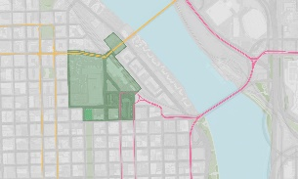
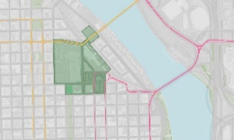
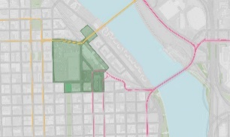
NEIGHBORHOOD & CONTEXT
View Corridors
NW Johnson at Jamison Park
Mid-way of Broadway Bridge
Old Thunderbird Motel Site
Mid-way of Steel Bridge

