Slide 1
SE 102nd Avenue & Woodstock Blvd.
Local Improvement District
Resolution of Intent Hearing
July 25, 2018 – Agenda Item #787
Andrew Aebi, M.B.A., Local Improvement District Administrator; SE 102nd & Woodstock LID Project Manager
Geren Shankar, SE Foster-Woodstock Couplet (96th – 101st Avenues) Project Manager

Slide 2
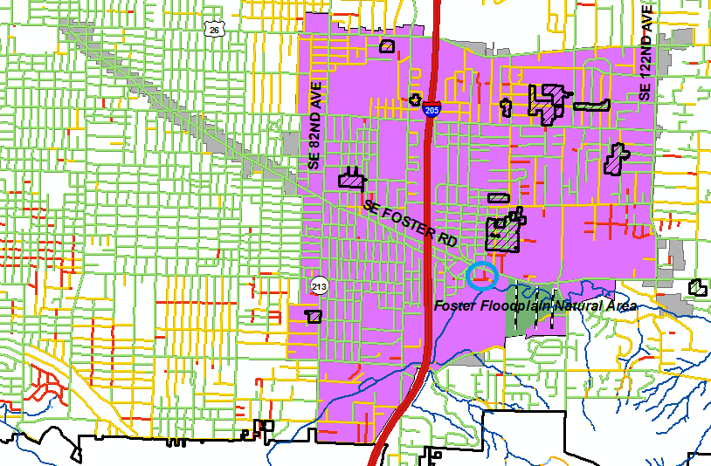
Project Located Lents Neighborhood & Lents URA
Original URA
Expanded URA
Paved With Curbs
Paved Without Curbs
Unpaved
Completed LIDs
City Boundary
Proposed New
LID Circled

Slide 3
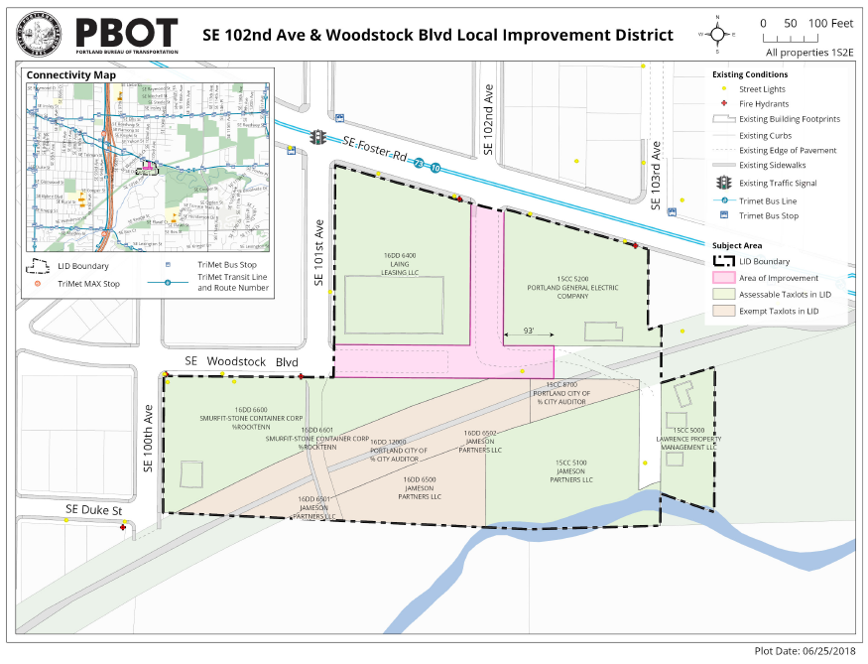
Project Map

Slide 4
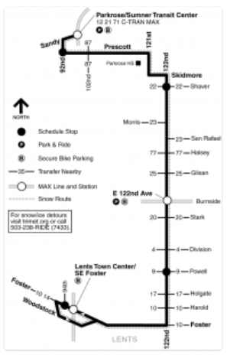
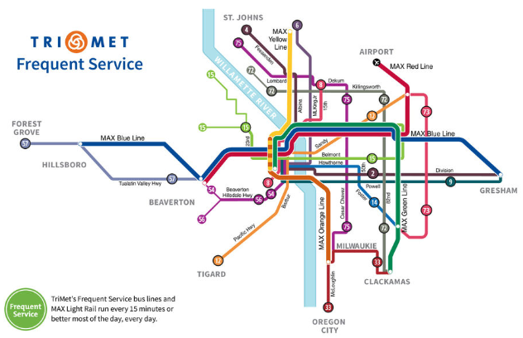
New LID Adjacent to New Sep. 2018 Frequent Service

Slide 5
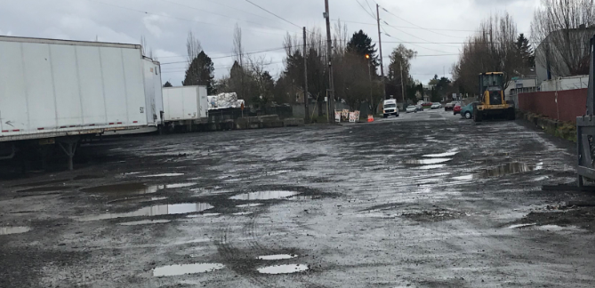
SE Woodstock Blvd. Street View
April 2018

Slide 6
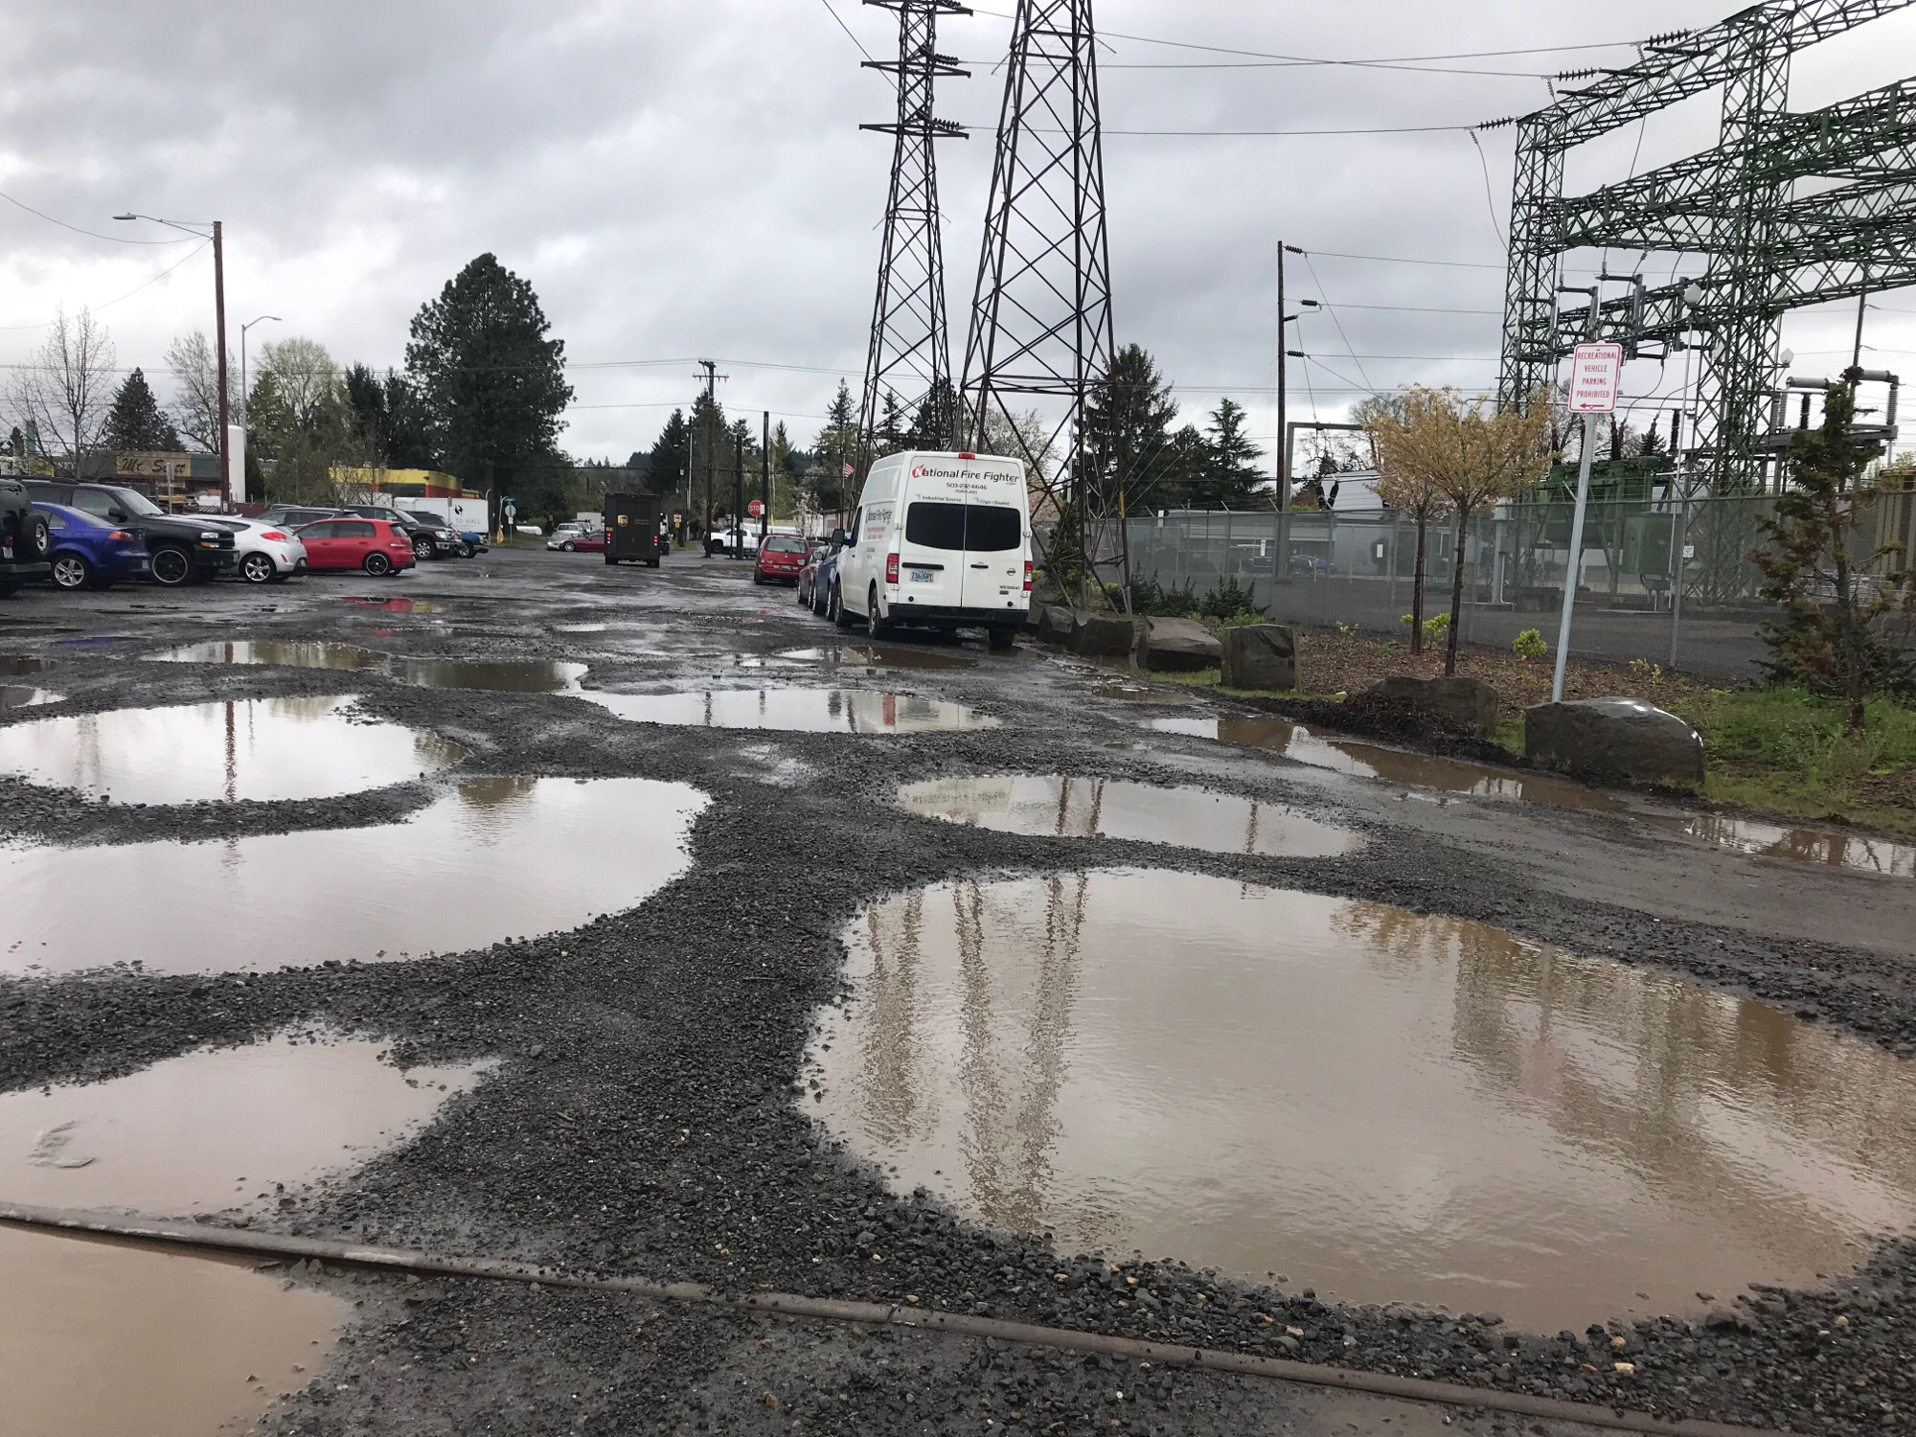
SE 102nd Avenue Street View
April 2018

Slide 7
Centerline Miles of Unpaved Streets
Current
3.5 Miles in Lents Urban Renewal Area
1.7 Miles in Lents Neighborhood Association
8 Completed LIDs in Lents URA Expiring in 2022
2.0 Miles
$ 474 / centerline foot in 2002; $599 / centerline foot in 2007
$1,570 / centerline foot in 2014; $991 / centerline foot in 2018
Foster Floodplain
0.8 Miles Eliminated with BES Project Completed in 2012; $0 on street
Combined Total
2.8 Miles Eliminated with BES & LID Projects Combined
45% Reduction from 6.3 Miles Since Lents URA Formed in 1998
Proposed SE 102nd & Woodstock LID
8% Additional Reduction in Lents N.A. Unpaved Streets; $1,693 / CL foot

Slide 8
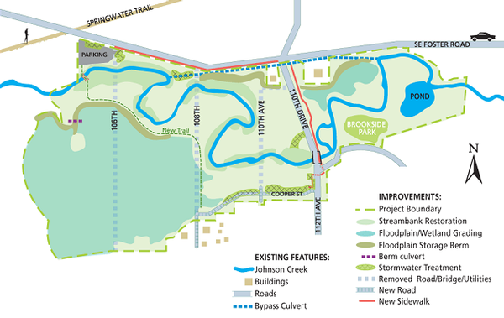
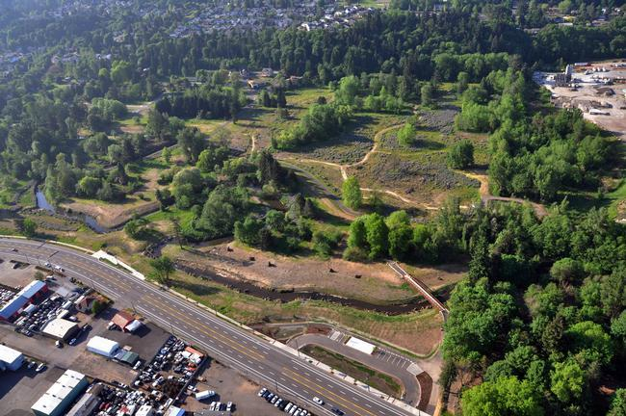
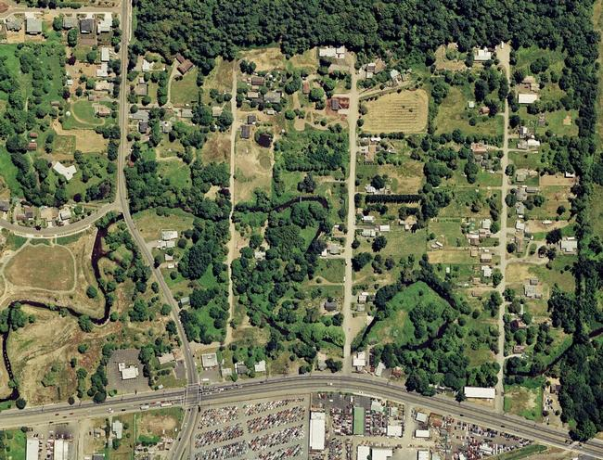
BES Foster Floodplain Project East of New LID
Completed in 2012 (above)
Prior to BES acquisition in 1998 (left)

Slide 9
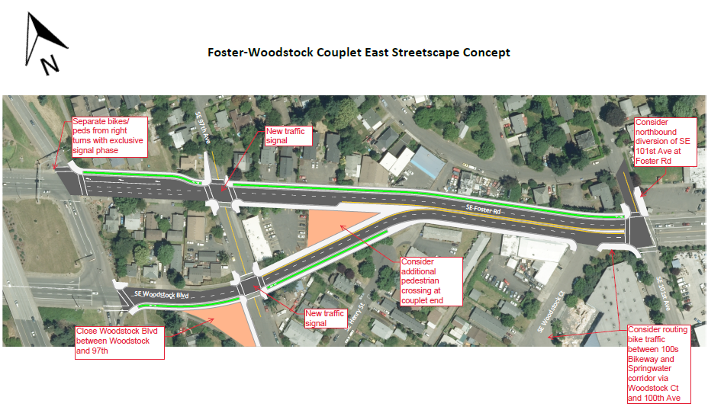
Foster / Woodstock Couplet Project West of New LID
Likely will survey, design and construct both projects together
Foster / Woodstock Couplet (96th – 101st Avenues) and new LID

