Slide 1
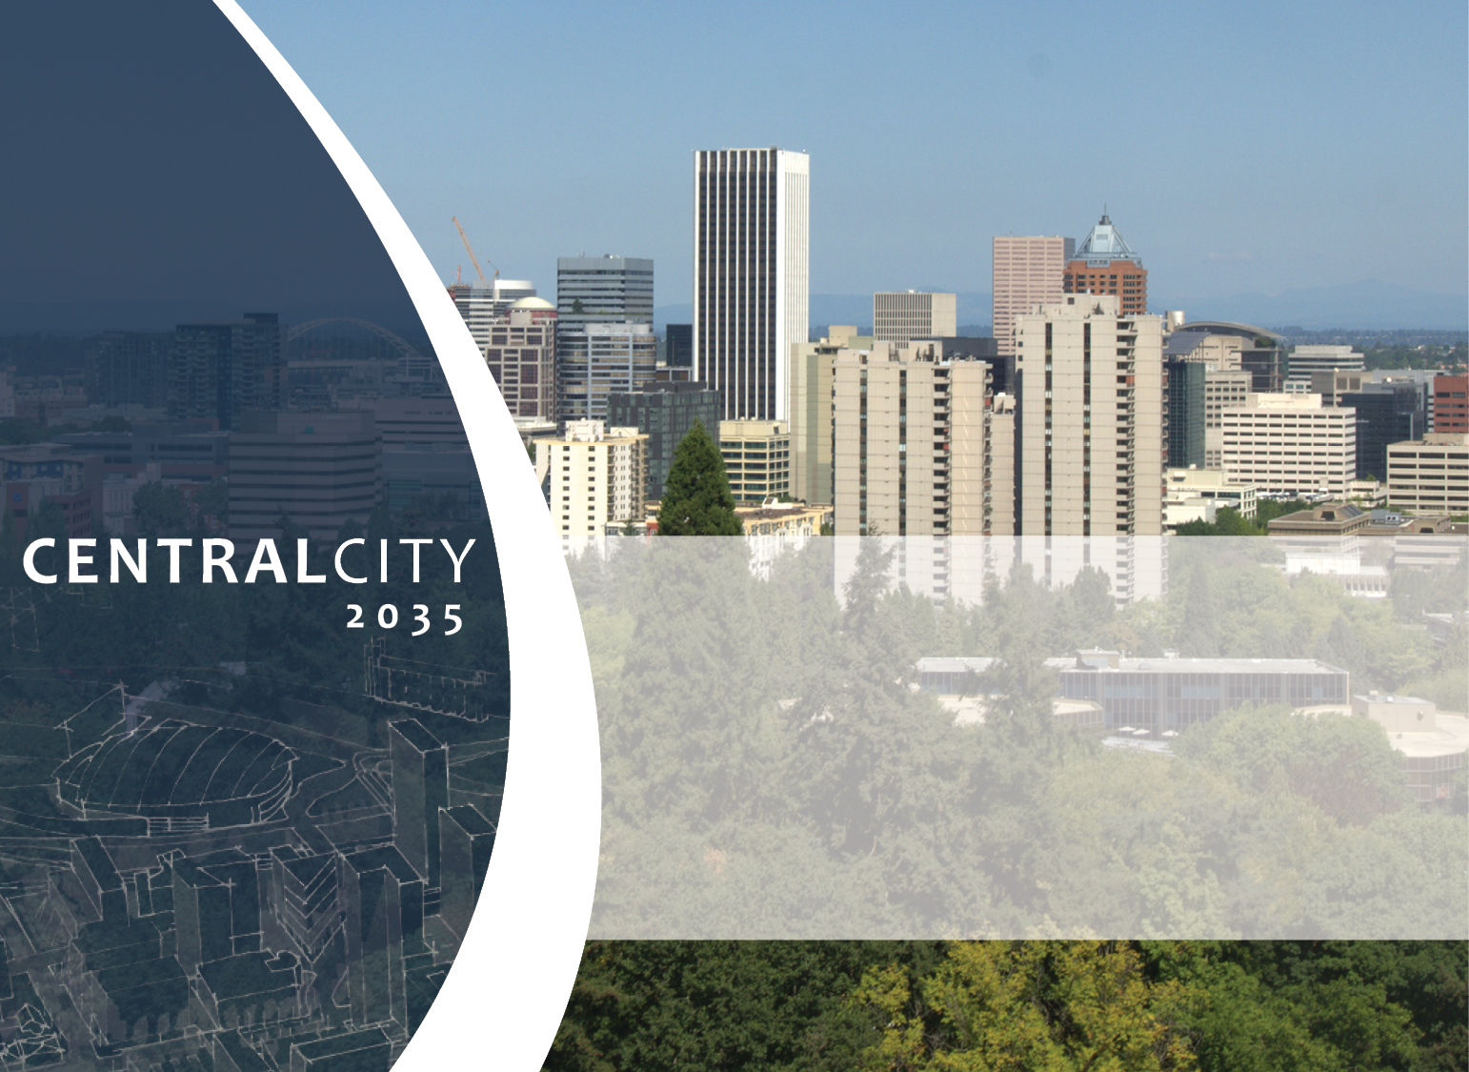

Design Commission
Briefing
July 12, 2018

Slide 2
CC2035 Plan Components
Volume 1 Goals and Policies
Volume 2A1 Zoning Code and Map Amendments-CC Plan District
Volume 2A2 Zoning Code and Map Amendments-Willamette River, Trails
Volume 2A3 Zoning Code and Map Amendments-Outside the Central City
Volume 2B Transportation System Plan amendments
Volume 3A1 Scenic Resources Protection Plan-Summary
Volume 3A1 Scenic Resources Protection Plan-Inventory
Volume 3A1 Scenic Resources Protection Plan-ESEE Analysis
Volume 3B Willamette River Protection Plan
Volume 4 Background Materials
Volume 5A Implementation-Performances Targets and Action Plans
Volume 5B Implementation-The Green Loop
Volume 6 Public Involvement
Notes:
Hello, Rachael Hoy with BPS
Central City 2035 was adopted by City Council June 6 and went into effect July 9
Many volumes of work adopted with Central City 2035 today I’m talking mainly about updates to the CC Plan district zoning code.
Staci provided you with a handout that briefly describes changes to the plan district. We are not going to go through all of these but really hit the highlights that are relevant to your Commission work.

Slide 3
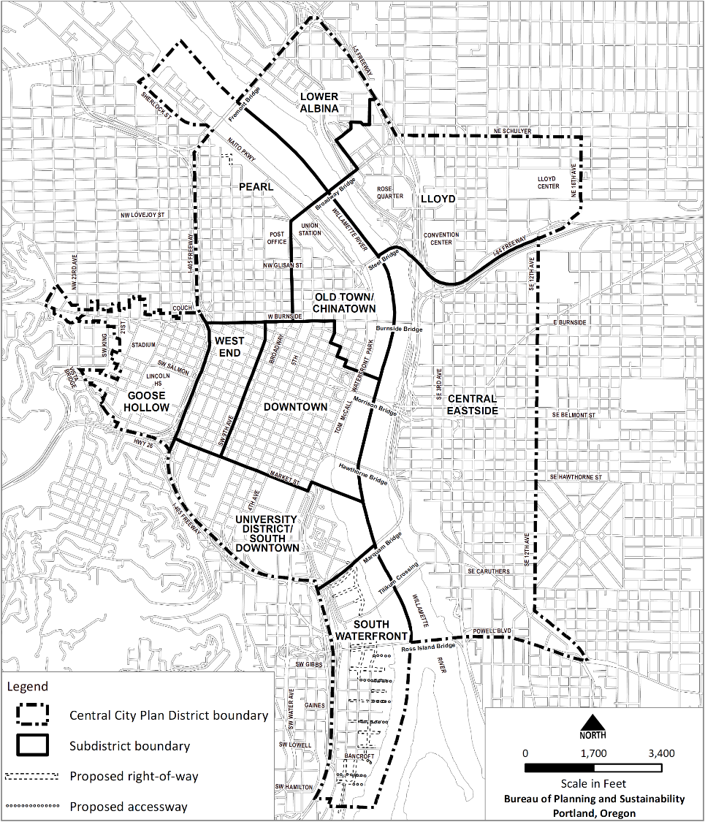
New Central City Subdistrict Boundaries
No River District
Downtown smaller
New West End & University/South Downtown
Blanchard Site into Lloyd
Clinton Station
Notes:
I’m going to provide an overview to get us started. We’ve got 10 subdistricts in the CC. River District has gone away replaced by the Pearl and old Town Chinatown. Smaller Downtown district with West End becoming its own district.
Portland Public Schools Blanchard site becomes part of Lloyd subdistrict
The Central City boundary has been expanded to include Clinton Station area

Slide 4
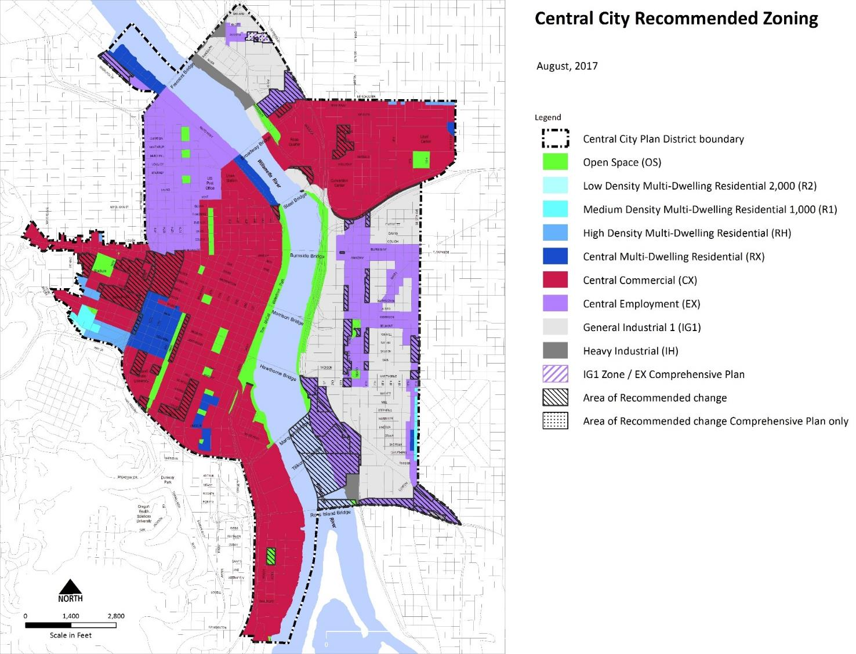
Central City Zoning
Notes:
Generally most of the Central City is Central Commercial which allows for flexibility of residential and commercial mixed use developments. The proposed changes are in an effort to simplify the zoning pattern and add more flexibility across the central city.
-RX zoning is being changed to CX zoning in some areas West of river and also in the Lloyd district. This change is being made to add more flexibility for commercial and housing at these sites. We’ve seen more residential development in our mixed use zones than in the RX zone.
-the remaining RX zoning- we’ve made it more flexible to allow for more office/commercial on the ground floor.
-Also in an effort to preserve older non-residential buildings (for example like the YWCA) that may not be formally designated as historic, but that we want to preserve. These buildings may have up to 100 percent of the building in retail sales or service or office use. This allows for more options for re-use and rehabilitation.
-Increasing Employment (EX) zoning along the east side of the river. OMSI, Clinton station, Blanchard site
-Some of the EX along the waterfront- housing possible through a conditional use
-EX along Powell Blvd and in Lower Albina -prohibiting housing
-Expand industrial office uses to the entire Central Eastside (white area in CES). Historic landmarks and contributing resources in historic and conservation districts can be 100 industrial office in the IG1
-Additional uses allowed in the Open Space zone: we changed this code to allow for small retail sales and serve uses in the OS throughout the CC.

Slide 5
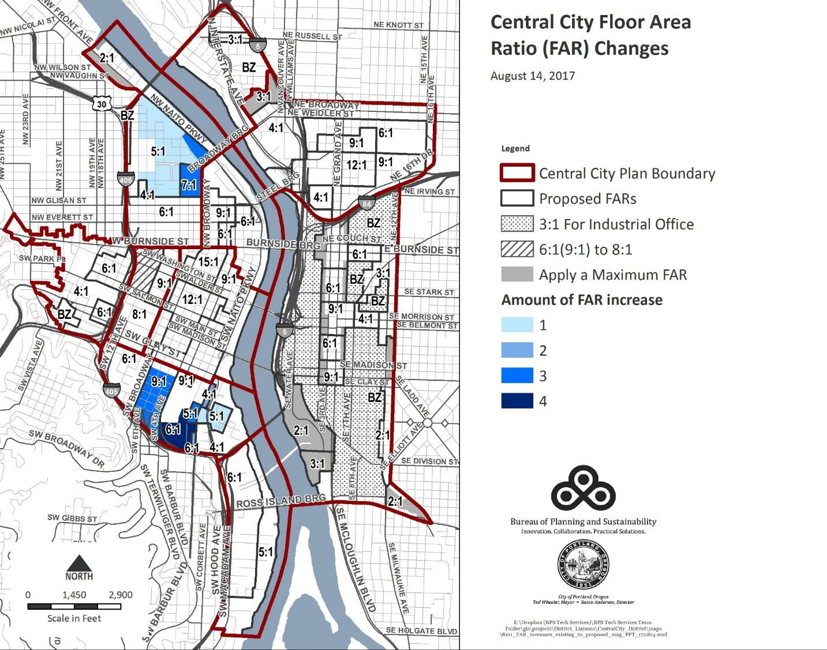
Notes:
This map reflects FAR changes:
-Minimum FARs applied across the CC (1:1 to 3:1). Sites zoned industrial and open space are exempt, plus public schools.
A few areas of increases:
-transit mall and Lincoln station area
A few other areas I want to point out:
-Riverplace, North Pearl - Slight increase in FAR from 4:1 to 5:1 makes these areas eligible for a better inclusionary housing incentives package, may encourage redevelopment more quickly and increase the amount of affordable housing in these areas.
-Post Office site – both the West Quadrant plan and the Broadway Corridor framework plan called for increased allowances of FAR and height for a high density mixed use development with affordable housing,
-update in west end – existing FAR is 6:1 for commercial and 9:1 for residential. . We wanted to simplify the code and have one base FAR for the area. 8:1 is the current FAR to the South

Slide 6
Notes:
Retained some specific FAR regulations for South Waterfront and the south Park Blocks. West End and North Pearl special FAR provisions eliminated, making them more like all other areas in CC.
(transferring FAR to sites zoned RX is prohibited witihin the south park blocks frontage (area is mapped).
The Neighborhood facility (e.g. public school, daycare) exemptions from maximum FAR calculation is expanded to entire Central City.
Floor area ratios not increased Historic Districts except for block 33 in New Chinatown/Japantown historic district. The base FAR remains 6 to 1 but a future project can access a base of 9:1 if all floors above the ground floor on the western half of the block are in a residential use.

Slide 7
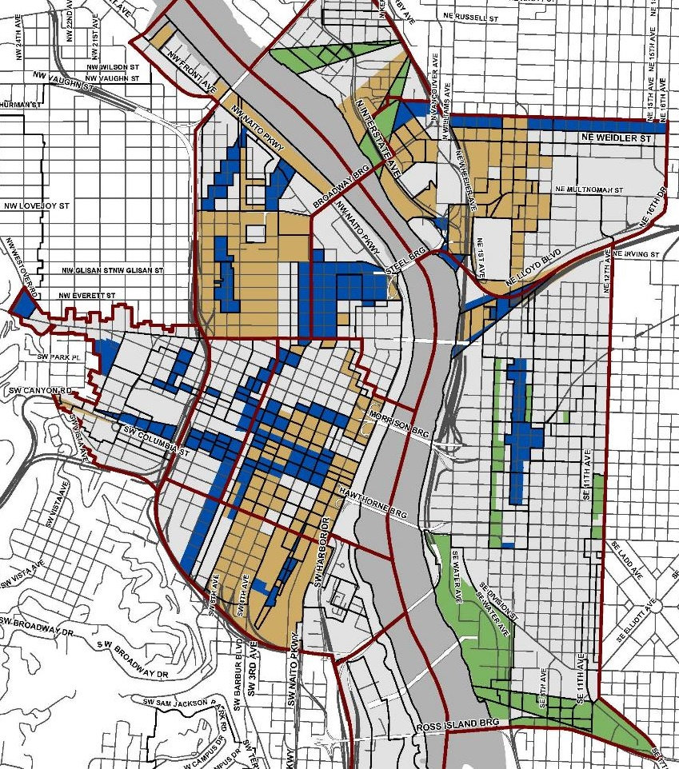
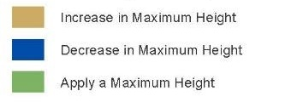
Height Changes
Bonus Heights
Height increase tied to bonus/transfer of FAR
Height Increases
Transit mall
Bridgeheads
Lloyd District (West)
Pearl District (South)
View Corridors
Height limits
Historic Districts
Heights reduced
Notes:
Overview map to show height increases and decreases across the Central city:
Increased height tied to bonus height which is accessed through the bonus and transfer system
-Areas include transit mall, bridge heads
-South Pearl
-Lloyd district
Decreases in height shown in blue are to preserve view corridors and historic districts. Generally in the historic districts the access to bonus height has been removed.
Areas in green is where we’ve applied a height limit for the first time -in some cases this is due to rezoning or protecting a public view. Areas of no change are in gray.

Slide 8
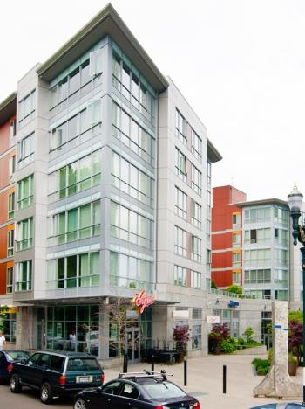
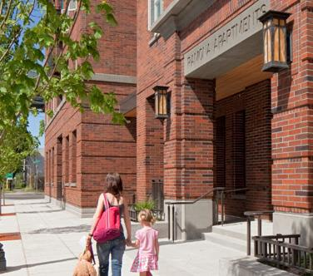
New FAR Bonus System
  Maximum amount earned through bonuses is 3 to 1
  Priority: Affordable housing: on site or pay into fund
  Riverfront Open Space bonus
  Existing South Waterfront greenway/open space bonuses retained
Notes:
NEW:
Most project can bonus up to 3 to 1 on their site, in SOWA we maintained previous regulations allowing bonuses to exceed 3 to 1 if the project uses the open space bonus for at least 1 to 1.
2) The priority is affordable housing bonuses – up to 3 to 1
-build it on site,
-Pay into an affordable housing fund
Next few are specialized or specific to certain areas of town:
2) Riverfront open space- only available to properties along the river. -Setback from the river earn additional floor area
4) 3 SOWA bonuses – existing bonuses that focus on open space creation and greenway development in the district
CC2035 has set a priority for the use of the bonuses
-If you are building residential and trigger inclusionary housing requirements – affordable housing will be built on site or pay into the fund
-if IH is not triggered and the project is primarily commercial then the project may pay into the affordable housing fund or transfer from a historic resource
-Valuable provisions for sites that already have additional FAR on site (from transfers or unused bonus FAR) –these can continued to be used on sites –

Slide 9
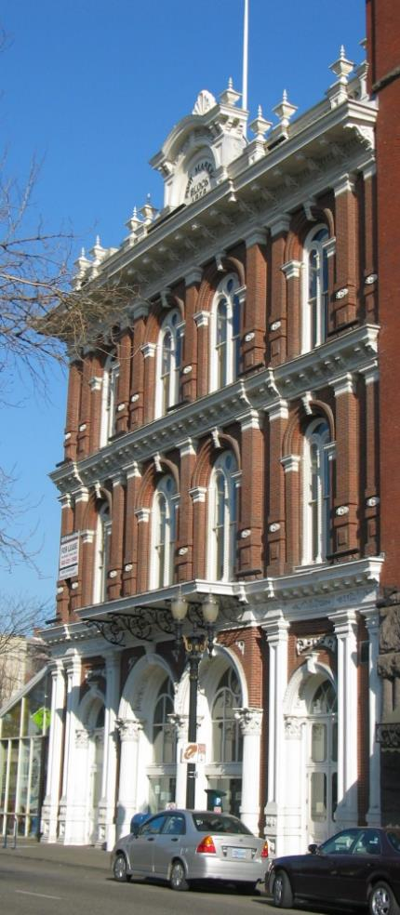
New FAR Transfer System
No limit to amount of transferred FAR (within maximum height)
Priority: Historic Resource transfer: requires seismic upgrade
Transfer within FAR Sectors (only after 3:1 earned with affordable or historic)
Notes:
First quick overview and then I’ll talk a little more about the historic resource transfer:
- There is no limit to amount of FAR that can be transferred to a site (needs to be within the maximum height limit).
-Sending site must retain a minimum FAR as already described.
-NEW: Open Space zoned properties may be a sending site but not a receiving site
Two Transfers:
1) Priority of the two transfers is the historic resource transfer –if a building does not trigger IH it can be used first.
-Applies to Landmarks and contributing resources. The historic resources must be seismically upgraded or sign an agreement with the city to complete upgrades before being able to transfer FAR( BPS is working on a template agreement modeled after the existing phased seismic agreement that is used today).
-historic resources will be provided with an additional 3 to 1 to transfer. This is to serve as a preservation and upgrade incentive to help support the cost of seismic upgrades
-Receiving sites can be anywhere in Central city (not SOWA)
-Owners of the sending and receiving site must complete a covenant documenting floor area on each site (and the covenant for the sending site must state that the owner will not demolish or relocate the historic resource unless the City approves through demolition review process.)
2) Transfer within a floor area sector (in most cases a project will only be eligible to use this transfer after they have earned 3:1 from the affordable housing or historic preservation

Slide 10
Notes:
Here is the map of the floor area transfer sector areas that correspond to transportation impact modeling, especially regarding the regional transportation system.

Slide 11
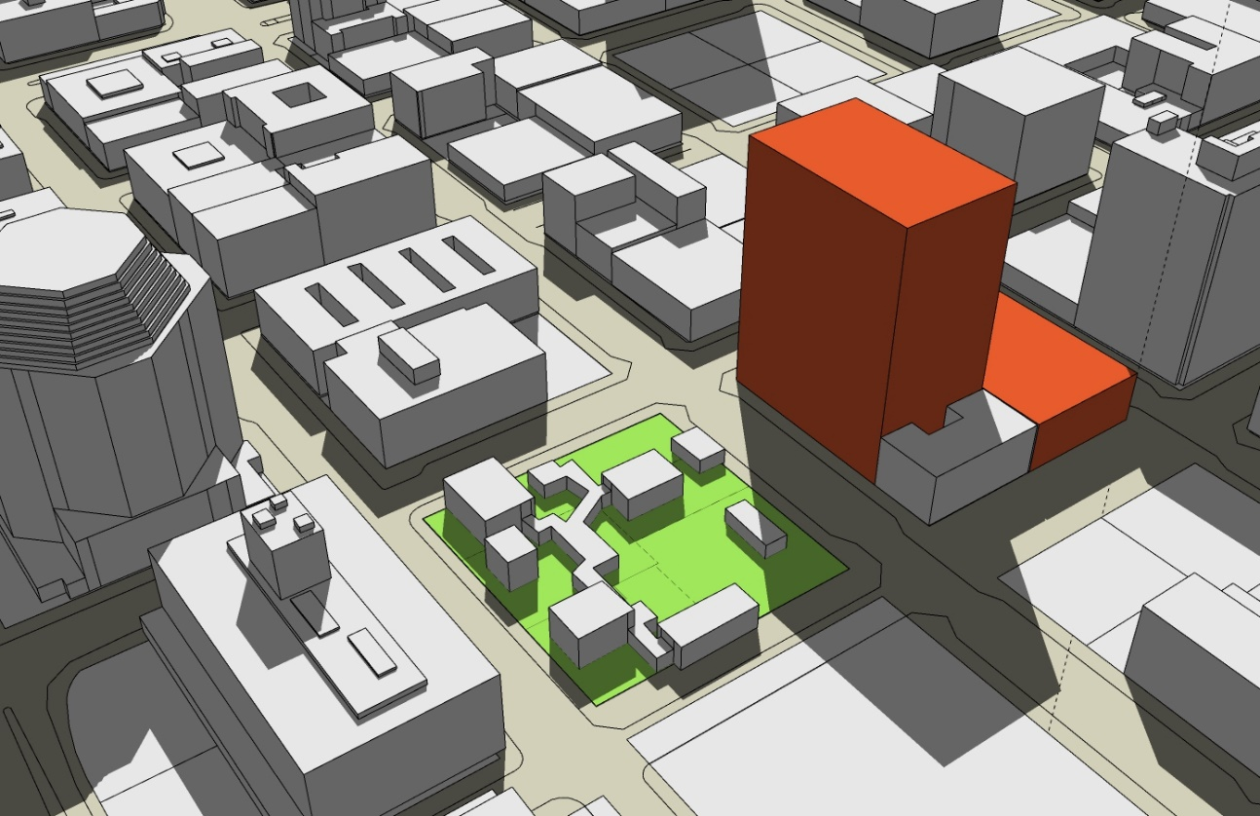
Expanded Shadow Study
Applies to:
More properties across the Central City
Properties south and west of the parks or open spaces
Properties on both sides of the Park Blocks
Notes:
Shadow study requirement has been expanded to a number of parks and open spaces across the Central City (including Lan Su Chinese Garden).
There are three different shadow study requirements:
The shadow study may be triggered if a property accesses bonus height,
there are also properties that have been added, such as south and west of Lan Su Chinese Garden which do not have access to bonus height but a shadow study is still required.
For both of these situations , the number of days and times have been expanded:
If a property is required to conduct a shadow study they must submit an analysis of how the new structure will shade the adjacent park for the spring and fall equinoxes and summer and winter solstices.
The other shadow analysis that is required is along the east side of the park blocks in an effort to allow for morning sun. This is a requirement for all new structures that are over 100 feet must conduct the analysis for March 21 at 10. no more than 50 % of the park can be shade at this time. This is not adjustable.

Slide 12
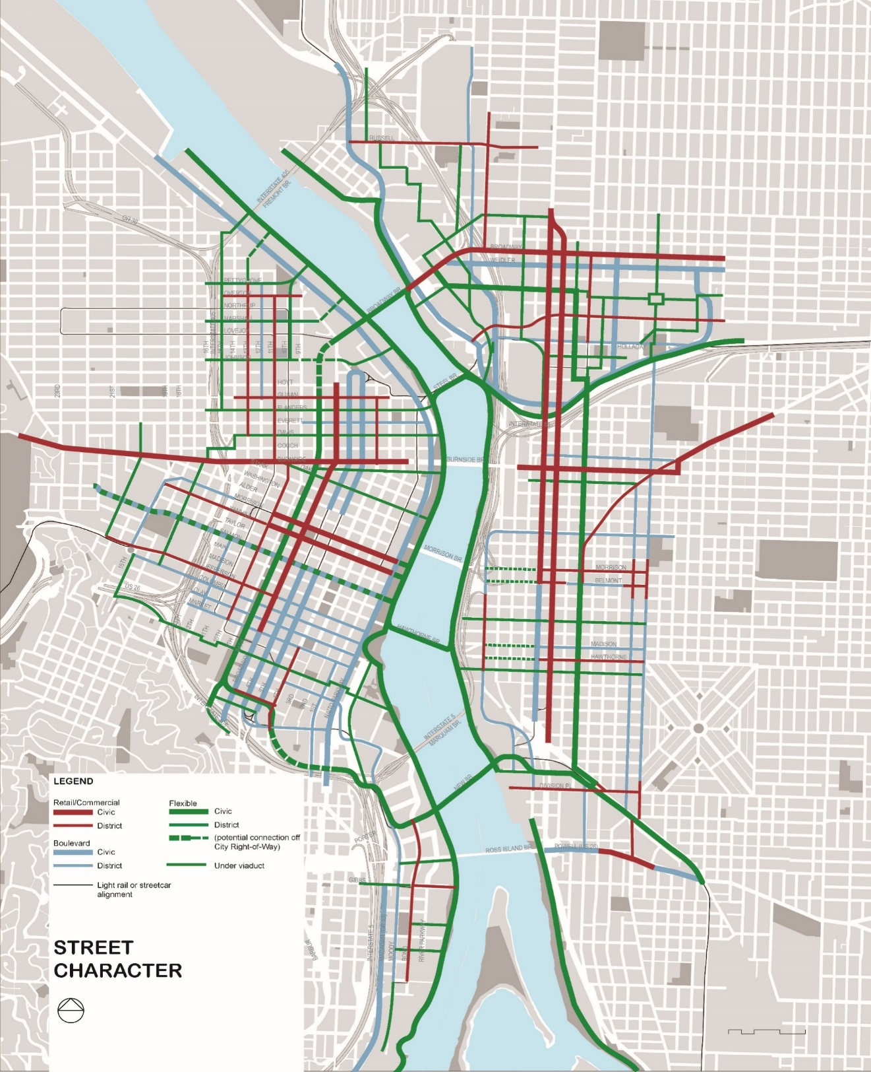
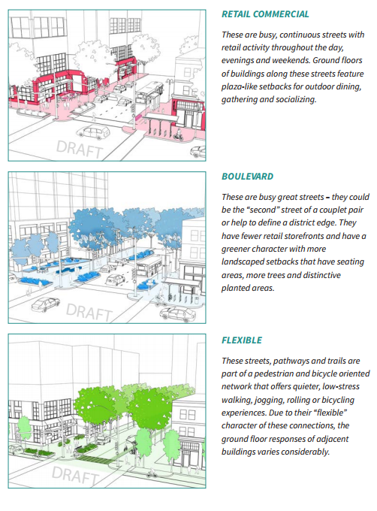
Street and Development Character Concept
Notes:
The street and development character concept provides an approach to design and development to improve the pedestrian experience. Since approximately 40% of the central city’s land area is in streets, we are being more intentional about what we want some of our ground level experiences to be.
Red streets are retail commercial (area in yellow is downtown retail core)
Blue streets are busy streets where there may be more landscaping and landscaped setbacks, ground floor retail encouraged at key areas
Green streets are quieter – more green features, limited ground floor retail, alternative access for peds, and bikes

Slide 13
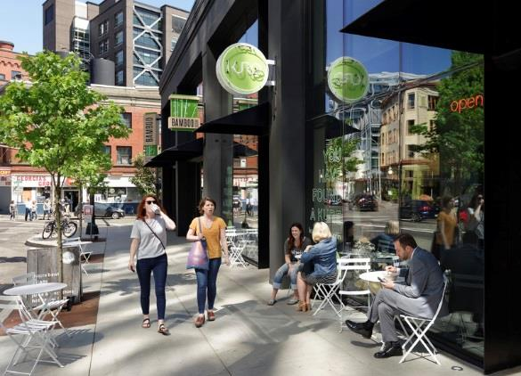
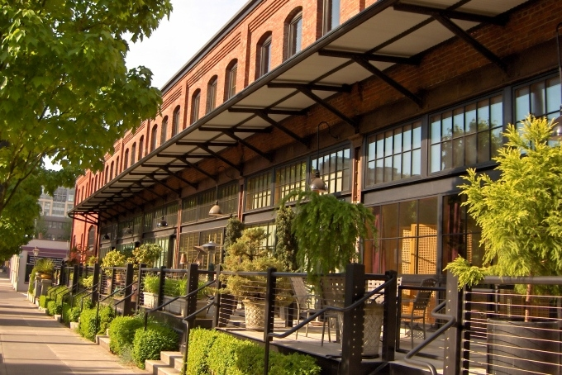
Street and Development Character
Updates to existing standards:
Required Building Lines (Setbacks)
Ground Floor Windows
Ground Floor Active Uses
Prohibit Drive Through Facilities
Notes:
The street and development character concept results in a number of code updates to support this hierarchy of streets:
-Required building setbacks along the Park blocks
-Extensions of sidewalks and gathering areas on retail/commercial streets and landscaped setbacks along secondary busy streets or boulevards.
-More ground floor windows along a larger number of Central City streets- ranging from 60 in the commercial core to 40% on all other ground floor facades
-More active ground-floor uses, such as retail and commercial, through required tall and deep first stories and limitations on ground floor residences on some streets
-No new drive throughs
-
-expanding the existing drive thru prohibition to the entire Central city – this is intended to encourage high density pedestrian and transit oriented development that are not dependent on queuing lanes.

Slide 14
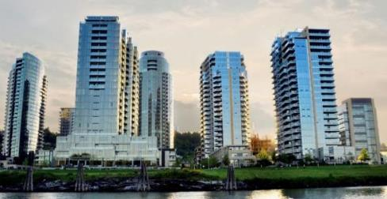

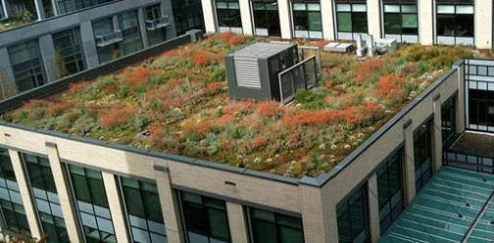
Green Buildings
Bird-Safe glazing: New development required to use bird-safe glazing on first 60 feet of a building with greater than 30% glazing
Ecoroofs: New buildings with over 20,000 sq ft must have an ecoroof that covers “100%” of roof (40% can be mechanical, patio, etc.)
Low Carbon buildings: Buildings over 50,000 sq ft required to register with a program, e.g. LEED
Notes:
Bird Safe -
Major remodels and new development on non-contributing blocks would need to meet the standard if the building triggers the threshold (only applies to buildings with more than 30% glazing). .
Historic landmarks and contributing resources in historic or conservation districts are exempt
The new requirement is to include windows with etching or UV coding on the first 60 feet of buildings to prevent bird strikes
This provision responds to City Council Resolution 37034 (Oct. 2, 2013) directing City bureaus to seek opportunities to incorporate bird-friendly building design into City plans and projects, including the Comprehensive Plan, Central City 2035, and the City’s Green Building Policy.
Ecoroof:
100% coverage on new Buildings 20,000 sq. ft. or greater – up to 40% of that may be in mechanical equipment and other necessary elements, or desirable elements such as patios
Low Carbon buildings on new buildings over 50,000 square feet or buildings that expand by at least 50,000 sq ft
The provision requires that developer register with one of 4 green building organizations. We are only requiring registration because the full certification is more stringent than the current state building code.
Energy use in commercial buildings accounts for about 25% of Portland’s carbon emissions.
Since 2001, most new construction in the Central City is using a green building program such as LEED. We want to keep that trend going.

Slide 15
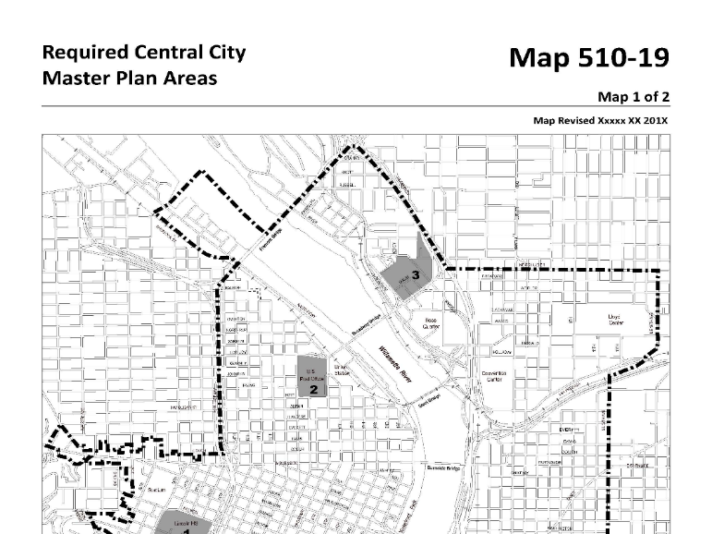
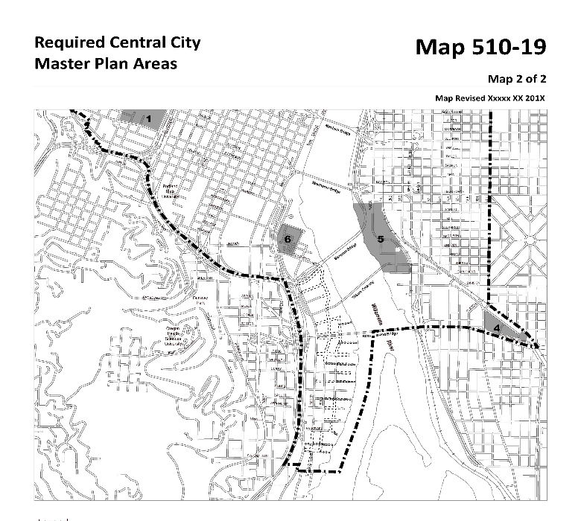
Central City Master Plans
Required Sites
OMSI Station Area
Clinton Station Area
Blanchard Properties
Main Post Office Site
Lincoln High School
RiverPlace
Approval Criteria
Building Massing
Open Space Layout
Circulation & Pedestrian Realm
Notes:
Troy discussed the new urban design tool. This is important for key redevelopment opportunities in the Central City. We will get the best results if these sites can be planned and designed as a whole as well as ensuring strong connections and integration with the surrounding neighborhood. Here is a list of a few required sites.
-There is also a voluntary option to use this tool over 160,000 sq. ft.
Stop:
The plan will take a close look at the circulation, pedestrian realm, and open space layout, infrastructure capacity, and building massing.

Slide 16
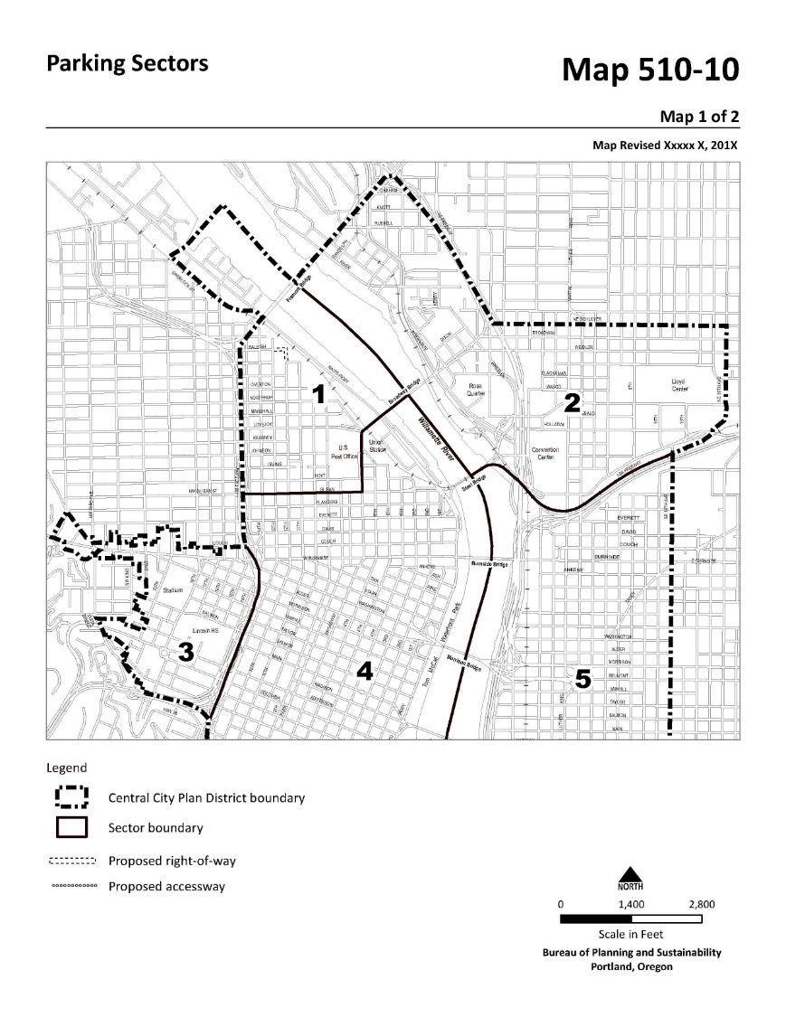
Parking and Access
Simplified parking code
No minimums and maximum ratios for all
Parking sectors from 26 to 6
Allow shared parking
Prohibit surface parking
New rules for all parking
Multi-modal mixed use area
Notes:
Overall Simplified parking code- new parking can operate as accessory or commercial parking
No minimums and lower maximum ratios for all
Parking sectors from 26 to 6
Allow shared parking- and transfer of parking entitlements is allowed through CC parking review within parking sectors
Prohibit surface parking- except in industrial zones and public school sites (this includes Lincoln High school)
New rules for all parking – carpool spaces, restrictions for parking access and loading along transit streets, ground floor active use requirements for new parking structures
MMA:New State designation that facilitates increases in density and the buildout of the Central City

