Slide 1
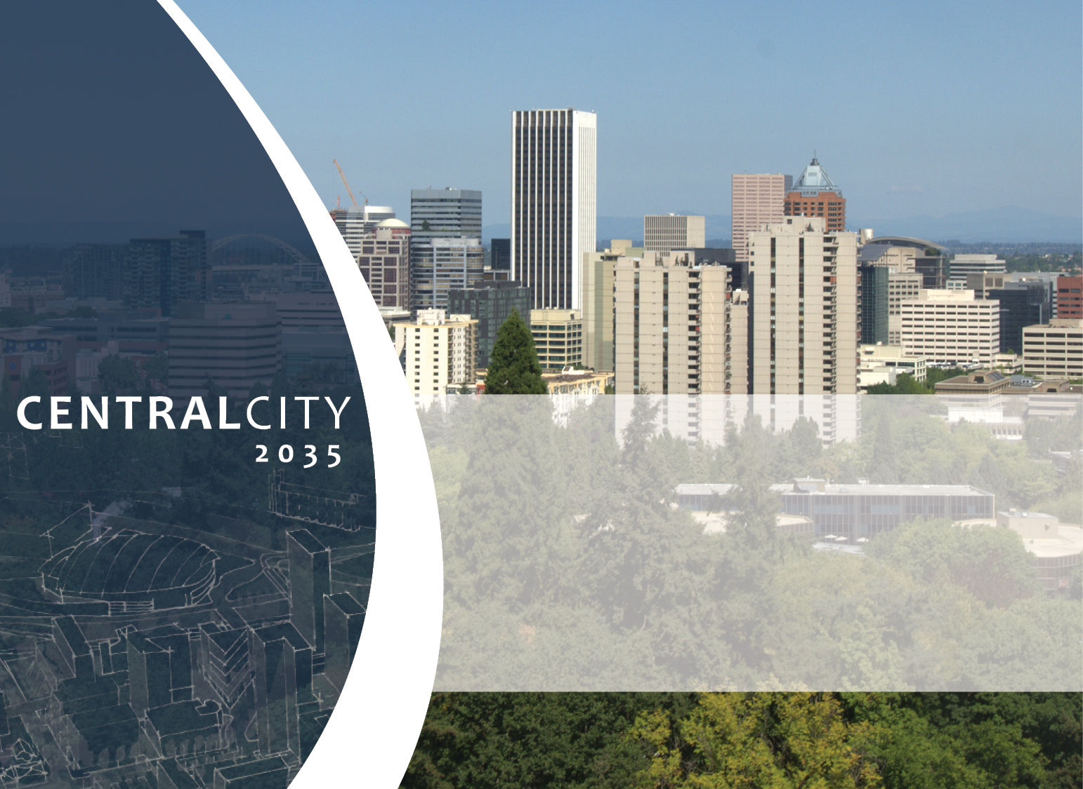

NEW! River Overlay Zones
Design Commission
July 12, 2018

Slide 2
Today’s Agenda
33.475
River General (g*)
  River Setback
  Landscaping standards
  Public Viewpoints
  Exterior Lighting standards
River Environmental (e)
  Exemptions
  Standards
  River Review
Clean-Up Sites
Green Buildings
Notes:
Today I’m going to be summarizing the new Central City zoning codes that apply to the Willamette River.
Here is the agenda. Please feel free to interrupt me as we go.

Slide 3
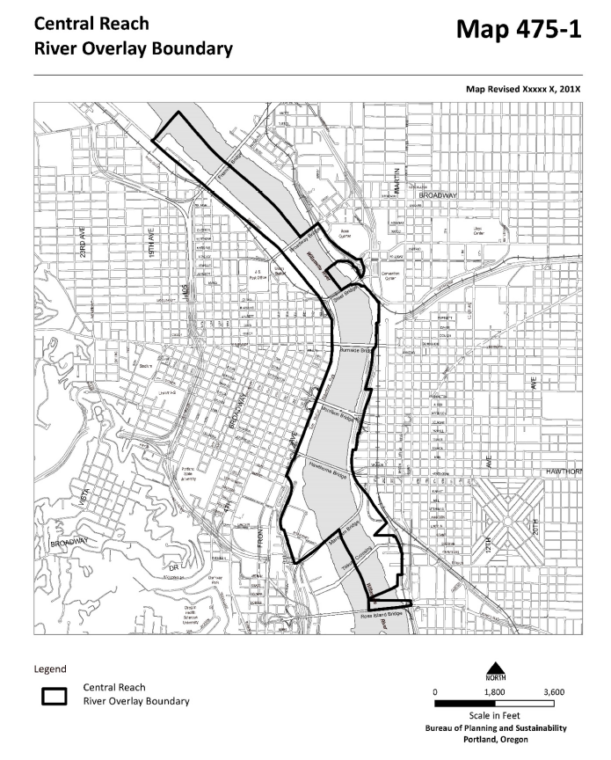
In Central Reach, 33.440, Willamette Greenway, is REPLACED by:
  33.475, River Overlay Zones, and
  33.865, River Review
Notes:
The biggest change is that for the Central Reach, shown on the map, the old 33.440, Willamette Greenway, code is replaced by 33.475, River Overlay Zones, and 33.865, River Review.
We will no longer be using the term “Greenway” in the Central Reach except when it refers to the “Greenway Goal Exception” which I will explain later.
In the North Reach and South Reach, 33.440 remains in effect.

Slide 4
Two industrial sites (red) remain regulated by 33.440
South Waterfront (purple) is regulated by 33.510
Notes:
There are two location in the Central Reach that are still regulated by 33.440. These are Industrial base zone and are similar to properties in the North Reach. We will address these two areas when we updated the zoning codes for the North Reach.
South Waterfront has it’s own river-related codes in 33.510.

Slide 5
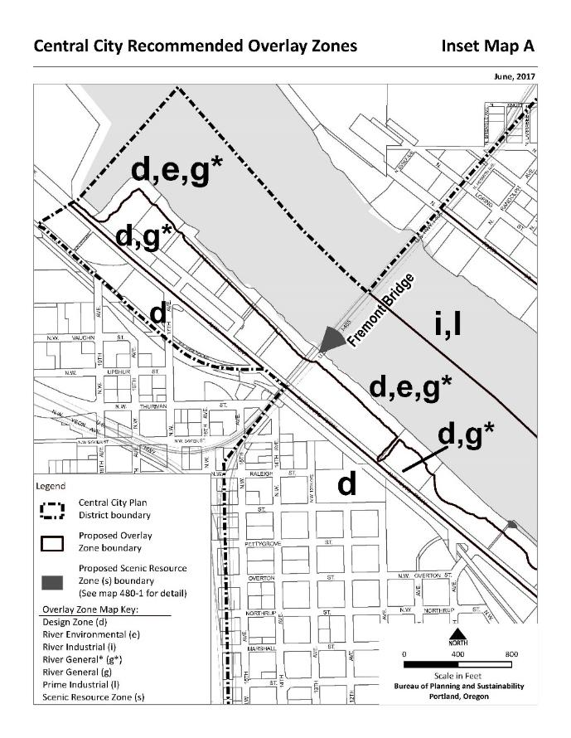
Two new overlays:
g* – River General Overlay
e – River Environmental Overlay
Notes:
In 33.475 there are two new overlays.
River General (g*) is very similar to the old (g) with some notable differences that I’ll explain.
River Environmental (e) is brand new, but if you are familiar with the e-zones in the rest of the city it will be similar.

Slide 6
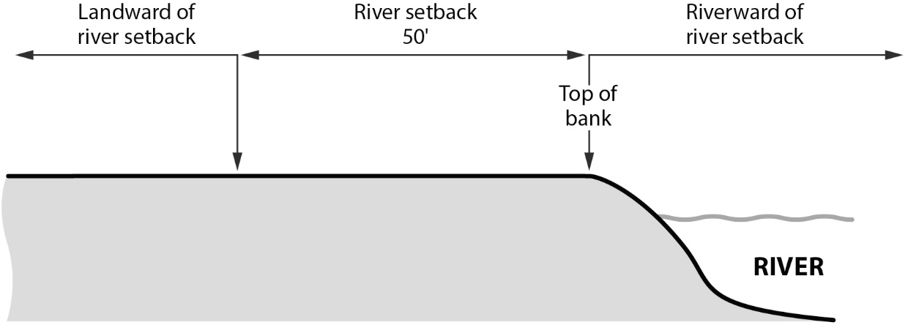
River General (g*) Overlay Zone
No use restrictions
50-foot setback for development that is not river-dependent or river-related
  Measured from top-of-bank
  Historic landmarks are exempt
Notes:
Let’s get into the details of the new (g*)
There are no use restrictions. The base zone regulates uses.
The setback is expanded from 25 feet from TOB to 50 feet from TOB. The only development allowed in the setback on riverward must be river-dependent or river-related.

Slide 7
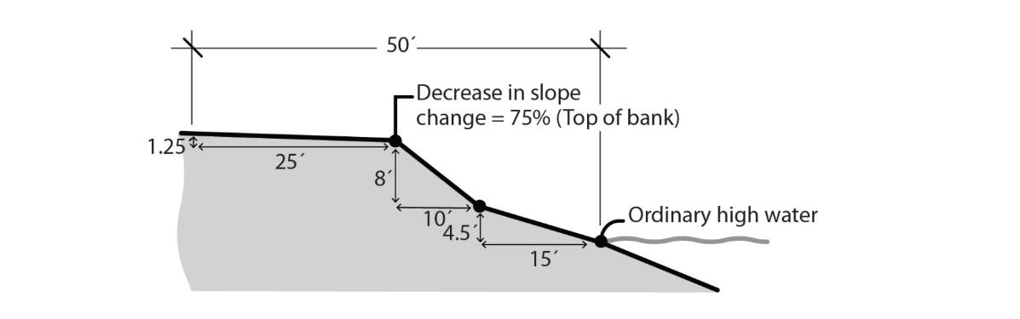
Top of Bank
Updated Definition
The largest decrease in slope that is 10 percent or greater between the ordinary high water mark of a water body and a point 50 feet landward from the ordinary high water mark.
Figure 930-20b
Example 2: Identifying a Decrease in Slope
Notes:
The setback is measured from top of bank. The definition of top of bank is updated. This change is for all water bodies in Portland – Willamette River, Columbia River, Johnson Creek, etc.

Slide 8
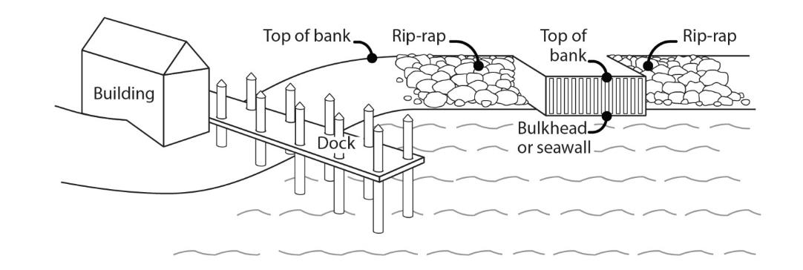
Top of Bank
New Measurements Requirement
Relationship to other structures
Figure 930-22
Top of Bank in Relation to Other Structures
Notes:
An important part of the update is as top of bank relates to structures over and on the river bank.
The intention is to measure top of bank from the underlying ground – under docks and wharfs.
If there isn’t an underlying ground, like when there is a seawall, the structure is the top of bank.
If there is an underlying ground, but it is not accessible, then the default top of bank may be use.

Slide 9
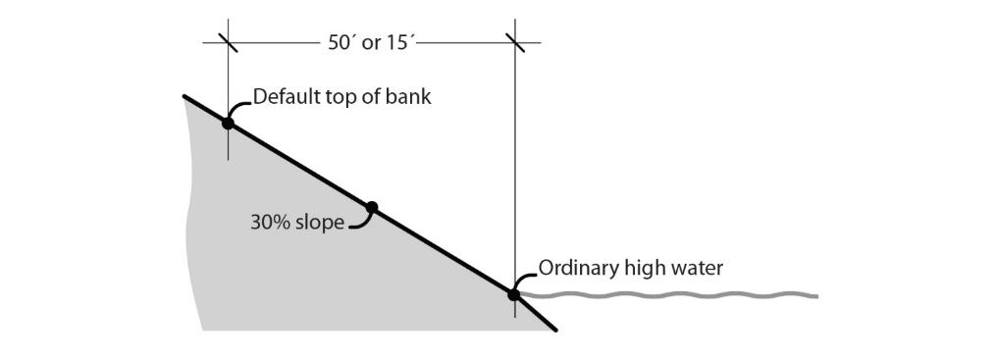
Top of Bank
New Measurements Requirement
Default top of bank
Figure 930-21
Measuring Default Top of Bank
Notes:
In the Central City, the default top of bank is 50 feet from the ordinary high water mark, measured horizontally.

Slide 10
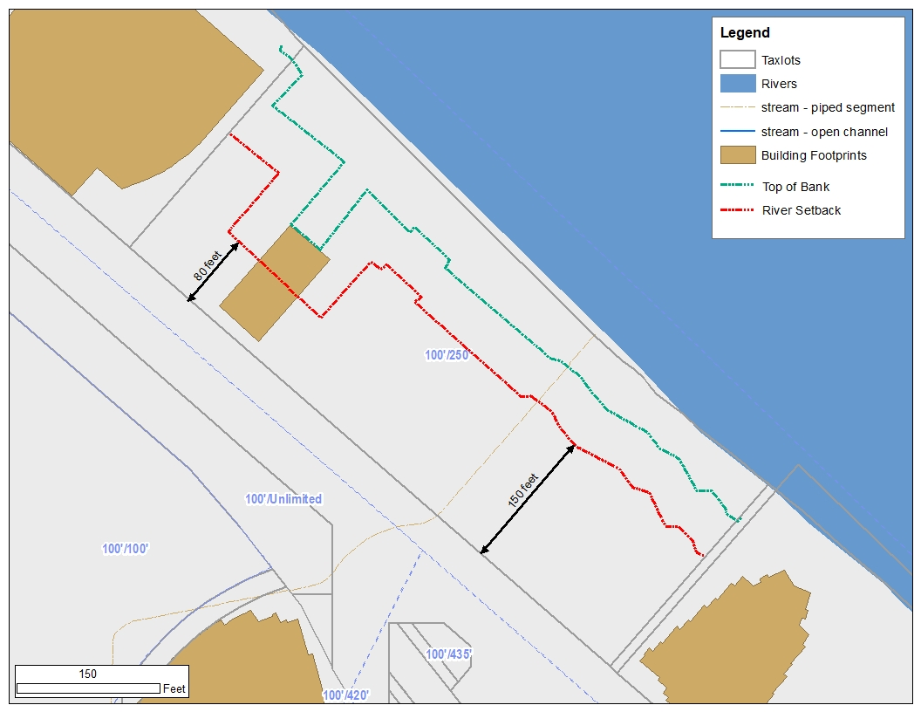
Notes:
Let’s look at an example site – Centennial Mills. The top of bank has not been mapped here; this is just an estimate based on topography and aerial photographs.
The blue dashed line represents the estimated top of bank. The old wharf and pilings were removed and under that was a seawall. That seawall becomes the top of bank for much of the site. It results in an odd shaped River Setback, but this is not uncommon along the Willamette River.
The River Setback is the red dashed line – 50 feet from top of bank.
Riverward of the setback only river-dependent or river-related development is allow. Those include the trail, public viewpoints, gangways to docks and docks, specific development for marine passenger terminals uses and natural resource enhancement (aka landscaping).
Not allowed in the River Setback are offices, residences, retail, parking – basically anything that does not need access to the river needs to be setback.
There is new exemption for Historic or Conservation Landmarks. The remaining structure is not a landmark, but if it were designated then it would be exempt from the setback meaning the uses inside would not have to be river-depend or river-related. Practically that means, if it is a landmark, then there can be a restaurant, kayak rental, classrooms, in the portion of the structure within the setback. If it’s not a landmark, then all uses in that portion of the structure, on all floors, must be river-dependent or river-related.

Slide 11
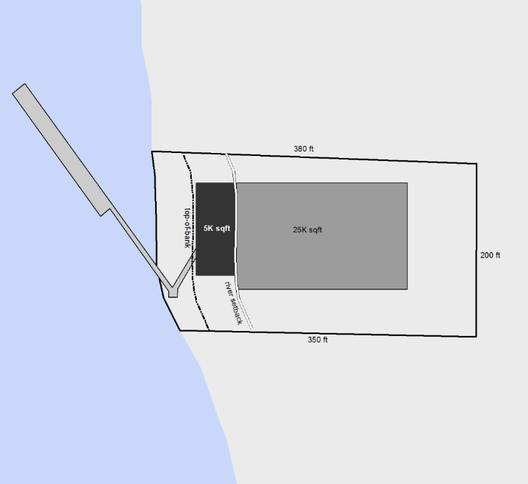
River General (g*) Overlay Zone
New allowance for marine passenger terminals
Passenger waiting and queuing areas, security checkpoints, and machine shops associated with marine passenger docks are river-related
Max 5,000 sq ft footprint within setback
Hypothetical Marine Passenger Terminal
Notes:
Another new allowance in the setback is passenger waiting areas, security checkpoints and machine shops associated with marine passenger docks for sub-regional travel.
The footprint is limited to 5,000 sq ft footprint but there can be more than one story of development, as long as all the use in the setback on all floors are river-dependent or river-related.
Are there questions about the river setback?

Slide 12
River General (g*) Overlay Zone
New landscaping standards
  Govenor Tom McCall Waterfront Park is exempt
3 subareas – more understory required closer to river; less understory upland
Different planting densities based tree canopy size at maturity – smaller trees more dense planting; larger trees less dense planting
Notes:
We updated the landscaping standards in the new (g*).
The goal is to have closed tree canopy in the setback, except at designated viewpoints, and to shift the densest understory nearer to the river is important for fish and wildlife habitat. Less understory is required upland is to create more relationship to development and the trail.
The code has different planting densities for different size trees. This is based on the tree’s canopy size at maturing. Trees that will be smaller when fully grown need to be planted closer together, while trees with very large canopy need to be given room to grow.

Slide 13
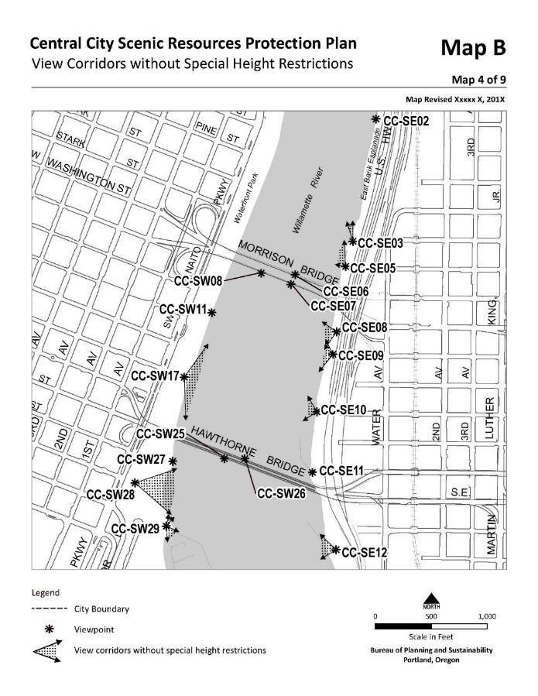
River General (g*) Overlay Zone
New public viewpoint requirement
  Most are already developed in Central Reach
  If not, then Central City Fundamentals guide viewpoint design
Notes:
While an overarching goal of the new River General overlay is to add much more tree canopy and understory to the river banks, it is important to maintain views.
Along the trail there are designated viewpoints. These are areas where people should be able to see the river, bridges and the skyline across the river. When the trail is constructed, these viewpoint need to be developed.
In order to preserve these views, there is a new Scenic (s) overlay zone where trees cannot be plant – only shrubs and ground cover. And there is an allowance for tree maintenance and removal to open up views that become blocked.

Slide 14
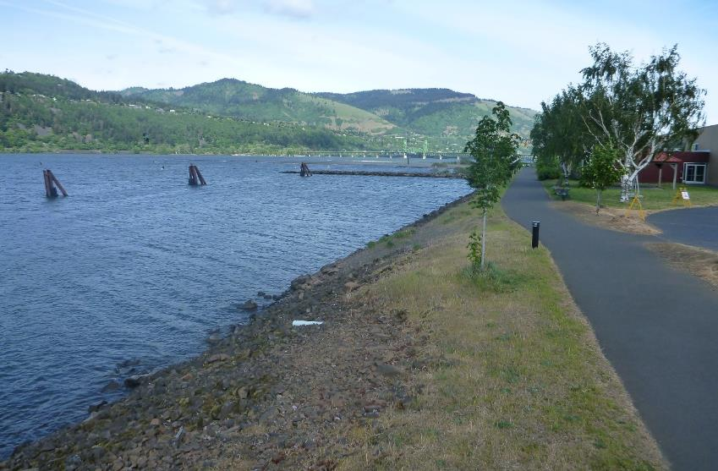
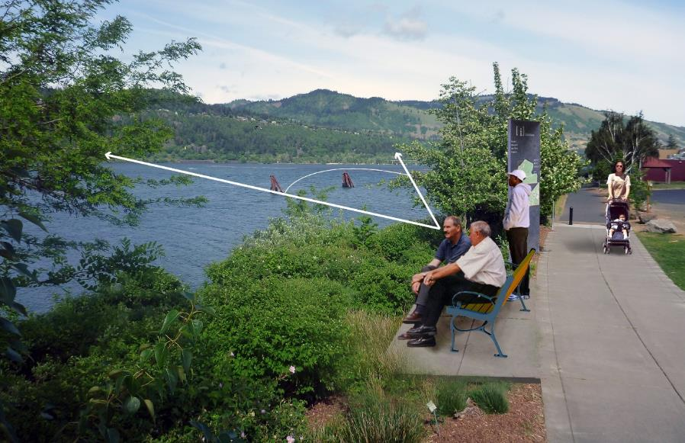
Notes:
This is an example of a public viewpoint. The top picture is a viewpoint along a trail but the viewpoint is not developed and the river bank is not landscaped.
The bottom picture is what the viewpoint could look like after development and landscaping. A small area is created off the mail trail, a bench and sign are added. No trees are planted in the view, but trees are planted to each side of the viewpoint. Shrubs and ground cover are added to the riverbank in the view.

Slide 15
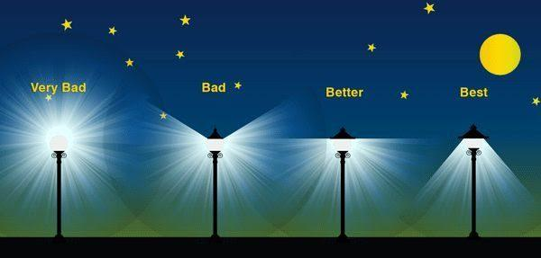
River General (g*) Overlay Zone
Goal is to minimize light glare and reduce light pollution
All lights must not project light up or to the sides of the fixture
In and near river setback additional standards
Not allowed within (g*)
Allowed
Notes:
Riverward of the setback and landward for 20 feet exterior lights are only allowed for parks, public trails, viewpoints or river-dependent or river-related development.
The lights have to be 25 feet apart and must not project directly into the river.
The image shows what the standard is trying to achieve. We want light to shine on trails, public viewpoints but not to spill out or upwards.
Note – Waterfront Park and public streets are exempt from this standard.

Slide 16
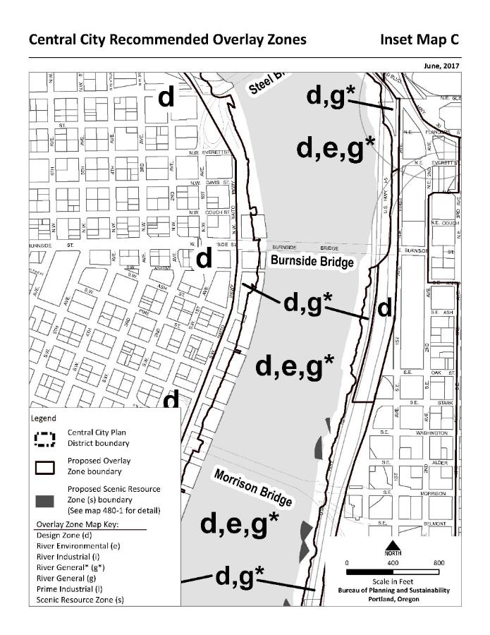
River Environmental (e) Overlay Zone
Covers the river, riverbanks and land within at least 50 feet of top of bank
Could be wider if there are resources like trees further from the river
Notes:
Let’s switch now to talking about new River Environmental (e) overlay zones.
This overlay zone applies to the Willamette River, riverbanks and land within at least 50 feet of the top of bank, so it always at a minimum applies within the river setback.
It could be wider if there are natural resources, like trees that further from the river.

Slide 17
River Environmental (e) Overlay Zone
Exemptions copied from 33.430 exemptions, then revised to address Willamette River
Examples of revisions:
  Dredging in deep water
  Development on wharfs, piers and docks
  Size of trees that can be removed/trimmed
  Removal and remediation of hazardous materials
Notes:
The river e is modelled after the conservation overlay zone that applies to the rest of the city. The purpose is to maintain existing natural resources and preserve space for enhancing the resources.
There are exemptions for maintenance, repair and replacement of existing structures.
Also exempt:
Dredging in the navigation channel and maintained slips and berths is allowed; but dredging in shallow water habitat must go through review because that habitat is critical for Endangered Species Act-listed fish
Development on structures overwater must be for river-dependent or river-related uses
Trees 1.5-inch dbh or smaller are exempt – there are standards for trees larger than 1.5-inch
Removal and remediation of hazardous materials is addressed in 33.500

Slide 18
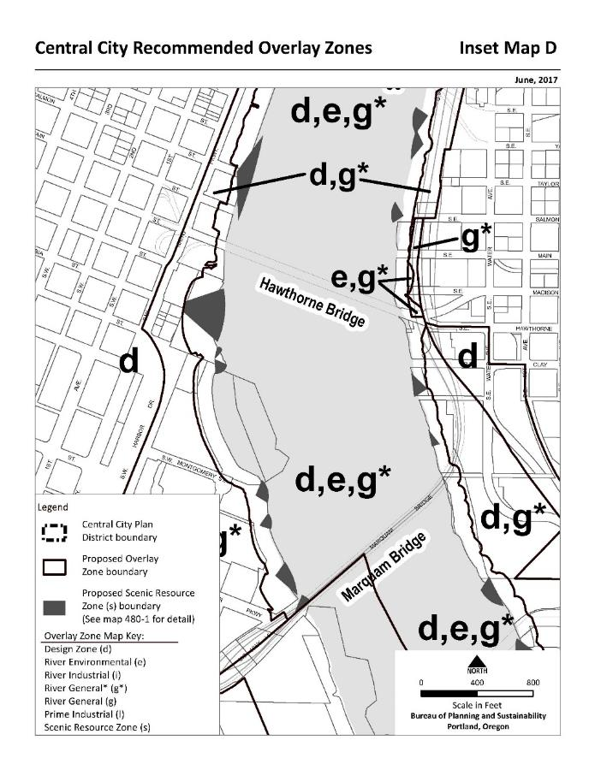
River Environmental (e) Overlay Zone
Standards are also the same as 33.430 with revisions to address Willamette River
Examples of revisions:
  View corridors
  Floating structures
  Vegetation pruning or removal
  Mitigation
Notes:
There are standards for things like the trail – location, width, surface, etc. – and required things like stormwater outfalls and utilities – all with size limitations.
Other standards include:
Shown in gray on the map, the new scenic (s) overlay zone has standards for removal and trimming of vegetation to preserve the view from designated viewpoints
Floating structures are swim platforms that can be put in the river during the summer months
Like mentioned before, the size of tree that is addressed is reduced to 1.5-inch dbh
There is a minimum mitigation ratio add of 1.5:1 mitigation acres to impact acres

Slide 19
River Environmental (e) Overlay Zone
If the development is not exempt and cannot meet standards, then River Review, 33.865, is required
33.865 is modelled after Environmental Review, 33.430
New minimum mitigation ratio 1.5:1, mitigation area to impact area¹
Notes:
If a proposal is not exempt and cannot meet standards then it goes through River Review. This is were a trail wider than the standard could be proposed. Mitigation is required and the minimum mitigation ratio is 1.5:1
This ratio can be increased through review depending on factors like the uniqueness of the resource impacted, the time lag between impacts and when the mitigation will be functioning, etc. If mitigation is done off-site, the minimum mitigation ratio is automatically increased 3:1 mitigation acres to impact acres.

Slide 20
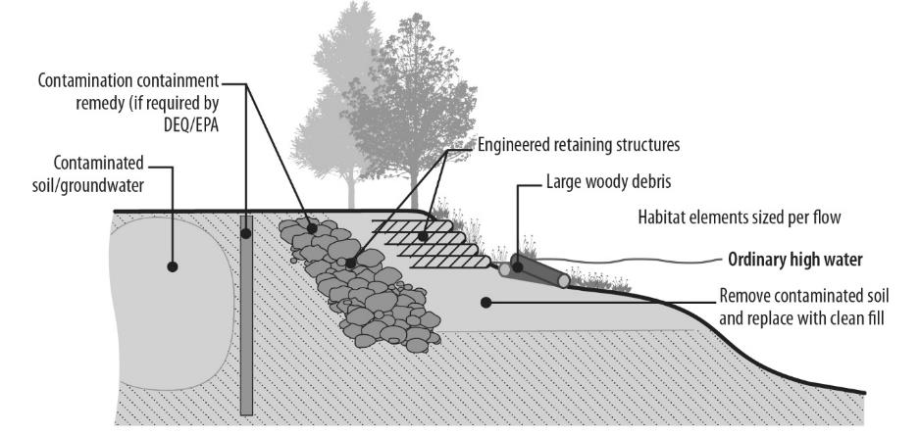
River Environmental (e) Overlay Zone
33.475.500 Removal and Remediation of Hazardous Materials¹
Notes:
Removal of hazardous material is exempt from procedural requirements of the zoning code but must meet the substantive requirements of the code. NEW 33.475.500’s consolidates the substantive requirements under to simplify review for applicants and staff.

Slide 21

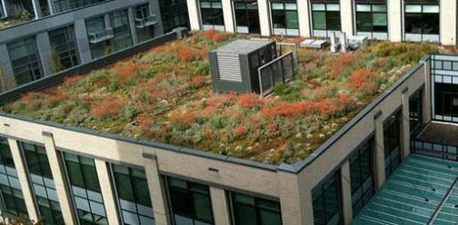
Green Buildings
Bird-Safe glazing: New development required to use bird-safe glazing on first 60 feet of a building with greater than 30% glazing
Ecoroofs: New buildings with over 20,000 sq ft must have an ecoroof that covers “100%” of roof (40% can be mechanical, patio, etc.)
Notes:
As Rachael mentioned there are new green building standard in the Plan District. I’m going to go into a bit more detail on two of those:
Bird-safe glazing
Ecoroofs

Slide 22
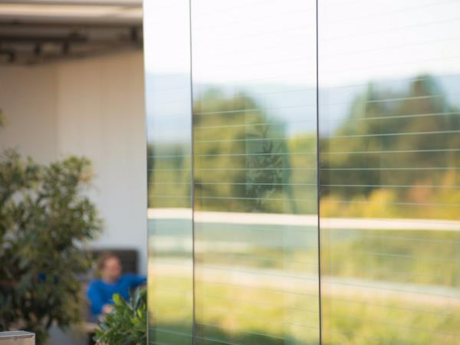
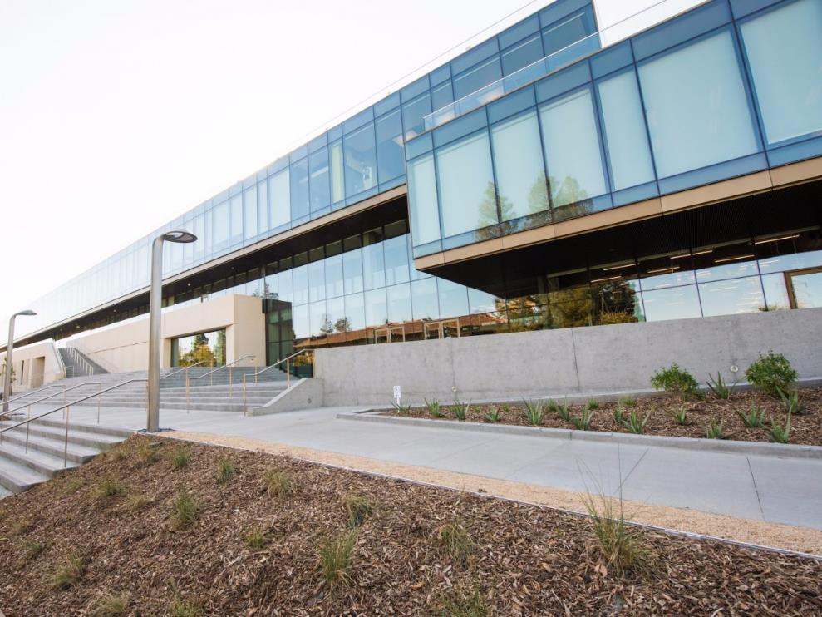
Bird-Safe Glazing
Notes:
This requirement is for the first 60 feet of the building and the first 15 feet adjacent to an ecoroof because those are the areas where the windows are likely to reflect vegetation. This is particularly critical along the Willamette River where the landscaping standard will add a lot of trees and vegetation.
The standard is in the Plan District zoning code and the specifics about the materials and application are in an Administrative Rule. We did that so the Admin Rule can be easily updated as technologies change.
In this example, the top is an up close picture of approved line etching and then the same material as seen from a distance. This etching disrupts the bird’s view of the reflection so they know not to fly into it, but it is hardly noticeable to the human eye.

Slide 23
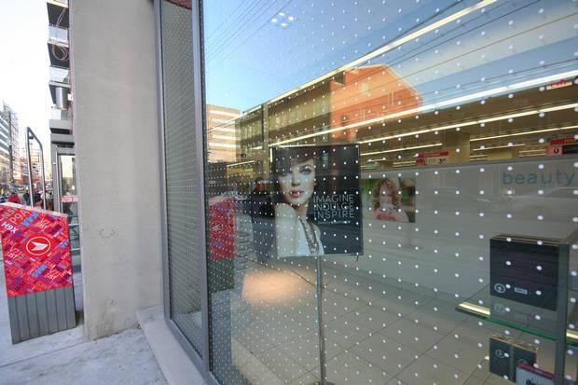
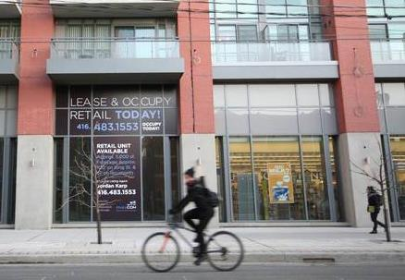
Bird-Safe Glazing
Notes:
Here is another approved material – dot etching or film. Again close-up you can see the dots, but at a distance it does not interrupt seeing into the ground floor.

Slide 24
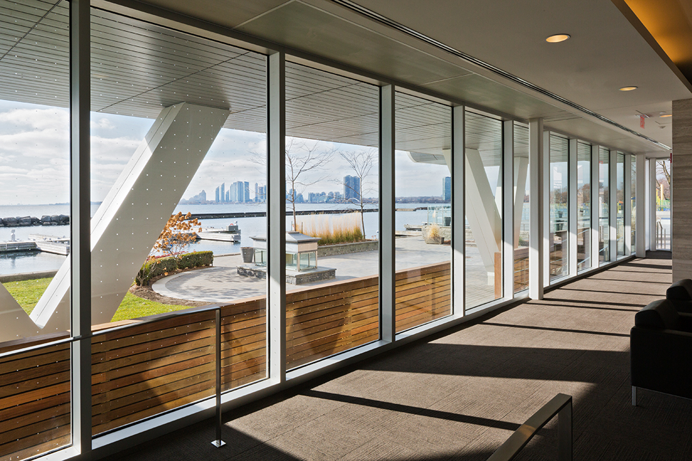
Bird-Safe Glazing
Notes:
This is another example of the dot pattern on the ground floor. If you look at the while post, you can see the dots, but otherwise the human eye looks past the pattern.

Slide 25
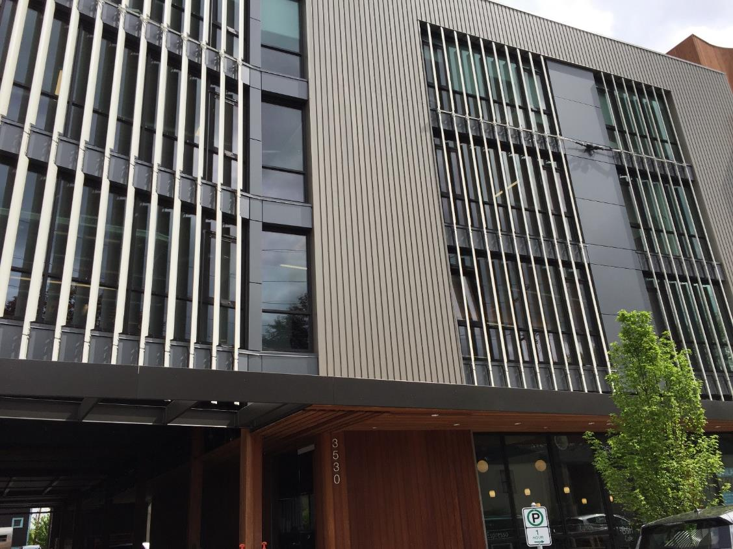
Bird-Safe Glazing
Notes:
The last example I want to provide is one of the approved options for glazing above the ground floor – exterior apparatus. These cannot be used on the ground floor.
There are many options for screens, fins, mullions, etc. that disrupt a bird’s view of the reflected vegetation and sky but still allow light penetration into the building.

Slide 26
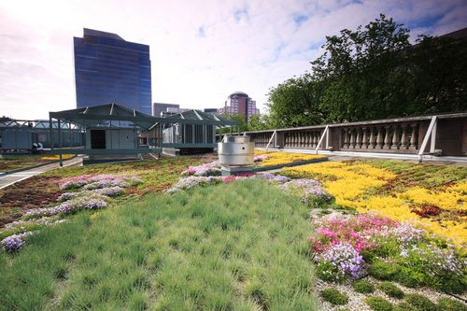
Ecoroofs
Notes:
The other green building standard I wanted to touch on is the requirement for ecoroofs on new buildings over 20,000 sq ft. The purpose is to maximize ecoroof coverage while allowing placement of structures on the rooftop and supporting architectural diversity. It does not apply to existing buildings.
Keep in mind that new development also has to meet the Stormwater Management Manual and ecoroofs are an approved technique. And, ecoroofs can be credited towards the Low Carbon requirement that Rachael mentioned.

Slide 27
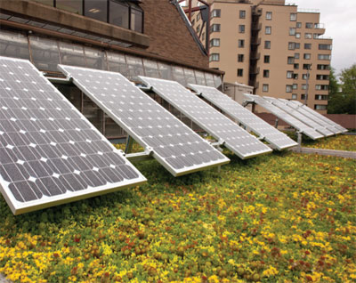
Ecoroofs
Notes:
Ecoroofs must cover 100% of the roof top except that up to 40% of the roof can be covered in other things in a specified list: mechanical equipment, fire evacuation routes, stairwell/elevator enclosures, skylights, solar panels, wind turbines, and uncovered common outdoor areas.
Here you see how an ecoroof can be used to create open space for building tenants by incorporating paths and seating and really amazing views.
Also, you can see how solar panels can be used with ecoroofs. Solar panels are a credit for the Low Carbon requirement too.

Slide 28
Ecoroofs
Notes:
In this example you can see how the ecoroof is placed on a podium and used as open space for employees or residents.

Slide 29
The end

Slide 30
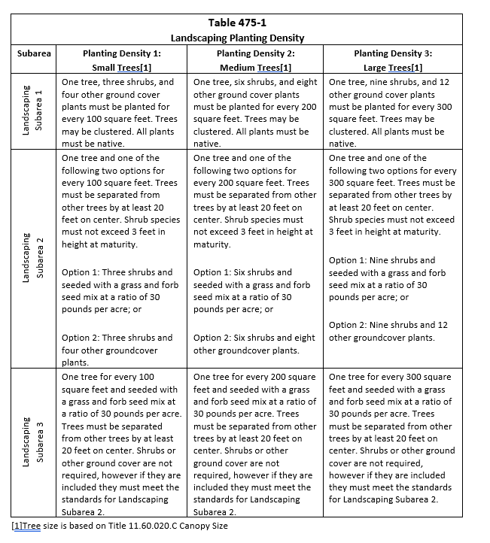
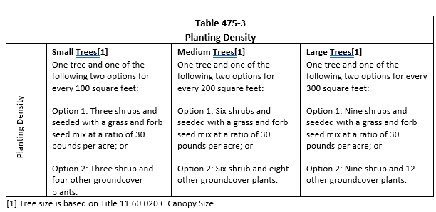
Landscaping in (g*) vs Mitigation in (e)
Landscaping in the Setback – 33.475.220
Mitigation in the river e-zone – 33.475.440
Notes:
The setback must be landscaped to the minimum planting densities specified in table 475-1.
Planting for mitigation must meet the minimum densities specified in table 475-3, which are the same as the landscaping minimum planting densities for Subarea 2.
Practically speaking
In Subarea 1, Table 1 has the higher minimum density and must be met
In Subarea 2, the densities are the same
In Subarea 3, if mitigation is required, Table 2 has the higher minimum density and must be met. If there is no mitigation needed and it’s just landscaping than Table 1 must be met

