Slide 1
Authorize contract with Tetra Tech Inc. to provide engineering services for the Columbia Boulevard Wastewater Treatment Plant Main Substation Replacement Project Council Item #685
Clarence Thompson, P.E.
Project Manager
BES Project Number E10897
June 20, 2018

Slide 2
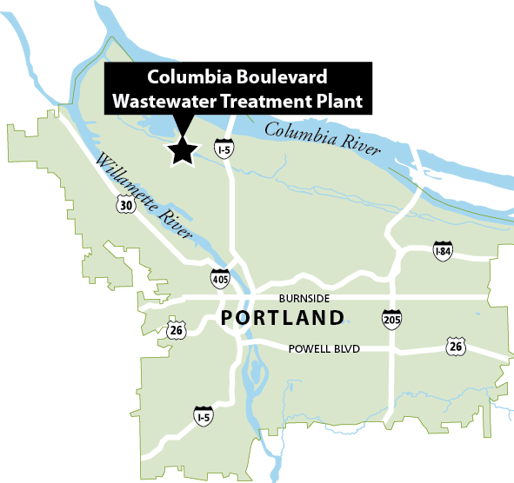
CBWTP Main Substation – Location
Main Substation

Slide 3
CBWTP Main Substation – Purpose and Function
Receives power for entire CBWTP from Portland General Electric (PGE)
Distributes power to all facilities and equipment at CBWTP
Protects the electrical distribution system from damage resulting from electrical malfunctions

Slide 4
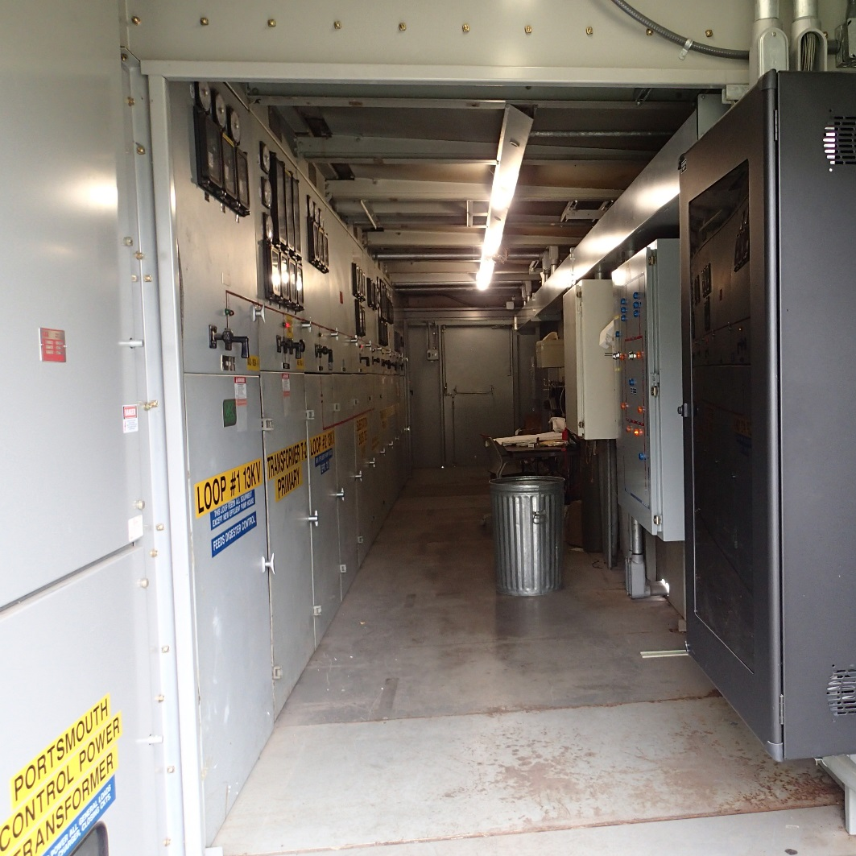
Problems with Existing Substation
Substation is over 40 years old
Older control components are starting to fail
CBWTP staff are now finding operational safety issues
Notes:
4

Slide 5
Project Budget and Schedule
Negotiated Contract amount: $650,630
Contract estimate level of confidence: Optimal
Construction Cost Estimate: $4,000,000
Construction cost estimate level of confidence: Low
Total Project Budget: $5,054,400

Slide 6
Professional Services Contract
Project work was advertised for competitive selection
4 proposals received
Selection committee included Minority Evaluator Program Participant
Tetra Tech was selected in accordance with City Code 5.68
Negotiated fee of $650,630 includes design, bidding, and construction support

Slide 7
D/M/W/ESB Participation
D/M/W/ESB Subcontracts are 59% of total not-to-exceed limit of $650,630
3 DBE/MBE/WBE/ESB firms: $342,420
Primary Medium-Voltage Electrical Design (MLC Engineering)
Structural Design (Akana, Inc)
CAD Design (Rivero Design)
1 ESB firm: $18,113
HVAC Design (Cundiff Engineering, Inc)
Additional funding for site meetings and other general tasks: $24,461

Slide 8
Recommendation
Authorize contract with Tetra Tech Inc. to provide engineering services for the Columbia Boulevard Wastewater Treatment Plant Main Substation Replacement Project, BES Project Number E10897 in the amount of $650,630

Slide 9
Questions
Thank you

