Slide 1
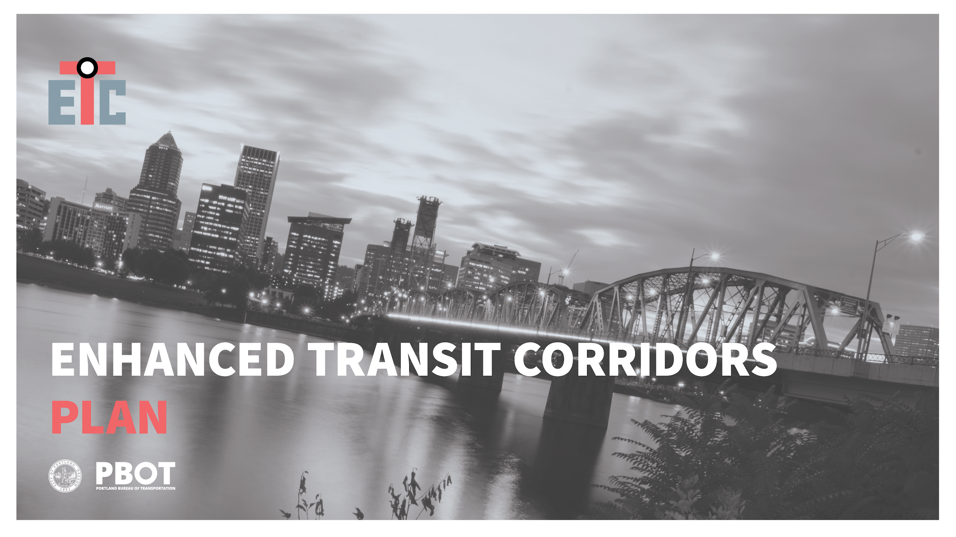
City Council Hearing
June 20, 2018

Slide 2

Recommended Council Action
Adopt the Enhanced Transit Corridors Plan
Endorse a list of Enhanced Transit candidate project locations for submittal to the Metro Regional Enhanced Transit Concept Pilot Program to help advance project development
ENHANCED TRANSIT CORRIDORS PLAN

Slide 3
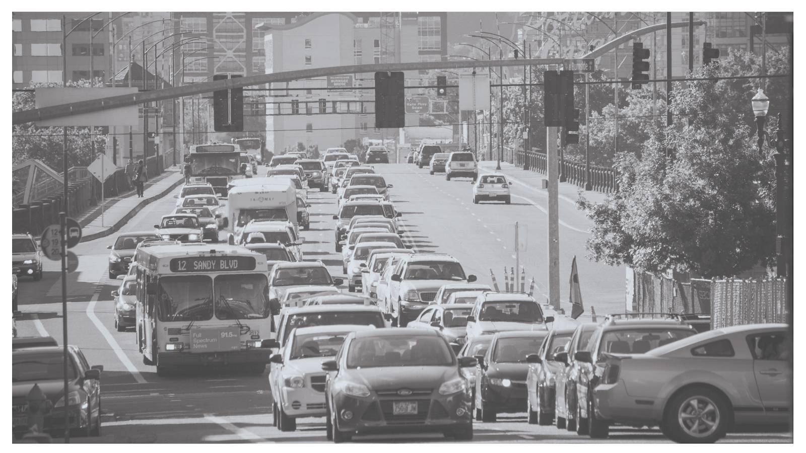
PORTLAND FACES A CRISIS OF
ACCESS AND OPPORTUNITY
Notes:
Freedom means freedom to choose.
But we have choices and opportunities only if we can get to them.
The City is growing denser.
But the space available for travel can’t grow with population.

Slide 4
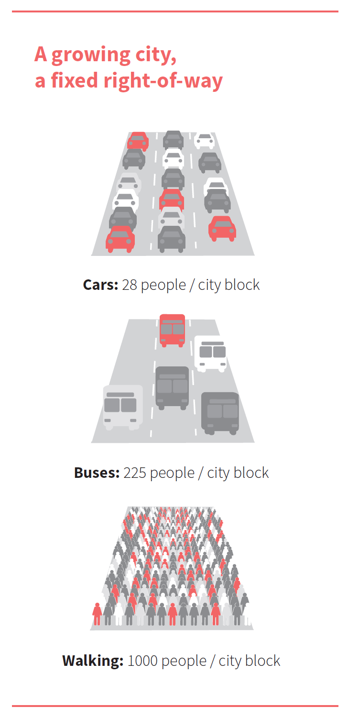
CARS TAKE A LOT OF SPACE PER PERSON, SO IF WE ARE ALL GOING TO FIT DOWN THE STREET,
WE NEED MORE PEOPLE TO TRAVEL WITHOUT DRIVING SINGLE-OCCUPANT VEHICLES
ENHANCED TRANSIT CORRIDORS PLAN

Slide 5
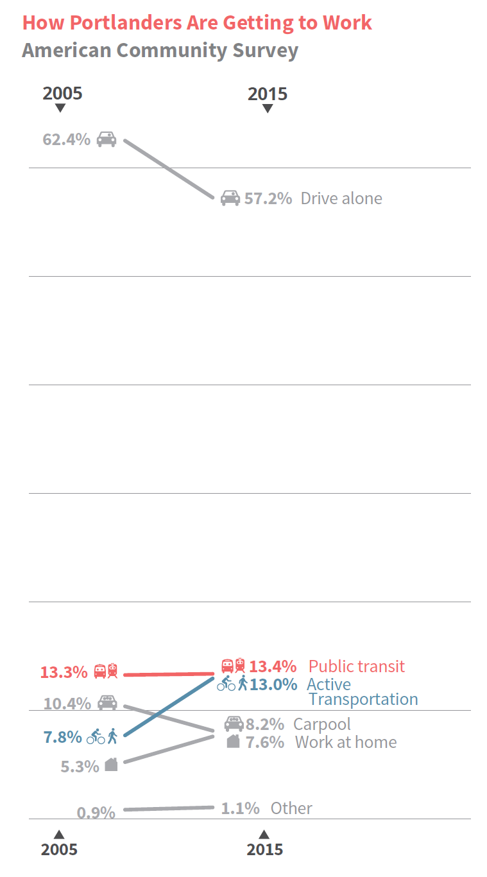
THE SHARE OF PORTLAND COMMUTERS WHO RIDE A BIKE TO WORK ROSE FROM 2% IN 2000 TO 7% IN 2014;
IN THE SAME TIME SPAN, THE SHARE OF PORTLAND COMMUTERS WHO RIDE
TRANSIT WAS STAGNANT AT 12% - 13%
ENHANCED TRANSIT CORRIDORS PLAN

Slide 6
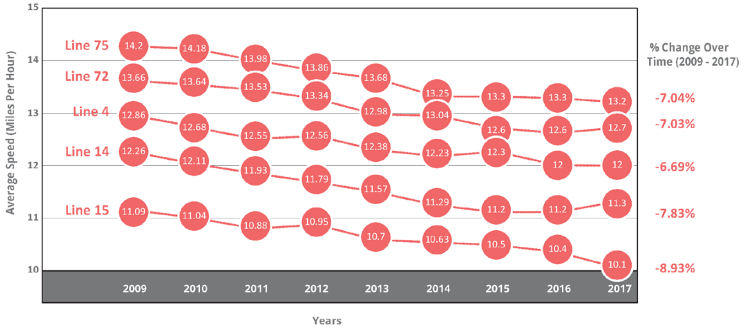
DESPITE TRIMET’S BEST EFFORTS,
PORTLAND’S BUSES ARE SLOWING DOWN
AVERAGE BUS SPEEDS
ENHANCED TRANSIT CORRIDORS PLAN

Slide 7
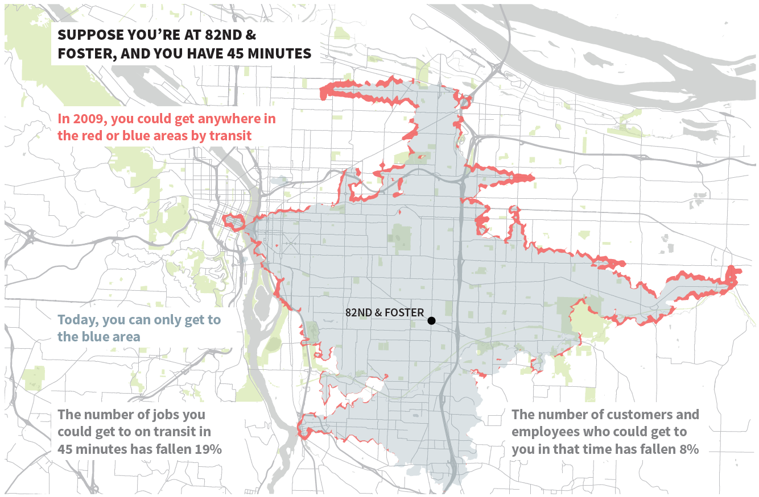
ENHANCED TRANSIT CORRIDORS PLAN

Slide 8
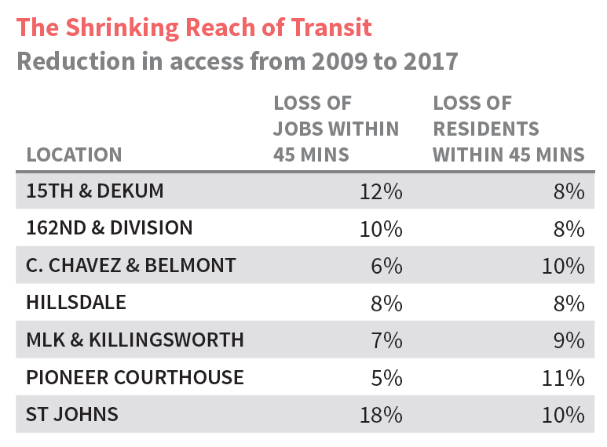
IF YOU RELY ON TRANSIT, BY CHOICE OR NECESSITY, YOUR ACCESS TO OPPORTUNITY IS SHRINKING
ENHANCED TRANSIT CORRIDORS PLAN

Slide 9
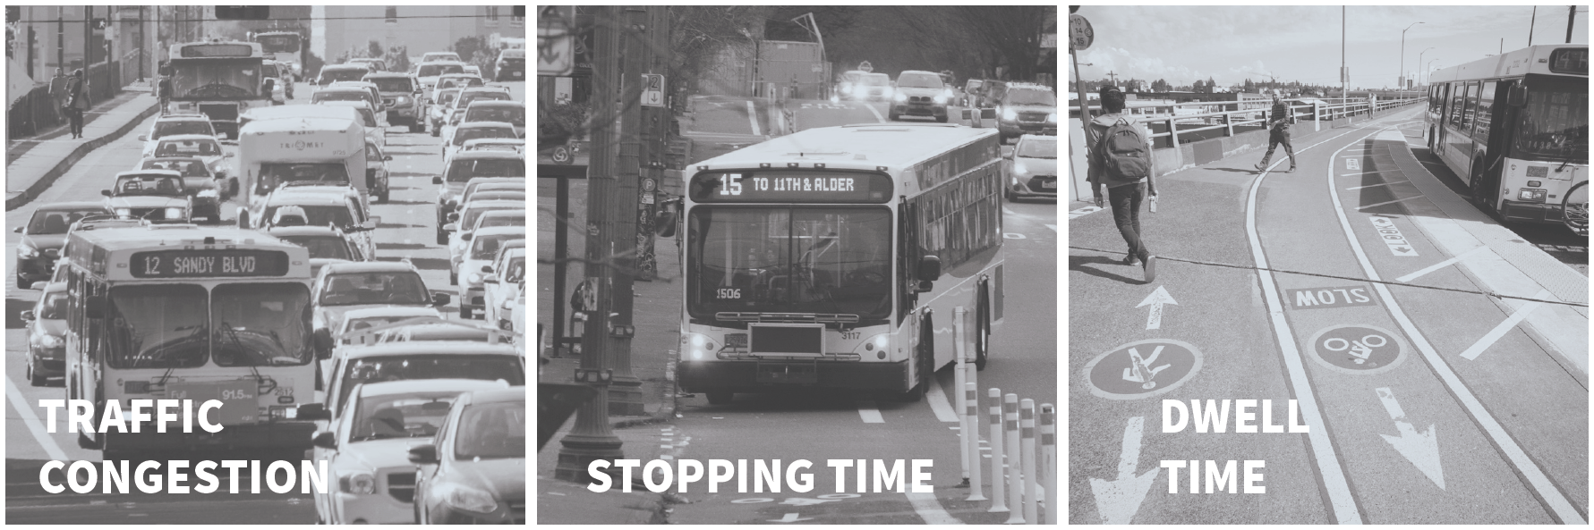
WHY IS TRANSIT DELAYED?
ENHANCED TRANSIT CORRIDORS PLAN

Slide 10
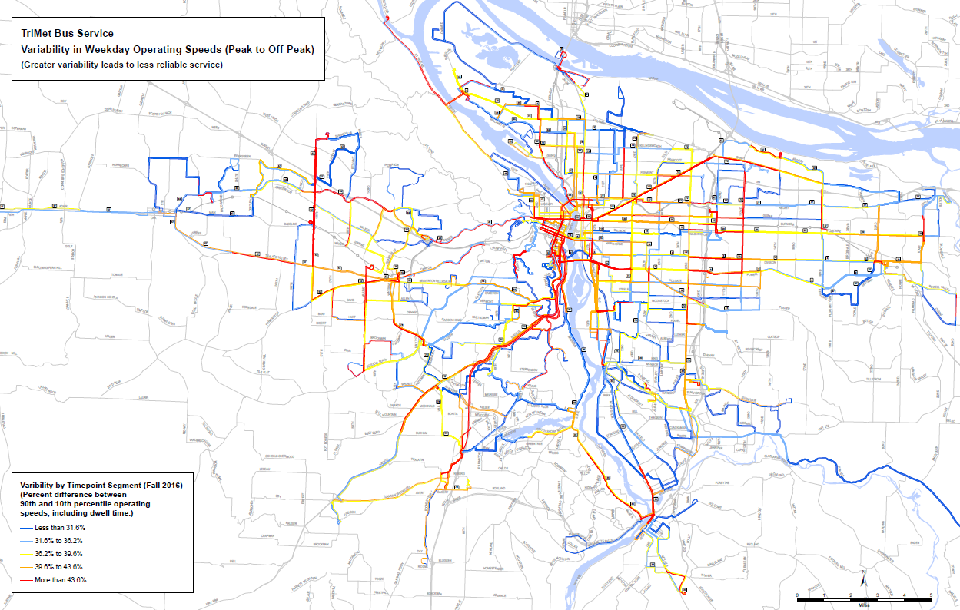
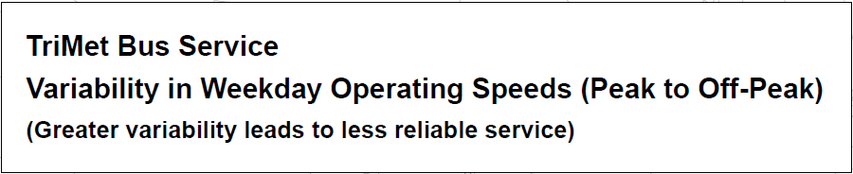
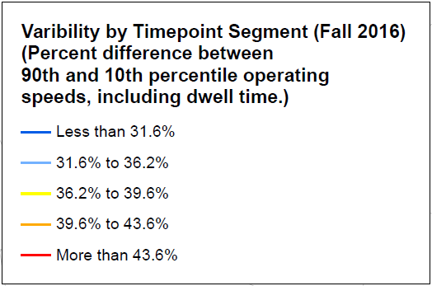
WHERE IS TRANSIT
MOST DELAYED?
ENHANCED TRANSIT CORRIDORS PLAN
Notes:
Buses are being delayed across the region, though many of the worst locations are in Portland.

Slide 11
THIS IS A REGIONAL PROBLEM
THAT NEEDS A REGIONAL SOLUTION.
SINCE LAST YEAR, WE HELPED SPUR A REGIONAL EFFORT...
METRO’S REGIONAL ETC PILOT PROGRAM
WITH $5 MILLION FOR PROJECT DEVELOPMENT
ENHANCED TRANSIT CORRIDORS PLAN
Notes:
This is a regional problem and need.
We also helped spurred/kicked off a regional effort, the Regional ETC Pilot program.
We plan to participate in it to help advance implementation.
We aim to build several projects within 2 years and develop a pipeline of projects to seek additional future funding.

Slide 12
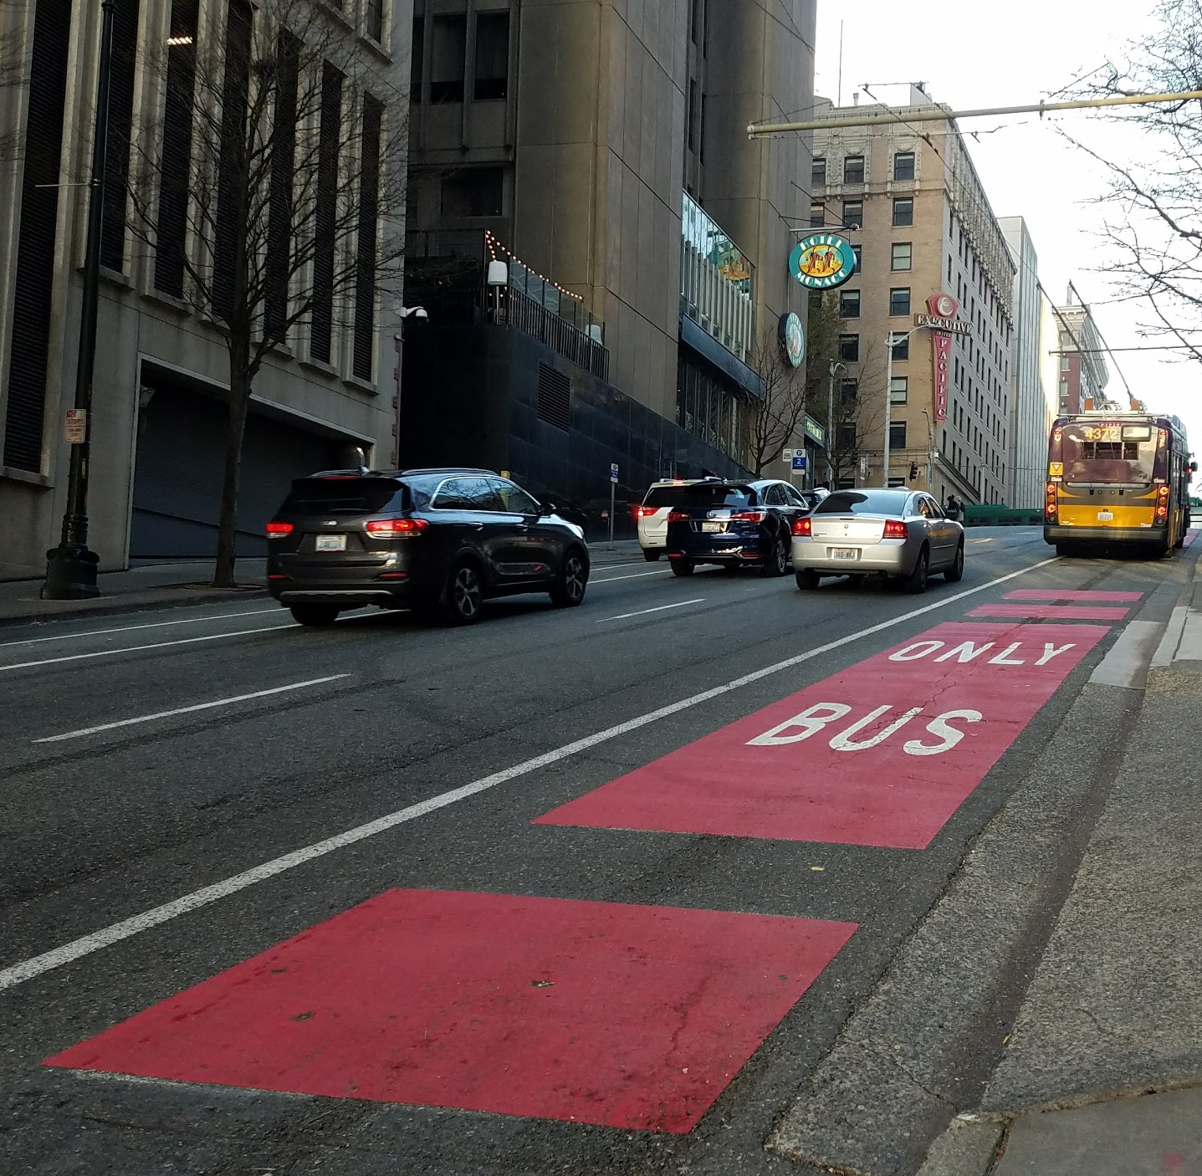
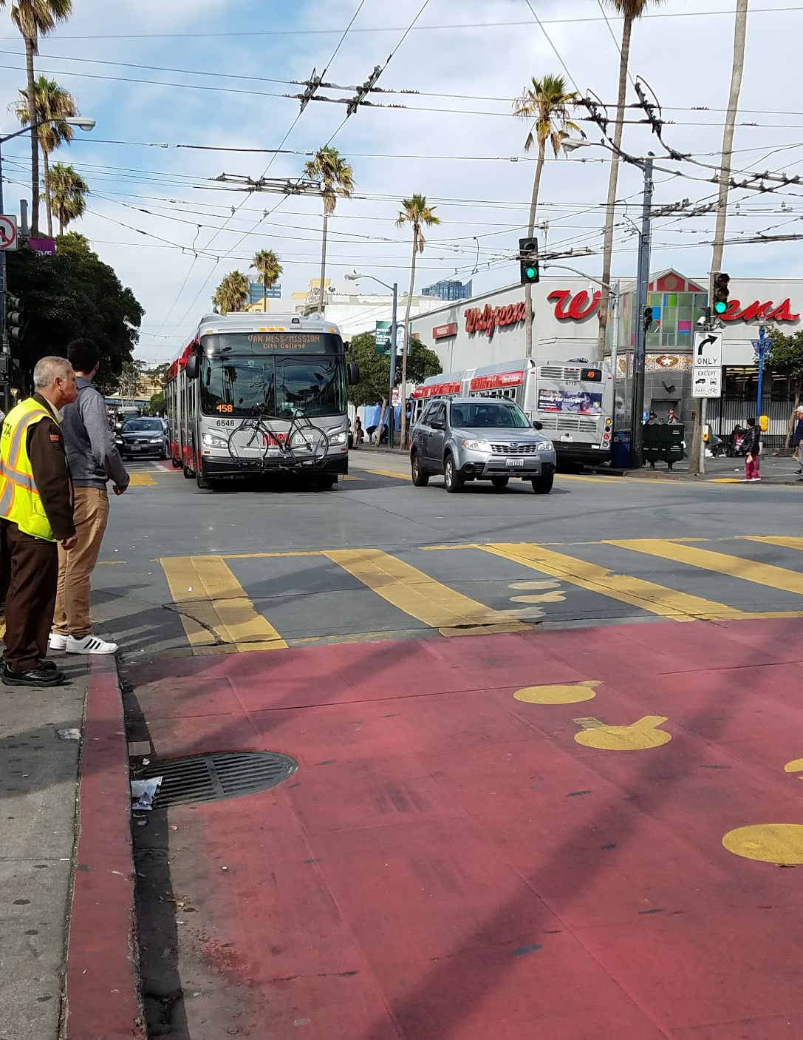
SEATTLE,
SAN FRANCISCO,
VANCOUVER B.C.,
ARE ALL AGGRESSIVELY INVESTING IN BUS SERVICE AND
GIVING THEM THE
SPACE THEY NEED.

Slide 13
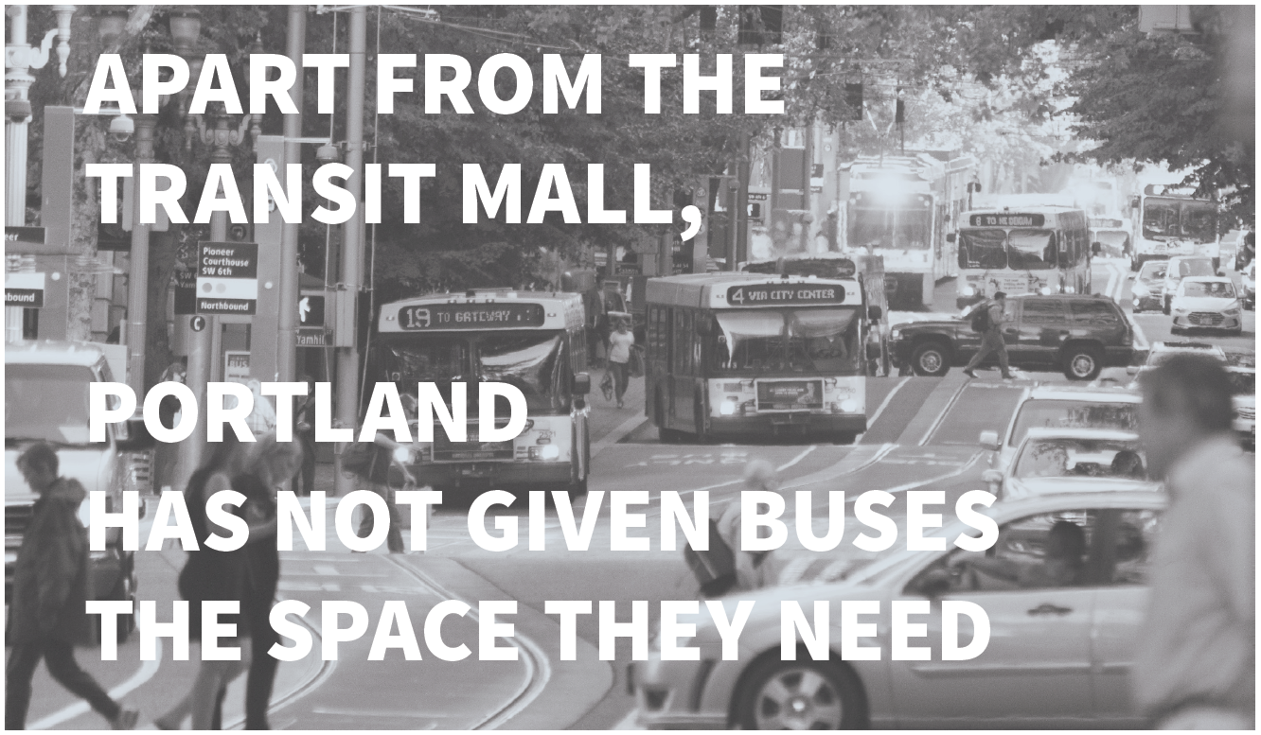
ENHANCED TRANSIT CORRIDORS PLAN
Notes:
SEATTLE, SAN FRANCISCO, VANCOUVER B.C.,
ARE ALL AGGRESSIVELY INVESTING IN BUS SERVICES AND GIVING THEM THE SPACE THEY NEED.

Slide 14
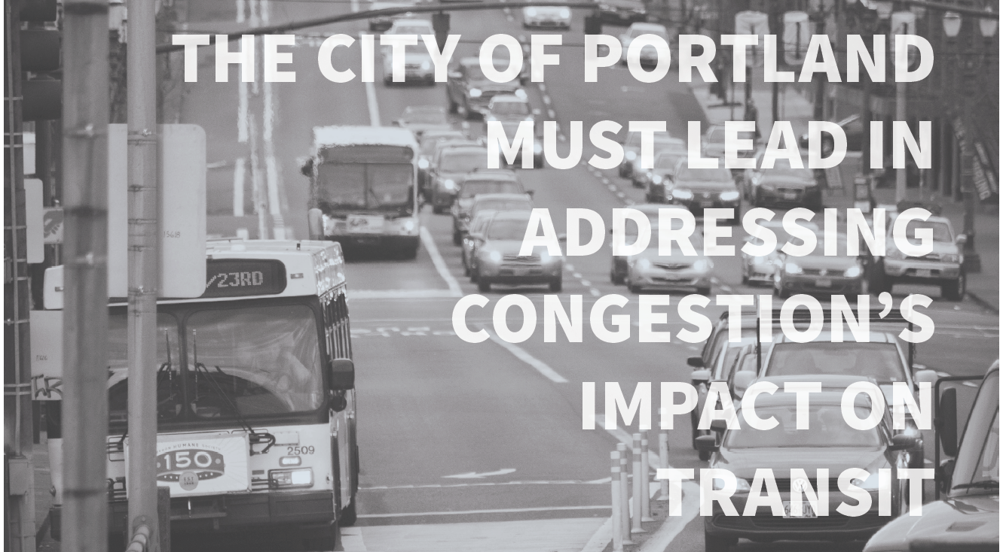
ENHANCED TRANSIT CORRIDORS PLAN
Notes:
TriMet has a lead role in dealing with many causes of dwell time at stops. TriMet and the City share responsibility for placing bus stops. On traffic congestion and friction, though, the City of Portland must lead. We need to see ourselves as a transit agency

Slide 15
What is Enhanced Transit?
Notes:
Tom

Slide 16
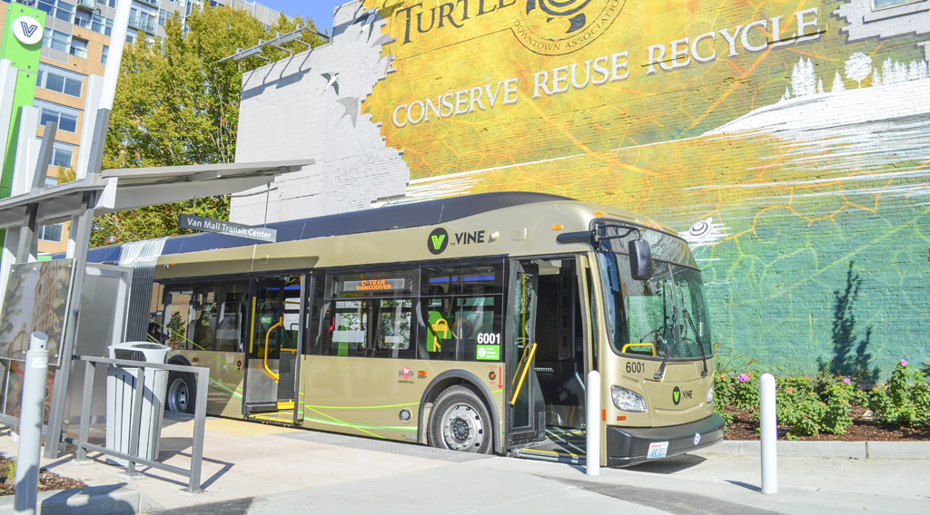

Characteristics of Enhanced Transit
Increased capacity, reliability and transit travel speed
Moderate capital and operational investments
Flexible and context sensitive
Can be deployed relatively quickly
Can include bus or streetcar
Could be a hot spot, corridor or full line
The Vine recently opened in Vancouver, WA

Slide 17
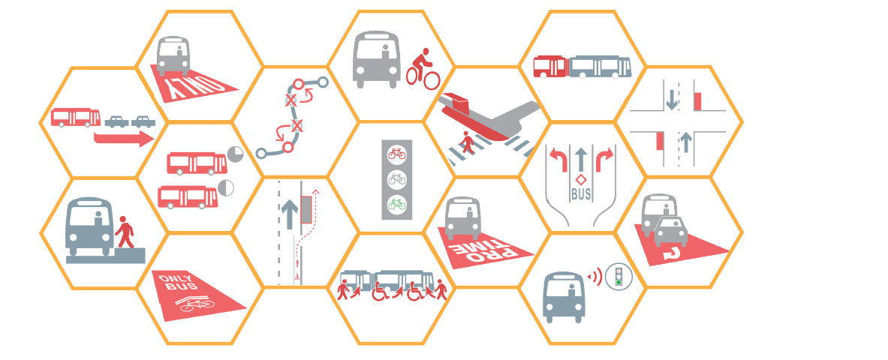
ETC Capital/Operational Toolbox
(20 tools that can be applied on streets and transit fleet)

Slide 18
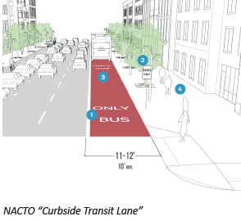
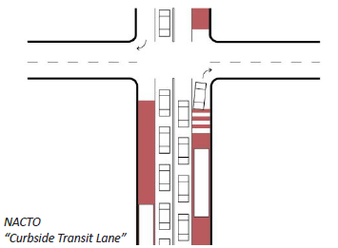
Laneways and Intersection Treatments
Dedicated Bus Lane
Business Access and Transit (BAT) Lane

Slide 19
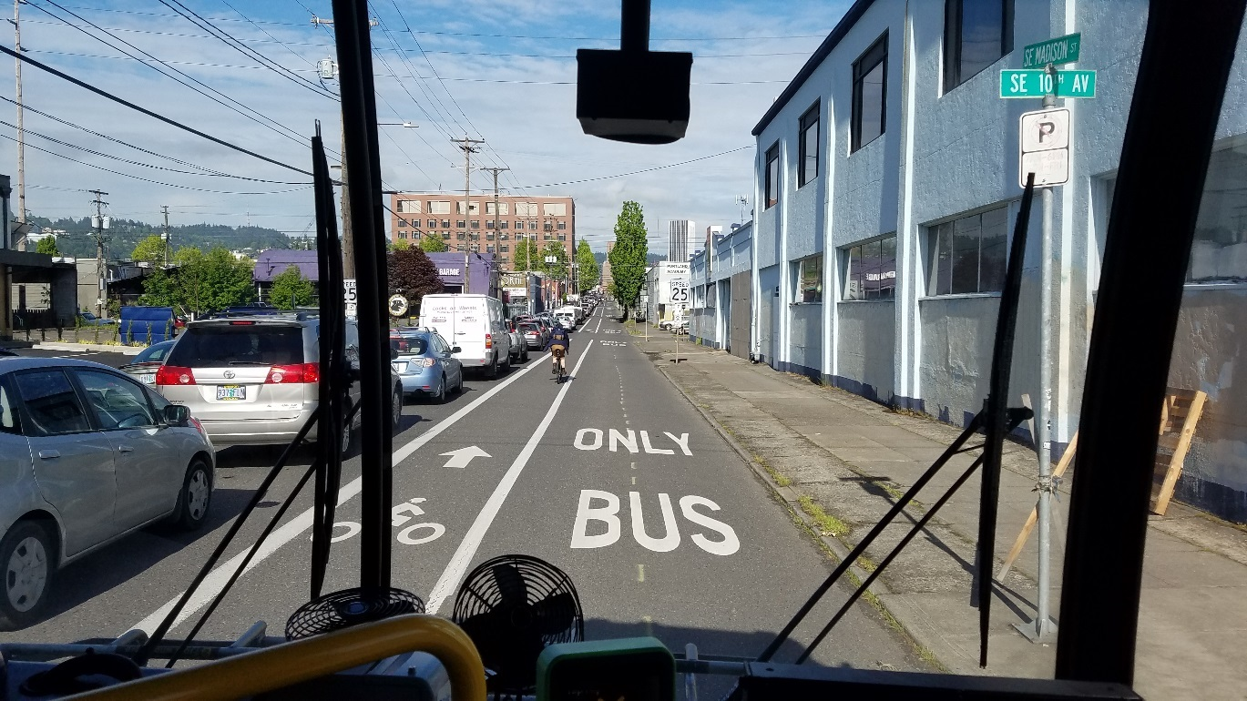
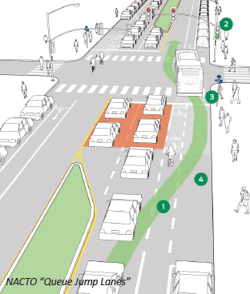
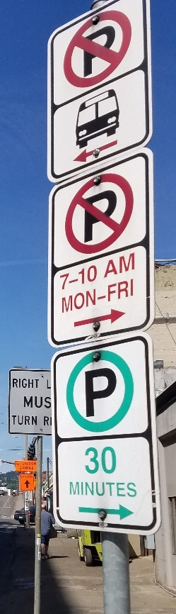
Laneways and Intersection Treatments
Intersection Queue Jump/Right Turn Except Bus Lane
Pro-Time (Peak Period Only) Transit Lane
SE Madison morning peak hour

Slide 20
ETC Plan Recommendation
Highlights
Notes:
Overall flow for this section
Start with kudos for inspiring the regional program
City sees regional program as an opportunity to advance ETC at the local level
Overview process timeline
Where? (City-specific) – this is where the integration with other projects makes sense
What can we expect? Priming for workshop and potential outcomes
We’ve been coordinating on this throughout the ETC Planning process
Making sure we can deliver on the outcomes – similar goals to ETC plan goals

Slide 21
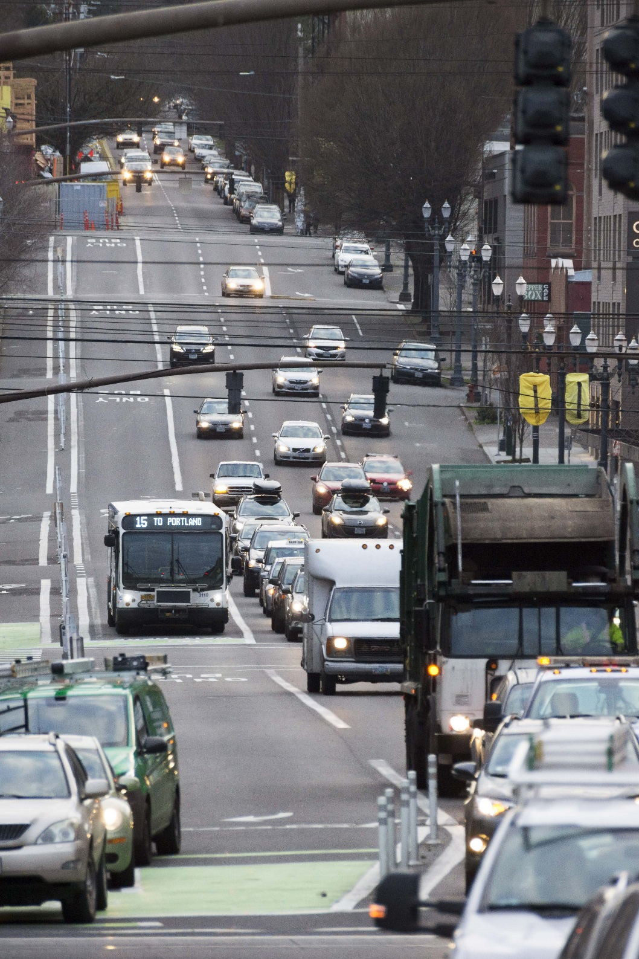
ETC Plan Recommendations:
Three-Prong Implementation Strategy
  Develop a 20-year Regional Transit Vision with a strong ETC component and nimble implementation
  Adopt policies and action items to better support transit
  Strengthen Ongoing Monitoring of Frequent Lines
Notes:
Potential Performance Metrics:
Customer experience
Delay
Reliability
Frequency
Efficiency/cost effectiveness of service
Capacity
Speed
Cost to operate service over time
Support Planned Growth and Equity
Transportation System Benefits
Severity of problem
magnitude of benefit & scale of treatment

Slide 22
1. New Approach and Vision for Transit
High Capacity Transit
  Larger transit vehicles carrying the greatest number of people, over longer distances in generally exclusive guideways with Frequent Service or better.
Enhanced Transit
  Improving bus and streetcar lines that carry more people with Frequent Service or better, to be more efficient, quicker and reliable. They operate mostly in mixed traffic with some transit priority treatments.
Growing Transit
  Improving bus lines that are new or less than Frequent Service yet planned for increased service in areas that also need infrastructure to make it safer and easier to access transit. They typically carry less people today with little traffic delay.

Slide 23
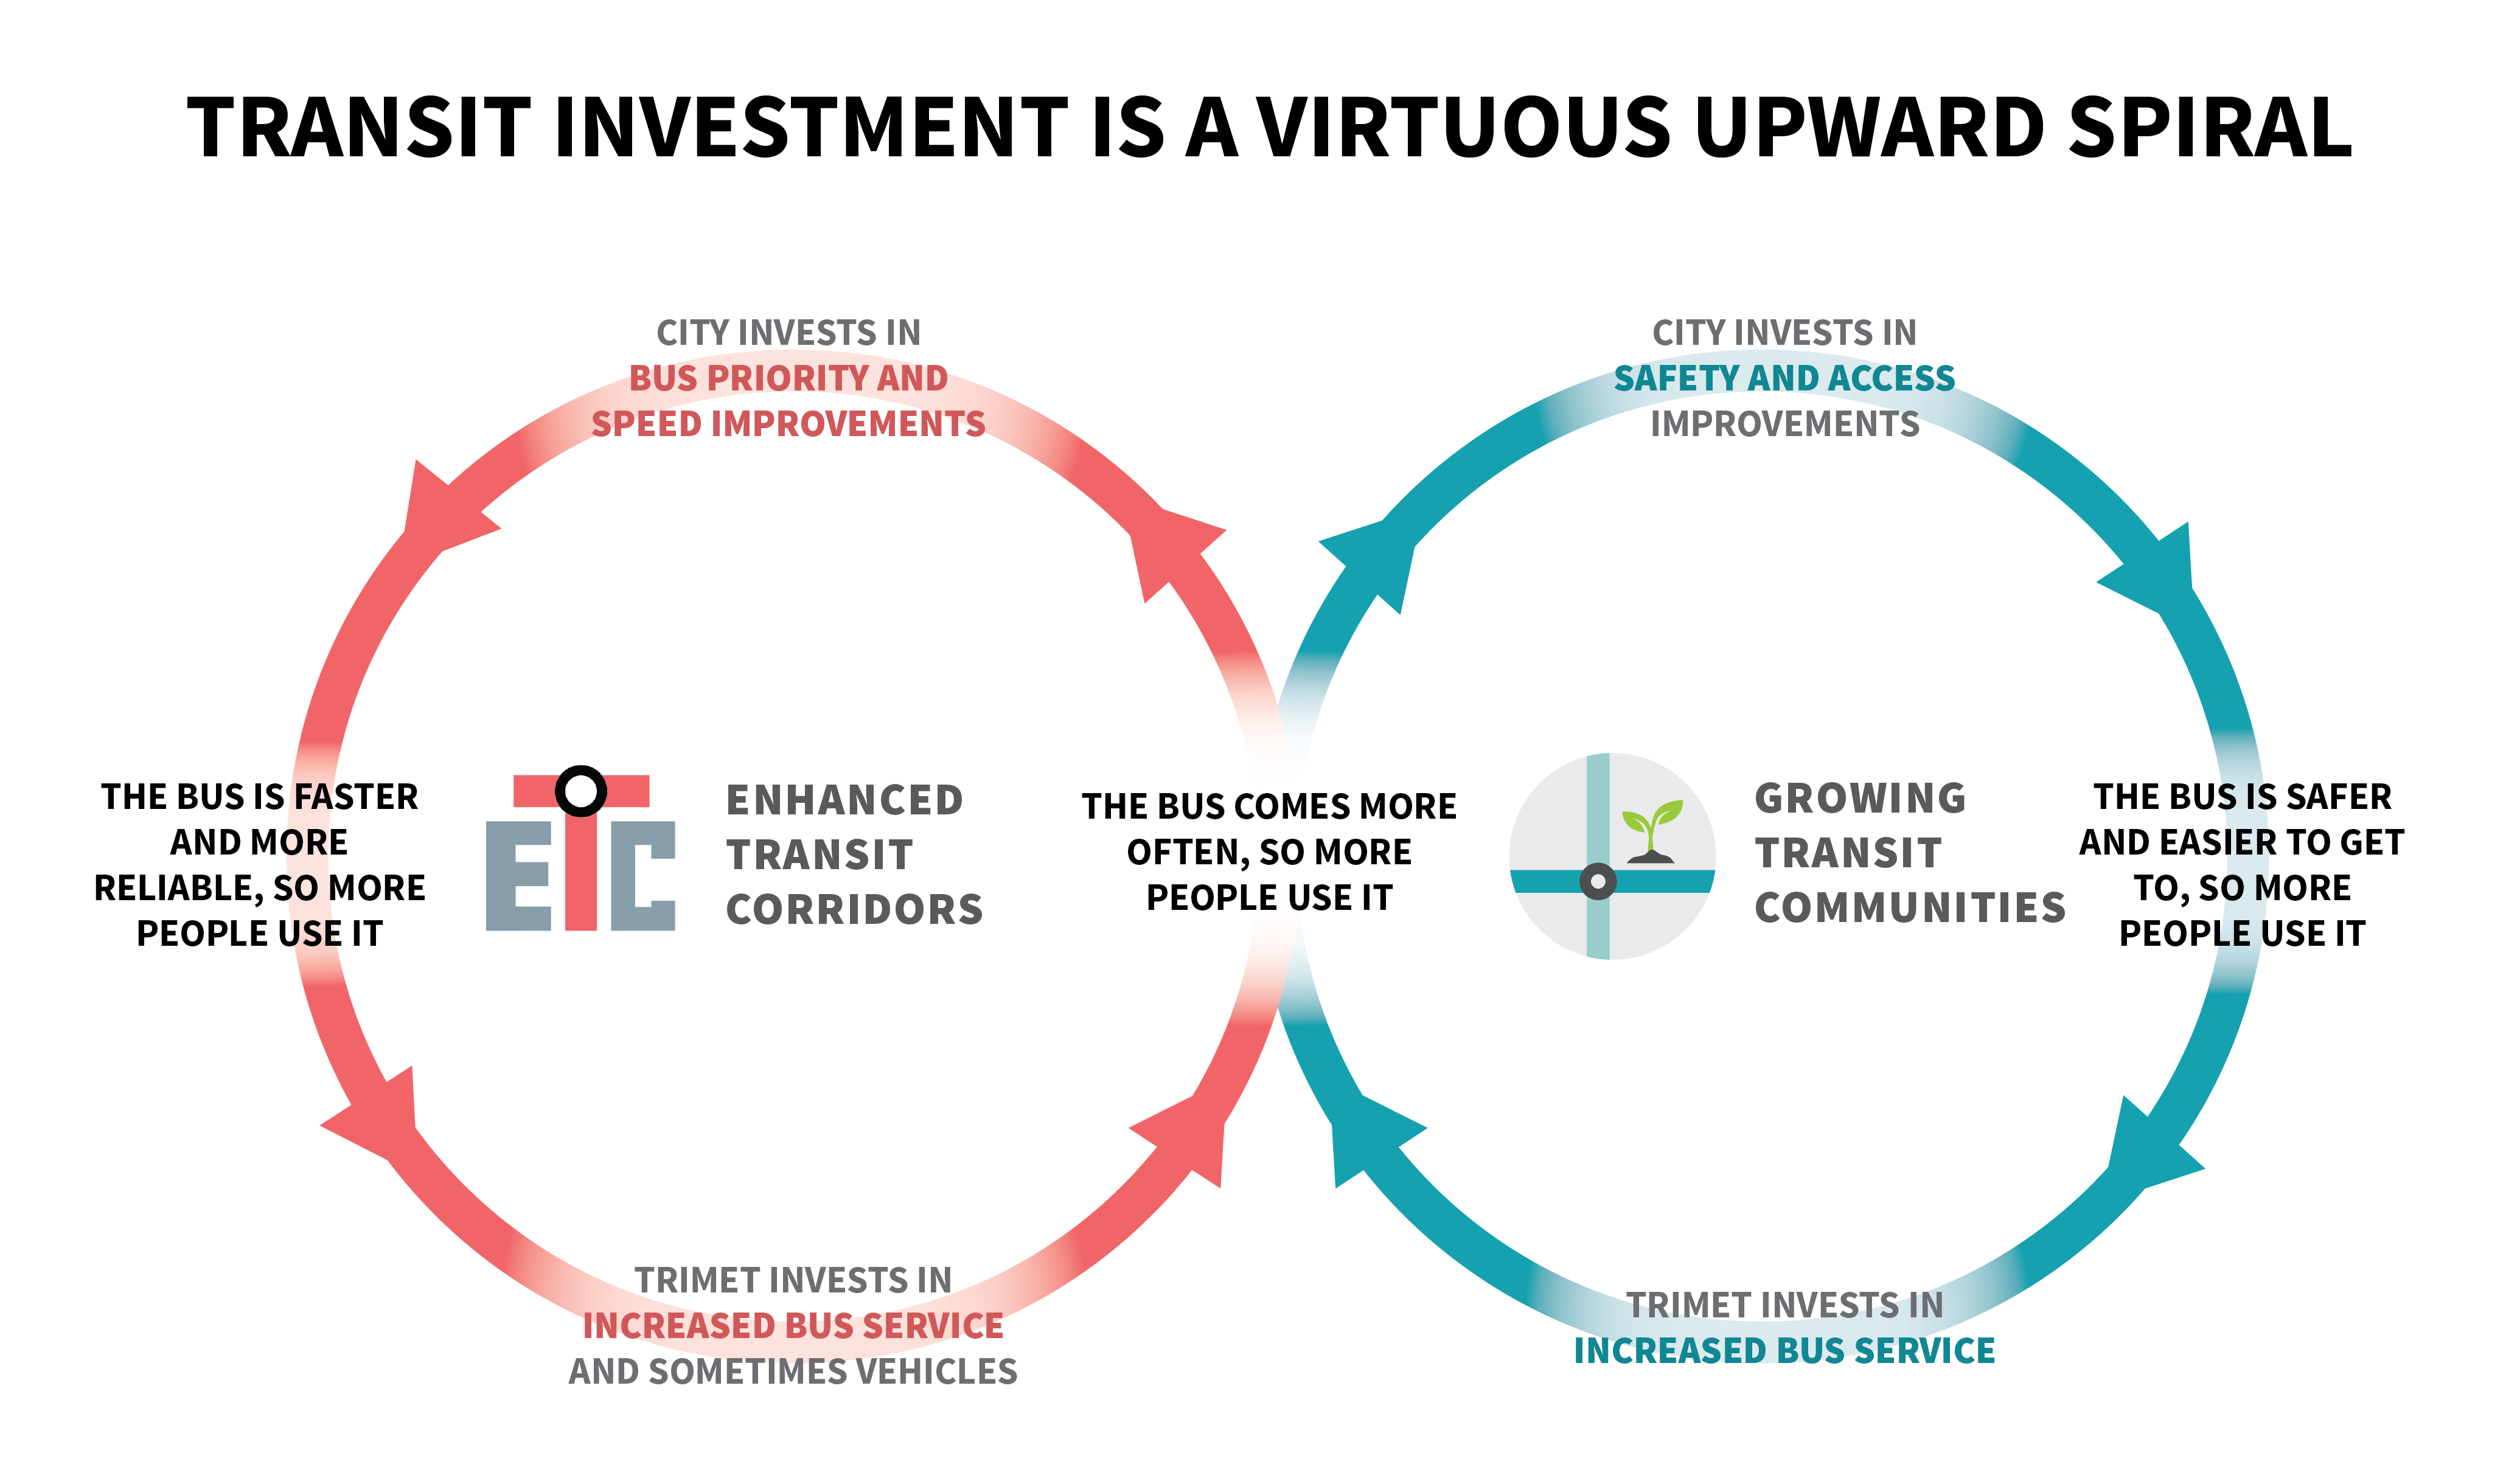

Slide 24
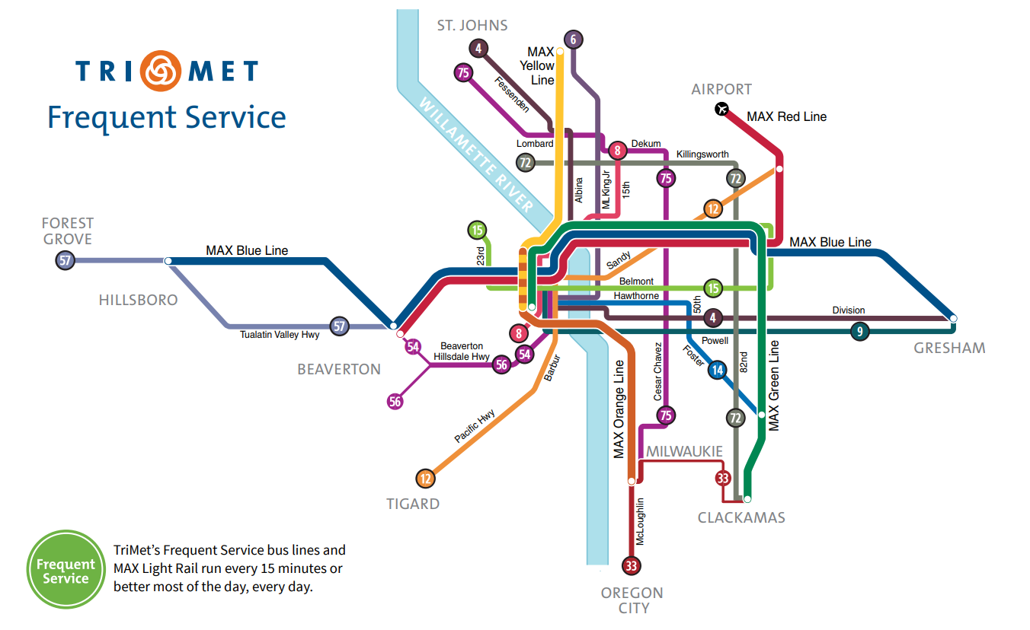
ENHANCED TRANSIT CORRIDORS BUILD ON THE TRIMET FREQUENT SERVICE NETWORK

Slide 25
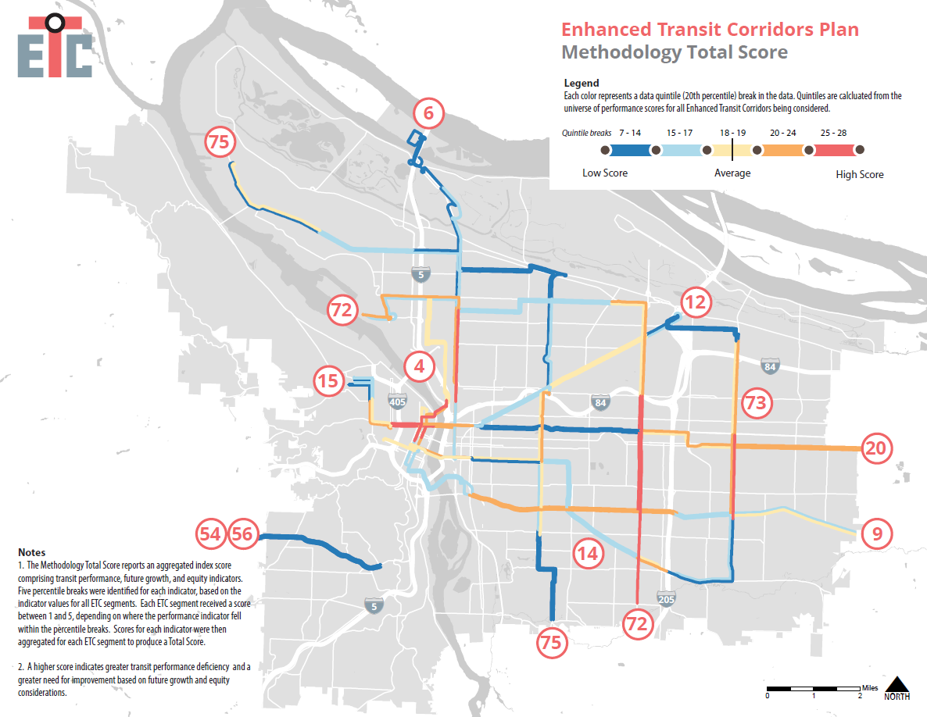
Initial Network of Enhanced Transit Corridors:
Where there is most need and potential now
Notes:
Total Score

Slide 26
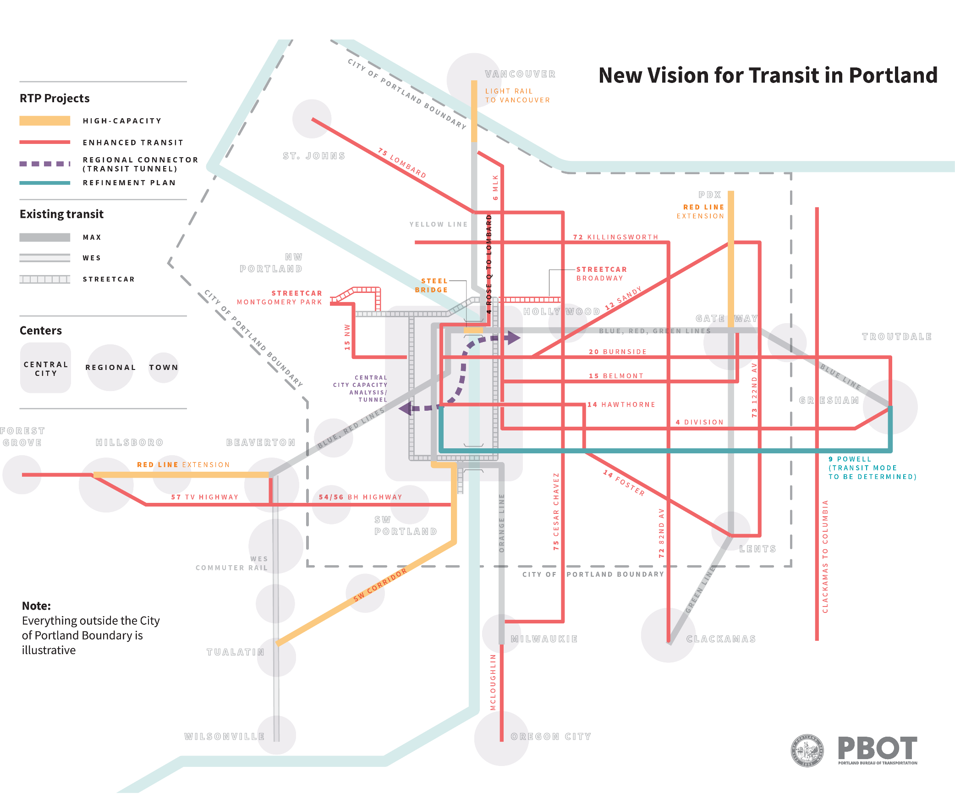
Add Enhanced Transit
  Streetcar
  Buses
Extend MAX lines
Address transit bottlenecks
Powell Corridor Refinement Plan (mode TBD)
Note: Proposal pending further input and coordination with regional partners.
Notes:
Identify an initial network of Enhanced Transit Corridors
Integrate ETC into a New Transit Vision
Recommend adding several projects to the RTP and TSP, in planning timeframes
Accelerate implementation of ETC treatments along both short segments and longer corridors
Identify new funding sources and combine investments with TriMet increases in transit service

Slide 27
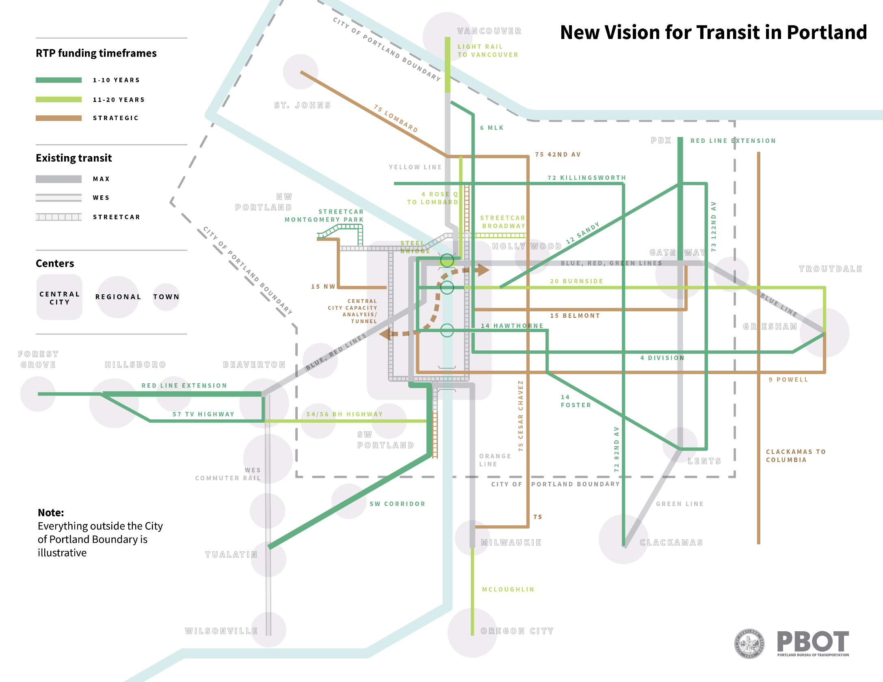
RTP Project List Timeframes:
1-10 Year Constrained
11-20 Year Constrained
Strategic
Notes:
Introduce Exhibit A. This is a candidate list of projects based on the proposed new vision for consideration in the RTP update.
I stress these are candidate projects for further analysis and vetting through the RTP update process.
Metro will lead the process for adopting final RTP projects and setting regional priorities.

Slide 28
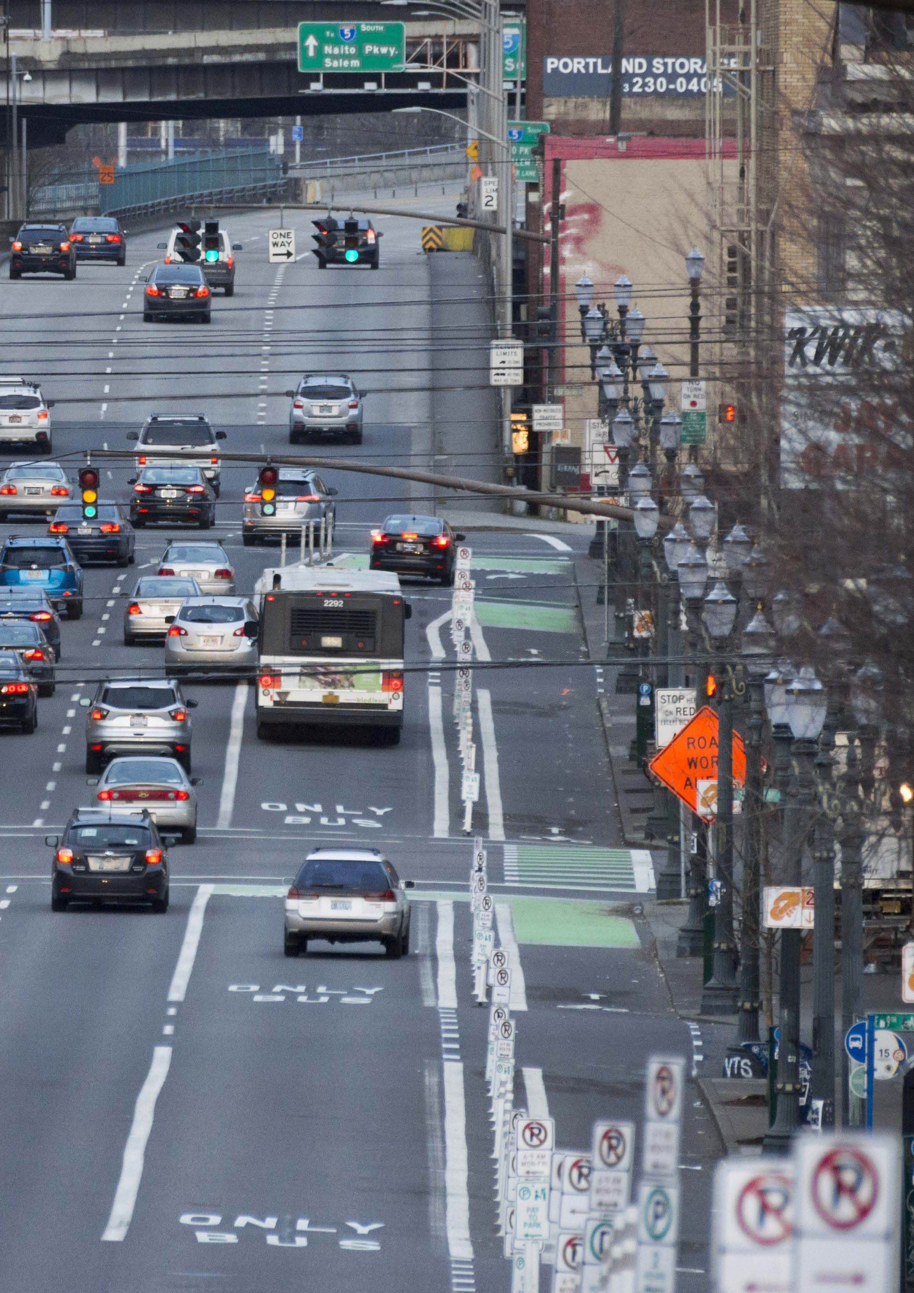
2. Policy and Actions to Better Support Transit
  Focus on longer trips: make transit the preferred mode for trips over 3 miles.
  Make space and time in the right-of-way for better transit performance.
  Integrate Enhanced Transit toolbox treatments into PBOT design guides, capital projects and development review requirements.
  Commit more funding to Enhanced Transit.
  Forge deeper partnerships with TriMet.

Slide 29
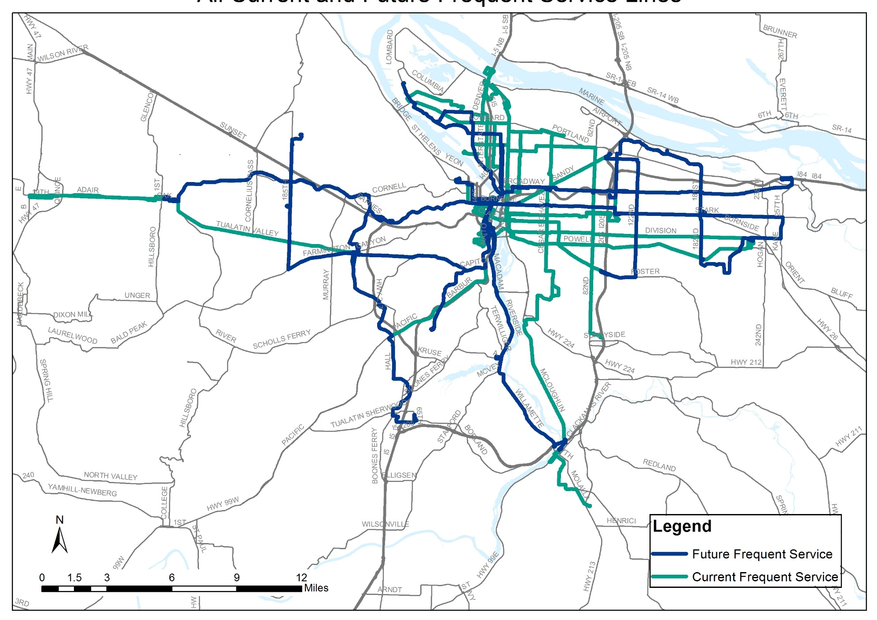
3. On-going Monitoring of Transit Performance
Monitor TriMet Frequent Service bus and streetcar lines, both current and planned routes.
City of Portland actively manages the ROW to support ETC improvements
City and TriMet execute improvements in service and reliability
Notes:
Tom
The Portland region needs to create a pipeline of lower cost transit offerings, developed in partnership between TriMet and local jurisdictions to serve the region's growth and be deployed quickly. (generic or graphical image)

Slide 30
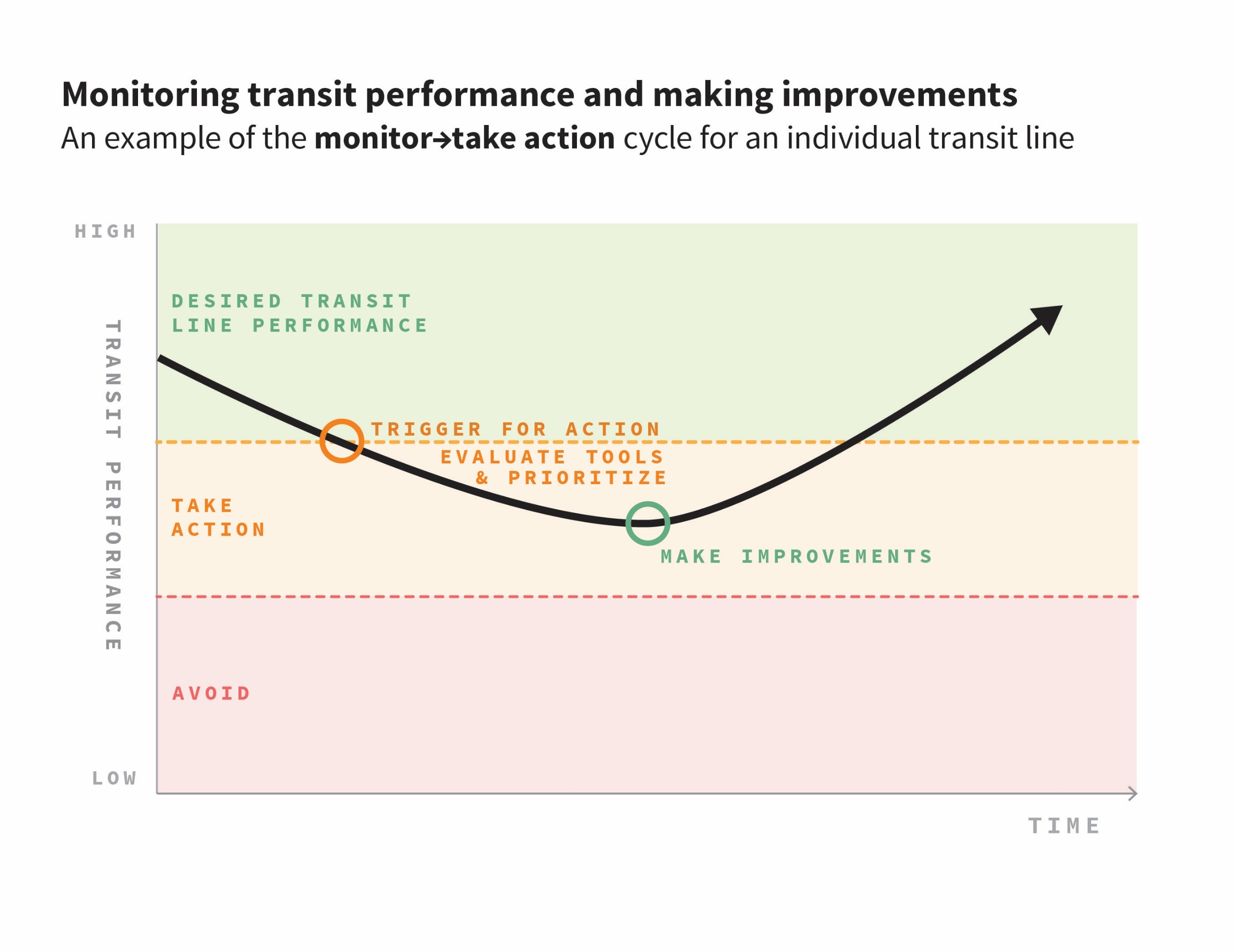
Notes:
April
Repeat as needed in Portland and throughout the region!

Slide 31
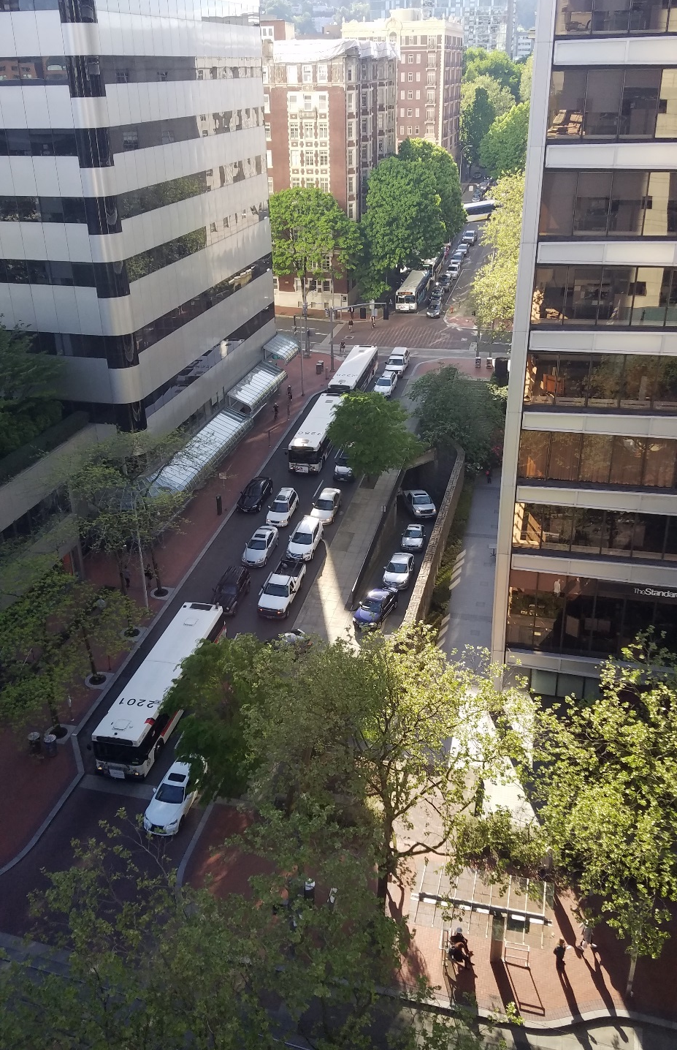
Performance Measure and Thresholds
Transit Peak Delay:
How much transit, and all the people on it, slows down during the peak congested time of the day.
Thresholds:
Crossing these thresholds would be a trigger to take a closer look and take actions to improve performance:
Over 75% peak delay variation = urgent priority to take closer look in Tier 2
50%-75% peak delay variation = take a closer look in Tier 2
Below 50% peak delay variation = acceptable, take a closer look only if there is other cause for concern
Notes:
Subset of trimet lines: Important point to make about the Universe of Option that go into the funnel each year: We will monitor the Planned Frequent Service Network of buses and streetcar lines, not just the candidates initially identified in the City’s ETC Plan or the Region’s ETC pilot program.
Identify needs and deficiencies (existing performance) using performance measures

Slide 32
Implementation
Notes:
Overall flow for this section
Start with kudos for inspiring the regional program
City sees regional program as an opportunity to advance ETC at the local level
Overview process timeline
Where? (City-specific) – this is where the integration with other projects makes sense
What can we expect? Priming for workshop and potential outcomes
We’ve been coordinating on this throughout the ETC Planning process
Making sure we can deliver on the outcomes – similar goals to ETC plan goals

Slide 33
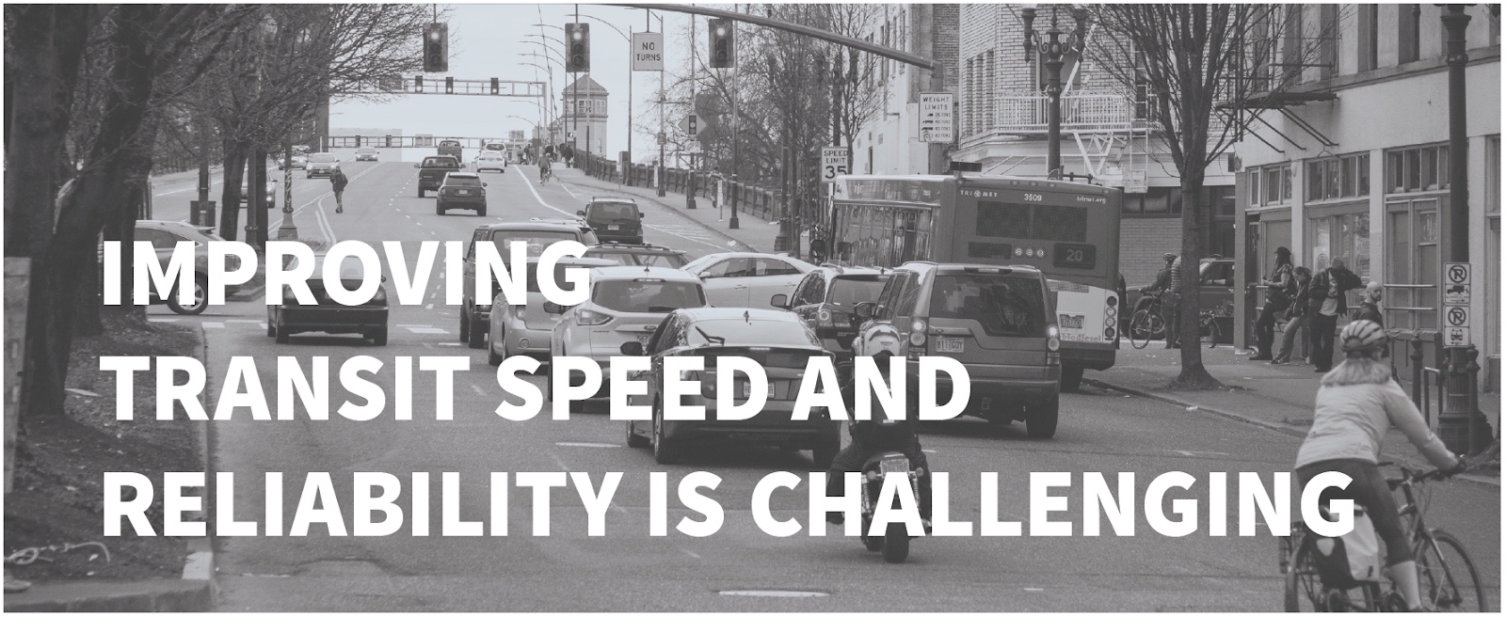

Slide 34
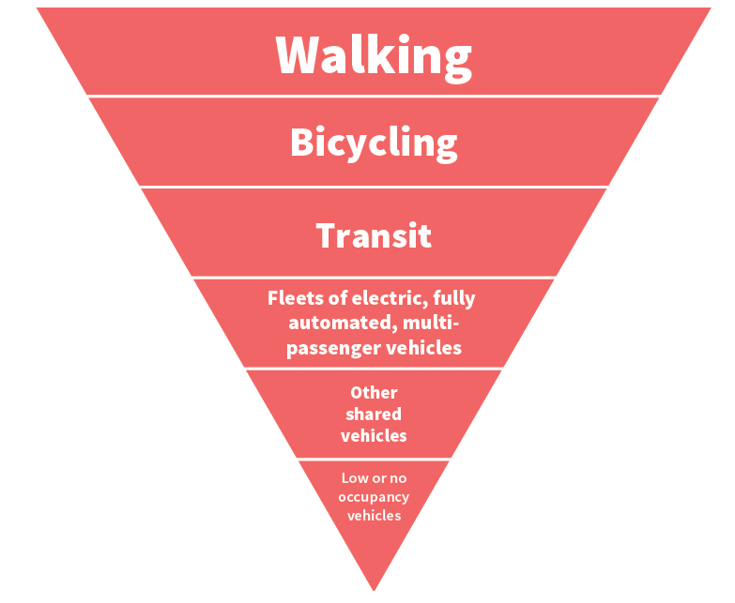
Strategy for People Movement
TSP Policy 9.6:
Strategy for People Movement
THE TRANSPORTATION STRATEGY FOR PEOPLE MOVEMENT PROVIDES POLICY SUPPORT FOR PRIORITIZING TRANSIT OVER SINGLE-OCCUPANT VEHICLES.
THE ETC PLAN PROVIDES TOOLS FOR WHERE AND HOW TO ACHIEVE IT.
Notes:
Potential Performance Metrics:
Customer experience
Delay
Reliability
Frequency
Efficiency/cost effectiveness of service
Capacity
Speed
Cost to operate service over time
Support Planned Growth and Equity
Transportation System Benefits
Severity of problem
magnitude of benefit & scale of treatment

Slide 35

During Implementation:
Making design decisions in constrained locations
  Re-allocate space and time in the street in a manner that is:
  Guided by policy, including Vision Zero, Complete Streets
  Informed by data
  Sensitive to context
  Efficient use of space
Notes:
Potential Performance Metrics:
Customer experience
Delay
Reliability
Frequency
Efficiency/cost effectiveness of service
Capacity
Speed
Cost to operate service over time
Support Planned Growth and Equity
Transportation System Benefits
Severity of problem
magnitude of benefit & scale of treatment

Slide 36
Tracks for Project Implementation
Transit Improvement Projects
identified in the ETC Plan and
on-going Transit Program
PBOT/TriMet
TSP Program: Transit Priority Spot Improvements
PBOT/TriMet
TSP: Major Capital Improvement Projects
Metro/TriMet/PBOT
Regionally Funded Projects
Metro/TriMet
Federal FTA Funded Projects
Notes:
Also integrate ETC into other projects.

Slide 37
Early Implementation
Notes:
Tom

Slide 38
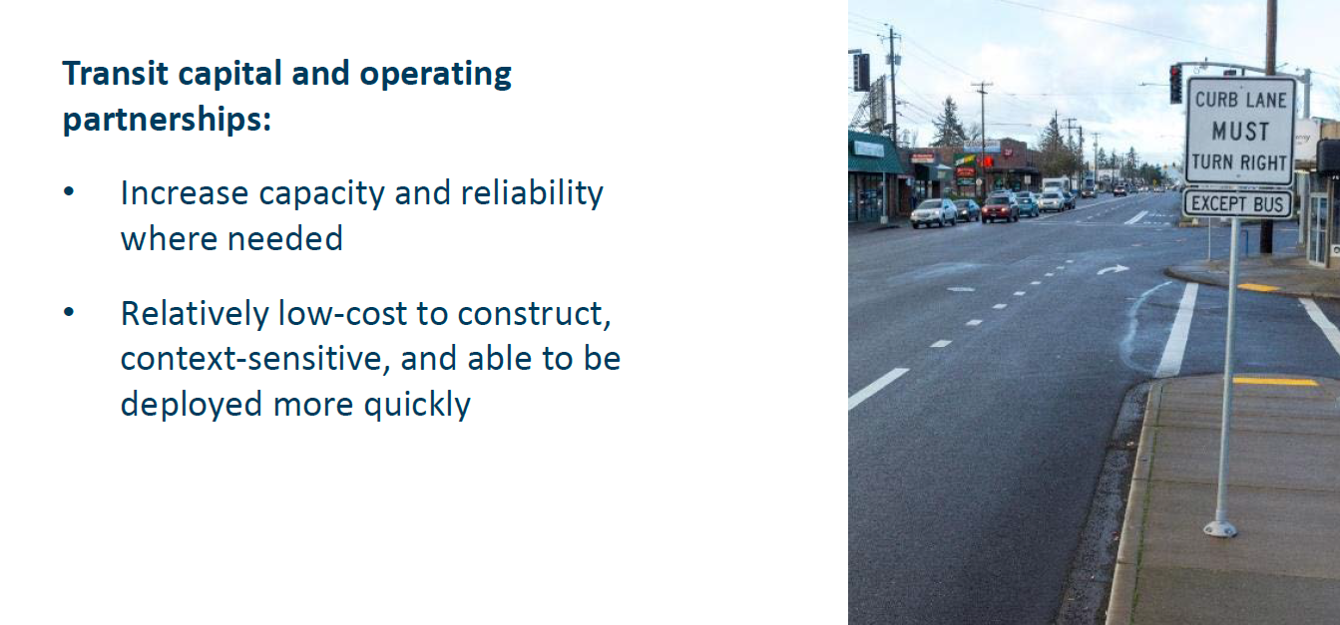
Transit Priority
Spot Improvements Program
Installed in 2017
Line 12: NE Sandy Blvd approaching 72nd
Line 14: SE 50th approaching Powell
Notes:
The charge of the pilot project will be to develop an initial pipeline for potential ETC projects. The premise is that these projects will support improvements to benefit transit reliability, speed, and capacity.
Note that these are very similar to the goals of what the local ETC Plan has tried to do, but applied at the regional level

Slide 39


SE Morrison Protected Bike and Pro-time Bus Lane/BAT Lane:
SE 11th – SE Grand
Upgraded in 2017
Notes:
The charge of the pilot project will be to develop an initial pipeline for potential ETC projects. The premise is that these projects will support improvements to benefit transit reliability, speed, and capacity.
Note that these are very similar to the goals of what the local ETC Plan has tried to do, but applied at the regional level

Slide 40
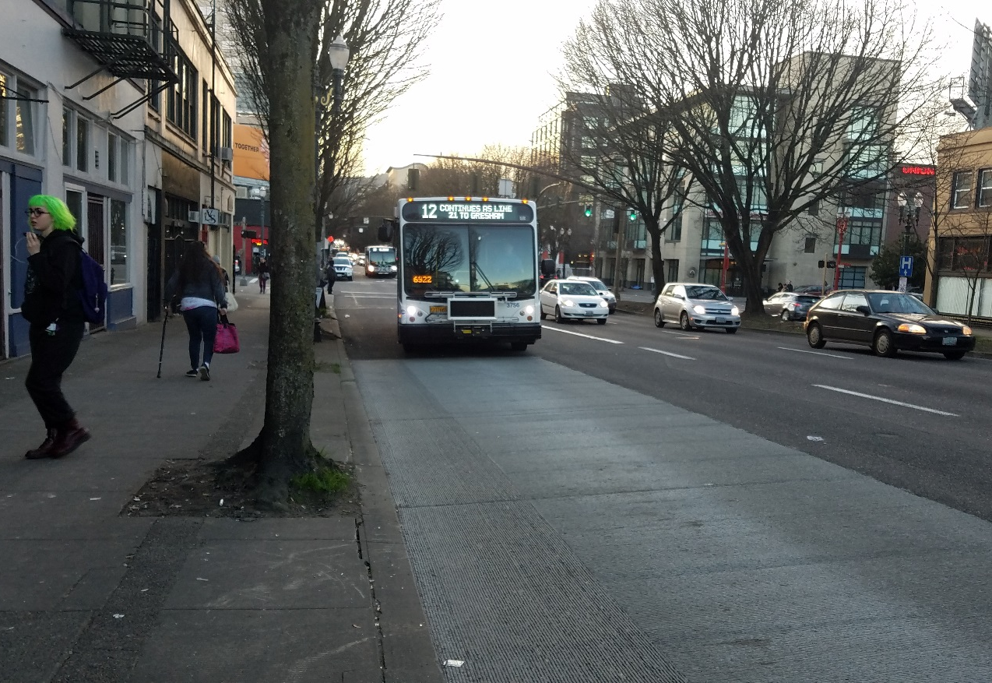
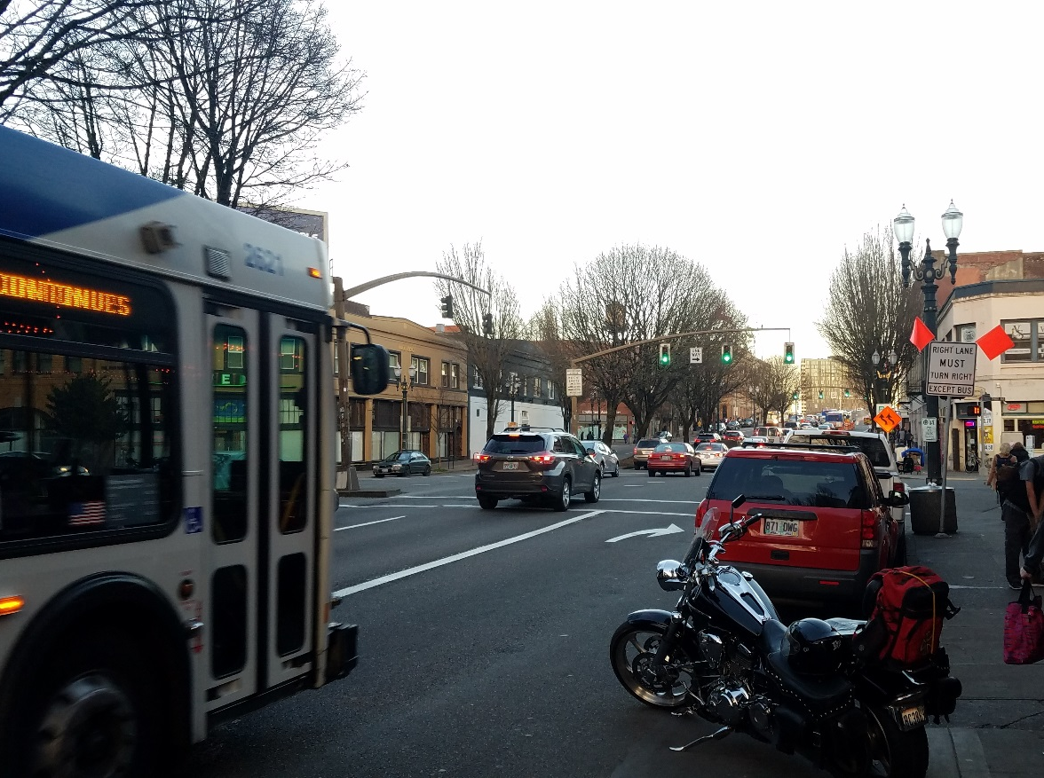
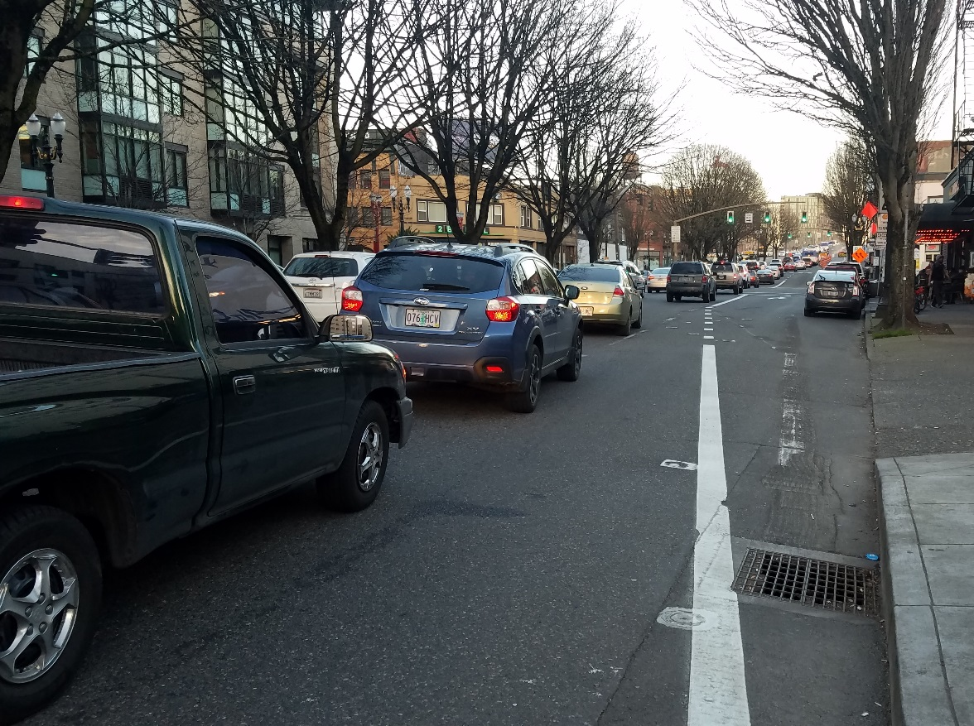
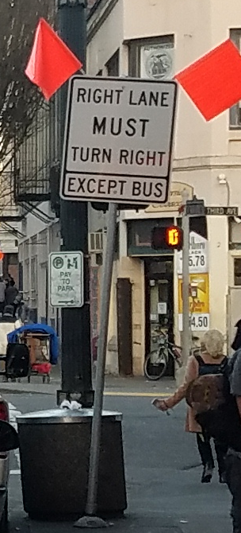
W Burnside BAT Lane/Queue Jump:
4th Ave - Bridge
Installed in 2017
Notes:
The charge of the pilot project will be to develop an initial pipeline for potential ETC projects. The premise is that these projects will support improvements to benefit transit reliability, speed, and capacity.
Note that these are very similar to the goals of what the local ETC Plan has tried to do, but applied at the regional level

Slide 41
Capital project coming in late 2018
NE Grand Business Access and Transit (BAT) Lane: SE Ankeny – NE Everett / I-84
Notes:
The charge of the pilot project will be to develop an initial pipeline for potential ETC projects. The premise is that these projects will support improvements to benefit transit reliability, speed, and capacity.
Note that these are very similar to the goals of what the local ETC Plan has tried to do, but applied at the regional level

Slide 42
Regional ETC Pilot Program:
An opportunity for advancing project development and early Implementation
Notes:
Overall flow for this section
Start with kudos for inspiring the regional program
City sees regional program as an opportunity to advance ETC at the local level
Overview process timeline
Where? (City-specific) – this is where the integration with other projects makes sense
What can we expect? Priming for workshop and potential outcomes
We’ve been coordinating on this throughout the ETC Planning process
Making sure we can deliver on the outcomes – similar goals to ETC plan goals

Slide 43
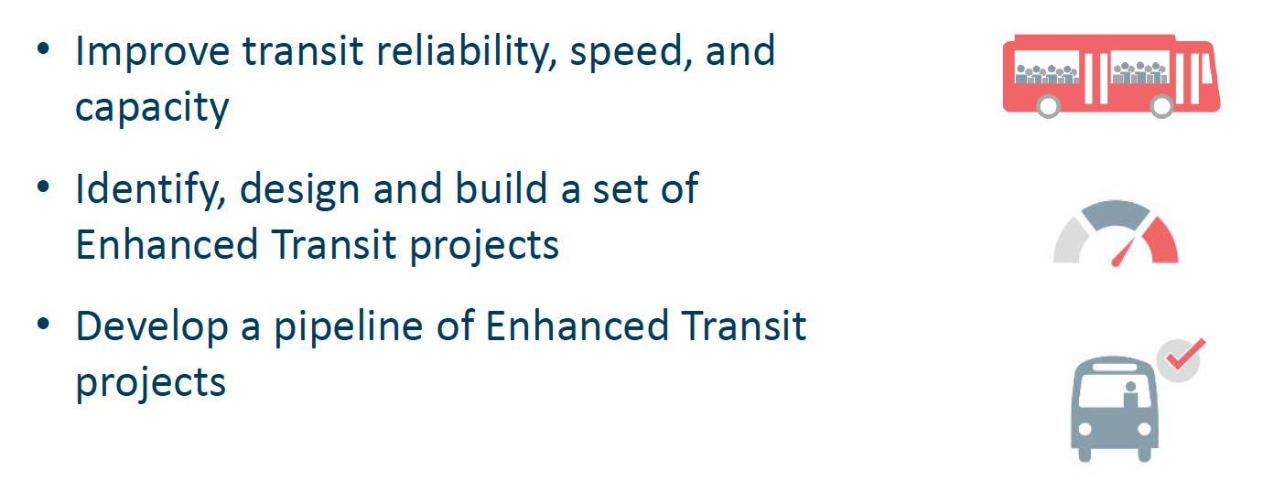
Regional Enhanced Transit Concept Pilot Program
Notes:
The charge of the pilot project will be to develop an initial pipeline for potential ETC projects. The premise is that these projects will support improvements to benefit transit reliability, speed, and capacity.
Note that these are very similar to the goals of what the local ETC Plan has tried to do, but applied at the regional level

Slide 44
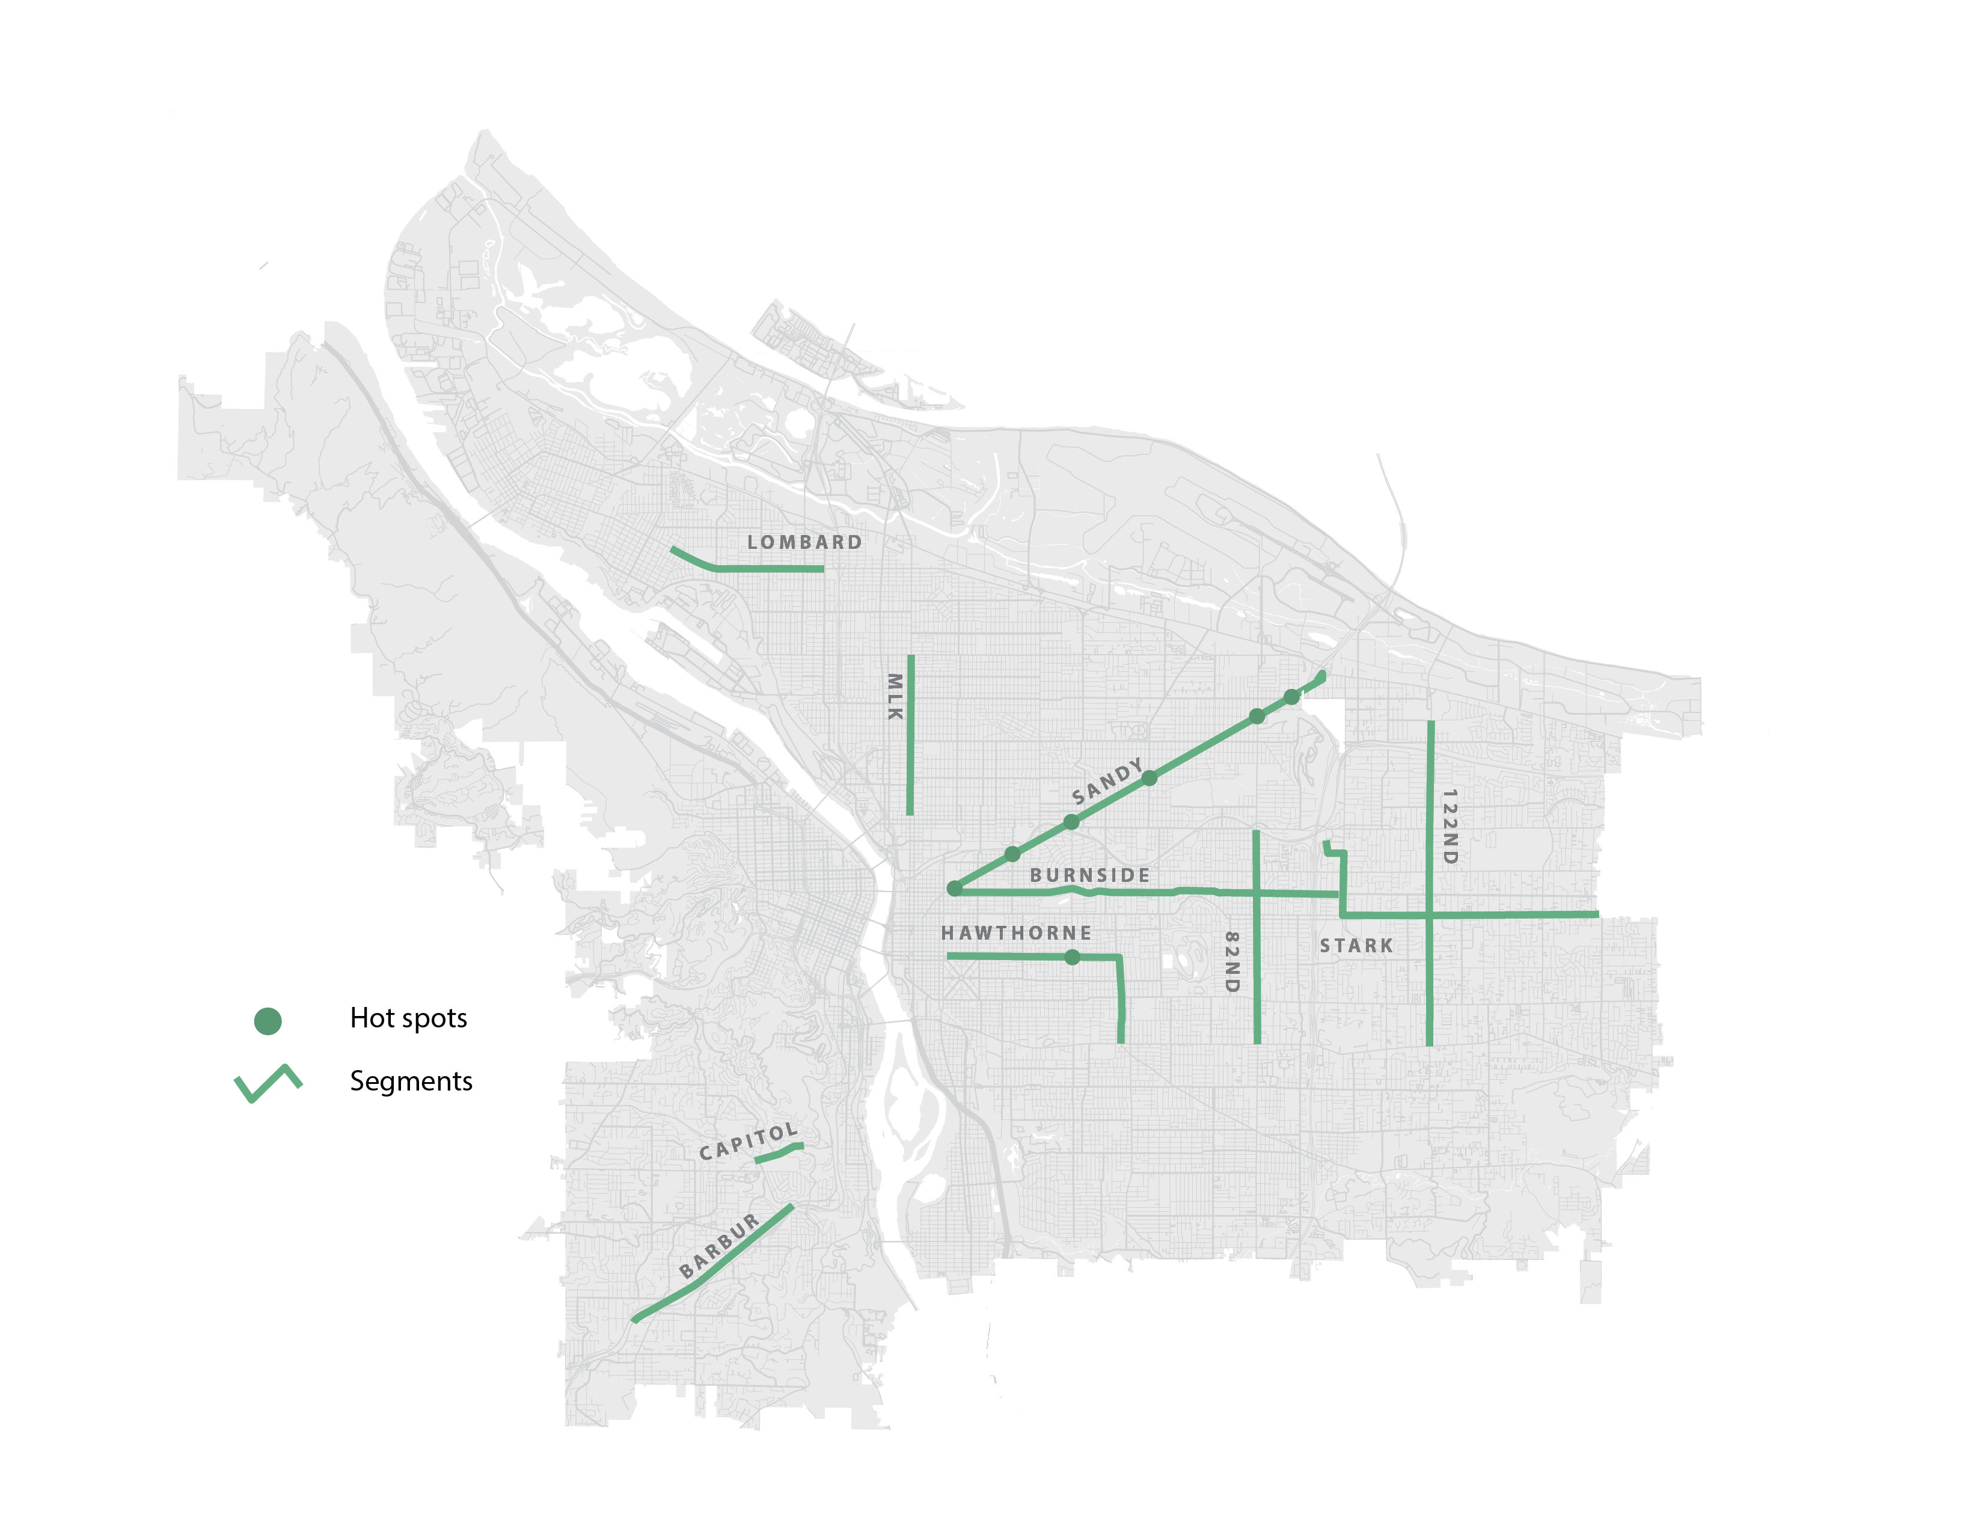
Exhibit B
Portland Outside Central City
Regional ETC Pilot Program
Candidate Enhanced Transit Locations
For Submittal

Slide 45
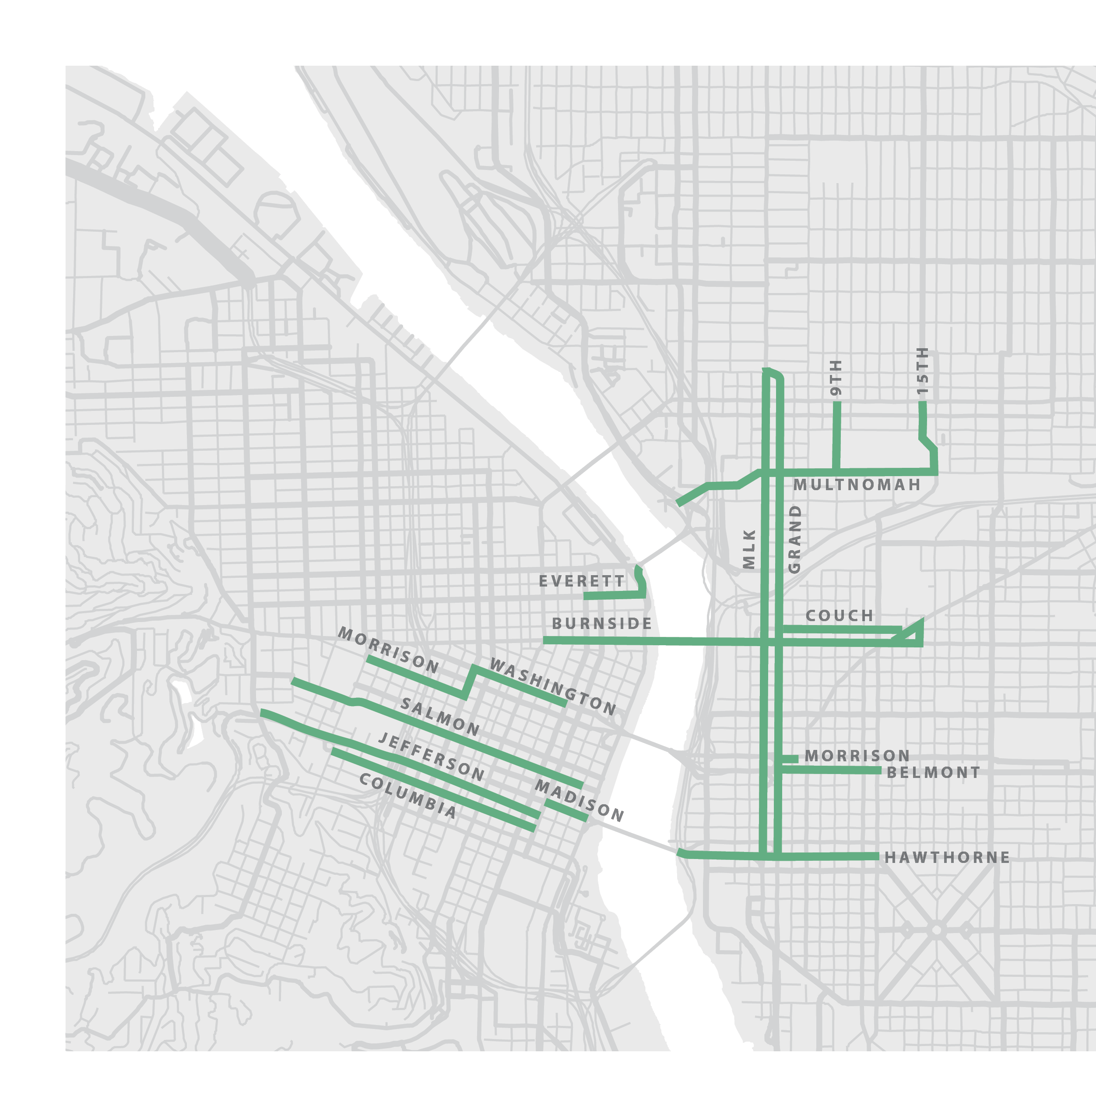
Exhibit B
Portland
Central City
Regional ETC
Pilot Program
Candidate Enhanced Transit Locations
For Submittal

Slide 46
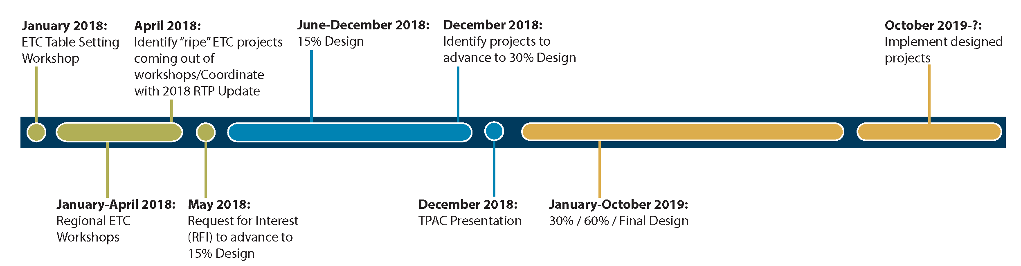
Regional Enhanced Transit Concept Pilot Program
We Are Here
Notes:
We are at the beginning of the process, and are at the stage of introducing the regional concept to partner jurisdictions
The next major milestone will be to conduct a series of (14) workshops to review potential ETC solutions in corridors and corridor segments throughout the region. This early work will inform a near-term implementation workplan and integration into the Metro RTP.
Once these near-term projects are identified, TriMet will issue an RFI to select segments and ETC solutions to be studied further, up to 15% design

Slide 47
Recommended Council Actions:
Adopt the Enhanced Transit Corridors Plan
Endorse a list of Enhanced Transit candidate project locations for submittal to the Metro Regional Enhanced Transit Concept Pilot Program to help advance project development
Notes:
Also note how this process will be applied to segments outside of Portland Central City

Slide 48
Thank you!
Learn more.
www.portlandoregon.gov/transportation/ETCplan

Slide 49
Additional slides to have on hand
Notes:
April

Slide 50
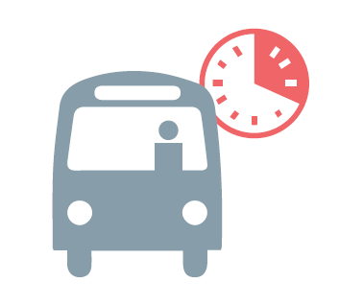

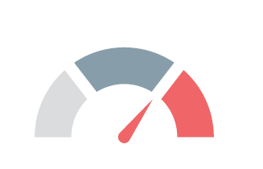
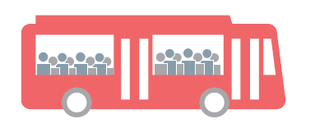
Initial Evaluation: Criteria and Measures
Ridership: Average Existing Weekday Transit Trips
Reliability: Delay due to traffic congestion
Transit Speed: Where buses are slower all day
Dwell Time: When the doors are open at bus stops
Equity: Higher number of People of Color, Low Income, Limited English Proficiency
Growth: Forecasted increase in population and jobs
Notes:
Transit Performance
Average Existing Weekday Transit Trips (FTA Warrants methodology): Average weekday passenger load entering the corridor and stop-level boardings along the line
Reliability: Percent difference between 90th and 10th percentile operating speed
Transit Speed: Average operating speed (exclusive of dwell time) proportional to the posted speed limit
Dwell Time: Average dwell time (time spent stopped at bus stops) proportional to average runtime
Equity and Future Growth (2010 – 2035)
Equity: Composite index score for three demographic factors:
Percentage of people of color
Low income populations (200% poverty level)
Limited English proficiency (LEP) households
Note: Index score also considers City-wide averages (define)
Forecasted Households and Job Growth
Based on 2035 Comprehensive Plan Growth Scenario

Slide 51
2. 20-year Regional Transit Vision with strong ETC component and nimble implementation
  Identify an initial network of Enhanced Transit Corridors
  Integrate ETC into a New Transit Vision
  Recommend adding several projects to the RTP and TSP
  Accelerate implementation of ETC treatments along both short segments and longer corridors
  Identify new funding sources and combine investments with TriMet increases in transit service
Notes:
Potential Performance Metrics:
Customer experience
Delay
Reliability
Frequency
Efficiency/cost effectiveness of service
Capacity
Speed
Cost to operate service over time
Support Planned Growth and Equity
Transportation System Benefits
Severity of problem
magnitude of benefit & scale of treatment

Slide 52
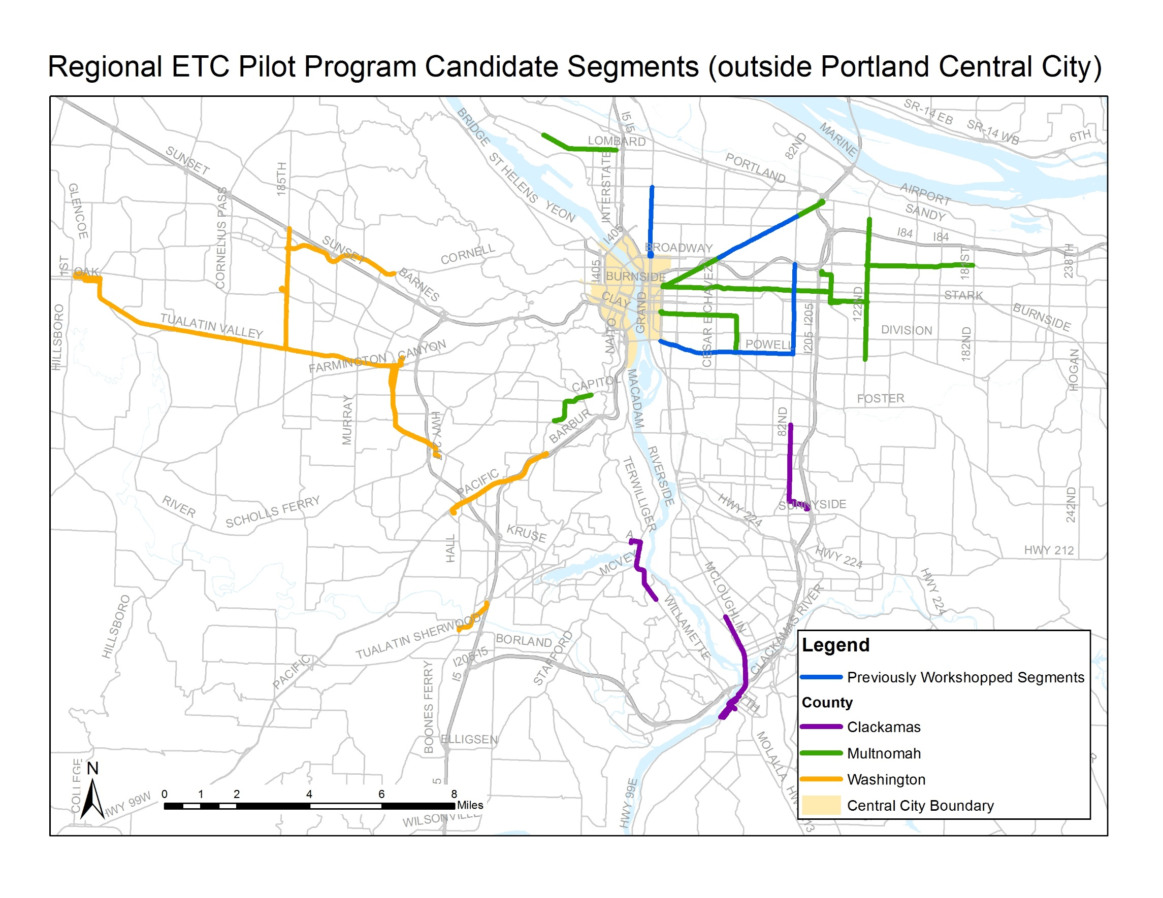
Additional Workshop Candidate Segments (outside Portland Central City)
Notes:
Also note how this process will be applied to segments outside of Portland Central City

Slide 53
Workshop Segments (within the Central City)
Notes:
These segments were selected using a very similar methodology to what we did in the ETC Plan, but focused on segments that this plan did not focus on.
These segments are important from a regional level since so many bus lines begin or end in the Central City
This also provided an opportunity to integrate ETC considerations into the Central City In Motion Plan/Project and Streetcar. The City will look for ETC opportunities within the Central City that are also supportive to other modes

Slide 54
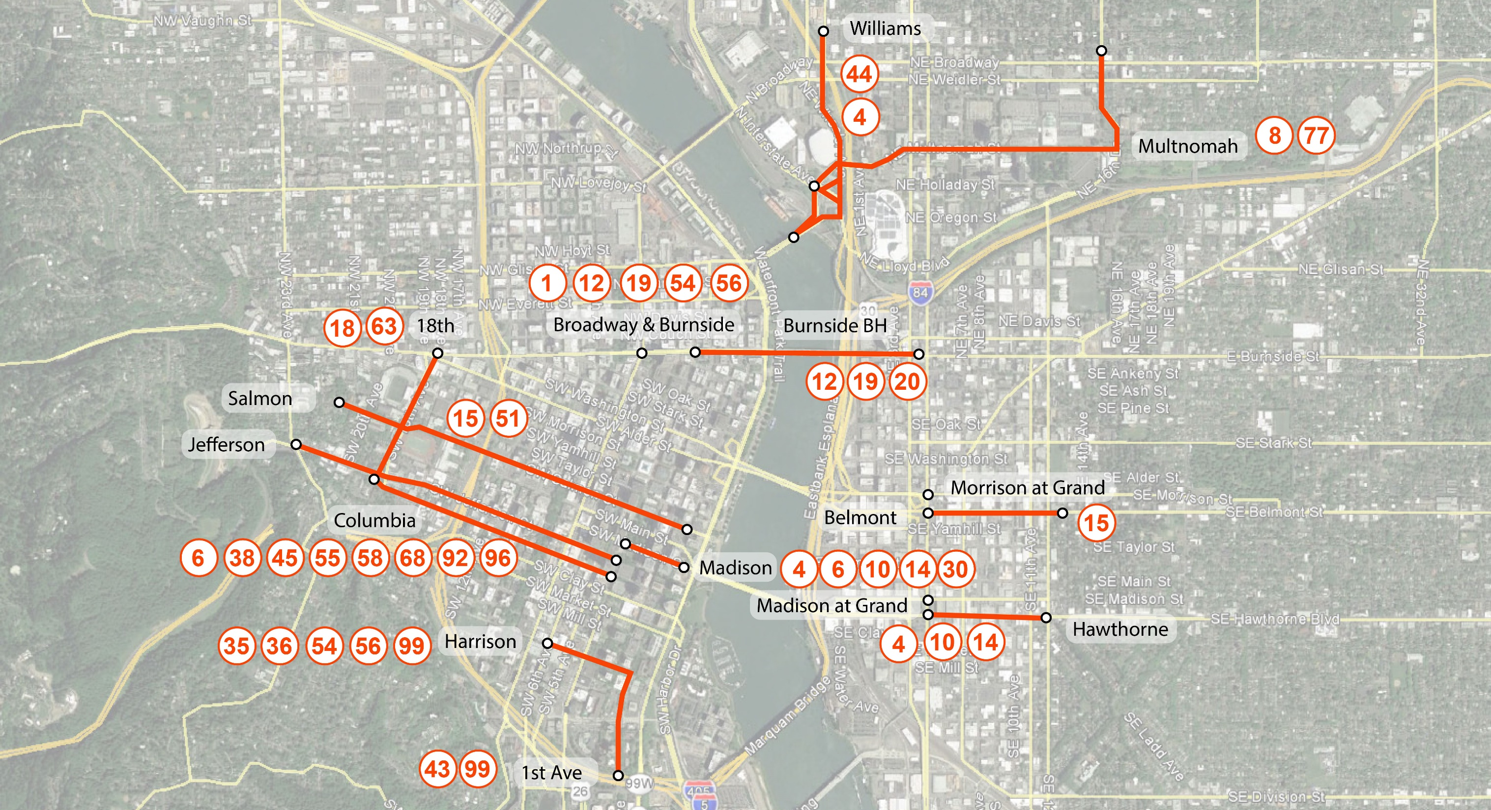
OVERLAP rETC/CCiM low stress bike
WEST SIDE
Madison
1st and Harrison
Salmon
Columbia
Jefferson
W. Broadway/Burnside
SW 18th NB and SB to Burnside
EAST SIDE
Rose Quarter/NE Williams
Multnomah from City Ctr
Hawthorne EB
Madison at Grand WB
Belmont EB
Morrison at Grand WB
Burnside Bridge
Portland Central City
Segments
OVERLAP rETC/CCiM low stress bike

Slide 55
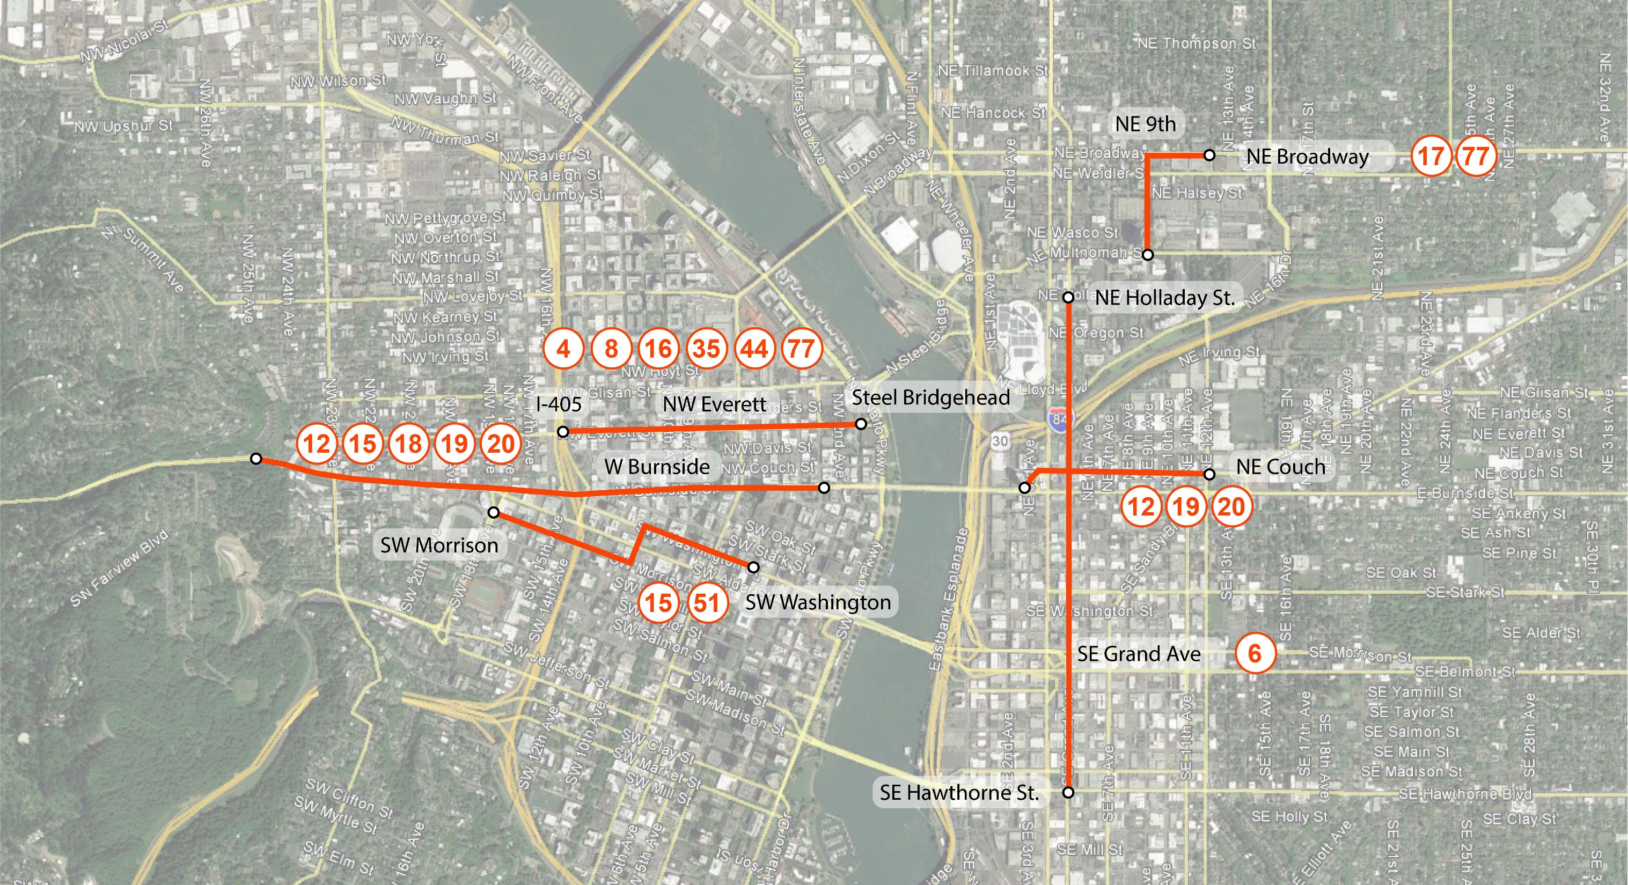
NO OVERLAP rETC/CCiM low stress bike
WEST SIDE
NW Everett
W Burnside
SW Morrison/Washington
EAST SIDE
NE 9th/Broadway
NE Couch
Grand
Portland Central City
Segments
NO OVERLAP rETC/CCiM low stress bike

Slide 56
122nd Avenue Plan:
Safety, Access and Transit
Develop a multi-modal conceptual investment plan.
Identify any cross-section changes.
Apply the Enhanced Transit Toolbox where feasible.
Identify a subset of priority project improvements to build with the remaining FOS funds for 122nd Ave and any additional funding secured.
Identify other recommended improvements for future projects to seek funding.

Slide 57
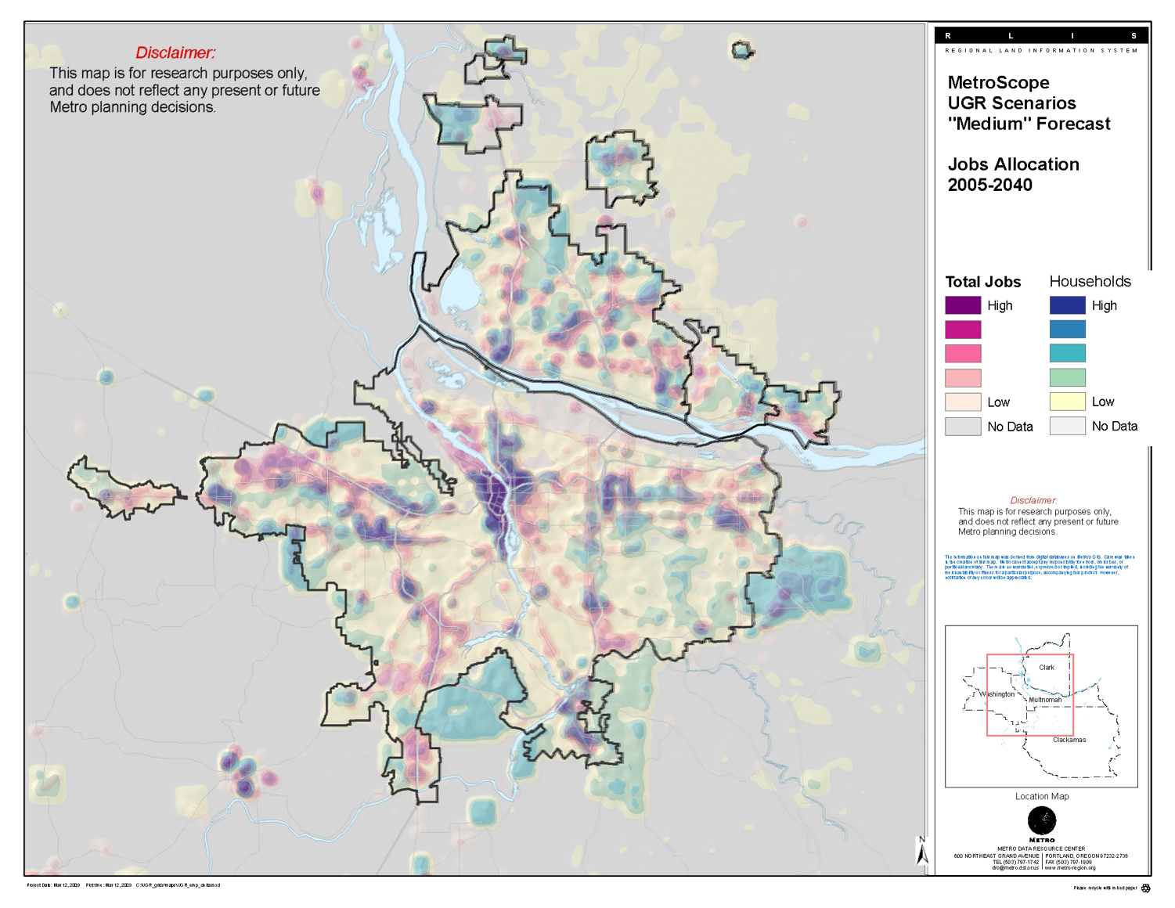
Central City in Motion
Increase Safety: 20 of the top 40 high crash intersections for walking and biking are within the project area
Accommodate Growth: By 2035, the Central City is expected to have 37,000 new household & 51,000 new jobs
Prioritize Transit: Provide time savings for commuters using TriMet in peak hours
Define clear bicycle network: the Central City lacks clearly defined routes for people of all ages and abilities to bike on
Clarify PBOT’s strategy: Stakeholders and the public expressed concern that PBOT wasn’t looking at the whole picture in making active transportation improvements in the Central City, particularly for the bike network.
Notes:
Why are we doing it? 5 key reasons

Slide 58
Recent Community Stakeholder Engagement
February 19: Public Open House
Feb 26 - March 26: Online Survey
February - April: Visit various stakeholder groups and committees
            OPAL Bus Riders Union
            Portland Bus Lane Project
            Businesses for a Better Portland
            NECN Land Use and Transportation Committee
            East Portland Land Use and Transportation Committee
            Bicycle Advisory Committee
            Pedestrian Advisory Committee
            PBOT Bureau and Budget Advisory Committee
            Portland Business Alliance
Notes:
Potential Performance Metrics:
Customer experience
Delay
Reliability
Frequency
Efficiency/cost effectiveness of service
Capacity
Speed
Cost to operate service over time
Support Planned Growth and Equity
Transportation System Benefits
Severity of problem
magnitude of benefit & scale of treatment

Slide 59
Portland’s ETC Plan Purpose
Identify where transit priority, streamlining, and access treatments could be most beneficial to improve transit reliability, travel time and capacity.
Help buses and streetcars be less stuck in traffic.
Help make transit a more attractive option for people to get to work, school, and to meet their daily needs, especially for people who depend upon transit.

Slide 60
ETC Plan Goals
Increase transit ridership and improve experience of current riders
  Help buses and people arrive on time
  Faster transit trips
  Not miss transfers
  Passengers not passed by late, over-crowded buses
Support equity goals
  Dependable transit is especially important for shift workers with strict start time policies.
  Faster transit helps people with longer trips, who may live further from work.
Support planned growth consistent with the 2035 Portland Comprehensive Plan

Slide 61
ETC Plan Outcomes
Define “Enhanced Transit” and a toolbox.
Identify where it is most needed.
Establish an on-going program and performance measures to define what success looks like.
Guide prioritization of investments.
Forge deeper partnerships and coordination with TriMet.
Help make all transit riders count!

Slide 62
ETC Plan Recommendations
New Approach and New Vision for Transit, including Enhanced Transit
Policy Recommendations, Actions and Next Steps
Enhanced Transit Monitoring Program and on-going performance

Slide 63
What could this mean for PBOT?
  Introduce new performance measures.
  Integrate transit priority treatments into design guidance; Complete Streets and future Streets 2035 guide.
      Multi-modal interaction
      Making trade-off decisions for allocating space and time on constrained streets
  Integrate transit priority treatments into project scoping and design.
      Add to Capital Improvement Projects
      Add to Asset Preservation Projects, such as paving and signal upgrades
      More small projects for Maintenance Operations crews
  Inform Development Review requirements for private development.
      Frontage improvements
      Multi-modal LOS
      Construction mitigation/ Traffic Control Plans
Notes:
Potential Performance Metrics:
Customer experience
Delay
Reliability
Frequency
Efficiency/cost effectiveness of service
Capacity
Speed
Cost to operate service over time
Support Planned Growth and Equity
Transportation System Benefits
Severity of problem
magnitude of benefit & scale of treatment

Slide 64
Closer Looks:
Early Analysis with
ETC Toolbox
Closer look with ETC Consultant Team
(3 corridors)
Closer look through other upcoming plans/projects
Notes:
Select up to three corridors to explore applying the toolbox and develop conceptual investment plans:
Line 72 – Killingsworth/82nd Ave, with a focus on 82nd Ave
Line 12 – NE Sandy Blvd
Line 6 – MLK Jr Blvd/Jantzen Beach (if resources allow)
Potential opportunity to focus on portions of candidates through other planning efforts:
Line 73 - through the 122nd Ave Safety Improvement Project planning process
Line 20 - through an Outer SE Stark Safety and Access planning process
Key bottlenecks, including in the Central City

Slide 65
Three ETC segment Closer Look Outcomes
Identified some potential ETC tools in spot locations.
Identified general considerations and potential impacts to traffic access, circulation, diversion, on-street parking, multi-modal environment, private property, etc.
No formal project recommendations at this time.
Additional project development and analysis is needed to understand the full potential benefits and trade-offs.
The Regional ETC Pilot Project could provide such opportunity.
Note: Proposal pending further input and coordination with regional partners.
Notes:
Introduce Exhibit A. This is a candidate list of projects based on the proposed new vision for consideration in the RTP update.
I stress these are candidate projects for further analysis and vetting through the RTP update process.
Metro will lead the process for adopting final RTP projects and setting regional priorities.

Slide 66
Note: Proposal pending further input and coordination with regional partners.

Slide 67
Note: Proposal pending further input and coordination with regional partners.

Slide 68
Note: Proposal pending further input and coordination with regional partners.

Slide 69
TSP Policy 9.6 –
Regarding the transportation strategy for people movement
Implement a prioritization of modes for people movement by making transportation system decisions according to the following ordered list:
  1. Walking
  2. Bicycling
  3. Transit
  4. Taxi / commercial transit / shared vehicles
  5. Zero emission vehicles
  6. Other single‐occupant vehicles
When implementing this prioritization, ensure that:
  The needs and safety of each group of users are considered, and changes do not make existing conditions worse for the most vulnerable users higher on the ordered list.
  All users’ needs are balanced with the intent of optimizing the right of way for multiple modes on the same street.
  When necessary to ensure safety, accommodate some users on parallel streets as part of a multi‐street corridor.
  Land use and system plans, network functionality for all modes, other street functions, and complete street policies, are maintained.
  Policy‐based rationale is provided if modes lower in the ordered list are prioritized.
Notes:
Potential Performance Metrics:
Customer experience
Delay
Reliability
Frequency
Efficiency/cost effectiveness of service
Capacity
Speed
Cost to operate service over time
Support Planned Growth and Equity
Transportation System Benefits
Severity of problem
magnitude of benefit & scale of treatment

Slide 70
REGIONAL TRANSIT SPECTRUM
Mixed traffic
Priority treatments
Exclusive guideway
Service Enhancement Plans/Master Plans
Tram
Local buses
Regional bus
Frequent Service bus
Enhanced Transit
Streetcar
Corridor based Bus Rapid Transit
Bus Rapid Transit
Rapid Streetcar
Light Rail
High Capacity Transit
Regional Transit Spectrum
Commuter Rail

Slide 71

Framework for Transit Monitoring Program & On-going Performance
Step 1: Identify the network universe
Step 2: Monitor Triggers to Talk
Step 3: Diagnose the kind of delay
Step 4: Apply ETC Toolbox
Step 5: Prioritize Investments and Implement
Step 6: Evaluate for success and on-going need
Repeat
Notes:
Subset of trimet lines: Important point to make about the Universe of Option that go into the funnel each year: We will monitor the Planned Frequent Service Network of buses and streetcar lines, not just the candidates initially identified in the City’s ETC Plan or the Region’s ETC pilot program.
Identify needs and deficiencies (existing performance) using performance measures

Slide 72
Note: Proposal pending further input and coordination with regional partners.
Notes:
Introduce Exhibit A. This is a candidate list of projects based on the proposed new vision for consideration in the RTP update.
I stress these are candidate projects for further analysis and vetting through the RTP update process.
Metro will lead the process for adopting final RTP projects and setting regional priorities.

Slide 73
Triggers to Talk:
Make transit more efficient and reliable
  Transit Run Time Variability:
    Measures the day-to-day variability of each bus trip end-to-end.
    Identifies deficiencies in reliability and need to add additional resources (operators/vehicles) to maintain schedule and be dependable.
    Measure at the route level.
Notes:
Potential Performance Metrics:
Customer experience
Delay
Reliability
Frequency
Efficiency/cost effectiveness of service
Capacity
Speed
Cost to operate service over time
Support Planned Growth and Equity
Transportation System Benefits
Severity of problem
magnitude of benefit & scale of treatment

Slide 74

Regional Transit Vision
Notes:
Through conversations between the City, Metro, and TriMet, enhanced transit has emerged as a key opportunity to support a region transit vision.

Slide 75



Regional Enhanced Transit Opportunities
Notes:
A key outcome of the ETC Plan has been its role in framing an approach for advancing Enhanced Transit regionally. The work we did as part of the ETC project was instrumental in getting TriMet and Metro talking about how to implement this in the broader region.

Slide 76
Key Outcomes of the Workshops
Identify potential conceptual improvements in these corridors for future study and project development.
Identify potential benefits, constraints, impacts, trade-offs and considerations.
Determine which segments to advance to 15% design and to potentially include in project list for the Metro RTP 2018 Update
Determine which potential ETC projects to place in an ETC project pipeline for additional study and refinement

Slide 77

Notes:
Freedom means freedom to choose.
But we have choices and opportunities only if we can get to them.
The City is growing denser.
But the space available for travel can’t grow with population.

