Slide 1
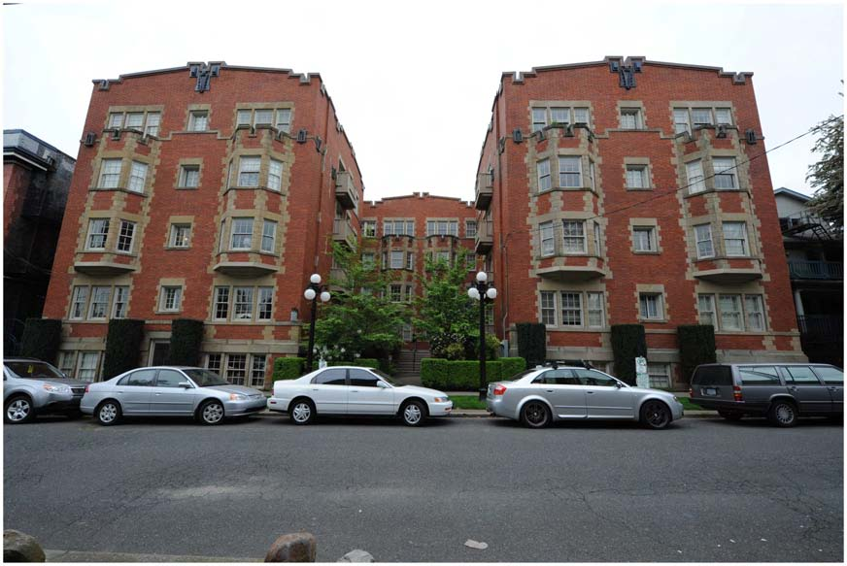
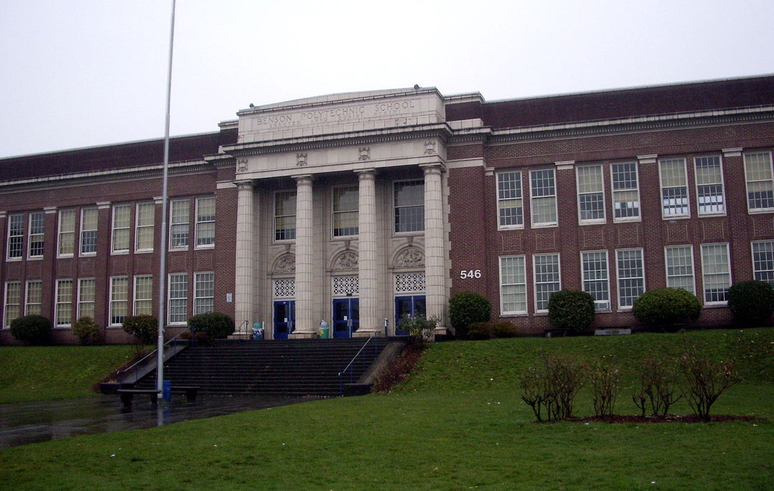
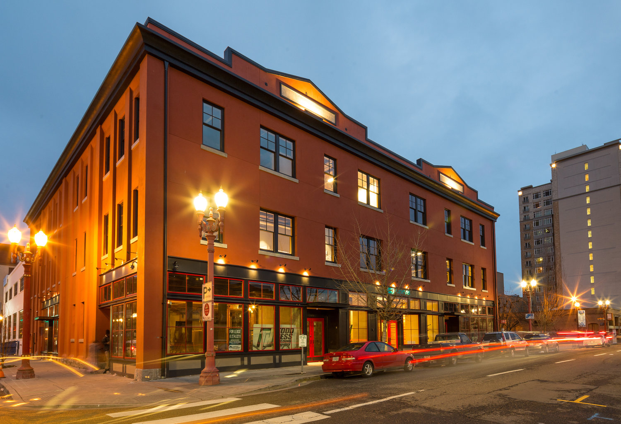
Unreinforced Masonry Building
Seismic Retrofit Policy
Jonna Papaefthimiou, PBEM | Amit Kumar, BDS | Shelly Haack, Prosper Portland
May 9, 2018

Slide 2
URM Retrofit Policy Committee (Jan 2016 - Nov 2017)
Margaret Mahoney, Chair
Affordable Housing Consultant
Dennis Andersen*
St. James Lutheran Church
Hermann Colas
Colas Construction
Tom Carrollo
Beardsley Building Development
Jim Edwards
Portland First Christian Church
Matthew Eleazer
International Union of Bricklayers and Allied Crafts
Brian Emerick
Emerick Architects P.C. and
Historic Landmarks Commission
Sean Hubert
Central City Concern
Matthew Illias
Norris, Beggs & Simpson
Jonathan Malsin*
Beam Development
Walter McMonies
Masonry Building Owners of Oregon
Javier Mena
Portland Housing Bureau
Peggy Moretti
Restore Oregon
Tom Sjostrom
Building Owners and Managers Association
Jen Sohm
Portland Public Schools
Stephanie Whitlock
Bosco-Milligan Foundation/Architectural Heritage Center
Reid Zimmerman
KPFF Consulting Engineers
* Left committee before final meeting.

Slide 3
URM Retrofit Standards Committee (Jan – April 2015)
David Bugni, P.E., S.E.
David Bugni and Associates
Brian Emerick, A.I.A.
Emerick Architects P.C. and Historic Landmarks Commission
Mike Hagerty, P.E., S.E.
Structural Engineer
Ian Madin, M.S., R.G.
Oregon Department of Geology and Mineral Industries
Mark Tobin, P.E., S.E.
KPFF Consulting Engineers
Reid Zimmerman, P.E.
KPFF Consulting Engineers and Structural Engineers Association of Oregon
Notes:
Remind them they’ve seen this (Council date)?

Slide 4
URM Retrofit Support Committee (June – Nov 2015)
Walter McMonies
Masonry Building Owners of Oregon
Steve Rose
Bristol Equities
Tom Sjostrom
Building Owners and Managers Association
Mike Hagerty, P.E., S.E.
Structural Engineer
Jessica Engeman
Venerable Properties
John Tess
Heritage Consulting
Avi Ben-Zaken
Urban Development Partners
Kristen Conner
Capital Pacific Bank Finance
(now with Heritage Bank)
Colin Rowan
Malden Capital Finance

Slide 5
Presentation Overview
Risk Overview
URM Building Inventory
Policy Process
Recommended Retrofit Standard and Financial Support
Public Notification
Resolution Summary

Slide 6



Cascadia Subduction Zone Risk to the City of Portland
Chris Goldfinger
College of Earth, Ocean and Atmospheric Sciences, Oregon State University
Active Tectonics Group, Ocean Admin Bldg 104, Corvallis OR 97333

Slide 7
The Basics
Cascadia risks come from three earthquake sources:
1) The subduction zone: “The Really Big One”. Repeat time ~ 240 years. Evidence based on numerous land and marine sites with very good correspondence.
2) Subducted slab tension earthquakes, i.e. Nisqually 2001. M=~ 6-7, repeat time, a few decades in Washington, unknown in Oregon.
3) Crustal Faults, i.e. Portland Hills Fault, Oatfield Fault, 1962 Portland (~Vancouver) earthquake (fault unknown) etc. M= 4-7, repeat time probably several thousand years for each fault, but could be a few decades for aggregate of all nearby faults. Poorly known.

Slide 8
Cascadia earthquake rupture modes.
31 of the 47 earthquakes represented here reach the latitude of Portland. Many others (16) occur further south, and will be felt in Portland, but may or may not cause damage.

Slide 9
The Really Big One
Cascadia has gone from unknown in 1985, to one of the best known faults in the world today. The basis for probability estimates is very strong.
Probability for affectin PDX is ~ 22-26% in the next 50 years (2017 Marine Geology paper), similar to Japan in 2011. These values are the minimum, and do not include the other two poorly known sources, or smaller (< M8) quakes offshore.
Magnitudes are highly variable, ranging from M7.1-M 9.2. M9 earthquakes are the most powerful events on Earth, dwarfing the largest volcanic eruptions, hurricanes and nuclear tests. Presently however, there is no way to estimate magnitude of the NEXT earthquake.
About half of the 46 earthquakes of the past 10,000 years are thought to be M 8.8 or greater, about half are smaller. About two thirds have reached the latitude of Portland.
The last great Cascadia earthquake was 317 years ago, and the average repeat time for M7.5 or greater earthquakes is ~ 240 years.

Slide 10
What will it be like in Portland?
For reference, the earthquake that destroyed San Francisco in 1906 was a M 7.9, at the low end for Cascadia. Much damage was also from fires which could not be put out. The comparison is not fair because the San Andreas is much closer to SF, only 1 mile. Portland is ~ 50 miles from the eastern end of the Cascadia rupture zone.
The long duration and larger magnitude of Cascadia earthquakes makes up for the distance, and may shake Portland for up to 4 minutes. Ground motions could exceed 0.3 G, well beyond the ability of URM structures to stay together. These structures are designed only for gravity and wind loads typically, that is, to not fall over on their own or in a breeze.

Slide 11
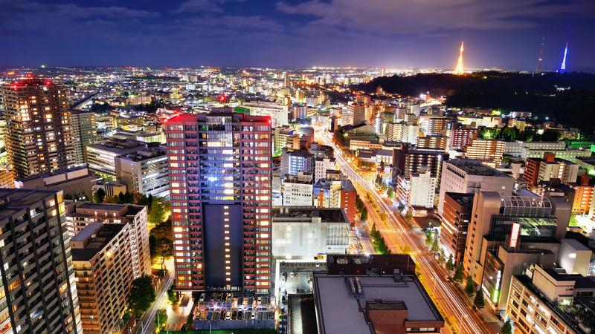
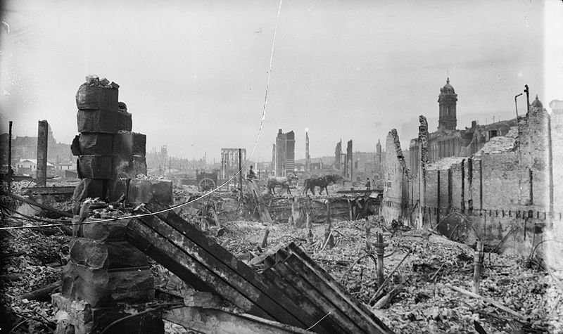
1906 San Francisco is a good analogy for Portland
Devastation after the 1906 San Francisco earthquake.
Photo taken by Arnold Genthe. http://www.mobileranger.com/uncategorized/shake-it-off-how-san-francisco-rebuilt-itself-fast/

Slide 13

URMs in Cascadia
Kent Yu, PhD, S.E.
Principal
SEFT Consulting Group, Beaverton Oregon
kentyu@seftconsulting.com

Slide 14
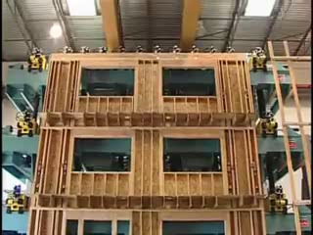
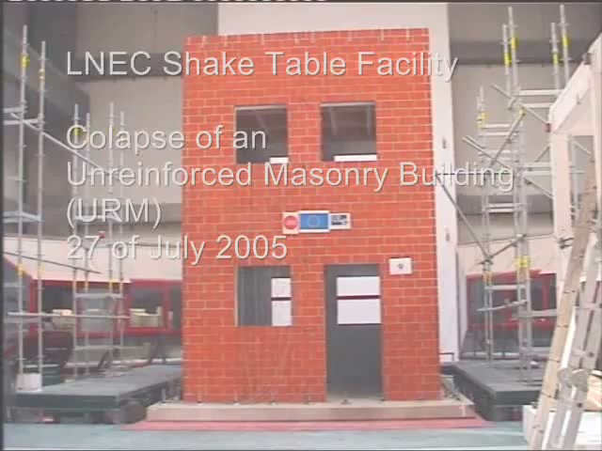
Wood Building vs. URM Building

Slide 15
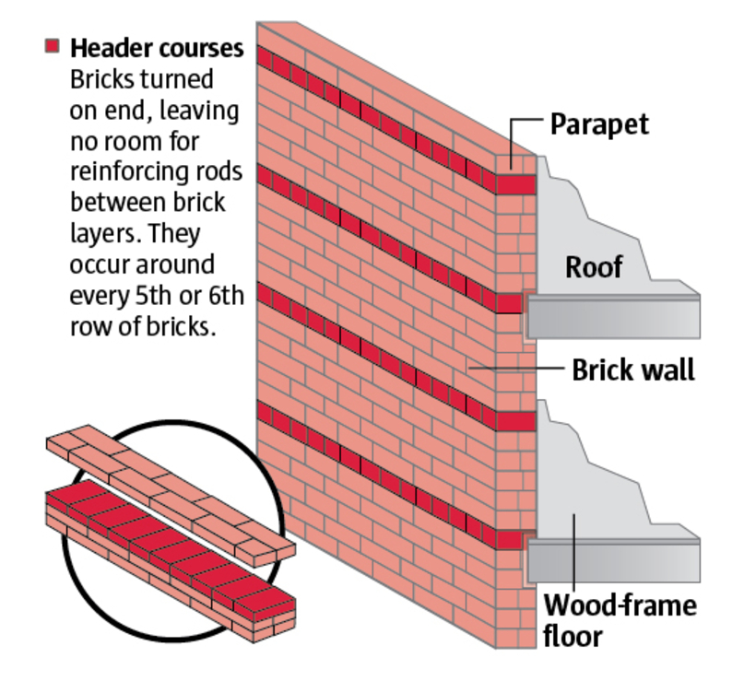
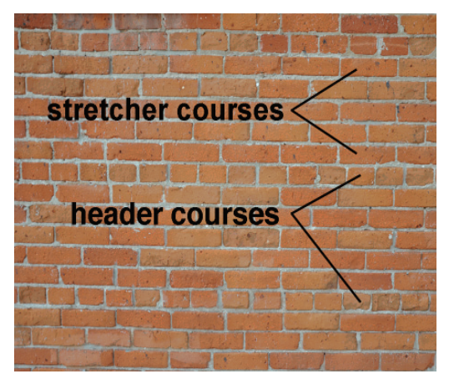
What is a URM?

Slide 16
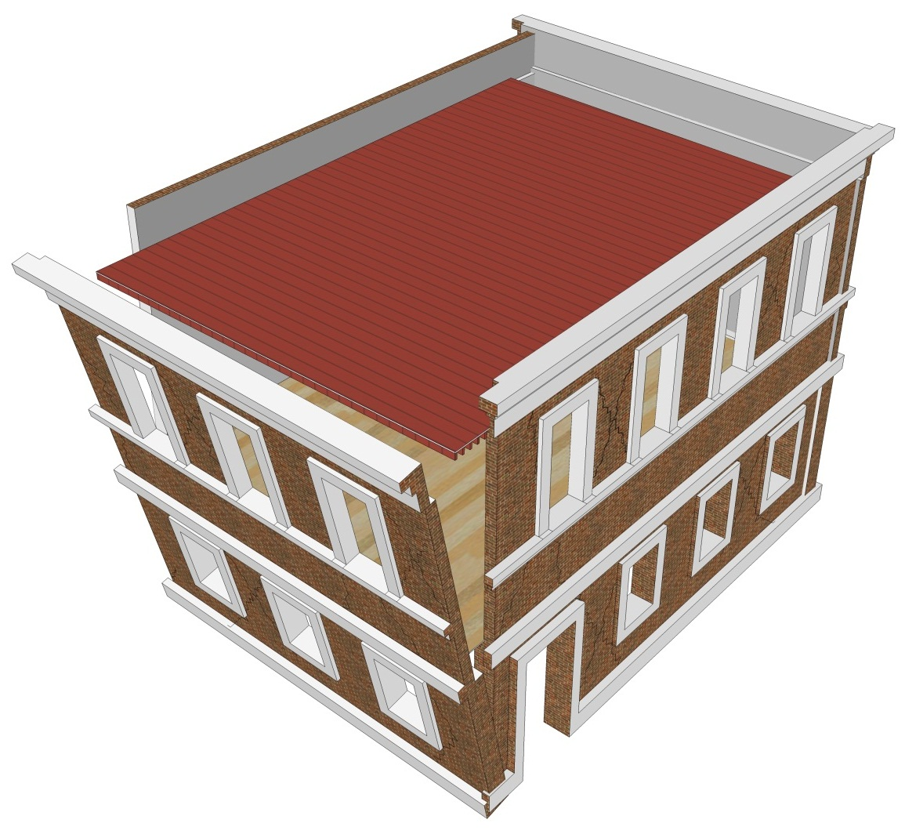
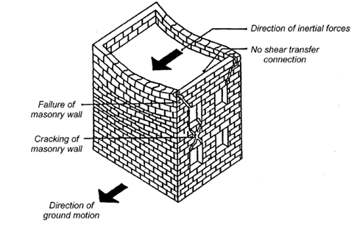
Seismic Load Path
Direction of inertial forces
Addition of shear transfer connectioequired
Direction of ground motion
LOAD PATH: OOP Walls >> Tension anchors >> Diaphragm >> Shear Anchors >> In-plane walls
Return wall separation and two way out-of-plane failure (FEMA 306, 1998)
(Courtesy of Prof. Jason Ingham, University of Auckland)

Slide 17
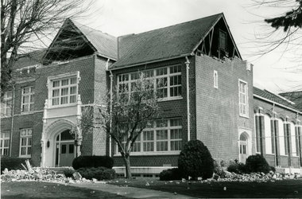
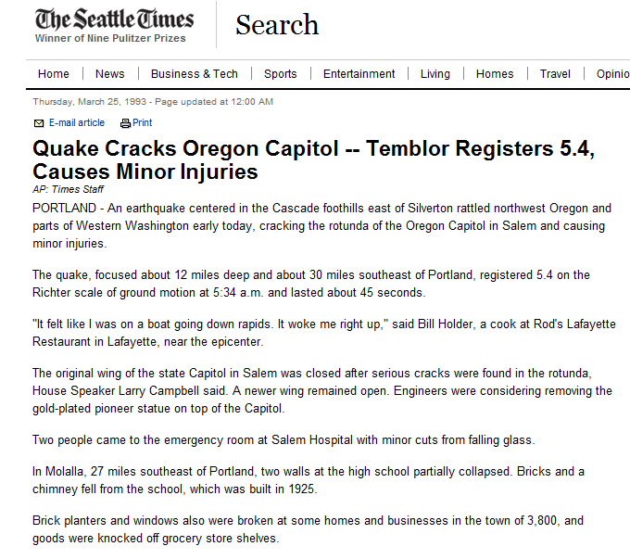
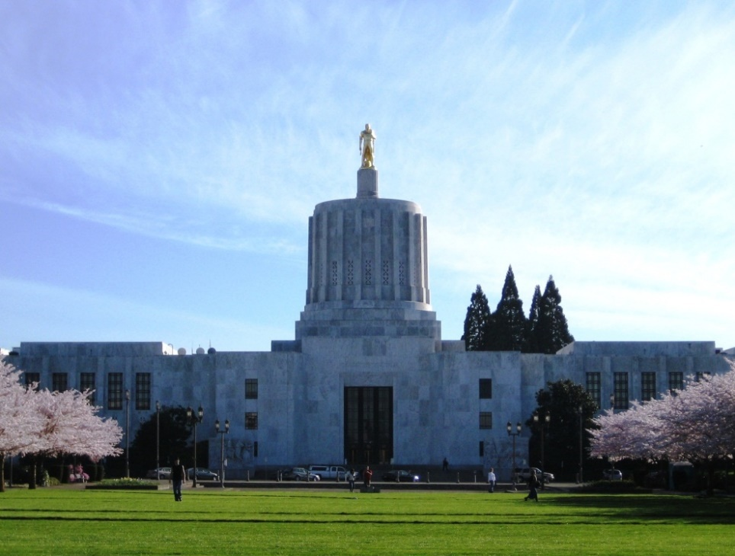
URM Performance in PNW Earthquakes
March 25, 1993 Scotts Mills Earthquake

Slide 18
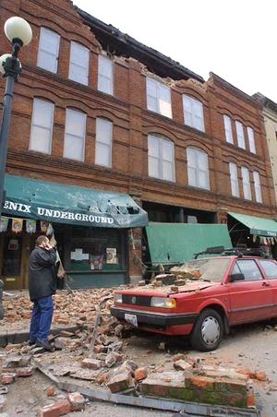
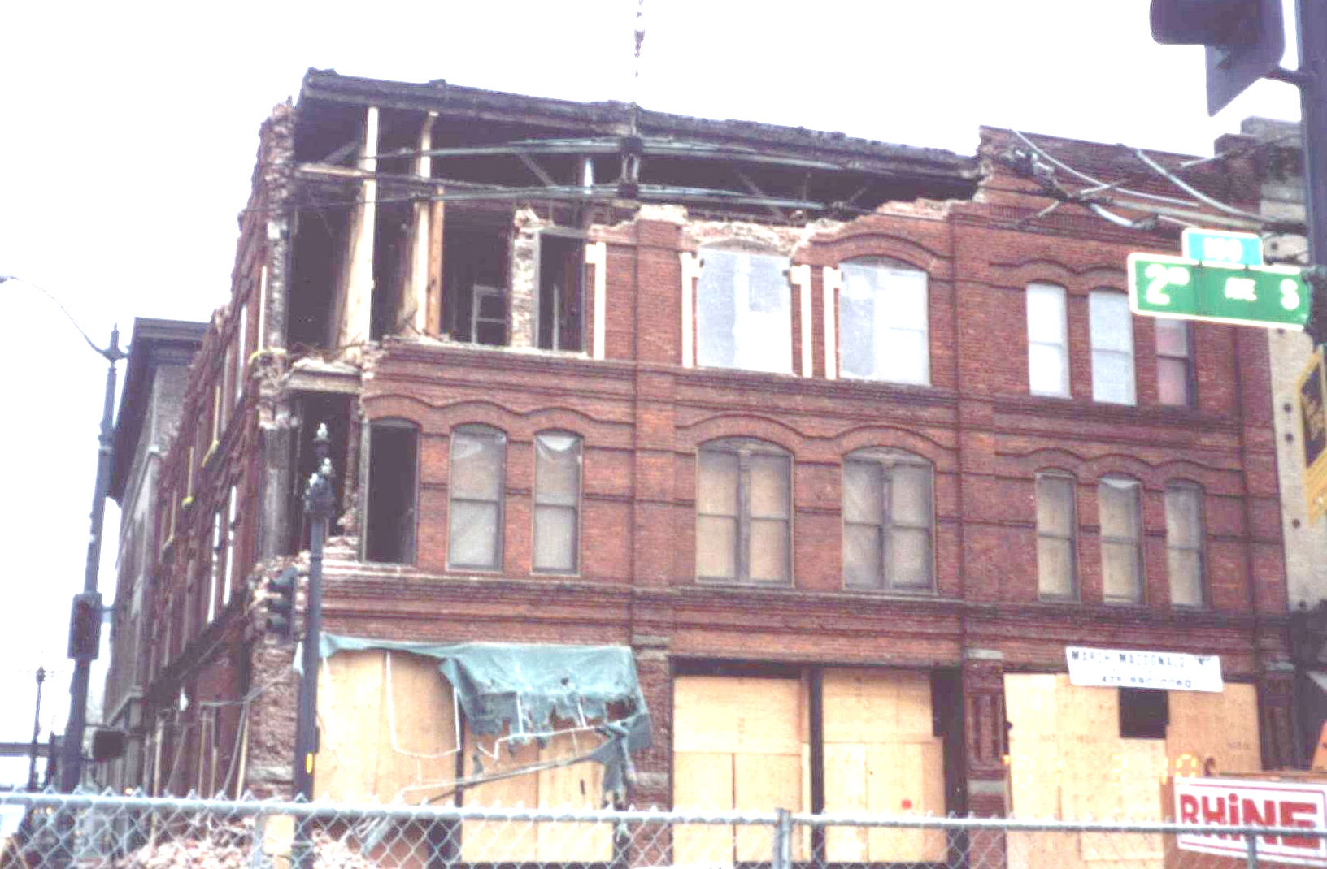
URMs in Nisqually

Slide 19
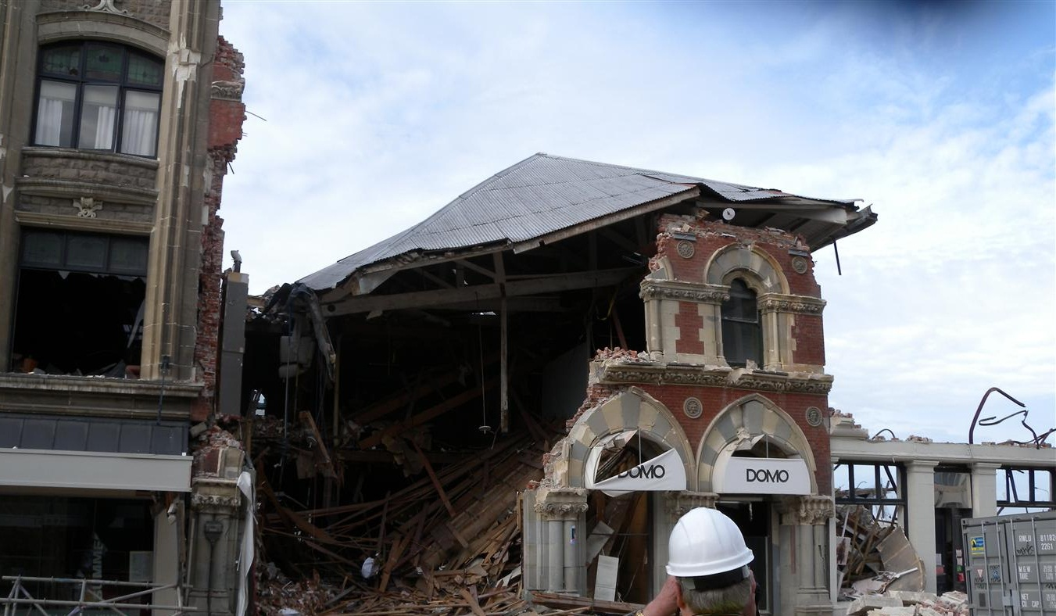
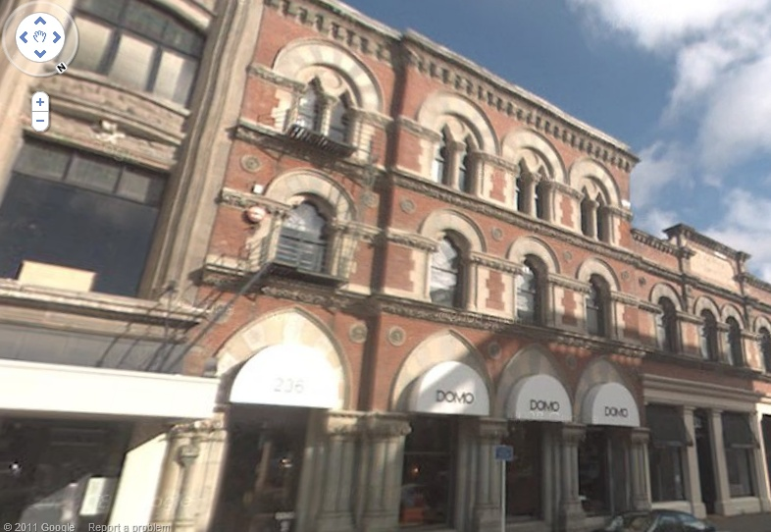
URM Commercial Buildings in Christchurch
(Courtesy of Cale Ash, Degenkolb Engineers)

Slide 20
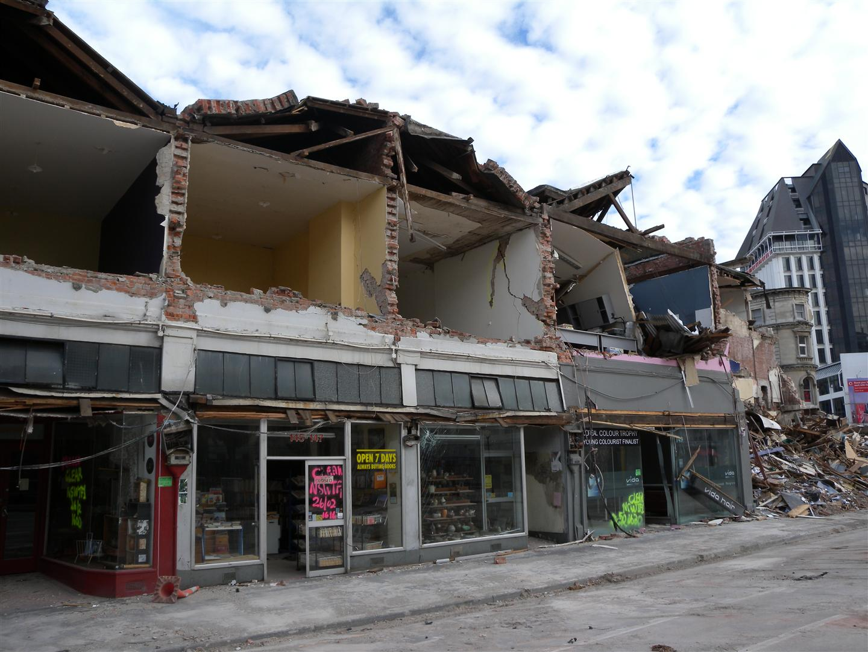
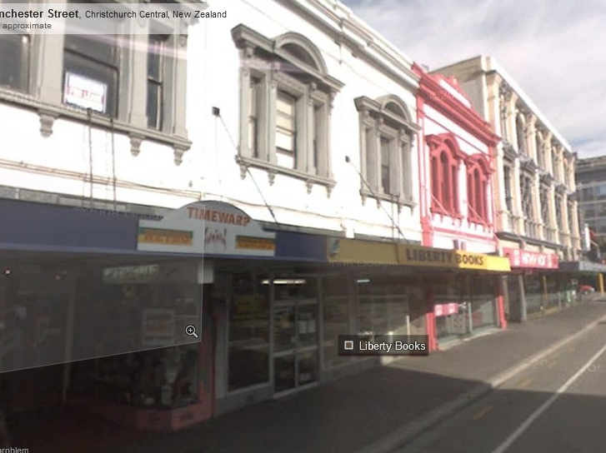
URM Commercial Buildings in Christchurch
(Courtesy of Cale Ash, Degenkolb Engineers)

Slide 21
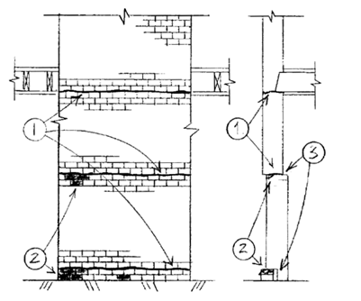

URM Out-of-Plane Bending
One-way bending (2 supports) is the lower bound value for situations where 3 or 4 edge supports may exist

Slide 22
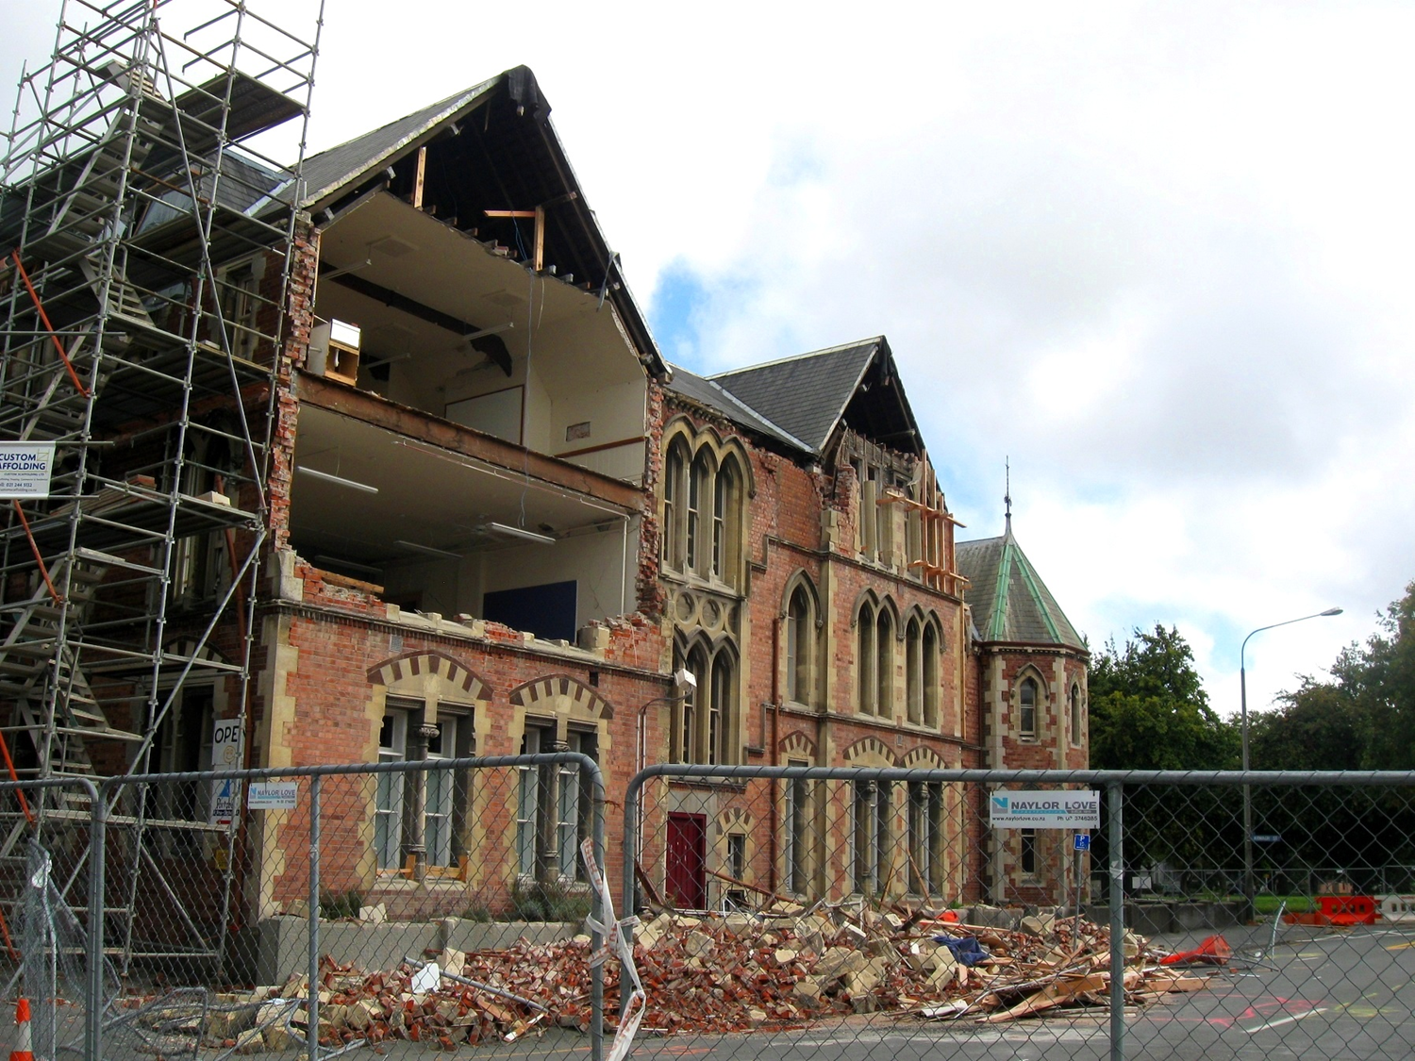
Vertical span is principally influenced by presence
or absence of (effective) wall-diaphragm anchorages
Note that corners
have fallen off
This is referred to
return-wall separation
(Courtesy of Prof. Jason Ingham, University of Auckland)

Slide 23
Vertical span is principally influenced by presence
or absence of (effective) wall-diaphragm anchorages
Note that corners
have fallen off
This is referred to
return-wall separation
(Courtesy of Prof. Jason Ingham, University of Auckland)

Slide 24
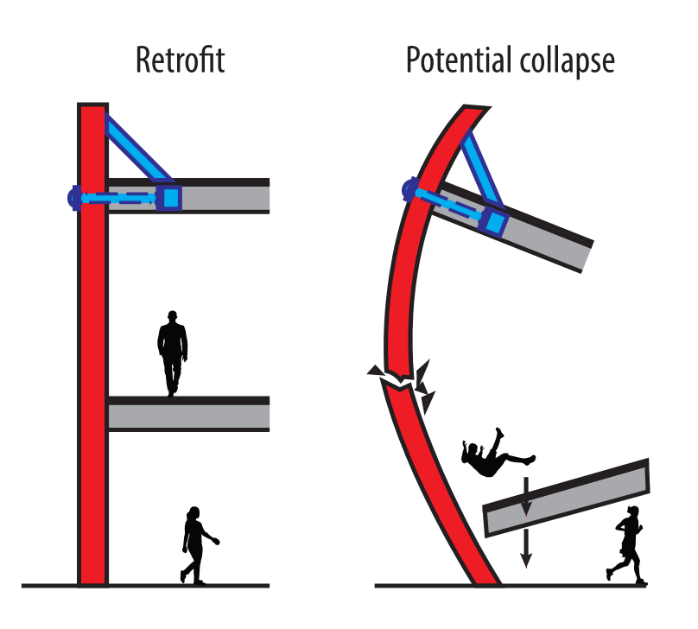
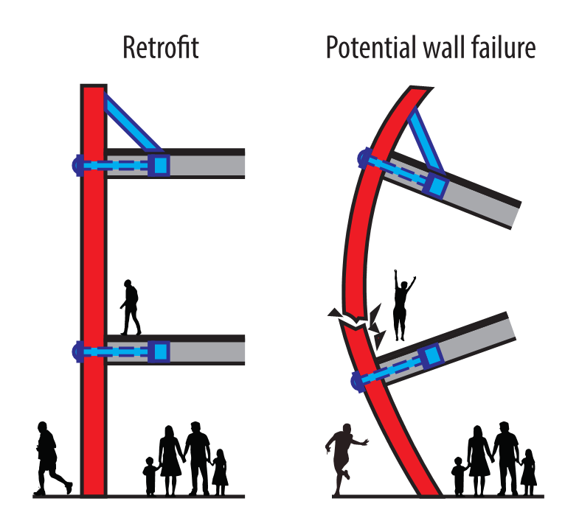
Level of Seismic Strengthening vs Performance

Slide 25
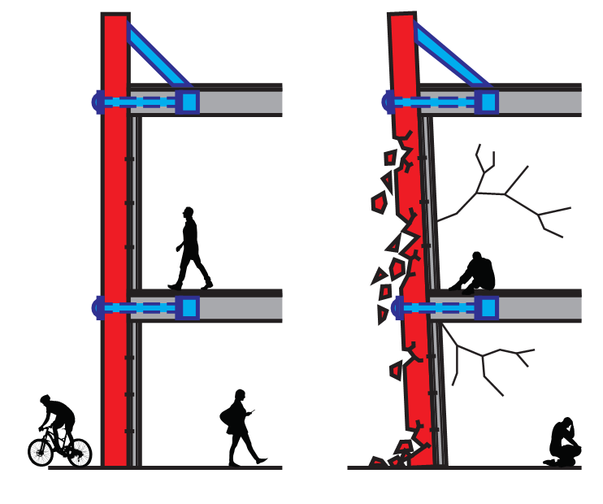
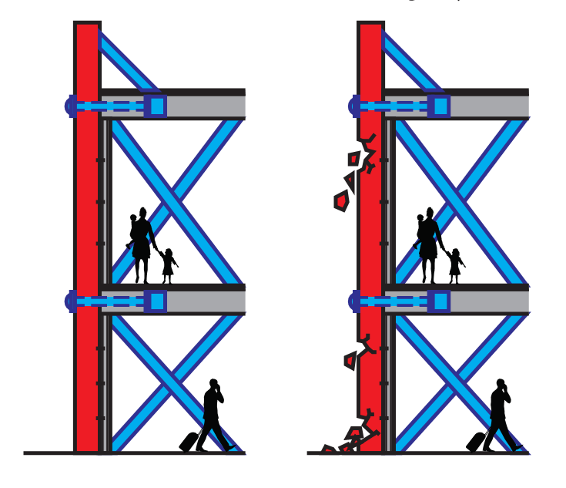
Level of Seismic Strengthening vs Performance

Slide 26
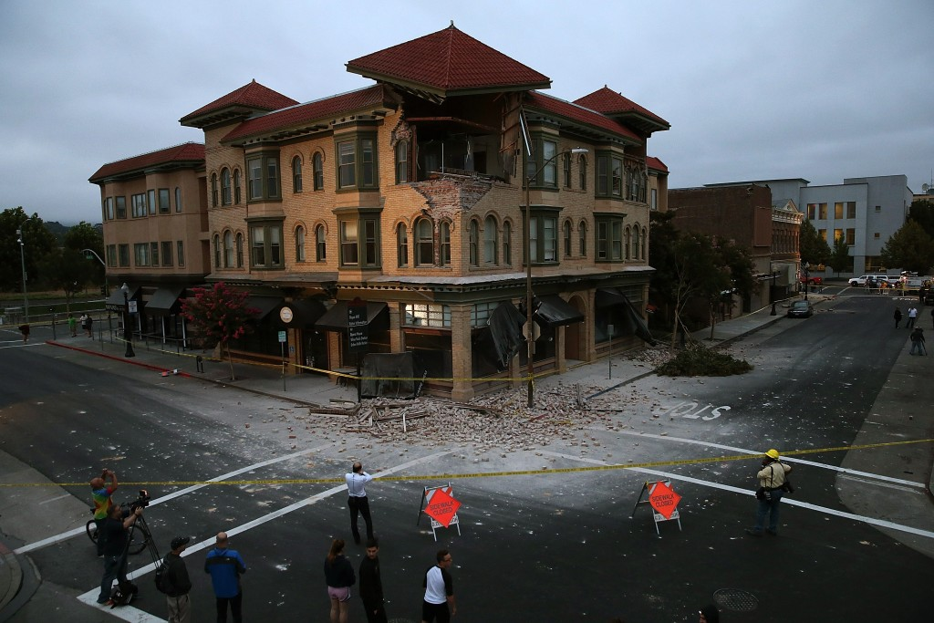
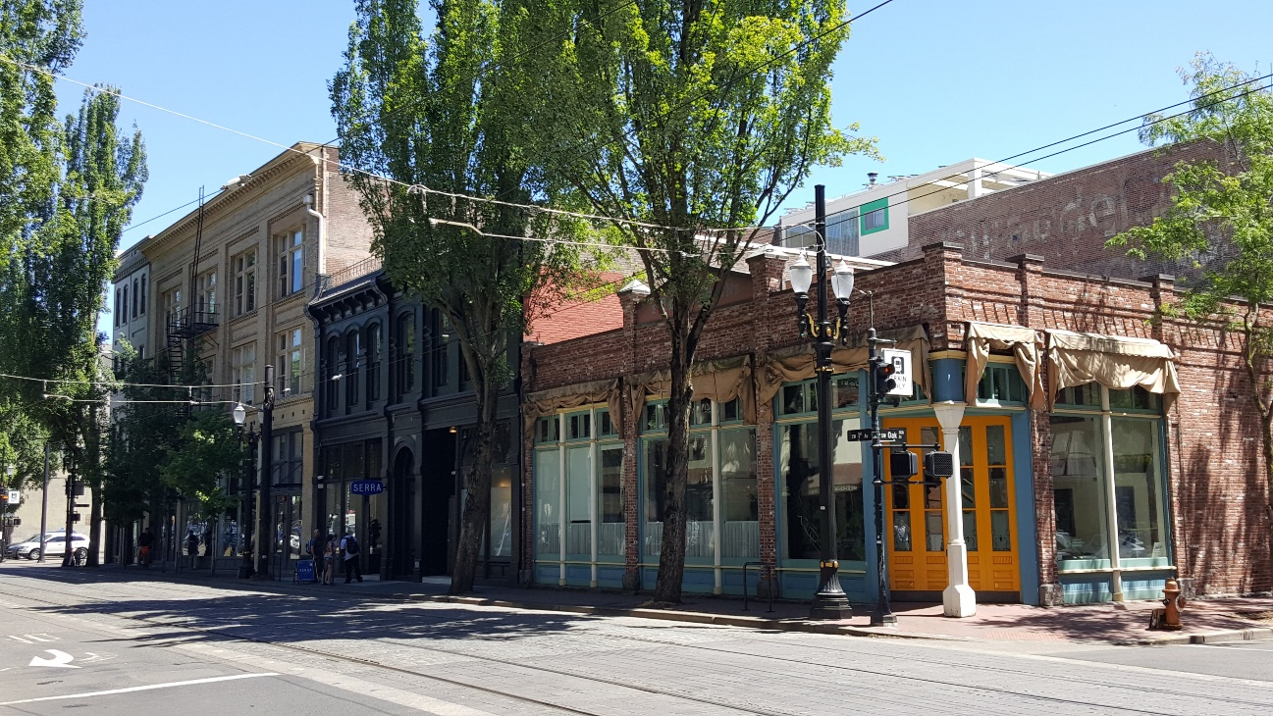
Why Act – Resilience Role
Light Rail Tracks
Source: Carmen Merlo
Notes:
1888

Slide 27
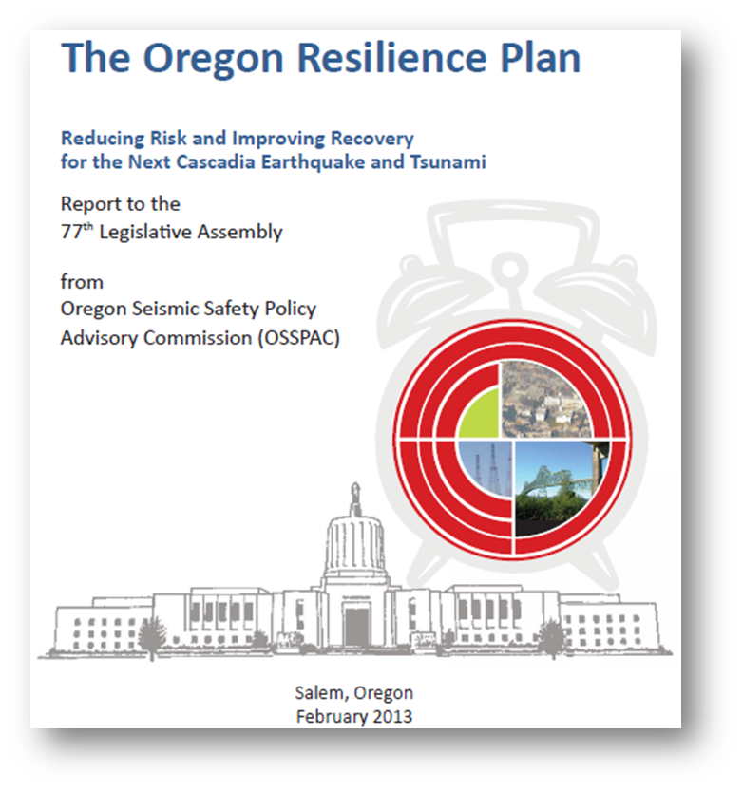
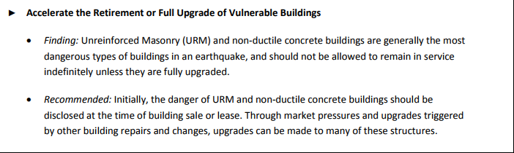
Why Act – Resilience Role
(Chapter 4 Critical and Essential Buildings)
Oregon Resilience Plan
Notes:
1888

Slide 28
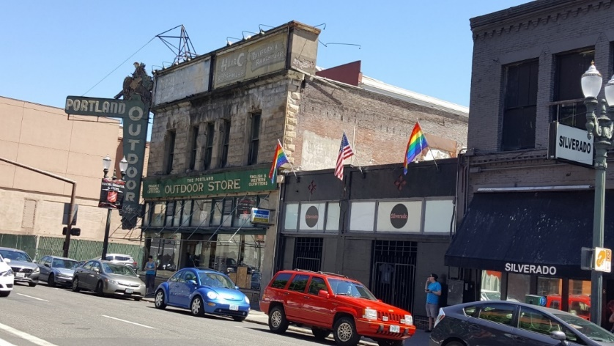
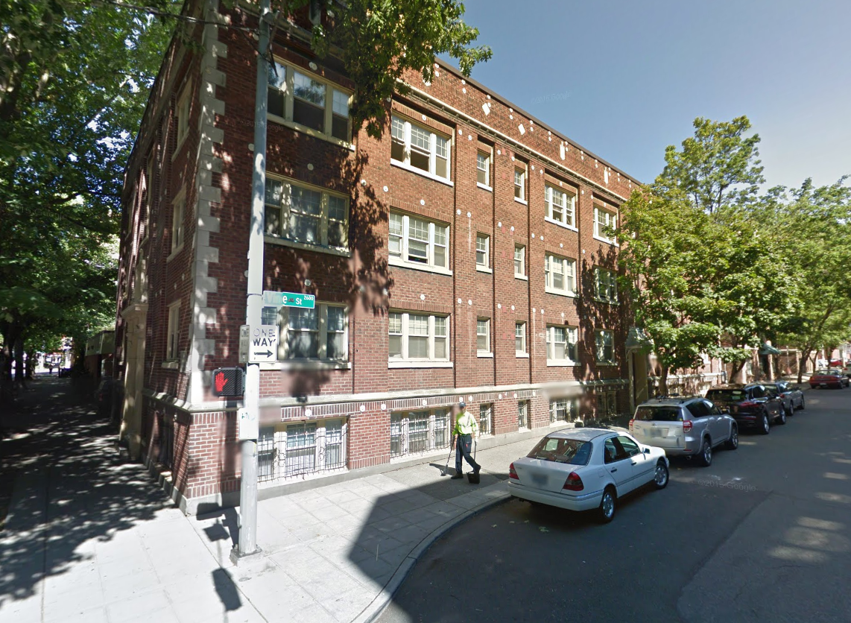
Conclusions
URMs house a variety of critical services & businesses in Cascadia
Earthquake performance is well-documented
Variety of retrofit options exist with varying performance level
Life safety and response and recovery for our community

Slide 29
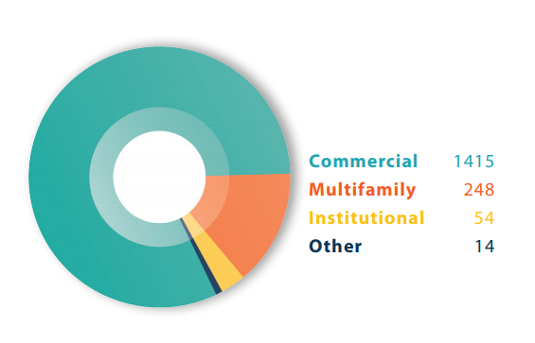
URM Buildings in Portland
Inventory
URM Buildings by Use
About 1,650 URM buildings (9% of building stock)
About 7,200 residential units
About 40 URMs City-owned
Commercial 1415
Multifamily 248
Schools and 54
community centers
Other 14

Slide 30
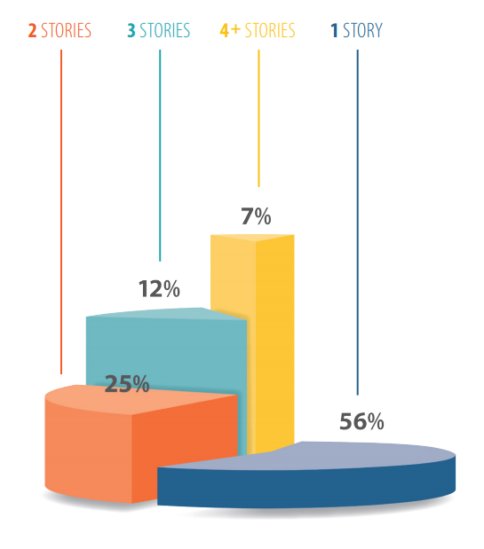
URM Building Characteristics
Inventory
URM Buildings by Height
Average age 89 years
About 567 historic buildings
More than half single-story
Notes:
NW, Buckman, Downtown, Old Town Chinatown

Slide 31
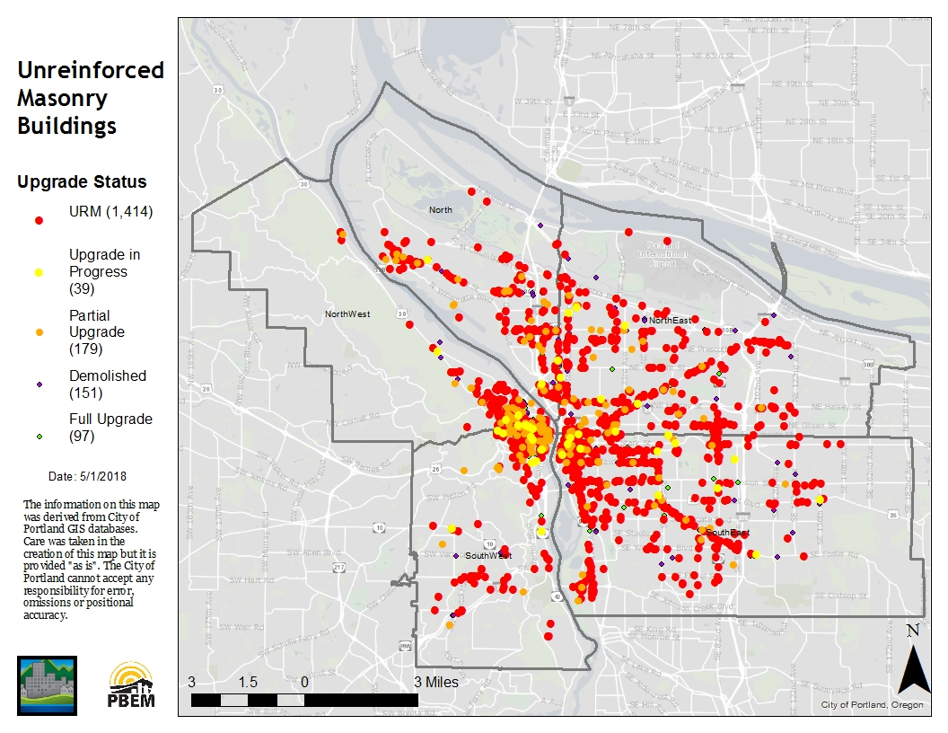
URM Building Locations
Inventory

Slide 32
Council Charge

Slide 33
Policy Development Process
Policy Process
Broad range of stakeholders worked on consensus basis.
Subcommittees on affordable housing, non-profits, and historic buildings.
Outreach to tenants and building owners: open house events, mailings, policy committee meetings.

Slide 34
Public Outreach
Policy Process
40+ different items in local media
20+ community presentations, including:
  Development Review Advisory Committee
  Historic Landmarks Commission
  Building Owners and Managers Association
  Portland Business Alliance
  Portland Downtown Neighborhood Association
  Central Eastside Industrial Council Land Use Committee
  SE Uplift Land Use Committee
  Northeast Coalition of Neighbors
  Pearl District Neighborhood Association
  Portland Public Schools Board
  American Institute of Architects
  League of Women Voters

Slide 35
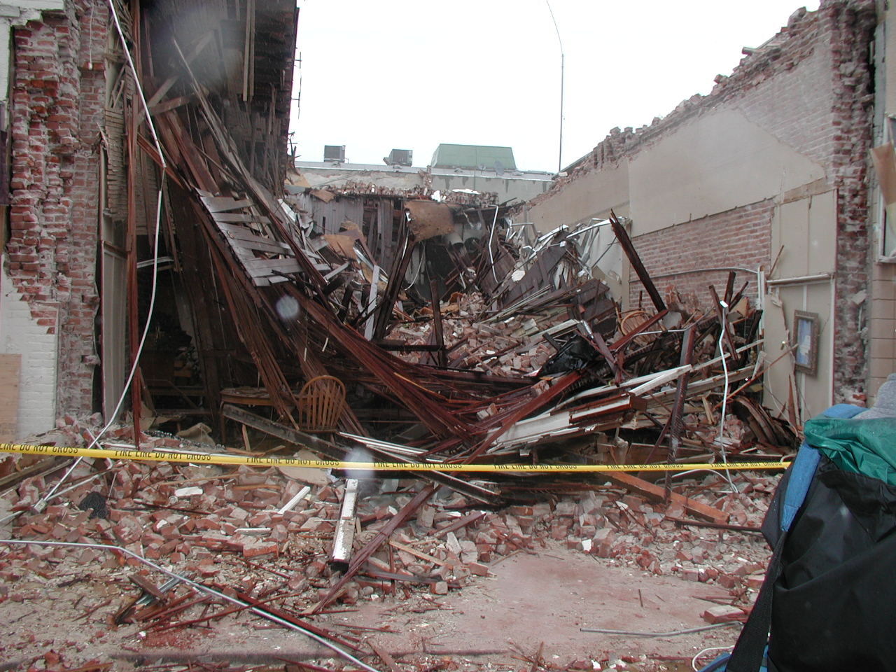
Notes:
The San Simeon earthquake 6.5 demonstrated the effectiveness of retrofitting URM buildings. Downtown Paso Robles has 53 URM buildings of which 9 have been retrofitted. None of the retrofitted buildings suffered major damage while many of the un-retrofitted buildings sustained enough damage to require them to be demolished. Two women died in the collapse of an un-retrofitted URM building. NOTE: they were running out of the building. People who stayed inside and sought shelter survived the collapse and were rescued.

Slide 36
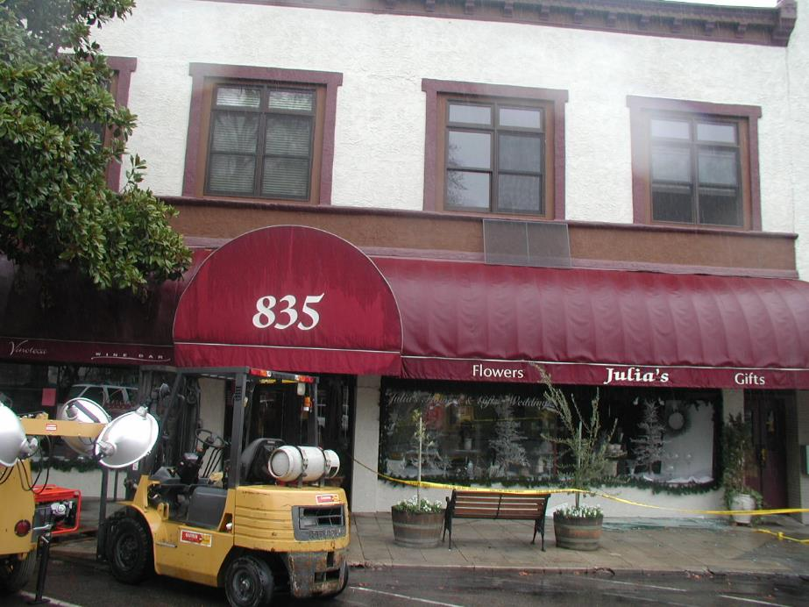
Notes:
This is just a few doors down from the collapsed building, and also a URM.

Slide 37
Retrofit Progress Under Current Code
Inventory
Parapets braced and roof tied to walls when 50% + of roof replaced.
Retrofits to higher standard only in major renovation or change of use.
Limited success. Since 1994:
  9% partially upgraded (roofs)
  5% fully upgraded.

Slide 38
Mandatory retrofits based on risk
Proposed Standard
Tiered system based on purpose, use, and number of occupants:
Class 1 – Critical public safety and emergency response (6 in Portland)
Class 2 – Schools and community centers (94)
Class 3 – Most commercial and residential buildings (1,332)
Class 4 – Small URM buildings <10 occupants, <3 stories. (201)

Slide 39
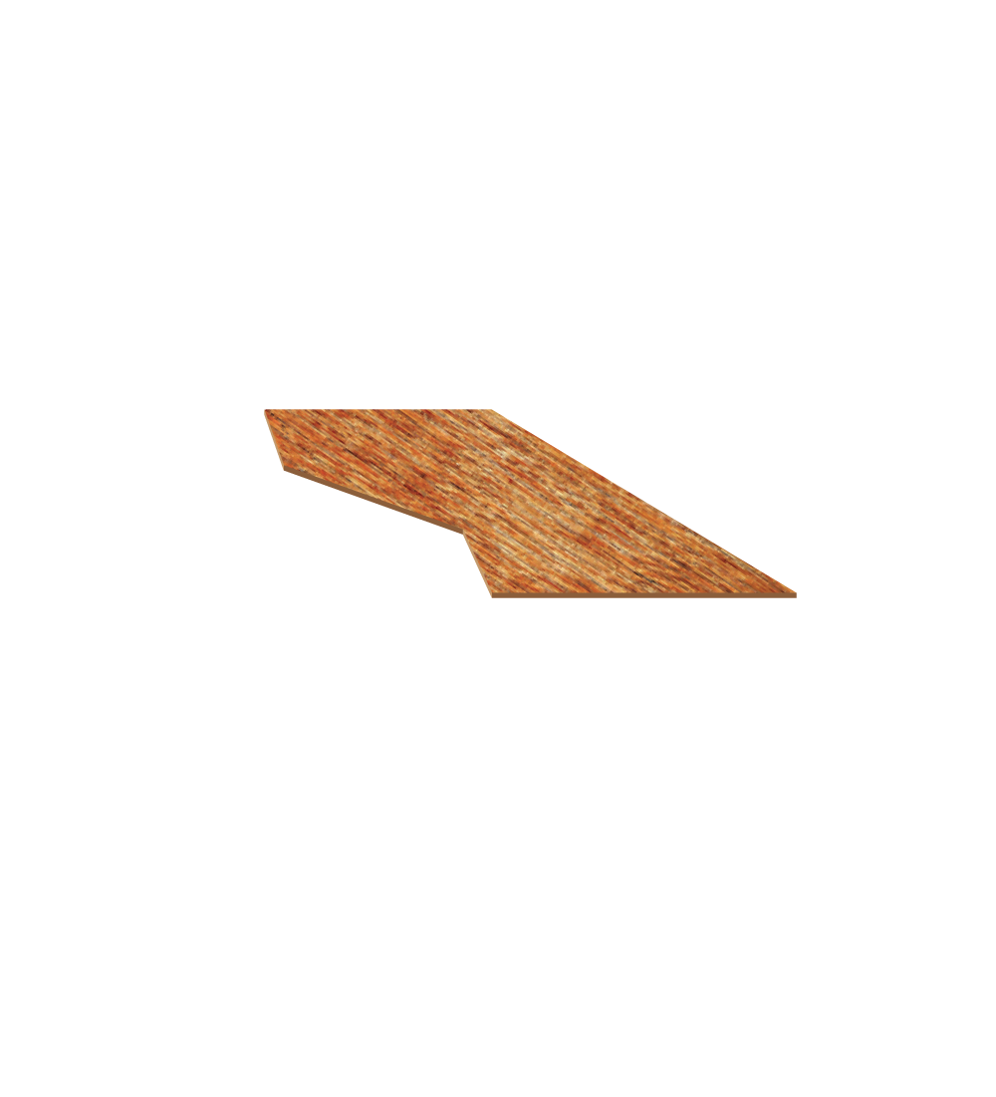
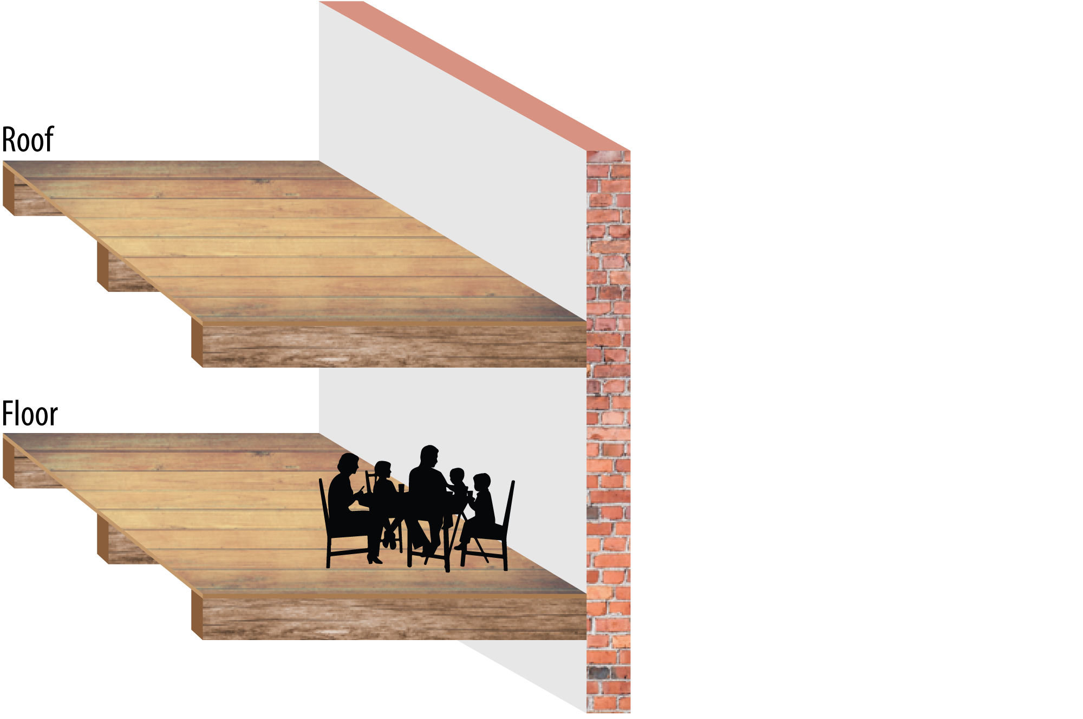
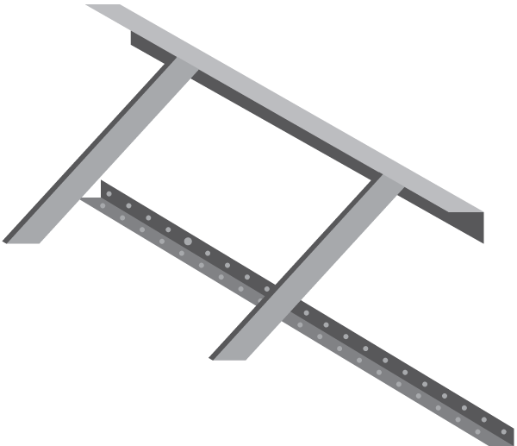

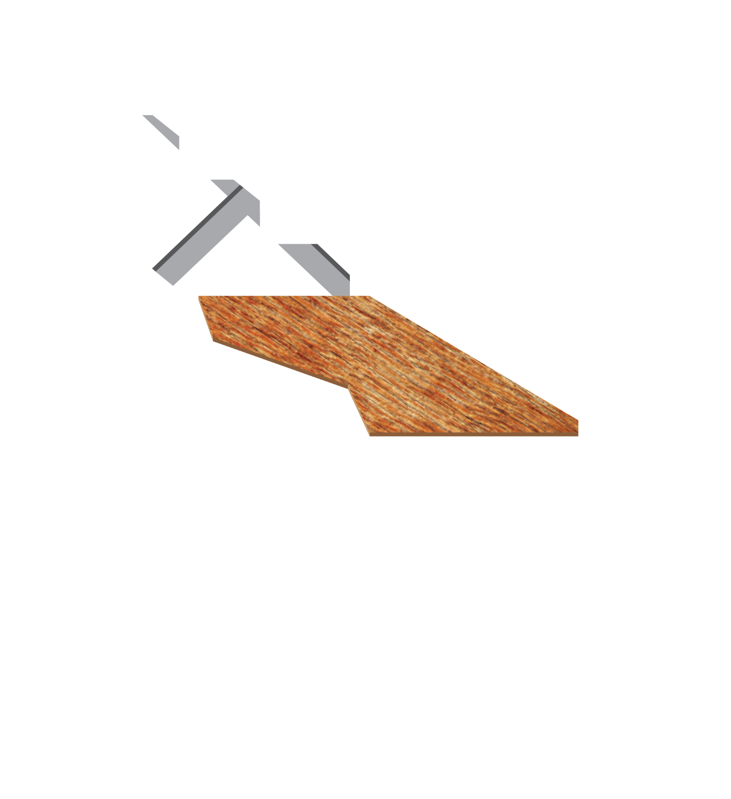








Key Elements of a URM Retrofit
Proposed Standard
A Brace parapets
B Attach wall to roof
C In-plane shear attachments and
roof sheathing, ties and cross ties
D Attach wall to floor
E Out-of-plane wall bracing
F Other upgrades as required

Slide 40
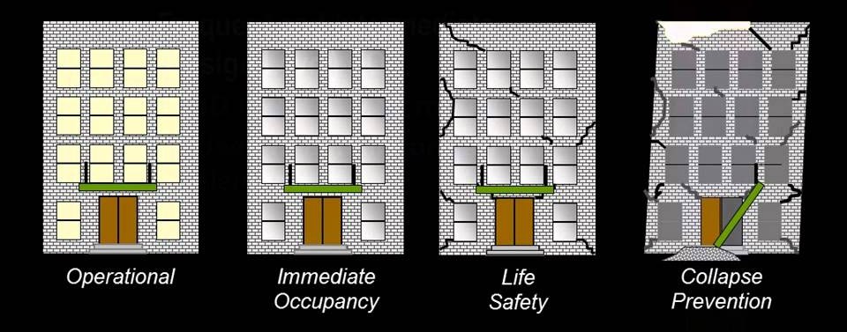
Levels of URM Retrofit
Proposed Standard
American Society of Civil Engineers:
Immediate occupancy: building can be immediately operational.
Damage control: building is damaged and needs repairs, but can be occupied and function with minor repairs.
Life safety: building is damaged but threat to life is minimal; building may or may not be repairable. (Current standard for major remodel.)
Collapse prevention: building is severely damaged, may be on the verge of collapse. Will likely be demolished.

Slide 41
Levels of URM Retrofit
Proposed Standard
Collapse risk reduction: Prescriptive modifications strengthen the building, but do not assure it will not collapse.
Parapet bracing: Prescriptive modifications mean that architectural elements are less likely to break off. Reduces risks to bystanders. Buildings 2+ stories still likely to collapse. (Current standard at re-roofing.)

Slide 42
Key Elements of a URM Retrofit
Proposed Standard
A Brace parapets
B Attach wall to roof
C In-plane shear attachments and
roof sheathing, ties and cross ties
D Attach wall to floor
E Out-of-plane wall bracing
F Other upgrades as required
Notes:
MENTION ABC ARE ALREADY REQUIRED SO D IS ONLY NEW THING

Slide 43
URM Building Classification
Proposed Standard
Proposed Standard | Building Class | Approx. # of Buildings
Immediate Occupancy | 1: Critical Buildings + essential facilities | 6
Damage Control | 2: Schools, community centers, high occupancy structures | 94 44 schools, 37 churches, 13 other
Collapse Risk Reduction | 3: All URM buildings not in 1,2, or 4 | 1,332 Plus 37 churches and other buildings owned by non-profits (but not schools) may choose this standard.
Parapet bracing only | 4: 1 and 2-story buildings with 0-10 occupants. | 201

Slide 44
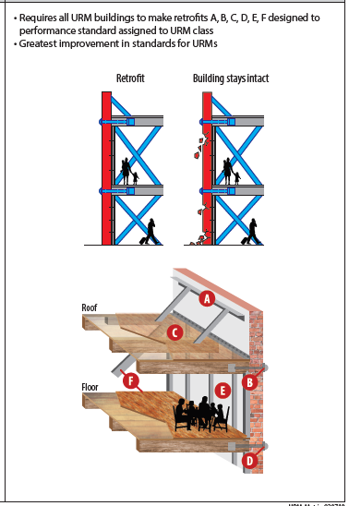
Class 1 and Class 2 Buildings Will Last
Proposed Standard
Class 1 critical buildings with immediate occupancy:
  10 years to complete all steps
  Est. cost $70 - $110 SF
Class 2 schools and community centers with damage control
  10 years for parapets
  20 years for full retrofit
  Est. cost $48 - 81 SF
Notes:
MAYBE NOT NECESSARY

Slide 45
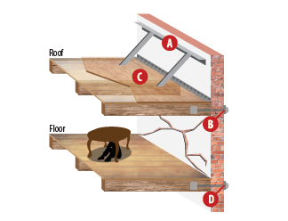
Class 3 Collapse Risk Reduced
Proposed Standard
Collapse risk reduction for 85% of buildings
10 Years for parapet bracing, wall to roof attachment, roof sheathing
15 Years for wall to floor attachment
Estimated $11/SF additional during re-roofing.

Slide 46
Class 3 – Estimated Cost Summary
Proposed Standard
 |  | COST RANGE PER SQUARE FOOT
COST COMPONENT |  | Min | Max | Median
Existing Ownership Expense
 | Re-roofing | $ 31 | $ 36 | $ 34
Existing Code Requirement
 | Parapet Bracing | $ 1 | $ 7 | $ 2
 | Roof-to-wall attachment | $ 1 | $ 8 | $ 2
New Code Requirement
 | Sheathing | $ 8 | $ 9 | $ 9
 | Floor-to-wall attachment* | $ 3 | $ 5 | $ 2
Total Estimated Cost Per SF |  | $ 43 | $ 65 | $ 48
Notes:
Phase 3 cost estimates do not include:
Tenant Relocation
Financing
Architect or Engineering Fees
The hard costs to comply with new elements of the proposed code range from:
$8-9 per square foot for single story buildings
$11-14 per square foot for multistory buildings

Slide 47
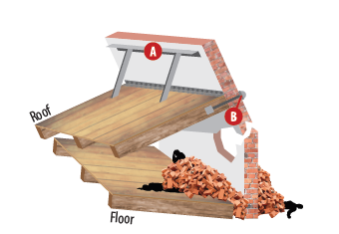
Minimal retrofits for small buildings
Proposed Standard
URM buildings with less than ten occupants brace parapets and tie roof (current code).
  Ten years to complete.

Slide 48
Strengthen existing triggers
Proposed Standard
Triggers in existing seismic regulations (Title 24.85):
Roof replacement – removal of greater than 50% of total roof area within a 5 15 year period requires wall anchorage for both in plane and out of plane forces and parapet bracing.
Costs of alterations or repair - When costs associated with building alterations or repair in a two five year time period or fifteen year time period exceeds, entire building shall be improved to resist seismic forces to meet ASCE 31 41 criteria.

Slide 49
Fairness in implementation
Proposed Standard
Notice and opportunity to appeal URM building status.
Timeline extension for class 3 and 4 with newer roof.

Slide 50
Independent Cost-Benefit Study
Proposed Standard
Used simple costs and benefits: construction costs and fees versus property damage, injuries, and deaths.
Used higher retrofit standard than now proposed.
Cost-benefit ratios 1:1.4 to 1:1.9.
Avoided death and injury are greatest benefit (55%).
Notes:
Struggled to find god cost estimates because seismic retrofitting is usually undertaken with another project (major renovation, change of use, etc); hard to break out the costs for retrofitting independent of other costs.
Ended up using 20-year-old FEMA study, adjusting for inflation and factor for local construction cost; results were in accord with the few case studies we developed.

Slide 51
Support for URM Building Owners
Proposed Support
Seismic C-PACE – Authorized and implemented
Property Tax Exemption (SB 311) – Authorized
State historic tax credit – Introduced, failed, try again
State seismic tax credit – in exploration
Capital pool to provide financial assistance – in exploration
City staff as advocates at BDS and Prosper Portland

Slide 52
Public Notification: Lease Agreement
Proposed Policy
Information will drive the market to greater retrofits.
Notify renters in the lease agreement if a URM is not retrofitted to Collapse Prevention.
Notes:
MENTION THIS IS STAFF RECOMMENDATION

Slide 53
Public Notification: Placards
Proposed Policy
Buildings retrofitted to a standard less than collapse prevention still pose a life-safety risk to the public.
Placard non-residential URM buildings not retrofitted to Collapse Prevention.

Slide 54
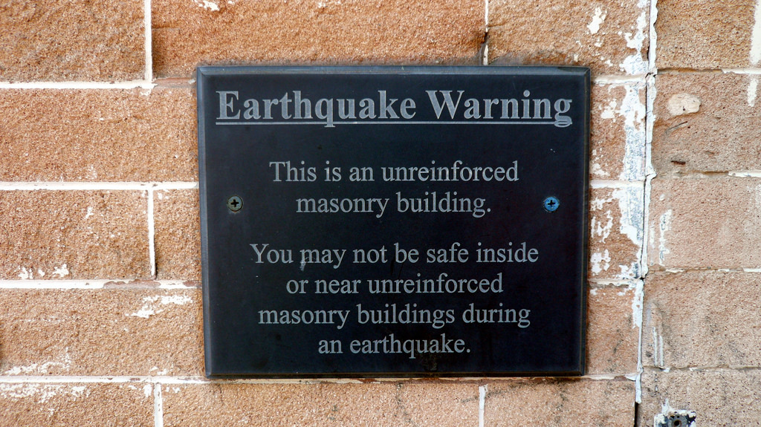

Slide 55
Resolution before Council
Next Steps
Return to Council within a year with:
Building code to implement mandatory seismic retrofit program:
  Critical building to immediate occupancy in 10 years
  Schools and community centers to damage control in 20 years
  Most buildings to collapse risk reduction in 15 years
  Small buildings brace parapets in 10 years.
Program to implement property tax exemption for URM building retrofits.
Proposal for seismic retrofit revolving loan fund.

Slide 56
Resolution before Council
Next Steps
Return to Council within a year with:
Staff program to assist URM owners.
City to assess its own URM buildings.
Legislative agenda to support additional tax credits:
  Historic building tax credit
  Seismic retrofit tax credit.

Slide 57
Resolution before Council
Next Steps
Ordinance for placarding of non-residential URM buildings not retrofitted to prevent collapse.
Ordinance requiring URM building owners to disclose URM status to renters, for buildings not retrofitted to prevent collapse.

Slide 58
Portland Fire and Rescue
Fire Chief Mike Myers

Slide 59
URM Building Policy Committee
Margaret Mahoney, Chair

Slide 60
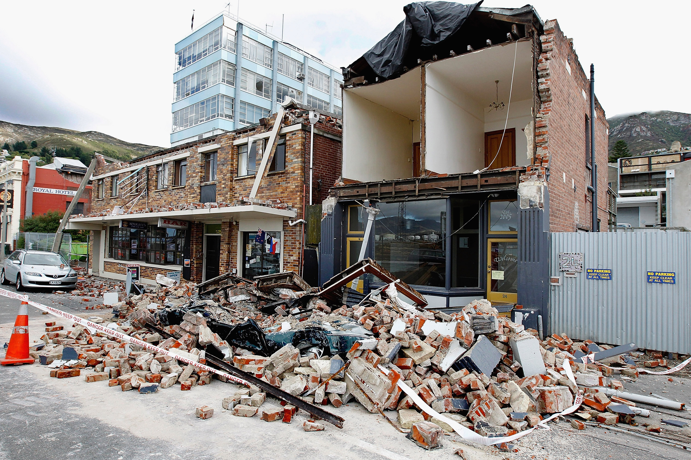

Slide 61
Message from Christchurch
Mayor Lianne Dalziel

Slide 62
