Slide 1
Southwest Corridor Plan
Update
Portland Design Commission
June 21, 2018
Notes:
Agenda of show…
Southwest Corridor Light Rail proposal
Project benefits
Draft Environmental Impact Statement
Initial Route Proposal

Slide 2
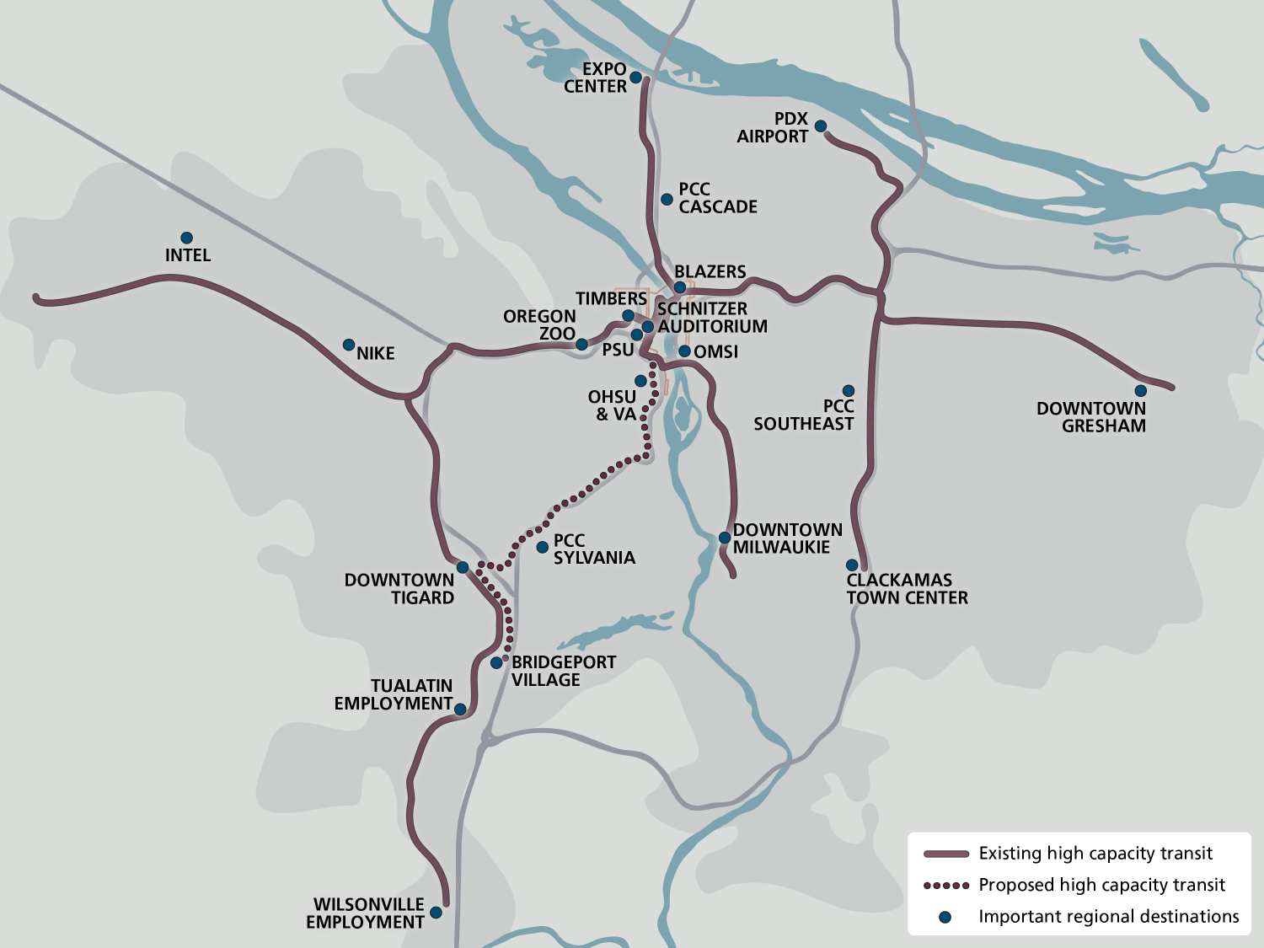
Notes:
This is an area that lacks reliable transit options

Slide 3
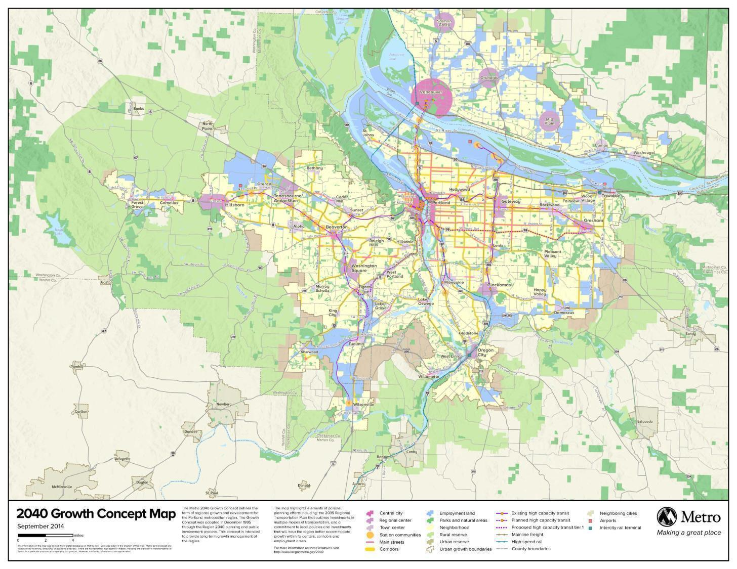
2040 Growth Concept
Notes:
We’ve been working on this concept for 20 + years.
Constantly learning how to improve our work.
Over 600,000 new residents in urban growth boundary. Similar to 6 new cities the size of Hillsboro

Slide 4

Notes:
Why the Southwest Corridor?
And lot more people are coming here. Communities in the corridor are making plans to handle this growth and keep up with the transportation demand it creates.
More transportation investments will be crucial to their success.

Slide 5
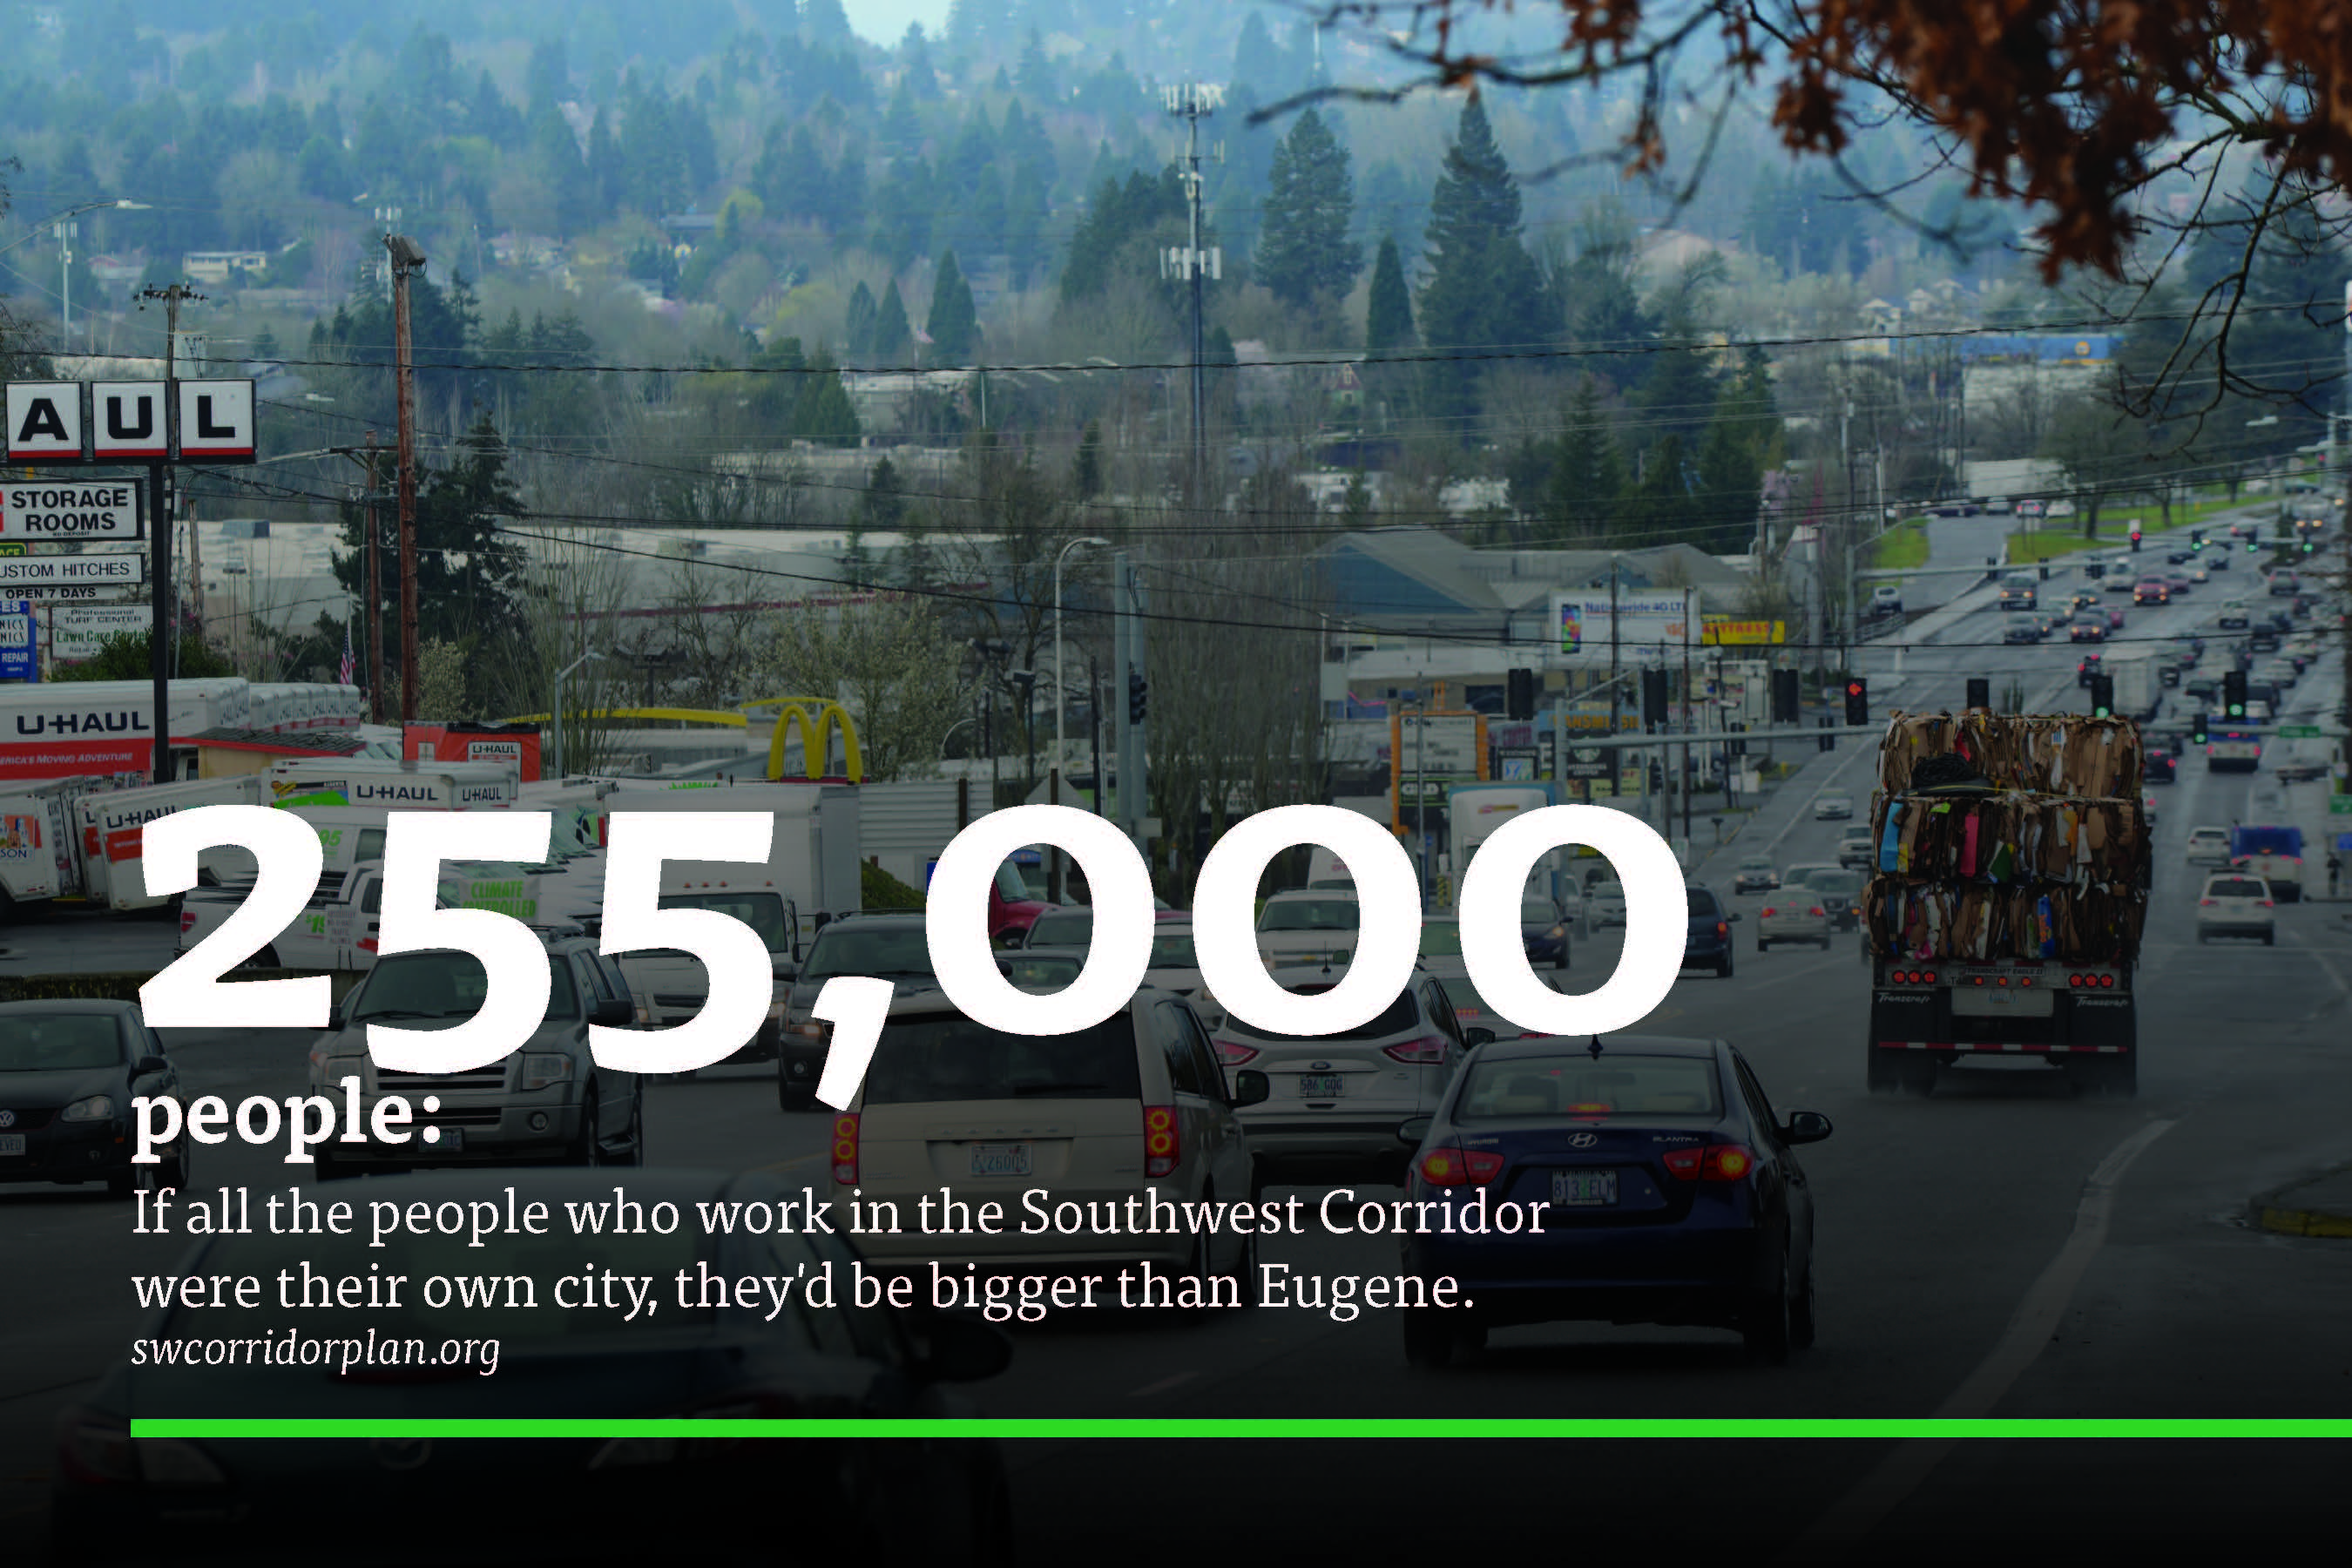
Notes:
The Southwest Corridor is a place of work. And the vast majority of people who work there commute from other cities.
As you know well, 93 percent of workers in Tualatin live outside of Tualatin
The Southwest Corridor Plan would build light rail and other projects to help workers get to the job and home again on time.
Projections show that by 2035 there could be more than 255,000 people working in the corridor. Supporting our economy means making sure people can get to work and products can move.

Slide 6
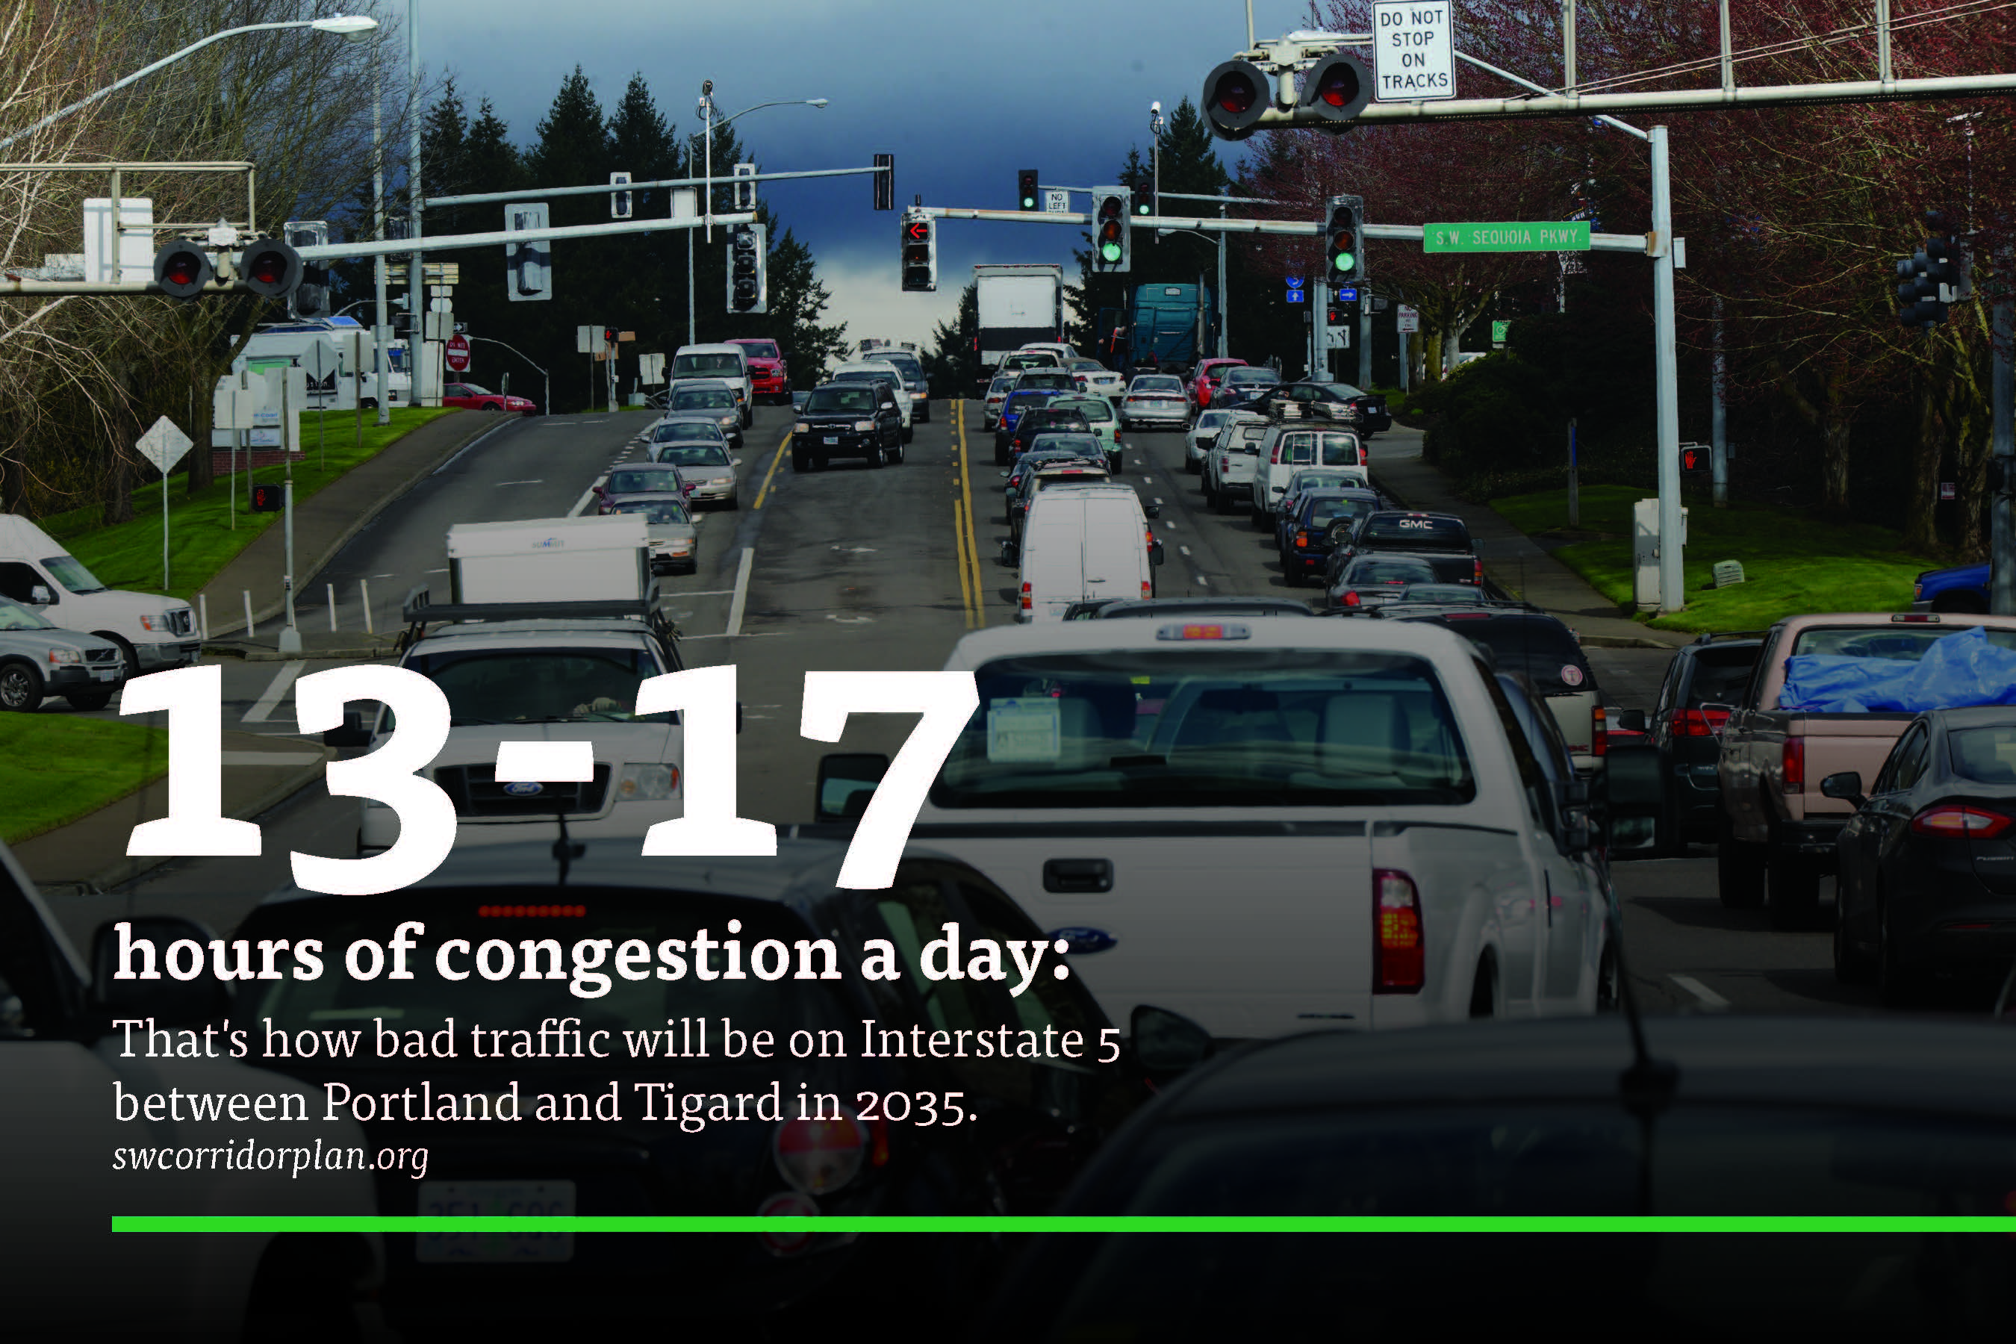
Notes:
The Interstate 5 and Barbur Blvd. corridor between Portland and Tualatin is one of the fastest growing and most congested in the State.
And as the area's jobs and population continue to grow, it is going to get worse.
Fortunately, light rail in the corridor could carry almost a quarter of peak hour, peak direction Interstate 5 commuters south of downtown Portland.
Over 46,000 students attend universities and colleges in the corridor (TriMet generated)
TriMet estimates that project design and construction would create over 23,000 jobs in the region.

Slide 7
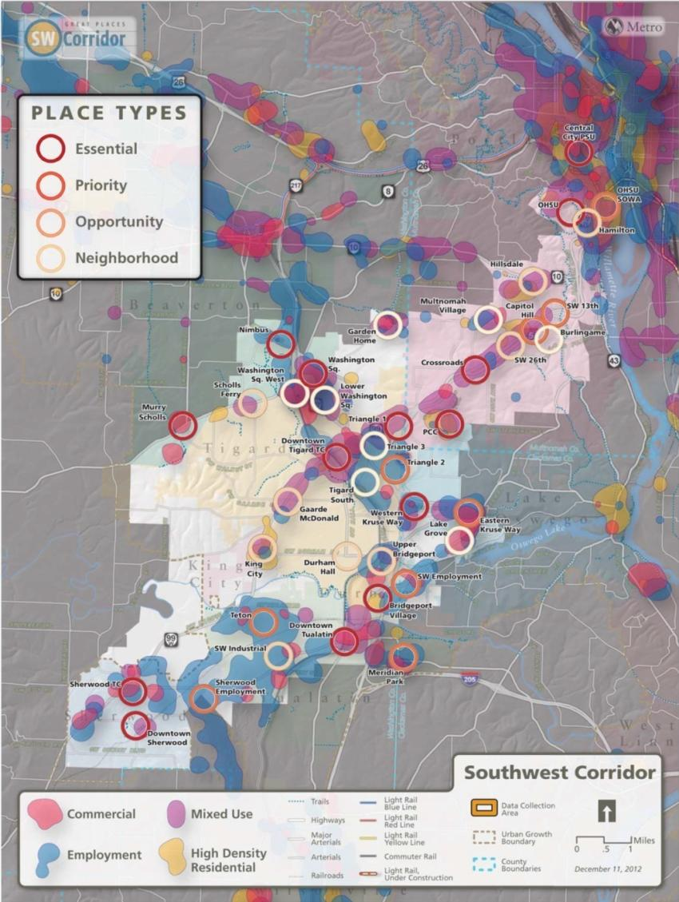
We started with land use to connect to places
Notes:
Barbur Concept Plan
Tigard High Capacity Transit Land Use Plan and Downtown Vision
Linking Tualatin

Slide 8
More than light rail…
new walk and bike connector between Barbur and Marquam Hill
2-mile shared transitway to allow buses to bypass traffic congestion
shuttle between PCC-Sylvania and nearby stations
continuous sidewalks and protected bike lanes where LRT is in Barbur

Slide 9
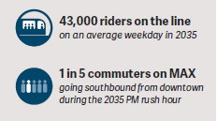
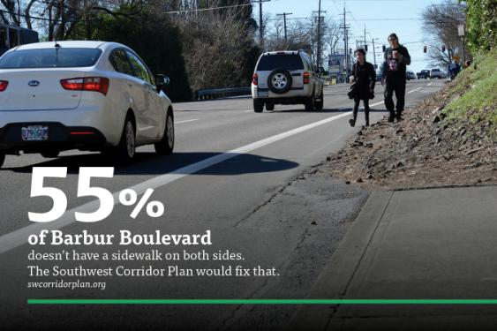
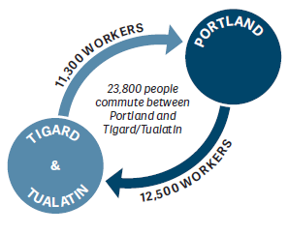
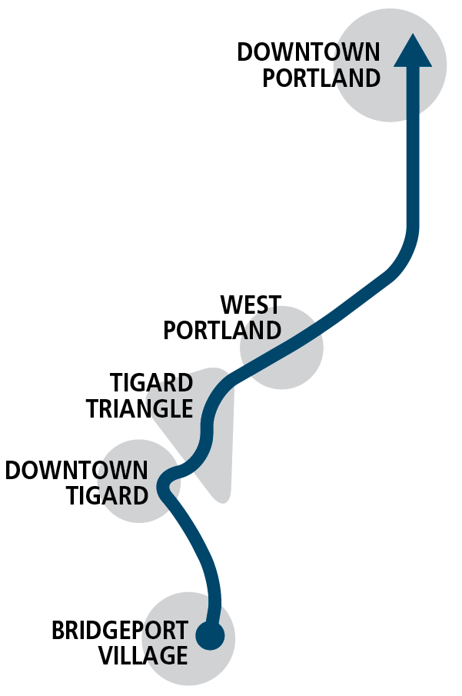
Project Benefits
Climate action goals
Infill TOD in regional town centers

Slide 10
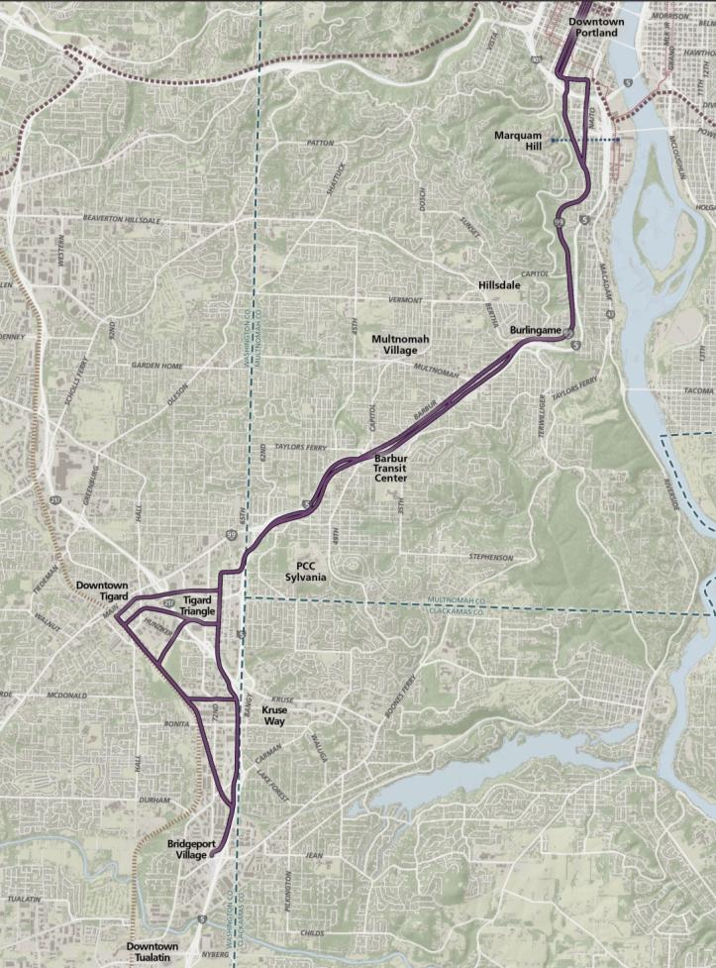
Downtown Portland
OHSU
Hillsdale / Burlingame
Barbur Transit Center
PCC Sylvania
Tigard Triangle +
Downtown
Bridgeport Village

Slide 11
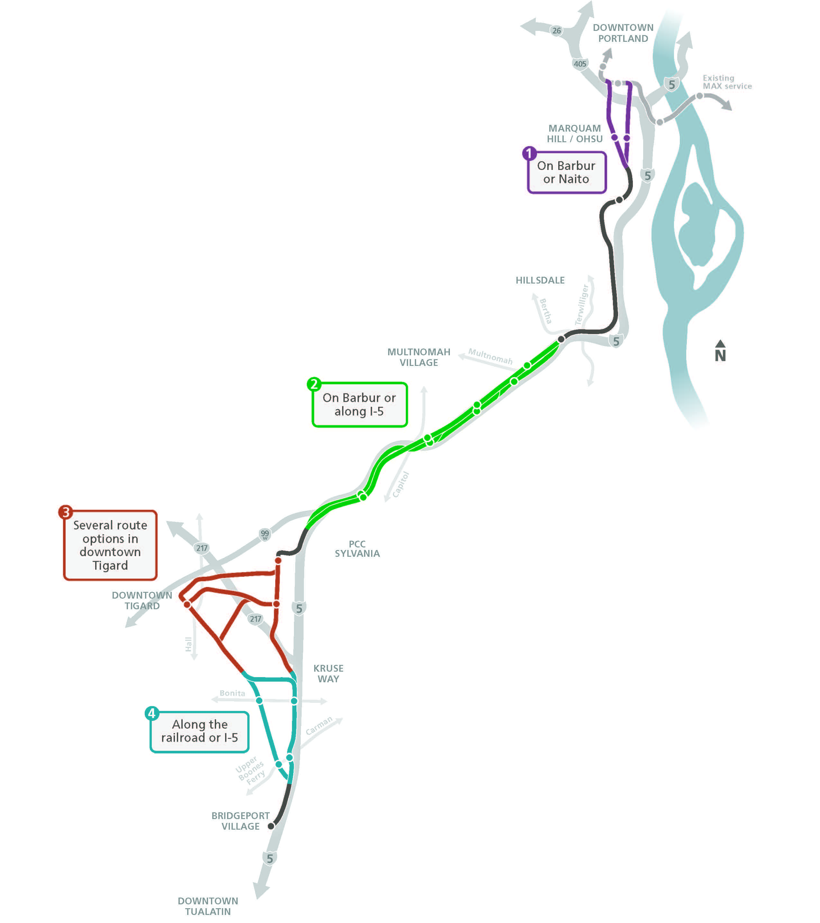
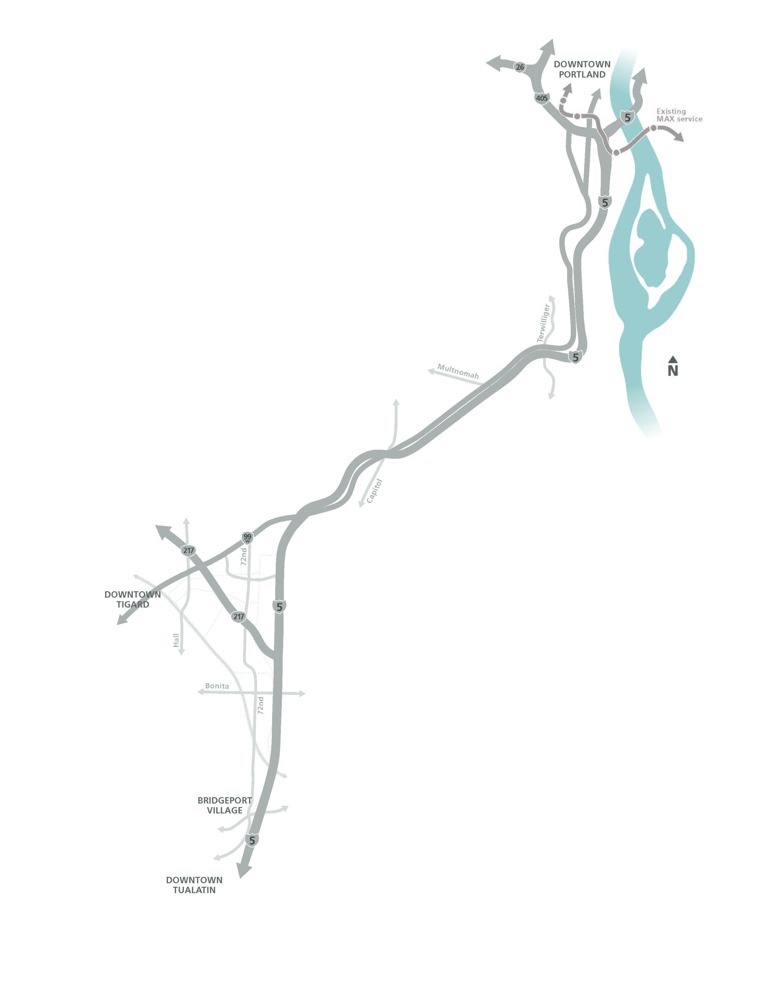
Major route decisions
Steering Committee narrowed from 60+ route options
Light rail selected over bus rapid transit
Portland
Tigard
Tualatin
Notes:
ERYN

Slide 12
Draft EIS
Disclosure document, intended to be neutral
Compares Project to No Project
Analysis and findings generally at “segment” level
Identifies potentially significant impacts and ways to mitigate
Based on frozen 5% designs
Not a permitting document

Slide 13
DEIS Comment Period
Public review period June 15 – July 30
Available now
  swcorridorplan.org
  swcorridordeis@oregonmetro.gov
  11 locations around project area
Around 300 pages + printed appendices + unprinted attachments
Executive summary is just 25 pages

Slide 14
Overall route
Initial route proposal
Through route
Better connectivity between Tigard and Tualatin
Better transit service for Downtown Tigard
Lower operating cost
More cost-effective and reliable operations
Notes:
Initial partner staff suggestion for the light rail route (shared in March)
Required for DEIS
NOT the Locally Preferred Alternative
Includes modifications to avoid/minimize impacts to housing, business, and cost identified in DEIS
Will be further studied in Final EIS

Slide 15
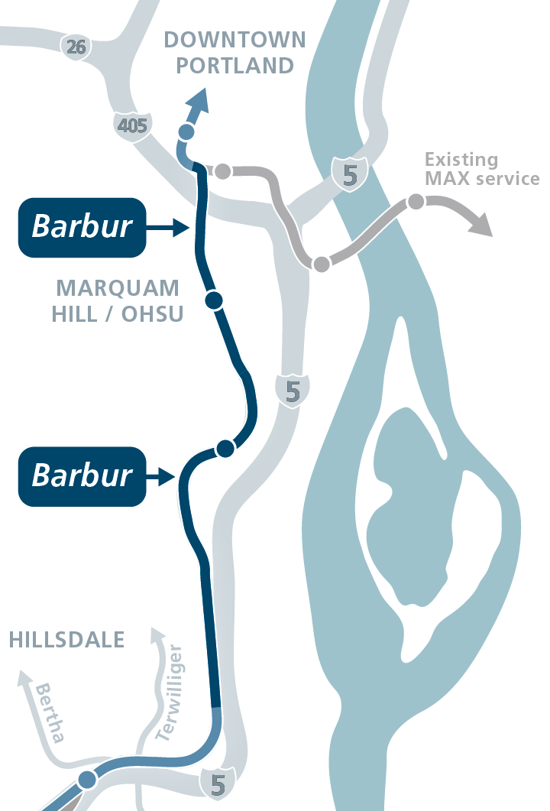
South Portland
Initial route proposal
Barbur
Shorter connection to Marquam Hill
Faster travel time
Fewer property impacts
(historic, residential, business)
Ross Island Bridgehead improvements necessary

Slide 16
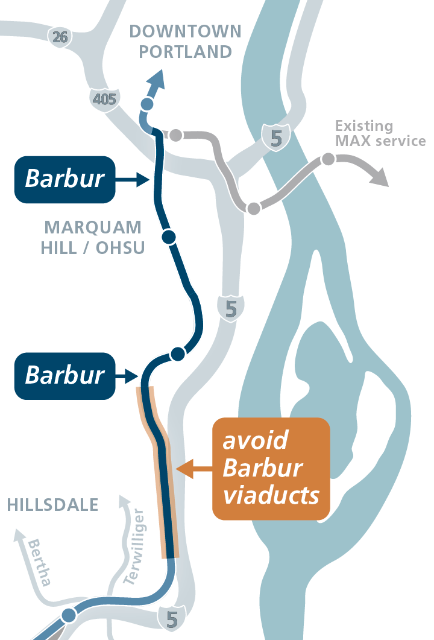
South Portland
Suggested modification
Avoid Barbur viaducts
Reduce construction impacts
Avoid historic and park impacts
Reduce cost

Slide 17
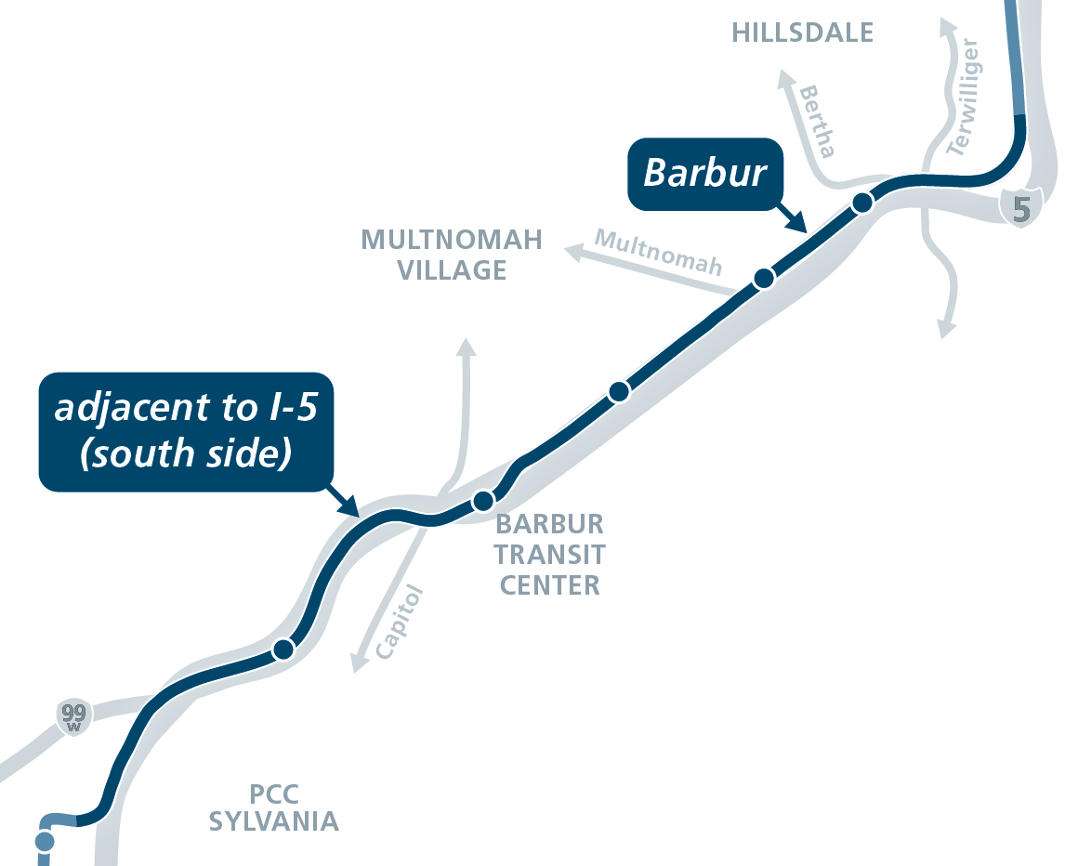
Hillsdale to Tigard Triangle
Initial route proposal
Barbur to I-5 at transit center
More accessible & visible stations
More safety improvements on Barbur
Fewer residential displacements
Avoids complex I-5 bridge reconstruction

Slide 18
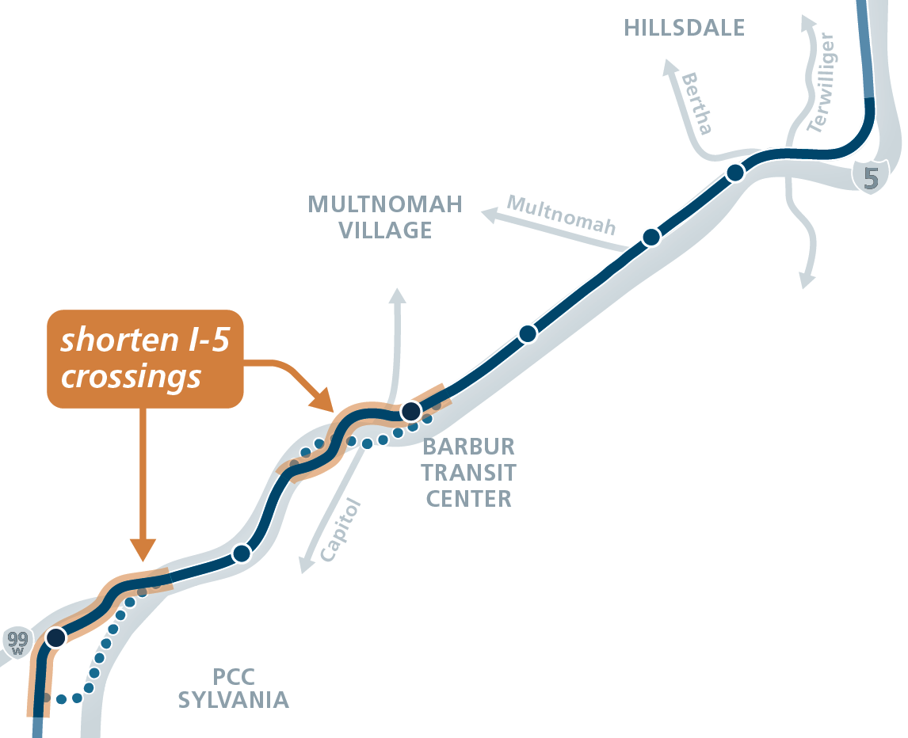
Hillsdale to Tigard Triangle
Suggested modifications
Shorten I-5 crossings
Reduce visual impacts
Reduce construction impacts
Reduce cost
Allows for a station on 68th near 99W

Slide 19
What is the Preferred Alternative?
Single light rail route for further design, study, funding
Included (option to be defined)
  Marquam Hill connection
  PCC Sylvania shuttle
  Operations & Maintenance facility
Work to do:
  Stations and Park and rides
  Design refinements
  Station access improvements

Slide 20
Implications
All other alignments dropped
  Clarifies adverse effects
TriMet will begin advanced designs
  Avoid or minimize impacts
  Develop detailed cost estimates
Environmental review
  Final EIS to evaluate updated designs
  Commit to mitigations
  Address DEIS comments

Slide 21
SW Corridor Design
At approximately 5% design to compare and contrast alignment options
Urban design contractor – October 2018
  Overall project designs
  Marquam Hill connections
  Station optimization and connections
  PCC connection

Slide 22
LRT Standards

Slide 23
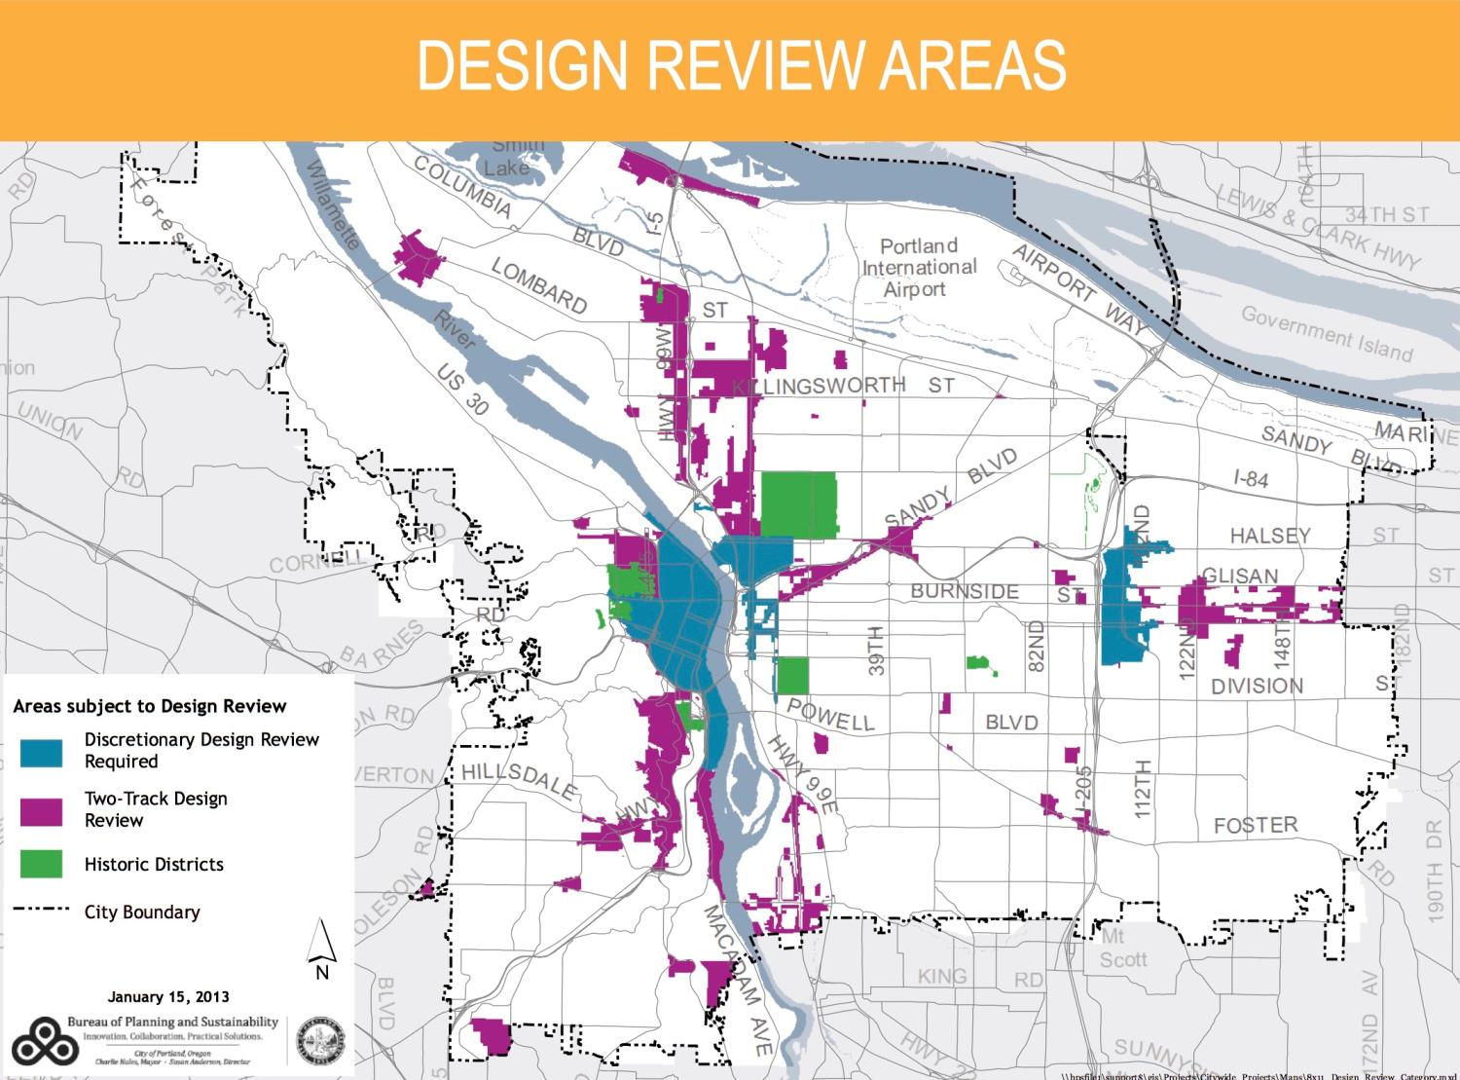
Extra slides

Slide 24
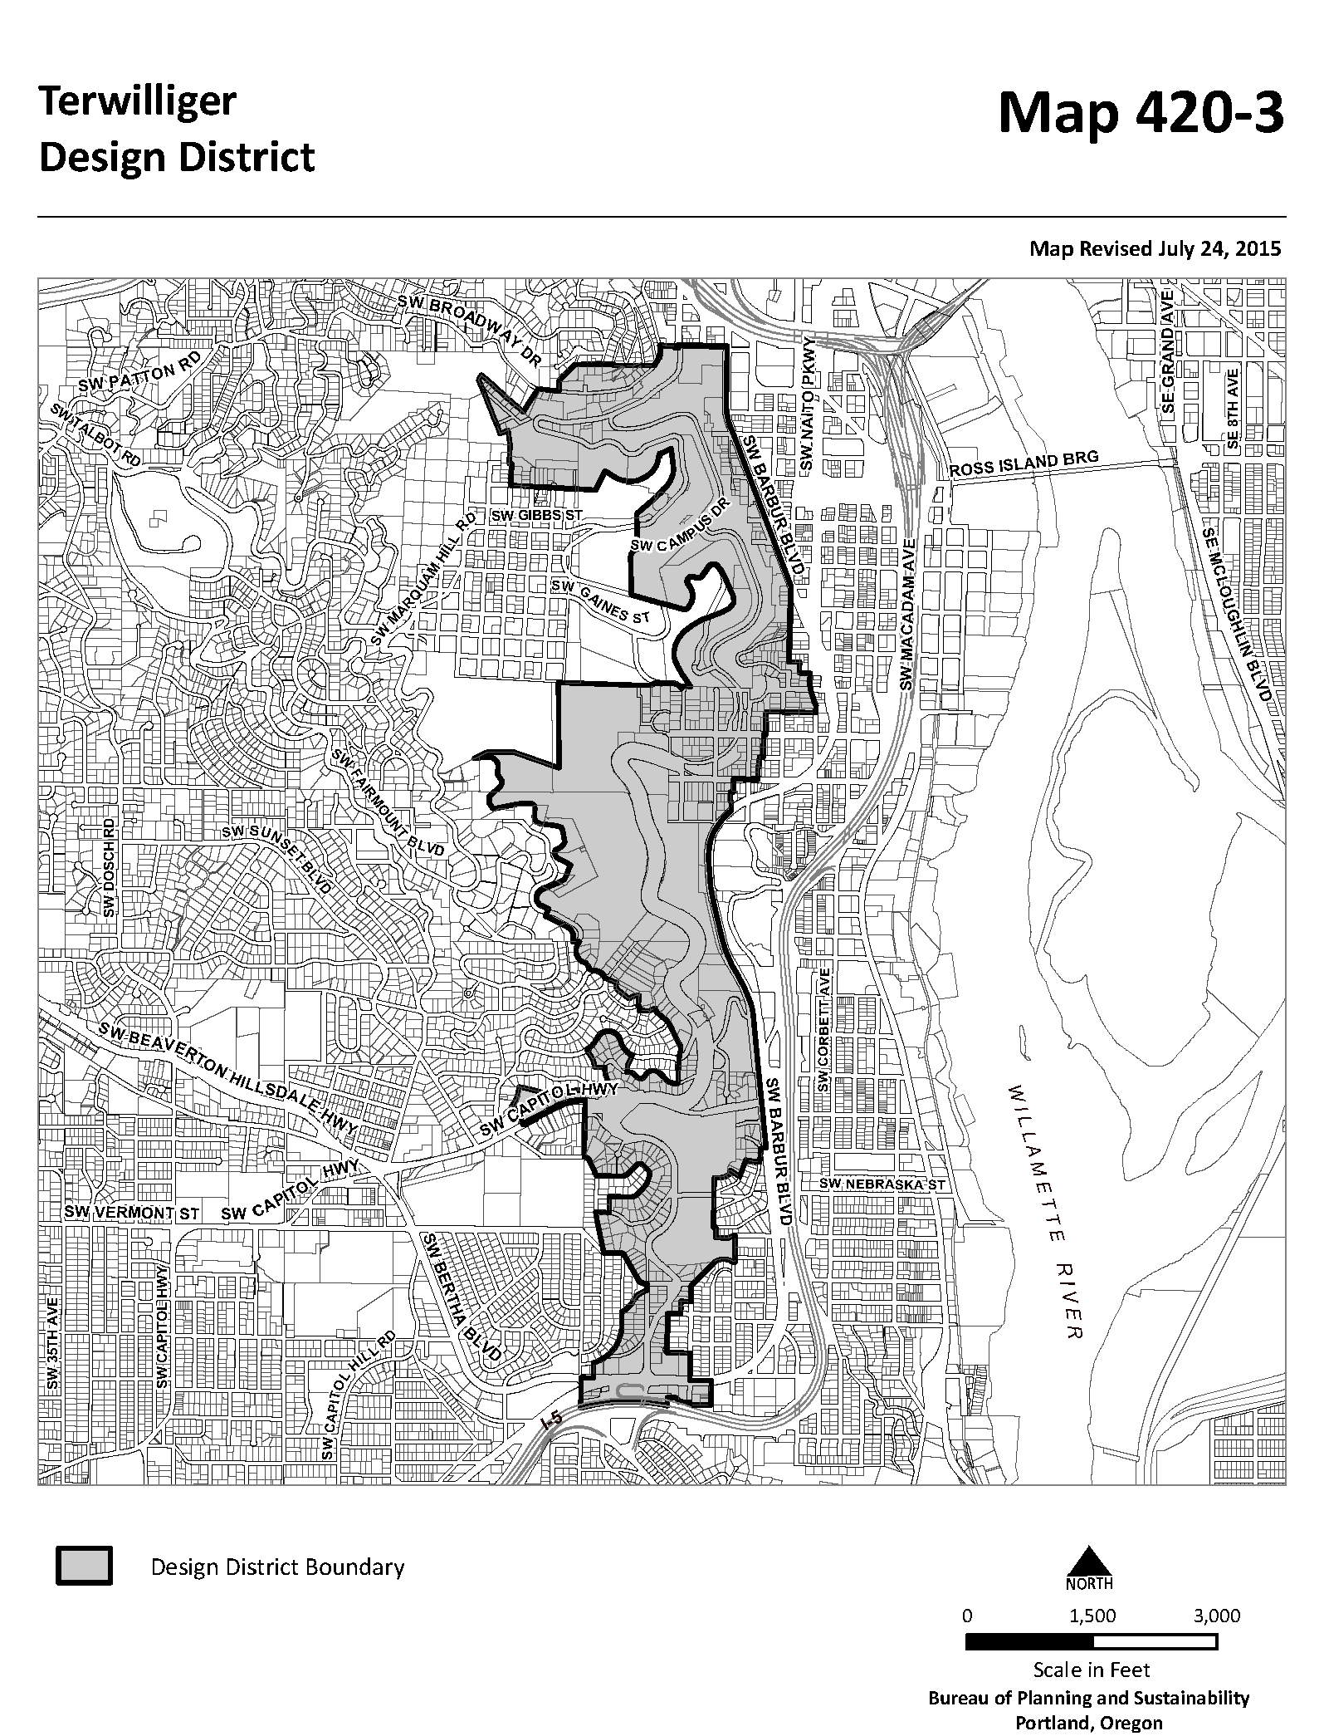
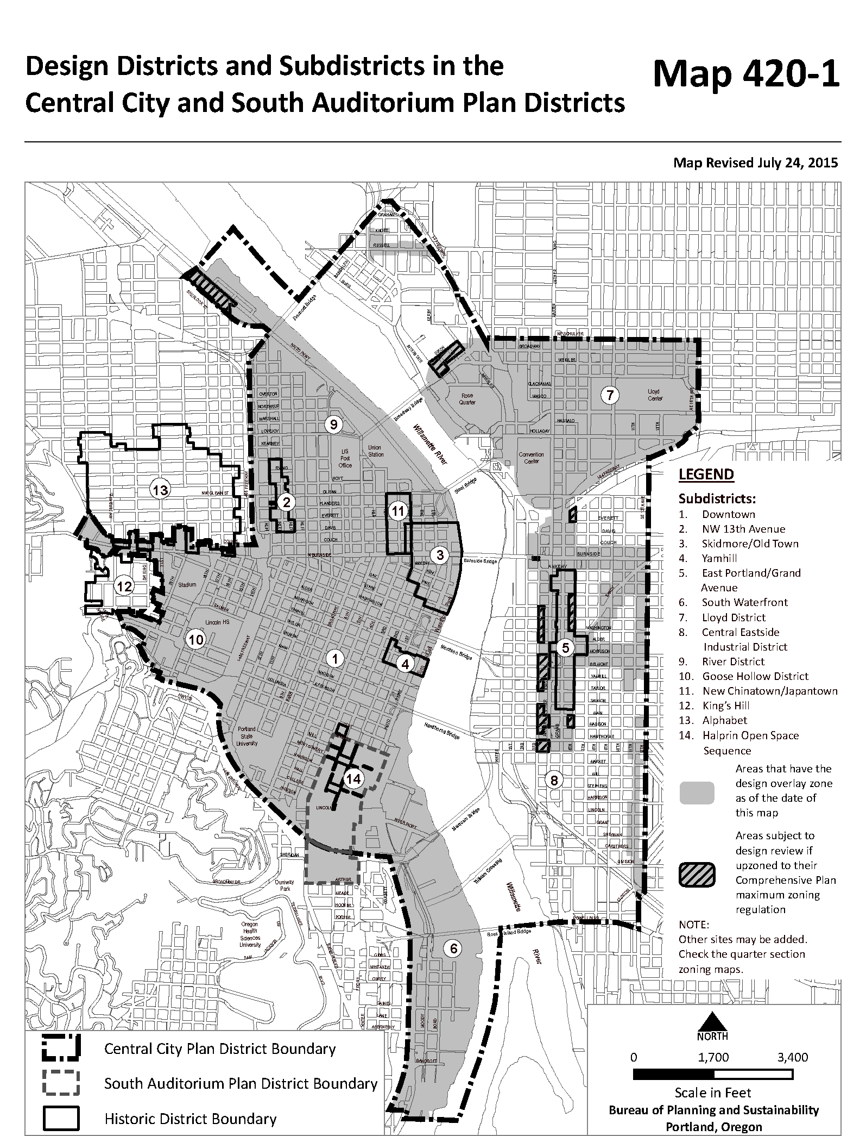
Terwilliger and Downtown Design districts

Slide 25
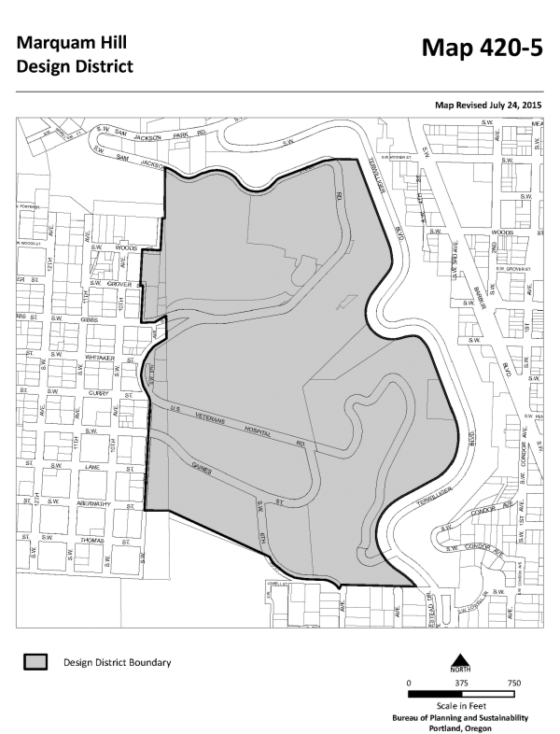
Marquam Hill Design District

Slide 26
Design overlay
Design overlay

Slide 27
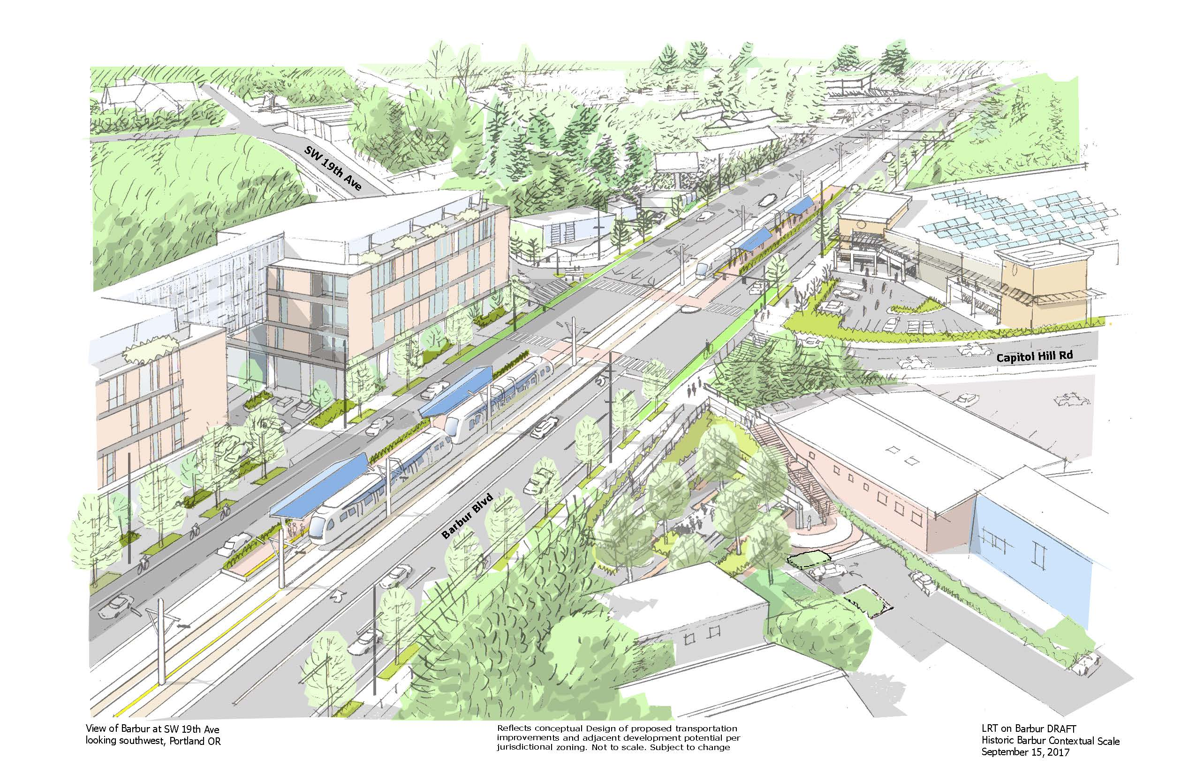
Station at SW 19th and Barbur

Slide 28
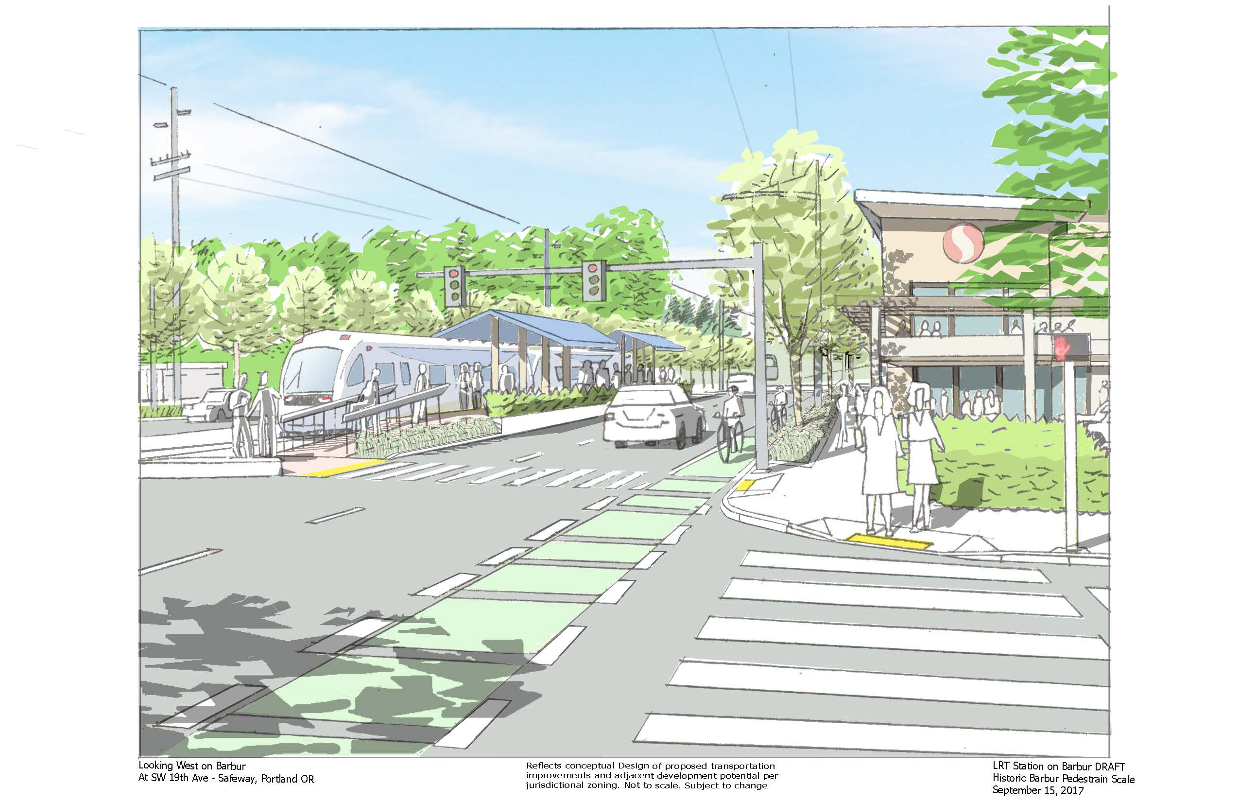
Station at SW 19th and Barbur

Slide 29
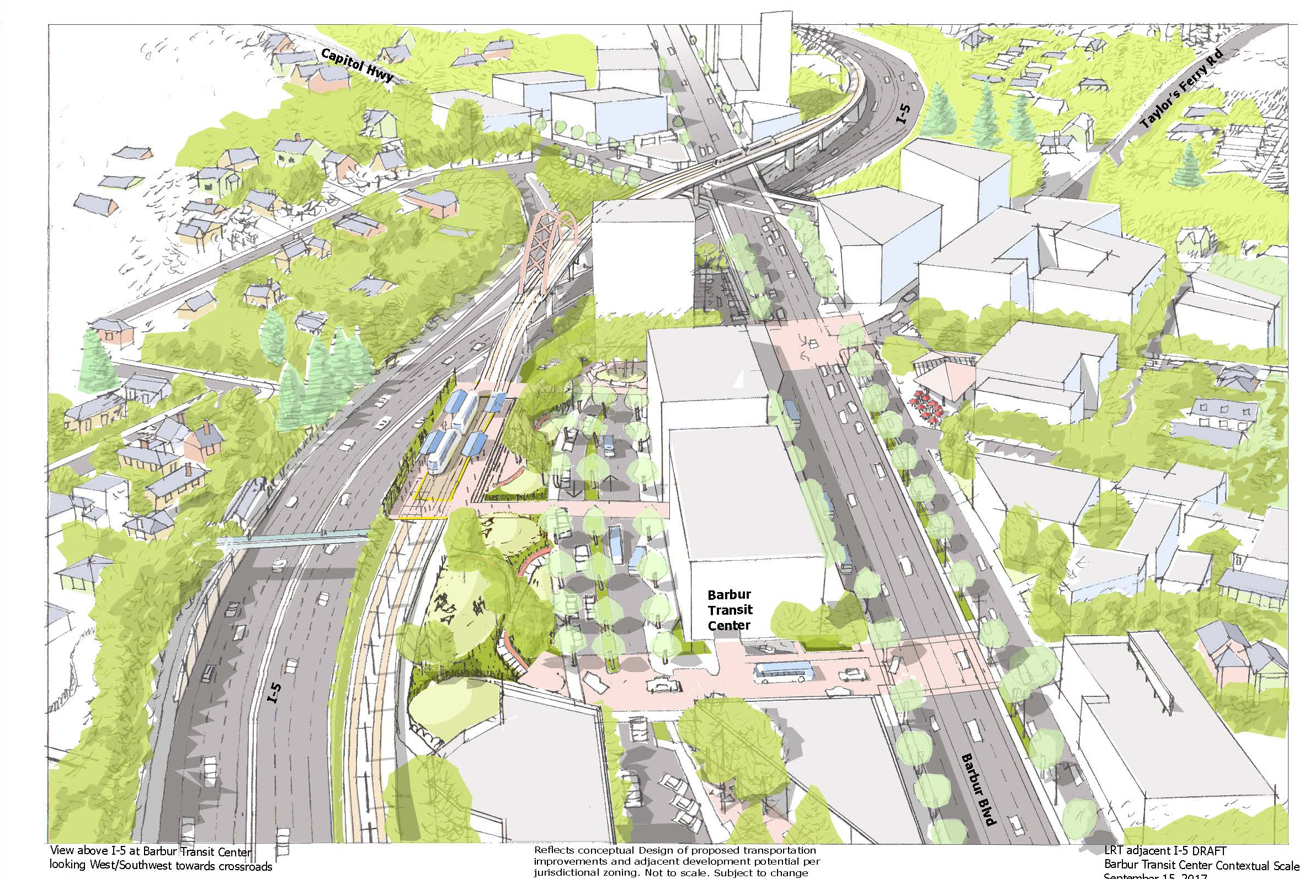
West Portland Town Center
Barbur Transit Center

Slide 30
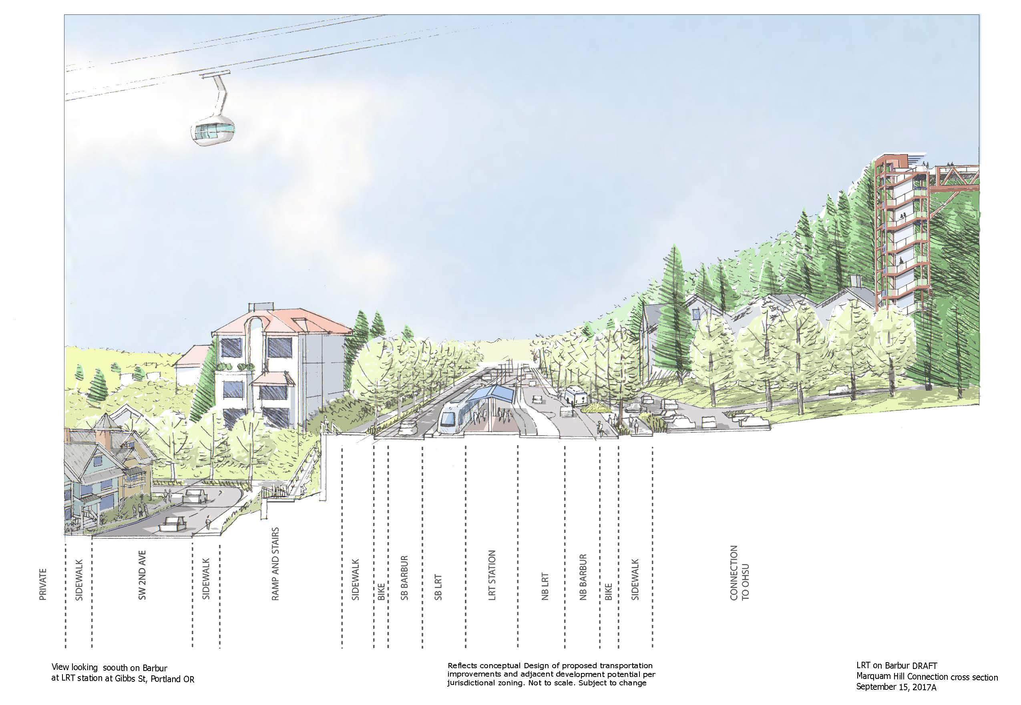
Station at SW Gibbs and Barbur

Slide 31
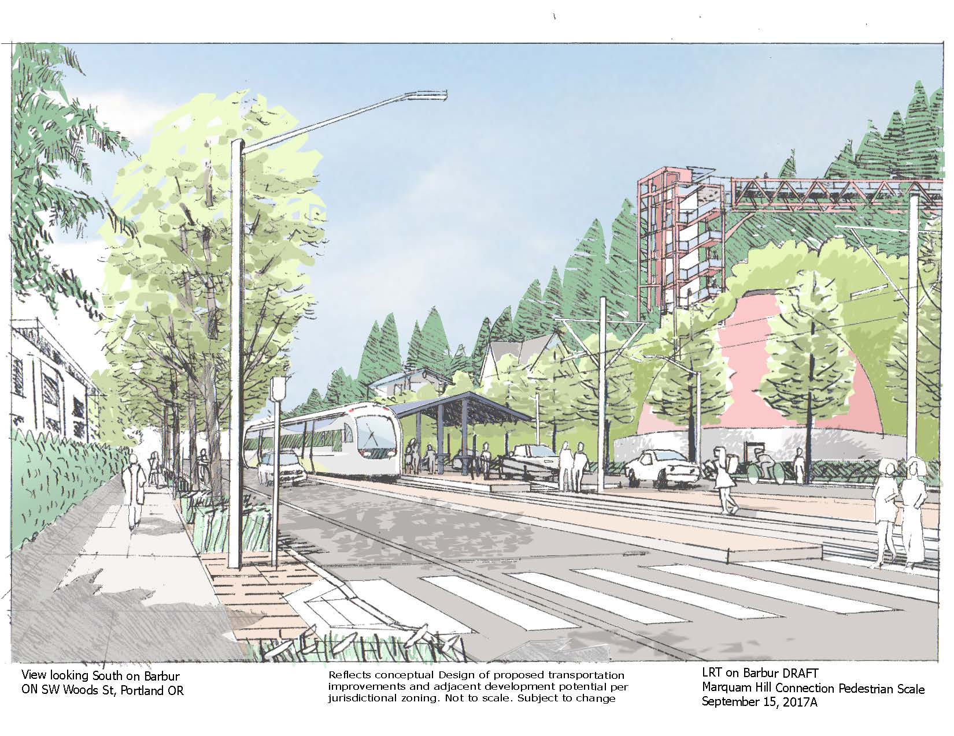
Station at SW Gibbs and Barbur

Slide 32
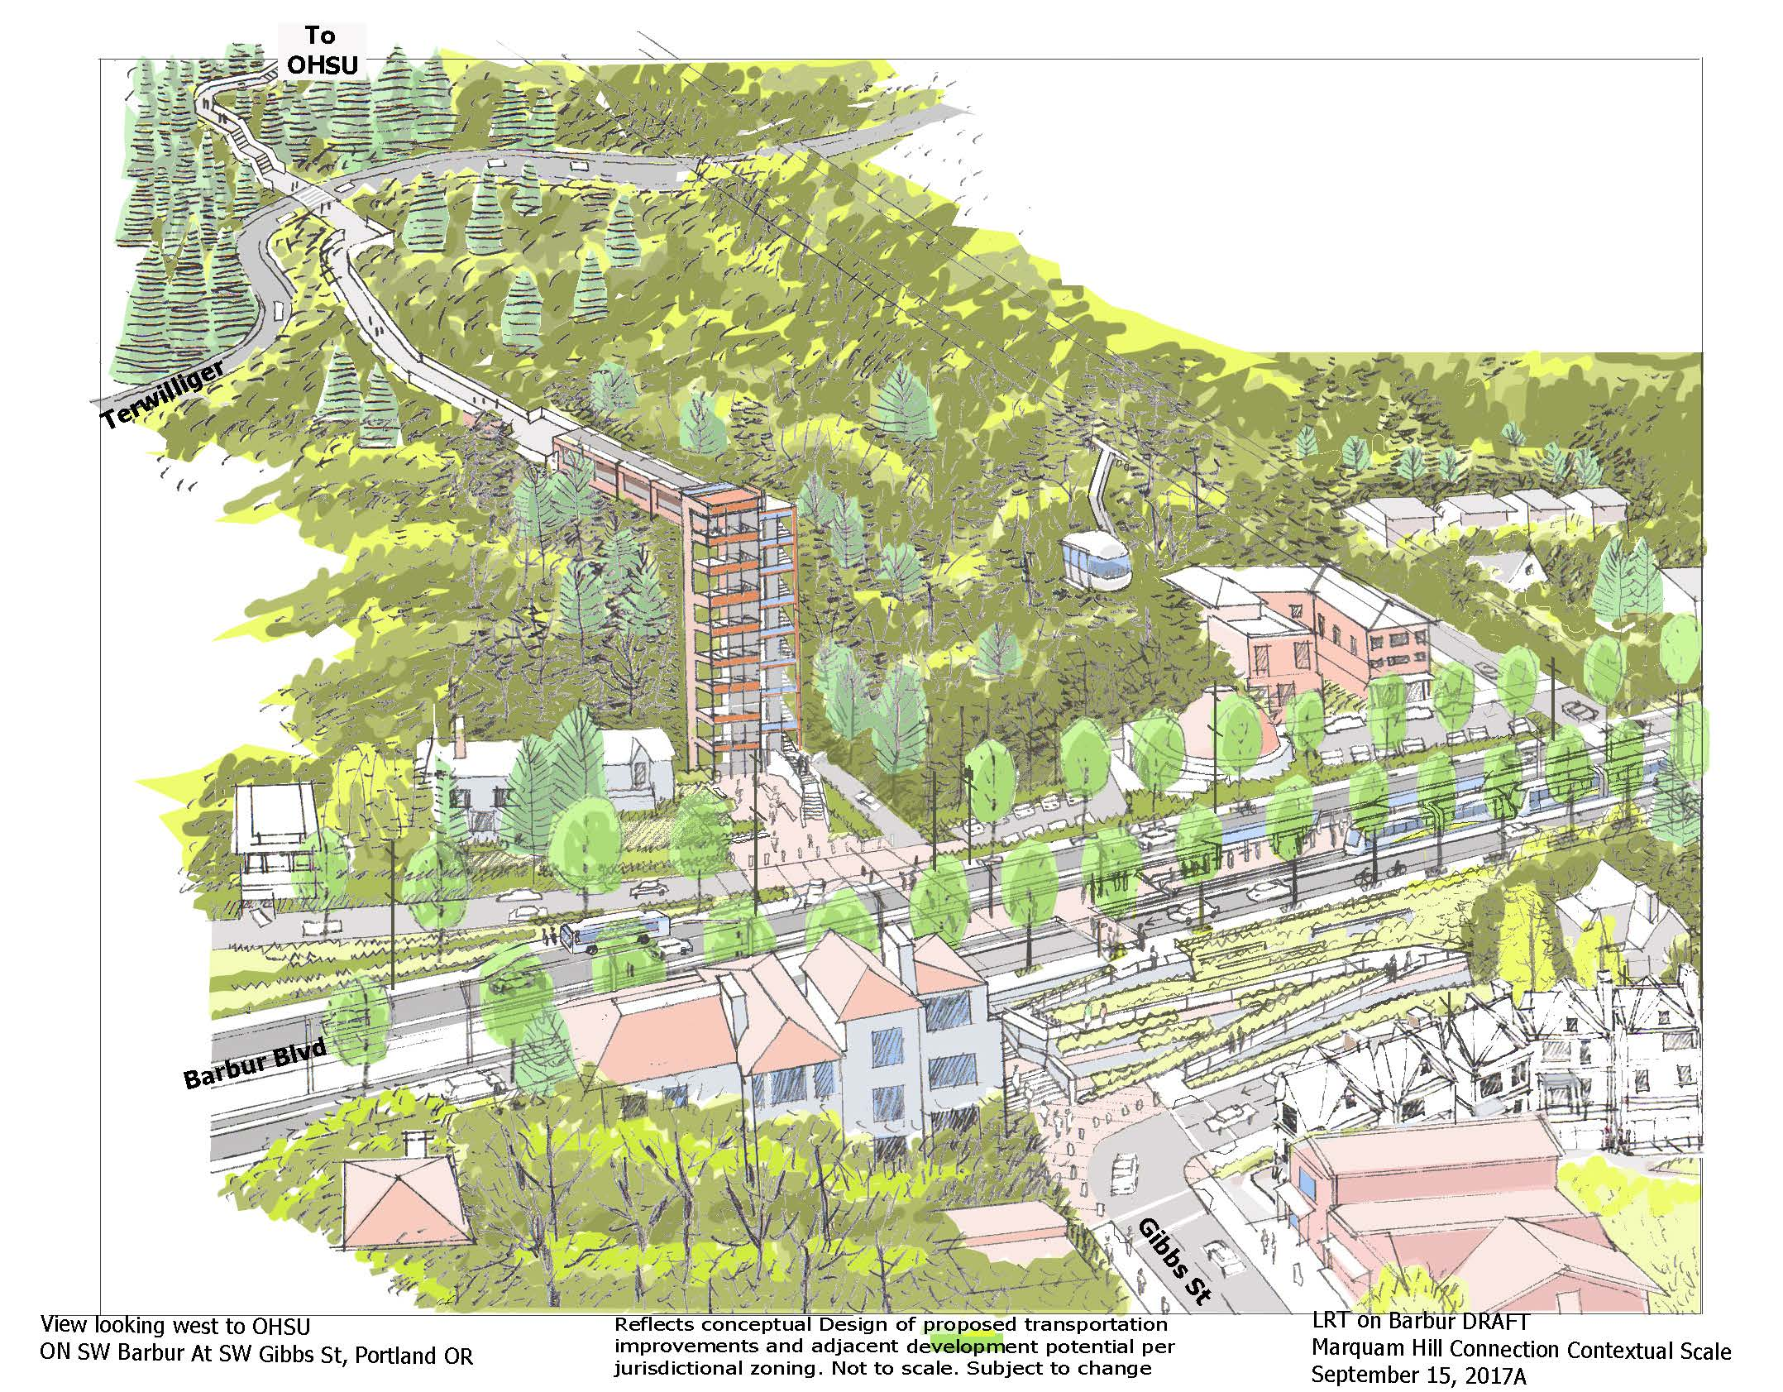
Marquam Hill connection option

Slide 33
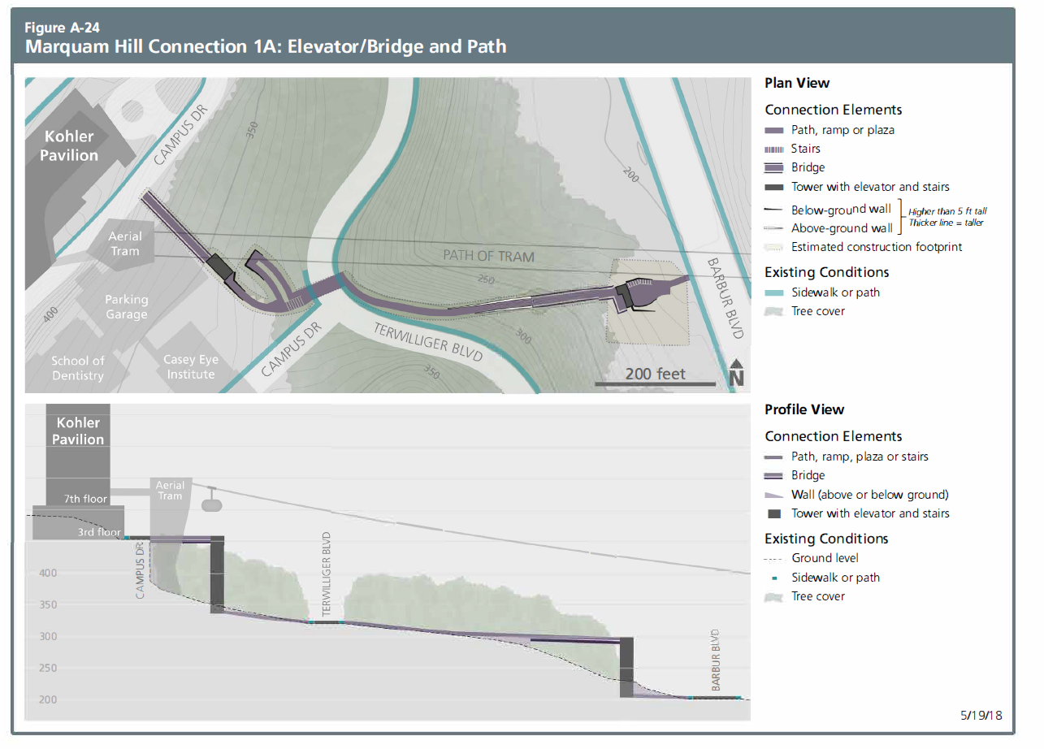
Marquam Hill – bridge/elevator/path

Slide 34
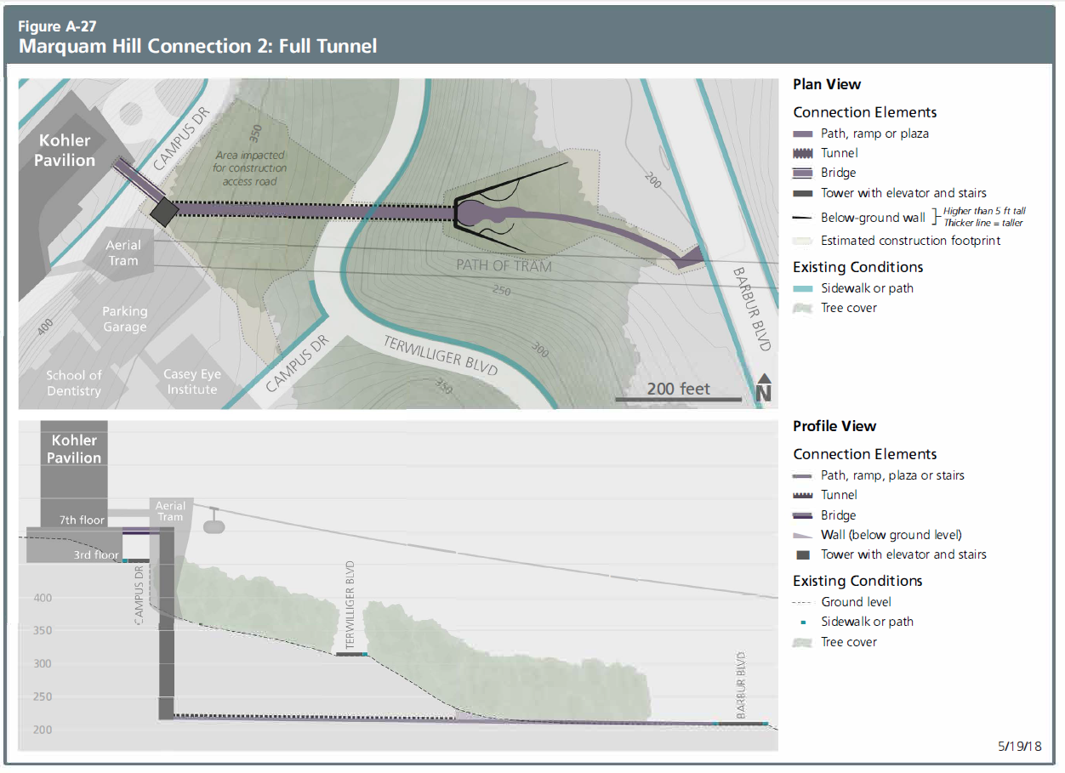
Marquam Hill – tunnel option

Slide 35
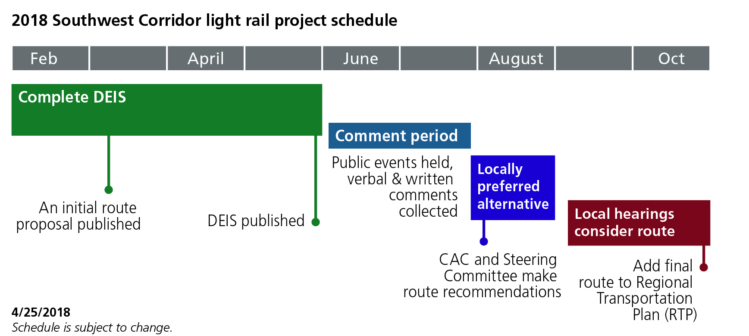
Upcoming decisions
Notes:
ERYN
In December (2016) the steering committee approved which project components and alternatives to study in federal environmental review.
This action marked a critical milestone for the light rail project. The review, a necessary step to qualify for federal matching funds, will assess the proposed alternatives and propose ways to avoid, minimize or mitigate significant impacts.
Around this same time, decision makers in all the jurisdictions will approve a locally preferred alternative, which defines the project’s location and all it’s components (scheduled for early 2018)
HANDOUT OF IRP + MODIFICATIONS

Slide 36
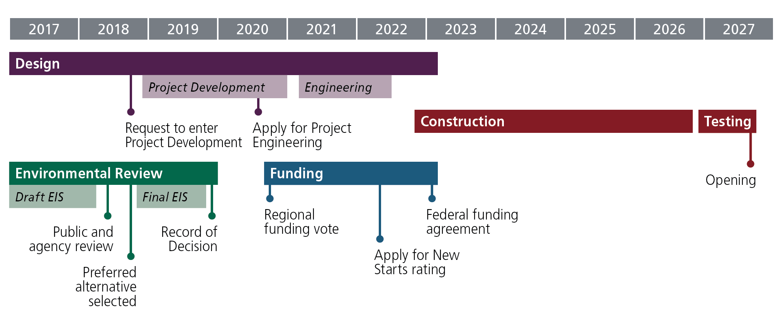
Long-term timeline

Slide 37
Questions?
DEIS comment period
June 15 – July 30 www.swcorridorplan.org
swcorridordeis@oregonmetro.gov

Slide 38
Displacements
Segment A (PSU to Terwilliger)
 | Residential Units | Businesses | Employees
A1 Barbur | 41 | 15 | 108
A2 Naito Brdghd | 53 | 22 | 371
A2 Naito Lim Acc. | 125 | 23 | 231
Segment B (Terwilliger to Tigard)
 | Residential Units | Businesses | Employees
B1 Barbur | 32 | 54 | 500
B2 I-5 / BTC on | 32 | 61 | 469
B3 I-5 / 26th on | 35 | 66 | 565
B4 I-5 / Custer on | 78 | 62 | 496

Slide 39
Displacements
Segment C (Tigard) *Does not include Design Mods
 | Residential Units | Businesses | Employees
C1 Ash / I-5 | 85 | 41 | 734
C2 Ash / RR | 85 | 37 | 323
C3 Clinton / I-5 | 5 | 35 | 839
C4 Clinton / RR | 5 | 31 | 428
C5 Ash Branch | 85 | 55 | 515
C6 Wall Branch | 7 | 47 | 545
See Appendix F for lists and maps of properties potentially acquired
(Does not distinguish full vs. partial)

Slide 40
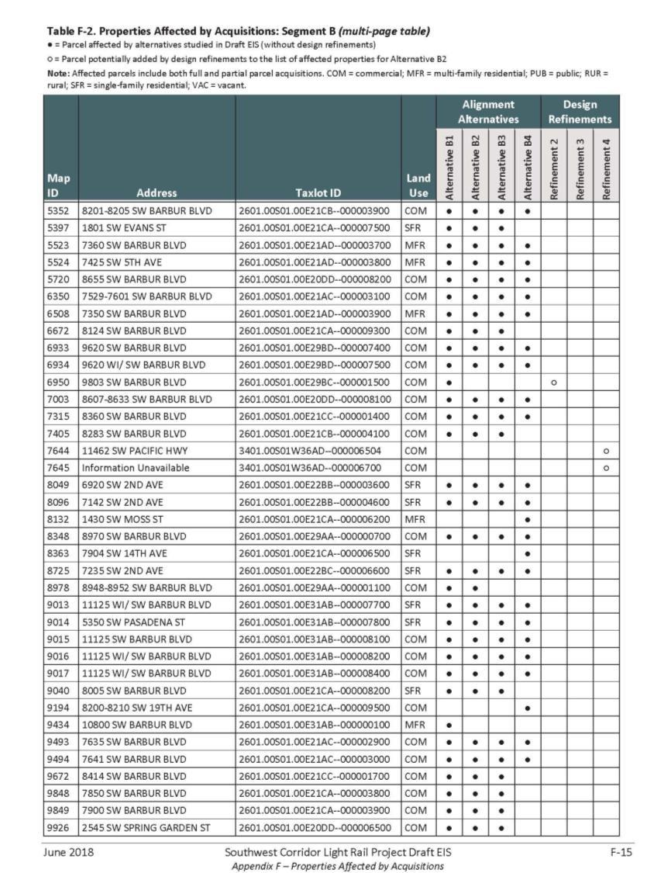
See Appx F for tables of potentially affected properties
Notes:
All of the NRHP‐listed properties in the APE are located in Segment A, which includes one of Portland’s oldest neighborhoods (Lair Hill), although potentially eligible properties exist in each segment.

Slide 41
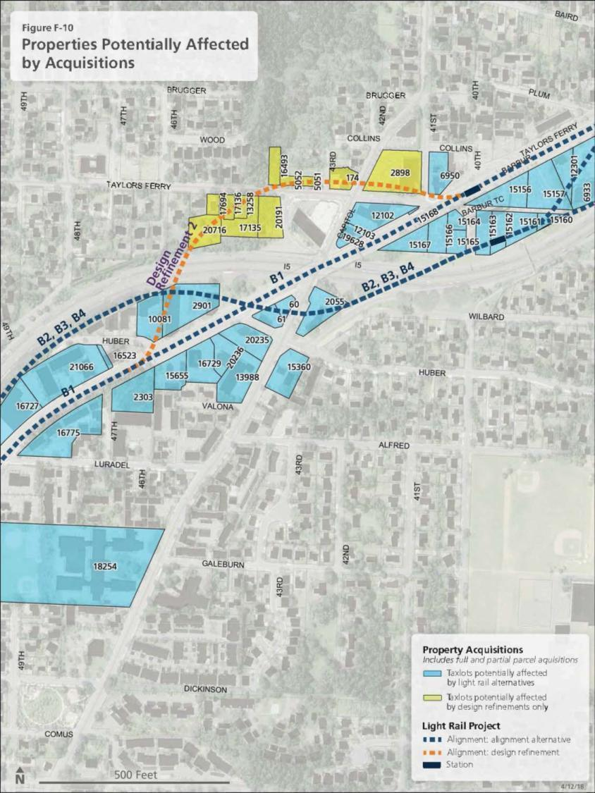
See Appx F for maps of potentially affected properties
Notes:
All of the NRHP‐listed properties in the APE are located in Segment A, which includes one of Portland’s oldest neighborhoods (Lair Hill), although potentially eligible properties exist in each segment.

