Slide 1



SW Corridor Light Rail Project
Design Commission
June 21, 2018
Teresa Boyle, Major Projects Section Manager
Notes:
Two things – project overview and partnership with DC

Slide 2
SW Corridor Light Rail Project
Basics
Portland to Tigard and Tualatin via Barbur Corridor
12 miles long
Multiple P&Rs – two in Portland
Final planned MAX line for region
43,000 riders in 2035
Budgeted at $2.6B - $2.8B

Slide 3
Partners
Project Leads: Metro - EIS & TriMet - design
ODOT
Washington County
Cities: Portland Tigard Tualatin Sherwood Beaverton Durham King City

Slide 4
City Team
Steering Committee: Comm. Saltzman/Leah Treat
PBOT: Project Management
BPS: Partner
  Other Bureaus:
  PWB, BES, Parks, BDS, Fire, Police, OMF, Prosper, PHB, City Atty
Notes:
18 mo deis

Slide 5
Key Project Milestones
DEIS - public review Mid June - July
Steering Comm select LPA Mid August
Council adopts LPA late Sept – Oct
Metro Council adopts LPA October - Nov
and updates the RTP

Slide 6
Alignments
In Portland
Studied in DEIS
Barbur or Naito S of I-405
Barbur or adj to I-5 Burlingame to Capitol Highway
Barbur or adj to I-5 from Capitol Hway west to City limits

Slide 7
Initial Route Proposal (IRP)
New Requirement by FTA
Initial suggestion for the light rail route
Published in DEIS to solicit comment
It is not characterized as the Locally Preferred Alternative (LPA)

Slide 8
What Comes After LPA?
2019/2020:
  Project Development
  Develop 30% plans
  Complete FEIS
2020: Portland and Partners commit local match
2020: Voters decide on regional funding
2022: Construction starts
2027: Light rail opens for service

Slide 9
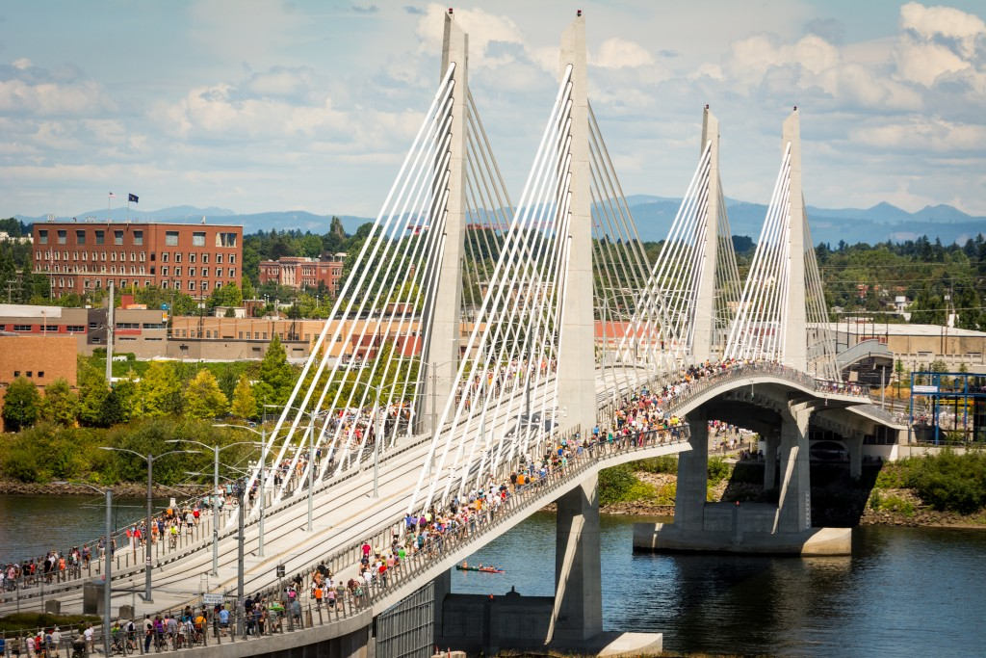
Transit Brings Quality Design
Notes:
TriMet and the City of Portland have been close collaborators over the years, and beginning in 2000 have created the ‘Guide to Standard Light Rail Transit Improvements in Public Streets’; a compendium of all the transit elements that have been reviewed and approved through the Design Review process.

Slide 10
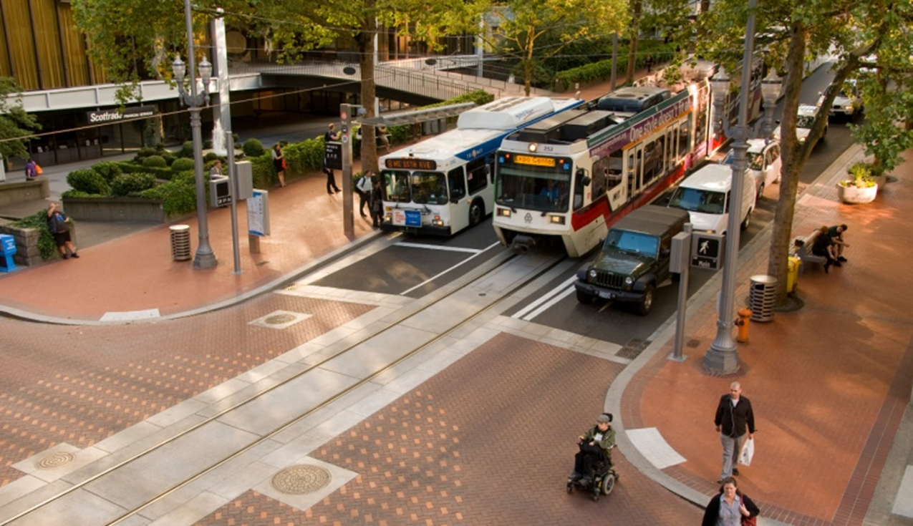
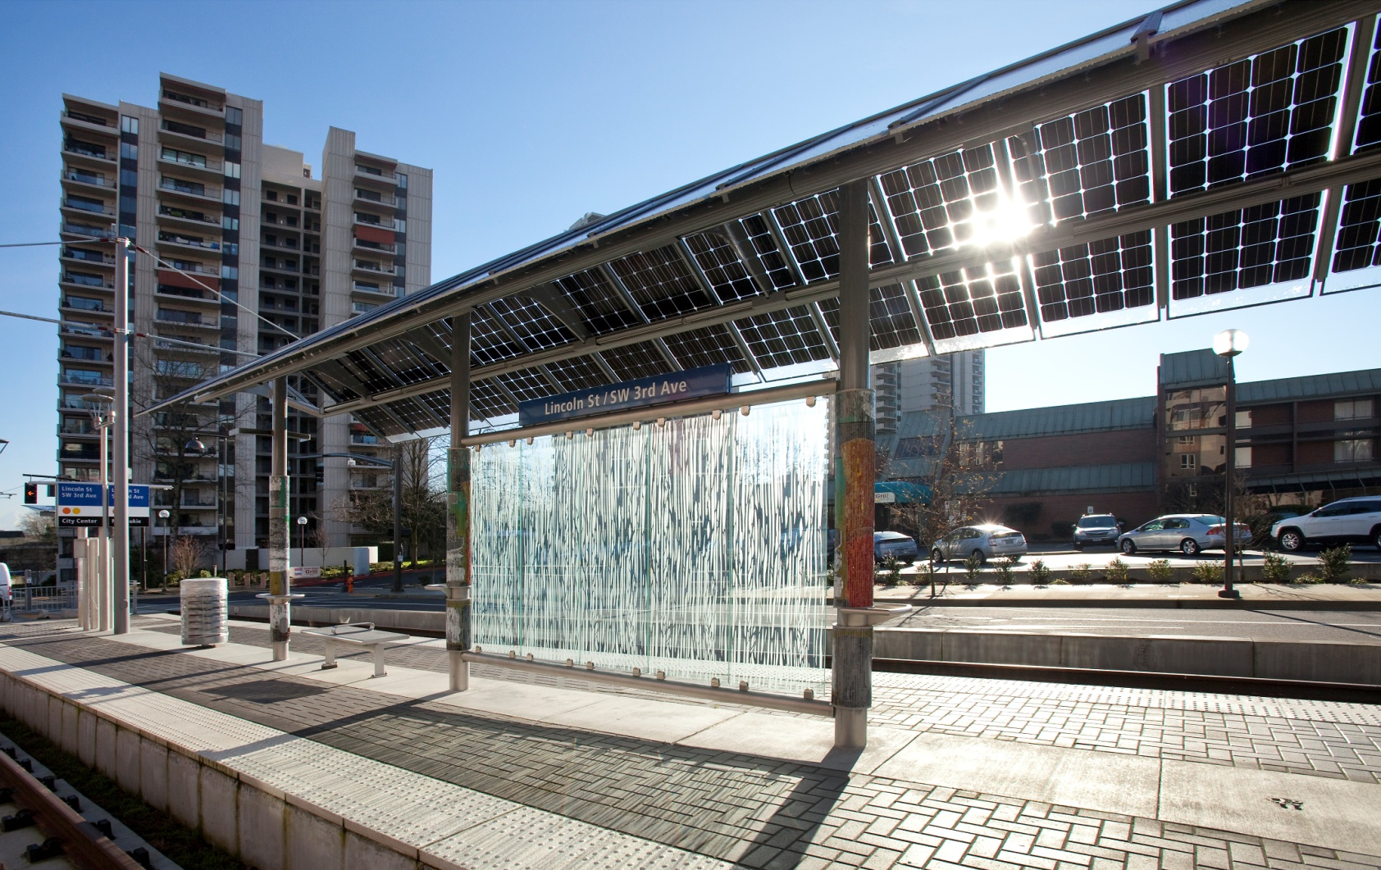
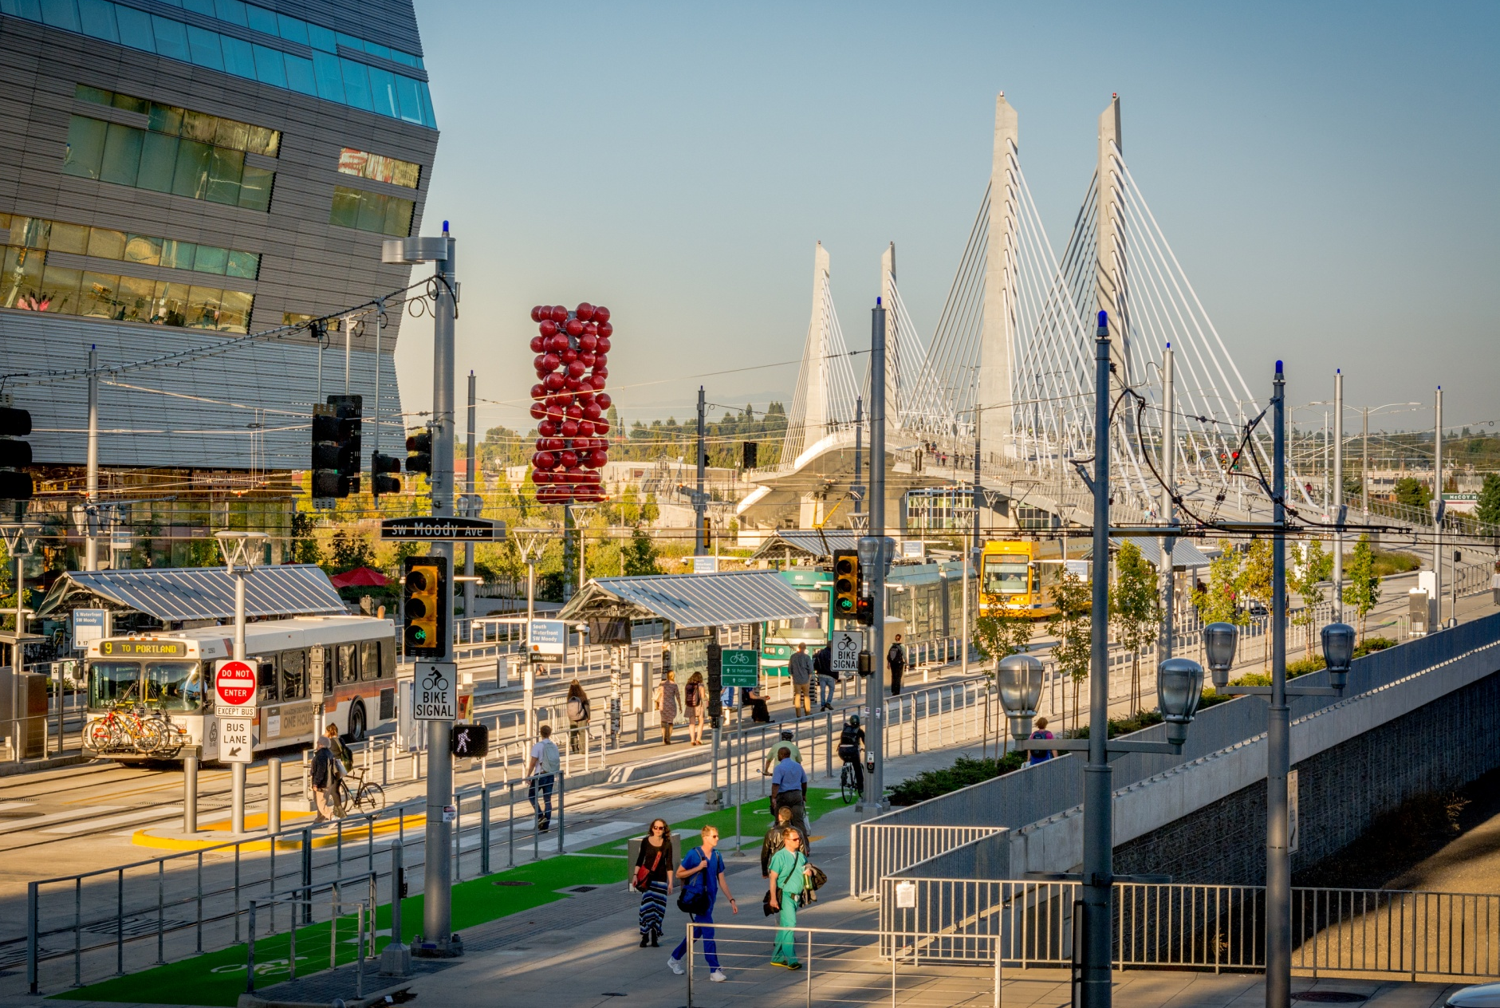
Design Commission - Collaboration
Notes:
These discussions help us hone our design options into plausible and approvable Final Design strategies. Once we establish agreement on the use of our benchmark Standard elements…establishing an acceptable design quality…we can then focus on new elements, or Non-Standard elements.

Slide 11
Standard Transit Elements in ROW
DC’s role – non std elements in public ROW
  Blue, Red and Yellow lines
BPS/PBOT/TriMet found better way
Adopted stds for transit in ROW in 2007
Updated with Orange Line
Notes:
Joslin/Heron, Boyle, Hastings
Trust
Mutual Respect

