Slide 1
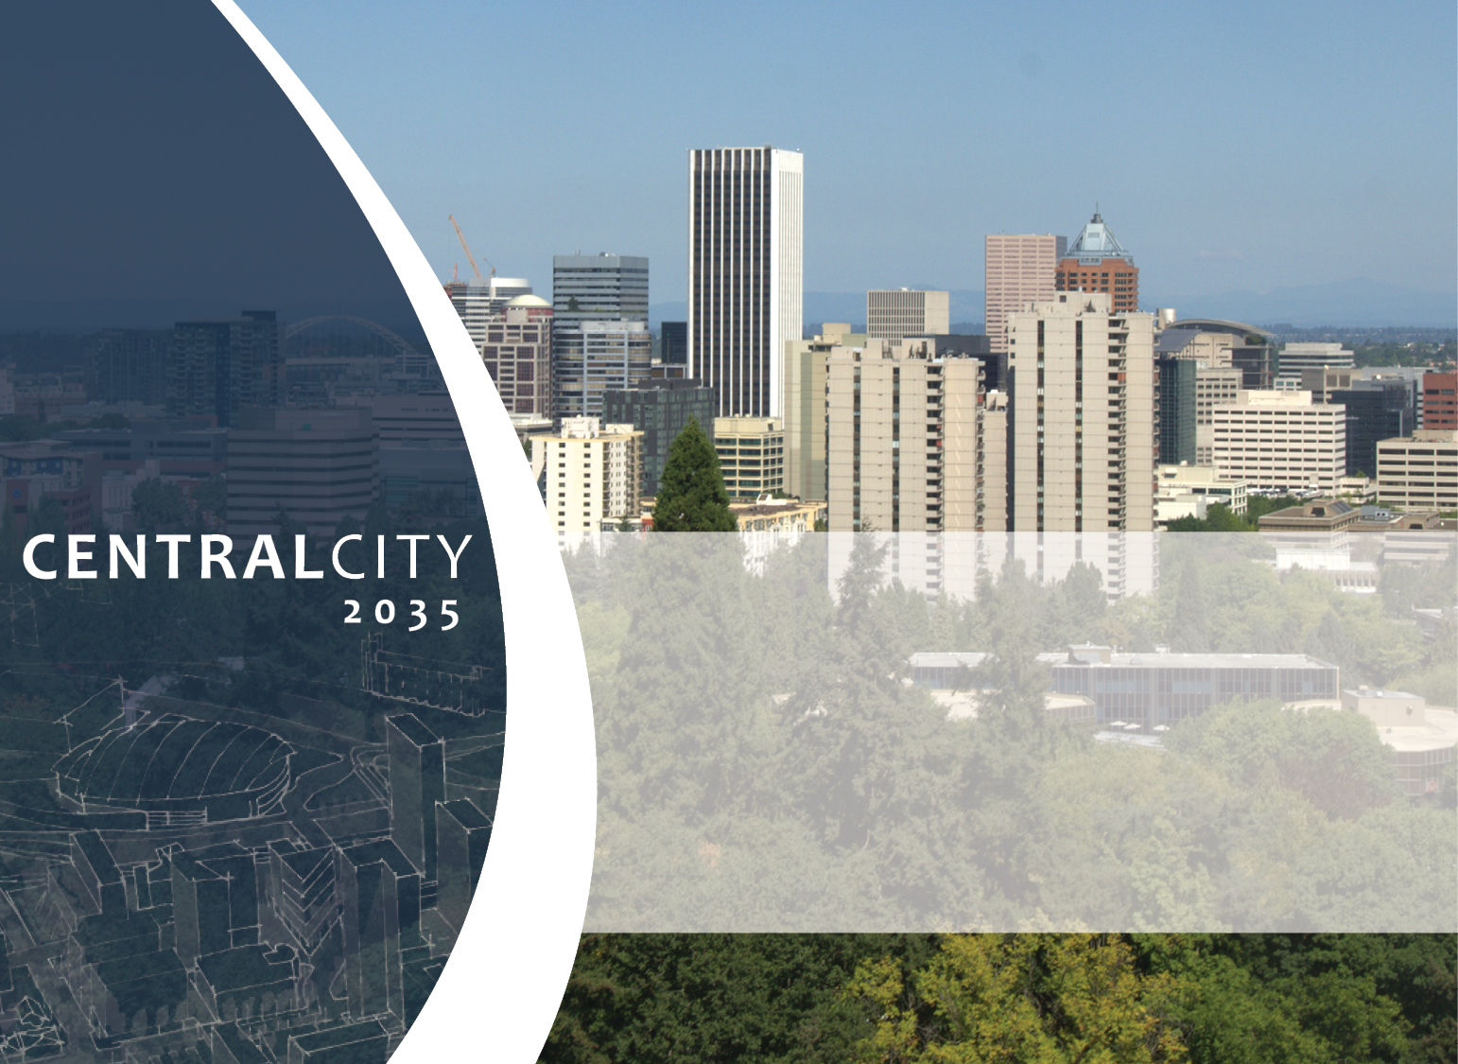

Central City Master Plan
Portland Design Commission Briefing
June 14, 2018

Slide 2
Purpose
Purpose. A Central City Master Plan establishes a clear development strategy for significant redevelopment sites in the Central City. Central City Master Plan review is intended to ensure that development on the site will positively contribute to the existing and desired surrounding urban form. The review will result in an urban design framework and layout for the site as a whole, allowing subsequent reviews for individual buildings and other development to focus on materials and façade treatment. A Central City Master Plan is intended to result in the following urban design outcomes:
A development site that has a strong orientation towards transit and multimodal transportation alternatives.
A safe and vibrant public realm, supported by active ground floor uses, open space areas and an internal circulation system that provides access to adjacent public rights-of-way and multimodal transportation options;
A development site that has adequate urban services such as water, stormwater, sewers, and fire-hydrants, and
Building bulk, height, orientation, and programming that protects public views and preserves light and air within the public realm, and is oriented to active and passive public gathering spaces, including public open spaces, transit stations, and the Willamette River.

Slide 3
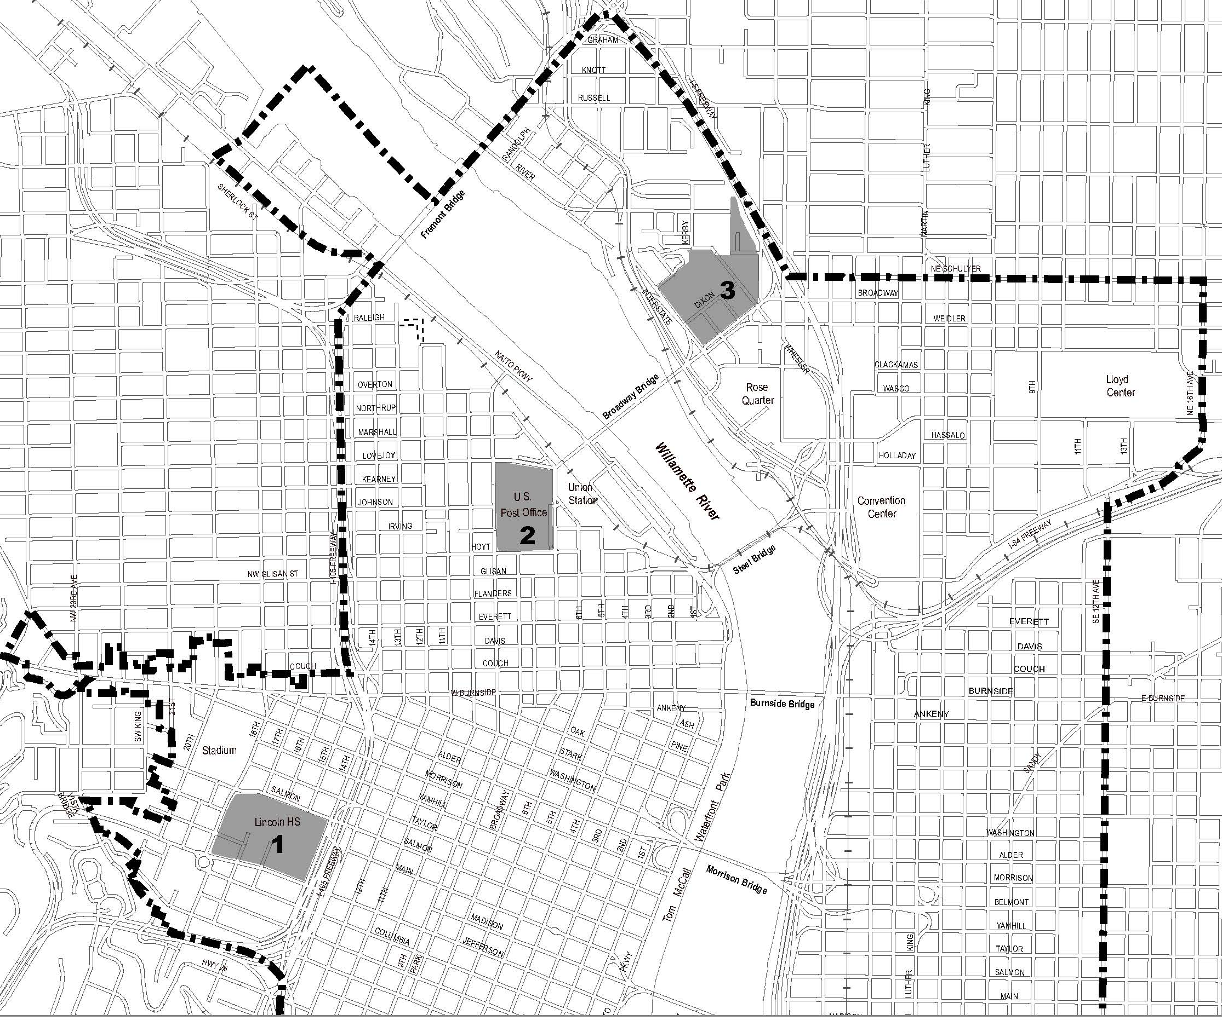
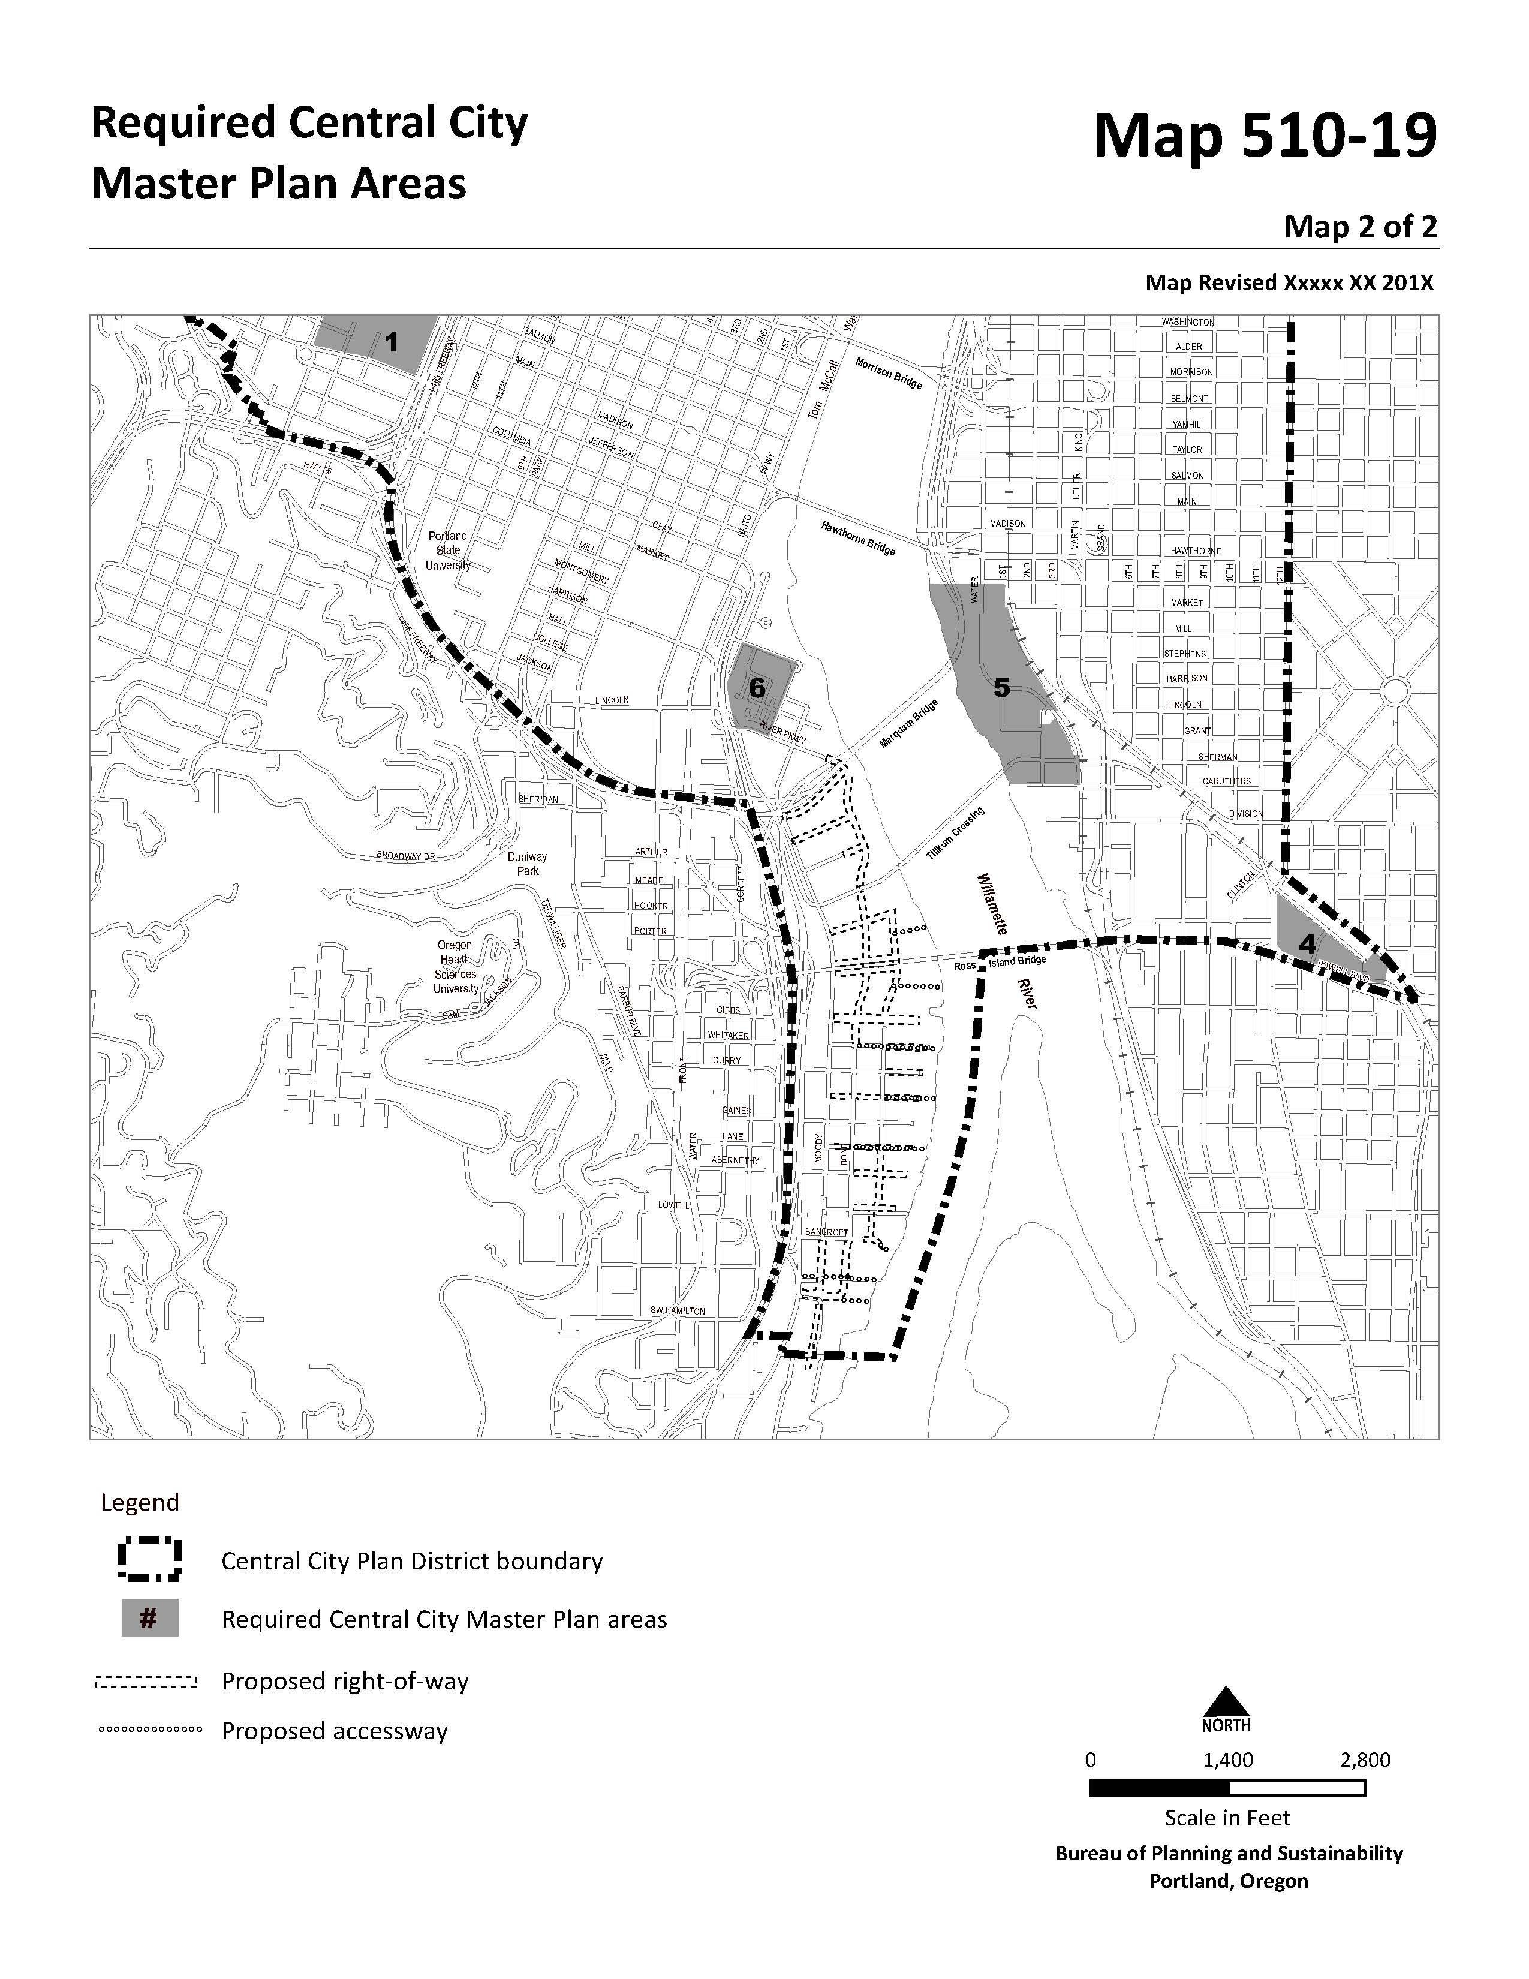
Required Sites
Lincoln High School: Area suffers from a lack of public open space and poor access for all transportation modes. However, the western edge of the area has access to light rail service.
US Postal Service Main Branch: 14-acre site located at the end of the Broadway Bridge and northern terminus of the North Park Blocks. The Broadway Corridor Plan extends park blocks onto the site as well as some adjacent public rights-of-way.
Portland Public Schools’ Headquarters (AKA Blanchard Site): 12-acre site in the Lloyd District is adjacent to industrially zoned lands in Lower Albina and MODA Center on south side of Broadway.
Clinton Station Area: This 10-acre area contains a light rail station and is owned primarily by two property owners. The site is surrounded by a combination of low density residential and industrial uses.
OMSI Station Area: Area is approximately 30 acres in size and contains properties held by OMSI, Portland Community College, and Portland Opera. Several lots are adjacent to light rail and streetcar stations, while others face the Willamette River.
RiverPlace Area: The 8-acre site, is adjacent to the riverfront, South Waterfront Park, and is visible from the Marquam and Hawthorne Bridges. Issues associated with site include need to provide additional open space and connections to local multimodal transportation network.

Slide 4
CCMP Flexibility
CCMP’s allow for:
FAR transfers between sites, without meeting the prioritization established by 33.510.205.B, which requires FAR to first be earned via Inclusionary Housing provisions, or transferred from a historic landmark or riverfront site.
New minimum FAR standard can be met on site as a whole, not required for each individual building site within master plan area.
Bonus heights may be achieved without having to first earn via an FAR bonus or transfer as required by 33.510.210.D.3.
Allows residential development within OMSI Station Area, as long as specific approval criteria is first met.

Slide 5
Review Procedure
Type III Review
All CCMP’s are processed by the Design Commission as a Type III design review.
Design Advice Requests
A Design Advise Request (DAR) is required before an applicant my submit an application for the review of a CCMP.
Duration and Amendments
CCMP’s expire 10-years from date of final decision in not development activity occurs
Amendments required for:
Changes to master plan boundary
Removing or changing location of approved right-of-way, accessways, and open areas
Changes to the number of buildings, location of ground floor uses
Increases or decreases of 15 percent or more to an approved building envelop

Slide 6
CCMP Components
Boundary Diagram

Slide 7
CCMP Components
Proposed Urban Design Framework: Site Plan

Slide 8
CCMP Components
Proposed Urban Design Framework: Three-Dimensional Massing Diagram

Slide 9
CCMP Components
Proposed Urban Design Framework: Sections, Elevations, and Perspectives

Slide 10
CCMP Components
Proposed Urban Design Framework: Project Narrative

Slide 11
CCMP Components
Proposed Urban Design Framework: Infrastructure Capability

Slide 12
Approval Criteria
Consistency with subdistrict goals and policies, and Central City Fundamental Design Guidelines
Activation of the Willamette Riverfront
No significant impacts on adjacent industrial operations, including freight mobility
Adjacent and interior parks will be activated and not significantly impacted by new development
Overall master plan site will be transit oriented
Open space is distributed through site and connected with adjacent open space areas and Willamette River
Local transportation system is capable of handling proposed scale of development
Master plan site is connected with adjacent multimodal transportation network
There will be adequate and timely infrastructure to support development on site
Site plan designed to reduce potential conflicts between uses on and adjacent to site.

Slide 13
Open Area Requirement
Purpose. The open area requirements promote a site design that provides access to light and air, opportunities for outdoor activities including active and passive recreation, public gathering spaces, and visual relief from the built environment.
The standards are also intended to produce open areas at a scale compatible to what large sites would have if divided by the 200’ grid pattern common to the Central City.
Required.
At least 20% of master plan site must be in open area. And, at least 20,000 sq. ft., or 50% (whichever is less) of open area much be a park or plaza.
One tree per 1,000 sq. ft. or park or plaza if using small trees.
One tree per 2,000 sq. ft. of park or plaza if using medium or large canopy trees.
Parks and plazas must be sited to ensure no more than 50% of area is in shadow at noon on 3/21. 6/21, and 9/21.
Parks and plazas must be site to ensure no more than 75% of area is in shadow at noon on 12/21, and 3:00 PM on 3/21, 6/21, and 9/21.

