Slide 1
Planned Development Bonus Portland Design Commission Briefing June 14, 2018

Slide 2
Planned Development Bonus
Mixed Use Zones project created new Commercial/Mixed Use Zones outside Central City: CR, CM1, CM2, CM3, CE, CX.
Planned Development Bonus is a new bonus option for sites over two acres in some C/MU Zones.
Not available in Central City, Gateway, Historic, Conservation and some PDs.

Slide 3
Planned Development Bonus
Allows additional height and access to FAR when project includes:
Inclusionary Housing - meet the requirements for inclusionary housing as part of the project.
Plaza or Park - a publicly-accessible plaza or park, equal to of 15% of the site area.
Energy Efficient Buildings - meet new BPS energy efficient buildings requirements.

Slide 4
Planned Development Bonus
Zone | Base Maximum Height | Base Maximum FAR | PD Bonus Maximum Height | PD Bonus Maximum FAR
CM2 | 45’ | 2.5:1 | 75’ | 4:1
CM3 | 65’ | 3:1 | 120’ | 5:1
CE | 45’ | 2.5:1 | 75’ | 4:1
CX | 75’ | 4:1 | 120’ | 6:1

Slide 5
Planned Development Bonus
Design Commission Review
Type III
Site plan, massing and transitions

Slide 6
Planned Development Purpose
The Planned Development regulations provide an opportunity for innovative and creative development… allow flexibility, and in some cases increased intensity of development… if the proposed development is well-designed and can be successfully integrated into the neighborhood and provides public benefits. Overall, a Planned Development is intended to promote:

Slide 7
Planned Development Purpose
High quality design that is integrated into the broader urban fabric, and complements existing character within the site and adjacent to the site;
Development that is pedestrian-oriented, with a strong orientation towards transit and multimodal transportation alternatives;
Building bulk, height, and orientation that ensures that light and air is accessible within the public realm, and that public view corridors are protected;

Slide 8
Planned Development Purpose
A safe and vibrant public realm, with buildings and uses that are oriented to activate key public gathering spaces, be they public open space, transit stations, or the Willamette River;
Open space areas that include gathering spaces and passive and/or active recreation opportunities;
Affordable housing; and
Energy efficient development.

Slide 9
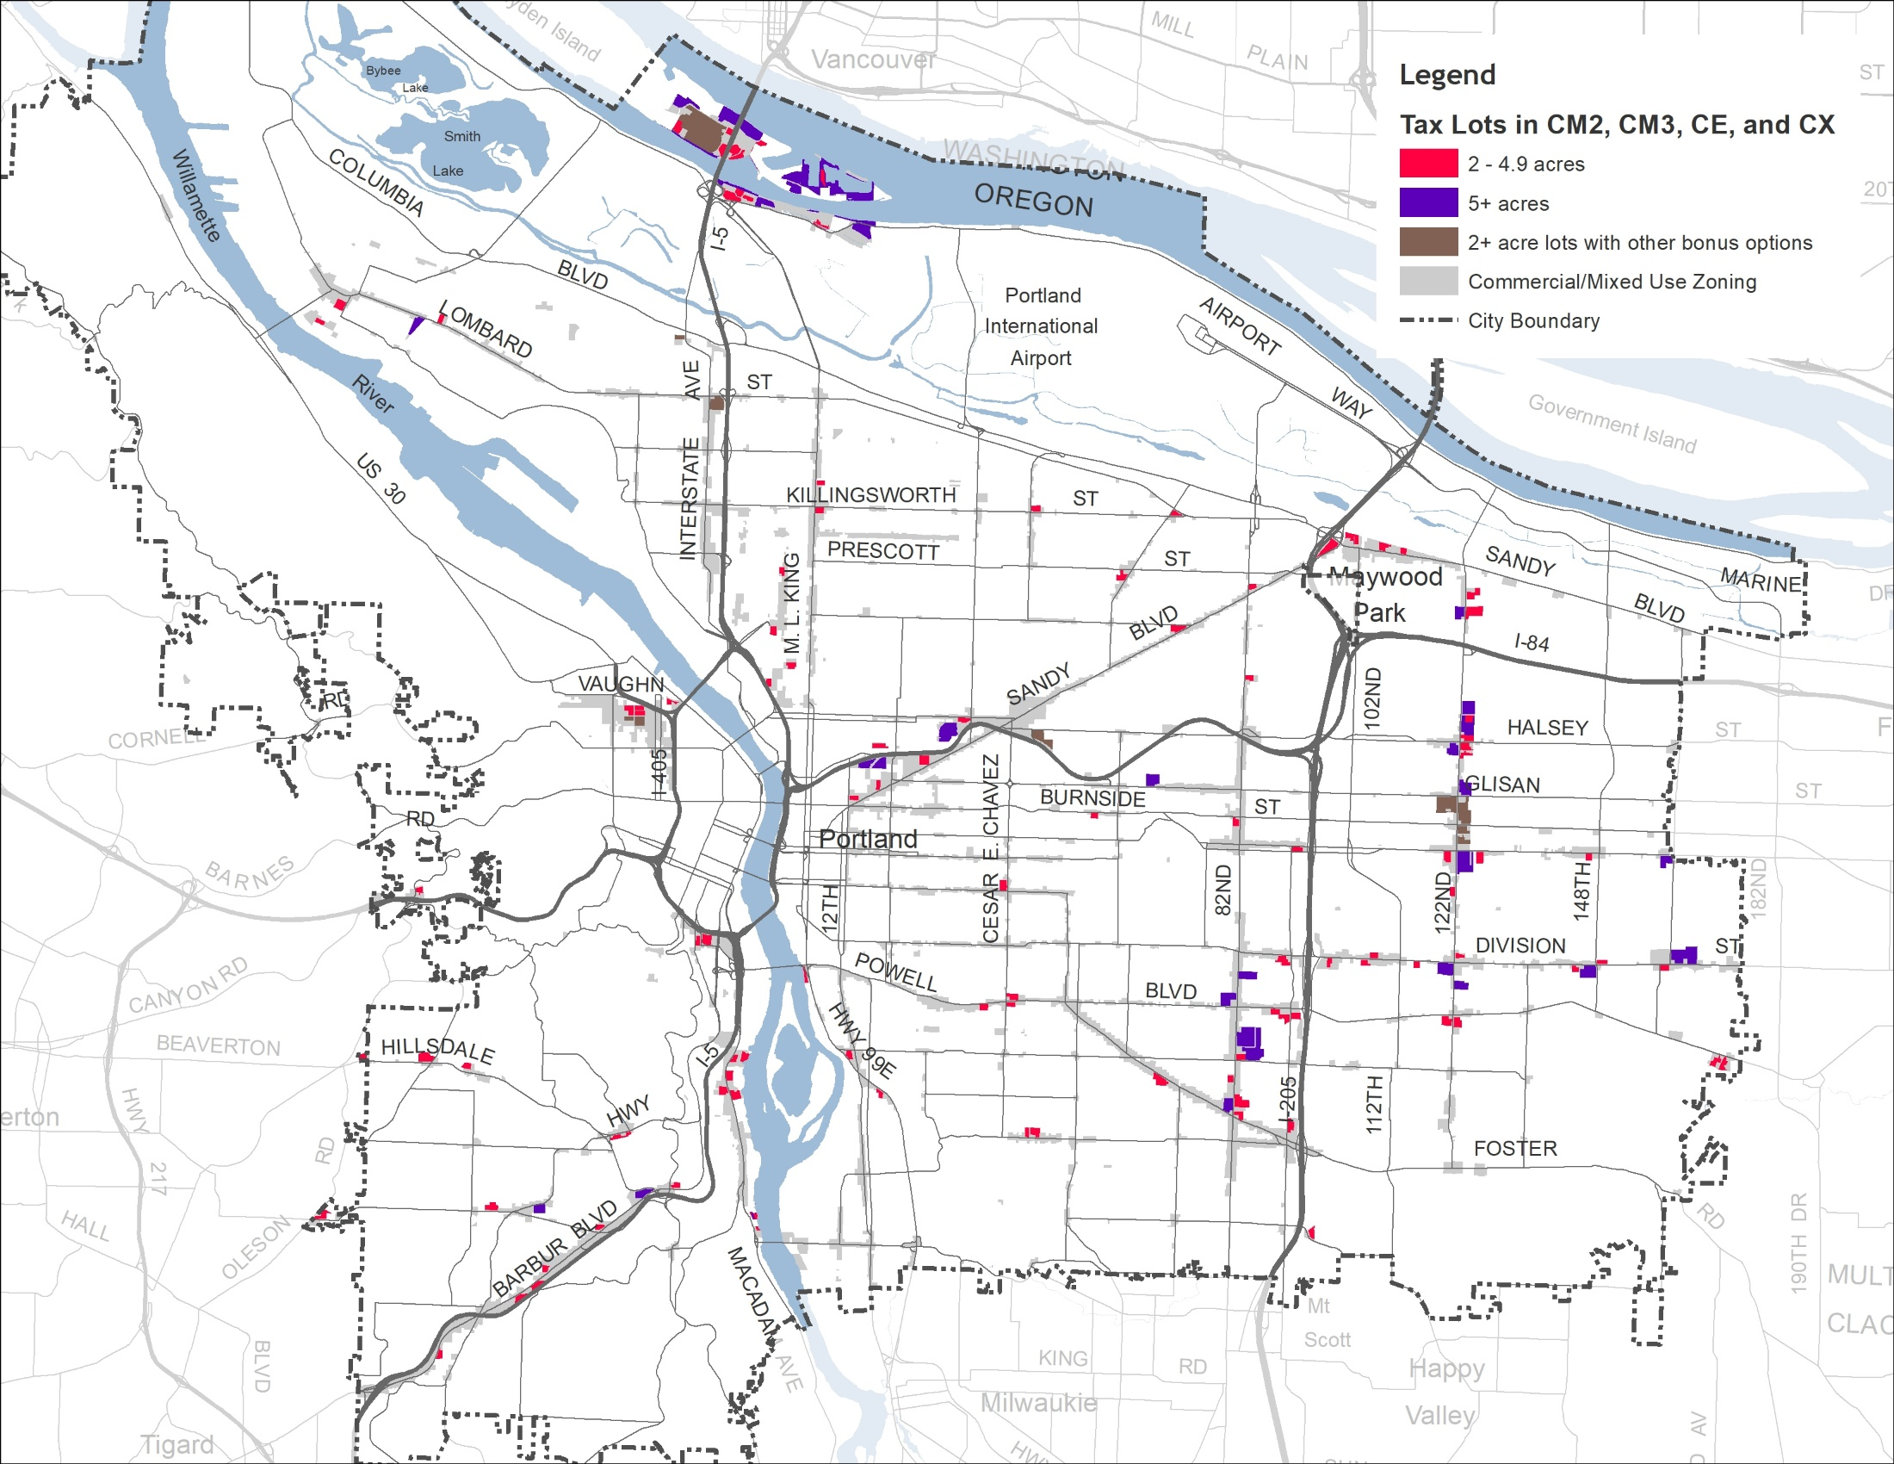
2+ Acre C/MU Sites (current)

Slide 10
Planned Development Approval Criteria
Urban design/development framework:
Community Design Guidelines
Context of the area, building massing and transitions to adjacent areas
Proposed parks, plazas, open areas
Active ground floor uses
Transportation and circulation
Stormwater management
Phasing, and required elements

Slide 11
Questions?

