Slide 1
Context Workshop
Design Commission | 3.1.2018

Slide 2
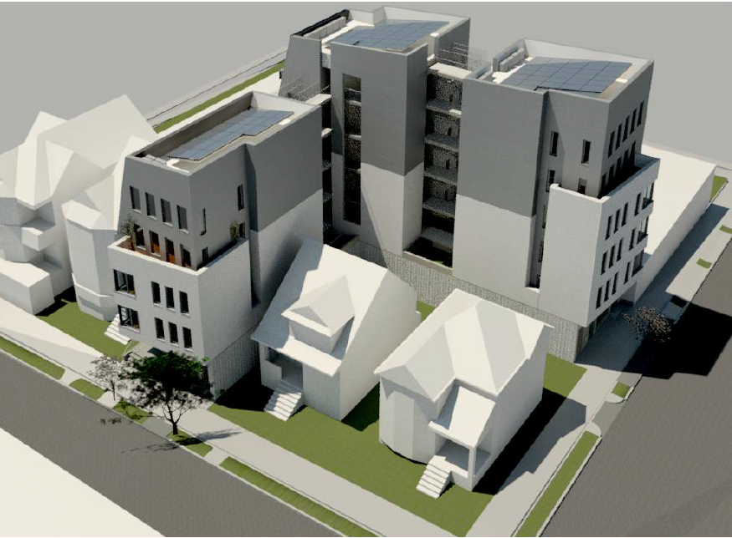
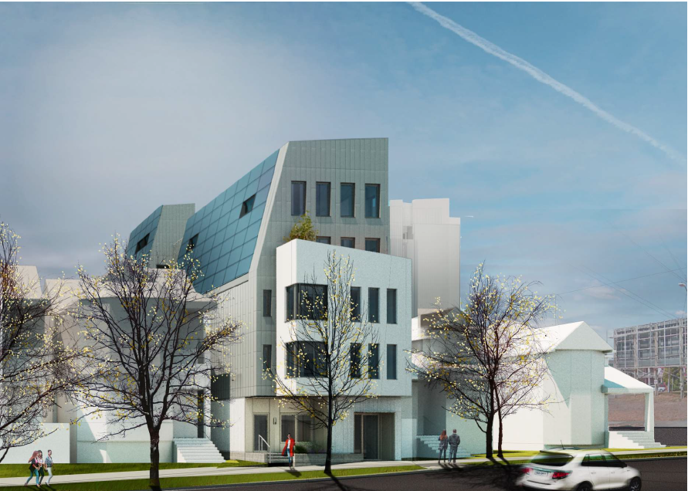
1122 SE Ankeny
Renderings
Design Commission | 3.1.2018

Slide 3
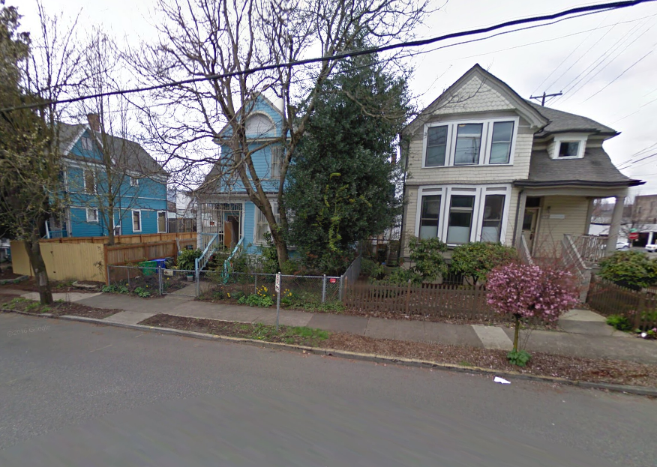
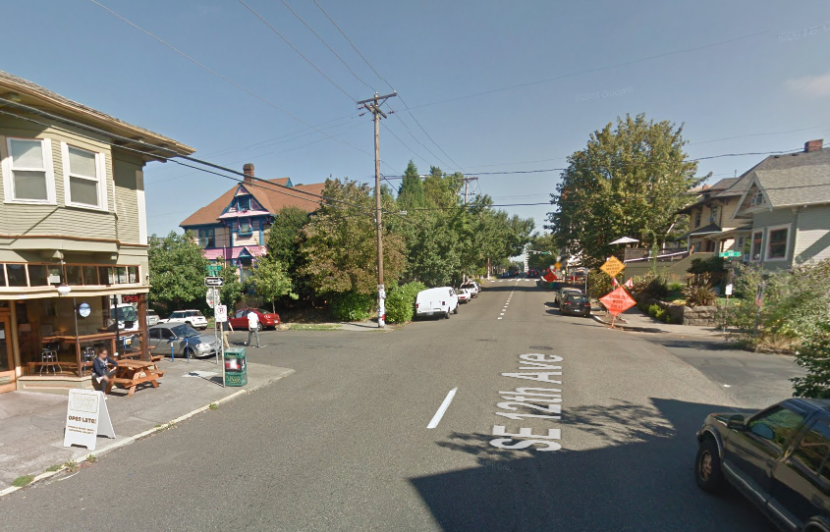
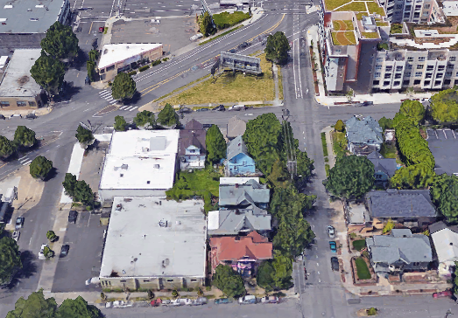
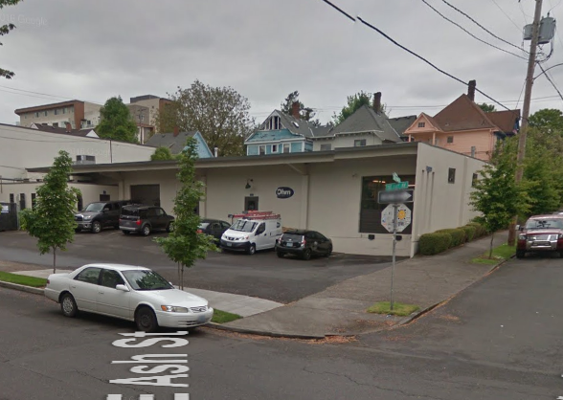
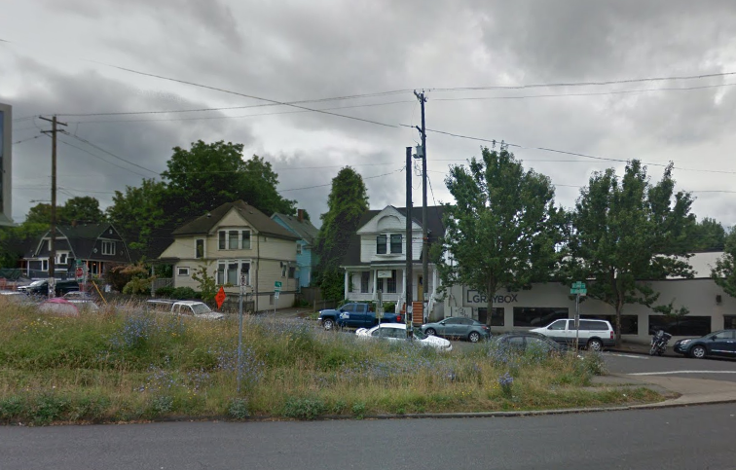
1122 SE Ankeny
Context
se 12th ave
Design Commission | 3.1.2018

Slide 4
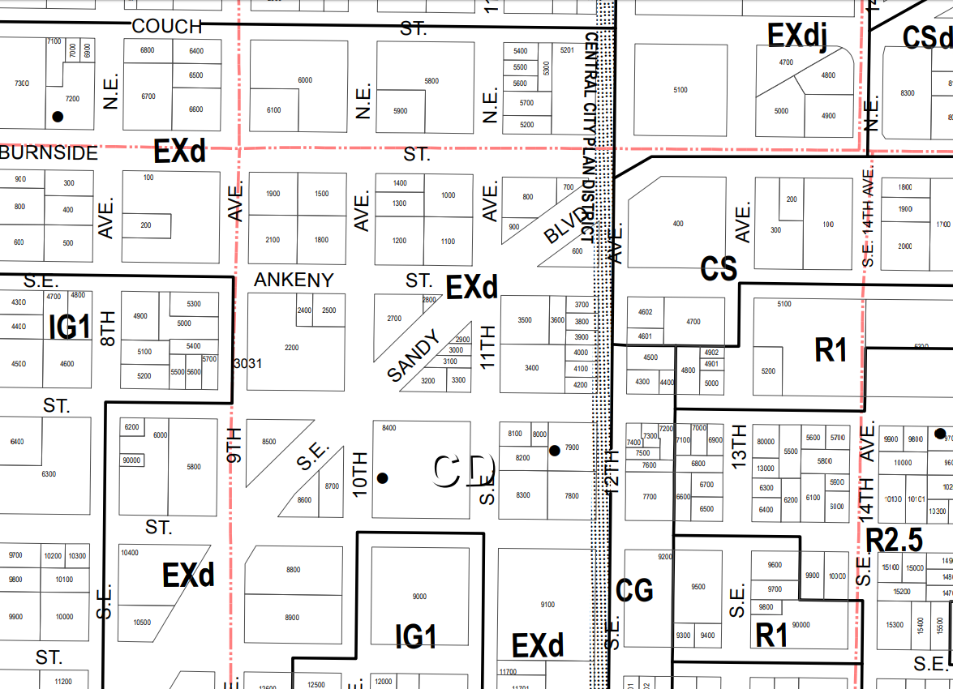
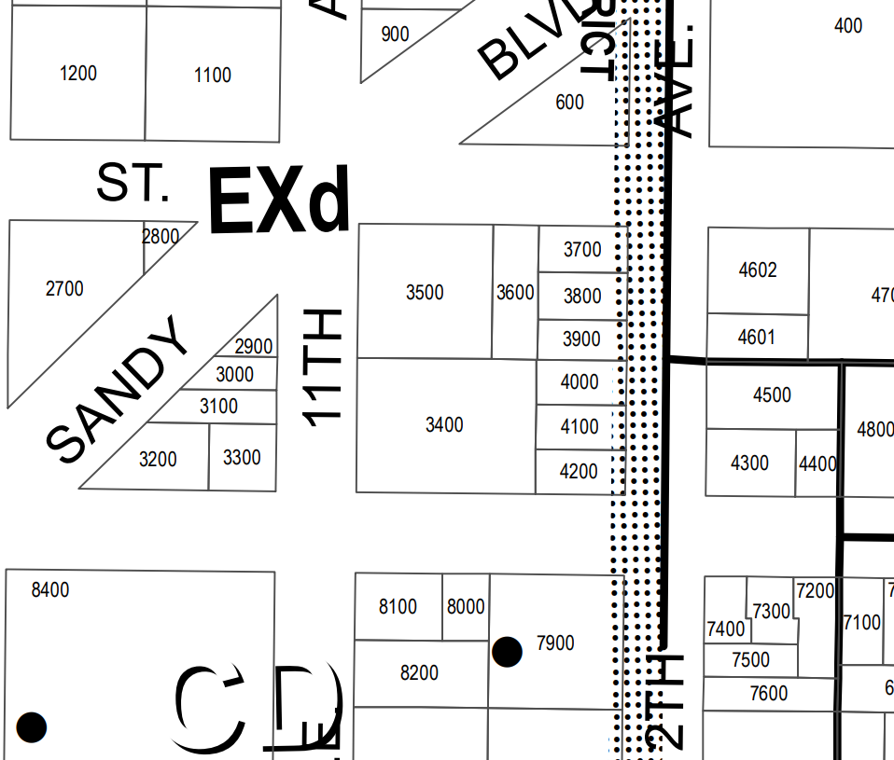
1122 SE Ankeny
Zoning
Central City Plan District/ Central Eastside Subdistrict
Central City Fundamental Design Guidelines
Special Design Guidelines for the Design Zone of the Central Eastside District
Design Commission | 3.1.2018

Slide 5
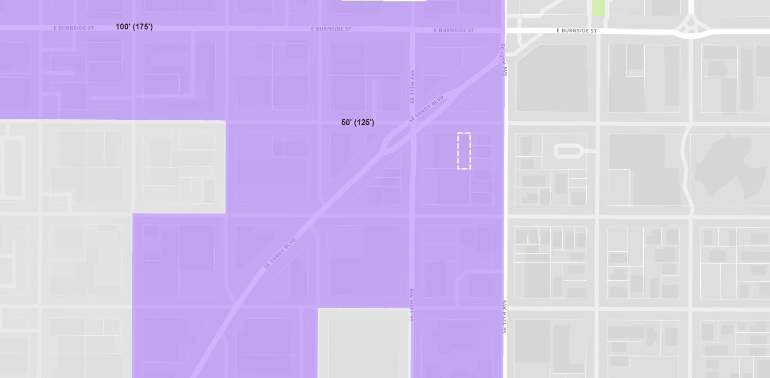
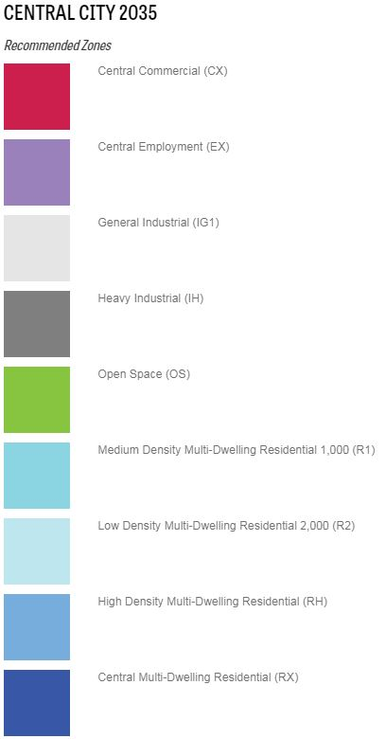
1122 SE Ankeny
Central City 2035
100’(175’)
50’(125’)
Design Commission | 3.1.2018

Slide 6
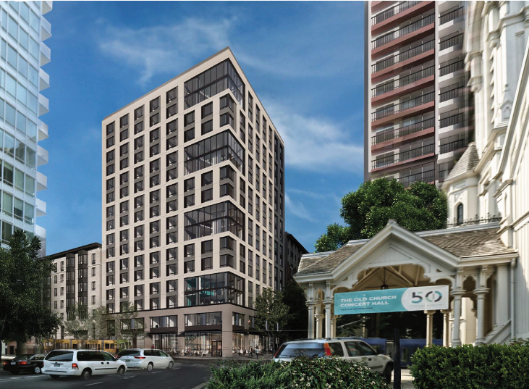
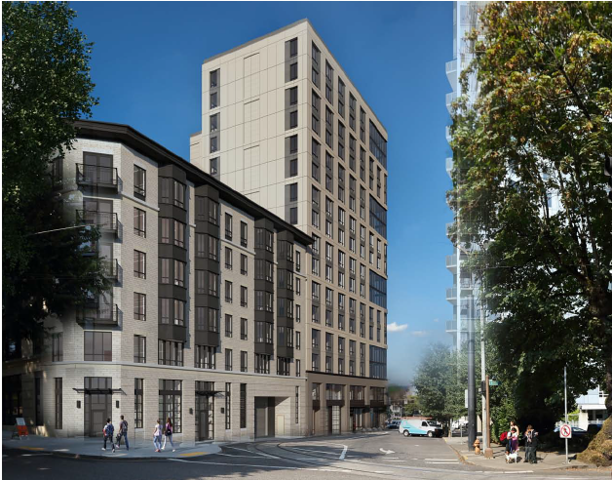
Clay + Tiffany
Renderings
Design Commission | 3.1.2018

Slide 7
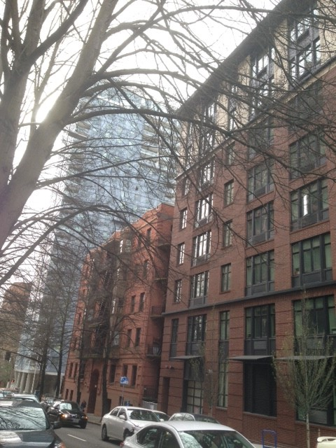
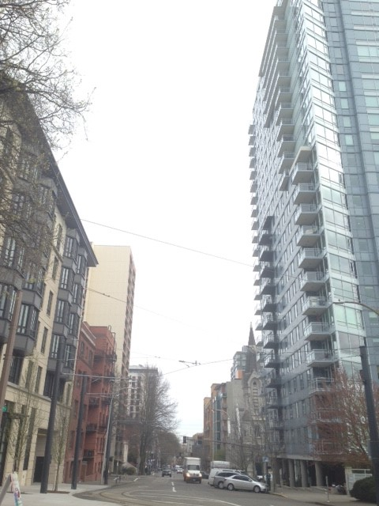
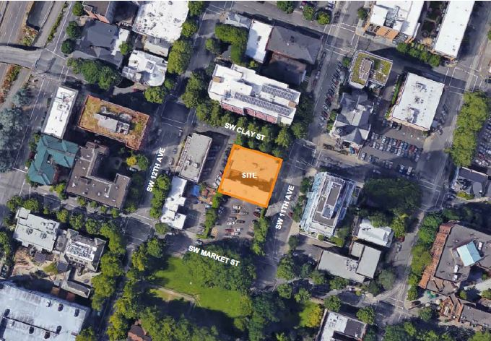
Clay + Tiffany
Context
Design Commission | 3.1.2018

Slide 8
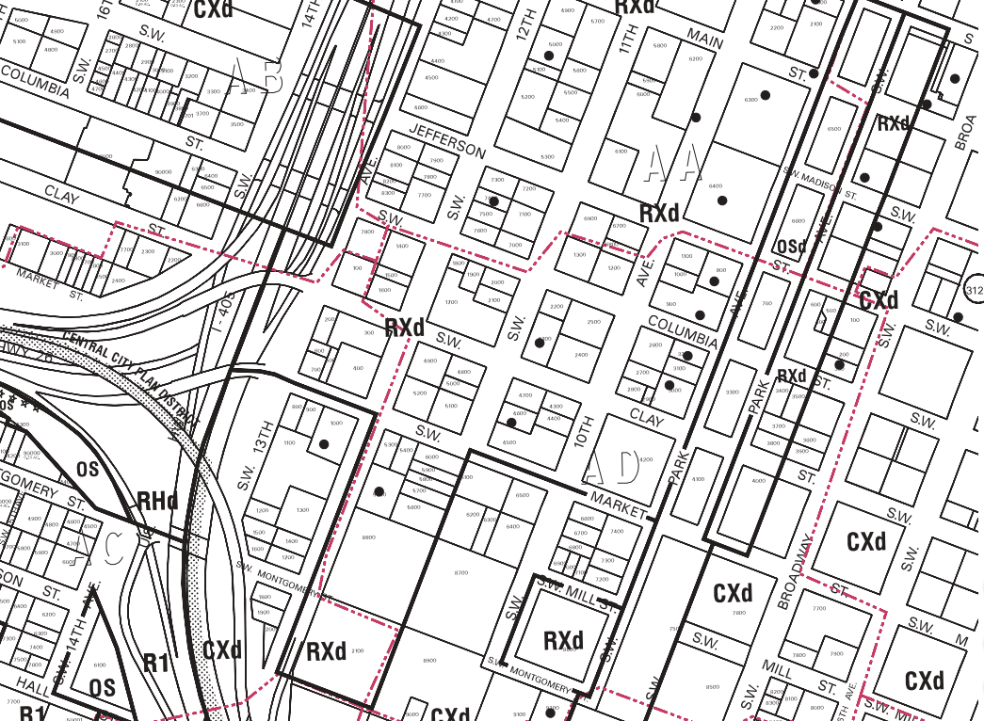
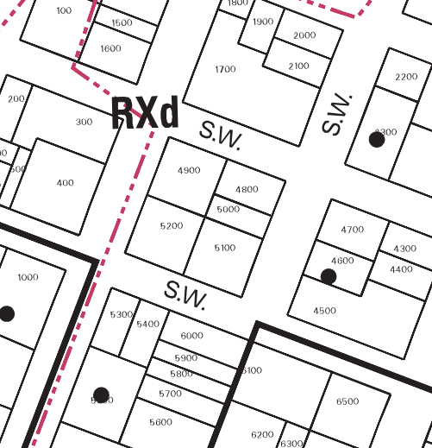
Clay + Tiffany
Zoning
Central City Plan District/ Downtown Subdistrict
Central City Fundamental Design Guidelines
Design Commission | 3.1.2018

Slide 9
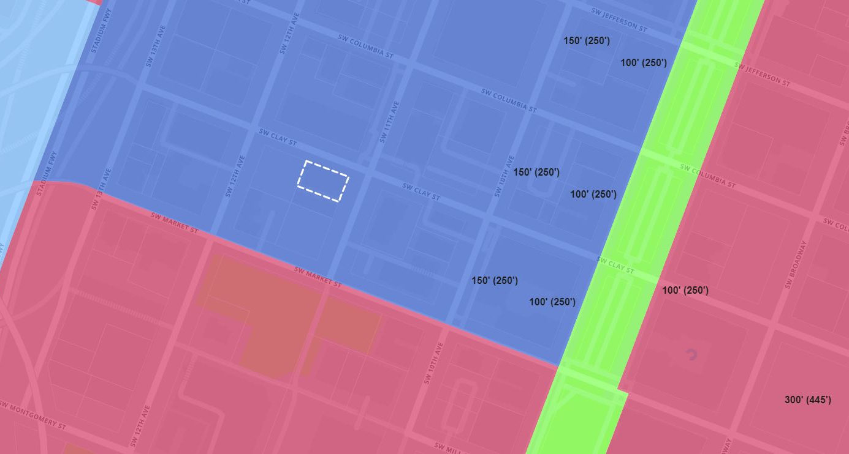
Clay + Tiffany
Central City 2035
150’(250’)
100’(250’)
100’(250’)
300’(445’)
Design Commission | 3.1.2018

Slide 10
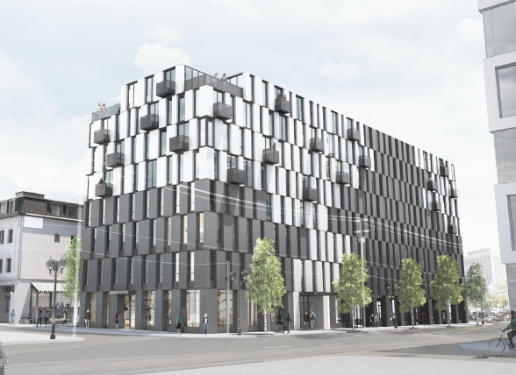
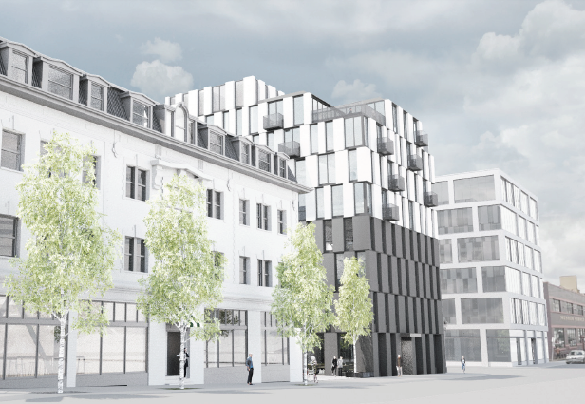
550 SE MLK Blvd
Renderings
Design Commission | 3.1.2018

Slide 11
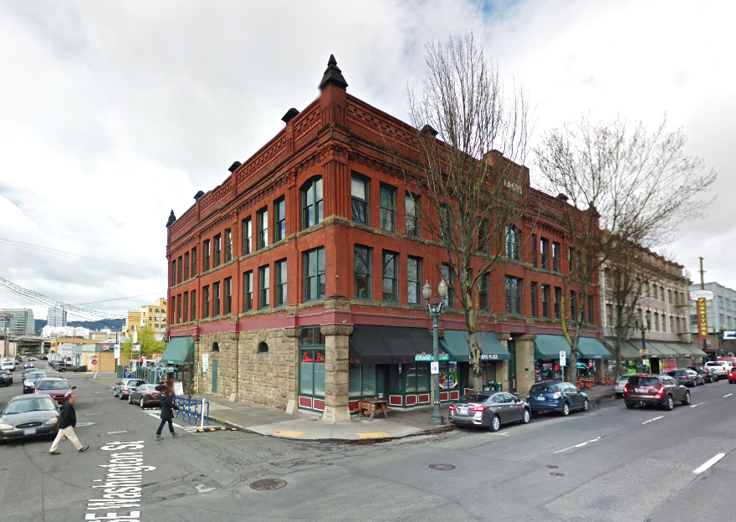
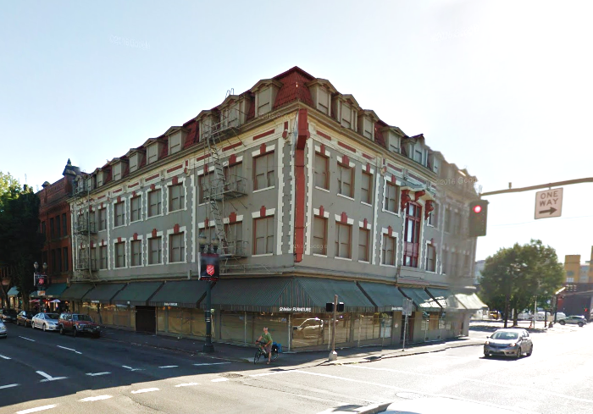
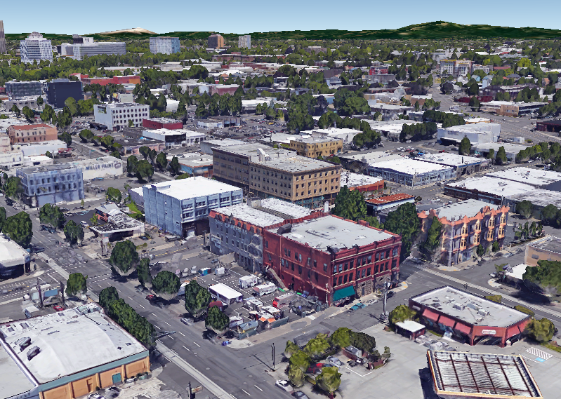
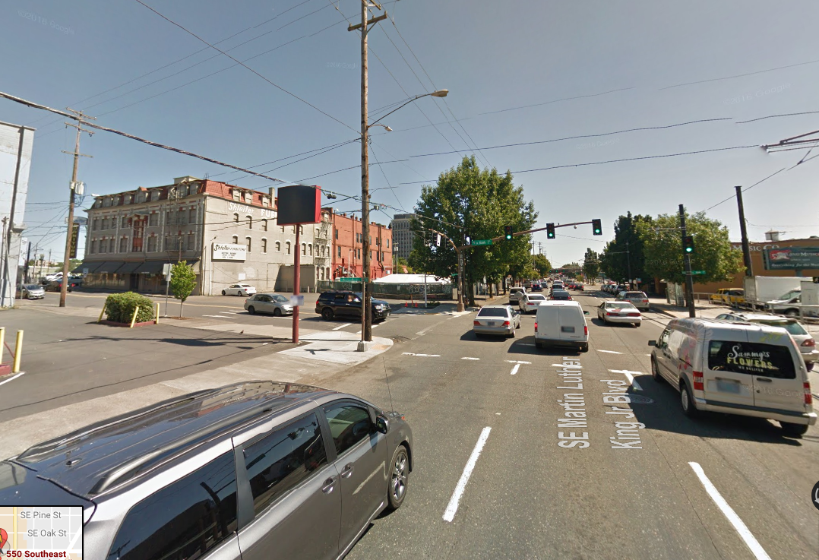
550 SE MLK Blvd
Context
se STARK st
se WASHINGTON st
Design Commission | 3.1.2018

Slide 12
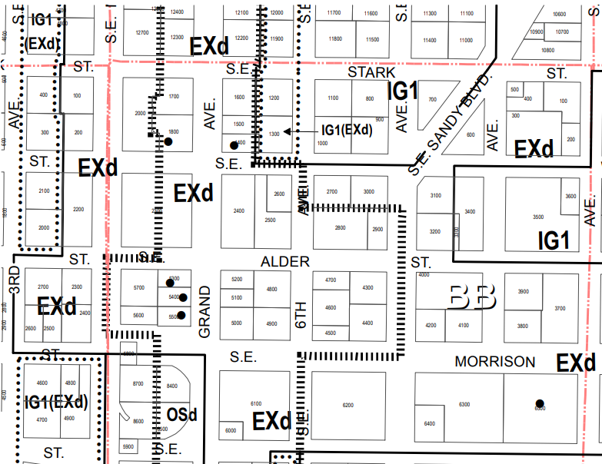
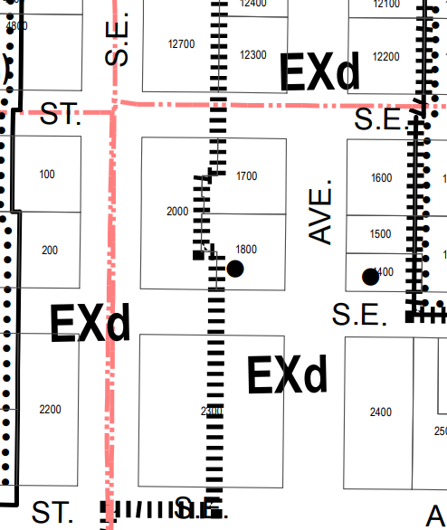
550 SE MLK Blvd
Zoning
Central City Plan District/ Central Eastside Subdistrict
Central City Fundamental Design Guidelines
Special Design Guidelines for the Design Zone of the Central Eastside District
Design Commission | 3.1.2018

Slide 13
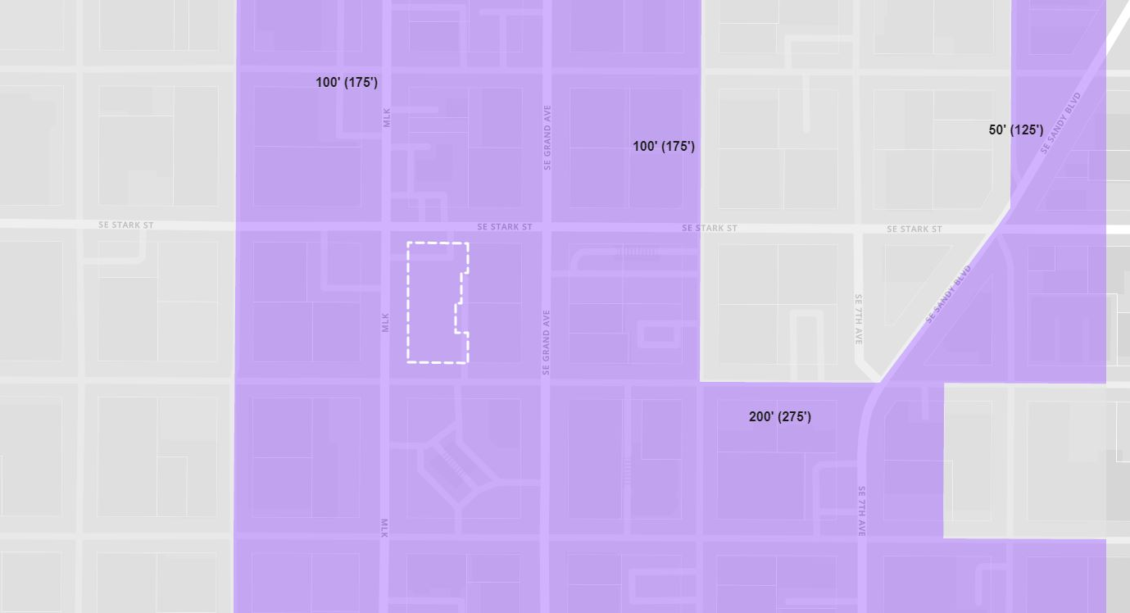
550 SE MLK Blvd
Central City 2035
100’(175’)
50’(125’)
200’(275’)
200’(275’)
Design Commission | 3.1.2018

Slide 14
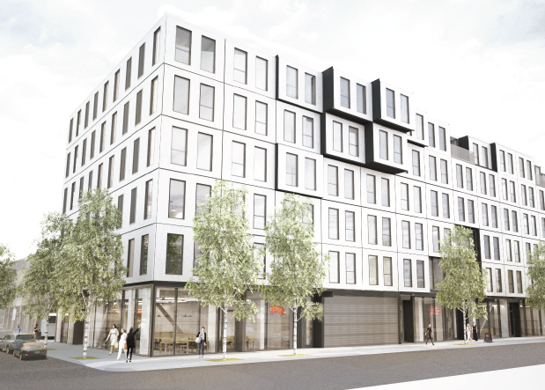
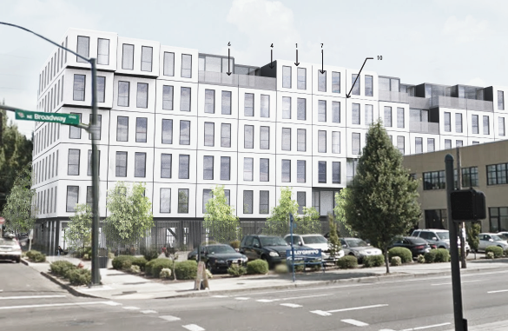
1732 NE 2nd Ave
Renderings
Design Commission | 3.1.2018

Slide 15
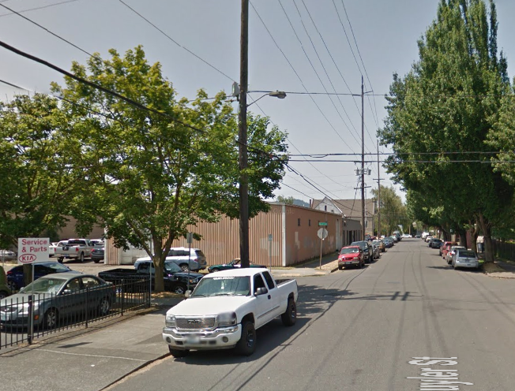
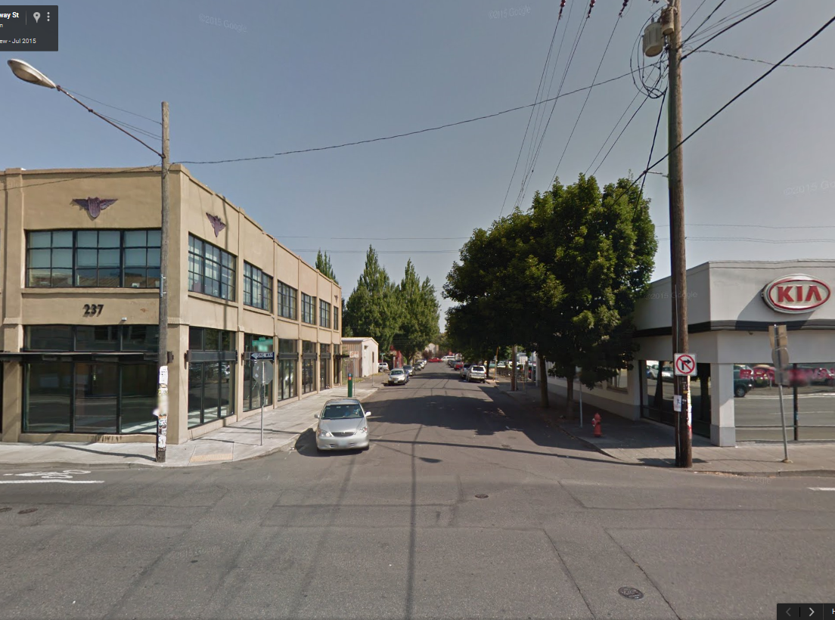
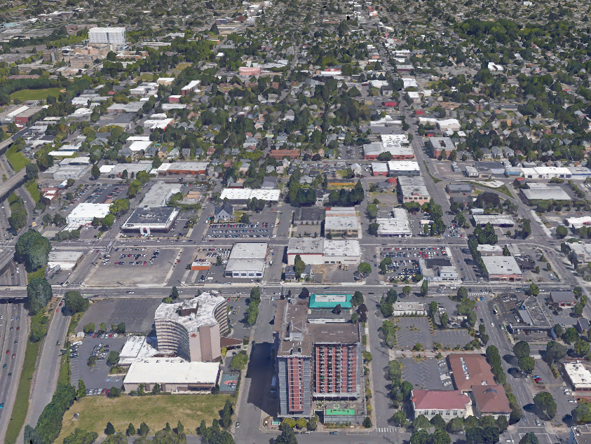
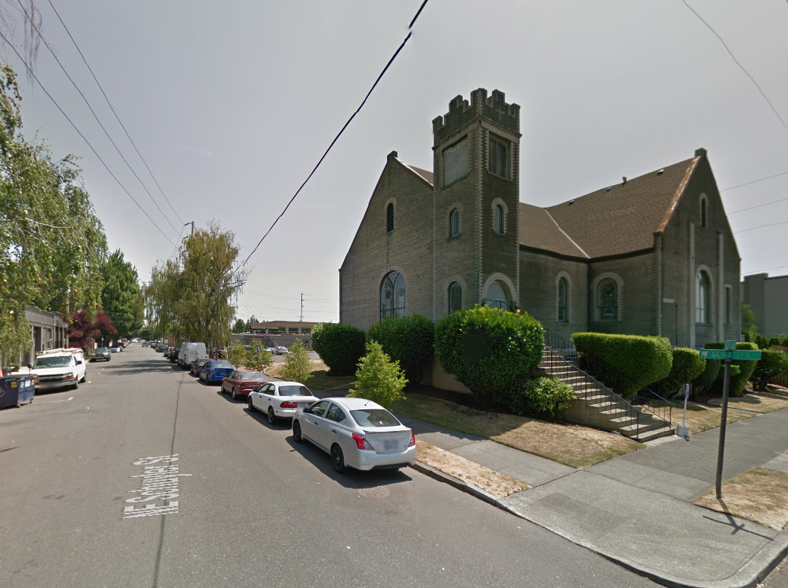
1732 NE 2nd Ave
Context
Design Commission | 3.1.2018

Slide 16
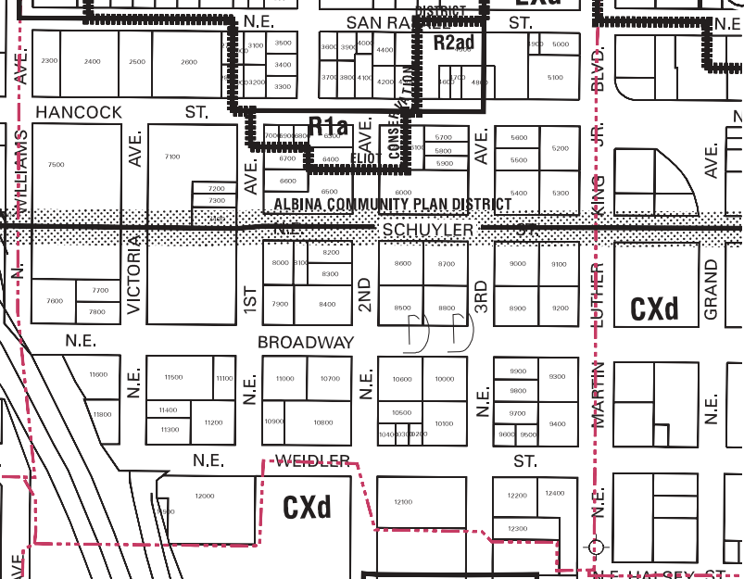
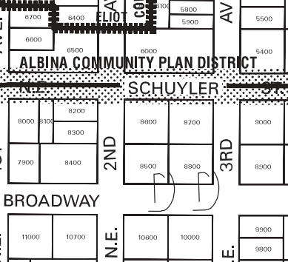
1732 NE 2nd Ave
Zoning
Central City Plan District/ Lloyd Subdistrict
Central City Fundamental Design Guidelines
Design Commission | 3.1.2018

Slide 17
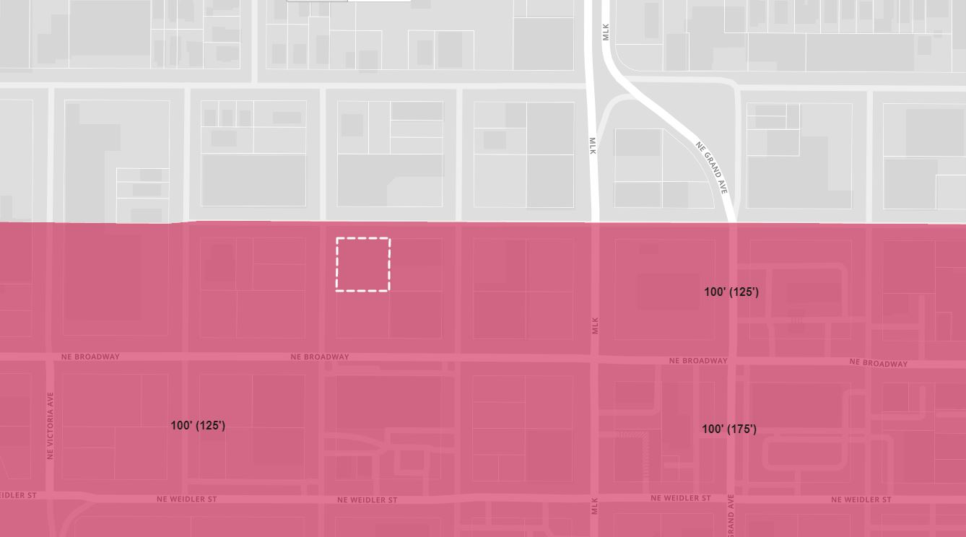
1732 NE 2nd Ave
Central City 2035
100’(125’)
100’(125’)
100’(175’)
Design Commission | 3.1.2018

Slide 18
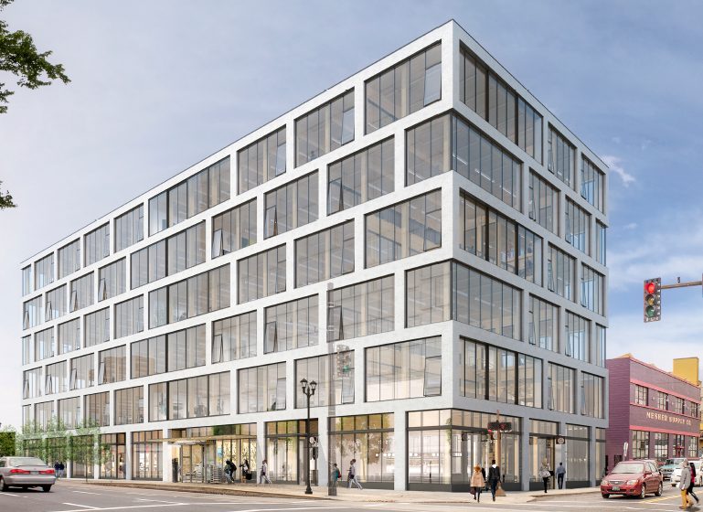
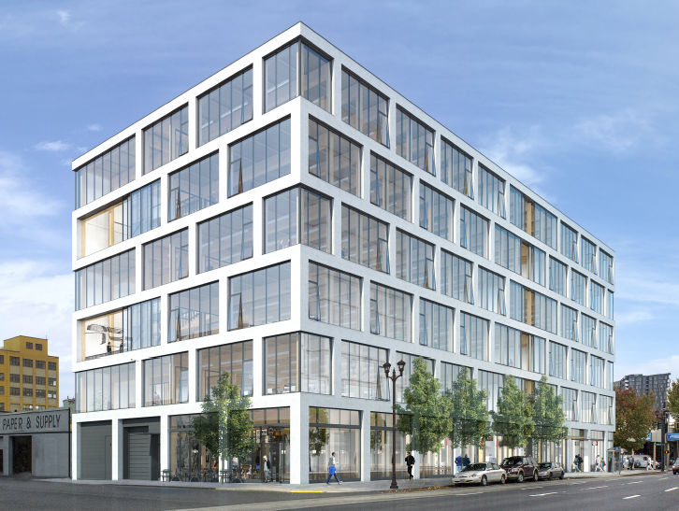
525 SE MLK Blvd
Renderings
Design Commission | 3.1.2018

Slide 19
525 SE MLK Blvd
Context
SE Washington St
SE Stark St
SE MLK Jr Blvd
Design Commission | 3.1.2018

Slide 20
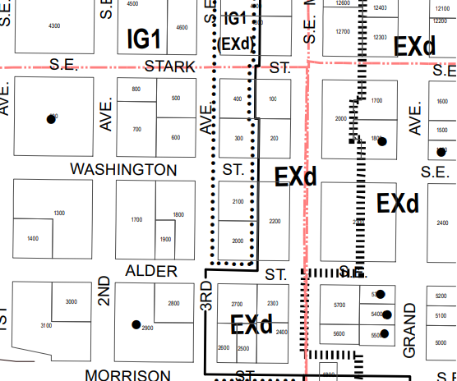
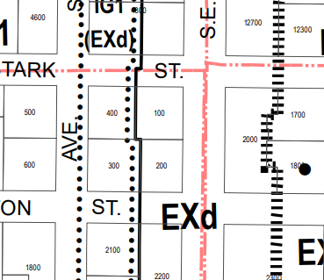
525 SE MLK Blvd
Zoning
Central City Plan District/ Central Eastside Subdistrict
Central City Fundamental Design Guidelines
Special Design Guidelines for the Design Zone of the Central Eastside District
Design Commission | 3.1.2018

Slide 21
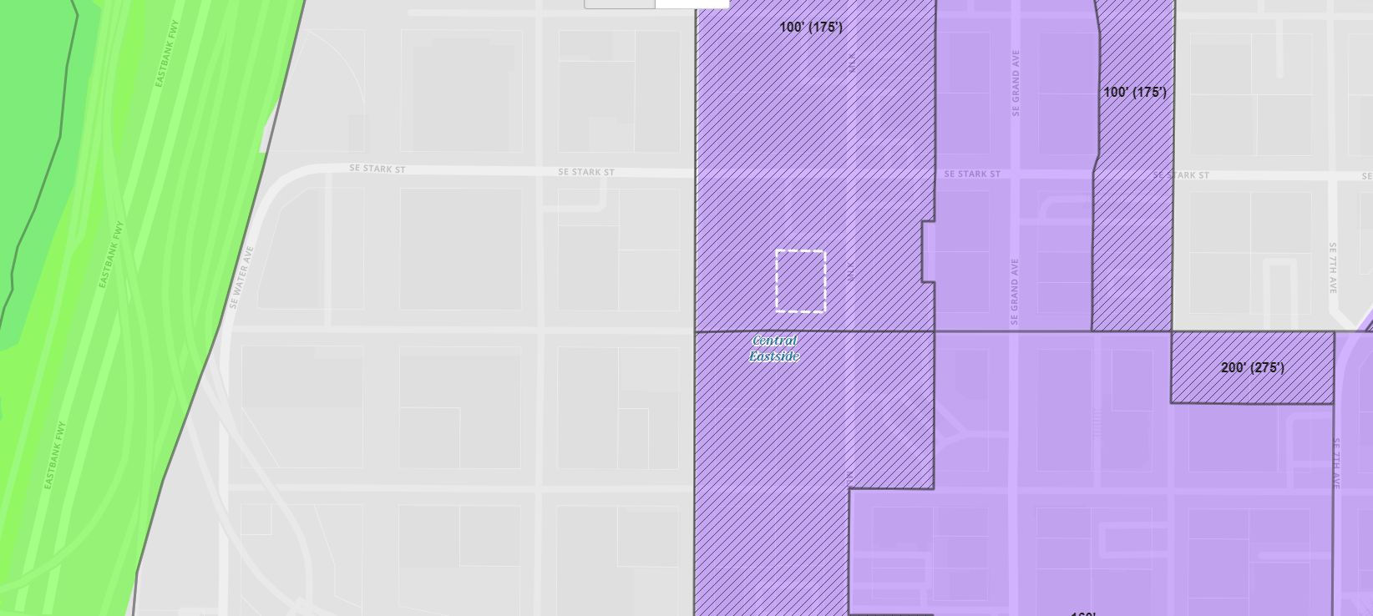
525 SE MLK Blvd
Central City 2035
100’(175’)
Design Commission | 3.1.2018

Slide 22
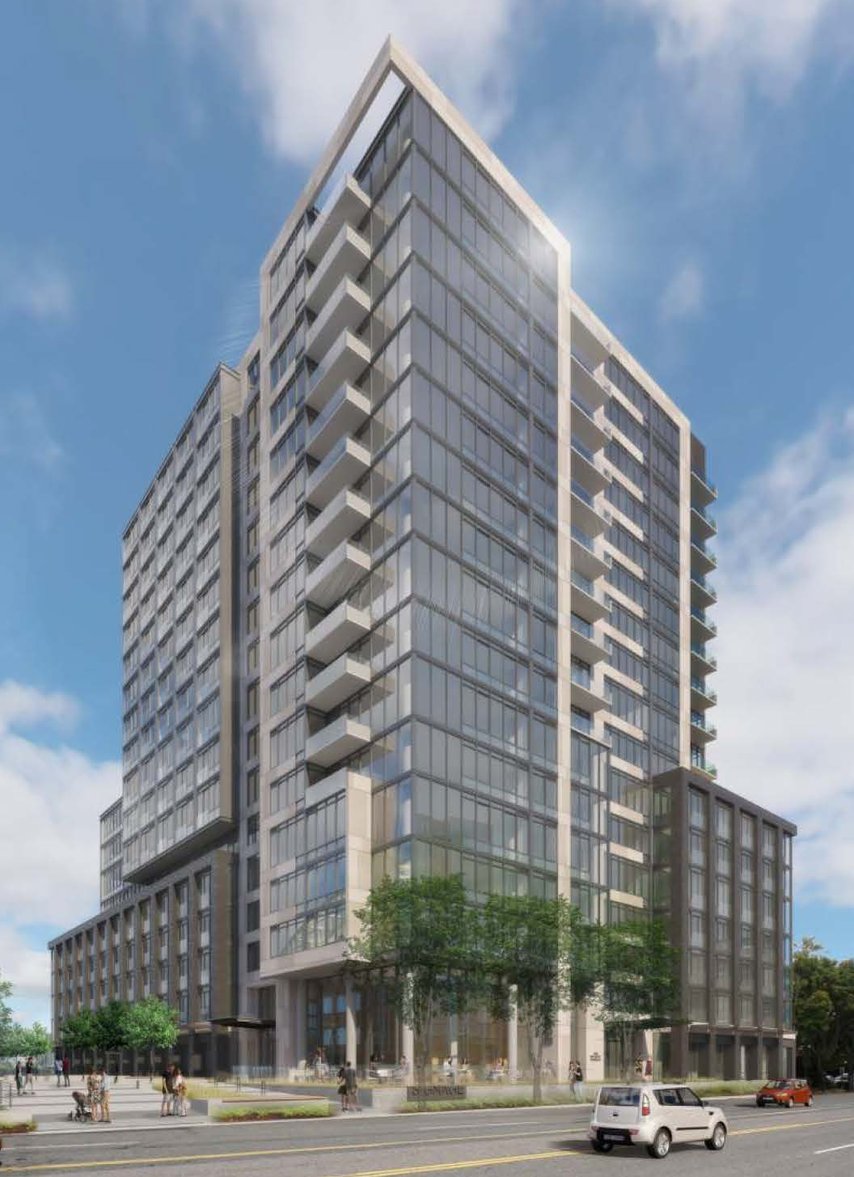
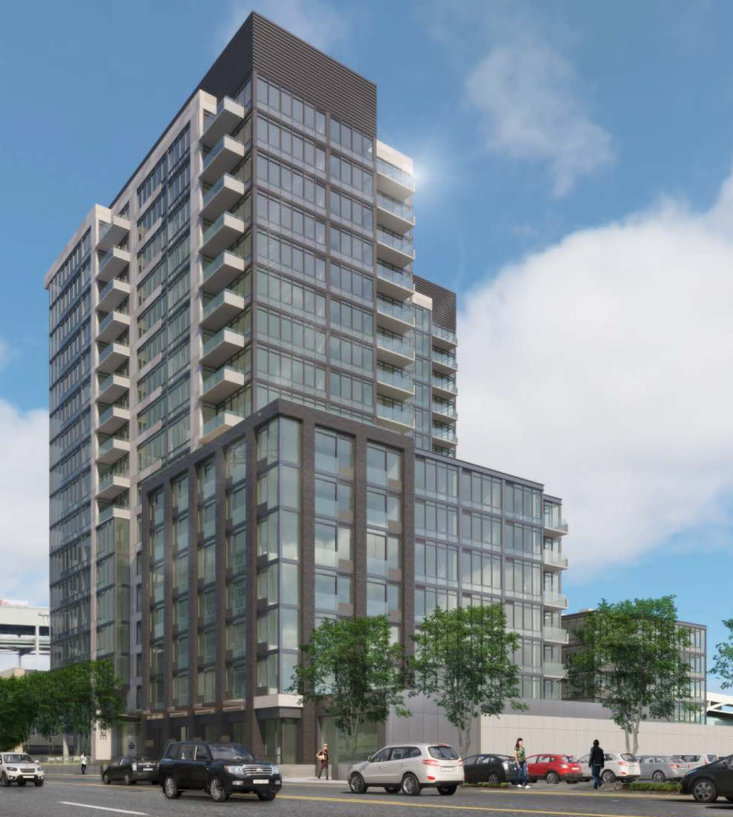
Fremont Apartments
Renderings
Design Commission | 3.1.2018

Slide 23
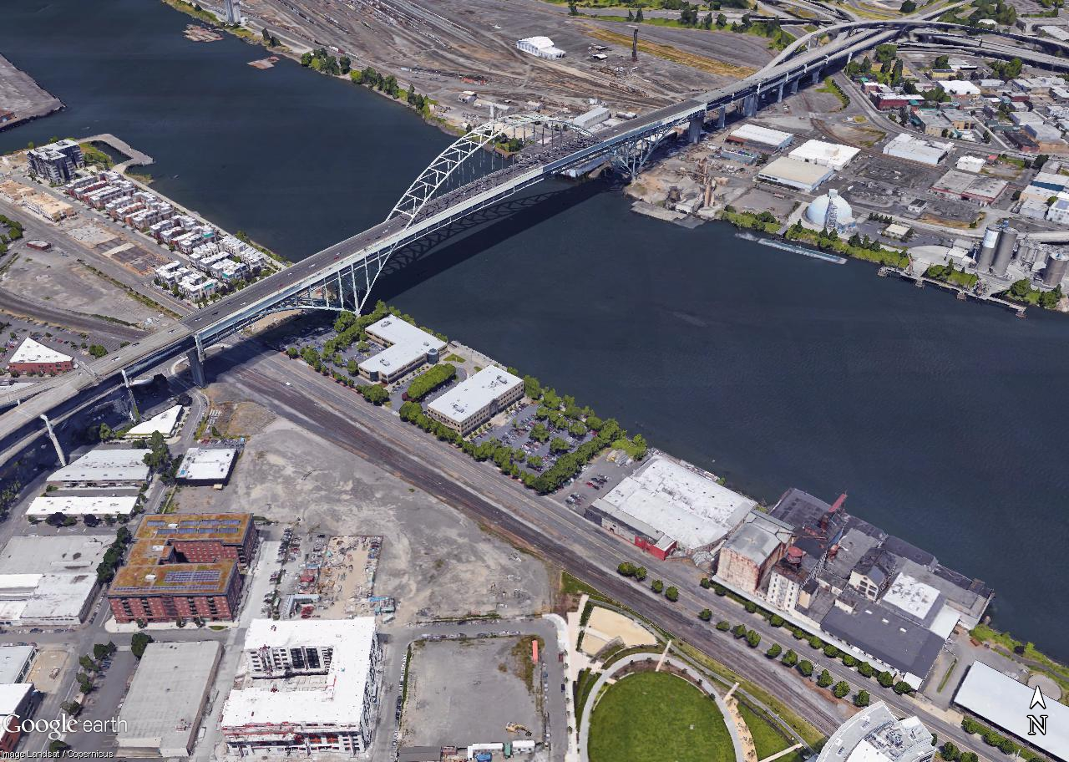
Fremont Apartments
Context
Design Commission | 3.1.2018

Slide 24
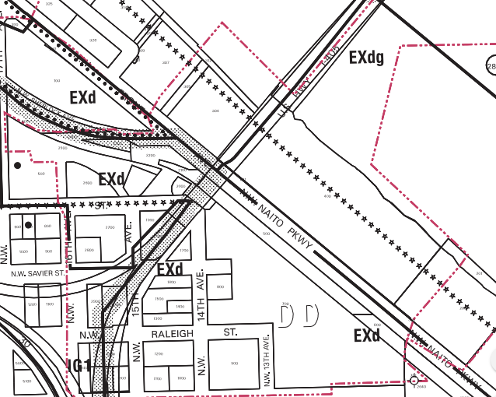
Fremont Apartments
Zoning
Central City Plan District/ Central Eastside Subdistrict
Central City Fundamental Design Guidelines
Special Design Guidelines for the Design Zone of the Central Eastside District
Design Commission | 3.1.2018

Slide 25
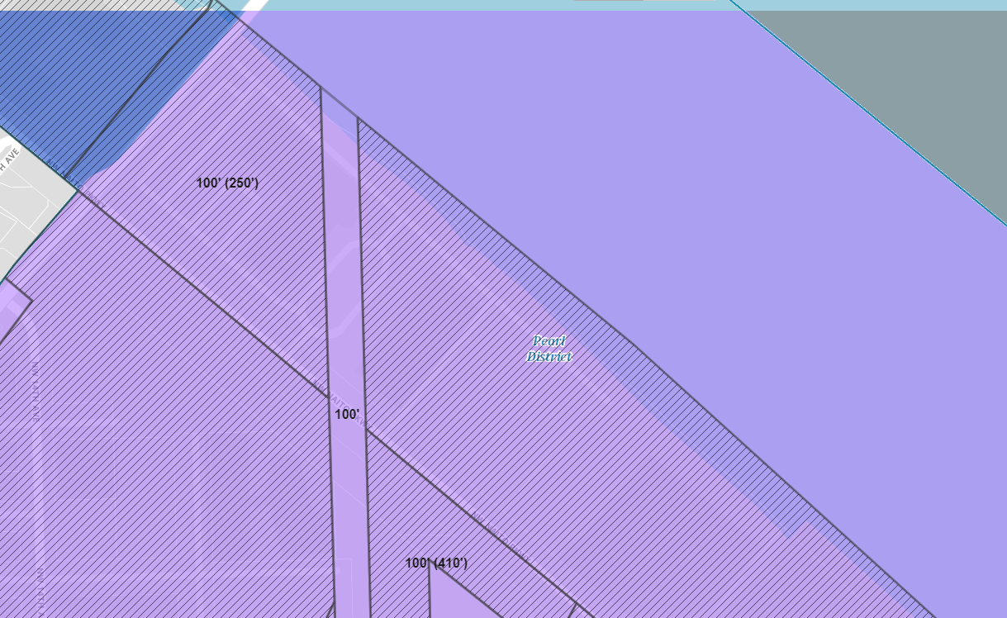
Fremont Apartments
Central City 2035
100’(250’)
100’
100’(410’)
Design Commission | 3.1.2018

Slide 26
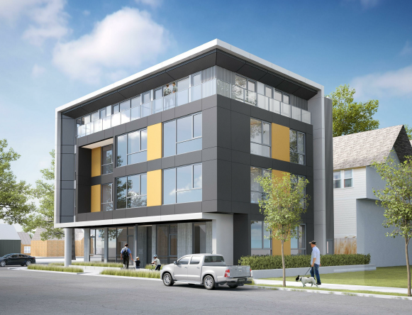
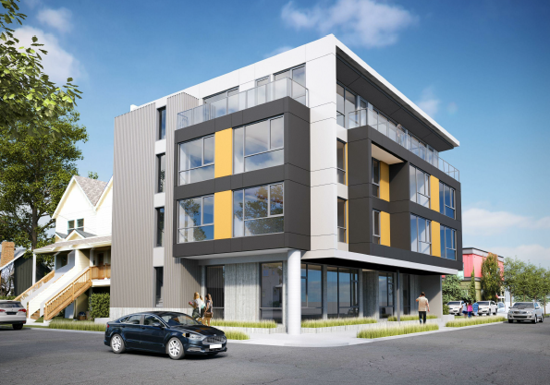
3904 NE Garfield Ave
Renderings
Design Commission | 3.1.2018

Slide 27
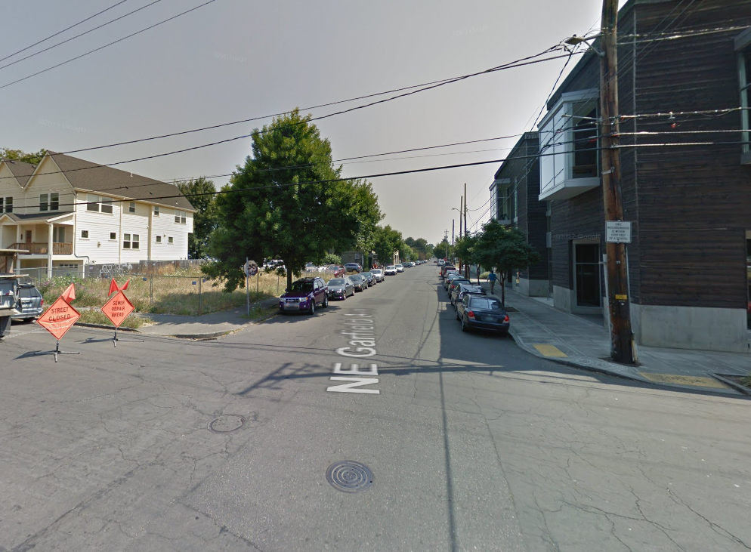



3904 NE Garfield Ave
Context
Design Commission | 3.1.2018

Slide 28


3904 NE Garfield Ave
Zoning
Albina Community Plan District
Design Commission | 3.1.2018

