Slide 1




Gideon Bike/Ped Overcrossing Project
Design Commission Briefing 18 January 2018
PORTLANDOREGON.GOV/TRANSPORTATION

Slide 2
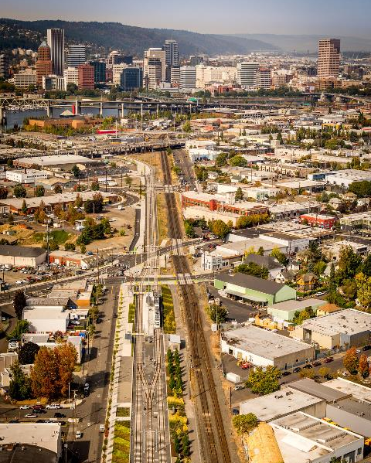
Input and Advice
Final piece of Portland-Milwaukie Orange Line
Non-standard element in public ROW
Clinton Triangle rezoned in Central City 2035 update. Adds D overlay south of Overcrossing site

Slide 3
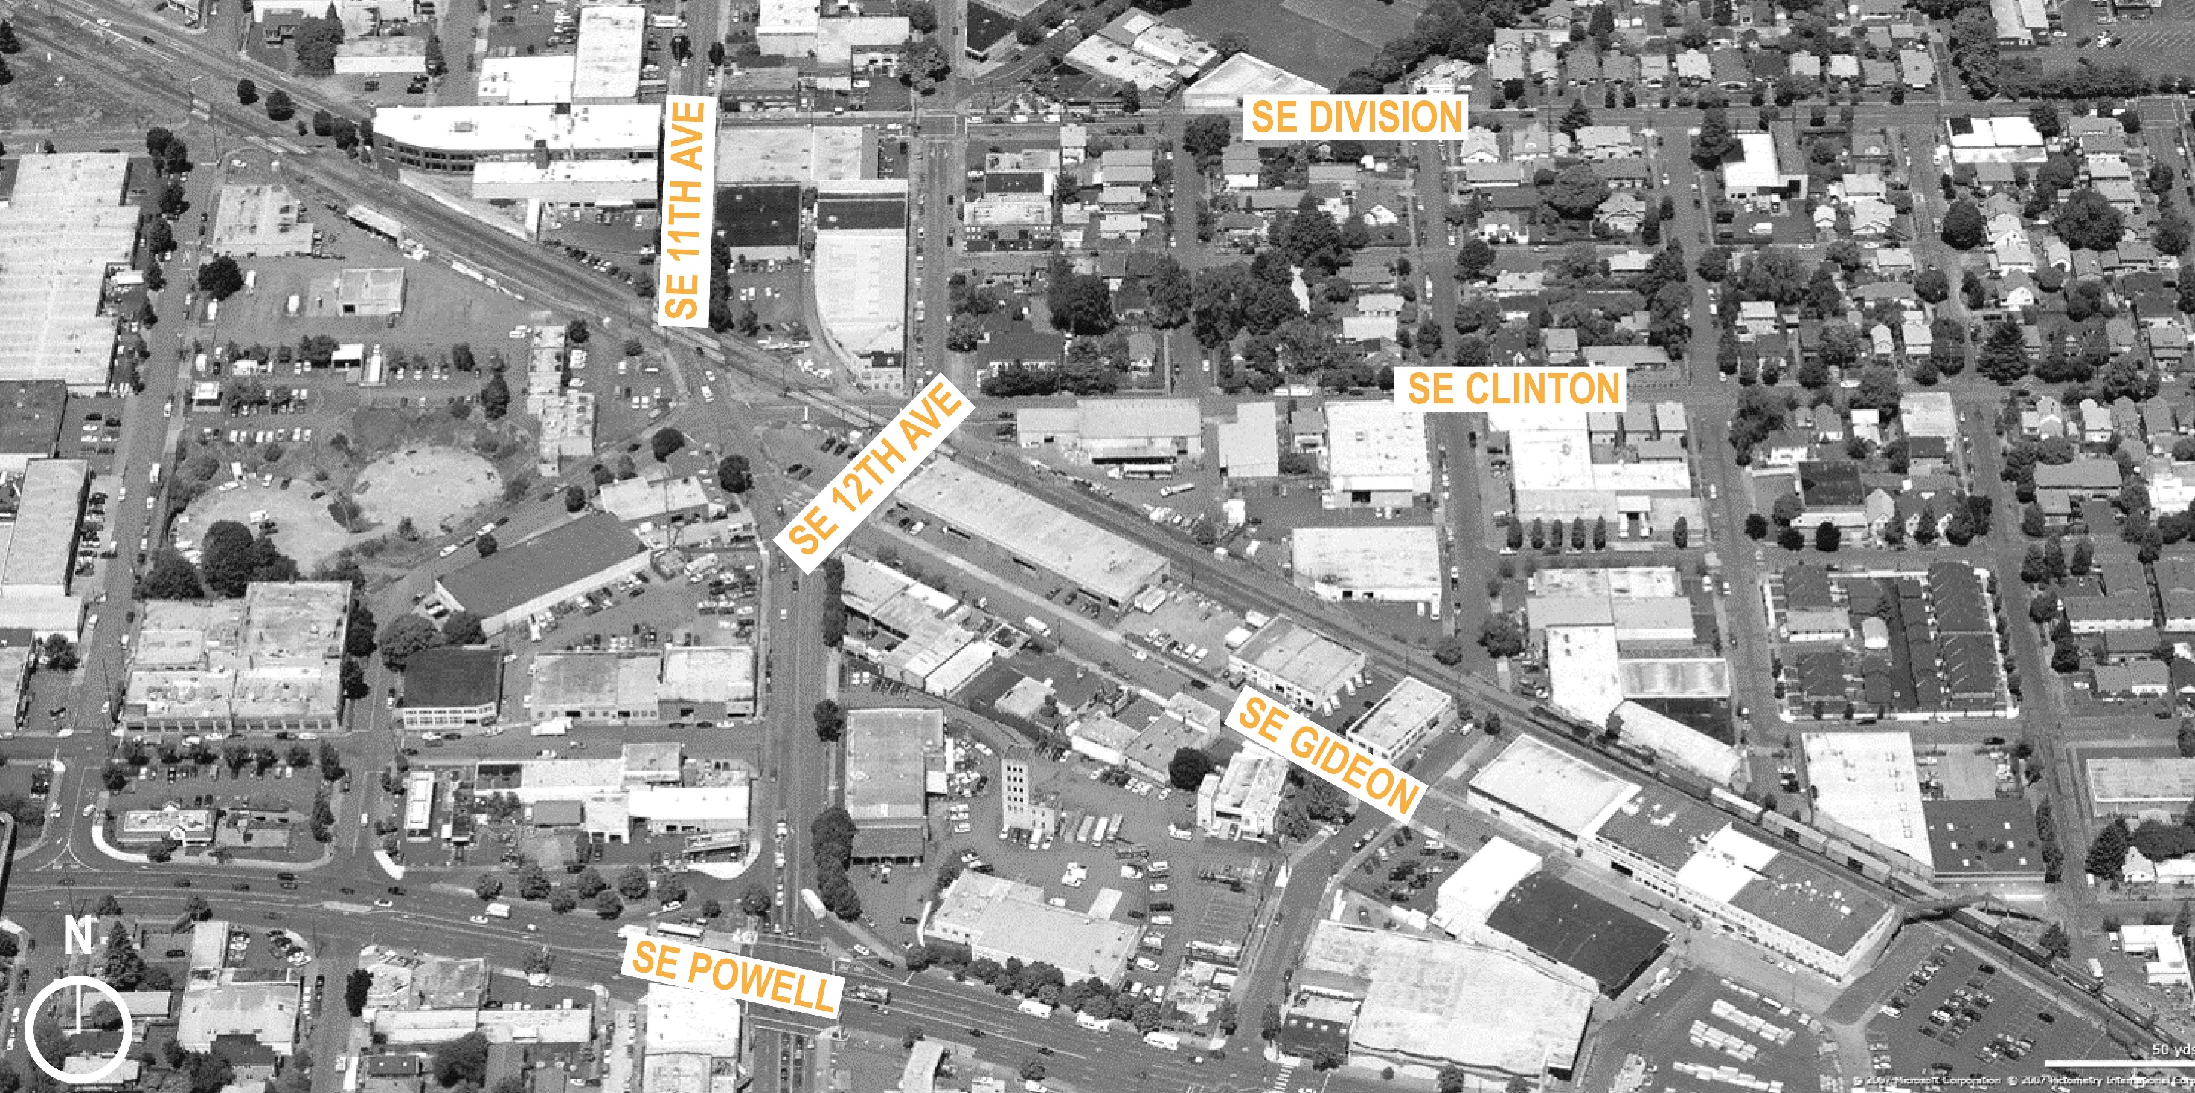
Before Orange Line
3

Slide 4
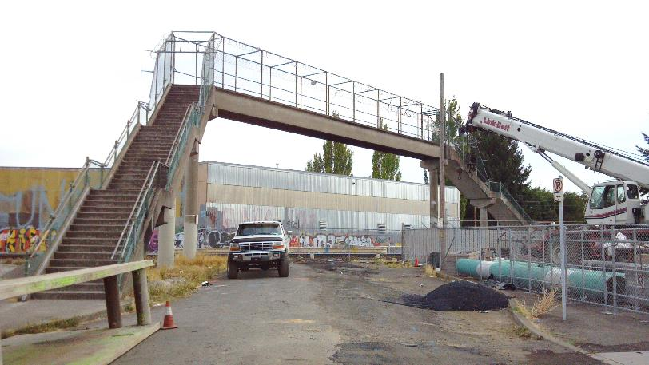
History
Built in ‘70’s
Adding LRT required removal
Orange Line planned to replace
Fed funding shortfall = deferral
Original Bridge, removed with PMLR Construction

Slide 5
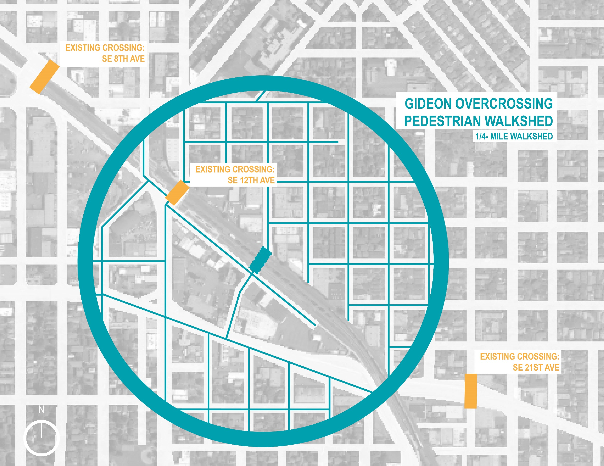
Need
Remains
Connects neighborhoods

Slide 6
Missing Link
Connection to/from river

Slide 7
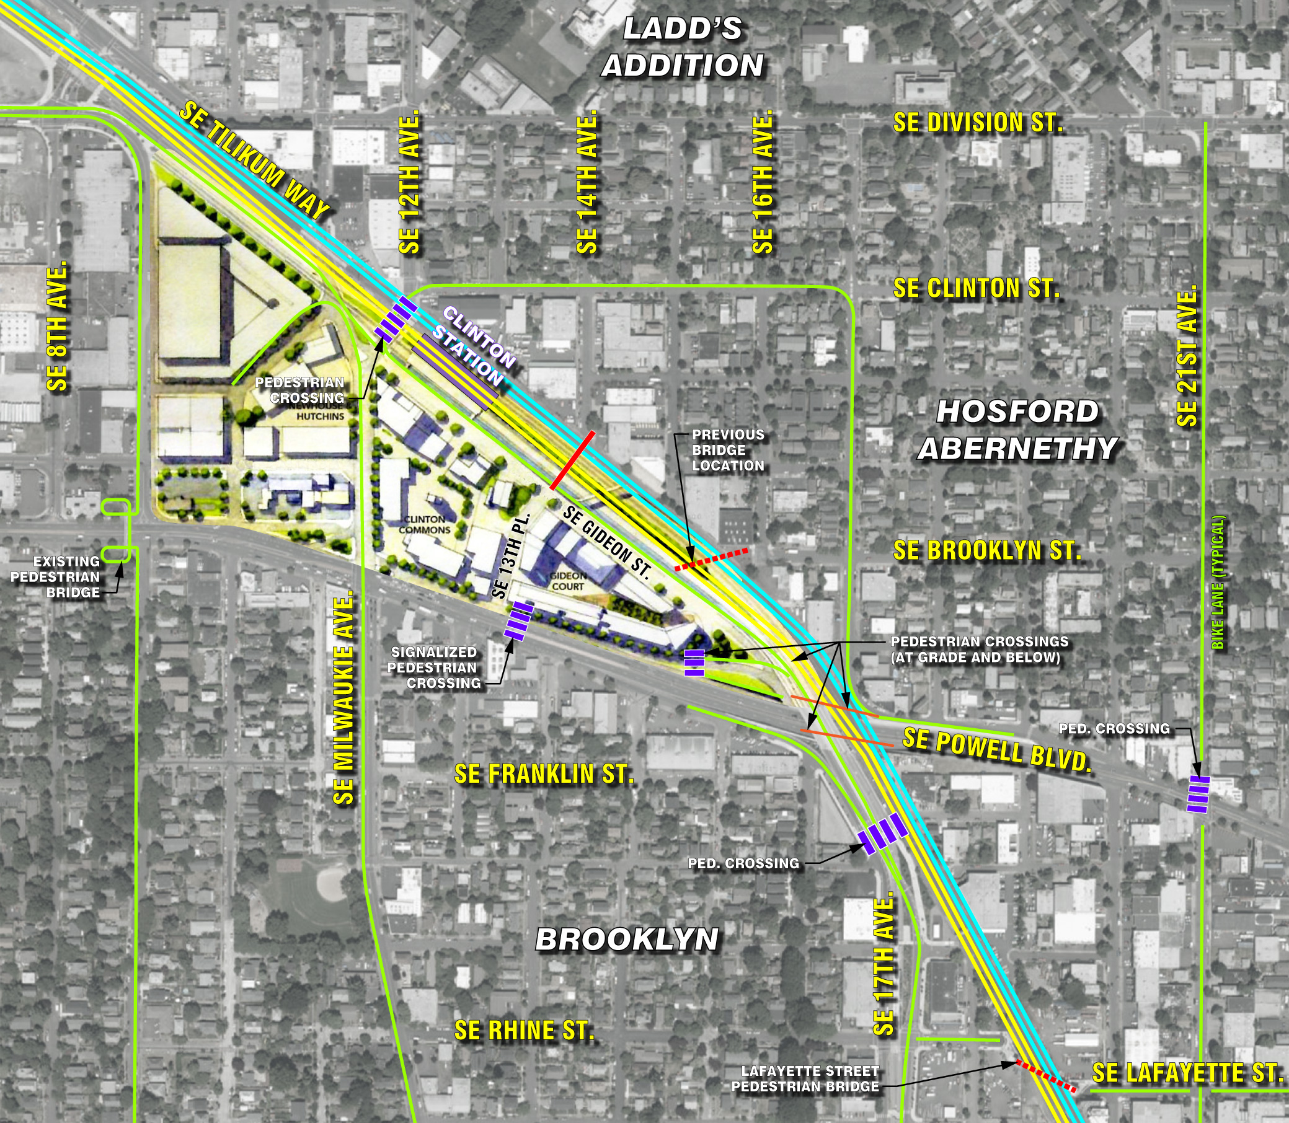
Future
Clinton Triangle
Redevelopment

Slide 8
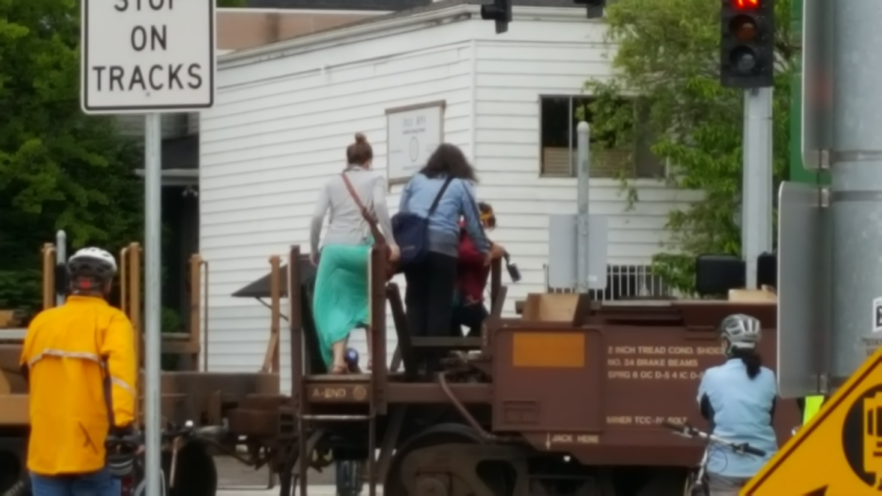
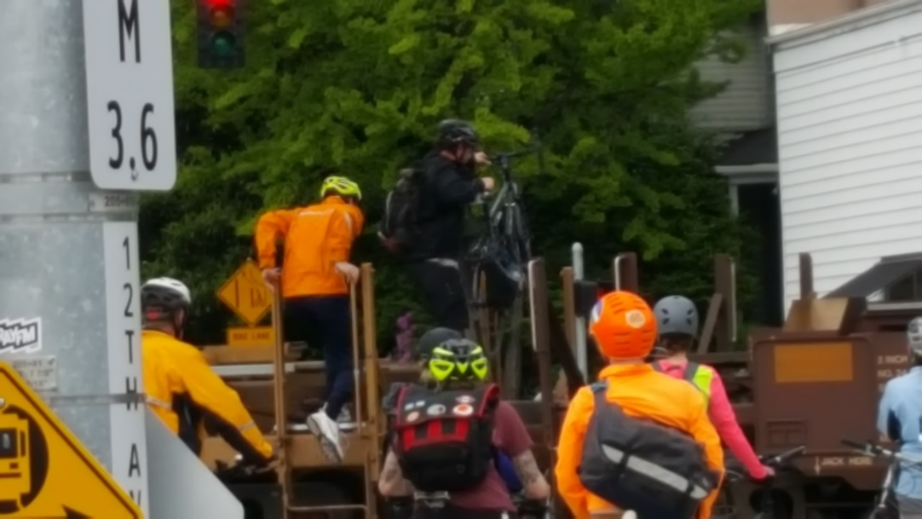
Safety
SE 12th

Slide 9
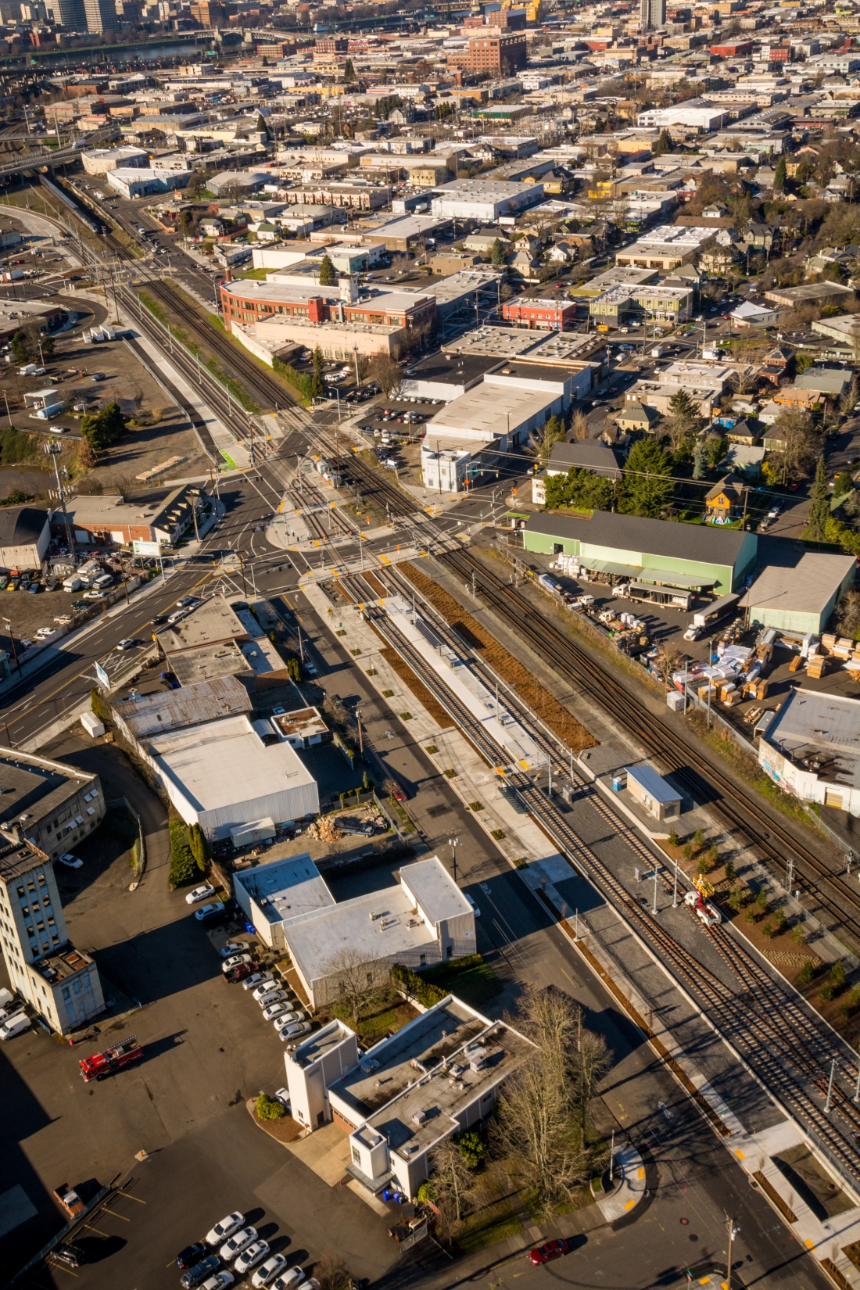
Details
TriMet implements; PBOT owns & maintains
Funds limited – leftover PMLR $
Spending deadline – FTA contract ends
Requires agreements with UPRR

Slide 10
Schedule
Conceptual Design Complete
Select Final Design Team Spring 2018
Select CMGC Contractor Spring 2018
Final Design & Negot. with UPRR Spring 2018 through Spring 2019
Construction Beginning Early 2019

Slide 11
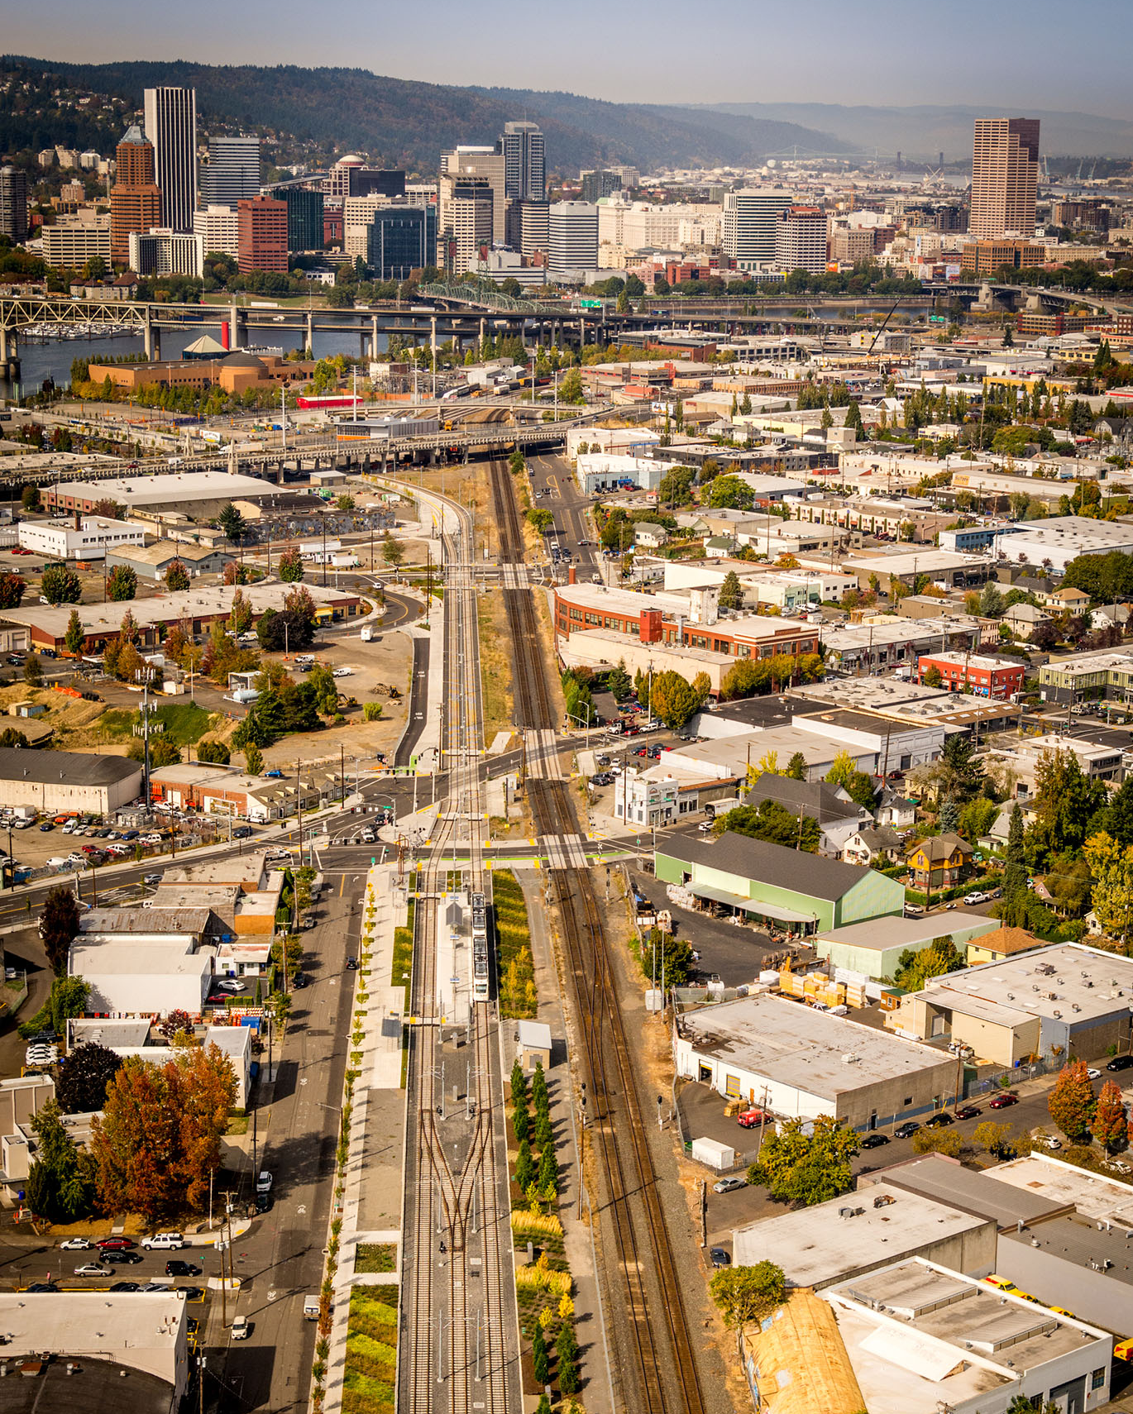
Gideon Overcrossing Project
Design Commission Briefing
18 January 2018
DAO Architecture LLC
Madden & Baughman Engineering, Inc.
Firwood Design Group LLC

Slide 12
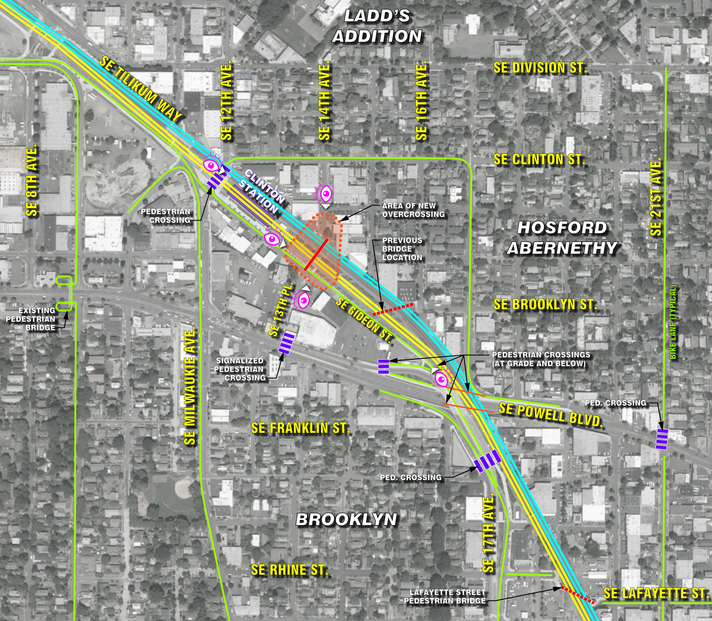
PORTLANDOREGON.GOV/TRANSPORTATION

Slide 13
PORTLANDOREGON.GOV/TRANSPORTATION

Slide 14
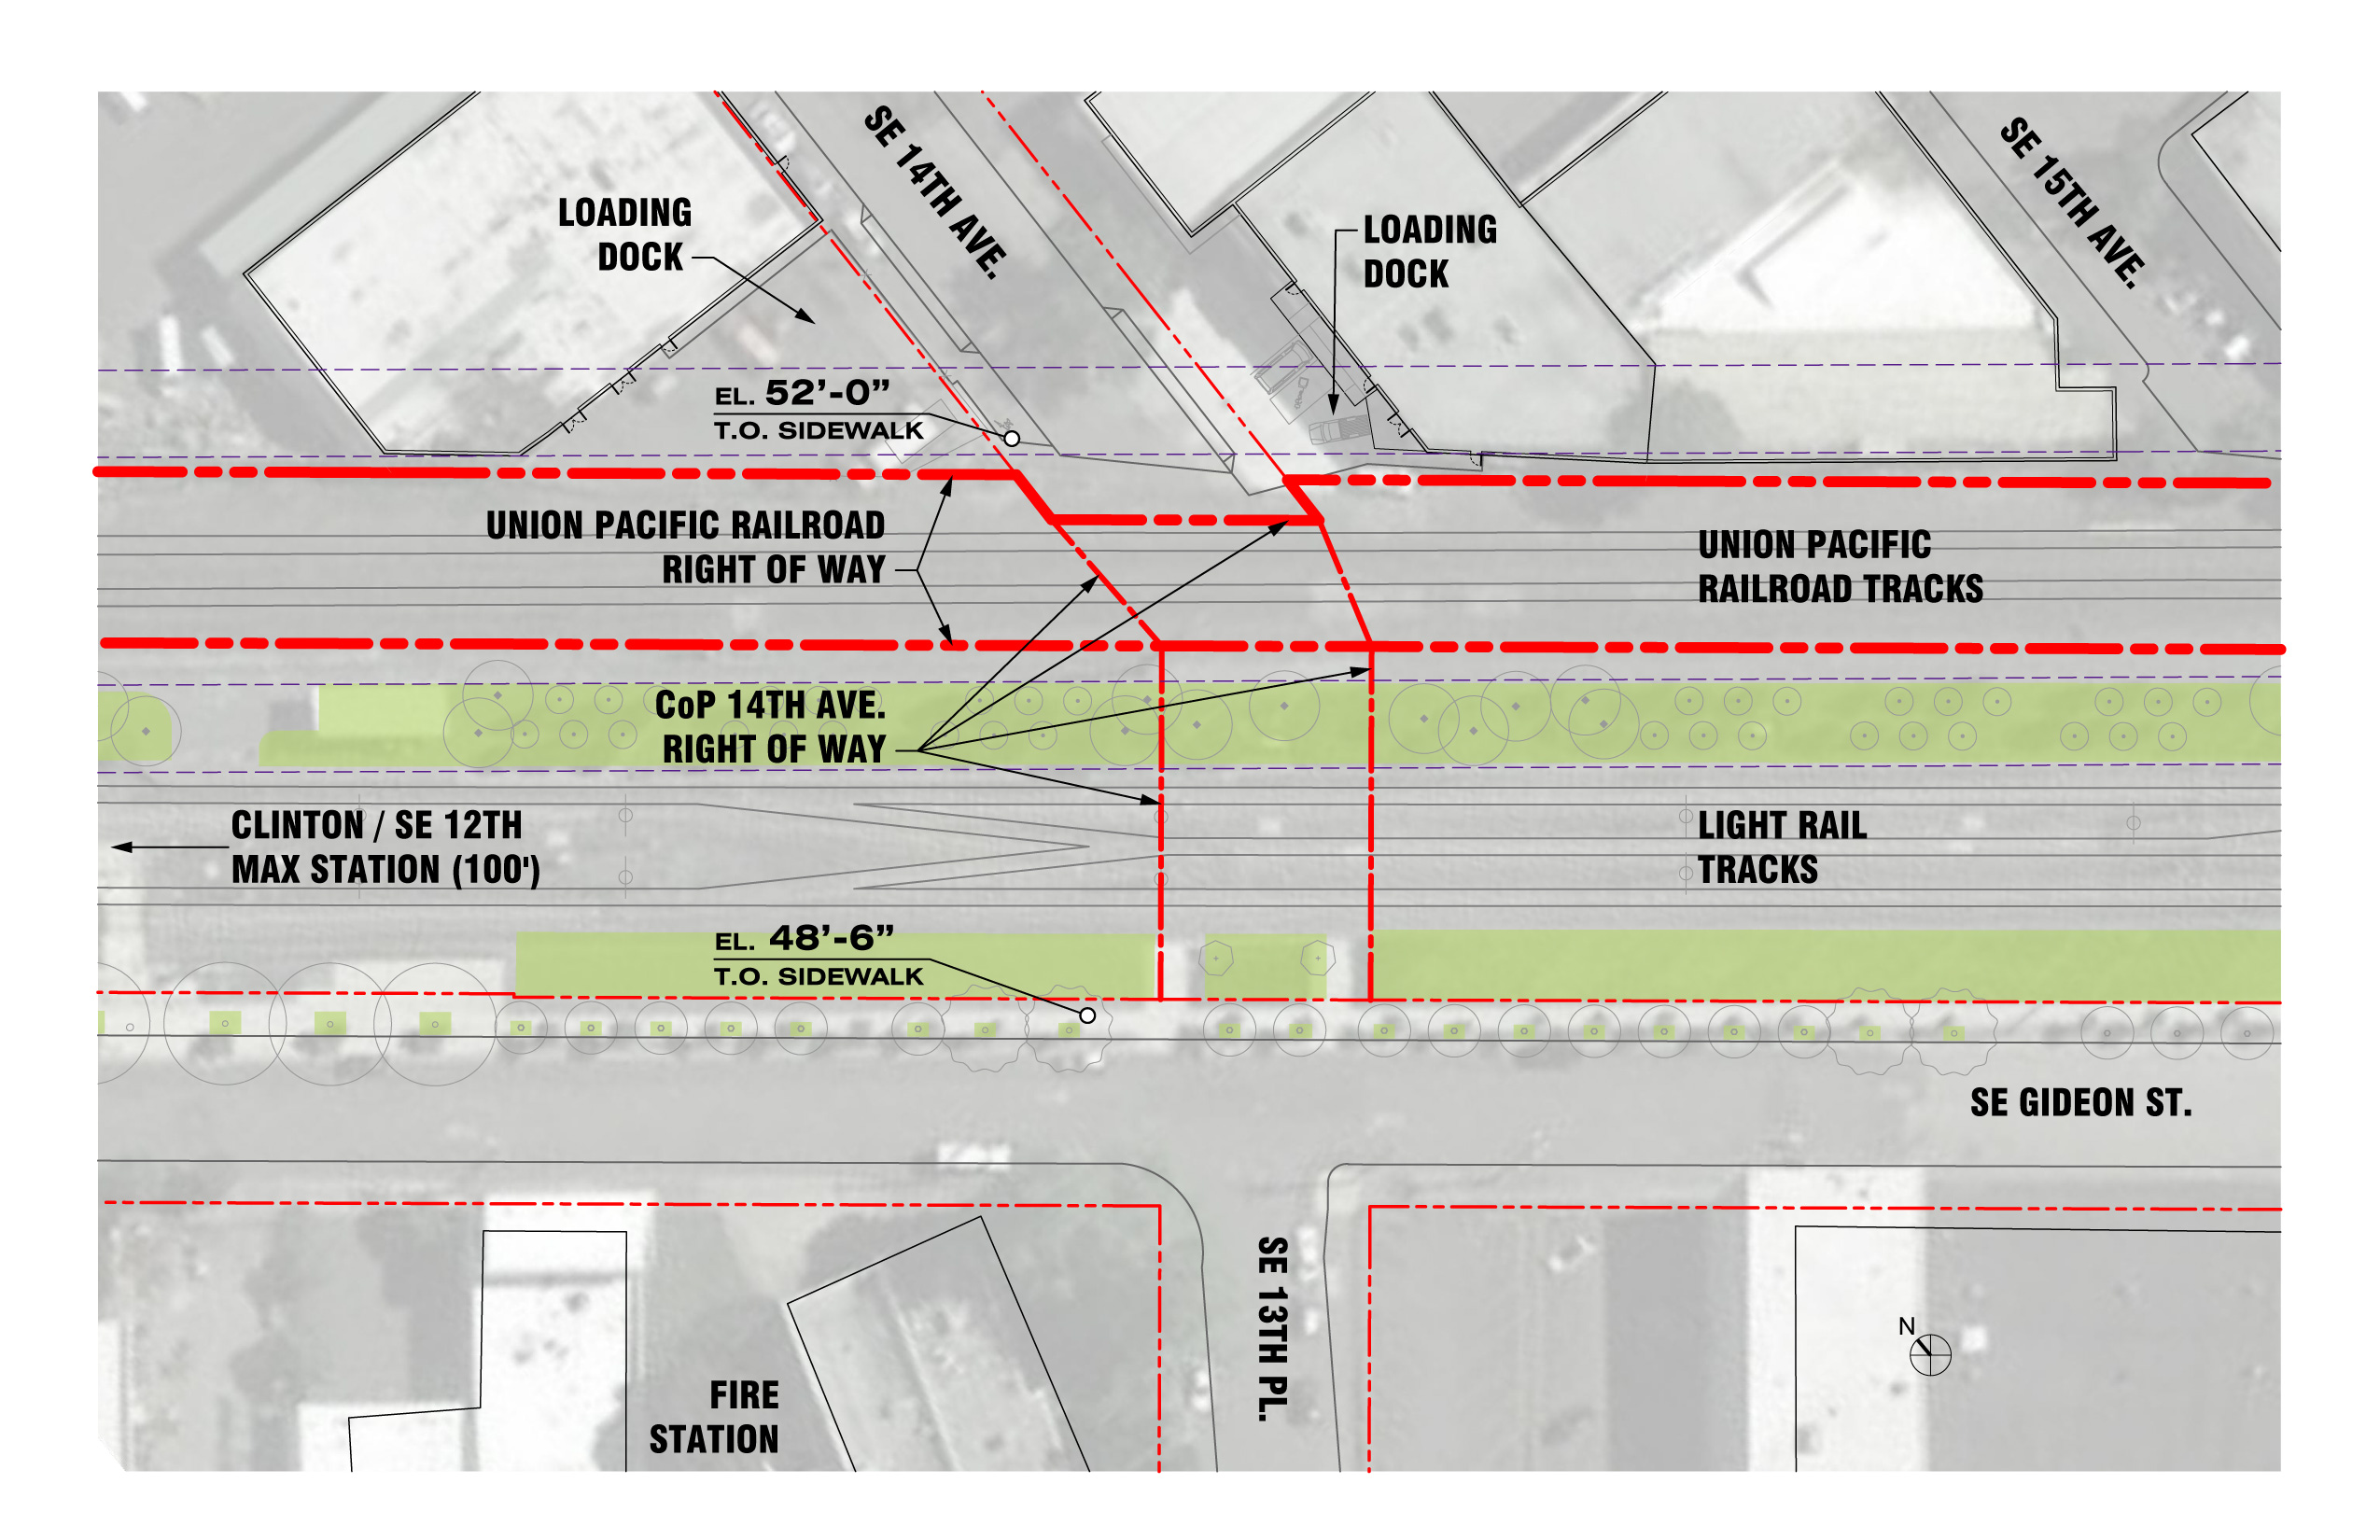
PORTLANDOREGON.GOV/TRANSPORTATION

Slide 15
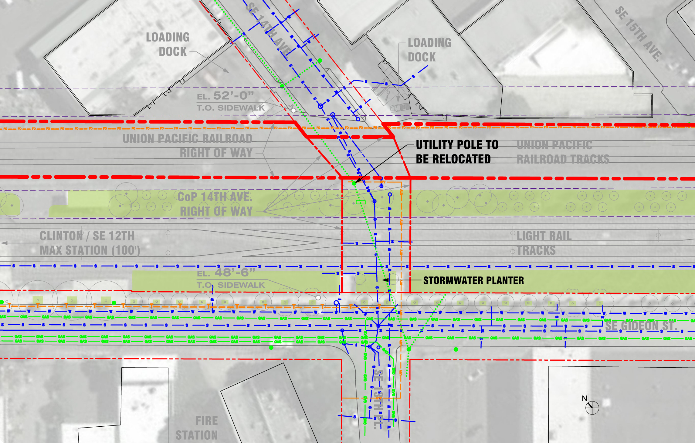
PORTLANDOREGON.GOV/TRANSPORTATION

Slide 16
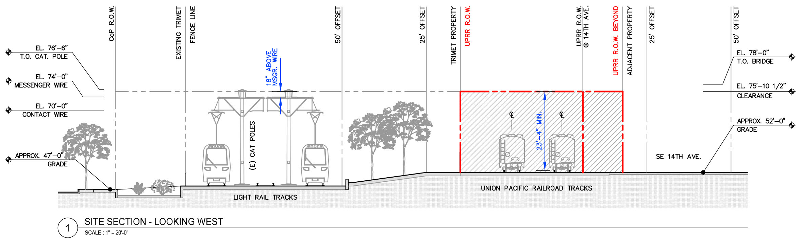
PORTLANDOREGON.GOV/TRANSPORTATION

Slide 17
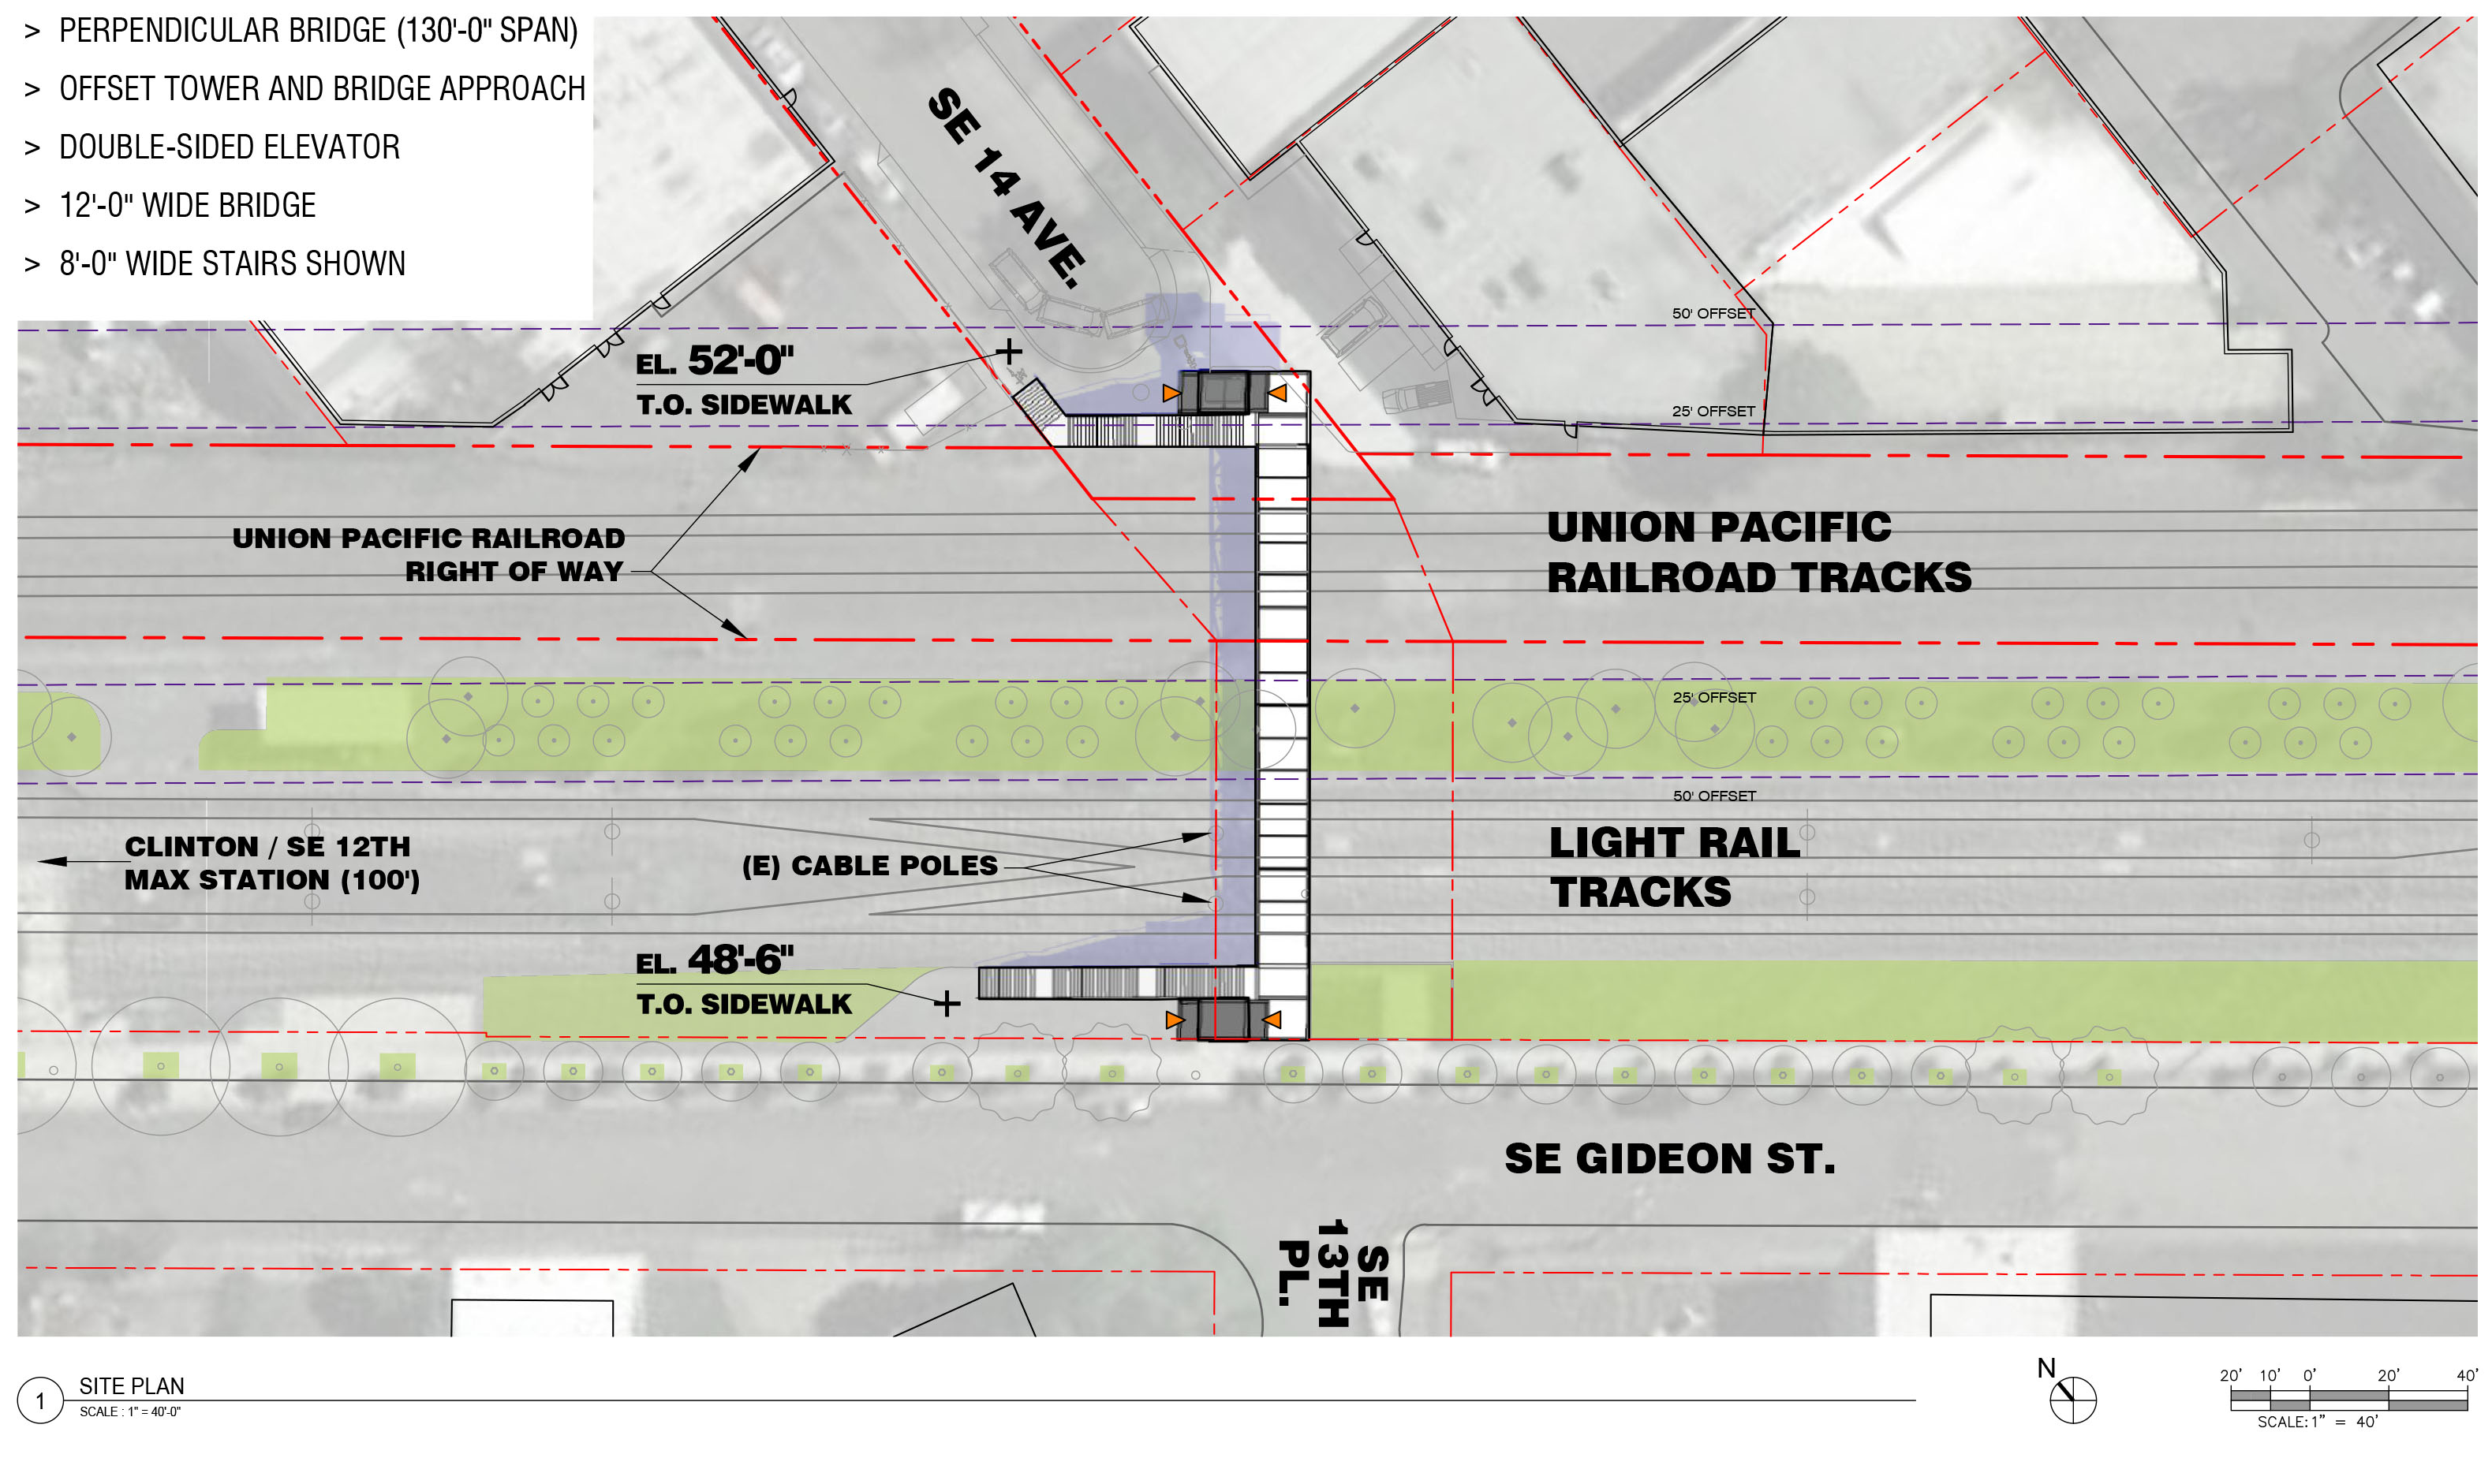
PORTLANDOREGON.GOV/TRANSPORTATION

Slide 18
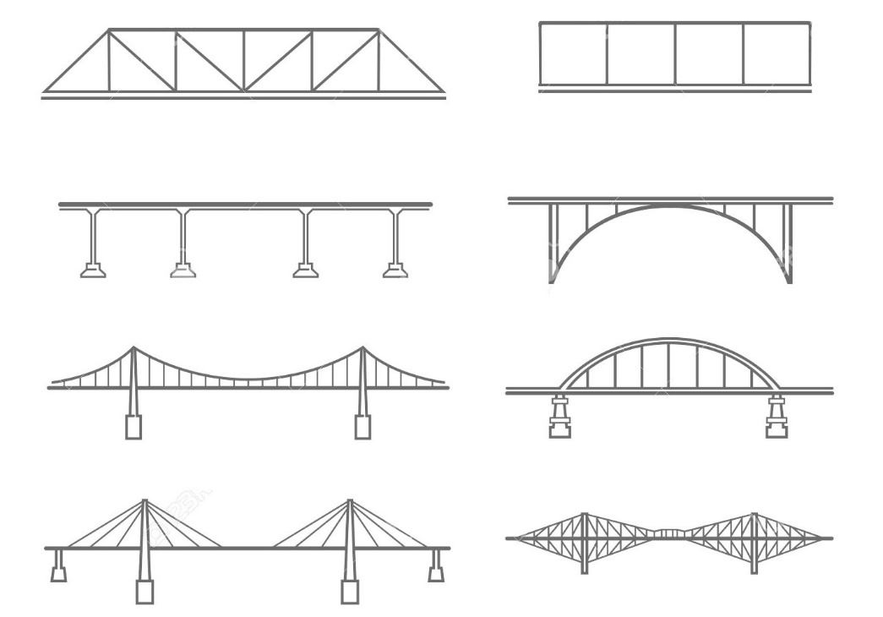
BRIDGE TYPES / STRUCTURE
TRUSS BRIDGE
VIERENDEEL TRUSS
BEAM BRIDGE
ARCH BRIDGE
SUSPENSION BRIDGE
TIED ARCH BRIDGE
CABLE-STAYED BRIDGE
CANTILEVER BRIDGE
PORTLANDOREGON.GOV/TRANSPORTATION

Slide 19
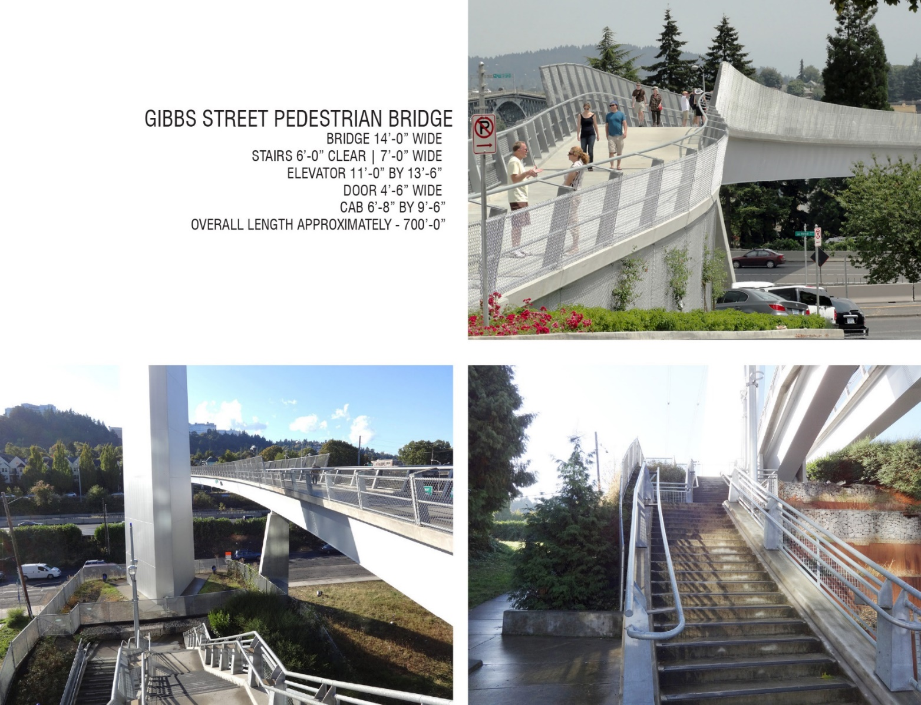
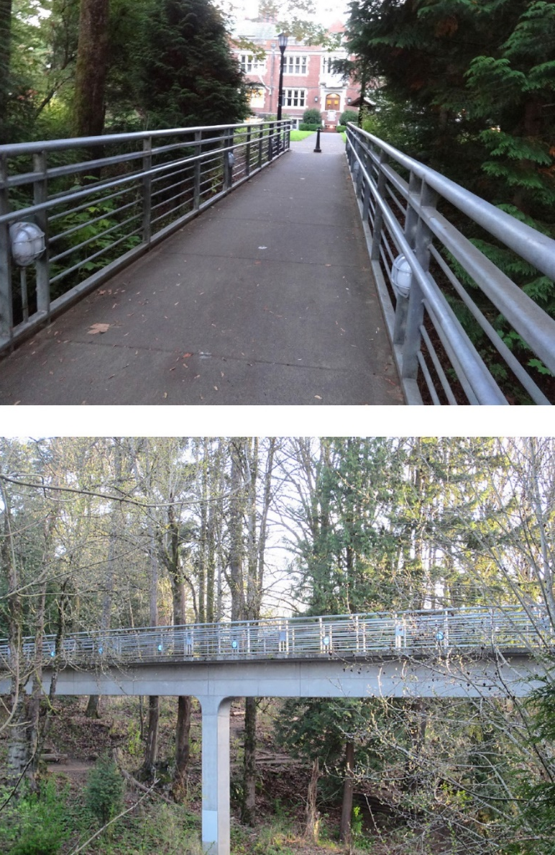
Gibbs Street Bridge
Reed College -- Blue Bridge
PORTLANDOREGON.GOV/TRANSPORTATION

Slide 20
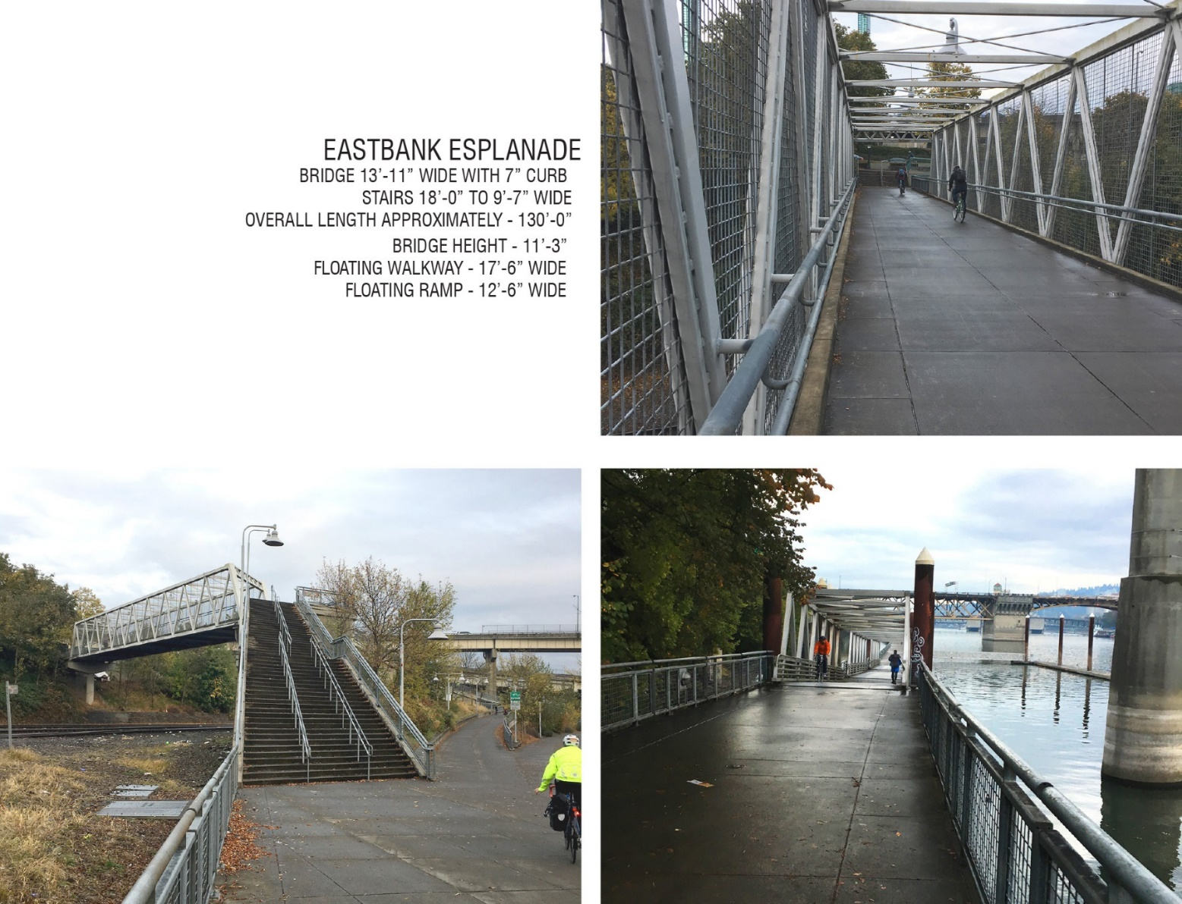
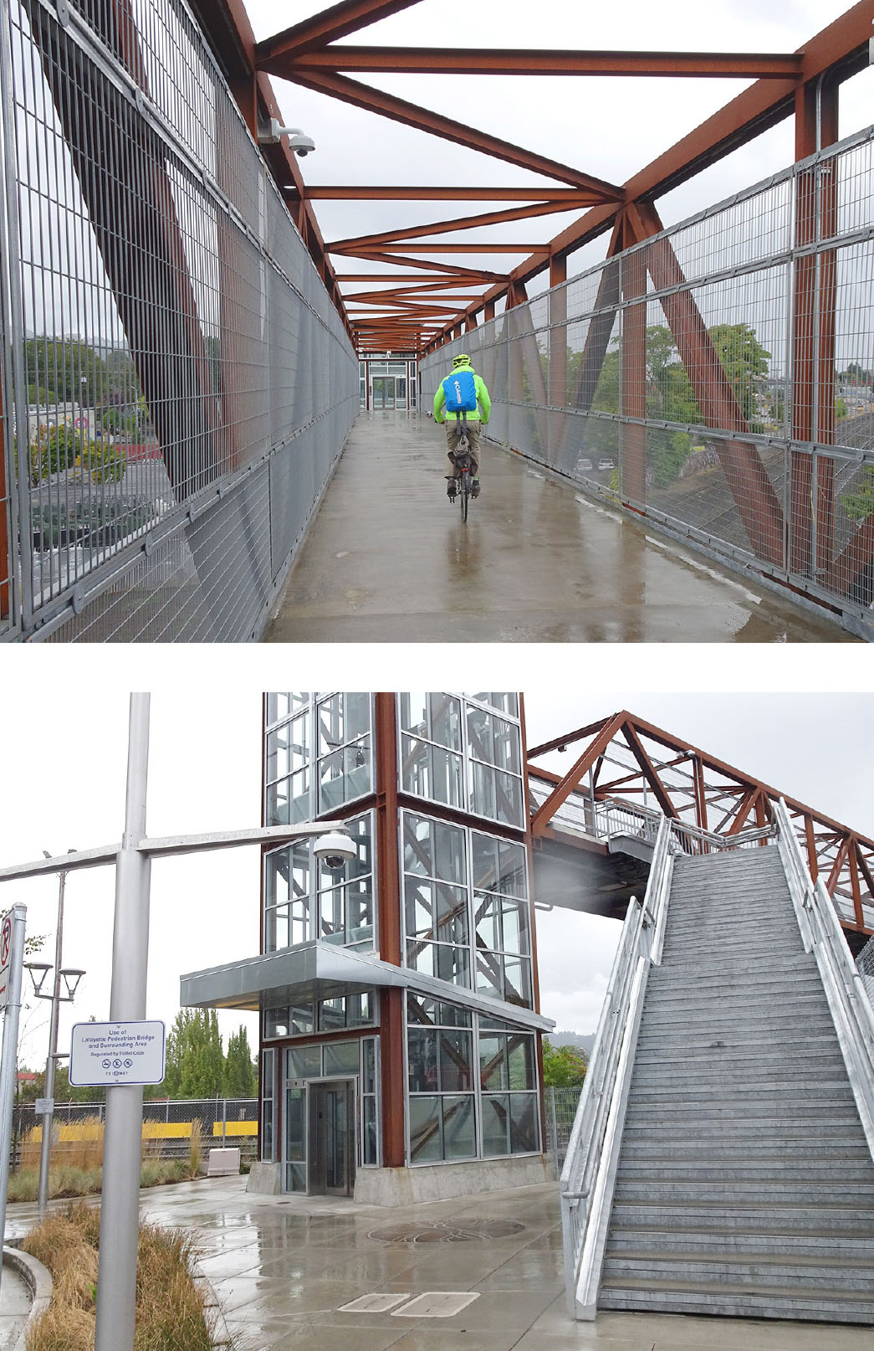
Eastbank Esplanade
Lafayette Bridge
PORTLANDOREGON.GOV/TRANSPORTATION

Slide 21
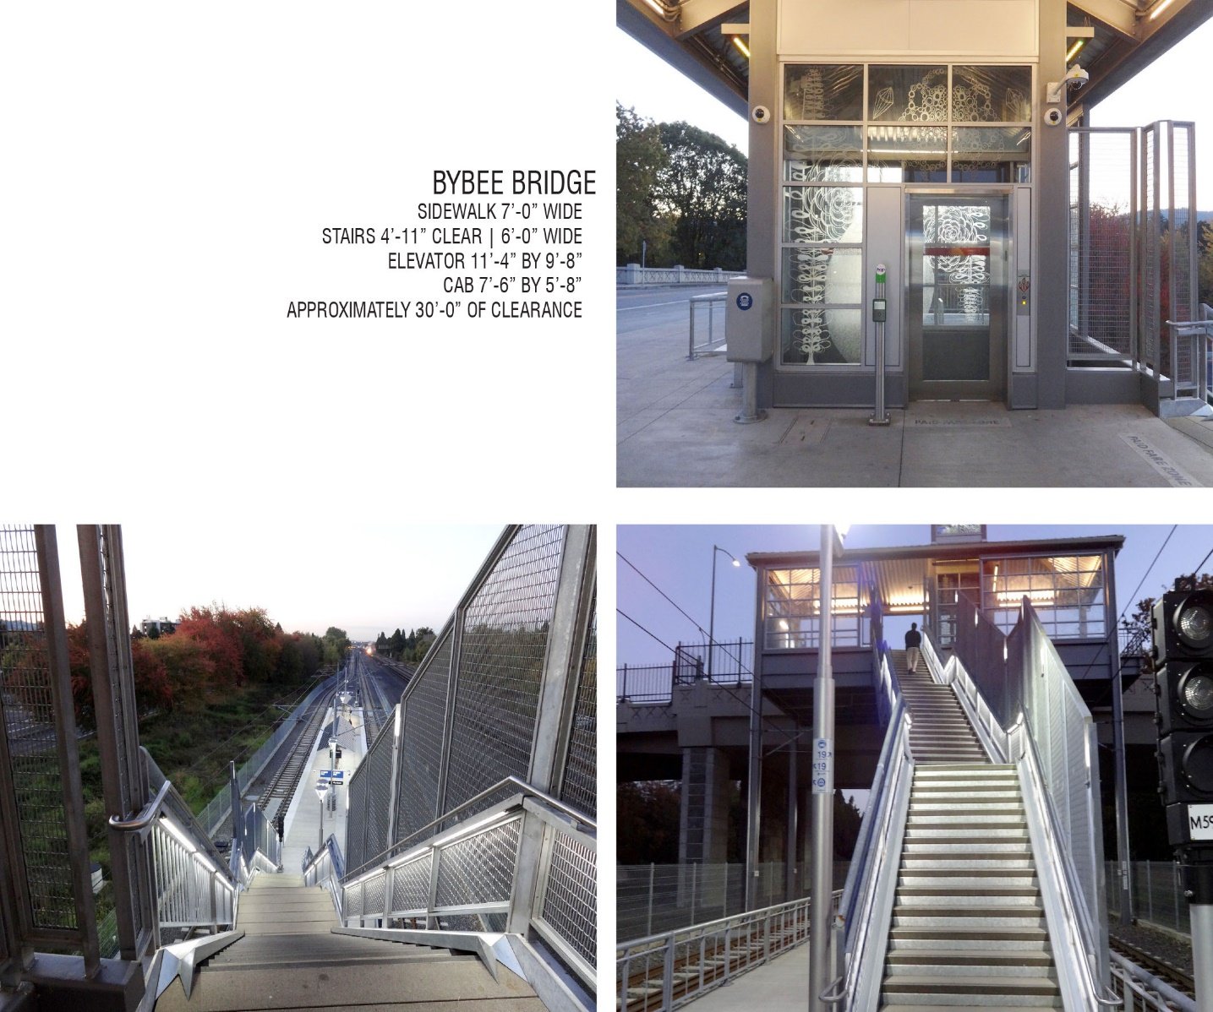
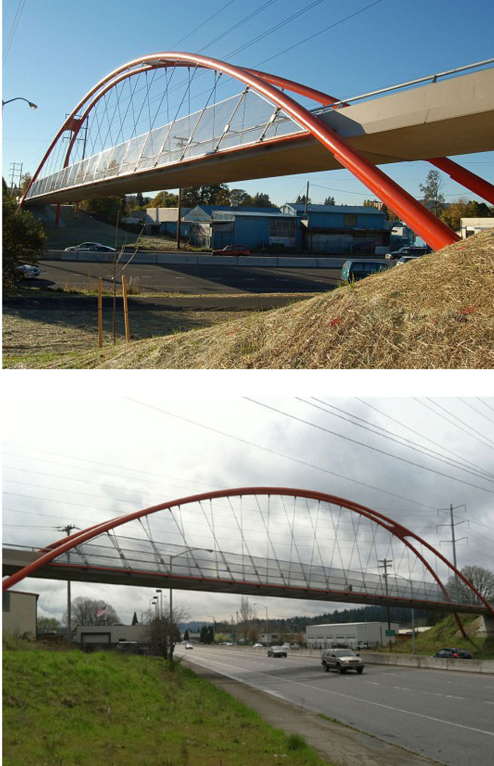
Bybee Overcrossing
Springwater Trail Bridge
PORTLANDOREGON.GOV/TRANSPORTATION

Slide 22
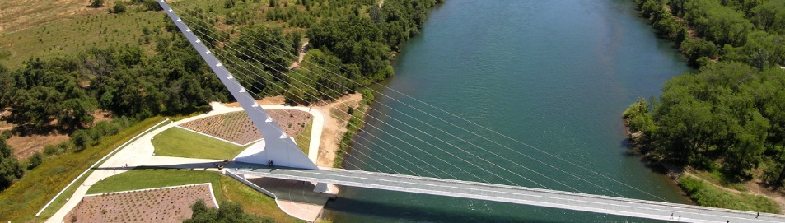
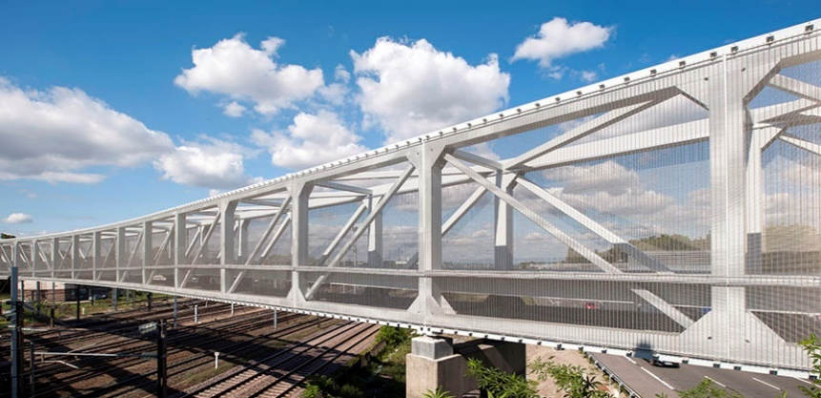
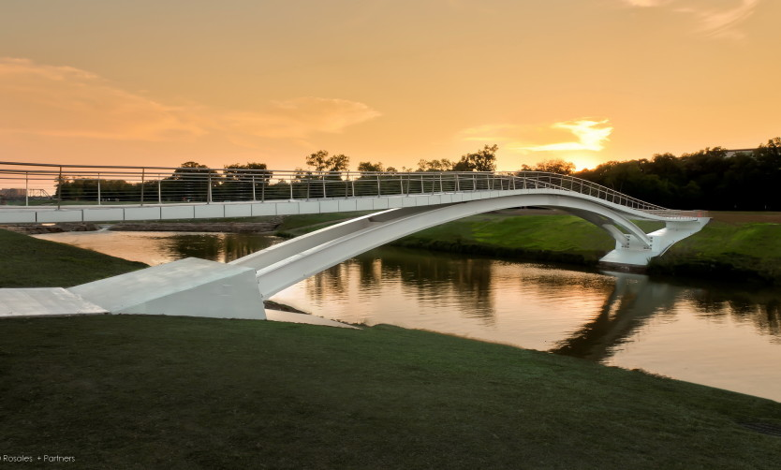
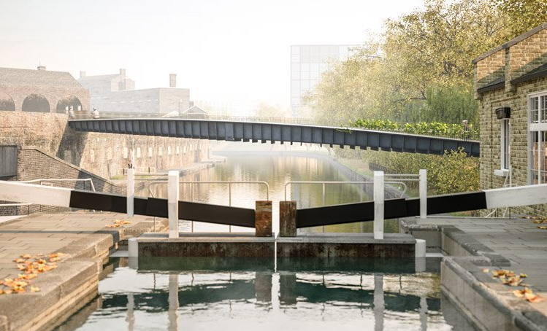
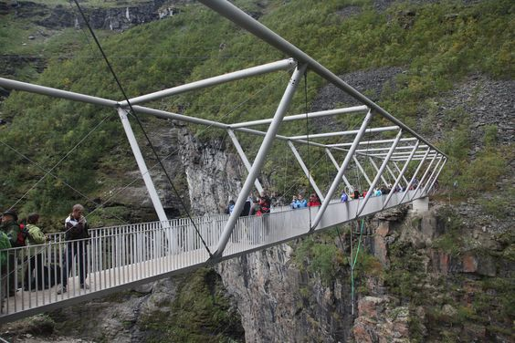
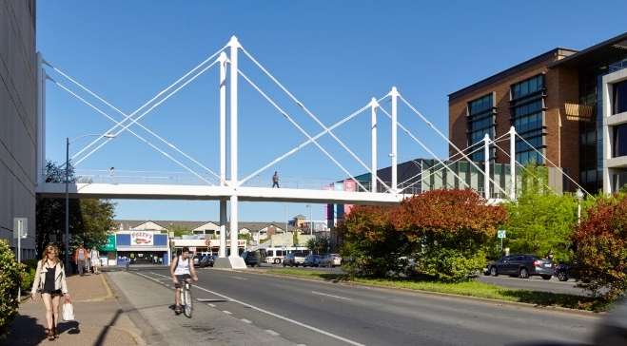
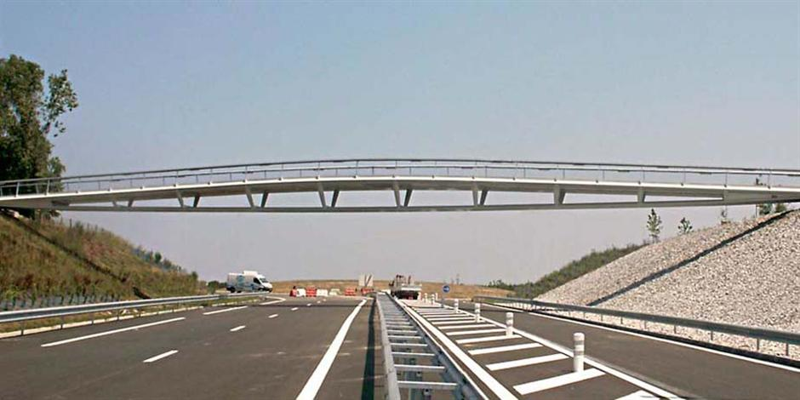
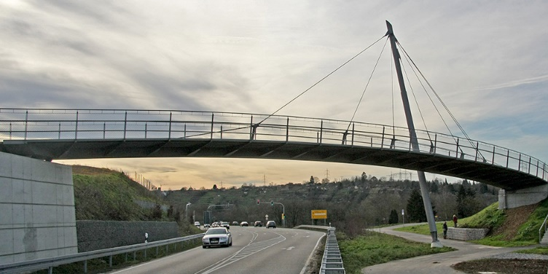
PORTLANDOREGON.GOV/TRANSPORTATION

Slide 23
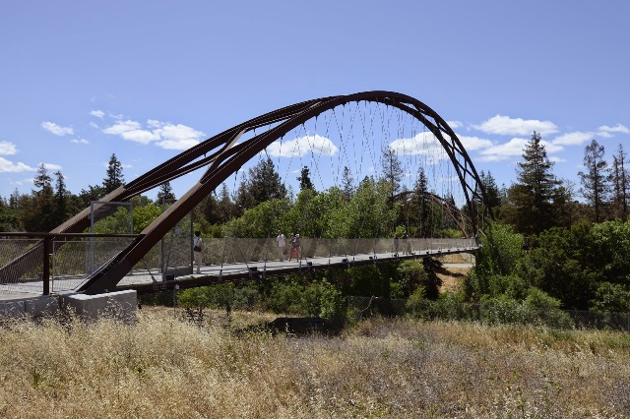
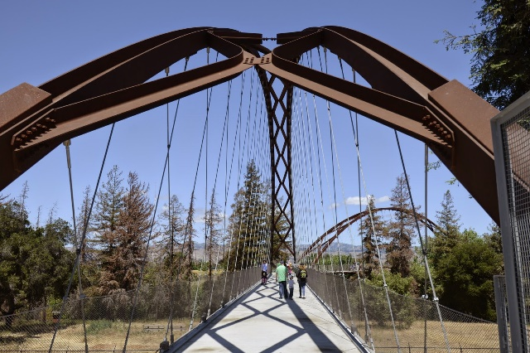
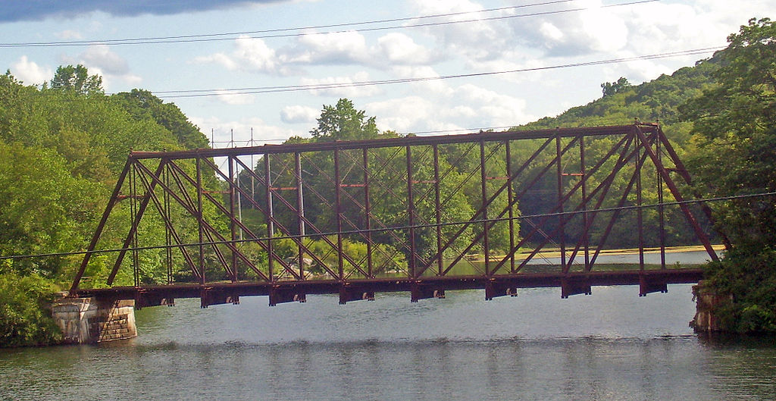
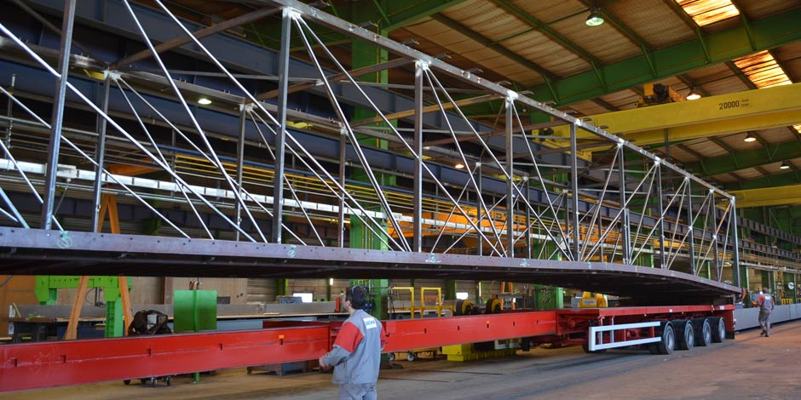
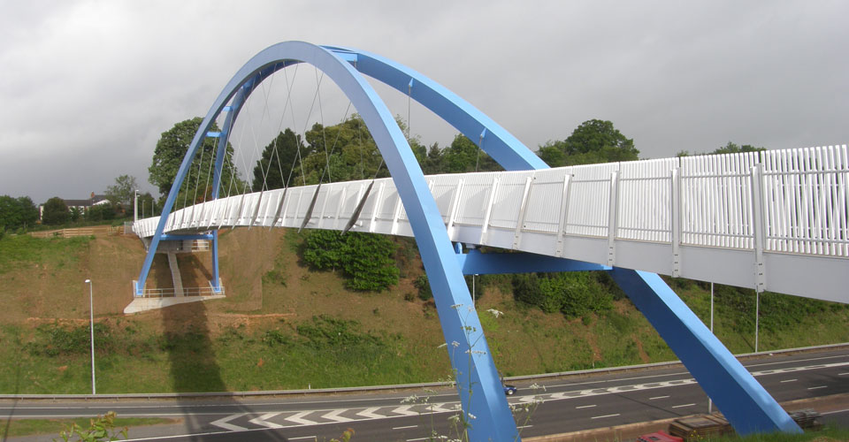
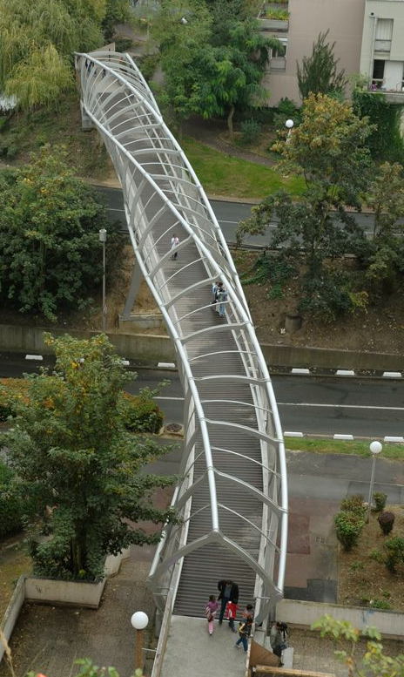
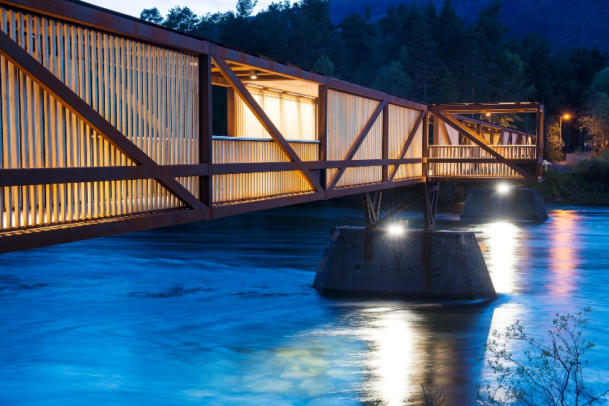
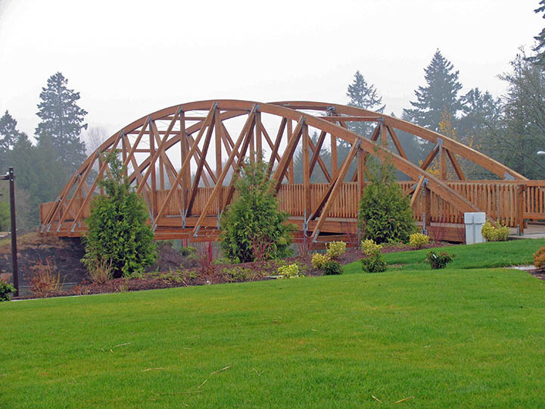
PORTLANDOREGON.GOV/TRANSPORTATION

Slide 24
BRIDGE TYPES / STRUCTURE
TRUSS BRIDGE
VIERENDEEL TRUSS
BEAM BRIDGE
ARCH BRIDGE
SUSPENSION BRIDGE
TIED ARCH BRIDGE
CABLE-STAYED BRIDGE
CANTILEVER BRIDGE
PORTLANDOREGON.GOV/TRANSPORTATION

Slide 25
BRIDGE TYPES / STRUCTURE
TRUSS BRIDGE
VIERENDEEL TRUSS
BEAM BRIDGE
ARCH BRIDGE
SUSPENSION BRIDGE
TIED ARCH BRIDGE
CABLE-STAYED BRIDGE
CANTILEVER BRIDGE
PORTLANDOREGON.GOV/TRANSPORTATION

Slide 26
PORTLANDOREGON.GOV/TRANSPORTATION

Slide 27
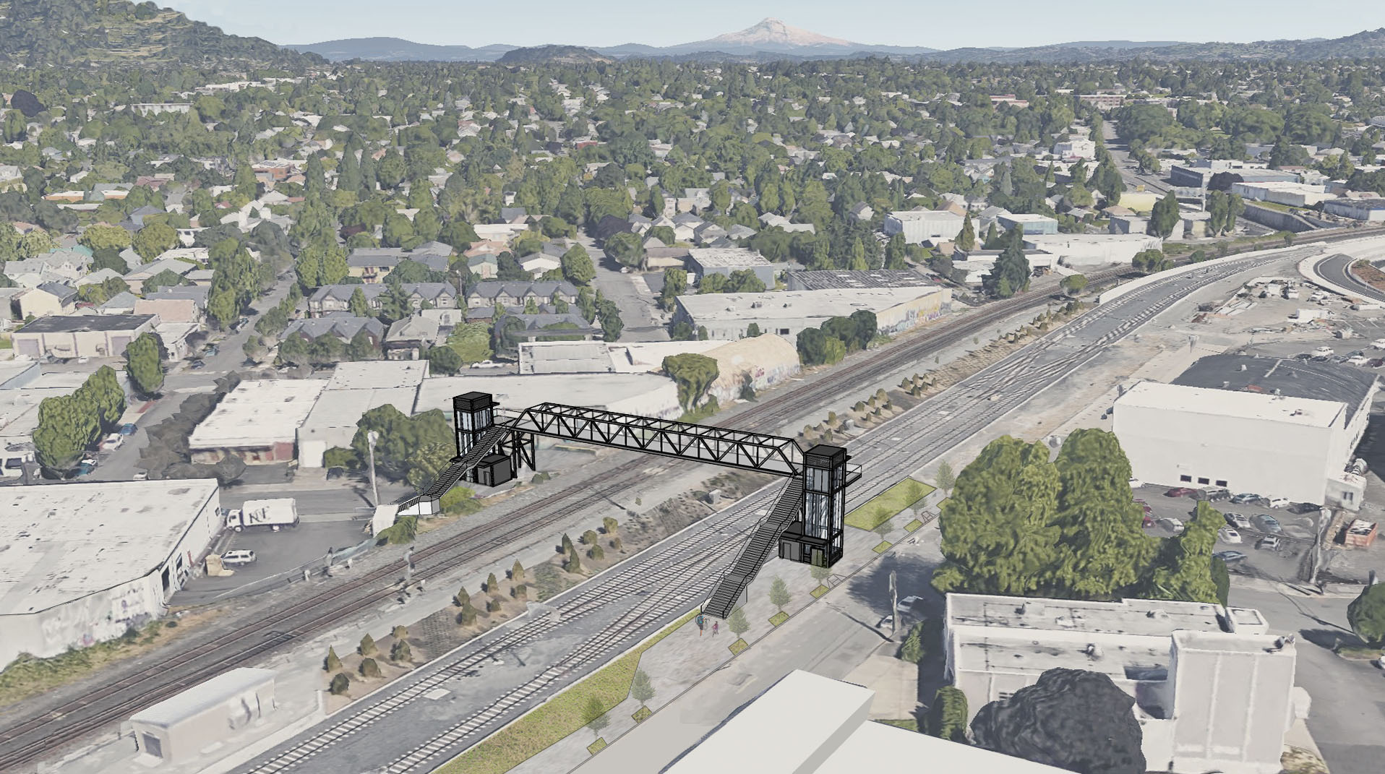
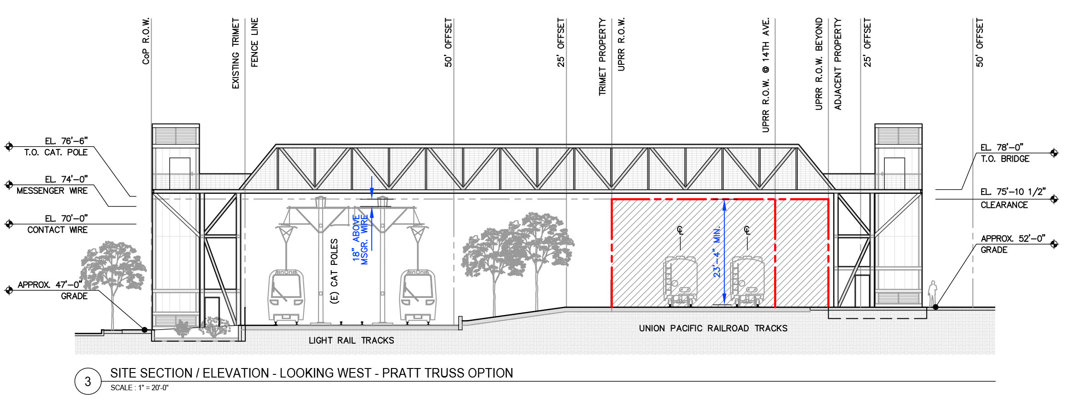
10% CONCEPT LEVEL DESIGN
PRATT TRUSS
PORTLANDOREGON.GOV/TRANSPORTATION

Slide 28
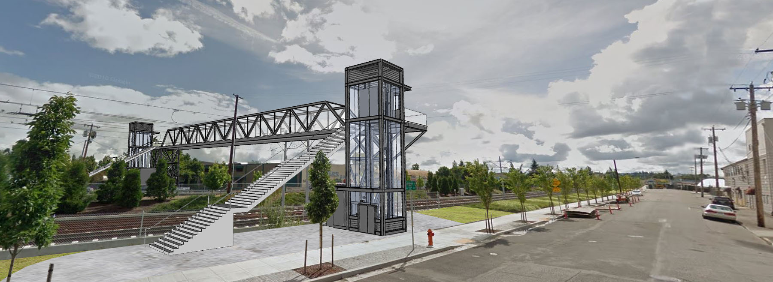
10% CONCEPT LEVEL DESIGN
PRATT TRUSS
PORTLANDOREGON.GOV/TRANSPORTATION

Slide 29

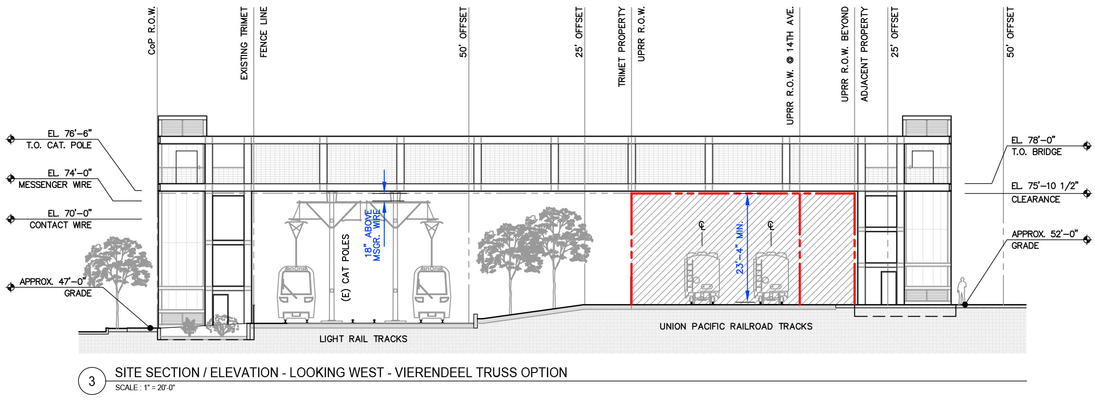
10% CONCEPT LEVEL DESIGN
VIERENDEEL TRUSS
PORTLANDOREGON.GOV/TRANSPORTATION

Slide 30

10% CONCEPT LEVEL DESIGN
VIERENDEEL TRUSS
PORTLANDOREGON.GOV/TRANSPORTATION

Slide 31
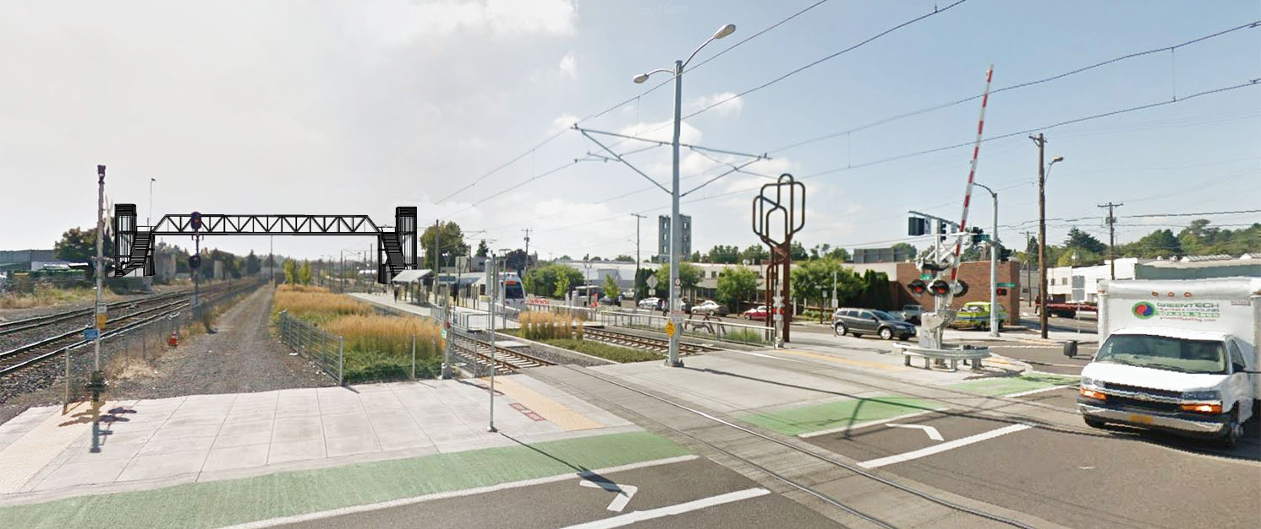
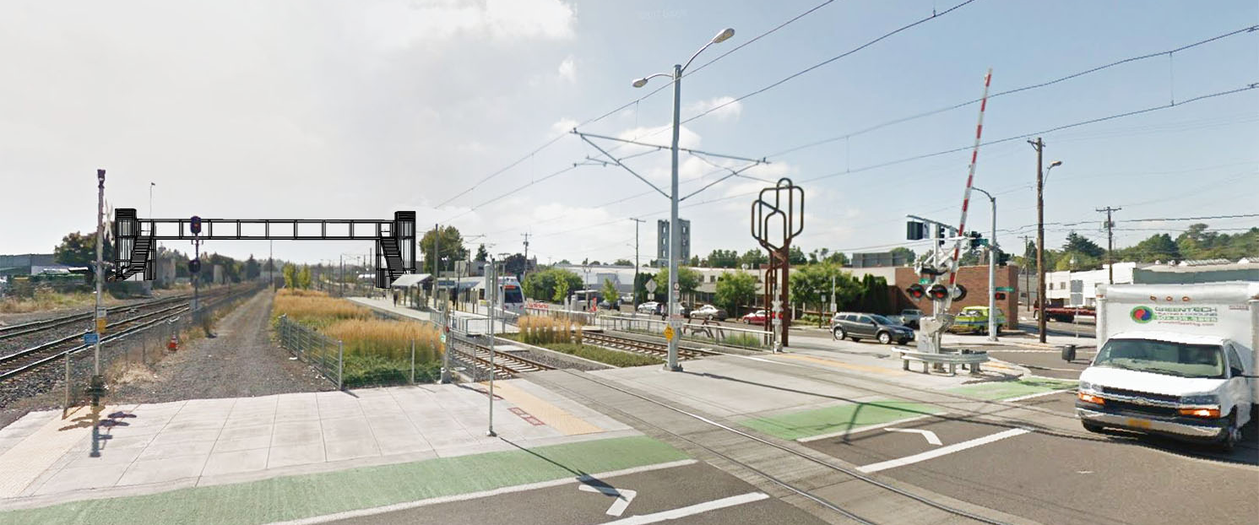
LOOKING EAST FROM 12TH AVENUE
PRATT TRUSS
VIERENDEEL TRUSS
10% CONCEPT LEVEL DESIGN
PORTLANDOREGON.GOV/TRANSPORTATION

Slide 32
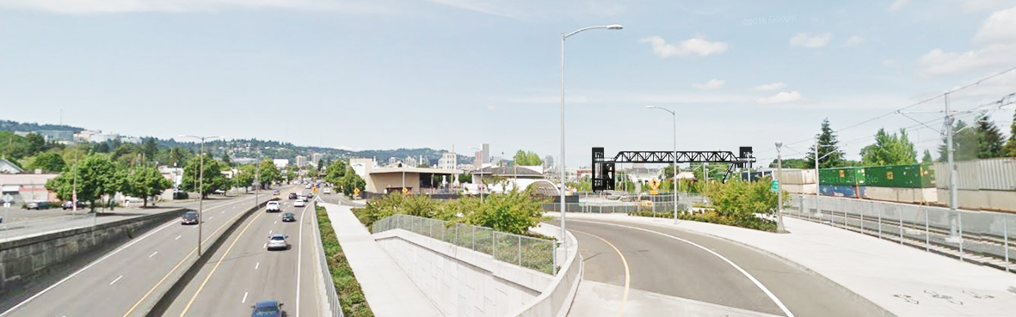

LOOKING WEST FROM 17TH AVENUE
PRATT TRUSS
10% CONCEPT LEVEL DESIGN
VIERENDEEL TRUSS
PORTLANDOREGON.GOV/TRANSPORTATION

Slide 33
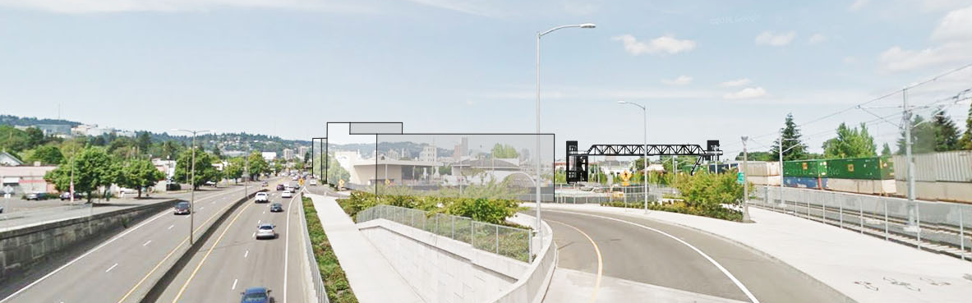

LOOKING WEST FROM 17TH AVENUE
PRATT TRUSS
10% CONCEPT LEVEL DESIGN
VIERENDEEL TRUSS
LOOKING WEST FROM 17TH AVENUE
VIERENDEEL TRUSS
PORTLANDOREGON.GOV/TRANSPORTATION

Slide 34
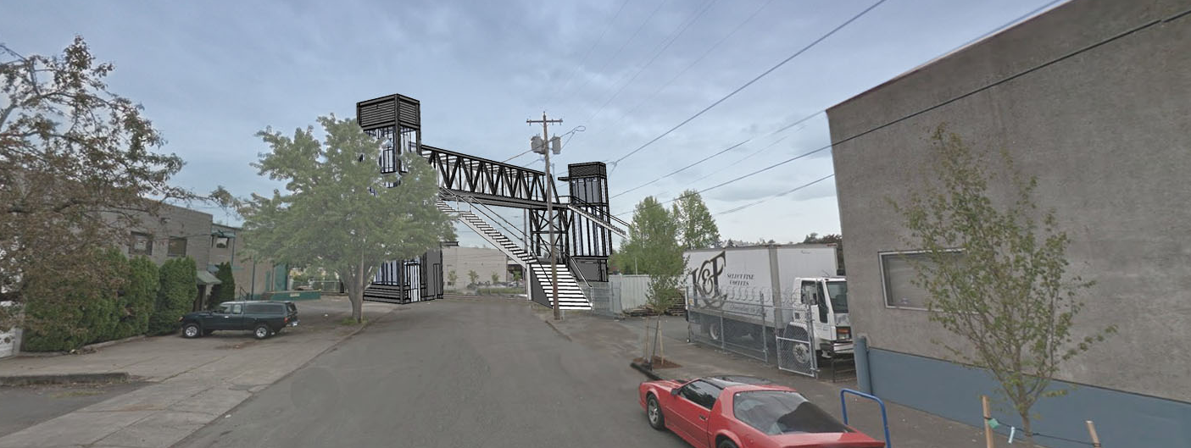
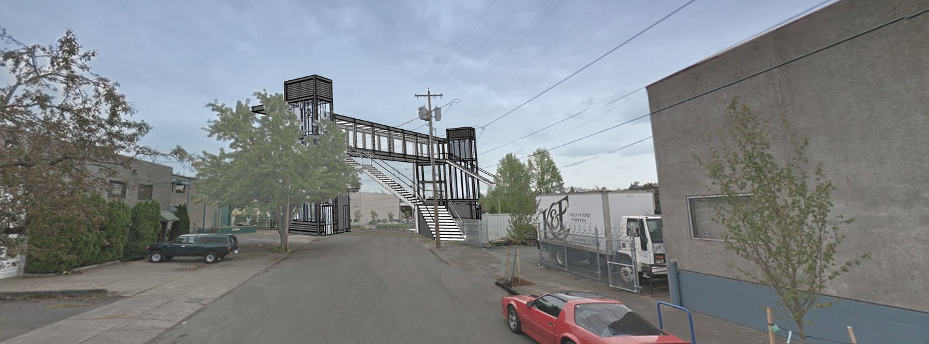
LOOKING SOUTH FROM 14TH AVENUE
PRATT TRUSS
VIERENDEEL TRUSS
10% CONCEPT LEVEL DESIGN
PORTLANDOREGON.GOV/TRANSPORTATION

Slide 35
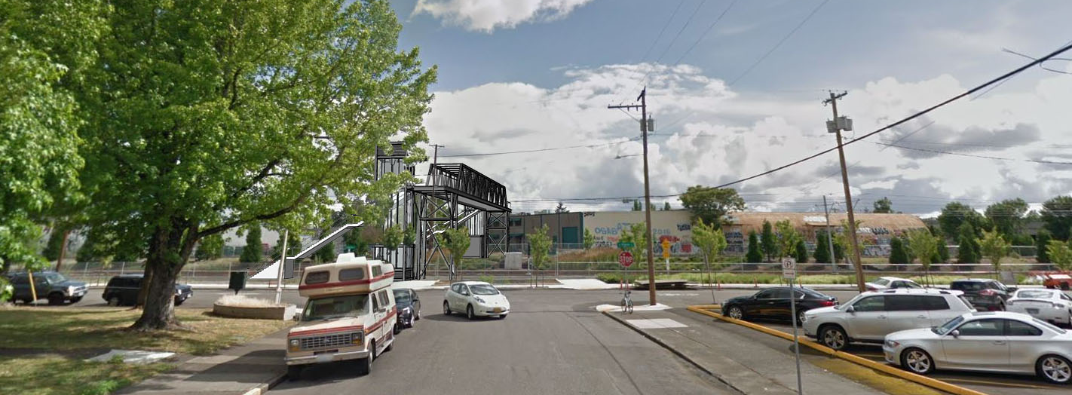
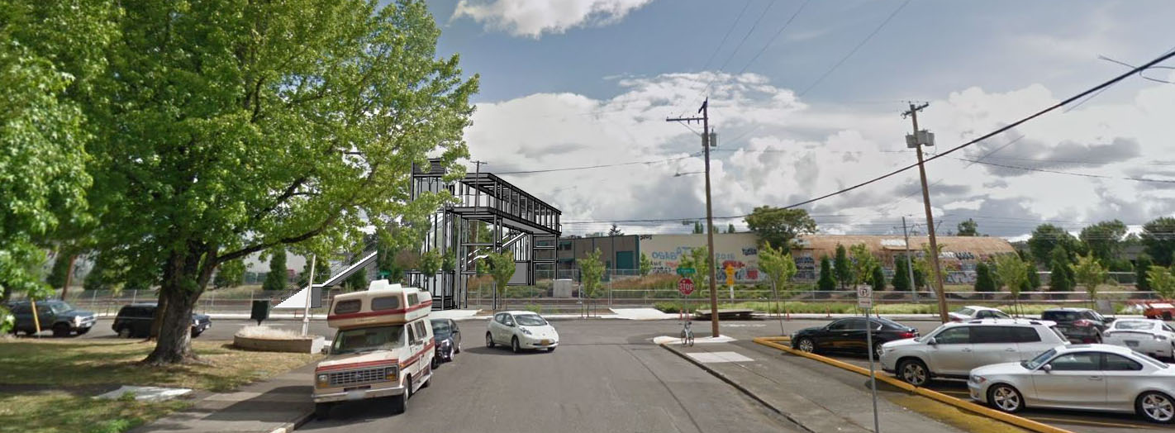
LOOKING NORTH FROM 13TH PLACE
PRATT TRUSS
VIERENDEEL TRUSS
10% CONCEPT LEVEL DESIGN
PORTLANDOREGON.GOV/TRANSPORTATION

Slide 36
10% CONCEPT LEVEL DESIGN
10% CONCEPT LEVEL DESIGN
THANK YOU
PORTLANDOREGON.GOV/TRANSPORTATION

