Slide 1
Sending Your Records to PARC
A Step-by-Step Guide for Packing and shipping Boxes

Slide 2
What This Guide Will Cover
Things to know before you start
Preparing files
Packing files into a box
What to do with non-standard files/materials
Box labeling guidelines
Getting a confirmation number
Scheduling box pickup for delivery to PARC
What happens after boxes are received at PARC

Slide 3
So You Want To Send Records To PARC
Things To Know Before You Start

Slide 4
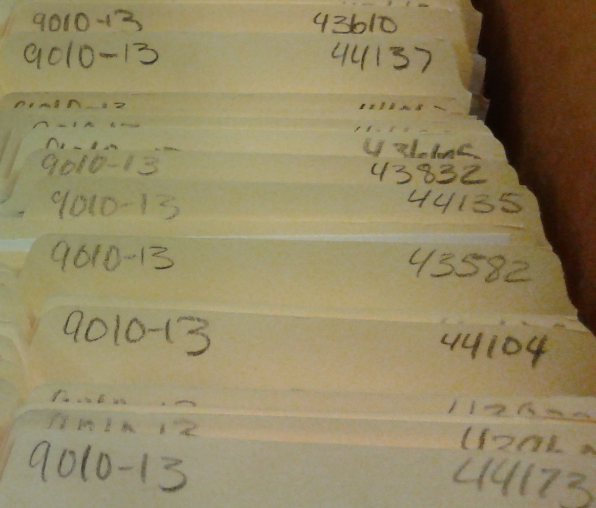
One Box, One Schedule
On File List:
All files within a box must have the same Retention Schedule number.
If you do not yet know the retention schedule to use, all schedules can be found online here: Records Retention Schedules
(For detailed instructions on using retention schedules see the Records Activity Notice (RAN) Tutorial)
The schedule number doesn’t have to appear on the folder tab, but this is a good illustration of the folders all having the same schedule

Slide 5
No Binders, Please
Binders are not accepted for storage or direct destruction. Please remove all materials from their binders and place in folders, titling the folders using the binder title.
If the materials need to be split up into multiple folders, include 1 of 3, 2 of 3, etc. in the folder title so anyone working with the files will know that the multiple folders are considered part of a whole.

Slide 6
No Removable Media
Do not include electronic records with the paper records. Removable media, such as CDs, DVDs, cassette tapes, and flash drives are not appropriate for storing record copy City records.
Electronic records deteriorate much quicker than paper. Removable media may be retained for a convenience copy, but is not suitable for storage as the official record.
For more information on how to properly handle any removable media, see this guidance page.

Slide 7
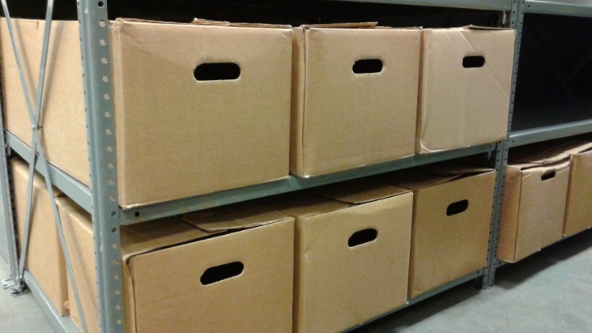
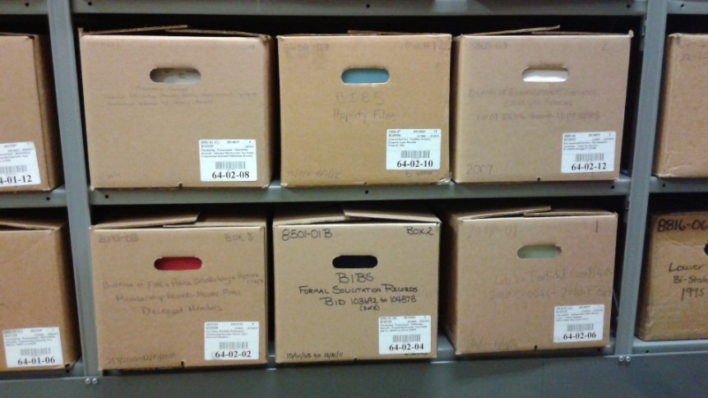
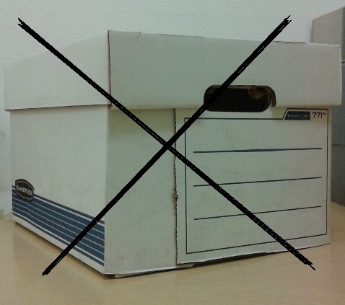
The Right Box: Choose Wisely
Standard Boxes
You must use approved boxes that are new, or in very good condition.
If you need boxes, go to the Ordering Archives Boxes instructions on the Records Center website.
Non-standard boxes will not be accepted for storage

Slide 8
Assembling a Box
Boxes will likely take less than a minute to assemble and because of their design require no additional securing. This means if you are having to use tape, staples, twine or anything else to keep the box together - it is not assembled correctly.
If you are having trouble assembling boxes, please contact PARC for assistance.

Slide 9
Preparing Files
Labeling and Tips

Slide 10
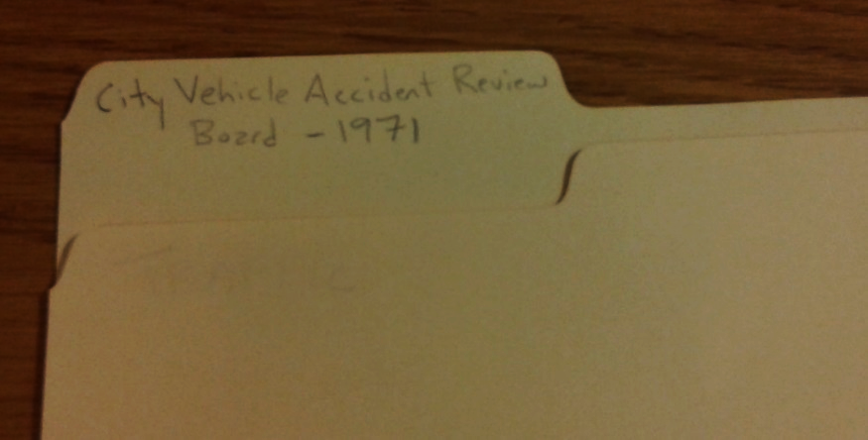
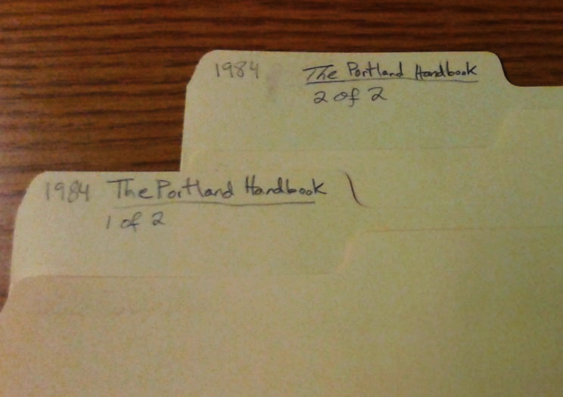
Label folders along the top so that the writing faces the front of the box (handwritten is best using pencil or permanent ink; do not use felt tip markers). Make sure all materials are in the correct file.
If files are part of a set, label folders ‘1 of 2’, ‘2 of 2’, etc.
If materials do not fit in standard folders, please contact PARC staff.
Files should be in folders or pockets, please contact PARC if you believe there are special circumstances preventing this.

Slide 11
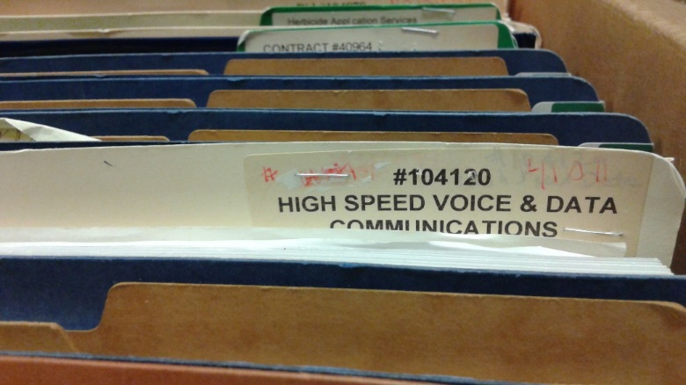
Additional Tips
Do not use rubber bands
Do staple adhesive labels onto the folder
Rubber bands are notorious for losing their elasticity and becoming brittle after a short period of time. The chemicals in the rubber band will also permanently react with the paper, staining the records and sometimes sticking to paper causing it to tear if an attempt is made to remove the rubber band.
Did you know that it only takes a few years for the adhesive on a label to fail? If you do use adhesive labels stapling them onto the file will ensure that the labels do not fall off when they lose their adhesion. If adhesive labels are used, staple the labels to the folders (although it is still best to handwrite titles on folders when possible).

Slide 12
Packing Files into a Box
What to know

Slide 13
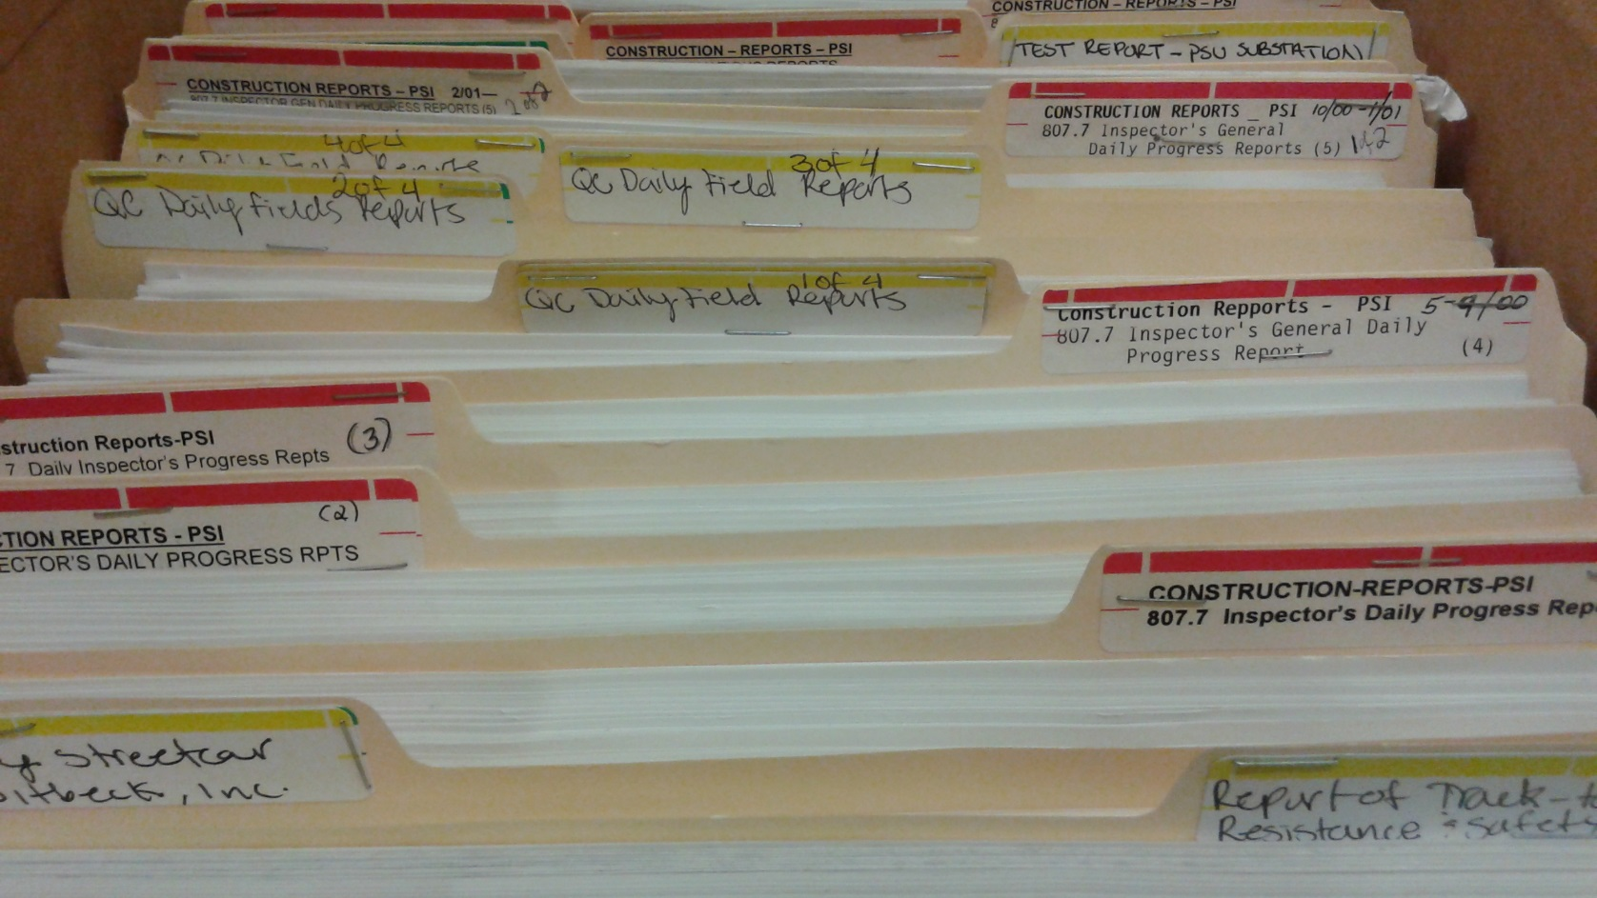
Files must be upright in the box, not stacked, and face the front of the box (which is the side you will label, see slide 16). Make sure the file listed as 1 on the File List is the first file at the front of the box.
(If you have legal sized folders, please contact PARC)

Slide 14
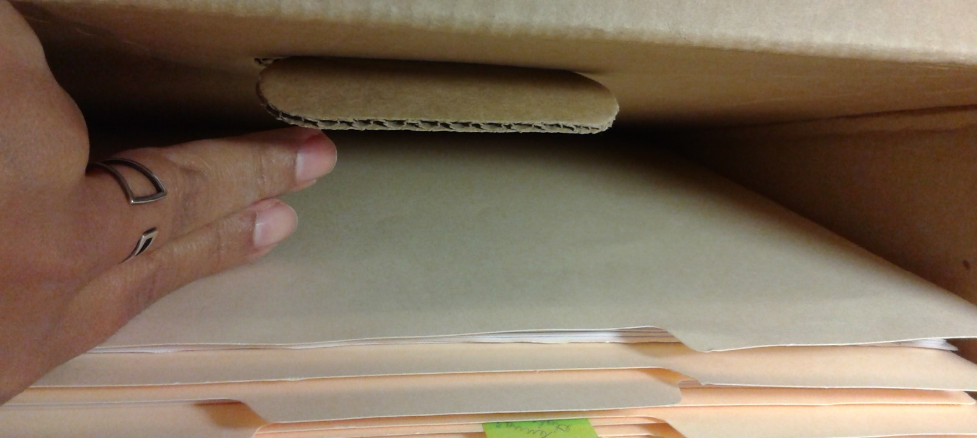
Boxes MUST BE FULL, leaving approximately 1-2 inches of space to allow for access (folders should have no room to slouch or be able to slide under one another). Boxes weighting greater than 50lbs will not be accepted for storage.
Partially filled boxes will not be accepted for storage. If the box is not full, do not use fillers like crumpled paper or small boxes. Instead, wait until you have enough files to fill up the box.
If there will never be enough files to send a full box, contact PARC staff to discuss alternative options.

Slide 15
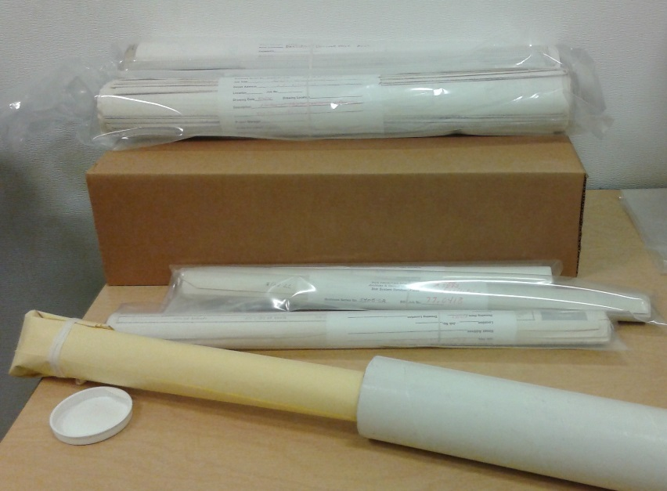
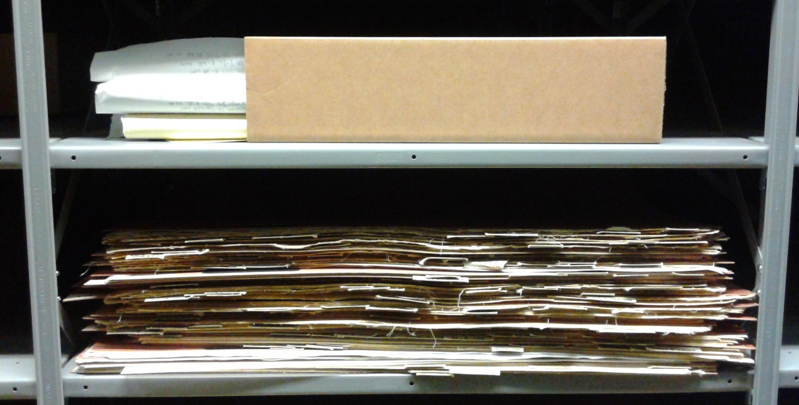
If records do not fit into a standard box – such as oversized/undersized materials, rolled maps or plans, or index cards - contact PARC for help on how best to transfer those records.
Non-standard Materials
Email: parc@portlandoregon.gov Phone: 503-865-4100

Slide 16
Once A Box Is Full
Once a box is full, you can fill out a File List for the box. If you need help filling out the File List, see the following section in the Records Activity Notebook [RAN] Tutorial. If you have multiple boxes, you can wait to fill out the entire RAN (including the File List) once all boxes are packed and labeled.

Slide 17
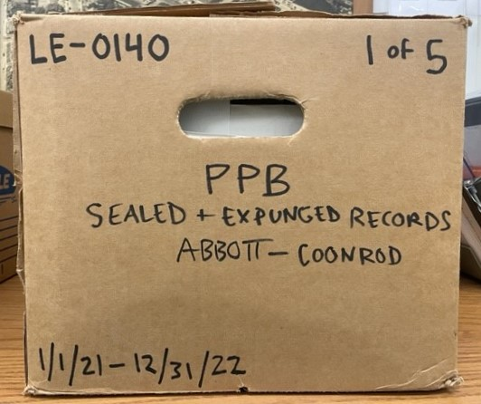
Label the box using the following guidelines
The information you write on the front of the box is the same as what you fill in for the Box List on the RAN. (For detailed instructions on filling in the Box List see: Records Activity Notice [RAN] Tutorial)
Do not use labels or sheets of paper taped to the box to supply this information. You must write the information directly on the box.
Retention Schedule Number (e.g.: LE-0170 (b) , ADM-0100)
Box Number (e.g.: 1; 1 of 3 – number of boxes will be the same as the number of boxes listed on the Box List)
Bureau (e.g.: PPB, OMF, City Auditor, FDPR)
Schedule Title (e.g.: Land Use Review (LUR) Records, General Ledgers, Sealed and Expungement Records)
Box Title (e.g.: Audit Schedules)
From Date (e.g.: 7/1/2011)
To Date (e.g.: 6/30/2012)
1
2
3
4
5
Leave space open for PARC label
6
7

Slide 18
Next Steps
After the box is packed

Slide 19
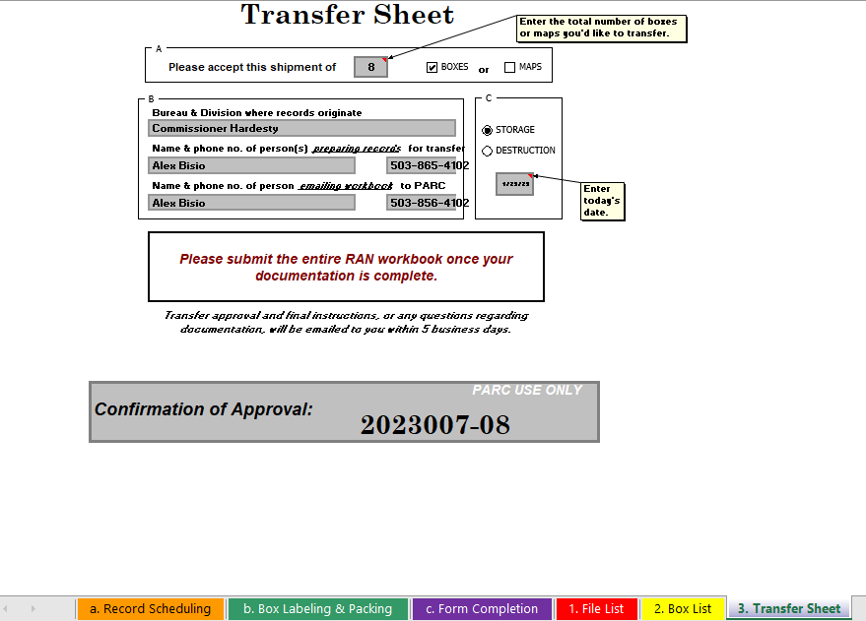
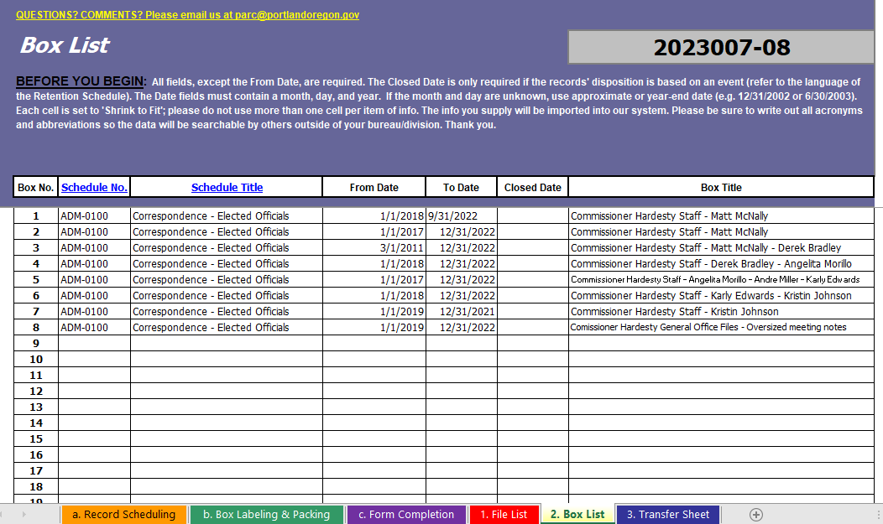
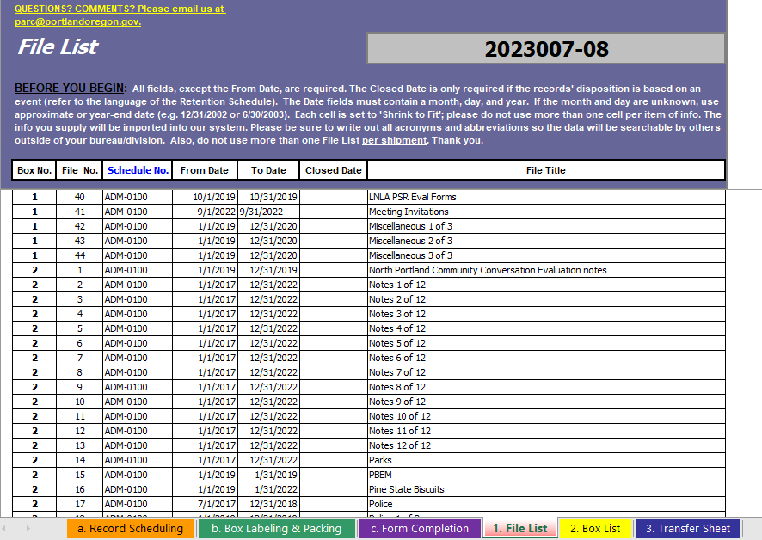
Now It’s Time To Make Your RAN!
With the box(es) packed, you can go to the Records Activity Notice (RAN) Workbook and fill-in the File List (if you haven’t already), Box List, and Transfer Sheet.
If you need help filling out the RAN, there is a step-by-step tutorial available here: Records Activity Notice (RAN) Tutorial.
Before emailing the RAN to PARC for approval, double check that the order of the folders in the box matches the File List order. When the RAN is approved you will receive a confirmation number, which allows you to send the boxes to PARC.

Slide 20
You’re Almost Finished!
After the RAN is approved and you have a confirmation number, print the Transfer Sheet from the approved RAN (that is where the confirmation number is given) and tape it to the top of the first box.
Contact Printing & Distribution to schedule a pickup for delivery to PARC by going to P&D Online Service Request. If you have any questions about filling out the request, please contact P&D's Customer Service (pnd.customerservice@portlandoregon.gov).

Slide 21
What Happens Next?
The review includes:
Boxes are packed properly for storage (looking to see if boxes are under or over packed; folders are positioned correctly within the box)
Boxes are properly labeled
Dates match between those on the RAN and those on boxes
The files in the box match the File List
Folders are labeled correctly
Once boxes arrive at PARC they are reviewed by staff. If there are any issues with the boxes or files, the employee whose name is listed as the ‘Preparer’ on the RAN’s Transfer Sheet will receive an email with instructions to correct the issues.
Although boxes are reviewed by PARC staff, it is the person preparing the materials for storage who is ultimately responsible for the accuracy of all information pertaining to those materials. Essentially the review is a last spot-check of records before they are imported into TRIM and should not be relied on to catch all issues.
Always double check your boxes and folders before sending them to PARC!

Slide 22
You’re Finished!
If there are no issues with the shipment, files will be entered into TRIM/Content Manager within a few days (depending on the size of the shipment) and be ready for requesting.
If you have any questions, please contact PARC

Slide 23
ADDITIONAL TRAINING
If additional training is needed, please contact the Records Center at 503-865-4100 or parc@portlandoregon.gov.
Trainings for temporary employees MUST also be attended by a permanent employee.

