Slide 1

Mortgage Credit Certificate
Loan Officer
Certification Training
Presented by Sharon Johnson and Dory Van Bockel
Portland Housing Bureau
Notes:
Introductory Slide
Welcome participants to the training
Things we need to check on:
Laptop capability
Ability to link to either a wireless or hard wire network

Slide 2
AGENDA
Introductions
Objectives
Overview of Portland Housing Bureau
Review of MCC Performance
Understanding the Mortgage Credit Certificate (MCC)
Processing the MCC
Marketing the MCC
Questions/Answers
Notes:
Introductions
Welcome participants to the training
Orient them to the facility, bathrooms, etc
State the exact amount of time for the training
Coffee, cookies, juice
Minimize distractions
Review materials that they will be using for the training
Walk through the agenda
Overview of Portland Housing Bureau
We will provide an overview of the PHB
PDC Housing transferred to the City and as a result we want to share the new expectations of the bureau
MCC – Round I
Understanding the Mortgage Credit Certificate (MCC)
Marketing the MCC
Questions/Answers

Slide 3
Mortgage Credit Certificate
Training Objectives:
Certify the loan officers on the revised Mortgage Credit Certificate (MCC) requirements and process.
Participants will learn about:
Program requirements
Qualification requirements for borrowers
PHB approval process & timeline
Disclosure forms/tools to qualify borrowers
Developing a marketing plan to reach households of color

Slide 4
        Our mission is to focus community resources on the
        unmet housing needs of the people of Portland.
We value:
EQUITY Our work must recognize Oregon’s history of housing discrimination and social injustice and address current‐day disparities in access to the resources, programs and opportunities our work provides.
STEWARDSHIP We invest, leverage and prioritize resources in projects and initiatives that provide the highest public value and greatest impact on critical community housing needs.
TRANSPARENCY We facilitate broad public engagement to shape our decisions, investments and policies. Our decisions result from processes that are clear, open and without bias.
INNOVATION We believe that new thinking, partners and solutions will help us solve long‐standing community problems and build a progressive and proactive organization.
Notes:
Portland Housing Bureau
In January of 2009, Mayor Elect Sam Adams and Commissioner Nick Fish announced the creation of a new city bureau that combined the City of Portland Bureau of Housing and Community Development (BHCD) and the Portland Development Commission (PDC) Housing department to form the new Portland Housing Bureau.
Since that time both agencies have been working diligently integrating the functions of the two agencies. In June 2009, Margaret Van Vliet was hired as the Housing Director. Director Van Vliet has been working with staff and community partners in defining the new mission of the bureau that will look to {Read the Mission}
The mission will be refined as part of a larger strategic planning process. In addition to developing a new mission and focus, Director Van Vliet in coordination with Commissioner Nick Fish engaged a early planning process where these four core values were developed which have begun to focus PHB programs moving forward. Those core values are Equity, Stewardship, Integrity and Collaboration.
With respect to the MCC, you will begin to see how these core values have shaped the changes and the future direction of the MCC program.
Questions

Slide 5
Mortgage Credit Certificate
Background & History
Operation H.O.M.E. was a community engagement process designed to raise awareness within the community and address the barriers among people of color to achieve homeownership in Portland
Community, business, and government leaders met to identify barriers and craft solutions
Developed goal of creating 14,000 new minority home owners to call Portland “home.”
One of the resulting recommendations was: Expand the availability of, and increase funding for, first-time homebuyer financial products.
Notes:
About five years ago, the City of Portland and the PDC at the direction of former Mayor Tom Potter and Housing Commissioner Erik Sten formed Operation Home Ownership and Minority Equity (H.O.M.E.).
Operation H.O.M.E. was a community engagement process designed to raise awareness within the community on the barriers among people of color to achieve homeownership in Portland
Community, business, and government leaders met for two and a half years to identify and craft solutions with the goal of creating 14,000 new minority home owners to call Portland “home.”
Several areas were identified as a result of the process for the city to proceed
The MCC began as a result of Operation H.O.M.E

Slide 6
Mortgage Credit Certificate
Private Activity Bond Committee
Authority for the MCC comes from the IRS and is approved by the Private Activity Bond (PAB) Committee
  In 2007, the City of Portland applied for and was awarded its first MCC bond cap allocation of $20 million from the State of Oregon
  In January 2010, the City requested $50 million and was awarded $25 million.
  In October 2011, the city requested $25 million and was awarded $20 million.

Slide 7
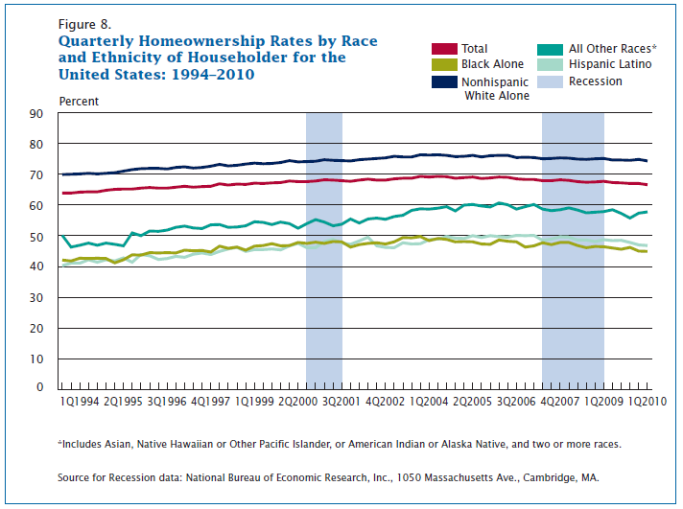
Key Findings
Notes:
About five years ago, the City of Portland and the PDC at the direction of former Mayor Tom Potter and Housing Commissioner Erik Sten formed Operation Home Ownership and Minority Equity (H.O.M.E.).
Operation H.O.M.E. was a community engagement process designed to raise awareness within the community on the barriers among people of color to achieve homeownership in Portland
Community, business, and government leaders met for two and a half years to identify and craft solutions with the goal of creating 14,000 new minority home owners to call Portland “home.”
Several areas were identified as a result of the process for the city to proceed
The MCC began as a result of Operation H.O.M.E

Slide 8
2000 vs. 2005-2009
Homeownership Rates by Race/Ethnicity
Notes:
About five years ago, the City of Portland and the PDC at the direction of former Mayor Tom Potter and Housing Commissioner Erik Sten formed Operation Home Ownership and Minority Equity (H.O.M.E.).
Operation H.O.M.E. was a community engagement process designed to raise awareness within the community on the barriers among people of color to achieve homeownership in Portland
Community, business, and government leaders met for two and a half years to identify and craft solutions with the goal of creating 14,000 new minority home owners to call Portland “home.”
Several areas were identified as a result of the process for the city to proceed
The MCC began as a result of Operation H.O.M.E

Slide 9
2000 vs 2010
Homeownership Rates
Notes:
About five years ago, the City of Portland and the PDC at the direction of former Mayor Tom Potter and Housing Commissioner Erik Sten formed Operation Home Ownership and Minority Equity (H.O.M.E.).
Operation H.O.M.E. was a community engagement process designed to raise awareness within the community on the barriers among people of color to achieve homeownership in Portland
Community, business, and government leaders met for two and a half years to identify and craft solutions with the goal of creating 14,000 new minority home owners to call Portland “home.”
Several areas were identified as a result of the process for the city to proceed
The MCC began as a result of Operation H.O.M.E

Slide 10
2005-2009 Percent Over/Under
Avg. Homeownership Rate-Portland, OR
Notes:
About five years ago, the City of Portland and the PDC at the direction of former Mayor Tom Potter and Housing Commissioner Erik Sten formed Operation Home Ownership and Minority Equity (H.O.M.E.).
Operation H.O.M.E. was a community engagement process designed to raise awareness within the community on the barriers among people of color to achieve homeownership in Portland
Community, business, and government leaders met for two and a half years to identify and craft solutions with the goal of creating 14,000 new minority home owners to call Portland “home.”
Several areas were identified as a result of the process for the city to proceed
The MCC began as a result of Operation H.O.M.E

Slide 11
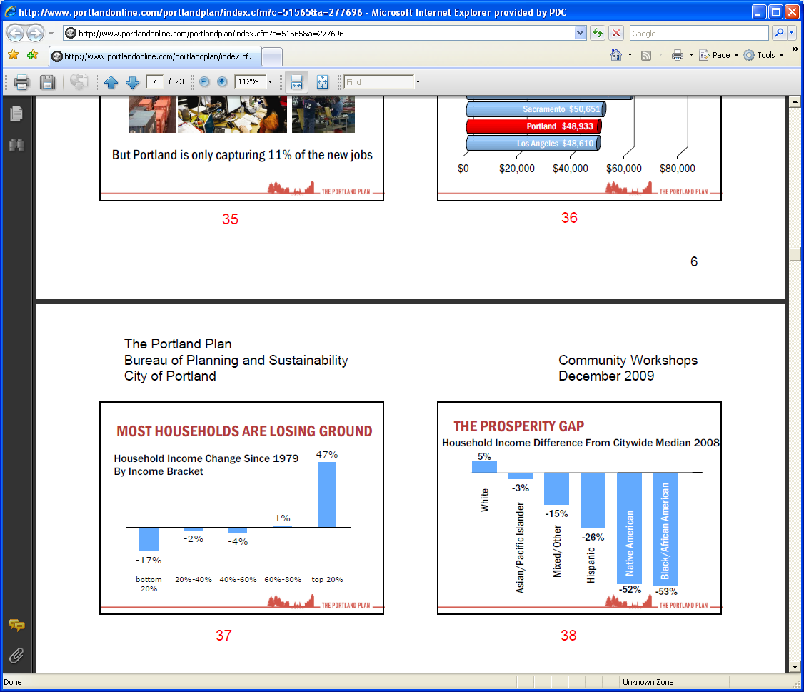
Household Income By
Race and Ethnicity

Slide 12
Mortgage Credit Certificate
Background & History
Notes:
About five years ago, the City of Portland and the PDC at the direction of former Mayor Tom Potter and Housing Commissioner Erik Sten formed Operation Home Ownership and Minority Equity (H.O.M.E.).
Operation H.O.M.E. was a community engagement process designed to raise awareness within the community on the barriers among people of color to achieve homeownership in Portland
Community, business, and government leaders met for two and a half years to identify and craft solutions with the goal of creating 14,000 new minority home owners to call Portland “home.”
Several areas were identified as a result of the process for the city to proceed
The MCC began as a result of Operation H.O.M.E

Slide 13
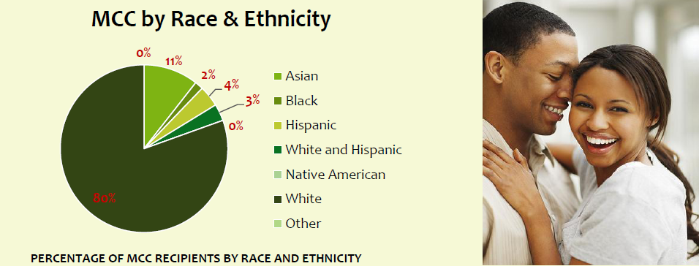
MCC Round 1
In the first round of the MCC program, 20% of the MCC clients were people of color.

Slide 14
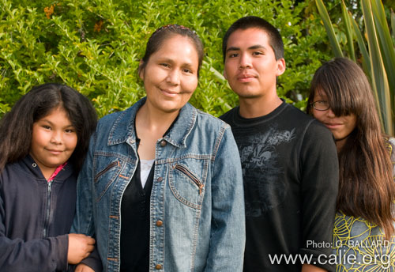
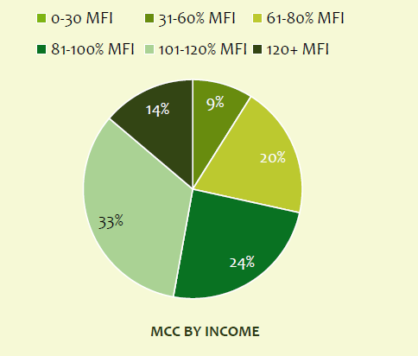
MCCs issued by MFI
57% of MCC customers earned between 80 % to 120% MFI
43% earned less than 80% MFI

Slide 15
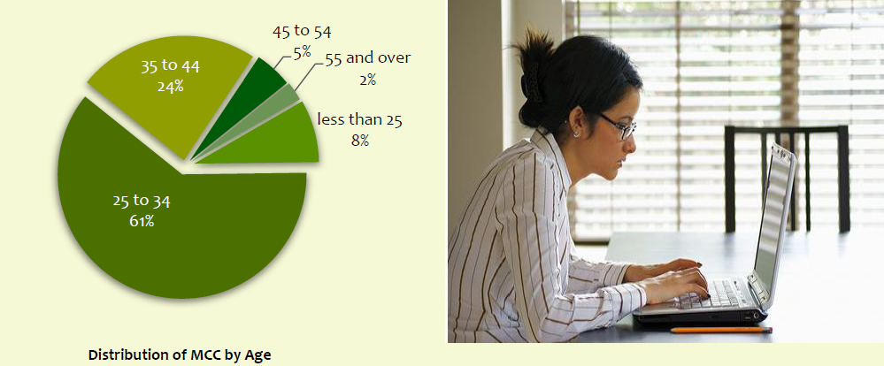
Over 60% of the MCC Recipients were between the ages of 25-34

Slide 16

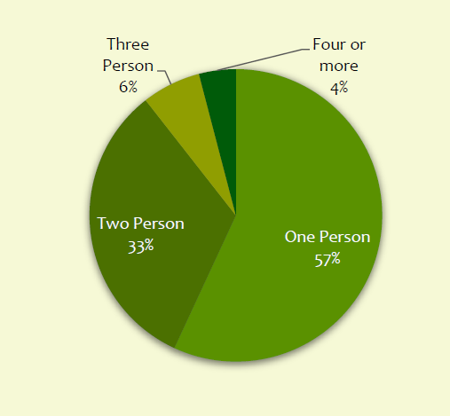
MCCs issued by Household Size
90% of MCC recipients were to single and two person households

Slide 17

Program Example
Loan Amount of $200,000 at a 5.00% rate
= $10,000 interest paid in a year
x .20 (20% MCC tax credit)
=$2,000 annual tax credit
=$166 per month
MCC credit is then added to income or subtracted from
PITI depending on the loan program.

Slide 18
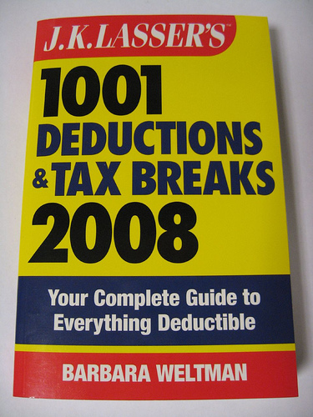
Benefits of the MCC
The Portland MCC is a direct federal income tax
credit that reduces the federal income taxes of a
qualified borrower ($1 tax credit = -$1 fed. taxes)
20% of the annual mortgage interest paid as a
federal income tax credit. The remaining 80%
continues to qualify as an itemized deduction

Slide 19

Benefits of the MCC
Borrowers can immediately realize the MCC
tax credit by adjusting their W-4
The MCC can increase the Borrower’s purchasing
power
    Decreases debt ratio
    Qualify for larger loan
Borrowers must file IRS Tax Form 8396 include at time of
Federal tax filing in order to benefit from the MCC credit
Notes:
( ask question)

Slide 20

Benefits of the MCC
Credit can be carried over for up to three years
MCC is valid for the life of the borrower’s loan for as long as the borrower lives in the house
MCC provides a dollar-for- dollar reduction in the borrowers federal income taxes

Slide 21
MCC Underwriting Guidelines
Loan Program | Impact of the monthly tax credit provided by the MCC | Lender Requirements | Reference
Fannie Mae | Maximum possible credit treated as an addition to income | Lenders must submit calculation of the adjusted income , copy of certificate, and W-4* and W-4 worksheet with file | X, 402.25
Freddie Mac | Reduction in housing expense/ PITI | Lenders must submit worksheet (Exhibit 21 or similar document**), copy of certificate, and W-4 and W-4 worksheet with file | A34.9 (f) and Exhibit 21
FHA | Reduction in housing expense/ PITI | Lenders must submit worksheet demonstrating benefits** and copy of certificate with file | ML 95-7 XVI
VA | Reduction in the Federal income tax, not to exceed $167/month ($2000 annual maximum), limited to the amount of the veteran’s maximum tax liability | Lenders must submit copy of certificate with file | 36.4337 (d) (2)(xi) (A-D)
Mortgage Credit Certificate (MCC) benefits by loan program
* IRS Form W-4 – Employee’s Withholding Allowance certificate and Worksheet
** Worksheets must demonstrate that a buyer has a sufficient tax liability to benefit from the program

Slide 22
Eligibility for the MCC
Eligible Homebuyers
First-time homebuyer (not an owner in past 3 years)
Primary residence (must occupy the property)
Borrower/Co-Borrower Income Limit:
1-2 persons 3+ persons
$73,000 $83,950
Target areas are not limited to first-time homebuyers
Homebuyer education required (before closing)
$675 MCC fee (invoiced by PHB at closing)

Slide 23
Income Eligibility
Income included in qualifying for an MCC
Annualized gross income by taking occupying Borrower
and Co-Borrowers current gross monthly income (at the
time of application) and multiplying by 12 (before deductions)
  Including wages, salaries, commissions, tips, part-time pay, overtime pay, net rental income, fees, bonuses, dividends and interest (including tax exempt), alimony, child support, public assistance, sick pay, social security, VA compensation, income from trusts, income for business activities and investments, and all other income

Slide 24
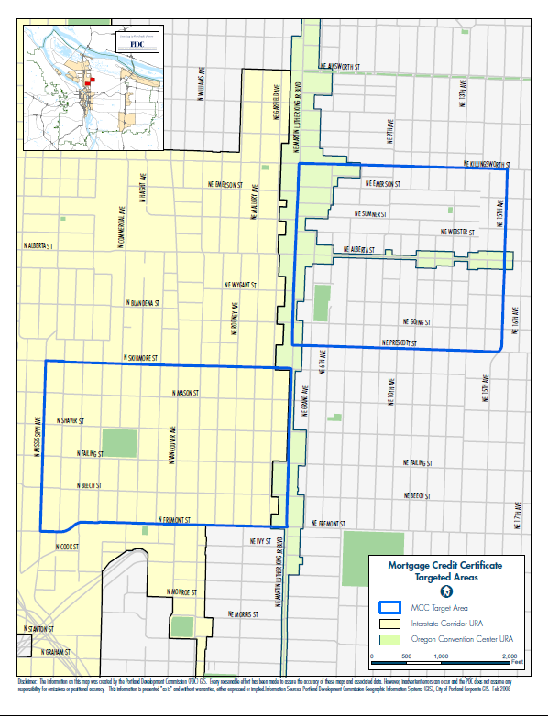
Within these areas you don’t have to
be a first time home buyer
Target Areas
Northeast MCC Target Area
The South border begins at NE Prescott St. and goes North along the West boarder of NE MLK BLVD to NE Killingsworth St. and reaches to the East border at NE 15th Ave.
North MCC Target Area
The South border begins at
N. Fremont St. and moves North along the West border of NE MLK BLVD. to N Skidmore St. then reaches West to the West boarder of N. Mississippi St.

Slide 25
Property Eligibility
Property must be located within the Portland
city limits. For verification of property go to:
http://www.portlandmaps.com/
Single-family units only, including condos and
townhomes
Purchase limit is $424,051 currently
First mortgages only

Slide 26
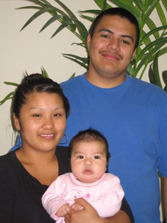
Program Limitations
  Can’t be combined with Oregon Bond or ODVA
  Borrowers must have a tax liability to benefit
  from the MCC tax credit
  Must be used with a fix-rated, fully
  amortized loan
  Must remain owner-occupied to receive the tax
  credit
  Good for the life of the loan –
  no refinancing

Slide 27
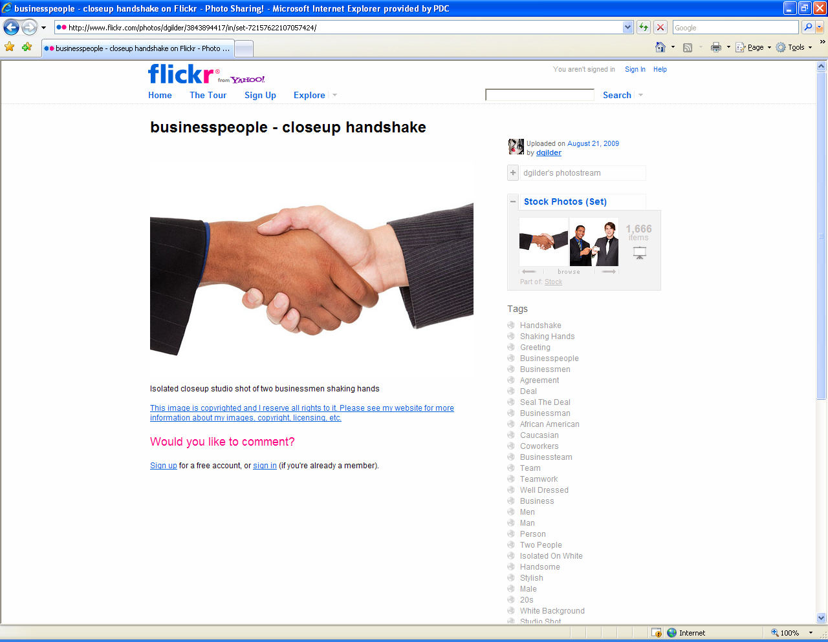
Maximum Allowable Fees
The net Loan Origination (including the YSP and other lender and broker fees) is limited to 2% of the loan amount plus $1000
This does not include the MCC fee or any third party fees

Slide 28
IRS Recapture Tax
The purpose is to make sure the lower rate benefits low to moderate income families. It is possible a borrower could pay the Federal Recapture Tax if the:
      Home is sold within the first nine years of ownership, AND
      Borrower makes a profit on the sale of the home, AND
      Borrowers’ income during year of sale exceeds the income
      threshold which increases 5% annually
Most borrowers do not have a recapture tax liability because they do not exceed the applicable income limits and/or don’t sell their home in the first nine years.
In no case would the tax ever exceed 6.25% of the original loan amount(worst case scenario), but the worst case is significantly reduced if the home is sold in any year other than the fifth year of ownership.

Slide 29
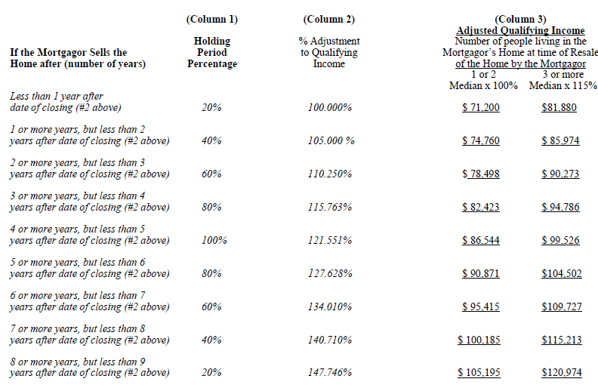
IRS Recapture Tax

Slide 30
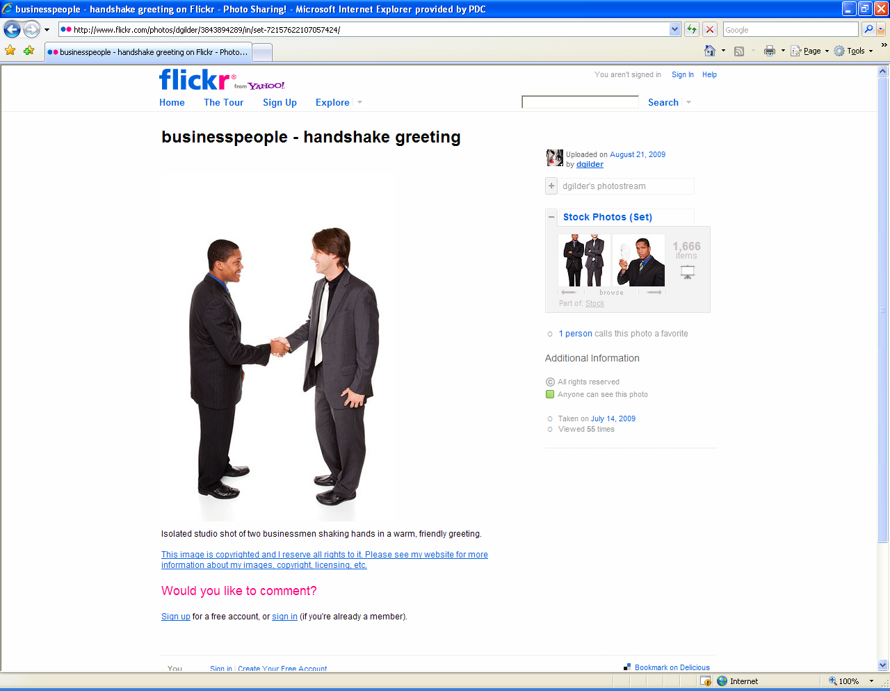
Benefits of the MCC for Lenders
Partner with PHB to address the minority homeownership gap
Proof that you are committed to helping the community
Ability to offer a unique product and expand
customer base - stand out from other brokers and lenders
Help your clients save & lower their tax liability
Lower your client’s debt ratios
Increase your client’s purchasing power
Close more loans!

Slide 31

Your Role
Outreach and marketing to communities of color
Educate your borrowers on the qualifications and benefits
of the MCC
Determine qualification of borrowers for the MCC
Process the MCC application packet
Facilitate the MCC through closing and final issuance

Slide 32
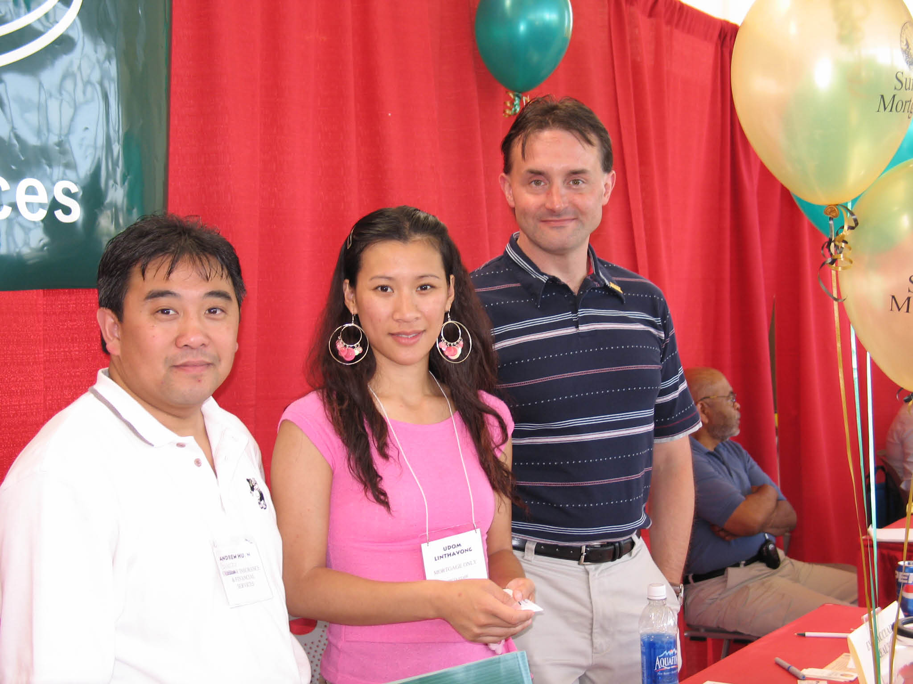
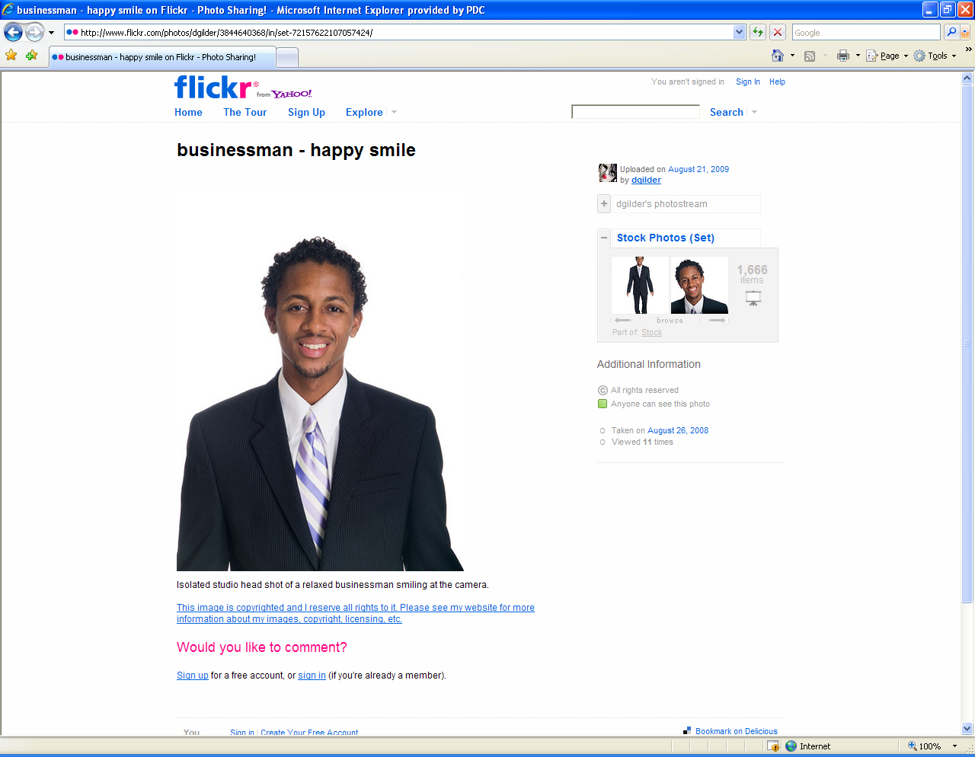
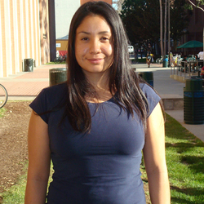
Processing the MCC

Slide 33
When to Consider the MCC
First time Homebuyer(s)
Buying within city of Portland
Income within Limits
Price Point within Limits

Slide 34
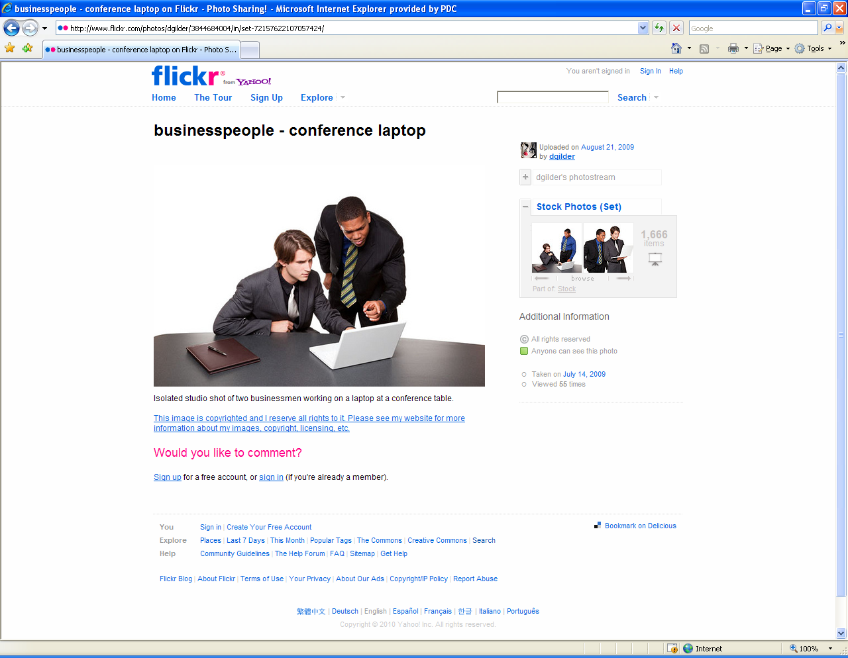
Talking to Homebuyers about the MCC
Before Submitting an MCC Application…
3 years Tax Returns
Plans to Stay in the House
Prospects for Life Changes
Tax Liability
Recapture Tax

Slide 35
Before Submitting an MCC Application
Please Review the Following:
MCC Program Manual
Underwriting Treatment
MCC Initial Disclosures
MCC Closing Disclosures
(All of the above are on-line)

Slide 36
MCC Application
Phase I
Loan Origination
Phase II
PHB Processing
Phase III
Underwriting & Verification
Phase IV
Closing/Final Issuance
Phase V
Record Keeping & Federal Reporting
Start
End

Slide 37
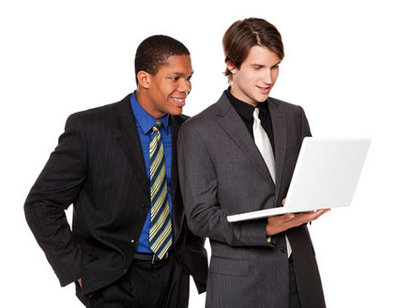
Reasons for Doing the MCC Comparison
Lead the Conversation with Homebuyers
Need to Ensure the MCC is the Right Fit
Displays the Benefits of the MCC
Data Input Populates all Initial Phase Documents
Available on-line in Excel 2003 & 2007
We want you to use the worksheet as a tool to engage and educate your client

Slide 38
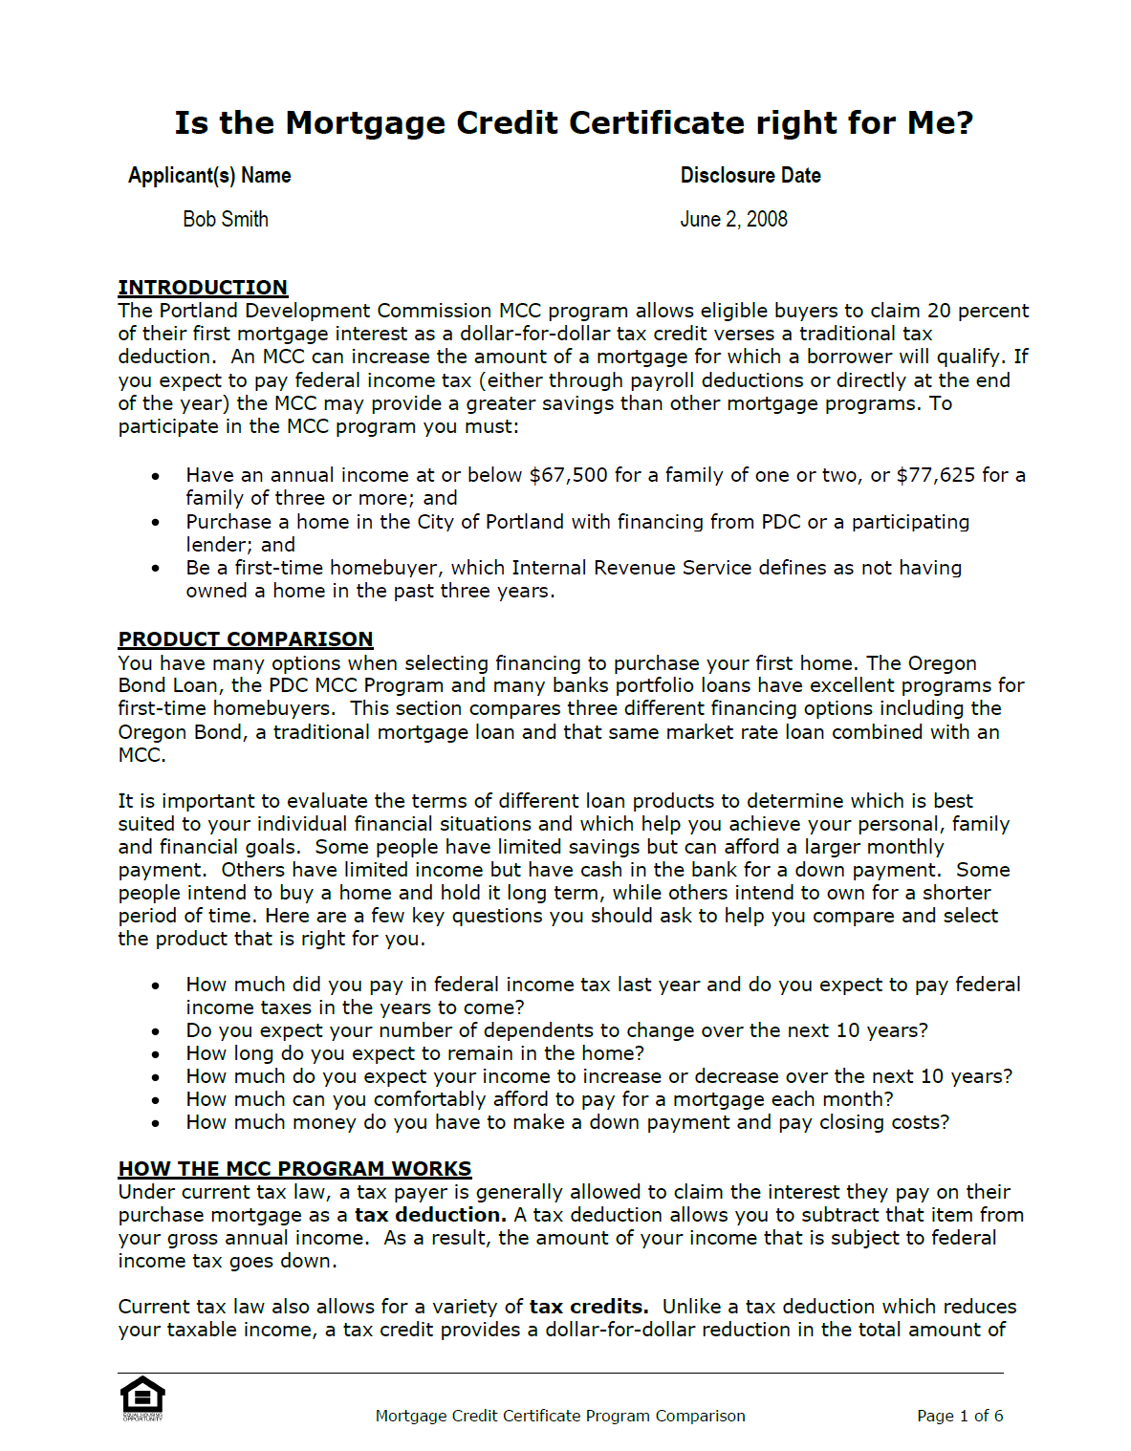
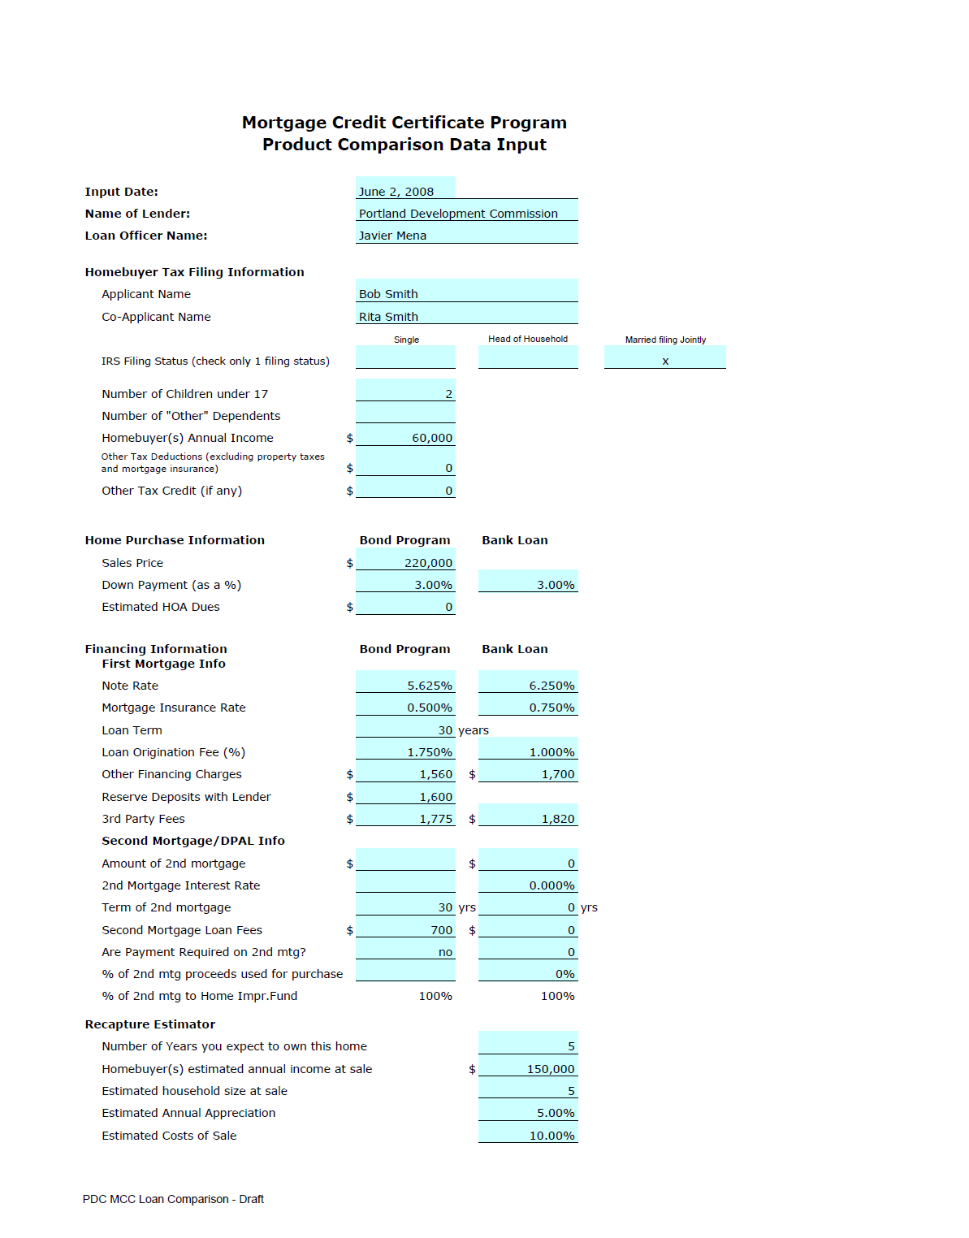
MCC Spreadsheet Template &
Program Comparison Disclosure
http://www.portlandonline.com/phb/mcclender
To see if a borrower can benefit from the MCC use the:
MCC Spreadsheet Template
&
Program Comparison
Disclosure

Slide 39
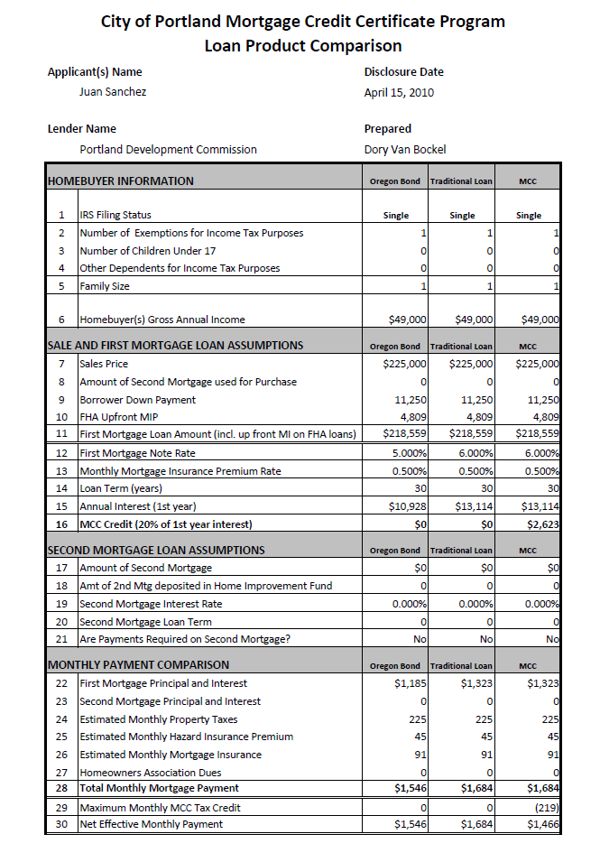
MCC Comparison Worksheet
Streamlines the loan submittal process so you only have to input information once
Allows you to see changes to disclosure documents based on new information

Slide 40
MCC Comparison Worksheet
Basic Completion and Comprehension of Scenario #1
– Juan Sanchez
(Prequalification)
Exploration
Input Scenario #1
Quick Check in
Explore Scenarios #2 through #5
Discussion

Slide 41
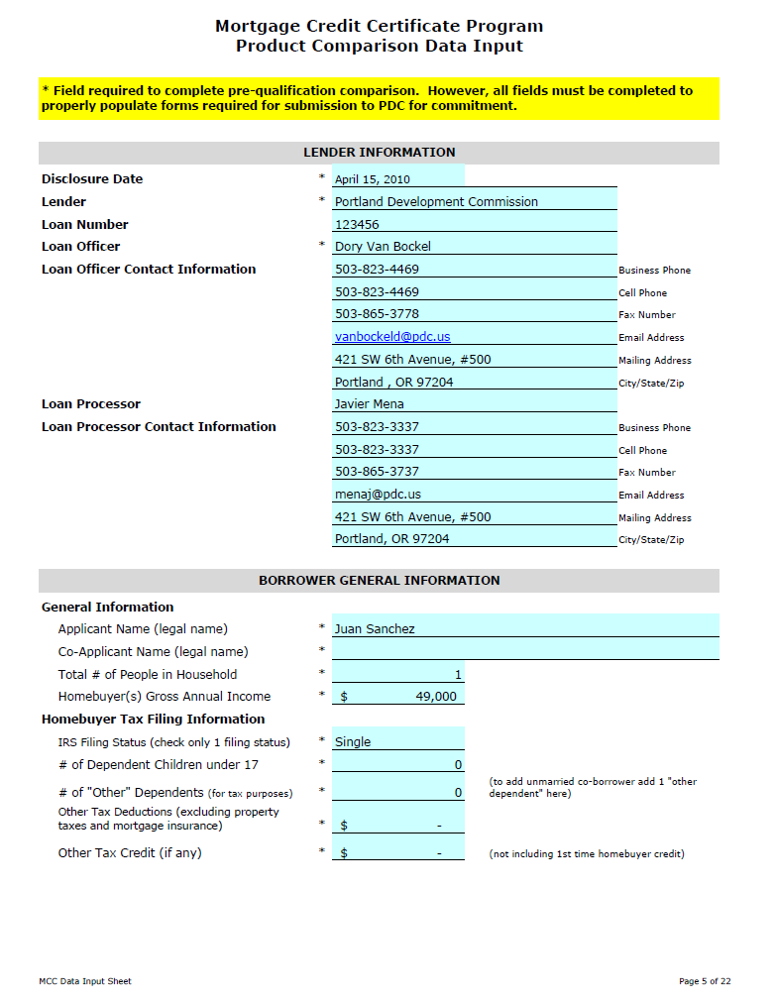
Initial Document Submission
Data Input for Comparison Populates Other Documents
  MCC Disclosure
  Transmittal (includes list of all necessary items to submit)
  Application Affidavit (legal certification)
  Notice of Potential Recapture

Slide 42
Application Review
Allow 5 business days for review
Incomplete submissions will not be processed
Allocation reserved once reviewed & committed
PHB emails MCC Commitment, Invoice and Closing Instructions
Commitments good for 120 days from the date income verified on Application Affidavit
If income changes from Application Affidavit, confirm MCC still beneficial
If Loan Amount changes by more than $5000, you must resubmit a new MCC Application

Slide 43
Closing and Issuance of the MCC
Closing Documents Prepared by Lender
  Closing Transmittal
  Seller Affidavit (notarized)
  Borrower’s Closing Certificate (notarized)
    Must disclose any changes since submission
  Lender’s Closing Certificate
    Must disclose any changes since submission
  Notice of Method to Compute Recapture

Slide 44

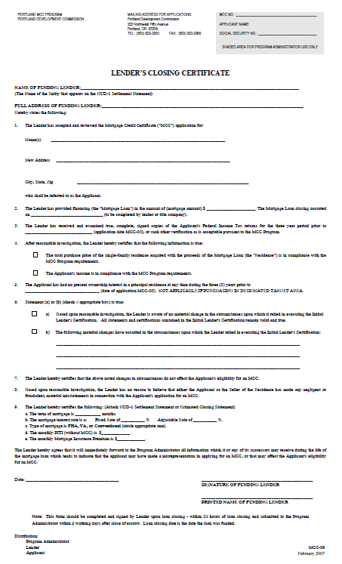
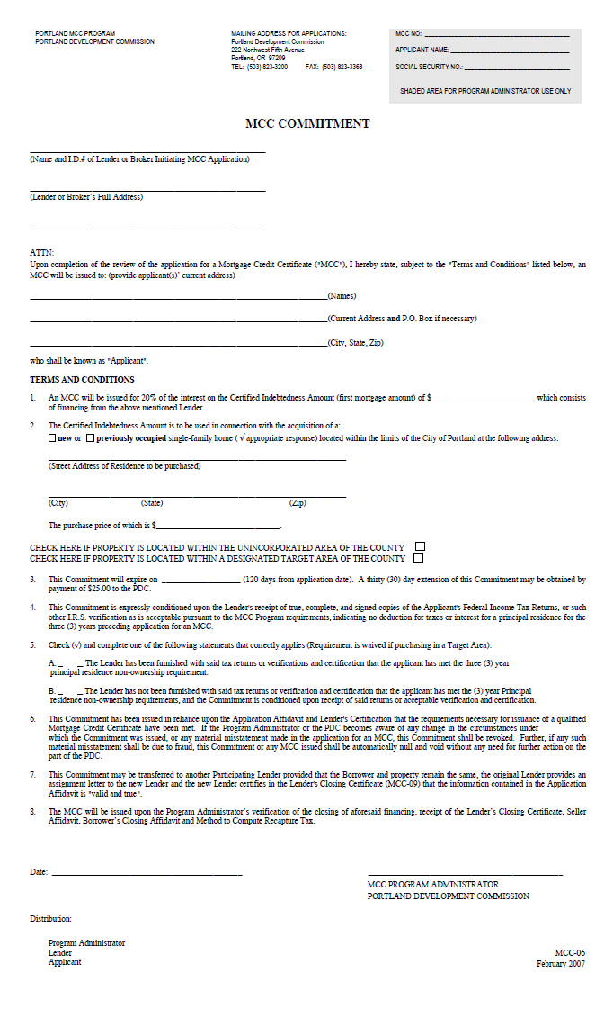
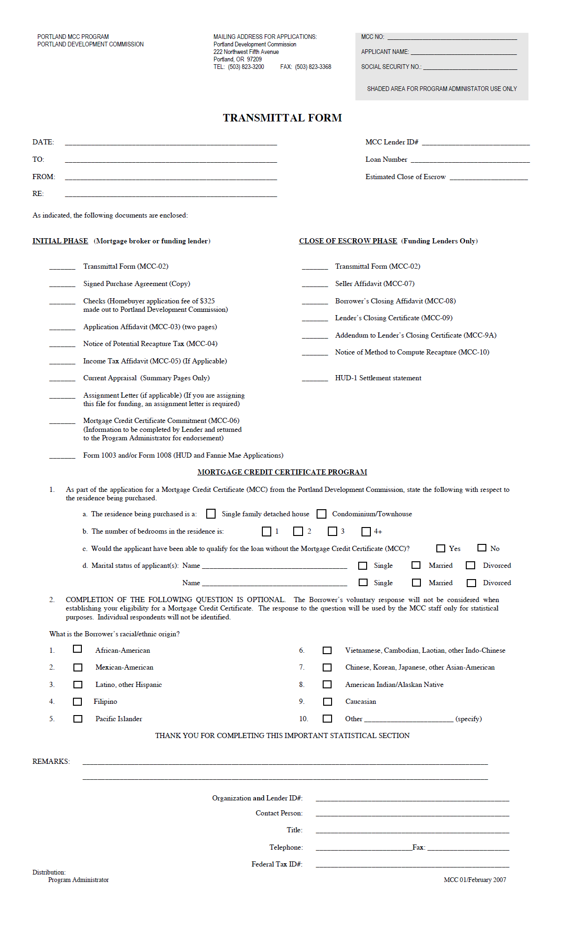
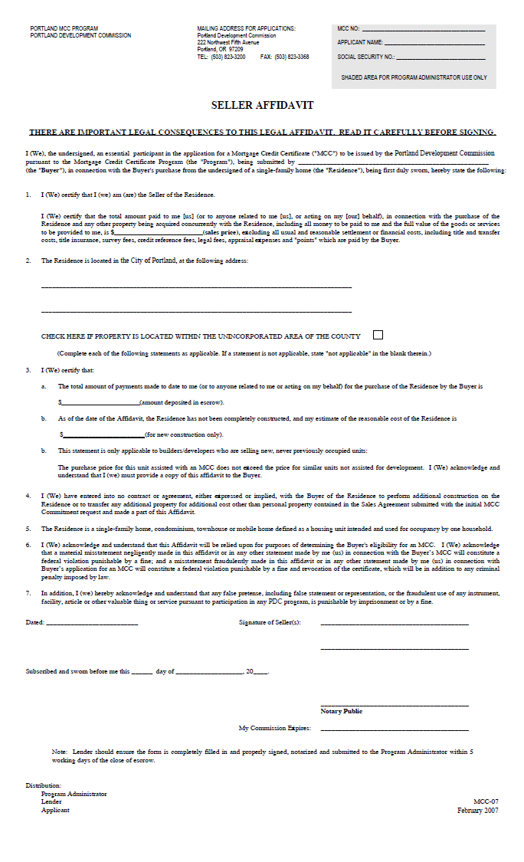
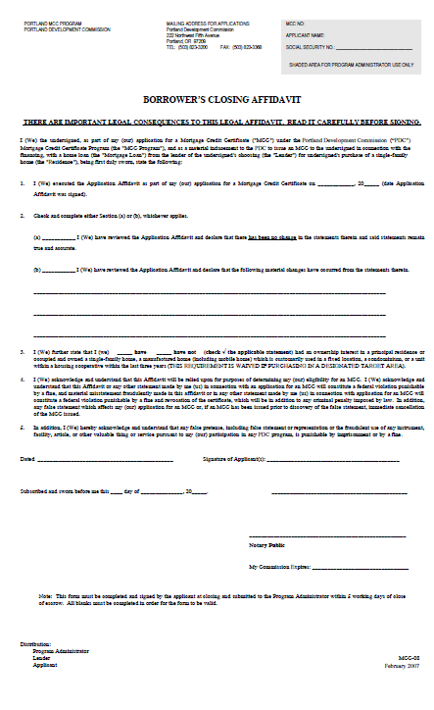
MCC Closing
Lenders Closing Certificate
Transmittal Form
Seller Affidavit
Borrower’s Closing Affidavit
Notice of Method
to Compute Recapture

Slide 45
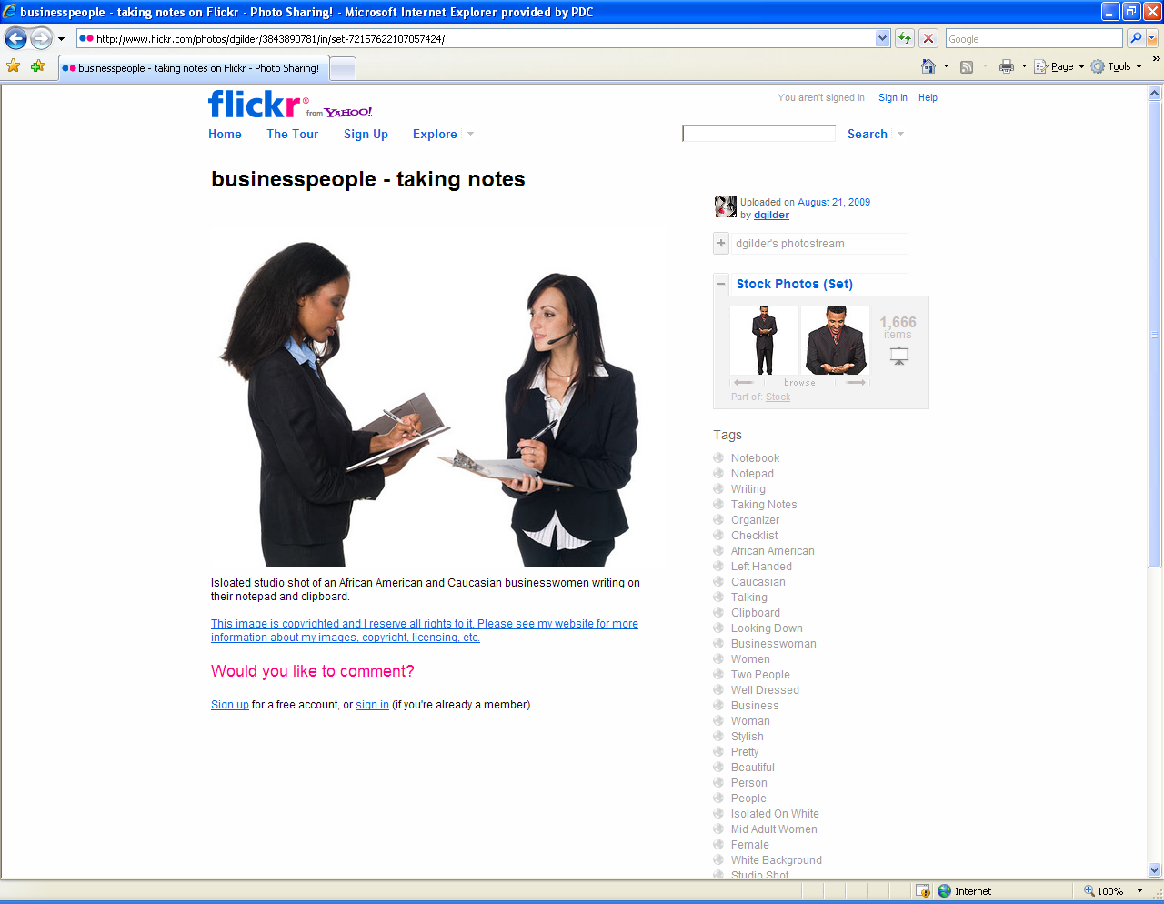
Closing and Issuance of the MCC
Escrow to return ORIGINAL MCC Closing Docs directly to PHB – NO EXCEPTIONS!
Documents are expected within 5 days of closing
Borrower to pay $675 through closing
Documents must be fully completed and signed
Certificates will not be issued until all items are received

Slide 46
Additional Closing Documents
MCC Escrow Closing Transmittal Form
Copies of the following:
  Final HUD-1 Settlement Statement
  Final Signed 1003 Loan Application
  Final Reg Z/TIL
  Appraisal used for underwriting purposes (summary pages only)
  Homebuyer Education Certificate (within 2 years dated prior to closing)

Slide 47


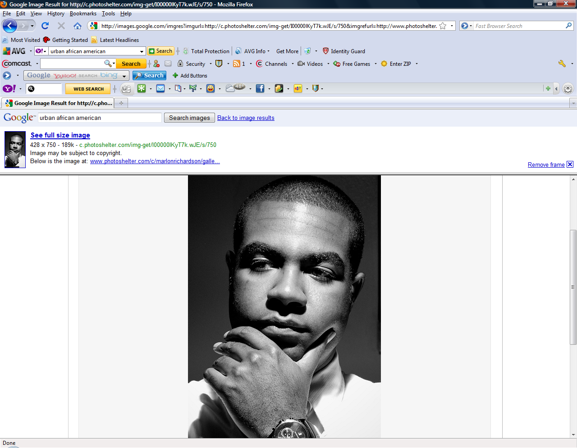

MCC Marketing Plan

Slide 48

Marketing
PHB has developed a
marketing plan template
that we will use as a guide
to support loan officers in
their marketing efforts
Tools/Resources
Self-assessment
Marketing Plan template
Training materials

Slide 49
Affirmative Marketing
Affirmative marketing differs from general marketing activities because it specifically targets potential tenants and homebuyers who are least likely to apply for the housing, in order to make them aware of available affordable housing opportunities.

Slide 50
Loan Officer Marketing Plan
Complete the Self–Assessment
Use the worksheet as a guide in developing your marketing plan for the MCC.
Know your target market. Where do they live, work, and play?
You can include those strategies and activities that your lender is currently doing, but only if they will help you reach your target market
Don’t reinvent the wheel! Do what works!

Slide 51
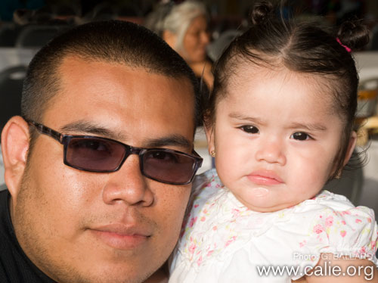
Developing A Marketing Plan for the MCC
Develop a marketing plan that identifies which segment of the market you will focus your marketing efforts
Use the MCC Marketing Template, or submit an existing plan and add additional detail on how you will use the existing plan to reach communities of color
Plan will need to be reviewed by PHB
Due in two weeks!

Slide 52
Self Assessment
Self Assessment Dimensions
General Knowledge
Personal Involvement
Resources & Linkages
Skills and Training
Outreach to communities of color
The purpose of the self-assessment is to provide a tool for loan officers to examine some key dimension that will be important if the individuals want to effectively reach and work with ethnic minority groups
In general, cultural self assessments serve as a valuable tool for determining how well industry professionals provide services that respond to the needs of diverse groups

Slide 53
Marketing Plan Template
The marketing plan template is available on the right side of
www.PortlandOnline.com/phb/mcclender
It is a Word Document so you can easily create, save and
update the plan
E-mail the plan to mcc@portlandoregon.gov
It is due in two weeks!

Slide 54
Make sure your goals are…
S
Specific
M
Measurable
A
Attainable
R
Realistic
T
Time bound

Slide 55

Target Market
Thinking about the overall goal, what are the characteristics of your target MCC client?
Income
Age
Occupation
Marital status
Family size

Slide 56

Target Market
Based on program statistics and program goals:
Young person of color that pays federal taxes
Single, married couples (no kids), or single
with a child
Typically between the ages of 25 to 44
Annual income earning is $40,000 (or 88% MFI)
Ready to buy a home of their own in Portland
More likely a female or couple than a male
“The aim of marketing is to know and understand the customer so well that the idea, product or service fits him/her and sells itself.”
Peter Drucker

Slide 57



Community Connection
What connections/partnerships do I have already established to the target market?
How can you build on those?
Who should I contact within the community that can help me reach people of color?
Write down the steps or actions I can take to strengthen my connection to the target market.

Slide 58
Developing Your Marketing Strategies
What strategies do you feel would be effective to reach and serve customers in the target market?
Share and discuss your strategies with a partner

Slide 59

Marketing Goals Examples
35% of the MCC clients we assist in 2011 will be homebuyers of color
Increase referrals from key community groups that are trusted and work with communities of color by 25% by Dec. 2012
Train 30 loan officers on how to implement culturally specific marketing plans in 2012

Slide 60

Taking Action
Who is your target audience and how will you reach it?
What organizations or individuals can assist you in your efforts?
Write down the action steps that can take over the next 60 days to improve your ability to reach the target market?

Slide 61
Next Steps
PHB will add you to the approved MCC loan officer contact list online.
You need to complete and submit a marketing plan within two weeks.
Attend networking meetings with loan officers, real estate professionals and community organizations of color
Implement your marketing plan!
Let us know how it is going and how
we can help.

Slide 62
MCC Staff
Contact Information
Sharon Johnson
MCC Administrator
803-823-1018
Sharon.Johnson@portlandoregon.gov
Dory Van Bockel
MCC Program Coordinator
503-823-4469
Dory.VanBockel@porlandoregon.gov
Submit applications to: mcc@portlandoregon.gov or 503.865-3480 fax

Slide 63
MCC Loan Officer Training
Questions?
Thank you for coming and partnering with PHB!

